Slide 1



LINKBIO
Leveraging Innovation for New Knowledge in BIOdiversity research and valorization
Carlo Calfapietra, Raffaella Maria Balestrini
NBFC & Agritech Communities

Slide 2
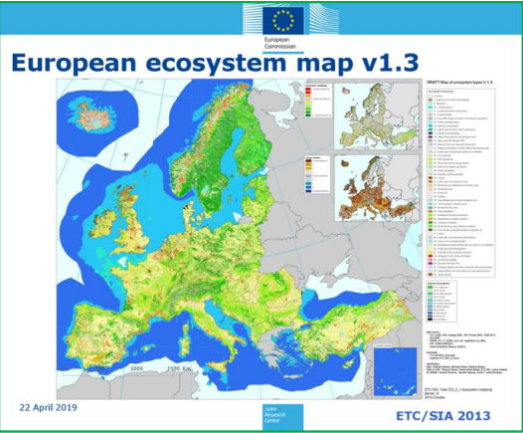
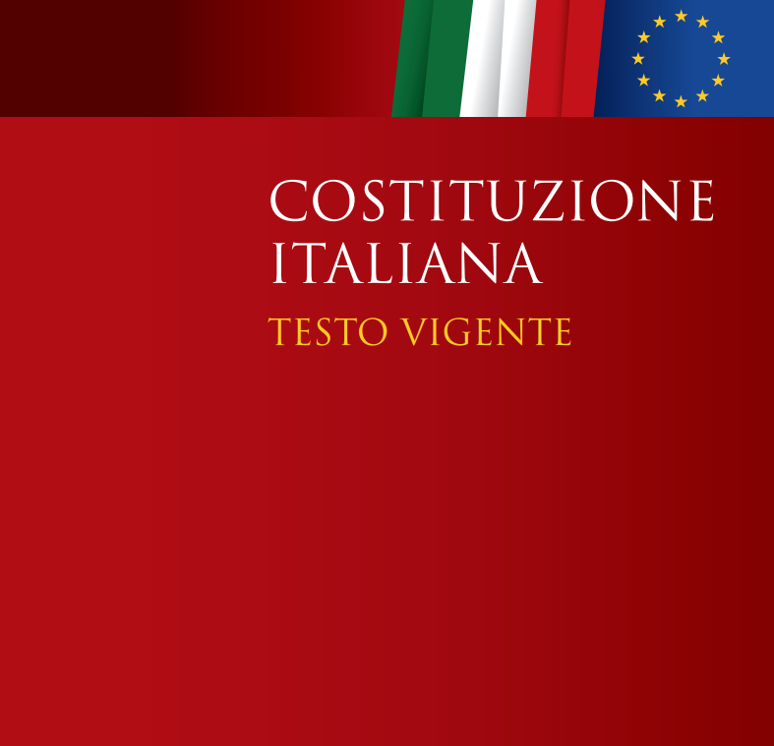
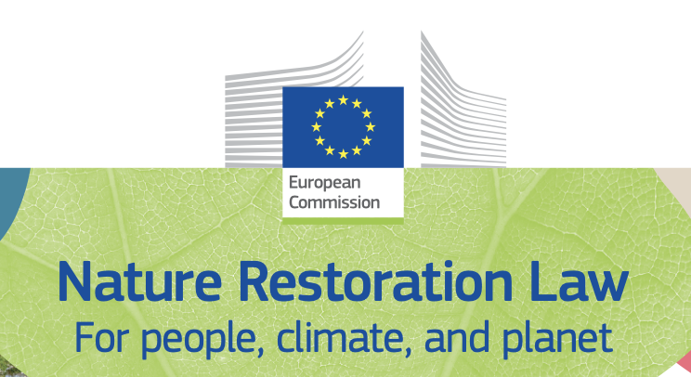
Strategic assets
Art.9 ….Tutela l’ambiente, la biodiversità e gli ecosistemi, anche nell’interesse delle future generazioni….

Slide 3
Post PNRR Strategies
-
Strengths and weaknesses of the previous NBFC-Agritech Projects
Development and integration of new research areas
Internationalization and alignment with global policies
Consolidation of infrastructures and data platforms
Financial sustainability and multi-actor participation
LINKBIO

Slide 4
LINKBIO Aggregating what
  CN NBFC (Spoke2, Spoke4, Spoke 6, Spoke 8,
  NBFC Affiliato Spoke1, Affiliato Spoke3, Affiliato Spoke5. Affiliato Spoke 7);
  Agritech (Spoke1, Affiliato Spoke 3, Affiliato Spoke 4, Affiliato Spoke 8)
  Dipartimento di Scienze del sistema terra e tecnologie per l'ambiente (DSSTTA)
  Dipartimento di Scienze bio-agroalimentari (DiSBA)
  The list of Institutes is just provisional and reflects those included in NBFC and Agritech right now
IAC, IAS, IBBR, IBE, IBF, IBSBC, ICB, IEOMI, IGAG, IGB, IGG, IIA, IMAA, IMATI, IRBIM, IREA, IRET, IRISS, IRPI, IRPPS, IRSA, ISAC, ISAFOM, ISB, ISGI, ISMAR, ISMED, ISP, ISPA, ISSIFRA, ISTI, ITB, NANOTEC,SCITEC, UVR, IBBA, IBB, IBPM, IMEM, IPSP, ISA, ISPAAM, ISSMC, ISTC, IFN

Slide 5







Synergies with ESFRI and other PNRR programmes
Under Discussion

Slide 6
Objectives
- Strengthening knowledge of urban, marine, terrestrial biodiversity, including agro-biodiversity
- Innovative monitoring of different species, including exotic pests, and of the pressures that impact biodiversity at a national level, including adaptation and mitigation of climate change
- Development and transfer of nature-based solutions for restoration for the recovery of stressed Italian environments in line with the EU Nature Restoration Law
- Development and transfer of innovative strategies to increase soil health and fertility and new improved genotypes in the field of breeding innovation
Improving the scientific development of the genetic resources in the collections
- Enhancement of biodiversity through innovation actions that produce economic, technological, environmental and social value for Italy through the strengthening of public-private partnerships
- Place knowledge of biodiversity and marine and terrestrial ecosystems at the basis of the development and implementation of policies and decision-making processes (evidence-informed policy-making), of transfer towards the economic system and innovation, of education, awareness building and direct involvement of civil society
- Development of indicators for the certification of biodiversity credits in line with national and international regulatory frameworks of both the public and private sectors
- Enhancement of biodiversity for the protection of human health in a One Health perspective

Slide 7
Numbers of NBFC + Agritech
PUBBLICAZIONI |  | TD |  | ADR |  | DOTTORANDI
SPOKE | TOT | SPOKE | TOT | SPOKE | TOT | SPOKE | TOT
1 | 40 | 1 | 5 | 1 | 2 | 1 | 1
2 | 33 | 2 | 25 | 2 | 8 | 2 | 4
3 | 107 | 3 | 5 | 3 | 0 | 3 | 1
4 | 112 | 4 | 19 | 4 | 1 | 4 | 2
5 | 95 | 5 | 6 | 5 | 0 | 5 | 0
6 | 68 | 6 | 17 | 6 | 0 | 6 | 2
7 | 0 | 7 | 0 | 7 | 0 | 7 | 0
8 | 0 | 8 | 15 | 8 | 5 | 8 | 5
Totale complessivo | 455 | Totale complessivo | 92 | Totale complessivo | 16 | Totale complessivo | 15
PUBBLICAZIONI |  | TD |  | ADR |  | DOTTORANDI
SPOKE | TOT | SPOKE | TOT | SPOKE | TOT | SPOKE | TOT
1 | 51 | 1 | 7 | 1 | 14 | 1 | 0
3 | 10 | 3 | 3 | 3 | 2 | 3 | 1
4 | 7 | 4 | 2 | 4 | 2 | 4 | 1
8 | 2 | 8 | 1 | 8 | 2 | 8 | 1
9 | 13 | 9 | 1 | 9 | 4 | 9 | 1
Totale complessivo | 83 | Totale complessivo | 14 | Totale complessivo | 24 | Totale complessivo | 4
Notes:
7

Slide 8
Structure of LINKBIO
Hub: Coordination CNR (DG nominated by CNR)
Steering Committee with Spoke leaders and
1 Scientific Director, 1 Innovation Director
Spoke 1 Biodiversity Restoration and NbS (In Land, Sea, Urban)
Spoke 2 Valorization of Biodiversity in one health approach (In Land, Sea, Urban)
Spoke 3 Modelling/ Innovation, AI and services.

Slide 9
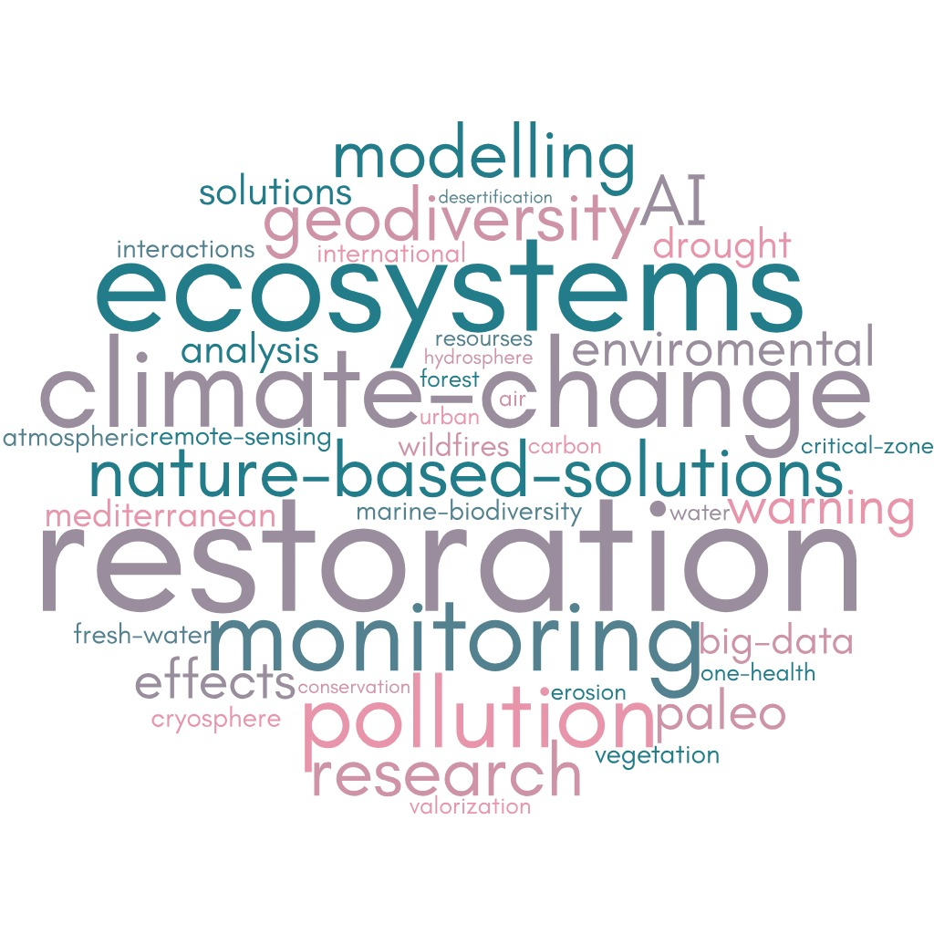
LINKBIO Keywords

Slide 10
Strategic Activities
Predicting the climate change-ecosystems interactions including carbon mitigation potential by ecosystems and role of drought on fires risk
Geoscience-based conservation and restoration strategies, including relationships between geological substrates and species distribution and conservation paleobiology and paleoecology
Adoption of Nature-Based Solutions for the restoration of natural, urban and agriculture ecosystems
Leveraging Deep Learning and Satellite Data for Global Air Quality Monitoring and Nature-Based Solutions Assessment including AI Data-driven approach and Big Data
Focusing on remote and endangered ecosystems such as Mountain, Polar, Coastal, Arid ones
Biological Early Warning System to detect the Impacts of atmospheric depositions, pollutants and nutrients on biodiversity-atmosphere-geosphere-hydrosphere and cryosphere interactions
Consolidation of the National Observatory and Geoportal of Marine Biodiversity and of the Observation systems and networks for marine biodiversity (from in situ sensors to genomics to remote sensing techniques)
Sustainable management and valorization of biodiversity (animals, plants, microbes, but also molecules) for applications in forestry and agricultural systems, through new approaches of circular economy, green chemistry and biotechnology
Conservation and characterization of the biodiversity in the collections
already established (i.e., –omics approaches)
-

Slide 11

The Biodiversity Gateway
Education
The Biodiversity Gateway connects the scientific community with society, the business system, public administrations, conservation professionals, the world of schools and citizens.
Networking
Communication
Citizen Science
Biodiversity Literacy

Slide 12

The Biodiversity
Gateway
1 web
www.biodiversitygateway.it
2 Locations
Venezia | Palermo
5 Nodes
Milano | Fano | Roma | Napoli | Lecce

Slide 13


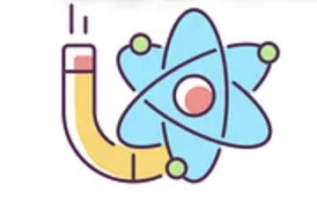

Natural Collections Digitization
5 milion samples
4000 samples
8000 natural compounds
Biodiversity Gateway- Data Platforms
DATA, TECHNOLOGIES, PEOPLE
Molecular Biodiversity
Ecosystem Biodiversity Monitoring platform
Bioresources (chemicals, metabolites)
covering 100% territory

Slide 14





Involvement of the private sector
…& Many others including several SMEs

Slide 15
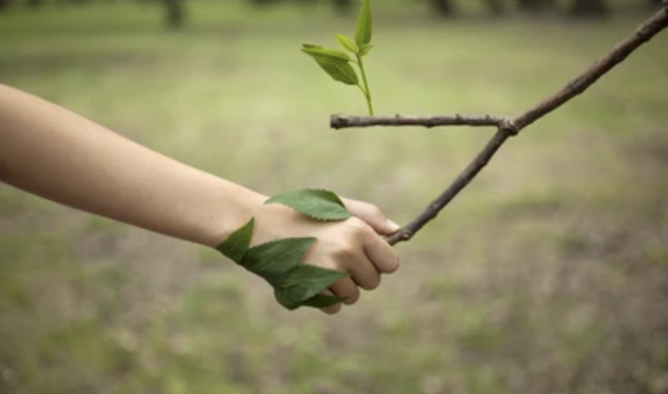
LINKBIO
Leveraging Innovation for New Knowledge in BIOdiversity research and valorization
Thanks!
Email: carlo.calfapietra@cnr.it
Eu 2050 - LIVE IN HARMONY WITH NATURE

