Slide 1

I-PHOQS LTP: High Power Laser Diagnostic and Data Analysis
L. A. Gizzi
I-PHOQS Laboratory Training Platform: High Power Laser Diagnostic and Data Analysis, 14th-16th May 2025

Slide 2
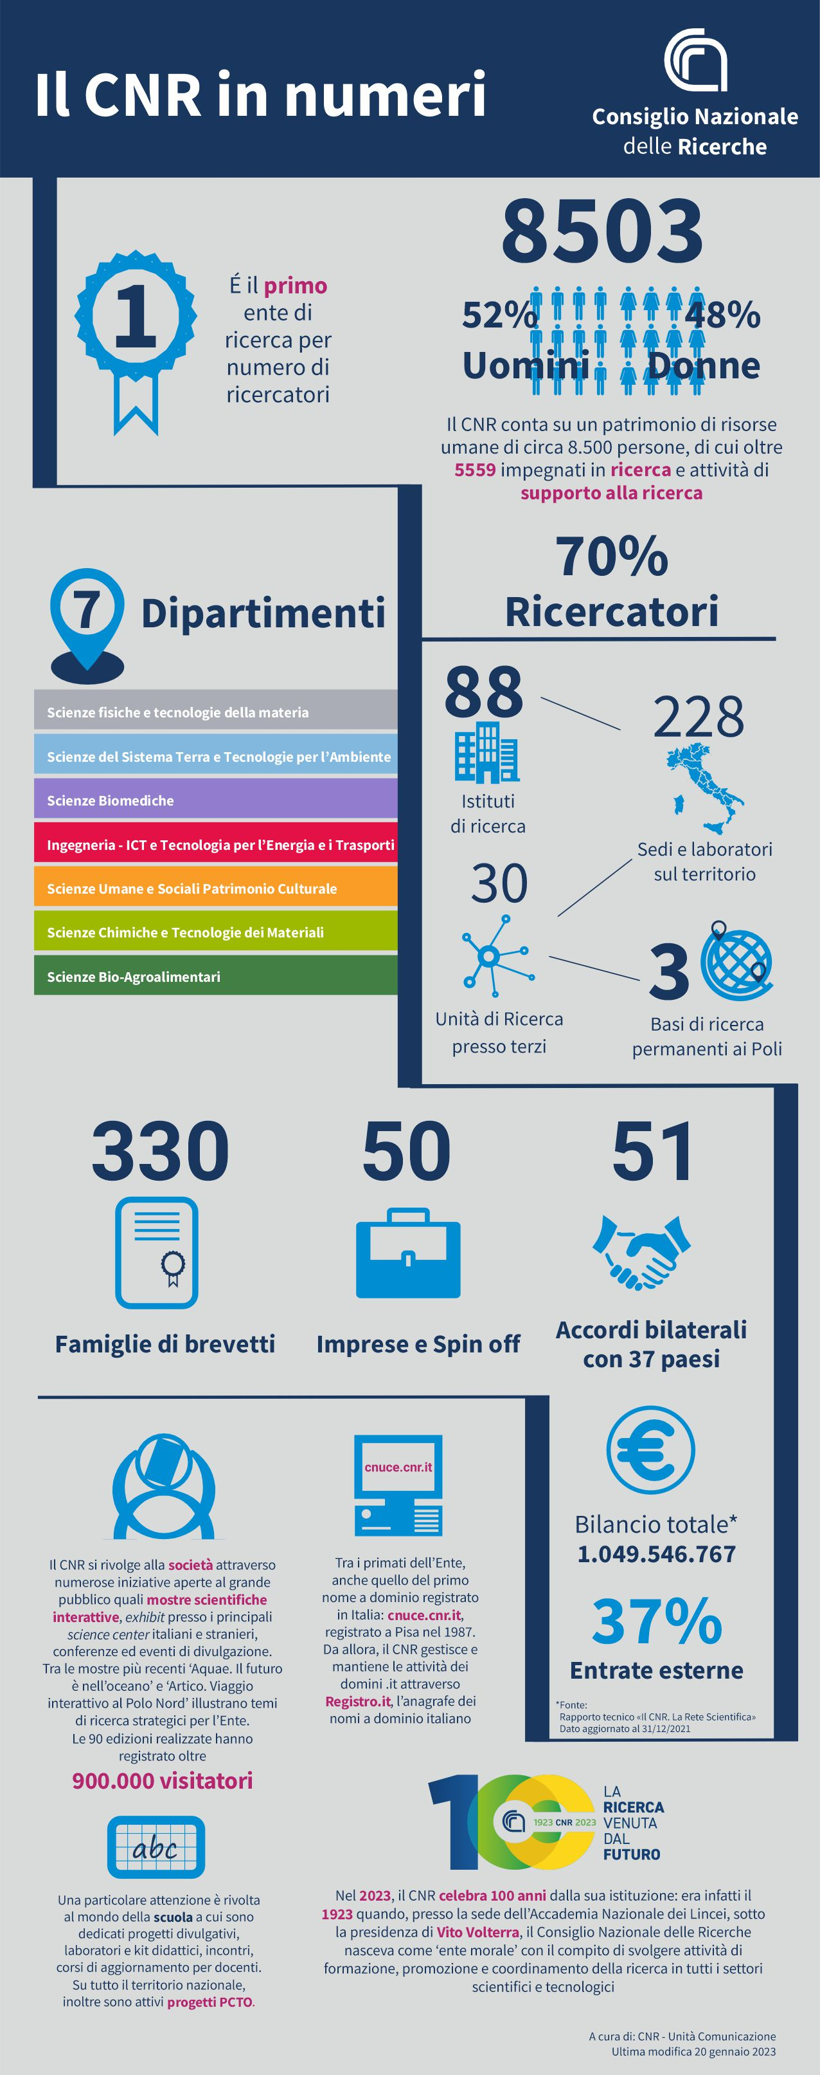
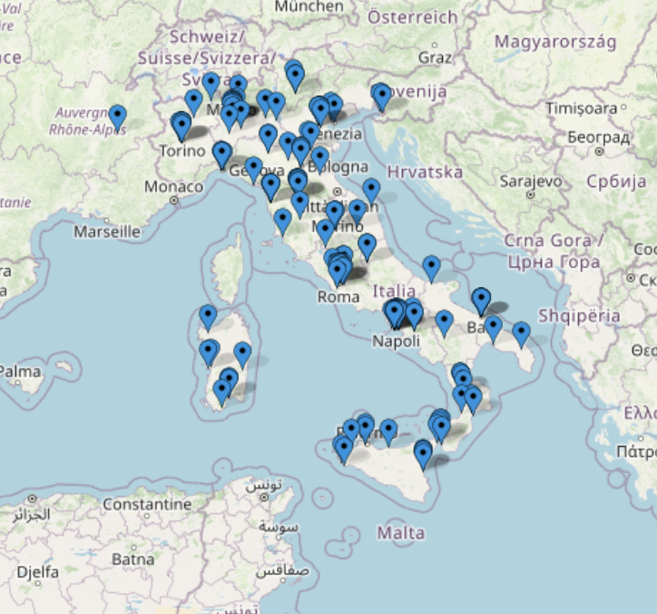
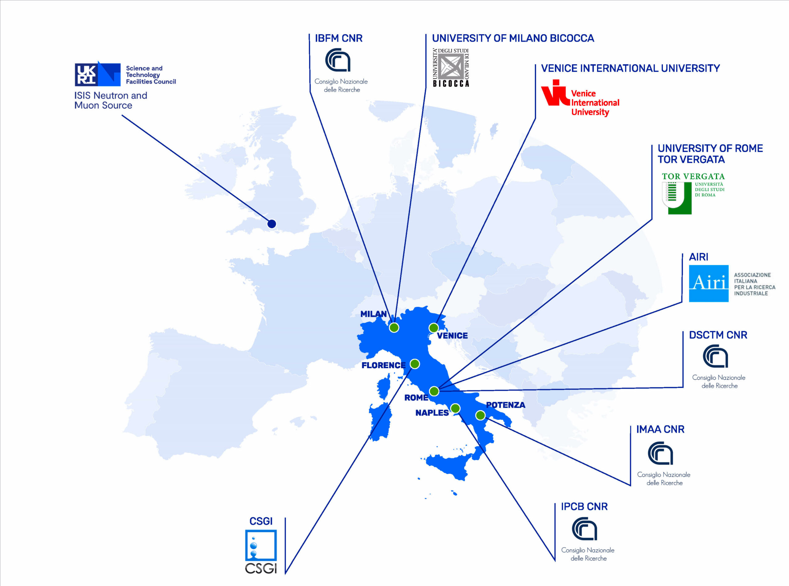
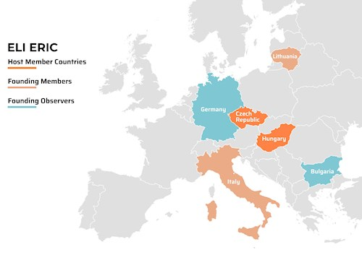
Consiglio Nazionale delle Ricerche (CNR)
Strong commitments to large scale facilities
http://www.dsftm.cnr.it/large-scale-facilities/
ELETTRA and FERMI (beamlines),
ESRF (beamlines)
ILL, ISIS, ESS, NFFA, XFEL, ELI

Slide 3

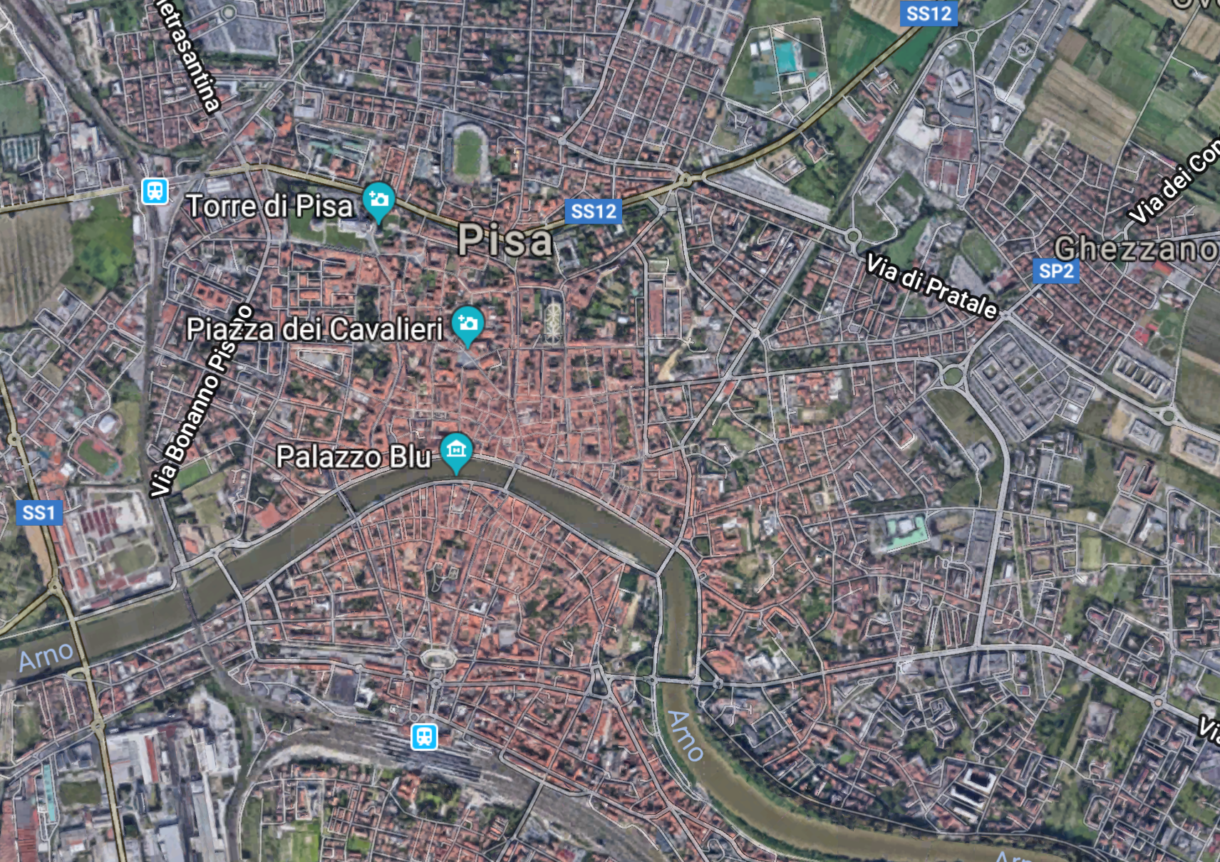

Slide 4
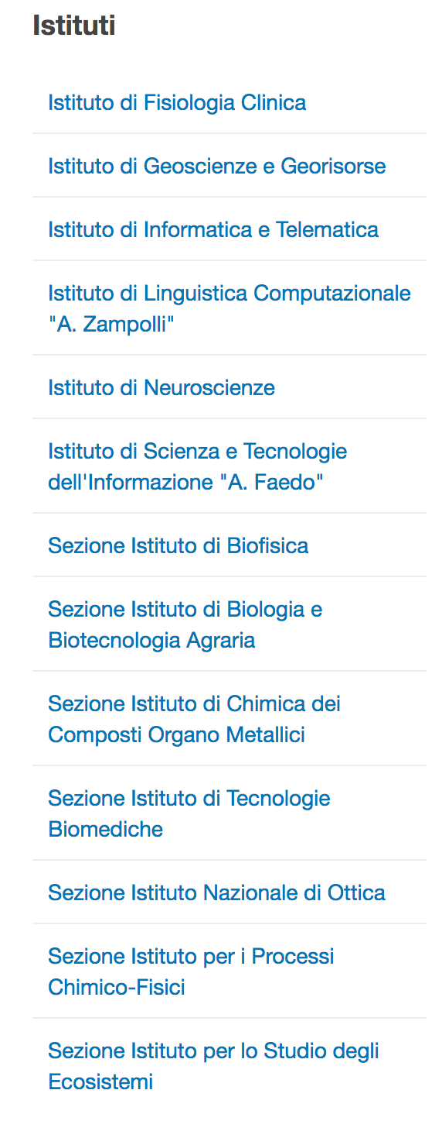
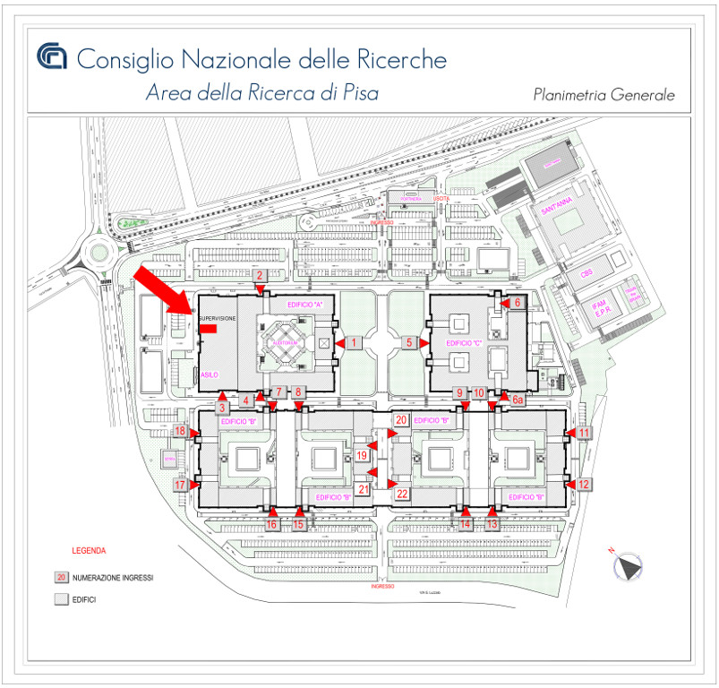

Slide 5
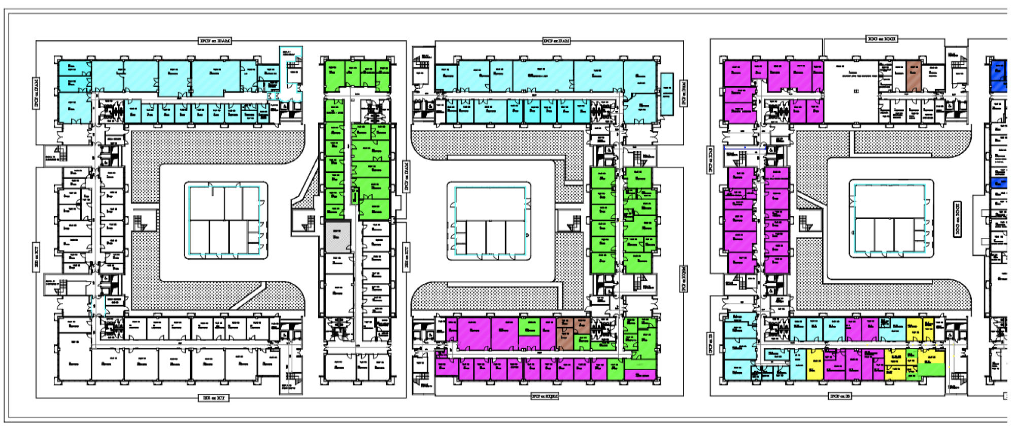
Istituto Nazionale di Ottica

Slide 6
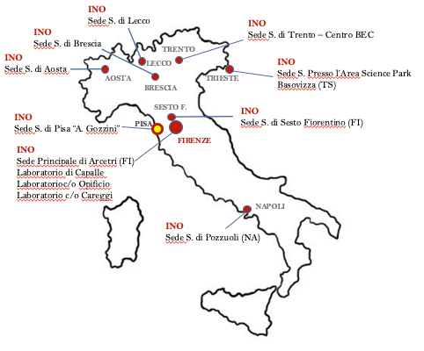
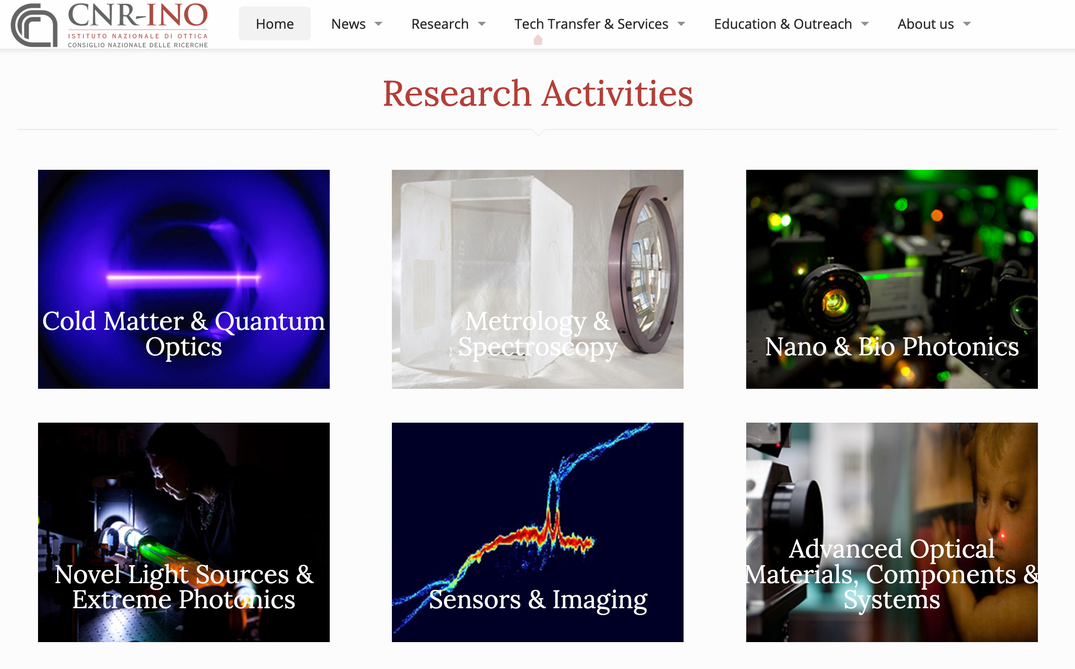
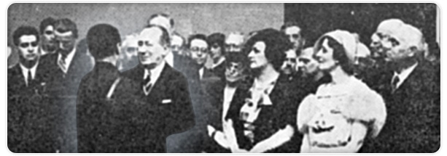
The National Institute of Optics (INO)
The National Institute of Optics is a leading institute of the CNR Department of “Physical sciences and technologies of matter“
Pure and applied research, technology transfer, and training, metrology, consulting, and testing in the field of Optics and related sciences
9 Local Units, Firenze, Napoli, Sesto F., Pisa, Brescia, Lecco, Trento, Aosta, Trieste
Guglielmo Marconi, 2nd President of CNR (1927-1937), with Vasco Ronchi, founder of INO.

Slide 7

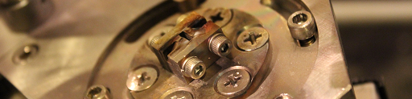
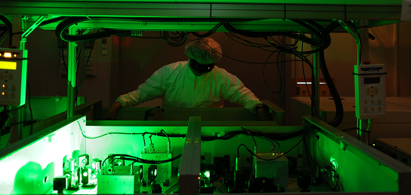
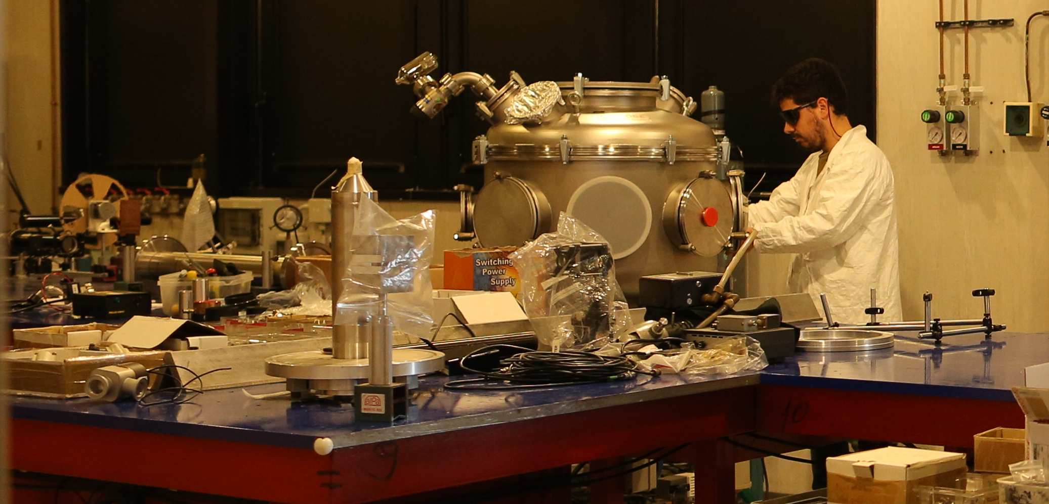



The Intense Laser Irradiation Laboratory (ILIL)
LASER DEV. LAB
Relatore:
Nome relatore
USER CONTROL
ROOM
TESTING AND PROTOTYPING
LASER FRONT END
10 TW, 10Hz
NEW HIGH DOSE UNDERGROUND BUNKER
POWER AMPLIFIER Up to 240 TW
LASER CAPABILITIES:
• 240 TW, Ti:Sa, up to 5 Hz, 27 fs;
• 1kHz, >20 mJ, Ti:Sa + OPA (commissioning in progress)
• 100 Hz, >1J, TiSA (procurement in progress)
SHIELDED TARGET AREA FOR PARTICLE ACCELERATION
Evento:
NEW BEAMLINE FOR PRE-CLINICAL STUDIES
Nome evento
L. A. Gizzi et al., High Power Laser Science and Engineering, 9 e10 (2021)

Slide 8
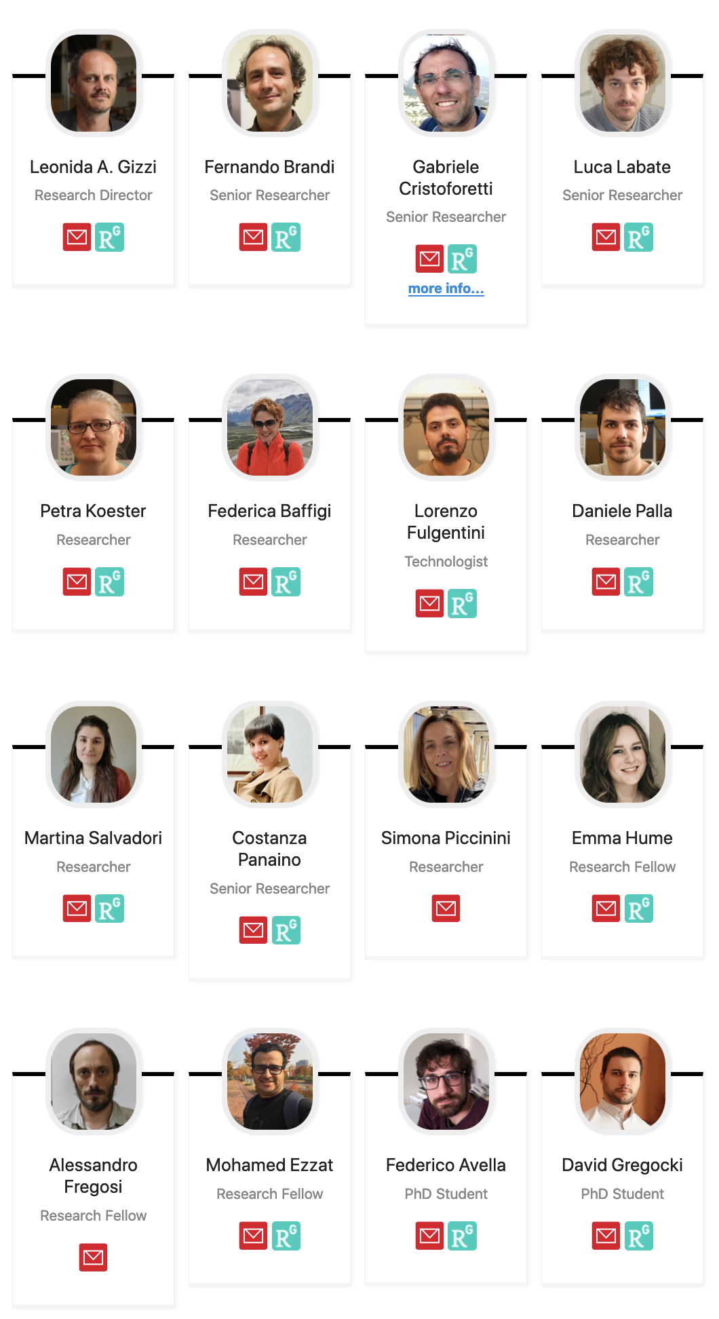

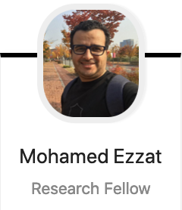

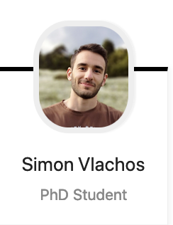
The Intense Laser Irradiation Laboratory (ILIL)
LASER DEV. LAB
Relatore:
Nome relatore
USER CONTROL
ROOM
TESTING AND PROTOTYPING
LASER FRONT END
10 TW, 10Hz
NEW HIGH DOSE UNDERGROUND BUNKER
POWER AMPLIFIER Up to 240 TW
LASER CAPABILITIES:
• 240 TW, Ti:Sa, up to 5 Hz, 27 fs;
• 1kHz, >20 mJ, Ti:Sa + OPA (commissioning in progress)
• 100 Hz, >1J, TiSA (procurement in progress)
SHIELDED TARGET AREA FOR PARTICLE ACCELERATION
Evento:
NEW BEAMLINE FOR PRE-CLINICAL STUDIES
Nome evento
L. A. Gizzi et al., High Power Laser Science and Engineering, 9 e10 (2021)

Slide 9


Cutting edge infrastructure: IPHOQS
A new network of priority national RI with a broad view on photonics and related fields, including high field photonics
Part of :
Will provide a platform for coordinated user access to the most advanced labs and facilities

Slide 10
The Laboratory training platform
These training programme, organized in the frame of the PNRR project Integrated Infrastructure Initiative in Photonic and Quantum Sciences (I-PHOQS) is intended for PhD students and aims to allow them to experience lab activities in various research fields
Past edition: Workshop on Diffuse optics @ PoliMI (November 2023)
Now ongoing: High Power Laser Diagnostic and Data Analysis
Stay tuned for the next events!

Slide 11
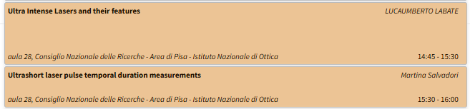
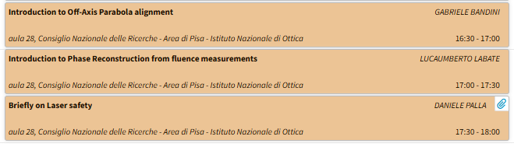
The Activities schedule: Wednesday Lectures
This afternoon is dedicated to lectures
Related to the
Hands-on session

Slide 12
The Activities schedule: Thursday Hands-on activity
Two groups will be formed Group A and Group B
Group A: Off-axis parabolic mirror alignment
Group B: Ultrashort laser pulse temporal duration measurement
Lunch Break
Group B: Off-axis parabolic mirror alignment
Group A: Ultrashort laser pulse temporal duration measurement
….. Don’t forget the social dinner!

Slide 13
The Activities schedule: Friday Hands on & Data Analysis
Group A: Phase reconstruction – Lab activity
Group B: Laboratories tour
Coffee Break
Group B: Phase recostruction – Lab actvity
Group A: Laboratories tour
Lunch Break
Group A and B: Phase reconstruction - Data Analysis

Slide 14

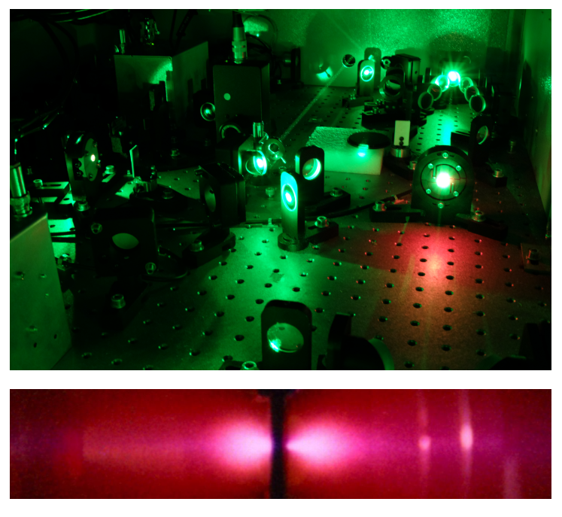
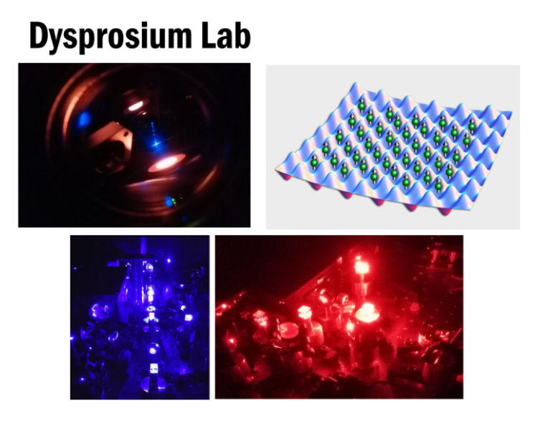
The Activities schedule: Friday Lab Tours

Slide 15
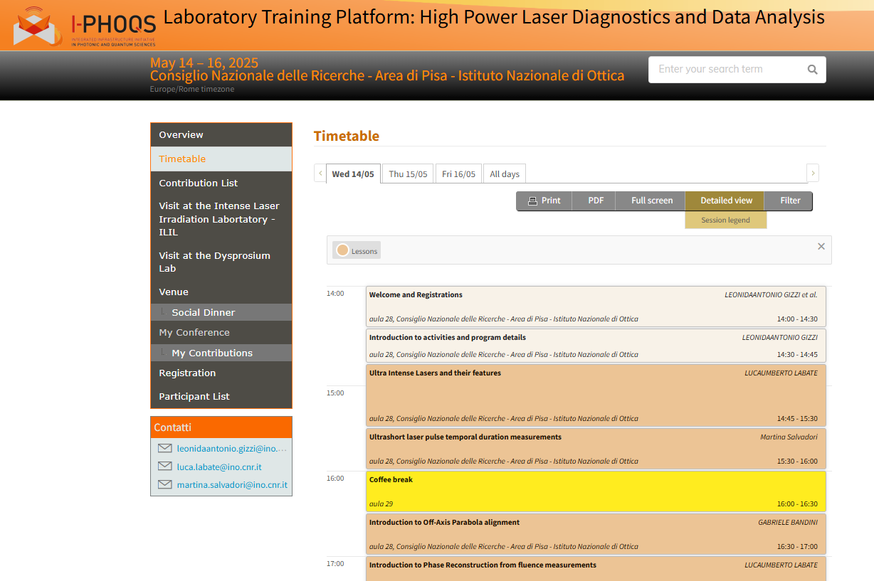
Detailed program and infos available on the dedicated indico page

Slide 16
Welcome and enjoy the training!

