Slide 1

Ultrashort Laser pulse temporal duration mesaurement
Martina Salvadori
I-PHOQS Laboratory Training Platform: High Power Laser Diagnostic and Data Analysis, 14th-16th May 2025

Slide 2

Chosing the proper «Time-Ruler»
Ultra-short laser pulses are characterized by temporal duration in the range of few/tens of femtoseconds
To measure a transiet phenomenon it is necessary to have a faster, controllable, quantity
Light measure Light approach. The laser itself is used also as reference pulse for the measurement.
Correlation
Simple and robust technique, allows to retrieve information only on the temporal duration of the pulse (i.e. BONSAI)
Spectrogram
Grants the complete characterization of the laser pulse combining autoccorellation technque with a calibrated spectrogram (i.e. FROG)
Spectral Interferometry
1D frequency-domain measurement relying on the spectral shearing interferometry. Allows for the complete pulse reconstructrion. (i.e. SPIDER)
Inserire testo Arial 28pt
Inserire il nome del Relatore 20 pt
Correlation
Spectrogram
Spectral Interferometry
Nome dell’evento, luogo e data 16 pt

Slide 3







Each technique allows to measure something different
We have seen that a laser pulse can be described in time domain or frequency domain
Time Domain | Frequency Domain
$$E\left(t\right)=A\left(t\right)e^{i\left(φ_{0}+φ_{a}(t)\right)}e^{iω_{0t}}\left(t\right)$$
$${\tilde{E}}^{+}\left(ω\right)=\left|{\tilde{E}}^{+}\left(ω\right)\right|e^{−iφ\left(ω\right)}∝\sqrt{I\left(ω\right)}e^{−iφ\left(ω\right)}$$
with
$A\left(t\right)=\sqrt{\frac{2}{ε_{0}c}}I(t)$
$$\{A\left(t\right), φ\left(t\right)\}$$
$\{I\left(ω\right), φ\left(ω\right)$}
Correlation
Spectrogram
Spectral Interferometry
$$A(t)$$
$$A\left(t\right), I\left(ω\right)→φ(ω)$$
$$φ\left(ω\right)$$
Time domain
Time & Frequency domain combined
Frequency domain

Slide 4
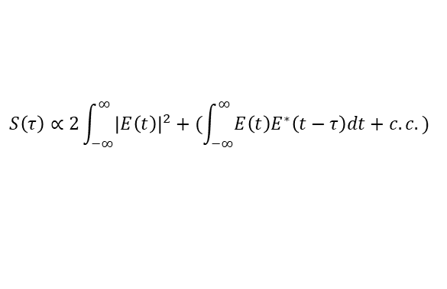

Linear or 1st order autocorrelators
Correlation
Delay between pulses from the two arms of michelson interferometer
$$τ$$
No information on spectral phase
Information on temporal duration can be inferred with some assumption on the pulse shape and its phase
$$S\left(τ\right)∝2\int_{−∞}^{∞}{{\left|E\left(t\right)\right|}^{2}+(\int_{−∞}^{∞}{E\left(t\right)E^{∗}\left(t−τ\right)dt+c.c. ) } }$$
FT
1st order autocorrelation function
$$S\left(ω\right)$$

Slide 5
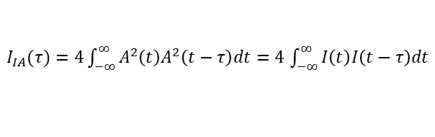
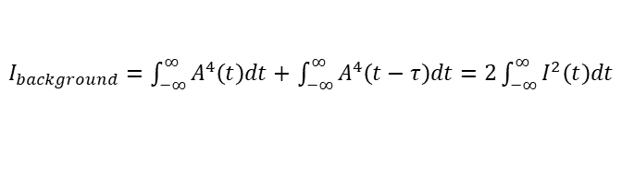


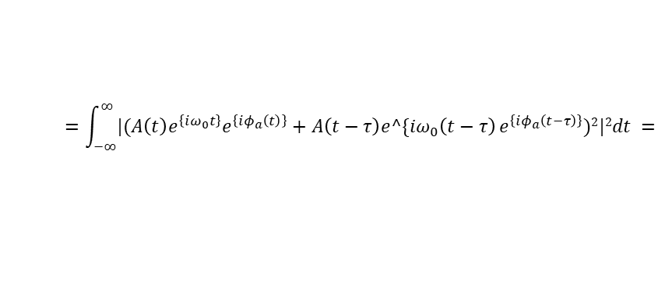
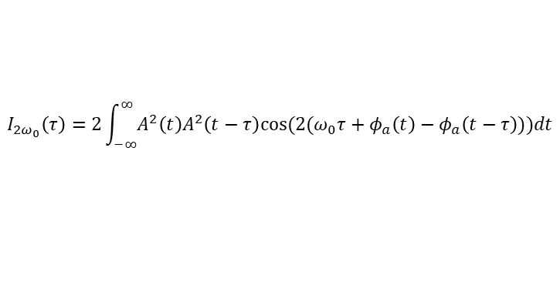
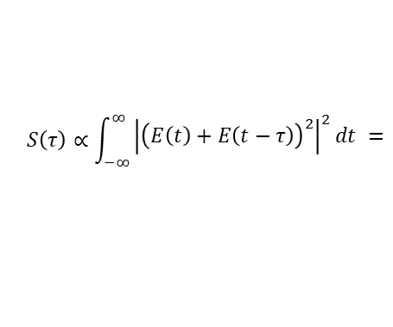
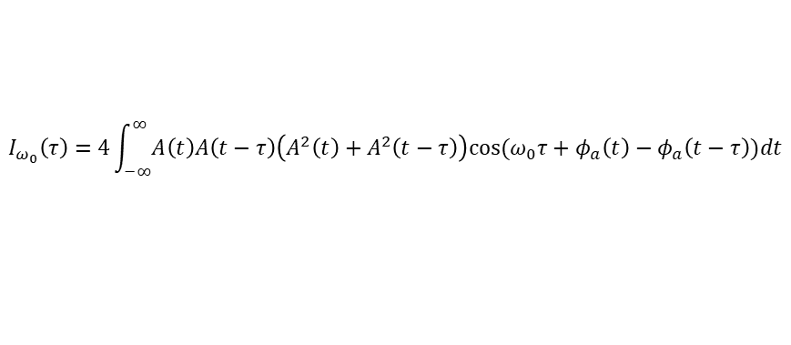

2nd order collinear autocorrelator (interferometric)
Correlation
Introducing a non-linear crystal to perform Second Harmonic Generation (SHG) before the detector we obtain what is called a 2nd order autocorrelator
$$S\left(τ\right)∝\int_{−∞}^{∞}{\begin{aligned}{\left|{\left(E\left(t\right)+E\left(t−τ\right)\right)}^{2}\right|}^{2}dt = \\ \end{aligned}}$$
$$=\int_{−∞}^{∞}{|(A\left(t\right)e^{\left\{iω_{0}t\right\}}e^{\left\{iφ_{a}\left(t\right)\right\}}+A\left(t−τ\right)e^\{iω_{0}\left(t−τ\right)}e^{\left\{iφ_{a}\left(t−τ\right)\right\}})2|2dt =$$
SHG
$$= …= I_{background}+I_{IA}\left(τ\right)+I_{ω_{0}\left(τ\right)}+I_{2ω_{0}}\left(τ\right)$$
$$ω$$
$$χ^{(2)}$$
$$ω$$
$$2ω$$
with
$I_{background}=\int_{−∞}^{∞}{A^{4}\left(t\right)dt+}$ $\int_{−∞}^{∞}{A^{4}\left(t−τ\right)dt=2\int_{−∞}^{∞}{I^{2}\left(t\right)dt}}$
$$P_{i}\left(2ω\right)=Σ_{j,k} χ_{ijk}^{\left(2\right)}E_{j}\left(ω\right)E_{k}(ω)$$
$I_{IA}(τ)=4\int_{−∞}^{∞}{A^{2}\left(t\right)A^{2}\left(t−τ\right)dt=4}$ $\int_{−∞}^{∞}{I\left(t\right)I\left(t−τ\right)dt}$
$$P_{2ω}∝(E\left(t\right)+E\left(t−τ\right))(E\left(t\right)+E(t−τ))$$
$$I_{ω_{0}}\left(τ\right)=4\int_{−∞}^{∞}{A\left(t\right)A\left(t−τ\right)\left(A^{2}\left(t\right)+A^{2}\left(t−τ\right)\right)cos⁡(ω_{0}τ+φ_{a}\left(t\right)−φ_{a}\left(t−τ\right))dt}$$
$$E_{2ω}∝(E\left(t\right)+E\left(t−τ\right))(E\left(t\right)+E(t−τ))$$
$$I_{{2ω}_{0}}\left(τ\right)=2\int_{−∞}^{∞}{A^{2}\left(t\right)A^{2}\left(t−τ\right)cos⁡({2(ω}_{0}τ+φ_{a}\left(t\right)−φ_{a}\left(t−τ\right)))dt}$$
J.M. Diels et al., Appl. Opt.24,1270 (1985)

Slide 6
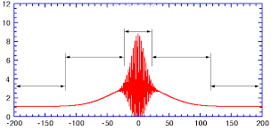
2nd order collinear autocorrelator (interferometric)
Correlation
averaging over
oscilations
Structure of a signal
Interferometric autocorrelation
Intensity autocorrelation
Intensity autocorrelation
Background
Background
Fringes at the carrier frequency appears in the measured signal due to the interference among different SH signal
Useful to get information on the chirp!
With a slight modification to the setup it is possible to get rid of the interference pattern
J.M. Diels et al., Appl. Opt.24,1270 (1985)

Slide 7
Hands-on session: 2nd order non collinear autocorrelator, BONSAI
Correlation
The beam replicas entering into the non linear crystal are no more collinear. In this case the signal is proportional just to the second order autocorrelation term
$$S\left(τ\right)∝I_{background}+I_{IA}\left(τ\right)+I_{ω_{0}\left(τ\right)}+I_{2ω_{0}}\left(τ\right)$$
If the delay between the pulses is much greater than the pulse duration, the two beams are not overlapping. The peak of the correlation gives thus information on the temporal duration of the pulse itself.
The second order autocorrelation is an even function of the dealy. It is thus not possible to retrieve univocally the intensity profile.
With the assumption of a symmetric intensity profile:
To recover non symmetric intensity profile information on the phase is needed.

Slide 8
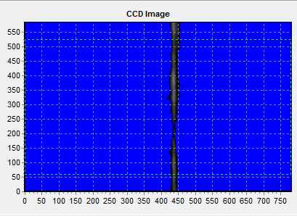
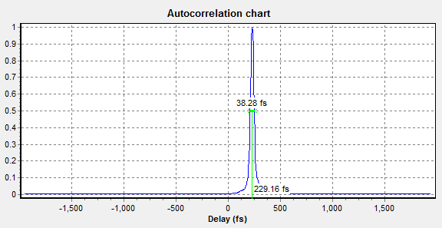
Hands-on session: 2nd order non collinear autocorrelator, BONSAI
Correlation
The delay is now encoded in the spatial position
The width of the signal recorded on the CCD is related to the temporal duration of the beam by a calibration factors that takes into account the angle of incidence of the two beams on the SHG crystal

Slide 9
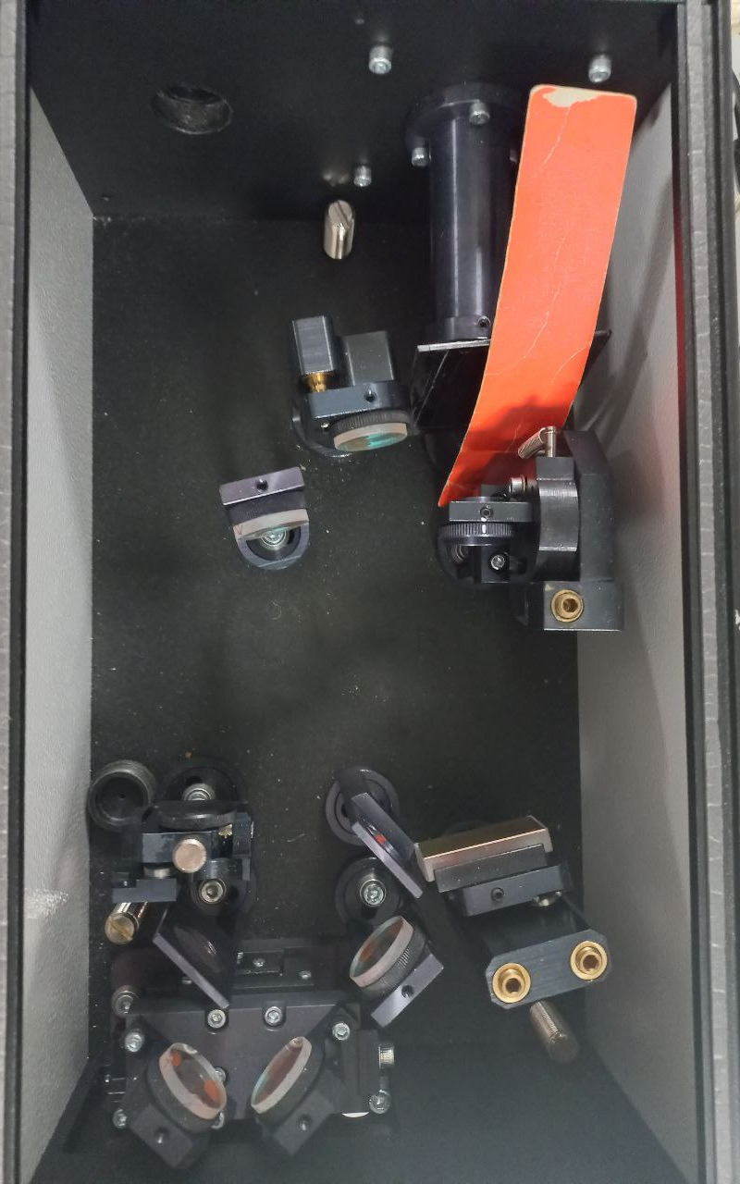
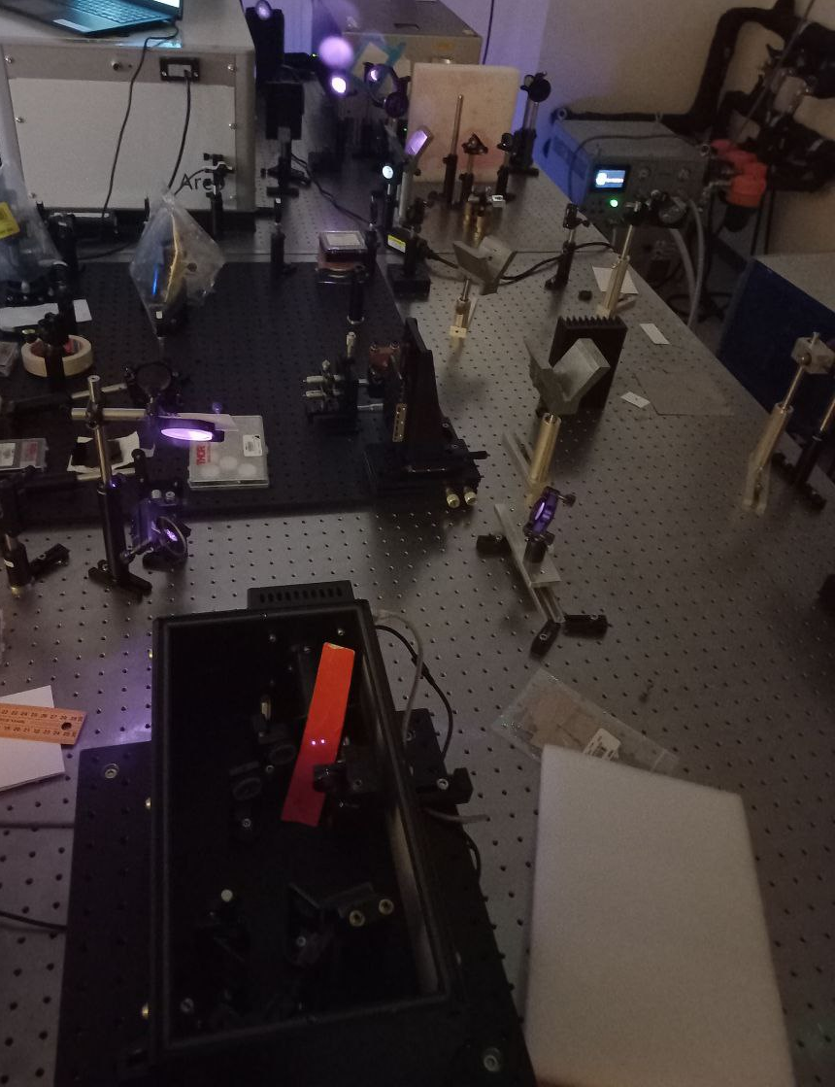
Hands-on session: 2nd order non collinear autocorrelator, BONSAI
Correlation
Objective: temporal profile measurement of an ultra short laser pulse with a 2nd order intensity autocorrelator.
Briefly:
Align laser on the pin-holes
check the laser path through the optical system
Perform the measure with the dedicated software

Slide 10
Hands-on session: 2nd order non collinear autocorrelator, BONSAI
Correlation
Objective: temporal profile measurement of an ultra short laser pulse with a 2nd order intensity autocorrelator.
Briefly:
Align laser on the pin-holes
check the laser path through the optical system
Perform the measure with the dedicated software

Slide 11
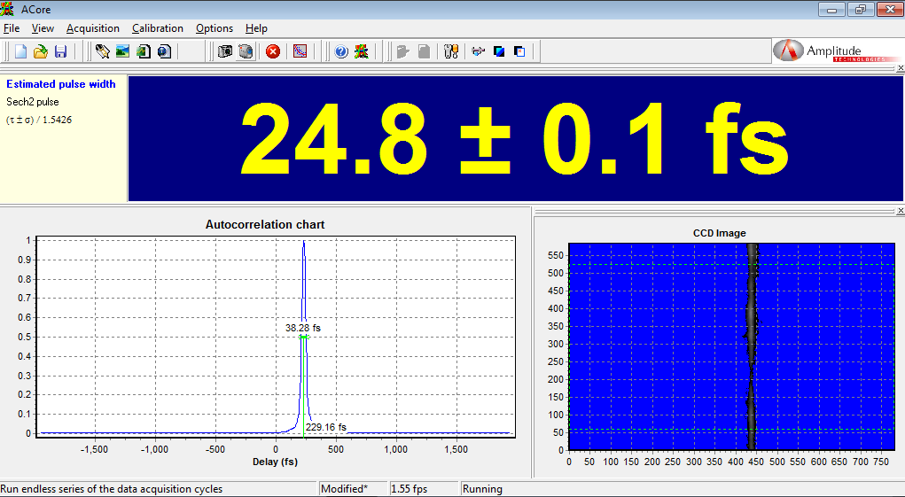
Hands-on session: 2nd order non collinear autocorrelator, BONSAI
Correlation
Objective: temporal profile measurement of an ultra short laser pulse with a 2nd order intensity autocorrelator.
Briefly:
Align laser on the pin-holes
check the laser path through the optical system
Perform the measure with the dedicated software

Slide 12
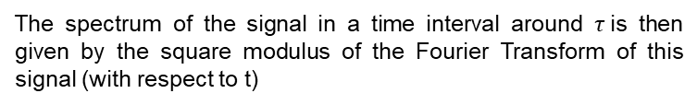
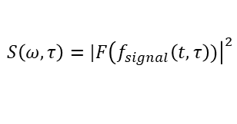

Frequency-Resolved Optical Grating: FROG
Spectrogram
R. Trebino et al., Rev. Sci. Instr. 68, 3277 (1997)
Measurement involving simultaneously temporal and frequency resolution are able to provide informartion both on pulse envelope and spectrum allowing to infer information also on the spectral phase
Measurement of the «instantaneous» frequency
Inserire testo Arial 28pt
Inserire il nome del Relatore 20 pt
Spectrograms are commonly used for the description of ultrashort laser pulse in the Time-Frequency Domain
$$f_{signal}\left(t,τ\right)=E\left(t\right)g(t−τ)$$
The spectrum of the signal in a time interval around $τ$is then given by the square modulus of the Fourier Transform of this signal (with respect to t)
$$S\left(ω,τ\right)=\left.​\right|F{\left(f_{signal}\left(t, τ\right))\right|}^{2}$$
We need an ultrafast gate function !
In FROG the pulse is used to gate itself exploitng a nonlinear optical interaction

Slide 13
Frequency-Resolved Optical Grating: SHG - FROG
Spectrogram
Different option possible:
PG – FROG
SHG – FROG
THG – FROG
…
Inserire testo Arial 28pt
Inserire il nome del Relatore 20 pt
Nome dell’evento, luogo e data 16 pt

Slide 14


Frequency-Resolved Optical Grating: SHG - FROG
Spectrogram
Different option possible:
PG – FROG
SHG – FROG
THG – FROG
…
«Frequency resolved intensity autocorrelator»
Inserire testo Arial 28pt
This configuration requires a quite similar setup to the one used for the 2° order intensity autocorrelator in which the CCD is replaced with a spectrometer
The gate function being:
$$g\left(t−τ\right) =E(t−τ)$$
Inserire il nome del Relatore 20 pt
Thus:
$$f_{signal}\left(t, τ\right)=E\left(t\right)E(t−τ)$$
Different algorithms exist for retrieving the field $E(t)$ starting from the measured traces. The latter can be quite un-intuitive since they depend both on the chirp of the gate pulse (if any) and the chirp of the pulse to be measured.

Slide 15
Frequency-Resolved Optical Grating: SHG - FROG
Spectrogram
Inserire testo Arial 28pt
Remember the simple «case» scenario?
Example of an algorithm

Slide 16
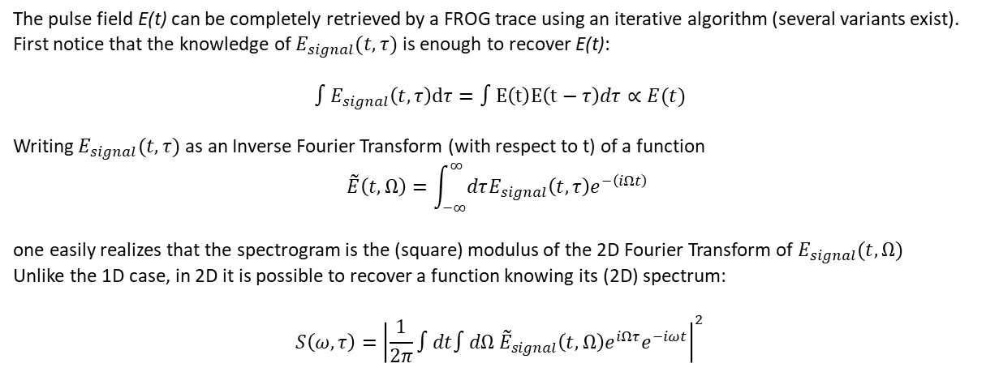
FROG Algorithm idea
Spectrogram
The pulse field E(t) can be completely retrieved by a FROG trace using an iterative algorithm (several variants exist).
First notice that the knowledge of $E_{signal}(t, τ)$ is enough to recover E(t):
$${∫E}_{signal}\left(t, τ\right)dτ=∫E\left(t\right)E\left(t−τ\right)dτ∝E(t)$$
Writing $E_{signal}(t, τ)$ as an Inverse Fourier Transform (with respect to t) of a function
$$\tilde{E}\left(t, Ω\right)=\int_{−∞}^{∞}{dτE_{signal}\left(t, τ\right)e^{−\left(iΩt\right)} }$$
one easily realizes that the spectrogram is the (square) modulus of the 2D Fourier Transform of $E_{signal}(t, Ω)$
Unlike the 1D case, in 2D it is possible to recover a function knowing its (2D) spectrum:
$$S\left(ω, τ\right)={\left|\frac{1}{2π}∫dt∫dΩ {\tilde{E}}_{signal}\left(t, Ω\right)e^{iΩτ}e^{−iωt}\right|}^{2}$$

Slide 17
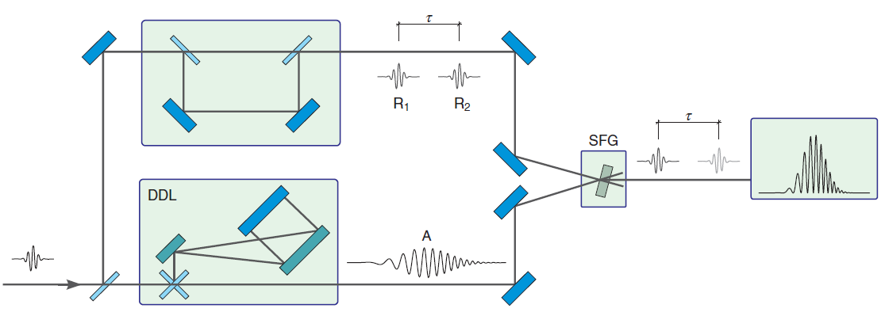
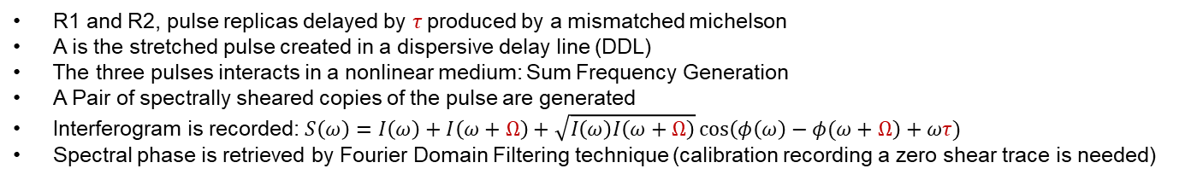
Spectral Interferometry Technique
Spectral Interferometry
Spectral Phase Interferometry for Direct Electric-field Reconstruction (SPIDER)
Technique evolution:
ZAP-SPIDER
SEA-SPIDER
Spectral fringes
Information on the spectral phase is encoded into the fringe spacing of the interferogram
G
G
R1 and R2, pulse replicas delayed by $τ$produced by a mismatched michelson
A is the stretched pulse created in a dispersive delay line (DDL)
The three pulses interacts in a nonlinear medium: Sum Frequency Generation
A Pair of spectrally sheared copies of the pulse are generated
Interferogram is recorded: $S\left(ω\right)=I\left(ω\right)+I\left(ω+Ω\right)+\sqrt{I\left(ω\right)I\left(ω+Ω\right)}\cos\left(φ\left(ω\right)−φ(ω+Ω\right)+ωτ)$
Spectral phase is retrieved by Fourier Domain Filtering technique (calibration recording a zero shear trace is needed)
M. E. Anderson et al., Laser Phys. Lett. 5, 4 (2008) and reference there in
C. Iaconis et al., IEEE Journal of quantum electronics 35,4 (1999)

Slide 18
Hands-on session: 2nd order non collinear autocorrelator, BONSAI
Correlation
Objective: temporal profile measurement of an ultra short laser pulse with a 2nd order intensity autocorrelator.
Briefly:
Align laser on the pin-holes
check the laser path through the optical system
Perform the measure with the dedicated software
See you tomorrow in the lab!

Slide 19
Further readings
Y. Cai et al., Appl. Sci. 10, 7401 (2020)
J. M. Diels, W. Rudolph Ultrashort Laser Pulse Phenomena, 2° edition Academic press: San Diego, CA, USA (1996)
J.M. Diels et al., Appl. Opt.24,1270 (1985)
C. Iaconis et al., IEEE Journal of quantum electronics 35,4 (1999)
M. E. Anderson et al., Laser Phys. Lett. 5, 4 (2008)
E. M. kosik et al., Optics Letters 30, 3 (2005)
R. Trebino et al., Rev. Sci. Instr. 68, 3277 (1997)

