Slide 1


ITINERIS-ACTRIS Pilot Access Program:
Enhancing Scientific Collaboration through Coordinated National and European Infrastructure Access
Cornacchia C., Gagliardi S., Gargano G., Loperte S., Petracca Altieri R.M. and Ricciardi F.
National Research Council - Institute of Methodologies for Environmental Analysis, Tito Scalo (PZ), Italy

Slide 2
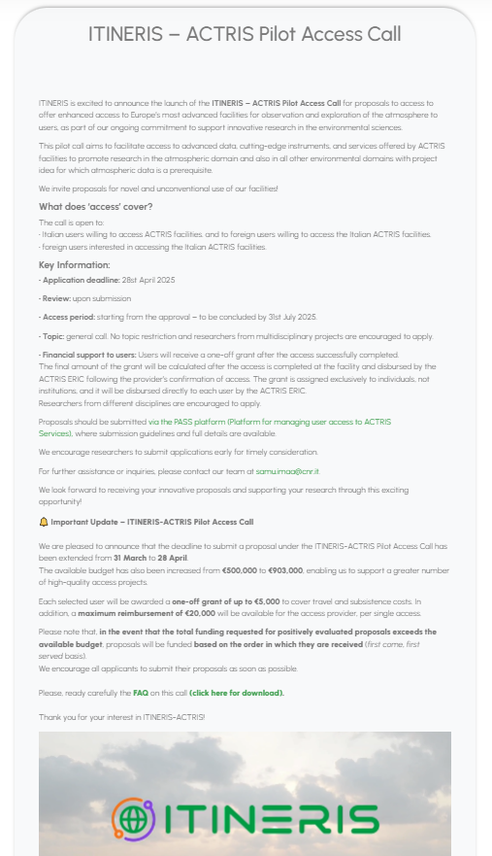
Key call information
Call details | Access of Italian users to European ACTRIS Facilities Access of foreign users to the Italian ACTRIS Facilities
Call important deadlines | Application submission from September 2024 to March 2025 → extension → April 2025 Access to be concluded by end of July 2025
What is funded | Reimbursement to ACTRIS Facilities providing access Financial contribution to users (travel and subsistence costs as per EU Decision C(2021)35). Budget allocated 903 K€
Grant limit | Up to €5,000 per user to contribute to travel and subsistence costs Up to €20,000 for access provider per single access

Slide 3

Innovative aspects of the call
«Curiosity-driven» approach
No pre-allocated budget per Facility
Centralized management by SAMU and direct reimbursement by ACTRIS ERIC
Agreement between ACTRIS ERIC and CNR-IMAA for the management of the call
Agreement on privacy and data management
Agreement between ACTRIS ERIC and Provider (Service Level Agreement) for service management
Funding
model
Legal Framework
First TNA program co-funded by national project
National
co-funding
Targeted dissemination activities
Live stream on YouTube
Video and slide show
Newsletter
FAQ
Outreach

Slide 4
ITINERIS-ACTRIS Pilot Access Call in number
63 applications submitted
58 access projects completed
113 users involved
Users accessing facilities abroad: 22
Users accessing facilities in Italy: 91
30% of the Italian ACTRIS facilities offered access for the first time

Slide 5
User affiliation

Slide 6
User profile

Slide 7
Access modalities

Slide 8
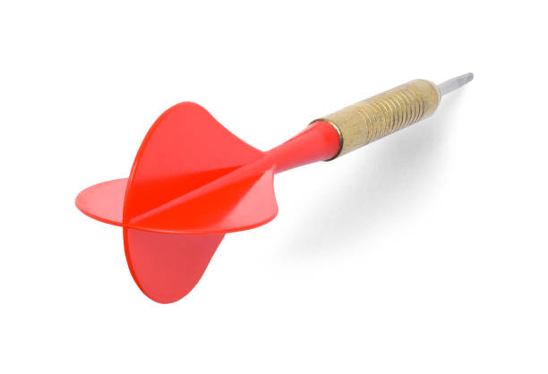
Conclusions
High interest and participation
→
strong community engagement
Development of skills and competences
→
collaboration
& multisciplinary
Different user groups participation
→
inclusiveness
Increased management efficiency
→
coordination and resource optimization
Streamlined procedures for users
→
reduced access barriers
ITINERIS-ACTRIS Pilot Access Call

Slide 9
francescaricciardi@cnr.it
samu.imaa@cnr.it

Slide 10
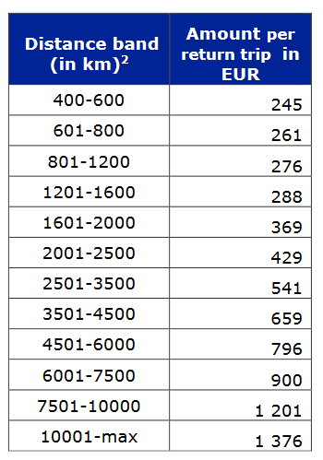
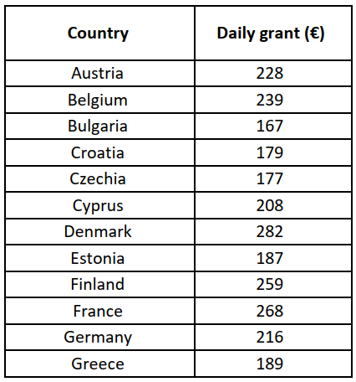
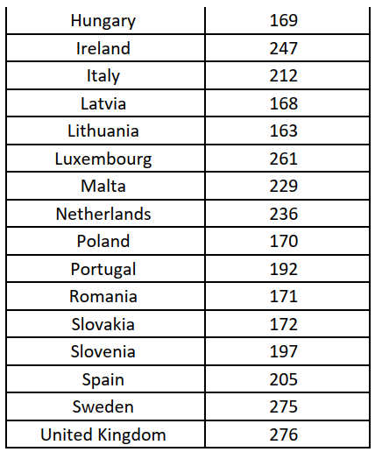
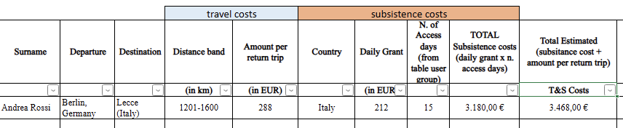
Travel and subsistence cost calculation
Based on flat rates for Travel (variable depending on the distance travelled) and Subsistence (variable depending on the country where the access takes place)
Preliminary calculation based on the information in the Application form, included in the award letter → by SAMU
Final amount of the grant determined based on the information in the provider’s CoA
(Commission Decision C(2021)35)

Slide 11
Provider’s reimbursement calculation
The provider’s reimbursement per access project is determined by multiplying the unit cost (declared for the facility and used in other EU projects) and the quantity of access declared in the CoA. Alternatively, the provider’s reimbursement is based on the real cost reported.
To proceed with reimbursement, a service-level agreement can be signed between the ERIC and the provider institution.

