Slide 1

FAIR convergence analysis across ITINERIS Research Infrastructure
Gianmarco Ingrosso, Enrica Nestola, Gregorio Sgrigna, Andrea Tarallo, Ilaria Rosati

Slide 2

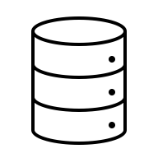






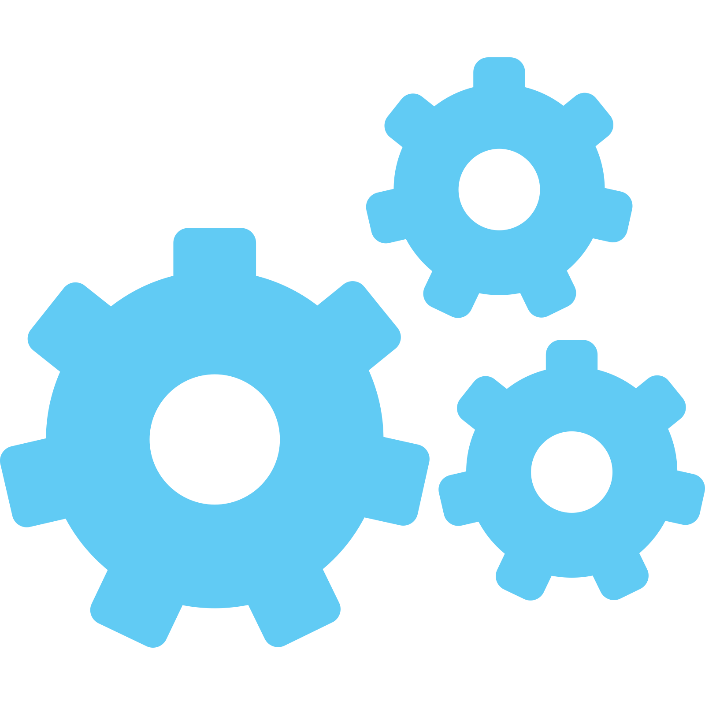

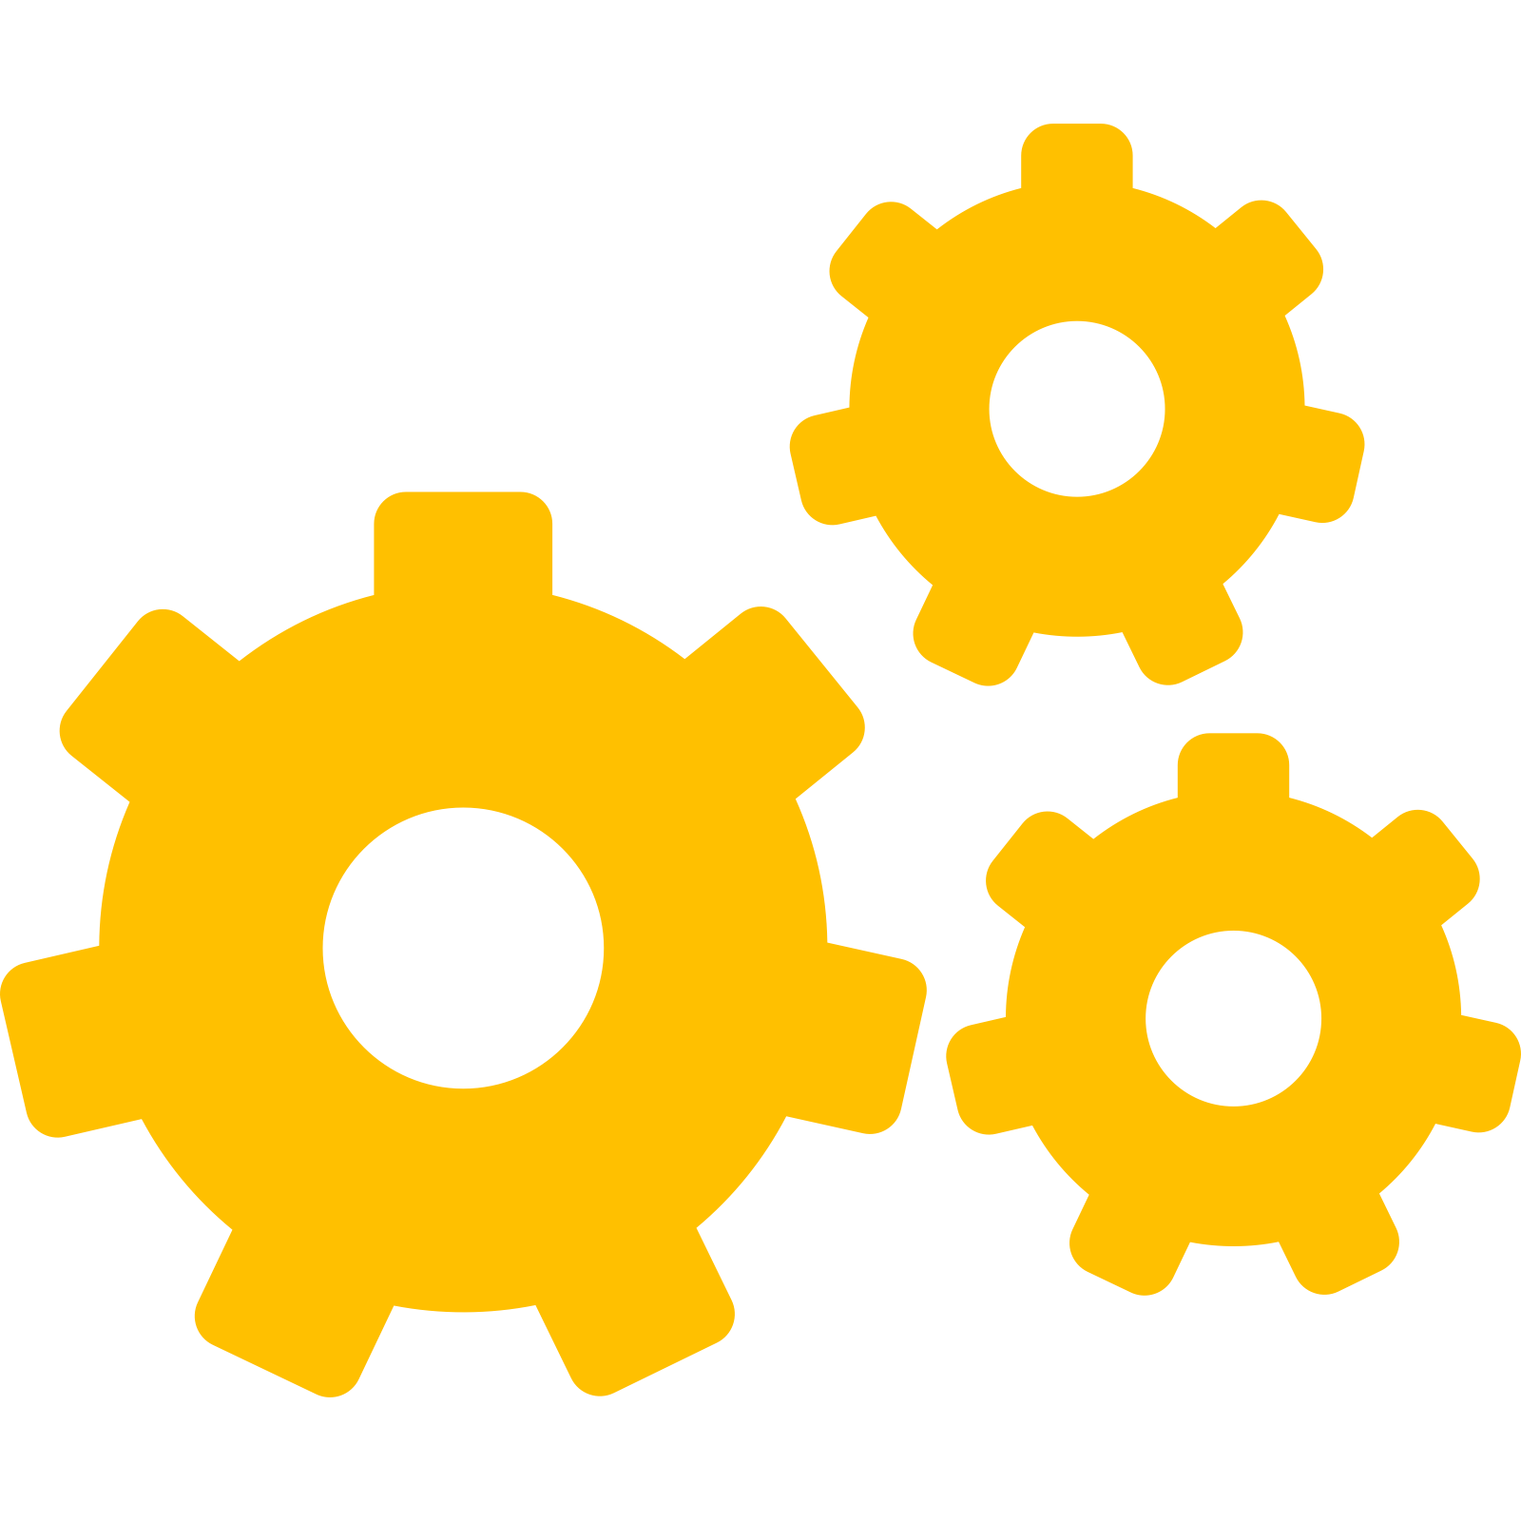













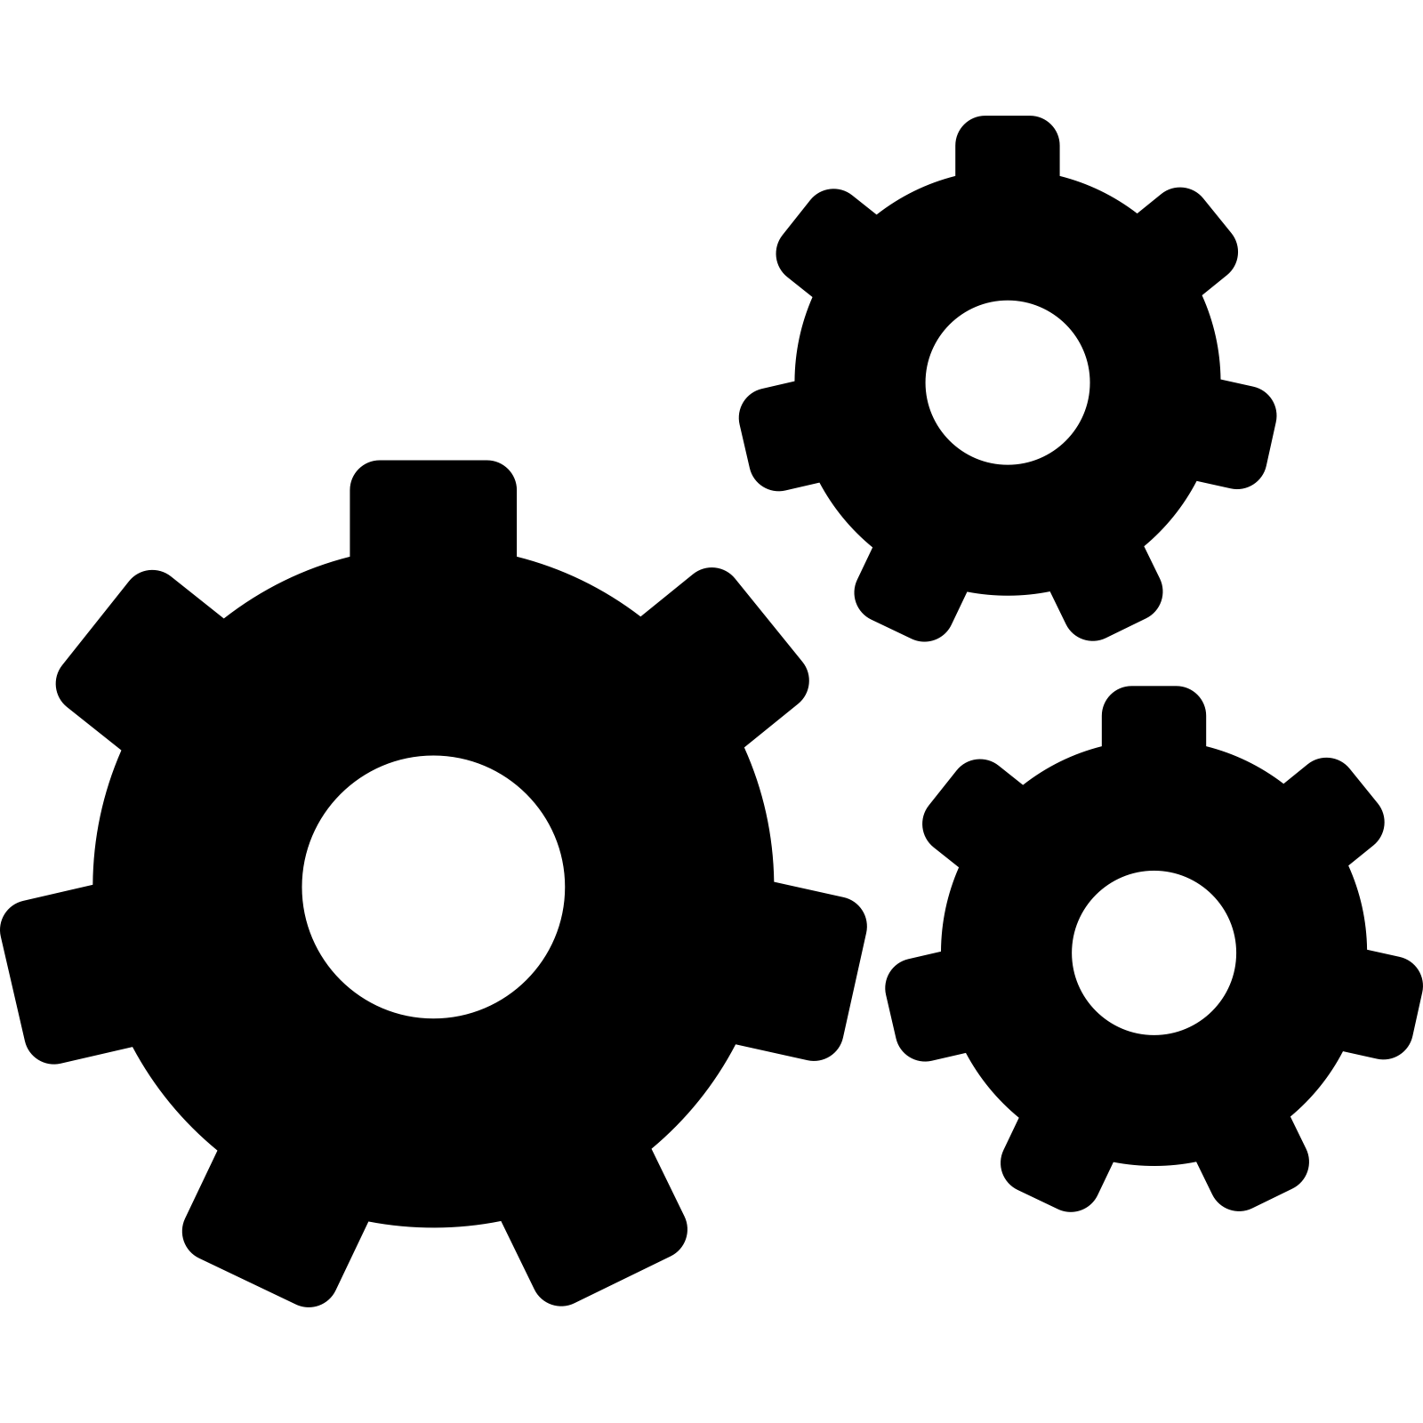
FAIR principles adoption across RIs
RI
RI
RI
FAIR
FAIR
RI
RI
FAIR
FAIR
FAIR
FAIR

Slide 3






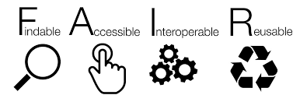
Objectives
RI’s FAIR Referent
Training
FIP Production
FAIR convergence assessment
Network analysis
Assess the capacity of RIs and ITINERIS HUB to share data and digital resources, based on common FAIR practices (Potential connectivity)
Methods
FAIR Implementation Profile (FIP)
RI
TRAINING

Slide 4
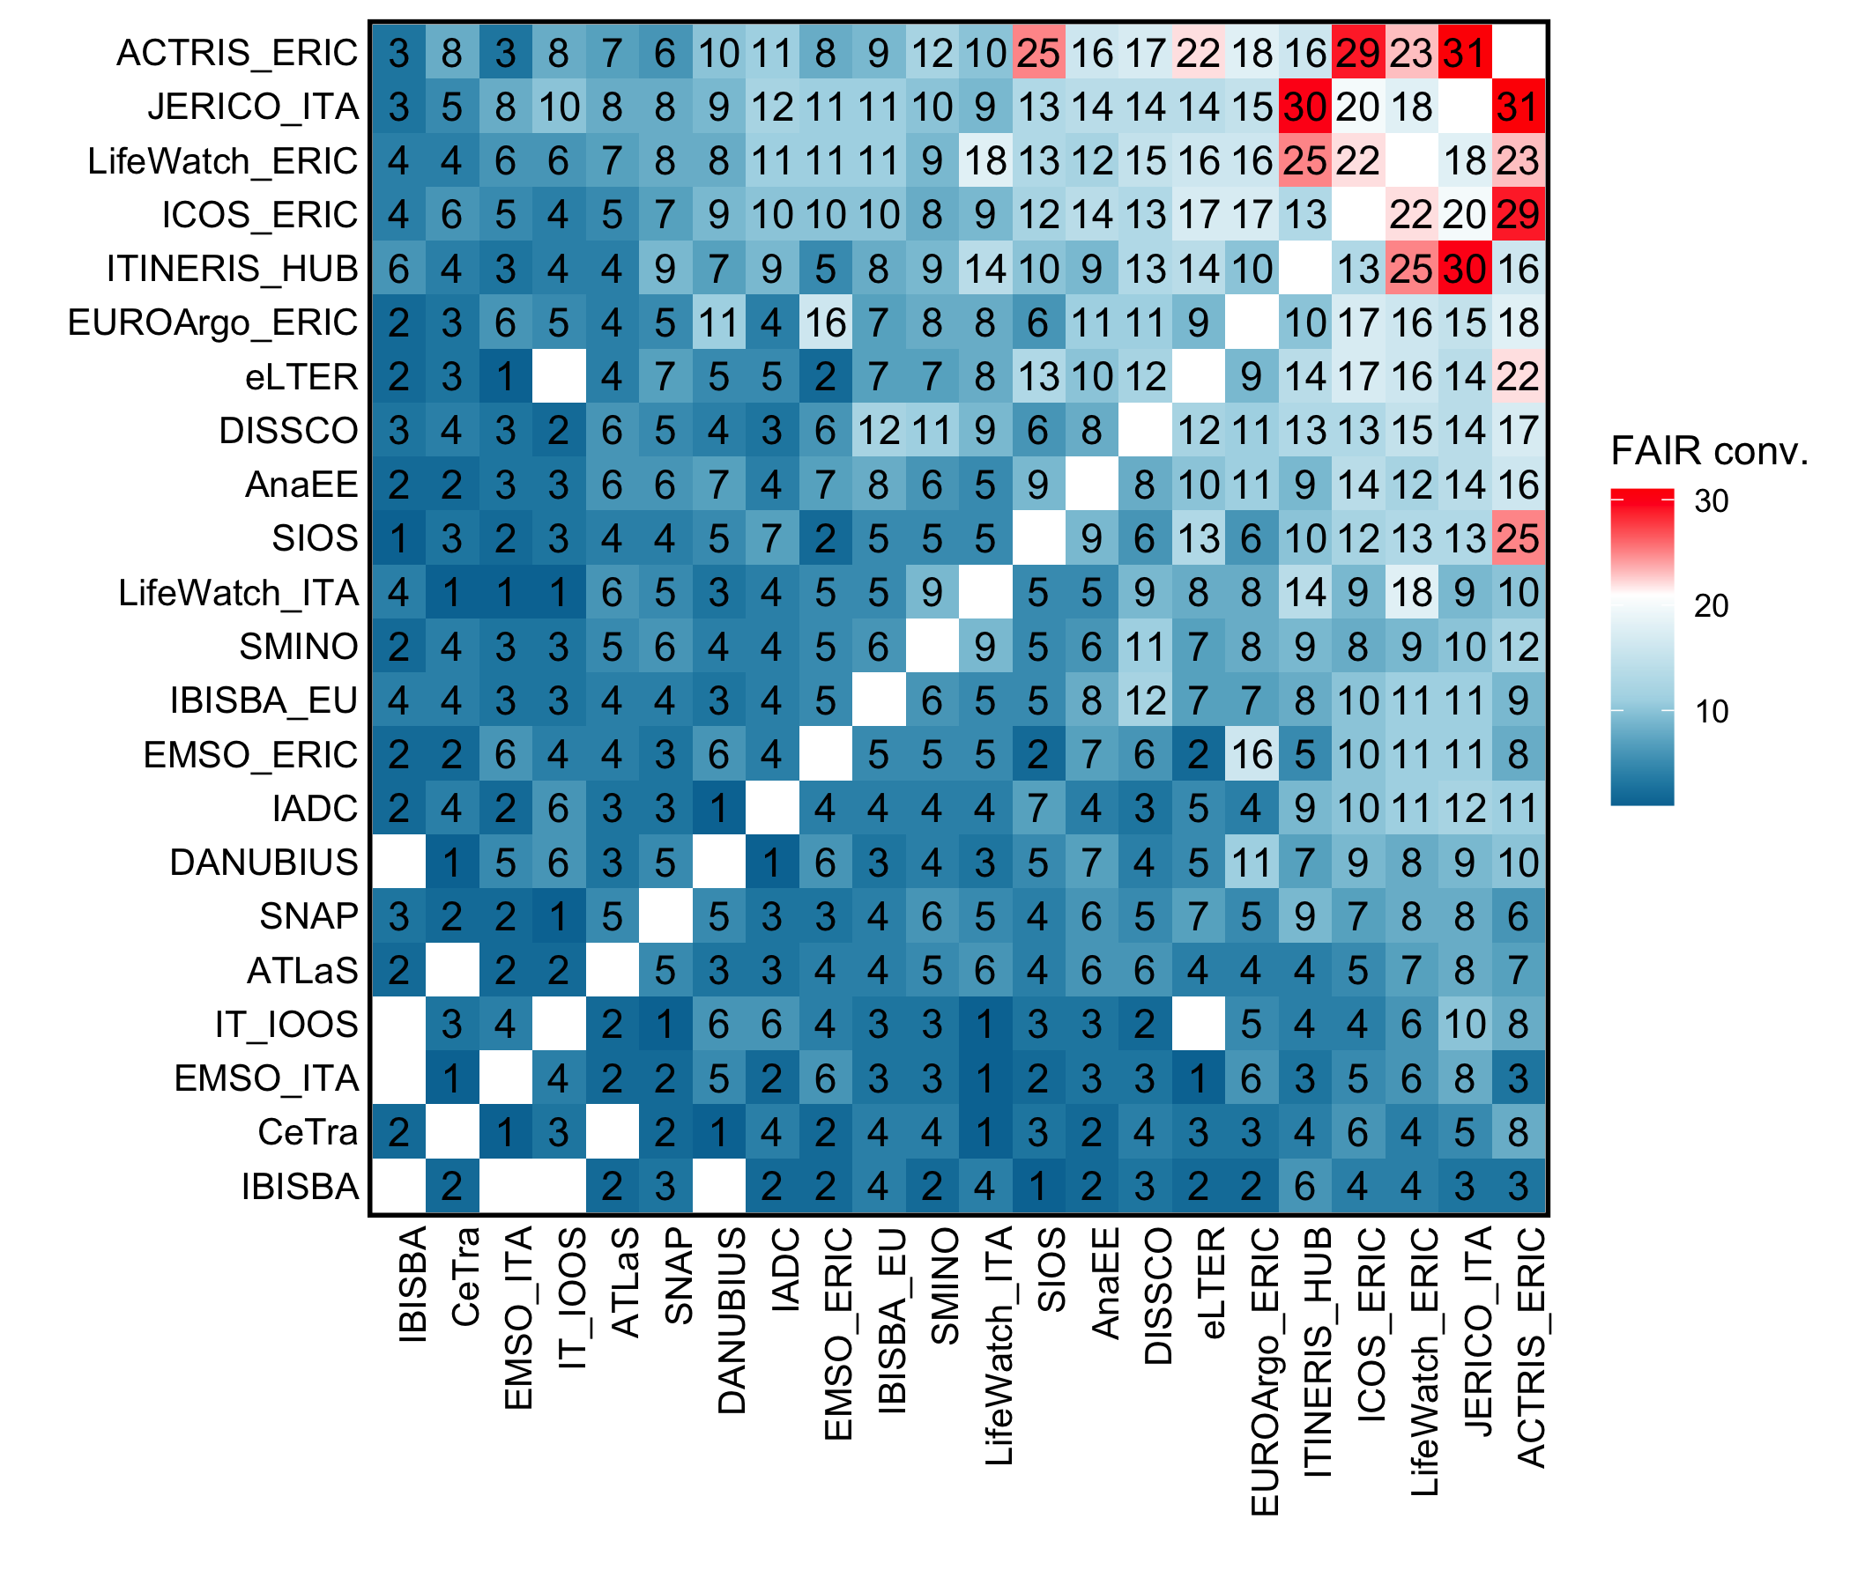

FAIR convergence assessment
13 RIs produced new FIPs
ATLaS
CeTra
DiSSCo
EMSO ITA
SMINO
IBISBA EU
IBISBA ITA
IT-IOOS
IADC
ITINERIS HUB
JERICO ITA
LifeWatch Italy
SNAP
ITINERIS ranked the fifth position among the RIs with the highest number of shared FAIR practices
ACTRIS, JERICO, and LifeWatch were at the top three positions.
ITINERIS revealed the highest convergence of FAIR practices with JERICO, LifeWatch, and ACTRIS.

Slide 5
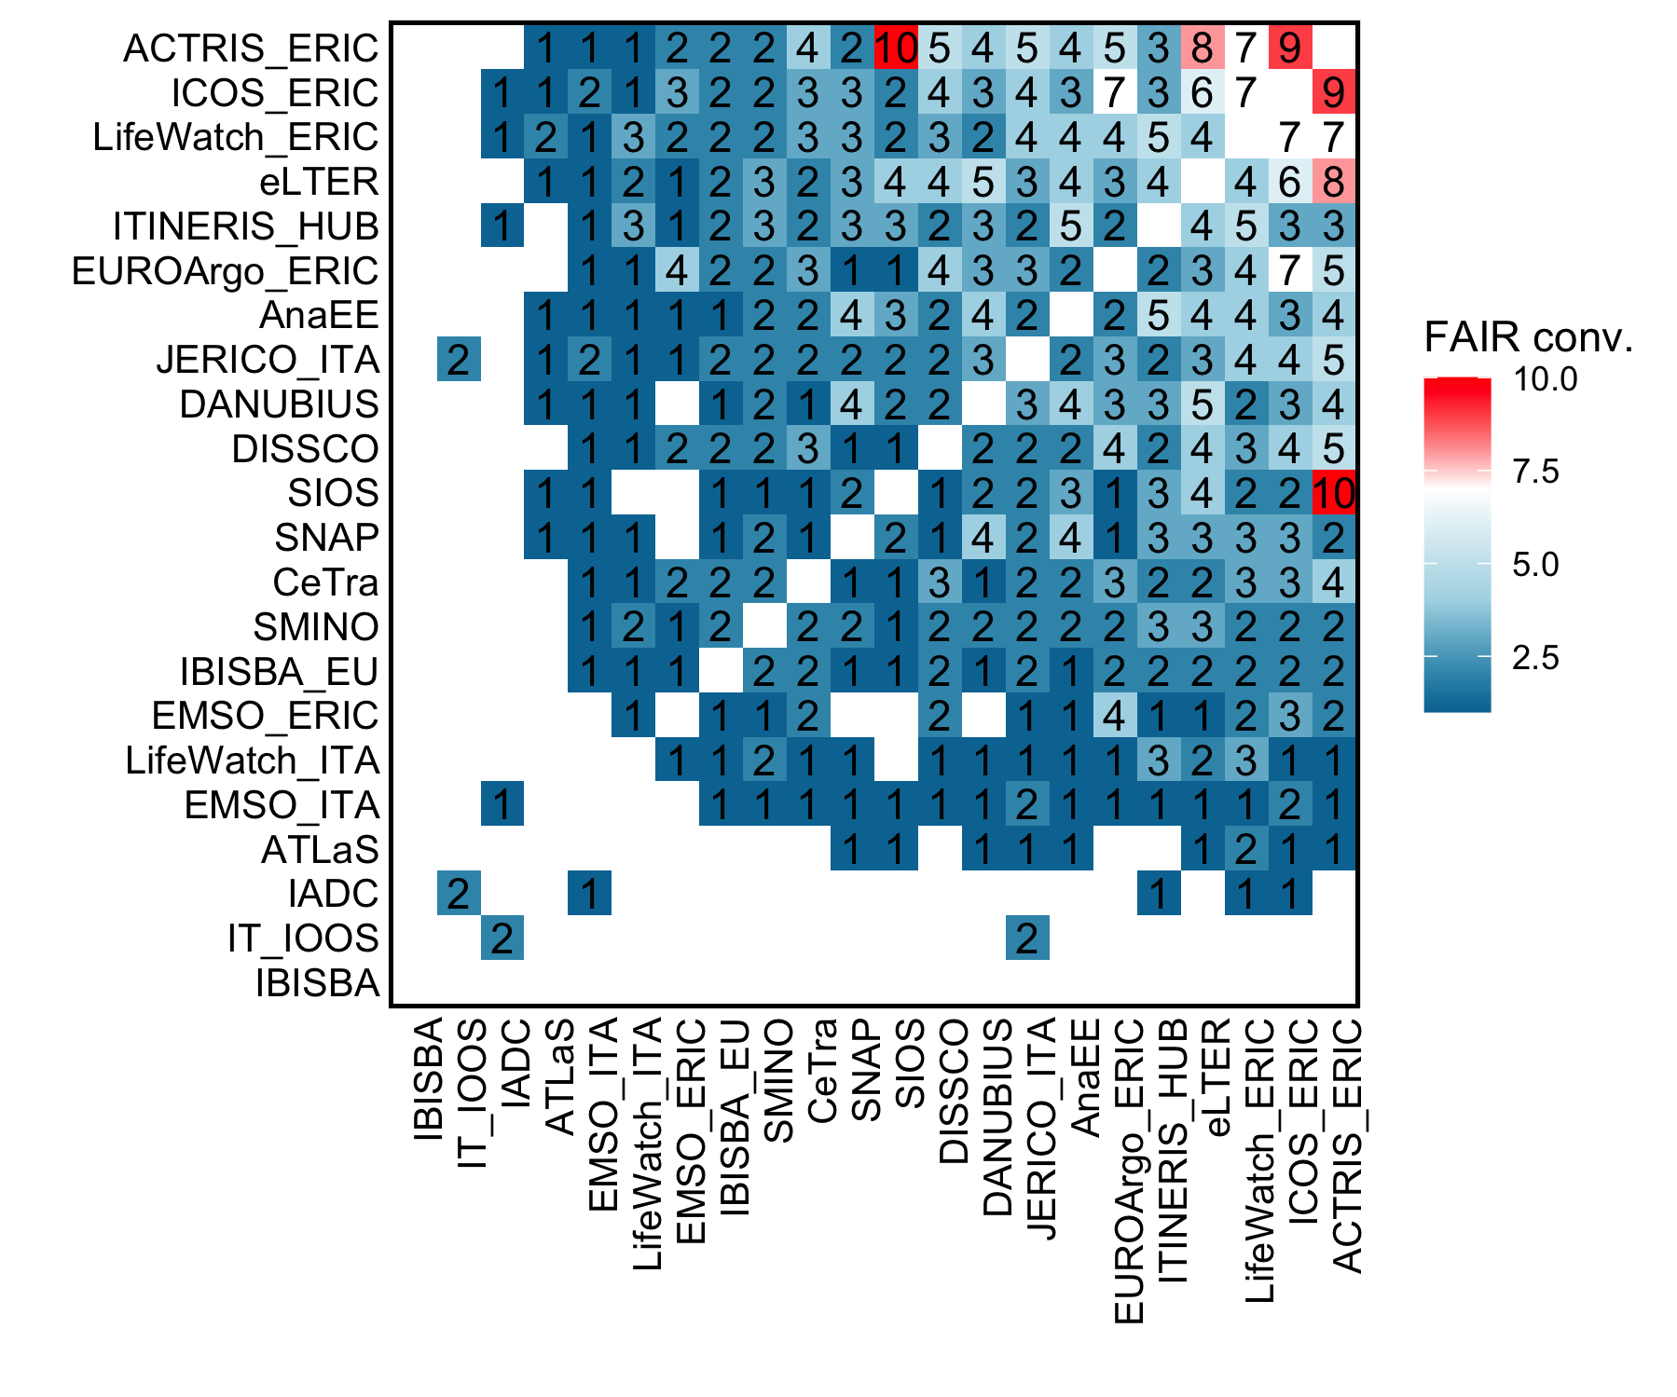
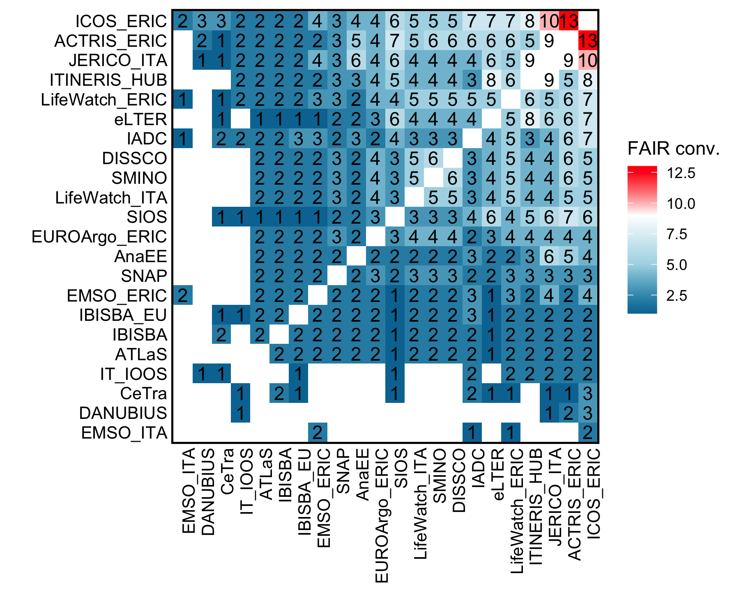
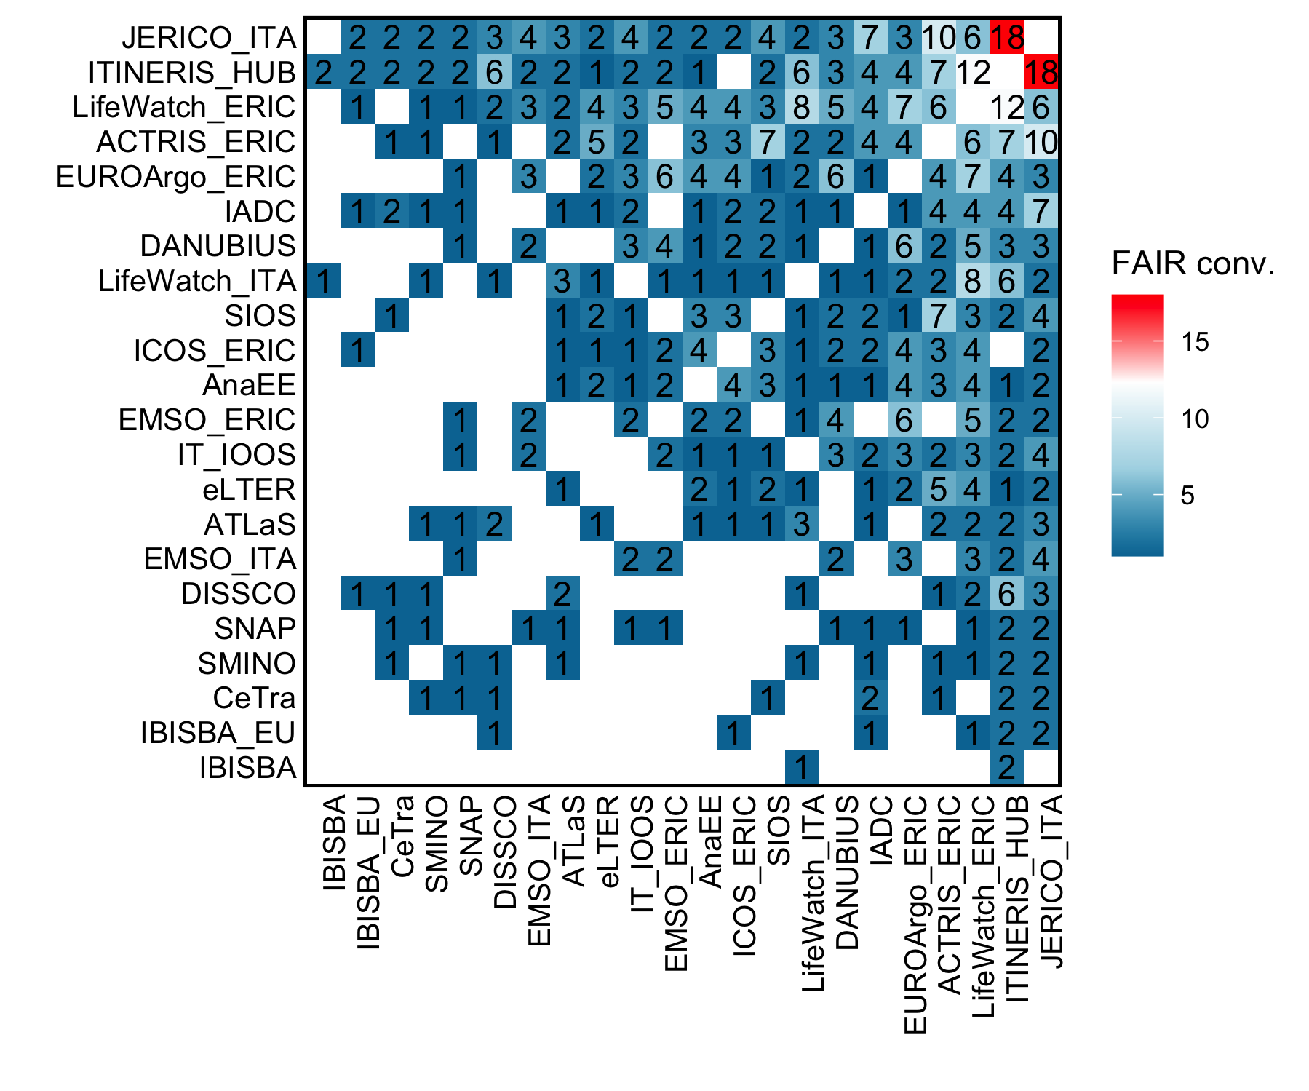
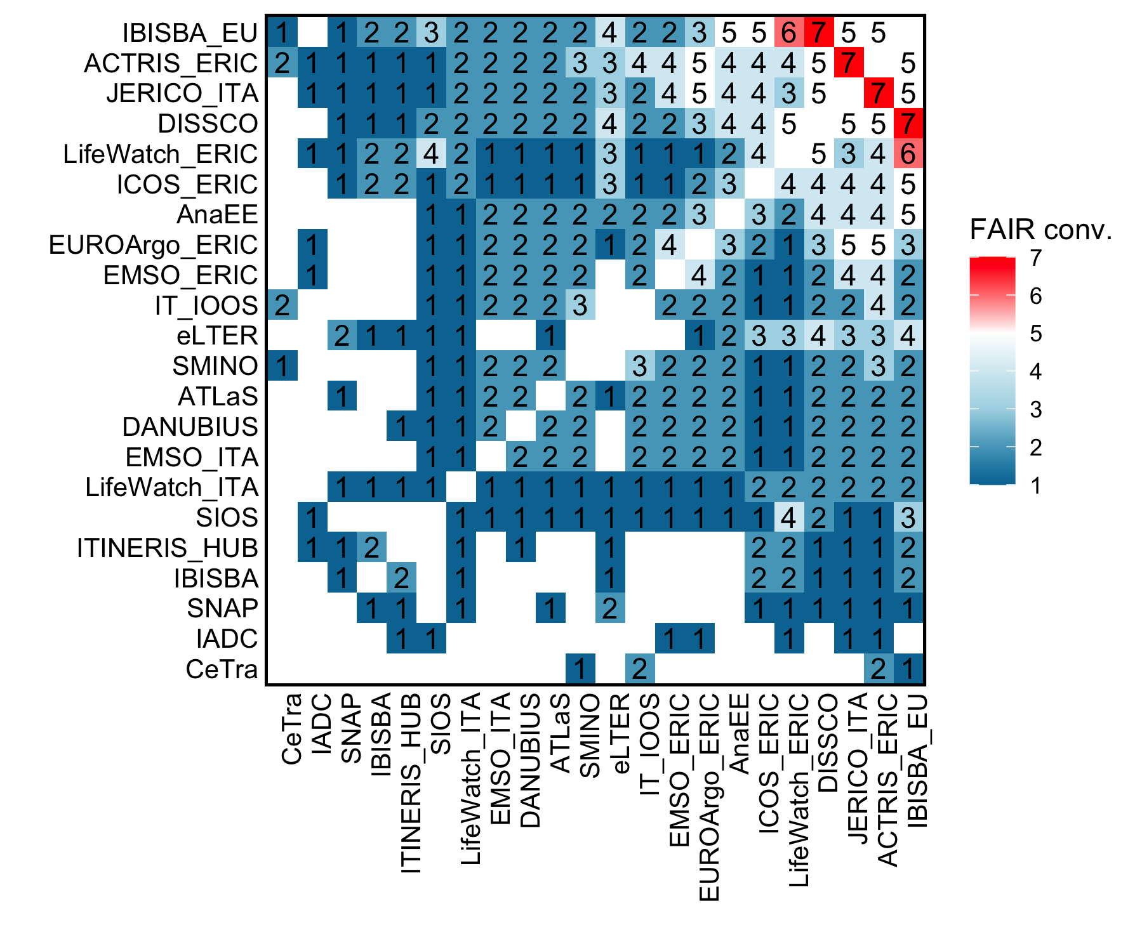
FAIR convergence assessment
FINDABILITY
ACCESSIBILITY
13 RIs produced new FIPs
ATLaS
CeTra
DiSSCo
EMSO ITA
SMINO
IBISBA EU
IBISBA ITA
IT-IOOS
IADC
ITINERIS HUB
JERICO ITA
LifeWatch Italy
SNAP
Analyzing the convergence of FAIR practices across the different principles, ITINERIS performs a good convergence in terms of Findability and Accessibility, very high common practices in Interoperability, but still requires further improovments when it comes to Reusability.
INTEROPERABILITY
REUSABILITY

Slide 6
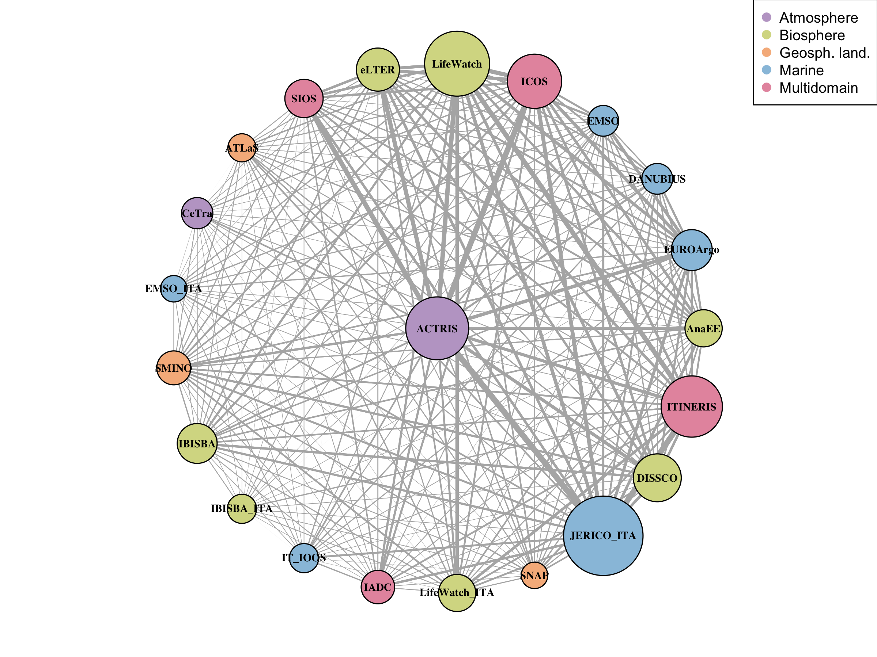
Network analysis
ITINERIS, despite having many connections, still has a marginal role for now.
ATCRIS currently holds the central position, with the strongest and most numerous connections.
Conclusions
This analysis is a first attempt to estimate potential interconnection between ITINERIS and other infrastructures (data and digital resource exchange).
Limitations exist (e.g., some FIPs not updated, the compilation is not uniformly detailed in all IRs)
The method provides a global overview, identify priorities for future improvements and implementations.

