Slide 1
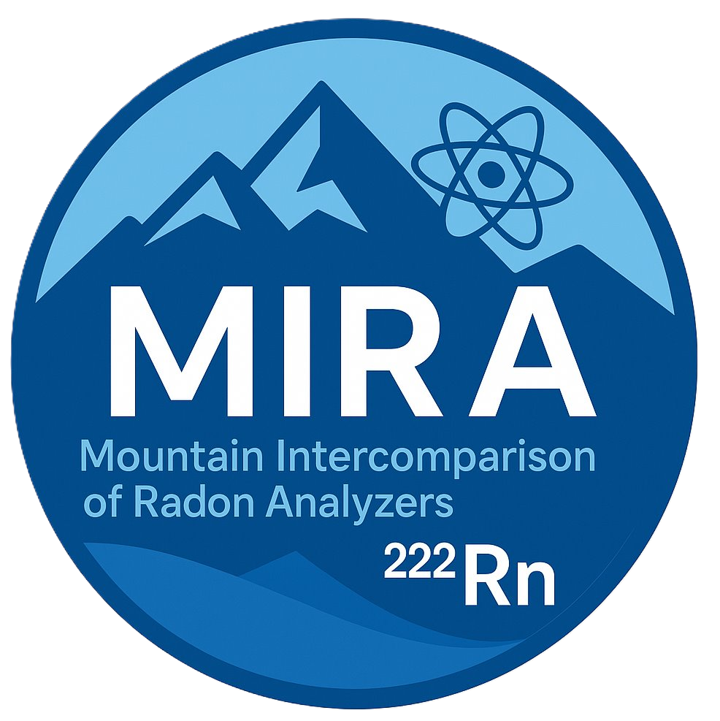
Mountain Intercomparison of Radon Analyzers (MIRA)
S. Montaguti¹, A. Cavaliere², P. Cristofanelli¹, C.R. Calidonna¹, L. Malacaria¹,
G. Gualtieri³, A. Zaldei³, A. Marinoni¹
1 Istituto di Scienze dell'Atmosfera e del Clima (CNR-ISAC), 2 Istituto di Scienze Polari (CNR-ISP), 3 Istituto di Bioeconomia (CNR-IBE)

Slide 2
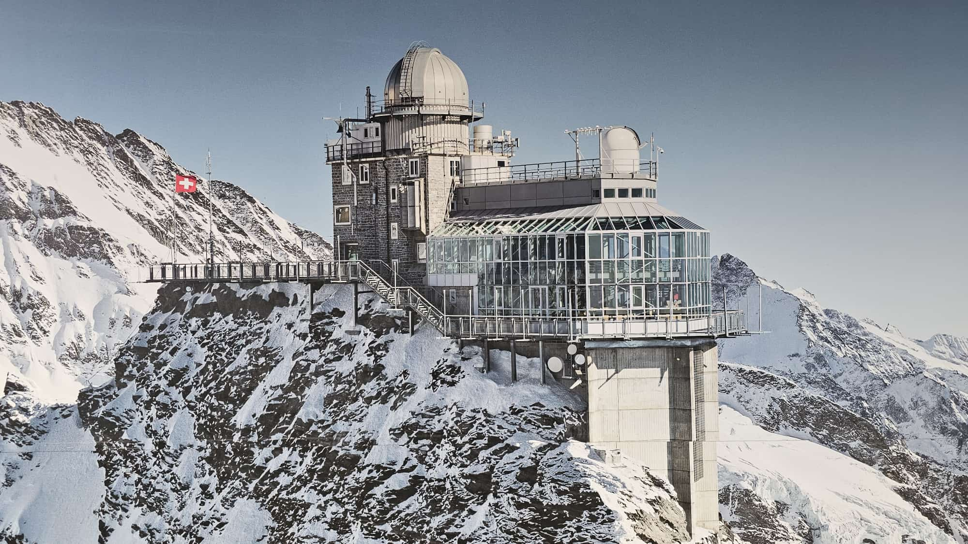
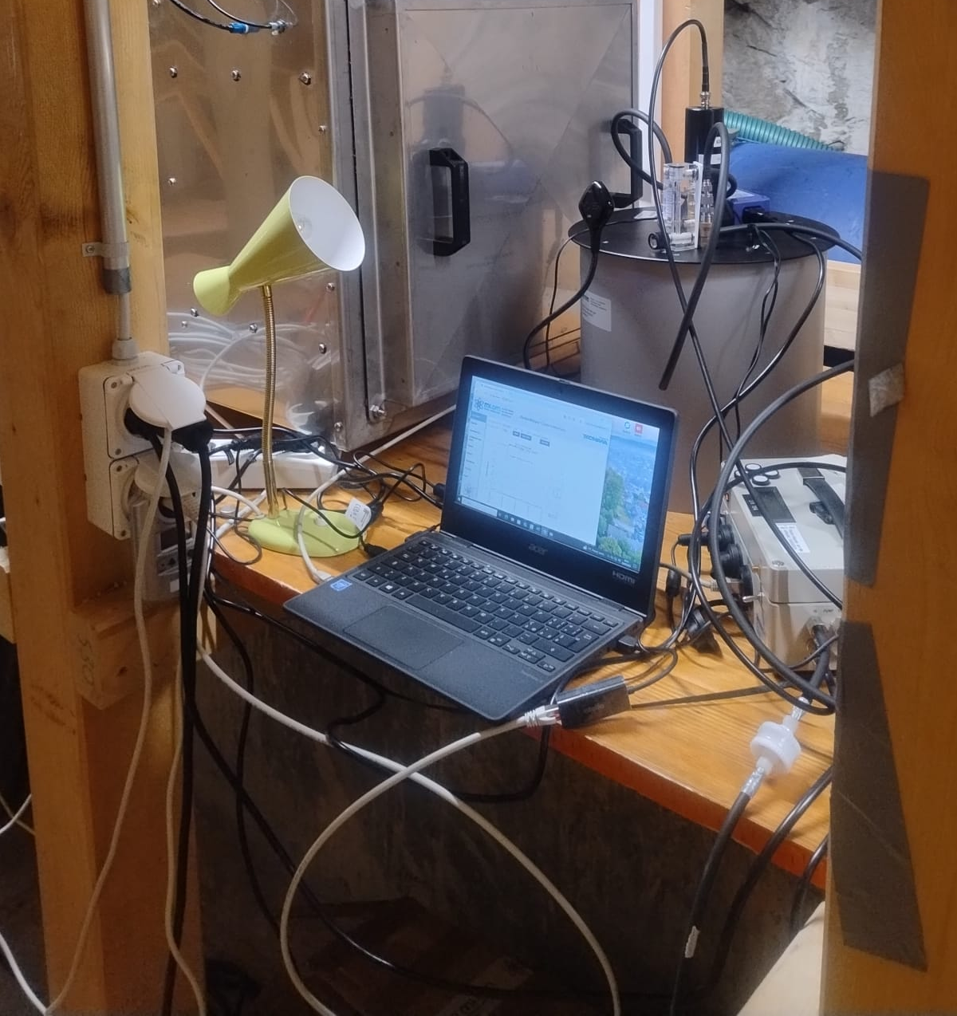
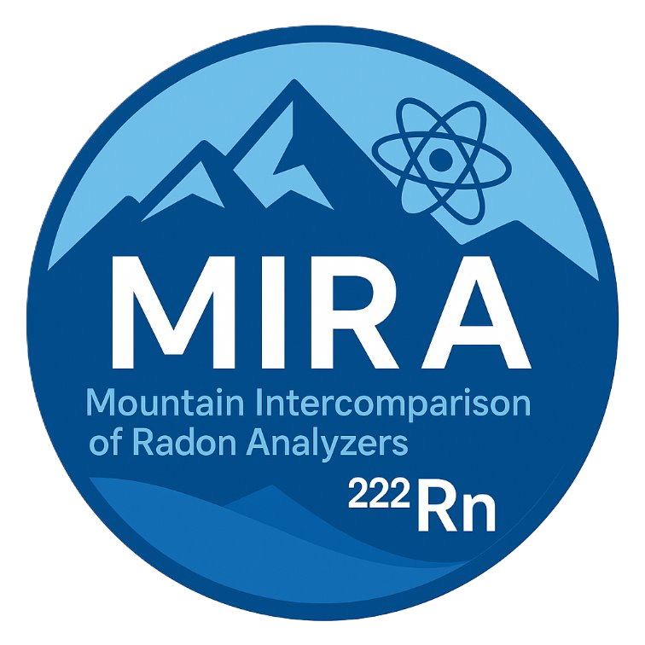
About the MIRA project
Assess reliability and suitability of Pylon detector (TEL model) coupled with Radon Mapper Monitor (Tecnavia/Mi.am, Italy) for scientific use in mountain environments.
Test performance with the Radon analyzer under ITINERIS TNA Access.
Conduct intercomparison at Jungfraujoch station (3454 m, Switzerland) in July 2025.
Combine on-site setup with remote monitoring and real-time data collection.
Build on experience from Mt. Cimone Observatory (2165 m, Italy), where a similar Pylon detector (TEL model) coupled with a Radon Mapper Monitor has been operating continuously since 2023.
Radon detector at Jungfraujoch (JFJ): The instrument, built at ANSTO (Australia), operate on a two-filter dual-loop principle (Whittlestone and Zahorowski, 1998), where the signal is directly proportional to gaseous ²²²Rn.
Radon detector of ISAC – CNR: Pylon detector (TEL model) coupled with Radon Mapper Monitor of Tecnavia/Mi.am (Italy).

Slide 3
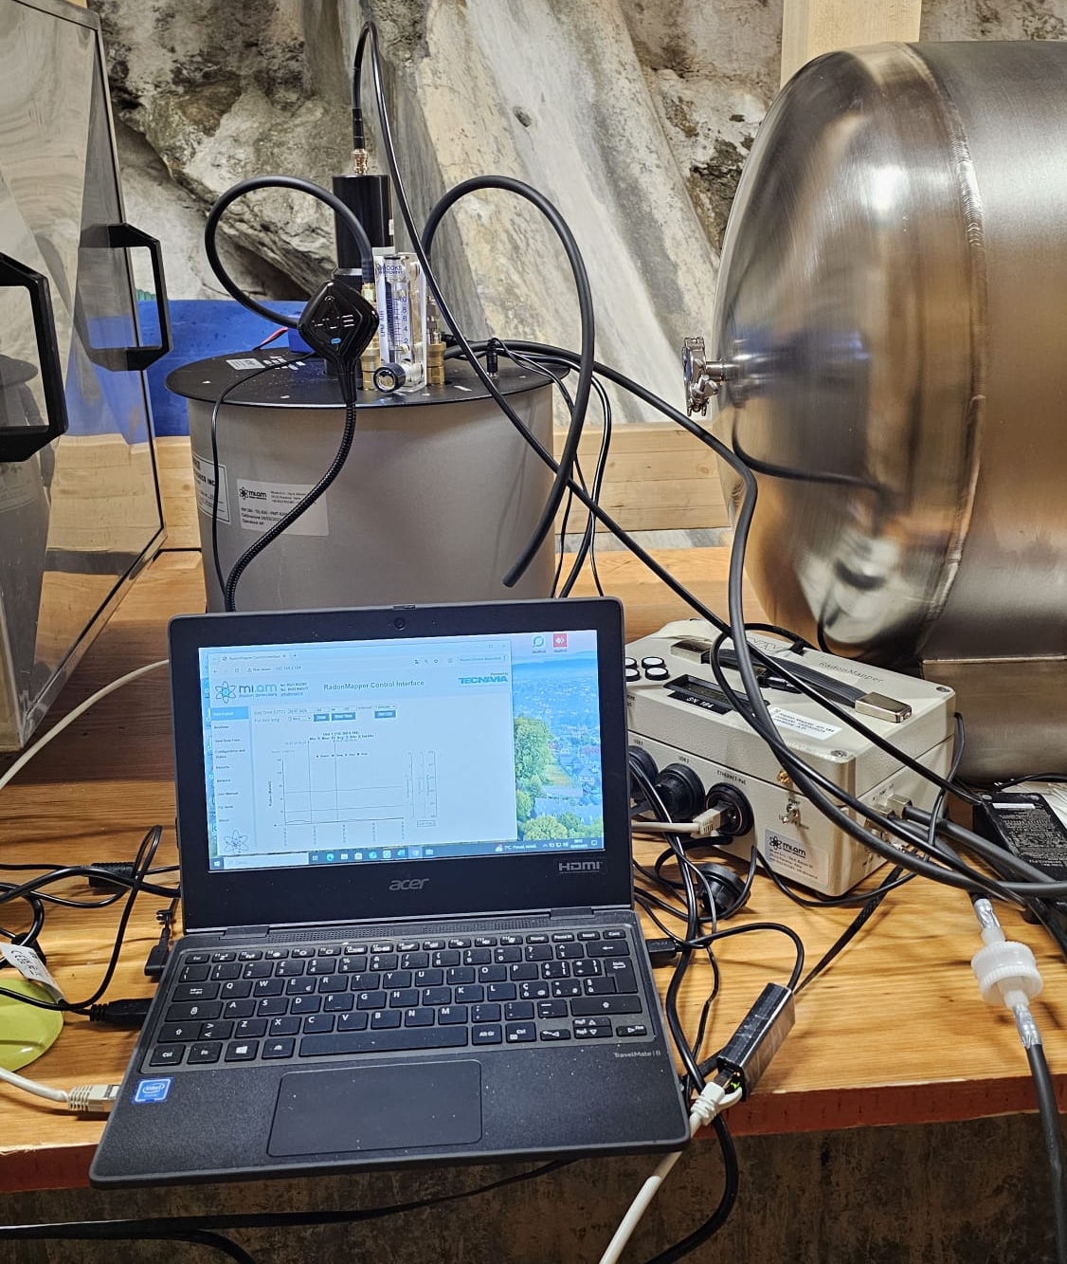
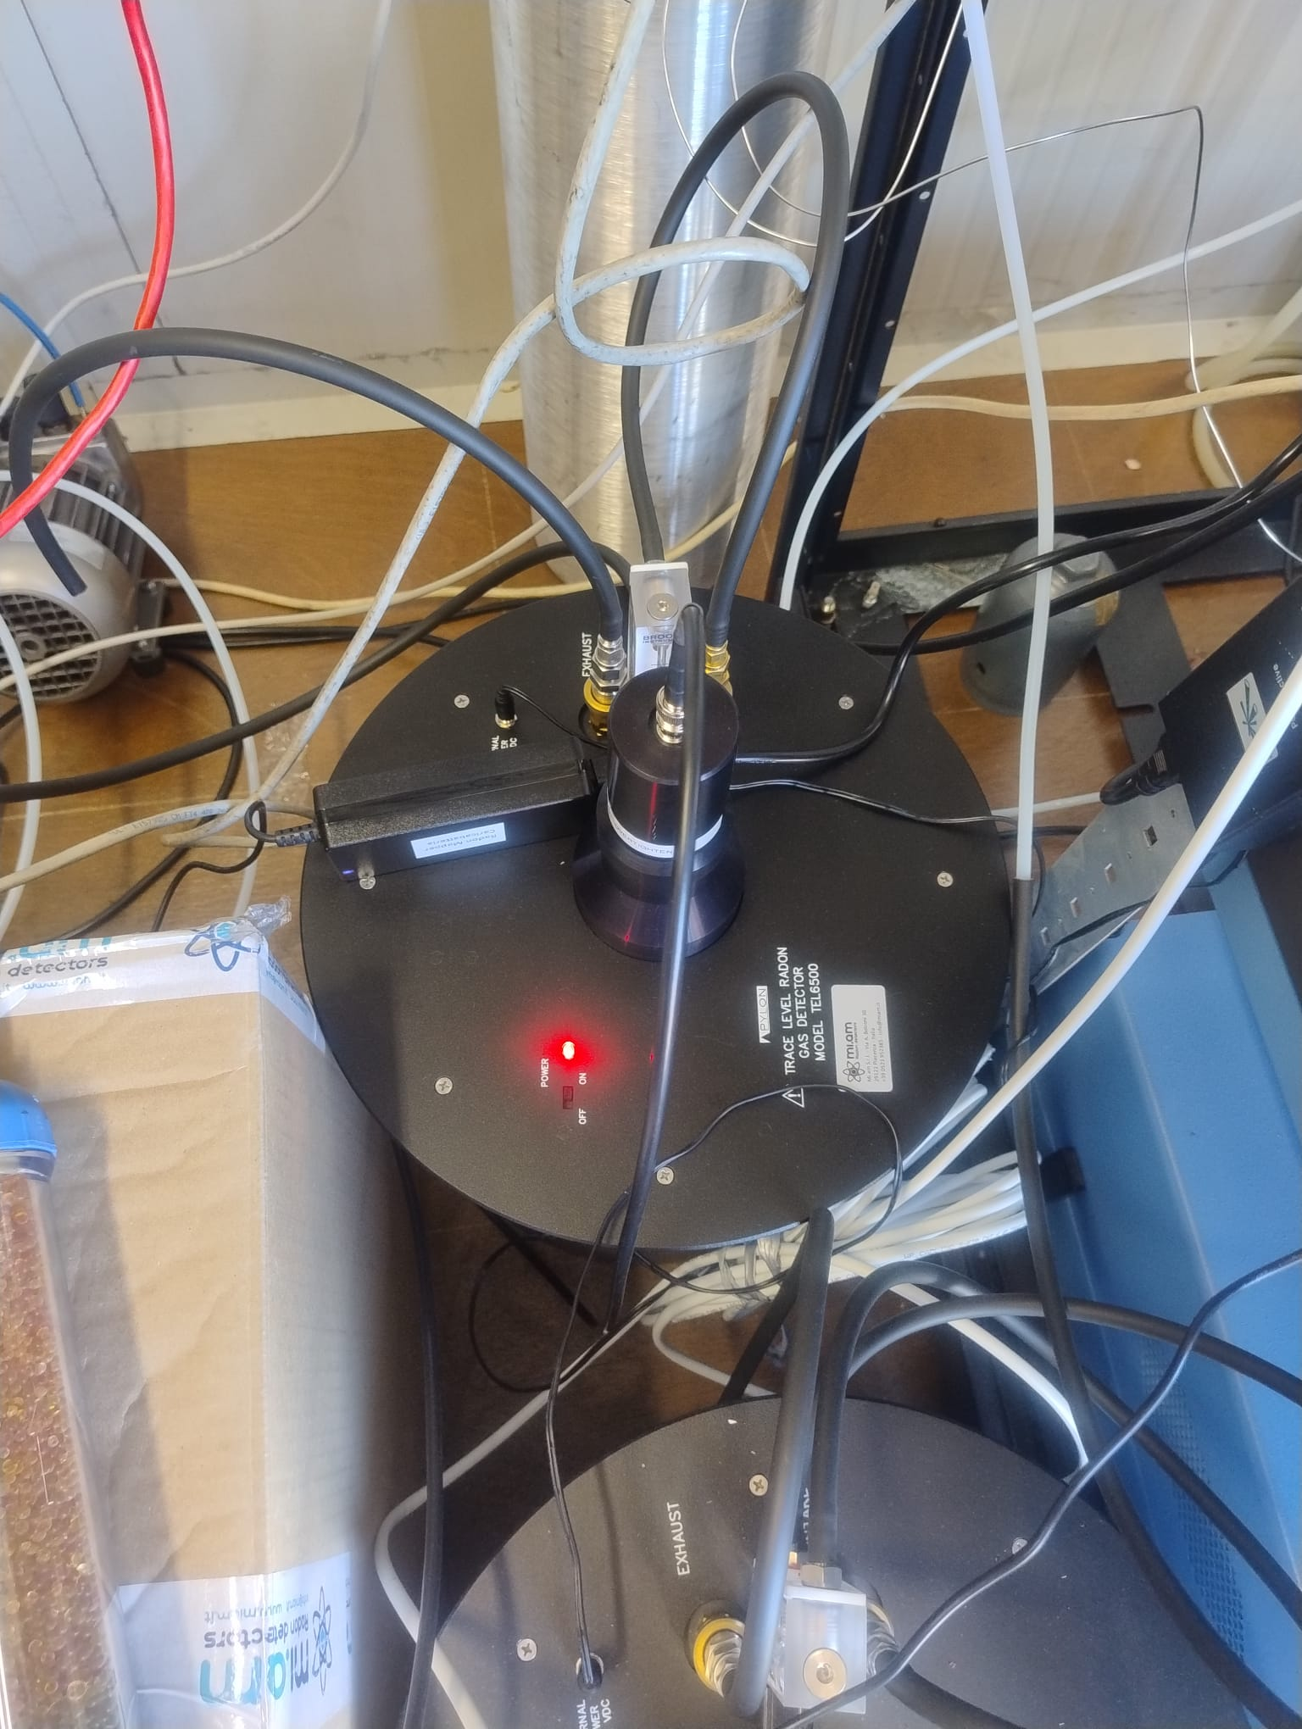
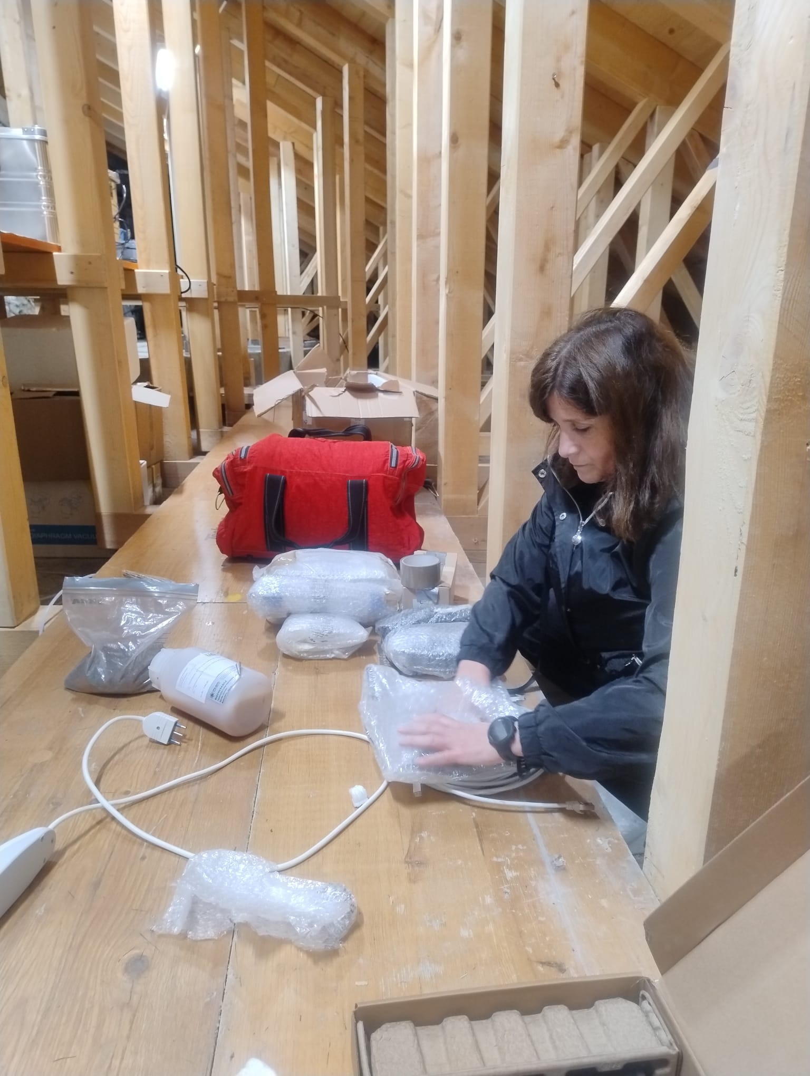
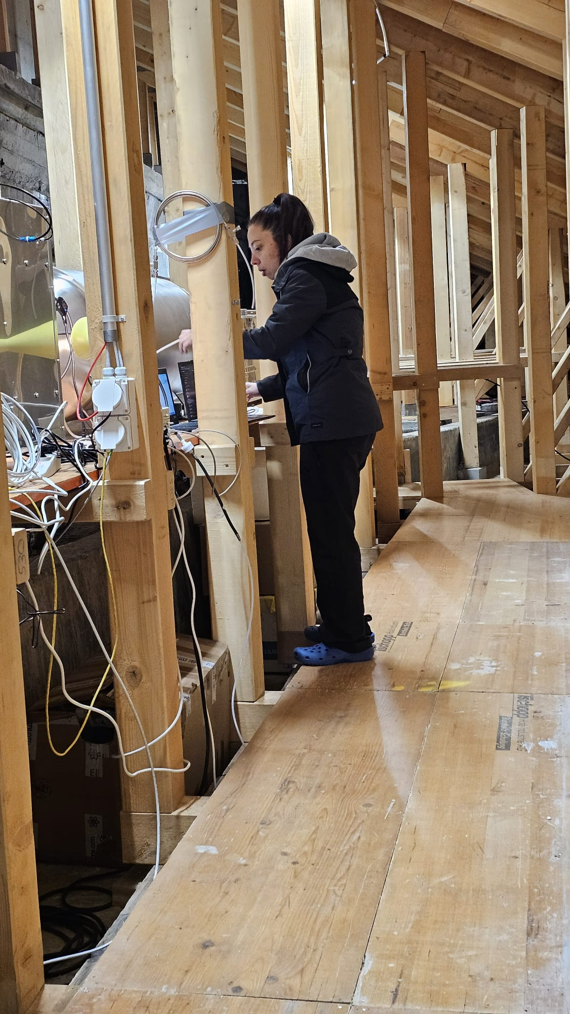
Installation and data acquisition phases
VPN access for secure remote data retrieval and management.
Webcam monitoring system to supervise and track real-time instrument readings.
Integration of data into the CNR-ISP mountain hub catalogue.
Data storage and compliance: all data generated during the campaign will be stored in the ITINERIS HUB repository, ensuring full adherence to FAIR principles (Findable, Accessible, Interoperable, Reusable).
Result: One month of continuous acquisition at 1-minute resolution, with approximately 42,000 measurement points collected (01-07-2025 to 30-07-2025)
Installation and management of the radon measurement campaign: Instrument setup, calibration and connection to data acquisition systems (first two images), preparation and packaging of equipment (third image) and setup the operational monitoring at high altitude (fourth image).

Slide 4
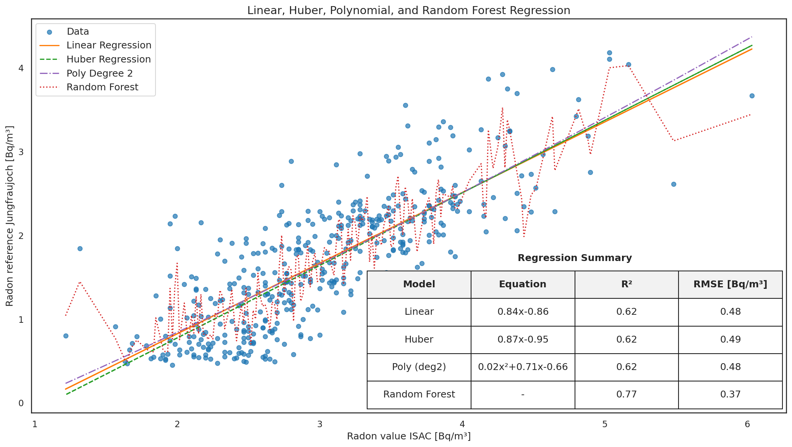
Cross-Site comparison
Key Insights from the Plot
All three linear-style regressions (Linear, Huber, Polynomial) produce very similar R² ≈ 0.62 and RMSE ≈ 0.48–0.49 Bq/m³.
Random Forest performs better (R² = 0.77, RMSE = 0.37 Bq/m³), capturing more variation and showing less error.
The scatter of blue points indicates some spread but a generally positive correlation between the two radon measurements.

Slide 5
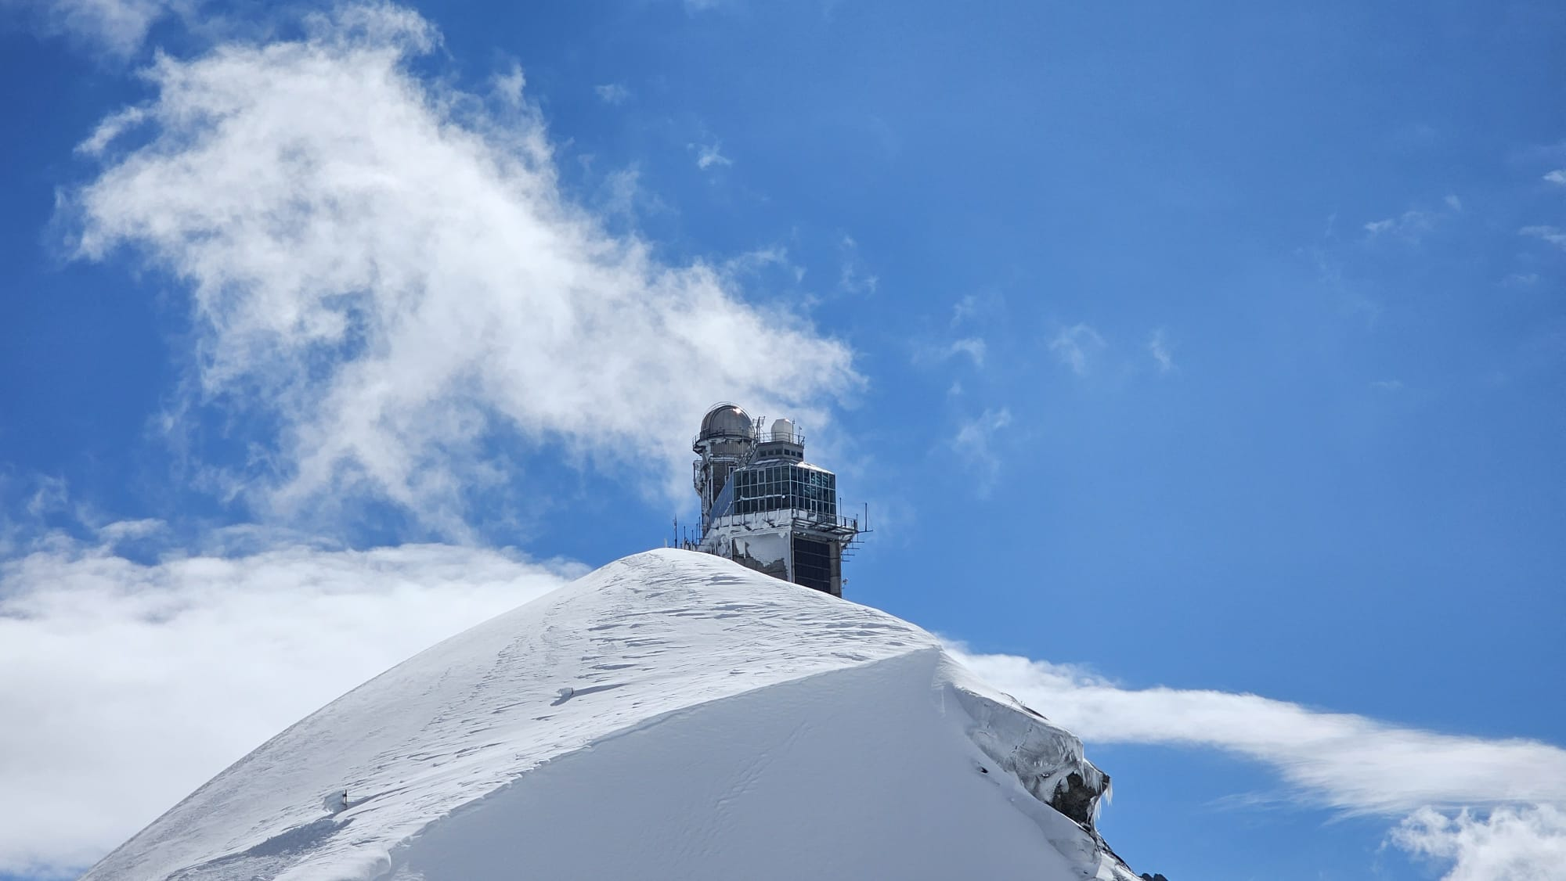
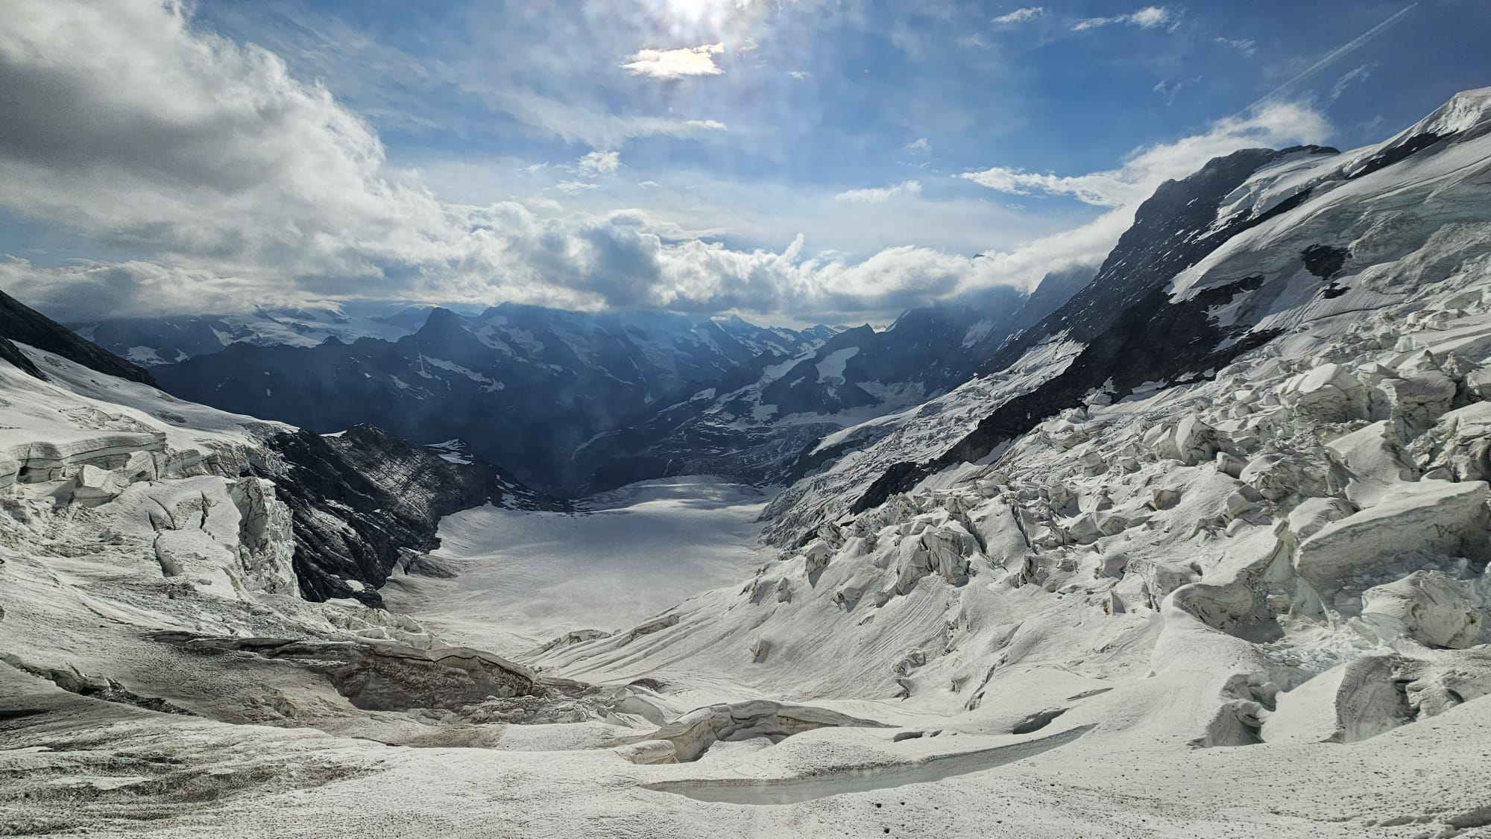
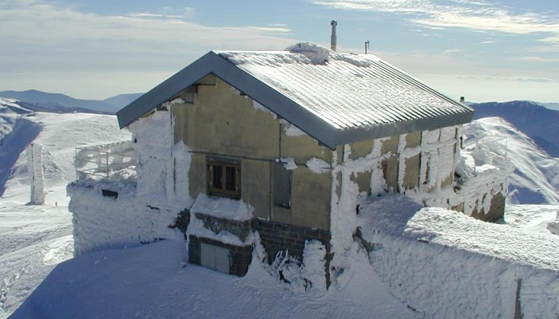
Future perspective
The campaign, conducted in July 2025, combined physical access and remote access for continuous monitoring and real-time data collection, enabling comprehensive instrument performance validation at JFJ. Next step:
Comparative Atmospheric Study: Conduct a detailed analysis of PBL dynamics’ influence on the free troposphere at two European mountain sites, leveraging ACTRIS and ICOS RIs frameworks.
Calibration & Machine learning integration at Mt. Cimone Observatory: Apply the calibration coefficients and machine learning models to the Radon detector at Mt. Cimone Observatory (2165 m, Italy) to improve measurement accuracy.
Benchmarking Low-Cost Sensors: Evaluate the performance of commercially available low-cost radon sensors, developed by IBE-CNR (AIRQino project), to assess their suitability for environmental monitoring at Mt. Cimone observatory.
Polar Campaign: Continuous radon monitoring in polar regions could reveal how snow cover and seasonal thaw influence soil–atmosphere exchange.
Radon measurement campaign at Alpine and regional observatories: Sphinx Observatory at Jungfraujoch (first image), Aletsch Glacier at Eismeer near Jungfraujoch (second image) and ISAC-CNR Osservatorio Climatico ‘O. Vittori’ at Mt. Cimone (third image).

Slide 6
Simonetta Montaguti: simonetta.montaguti@cnr.it
Alice Cavaliere: alice.cavaliere@cnr.it

