Slide 1
RIs as knowledge-sparkling Environments through the Territorial Cohesion Ecosystem strategy: a Study Case on the social impact of the ITINERIS Project
Corrado Russo, CNR IMAA – UniBa Aldo Moro

Slide 2
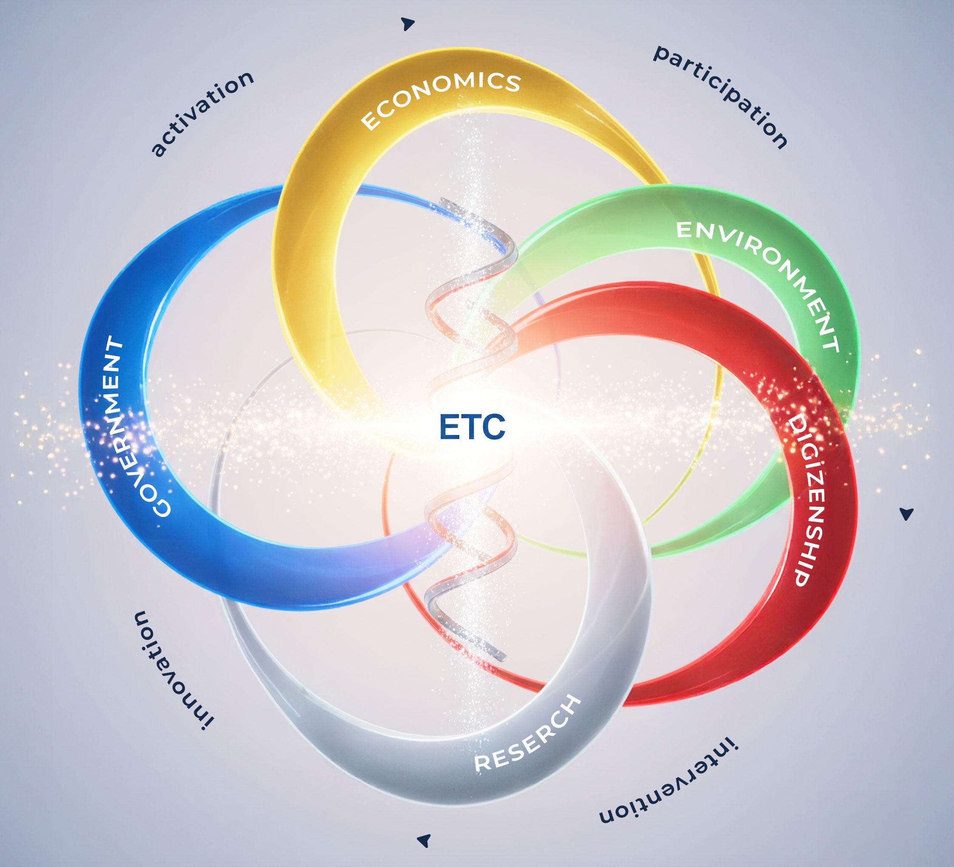
The Ecosystem of Territorial Cohesion® strategy

Slide 3
Methodology Framework of ETC strategy
ACTIVATION
Action Community Learning®
Needs Mapping
PARTICIPATION
Participatory Action Research
INTERVENTION
PMI®
INNOVATION
ETC®
Participatory Community-Based Research

Slide 4
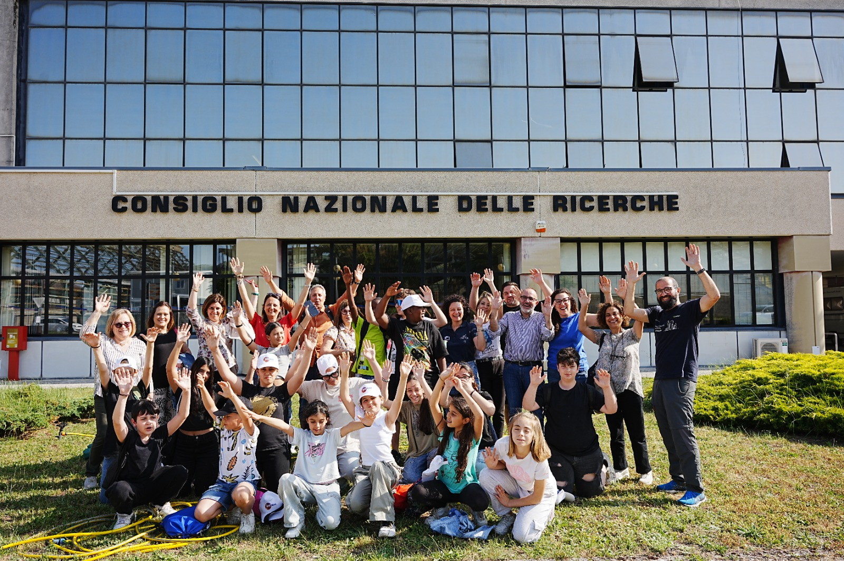
Lifewatch & Actris 2025: a Knowledge-Sparkling Experience

