Slide 1
Comparative Analysis of Enterococcus spp. from Conventional and Organic Farms:
Impact of Antibiotic Use on AMR Profiles
A. Mallardi *, J. F. Filipe, H. Delower, F. M. De Santanna , B. Castiglioni, P. Moroni, P. Cremonesi
*alessandra.mallardi@ibba.cnr.it

Slide 2
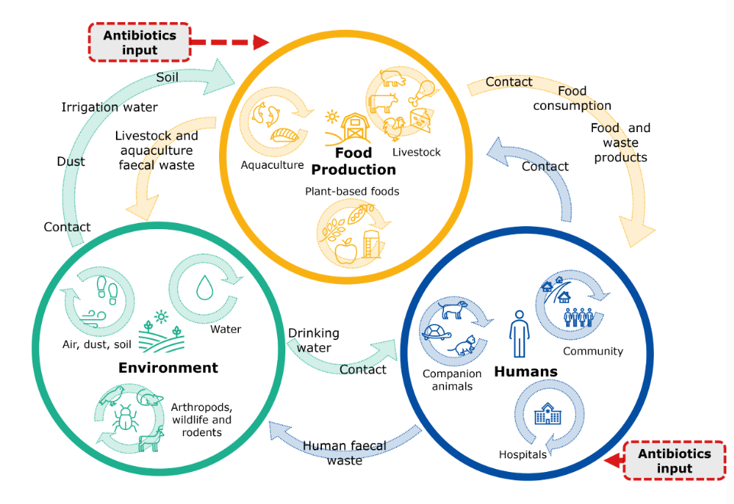
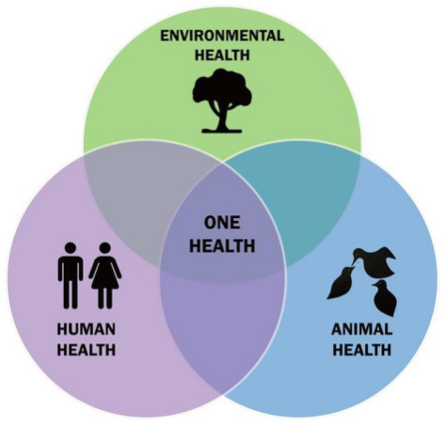
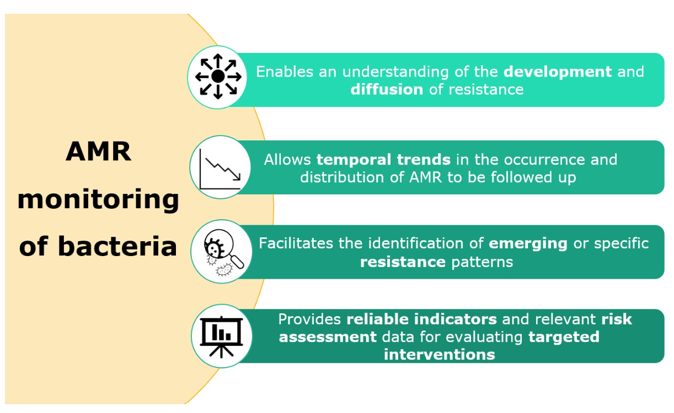

Background
Antimicrobial resistance (AMR) emergence
Significant concern for human and animal health
Common infection harder to treat
Spread of AMR bacteria and determinants across settings
European One Health Action Plan (2017)
Enterococcus spp.
Hospital-acquired infection (E. faecium, E. faecalis)
Gastrointestinal tract commensals
Adaptability and ability to acquire and transfer resistance genes
Indicators bacteria in AMR surveillance
www.efsa.europa.eu
García-Solache M, Rice LB. Clin Microbiol Rev. 2019;32. https://doi.org/10.1128/CMR.00058-18

Slide 3
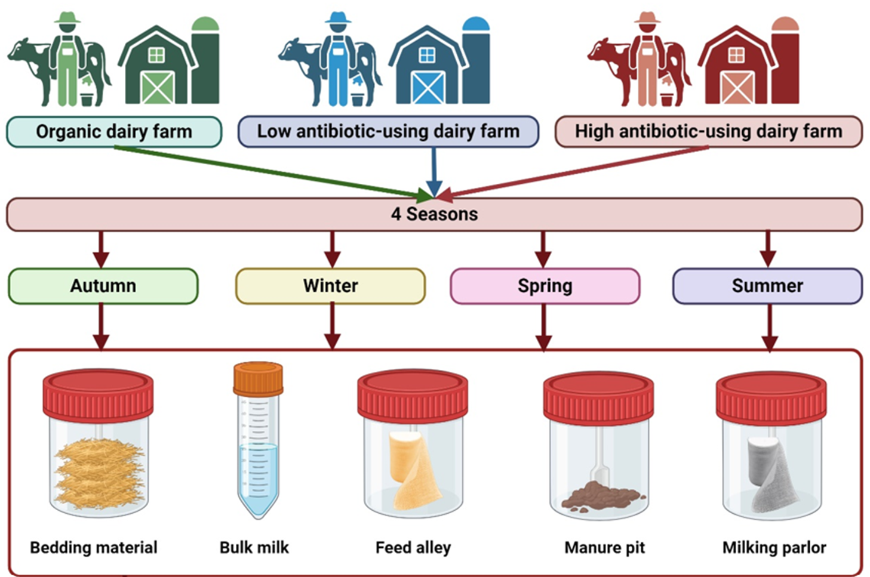
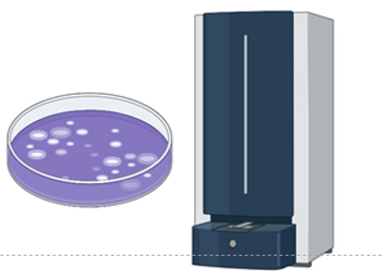
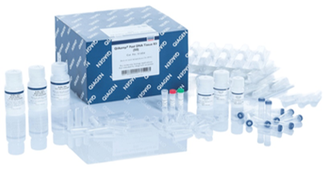
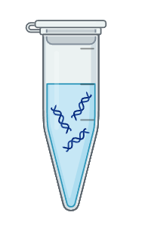
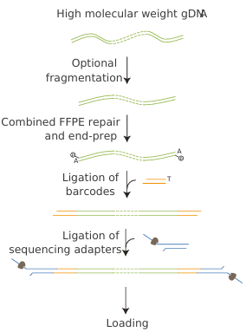
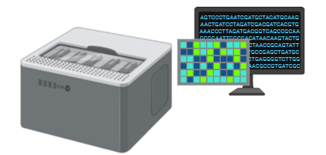
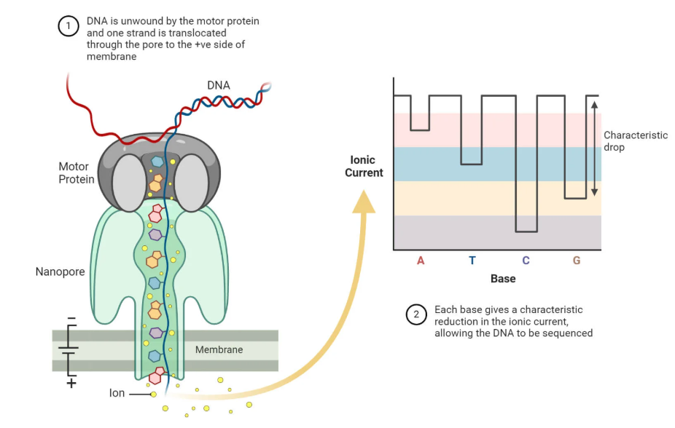



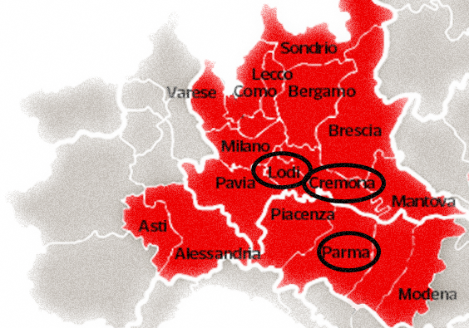

Objective and Experimental procedure
Investigate and compare the diffusion and the AMR profiles of Enterococcus spp. from dairy farms with different Defined Daily Dose usage: LOW, HIGH and ORGANIC (no use)
2. Isolation and identification with MALDI-TOF
3. DNA extraction
4. Library preparation and sequencing
platform
Sampling (2023-2024) from:
  environmental sources
  milk

Slide 4
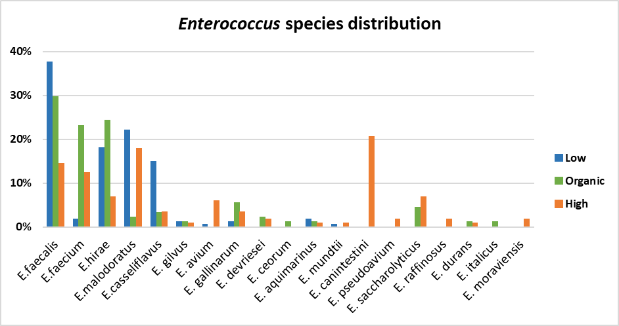
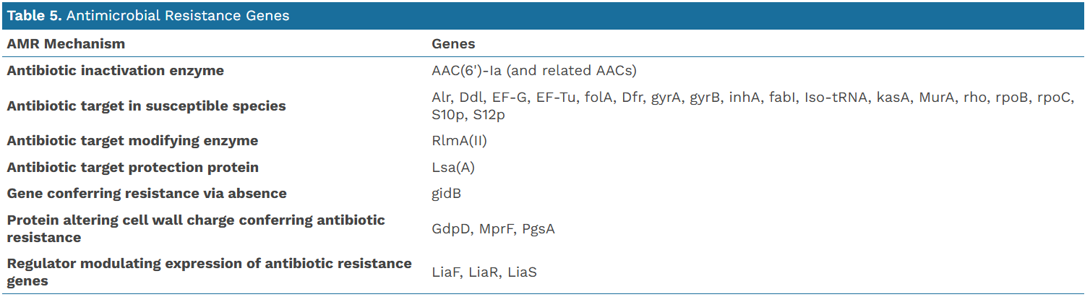
Preliminary results and work in progress
Species identified:
E. coli, Klebsiella spp and Enterococcus spp
Genome assembly results:
AAC(6')-Ia and related AACs genes in 90% of isolates
Resistance to aminoglycosides (streptomycin, gentamicin, tobramycin)
E. faecalis, E. faecium and E. hirae as potential indicators of farms with low or organic antibiotic use
E. malodoratus and E. canintestini were associated with farms using antibiotics
Sequencing and data processing in progress:
  E. faecium/ E.faecalis/ E. hirae
  E. malodoratus/ E. canintestini
  from different environmental and milk sources
E. hirae the most widespread in environmental samples in all farms
28 sample of E. hirae were sequenced

Slide 5







