Slide 1
From project to ocean: First ITINERIS glider-based insights in the Ligurian sea
Kokkini Z. , Berta M. , Boccacci A. , DiMacco A. , Lagomarsino Oneto D. , Sciascia R. , Tagliavini R. , Zarokanellos D. N. and Magaldi M.

Slide 2
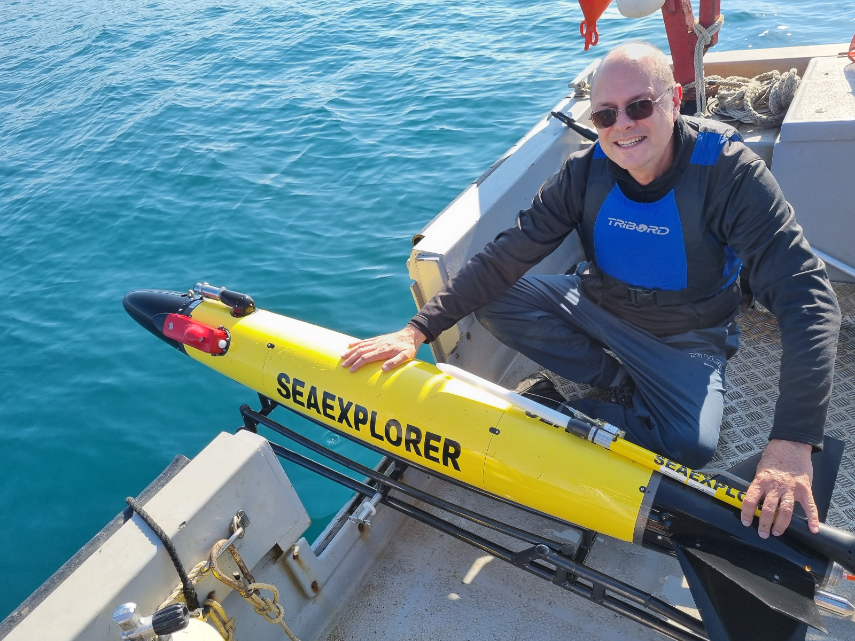
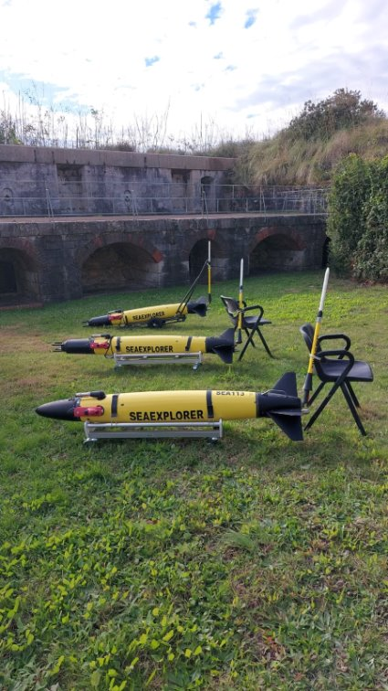
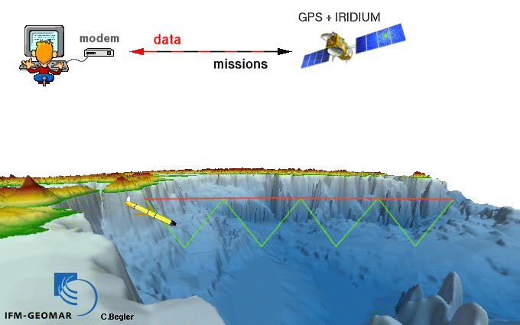
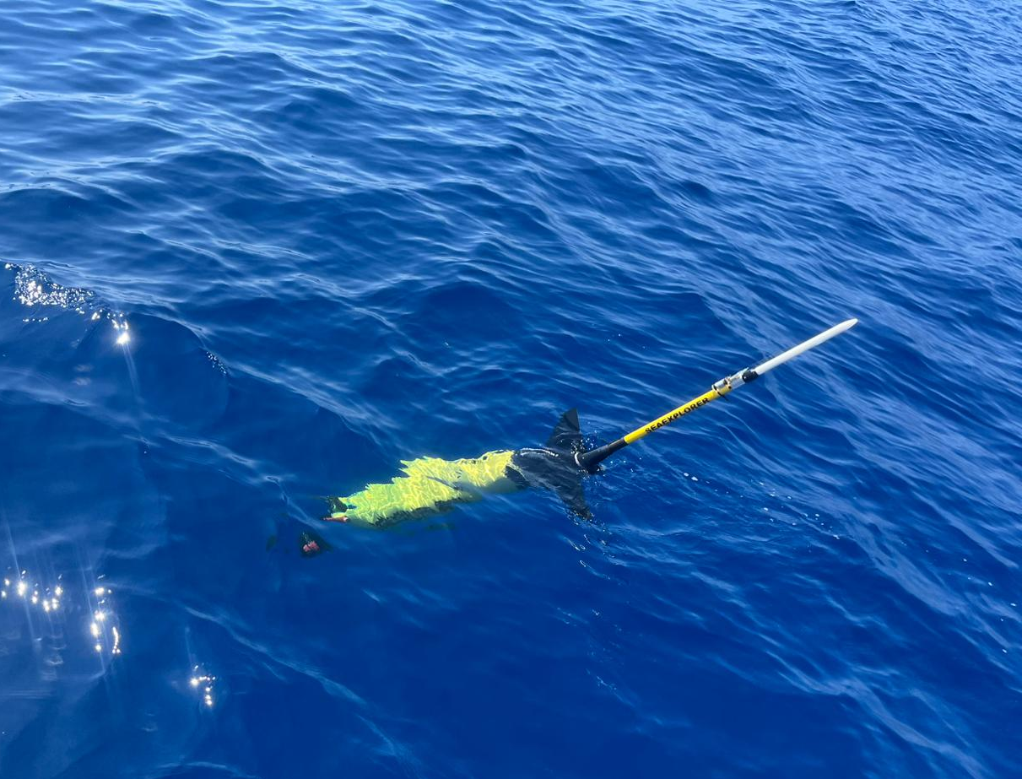
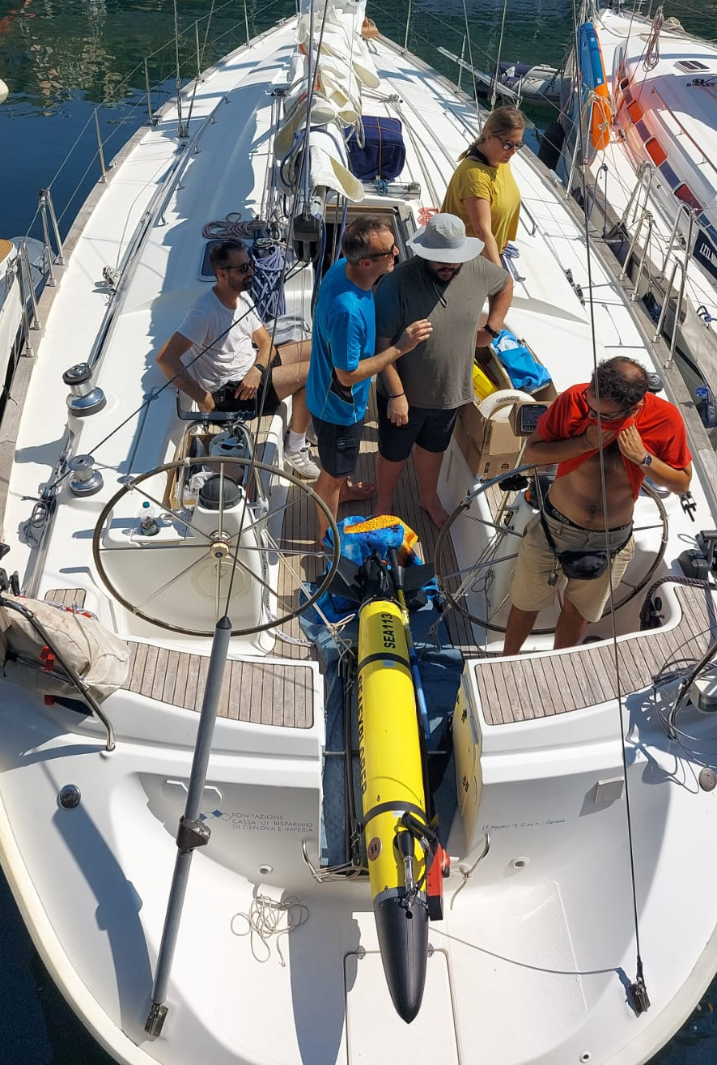
The Glider fleet
Glider SEA111 (Esmeralda): CTD, DO, Triplet (chl, bbp, cdom), ADCP, MRG (microturbulence)
Glider SEA112 (Pandora): CTD, DO, Triplet (chl, bbp, cdom) ), ADCP, MRG (microturbulence)
Glider SEA113 (Morgana): CTD, DO, Triplet (chl, bbp, cdom)
Horizontal velocity: U ~ 20-40 cm/s
Vertical velocity: W ~ 10-20cm/s
ITINERIS 3rd general meeting – Rome, 25-25/09/2025

Slide 3
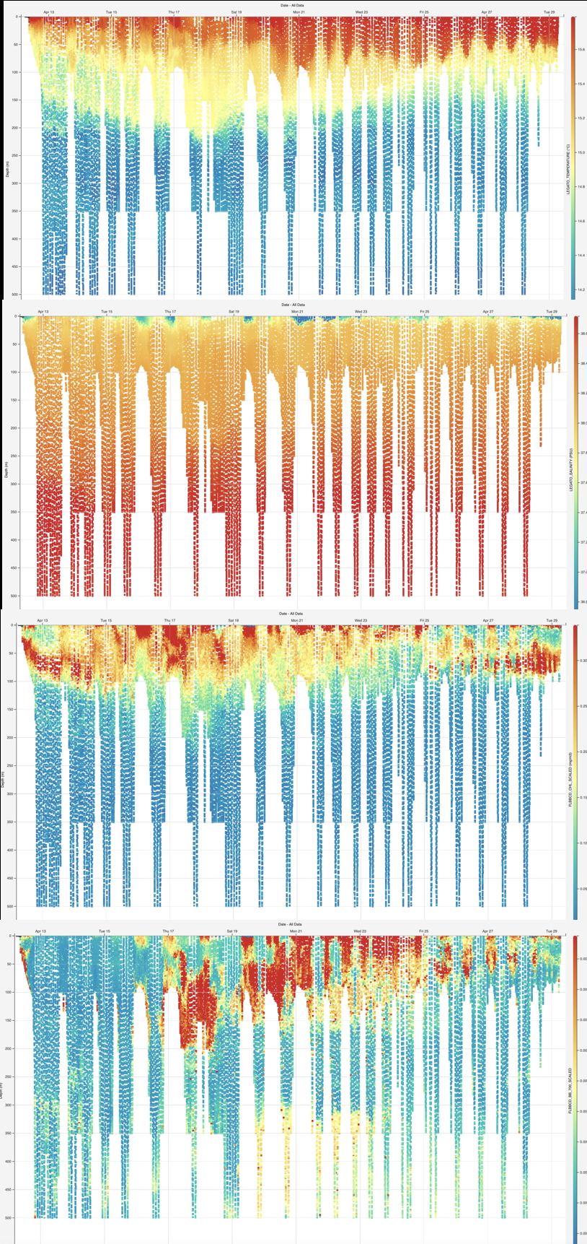
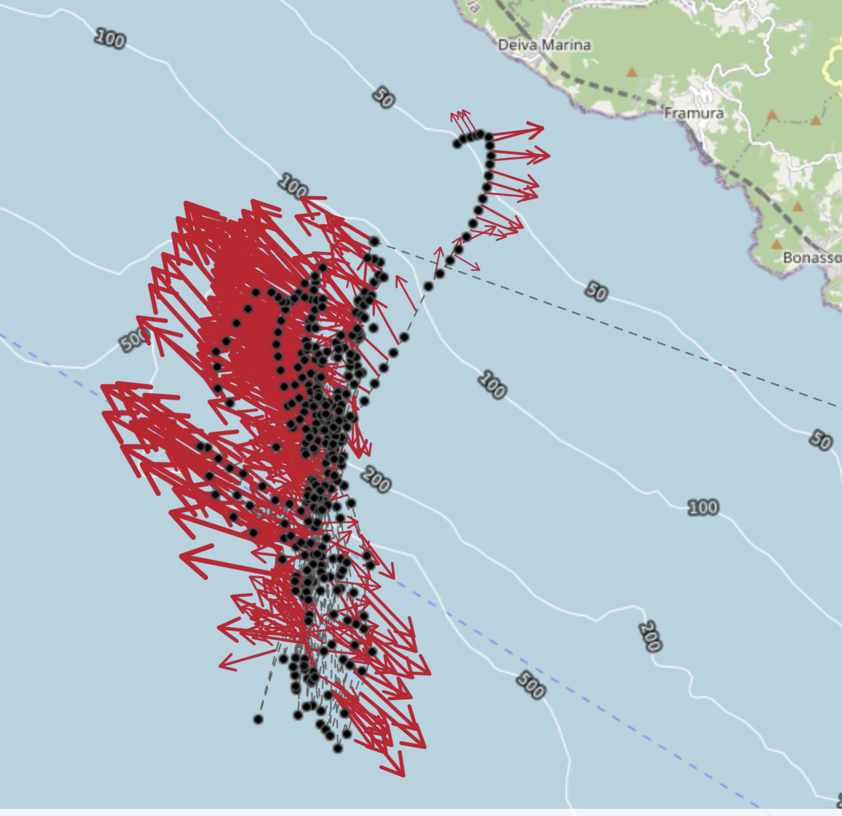
Autonomous Multiplatform Biophysical Observations – Winter 2025 AMBO-W25
Glider: Morgana (SEA113)
Sensors: CTD (T,S), DO, Fluorimeter
Duration: 17 days (12-29 April 2025)
10 km transect
Temperature (°C)
Depth average current
(red arrows)
Salinity
Chlorophyll (mg/m3)
Backscatter 700nm
ITINERIS 3rd general meeting – Rome, 25-25/09/2025

Slide 4

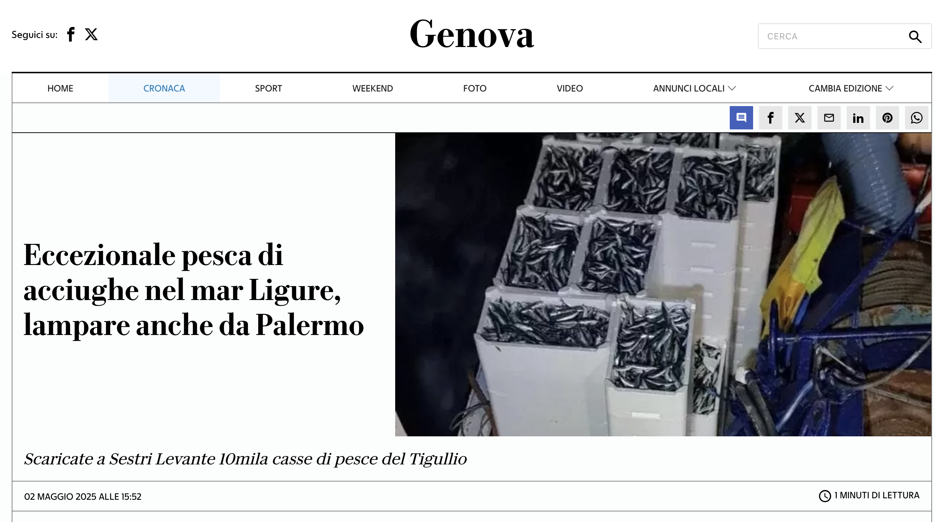
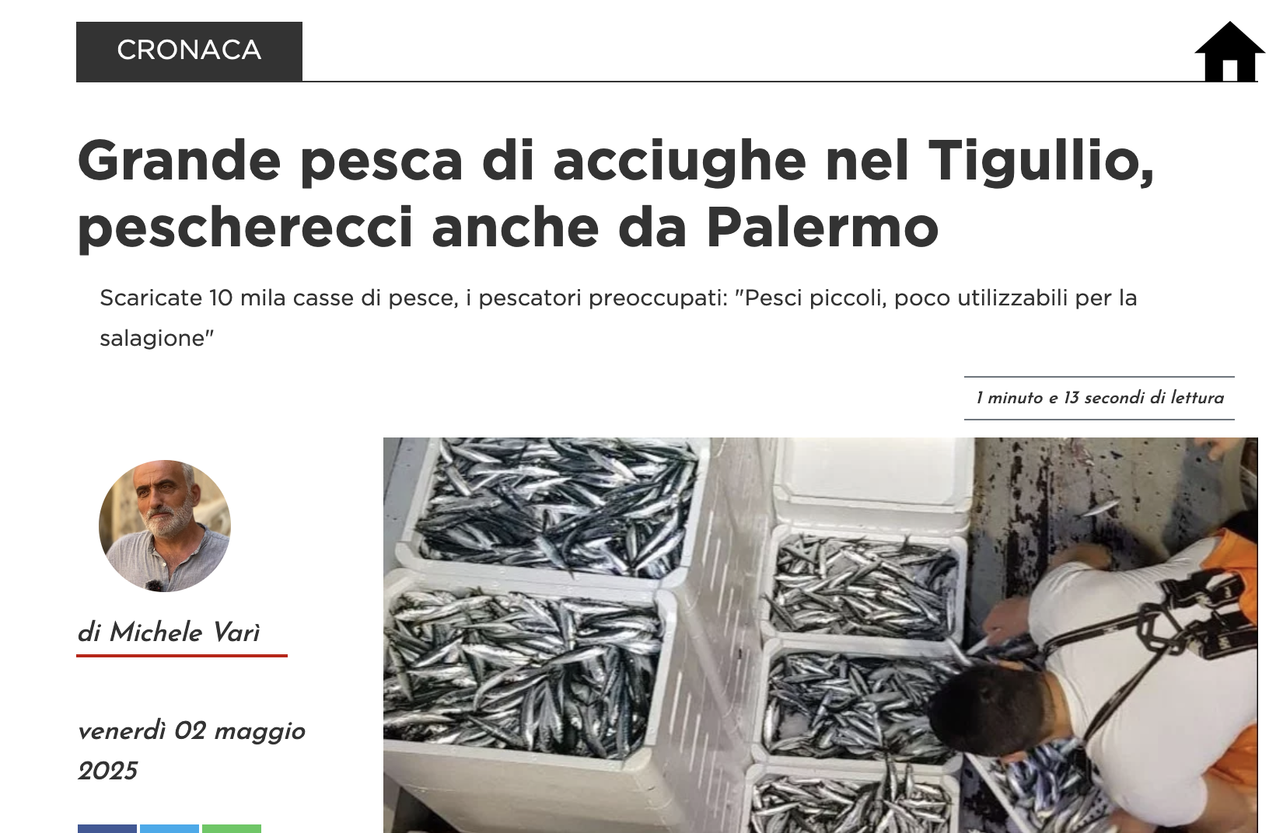
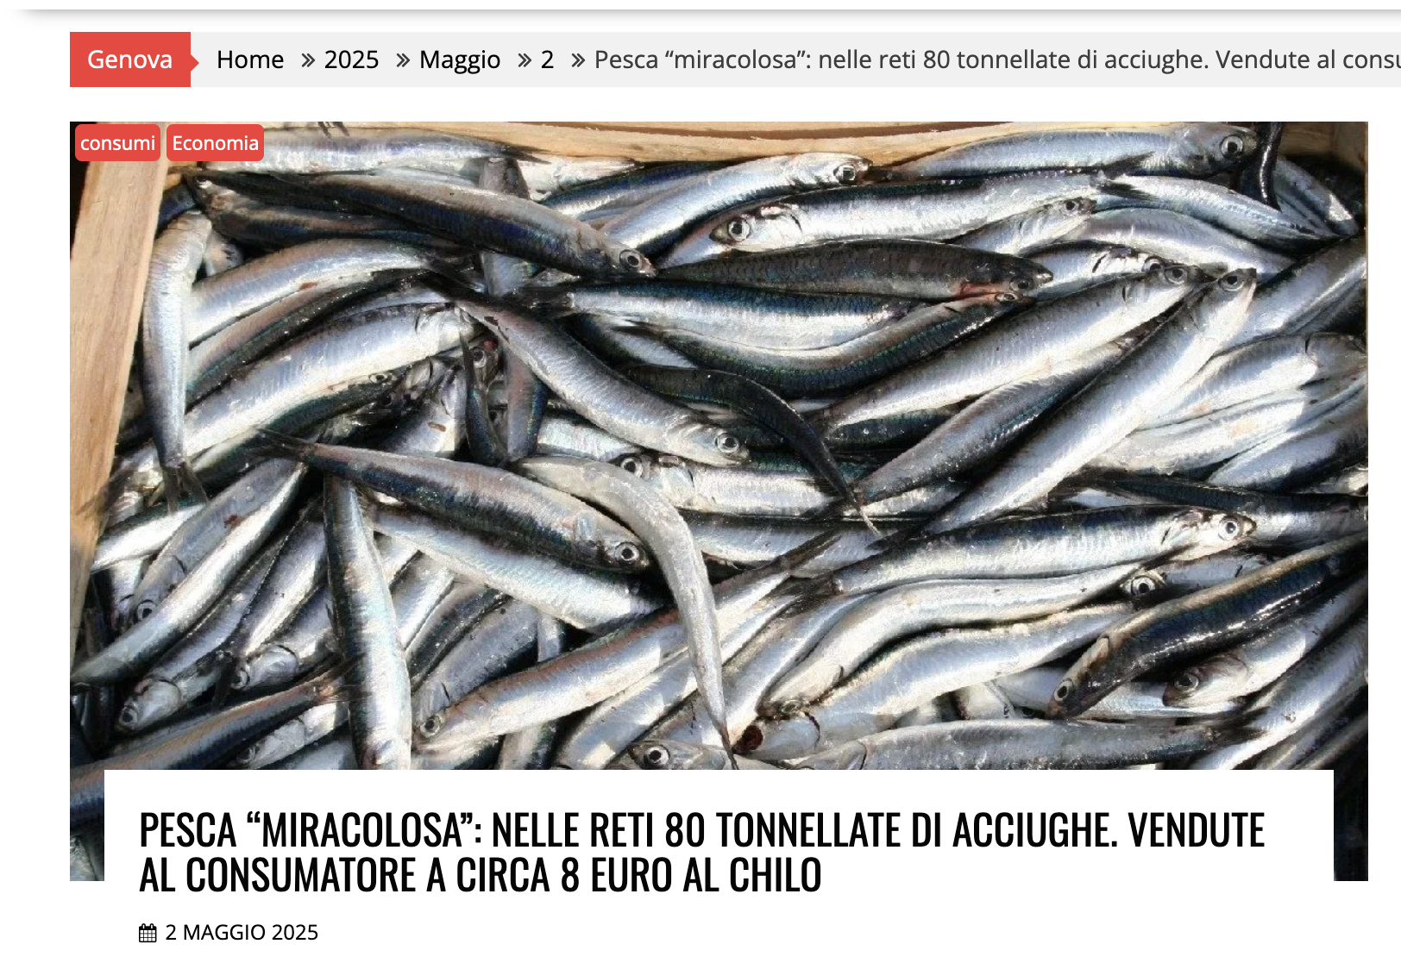
Autonomous Multiplatform Biophysical Observations – Winter 2025 AMBO-W25
Episode of exceptionally abundant anchovy catches
ITINERIS 3rd general meeting – Rome, 25-25/09/2025

Slide 5
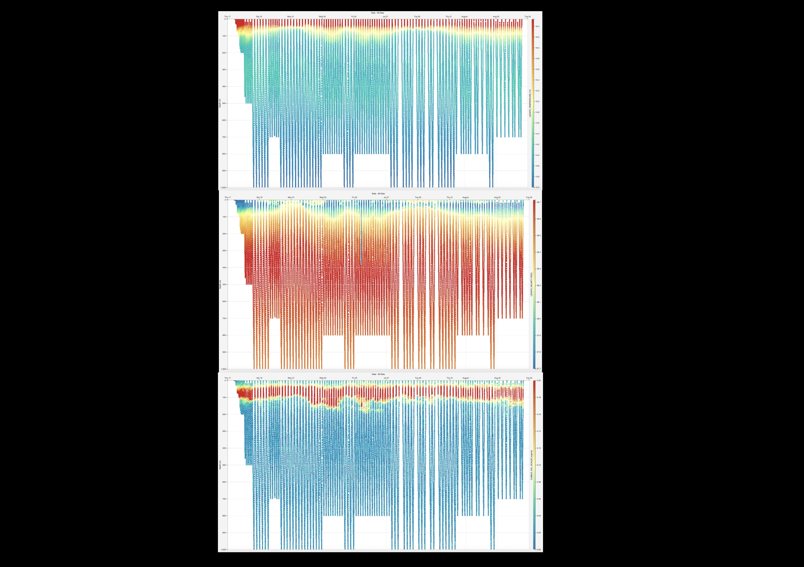
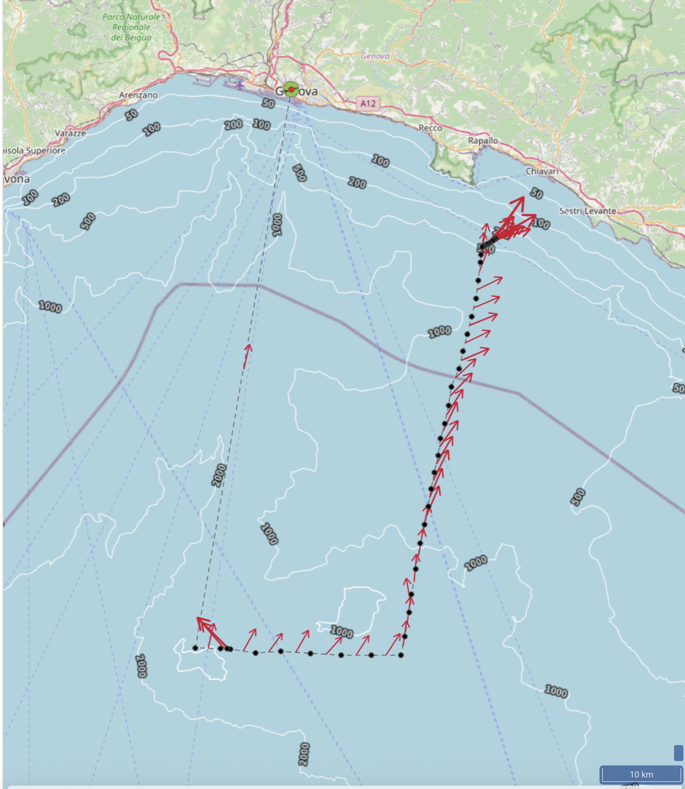
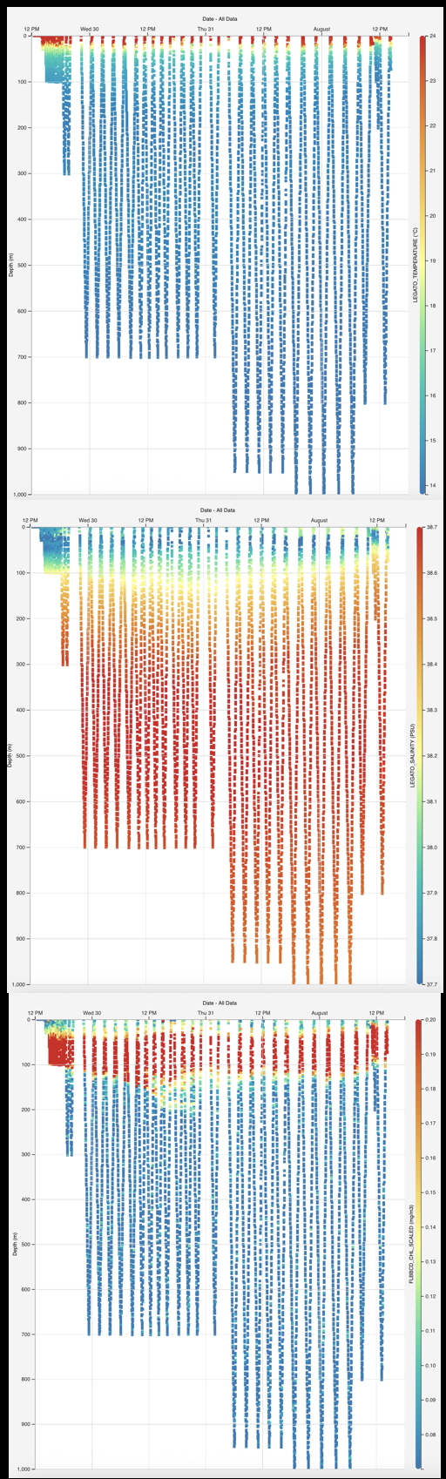
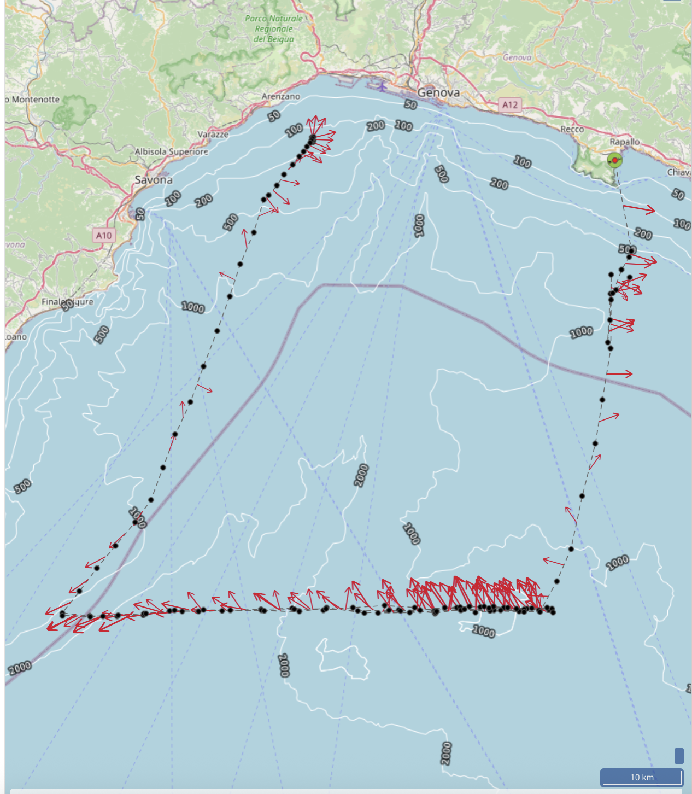
Autonomous Multiplatform Biophysical Observations – Summer 2025 EYES ON GLIDERS
SEA112
Plus:
ADCP
MRG data
Temperature (°C)
Temperature (°C)
Salinity
Salinity
SEA113
Chlorophyll (mg/m3)
Chlorophyll (mg/m3)
ITINERIS 3rd general meeting – Rome, 25-25/09/2025

Slide 6
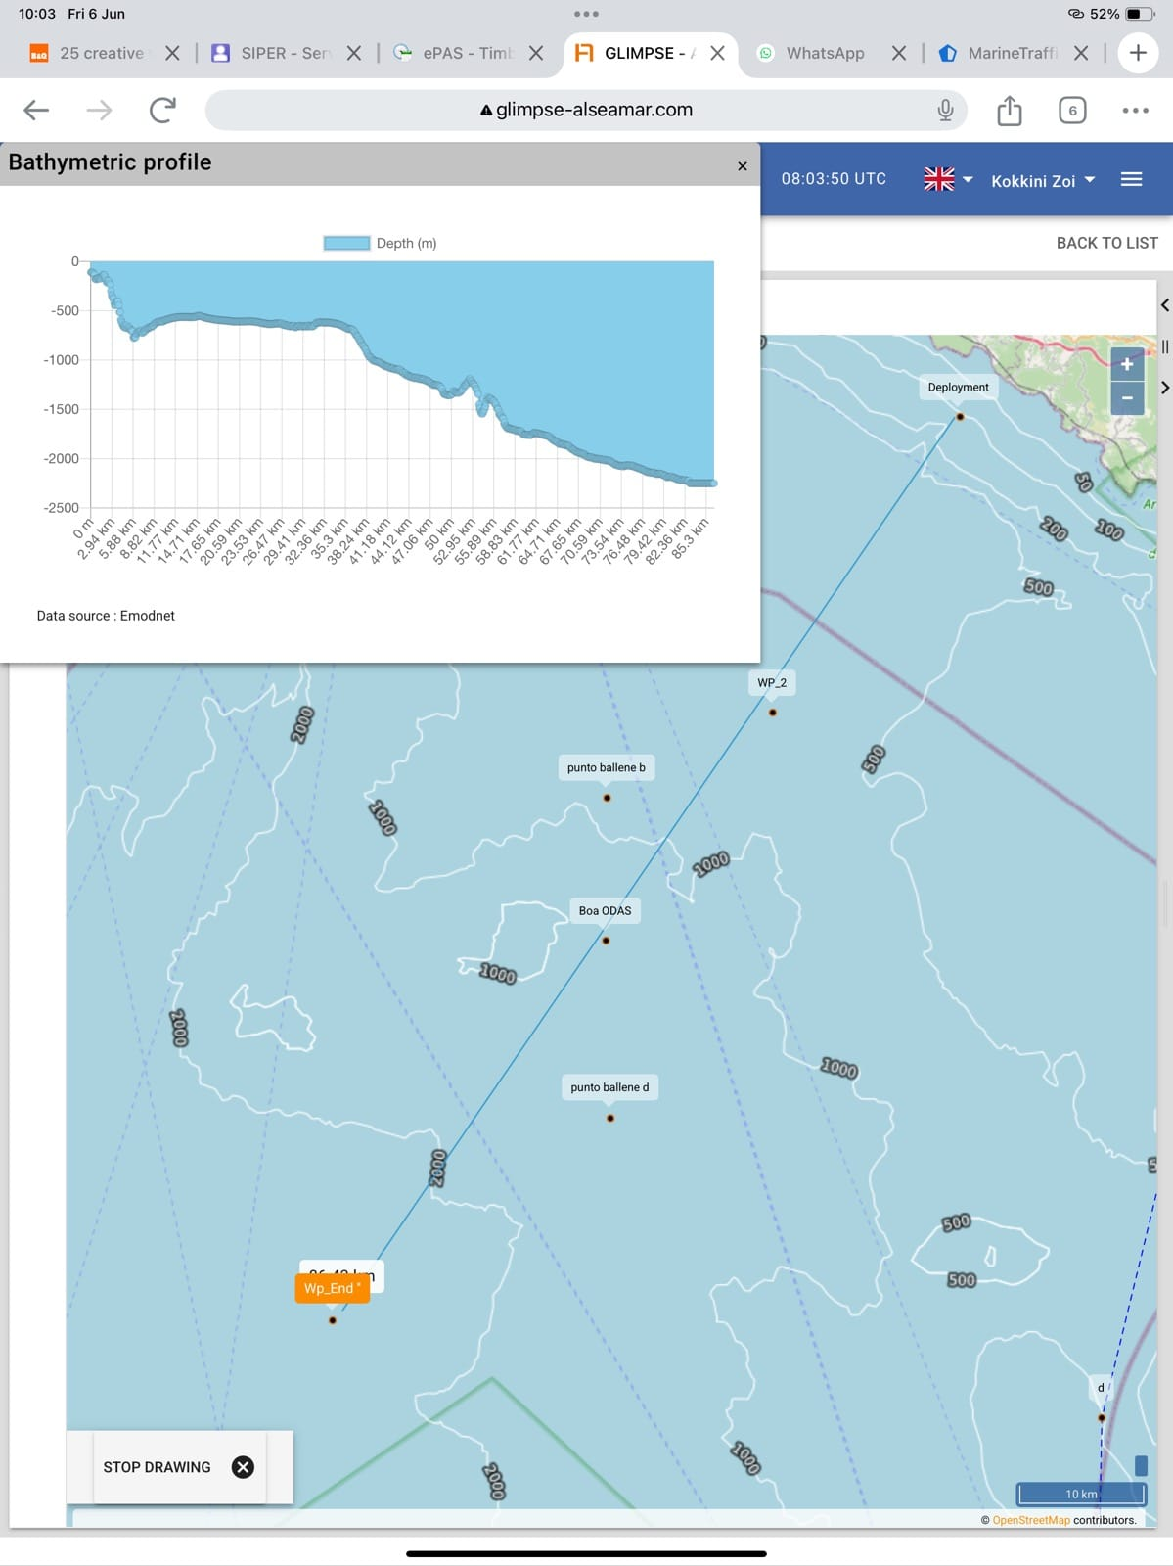
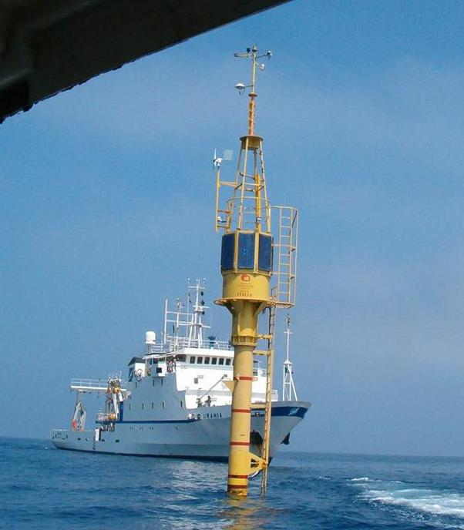
Future Planning
The ‘glider endurance line’ (long transect) for the NW Mediterranean – Ligurian Sea.
Extension of AMBO-W25/EYES transect offshore
– Deeper waters (>2000 m)
– Passing near EMSO-ICOS W1M3A (ODAS) buoy
– Microstructure turbulence measurements over the Janua Seamount (815m)
– Possible future interaction and intercalibration activities among RIs --> development of new services
– Testing & Best Practices site for combining operations of Glider + AD2CP + MRG
Cyclic operation of the three gliders
EMSO-ICOS W1M3A buoy
~ 85 km
ITINERIS 3rd general meeting – Rome, 25-25/09/2025

Slide 7
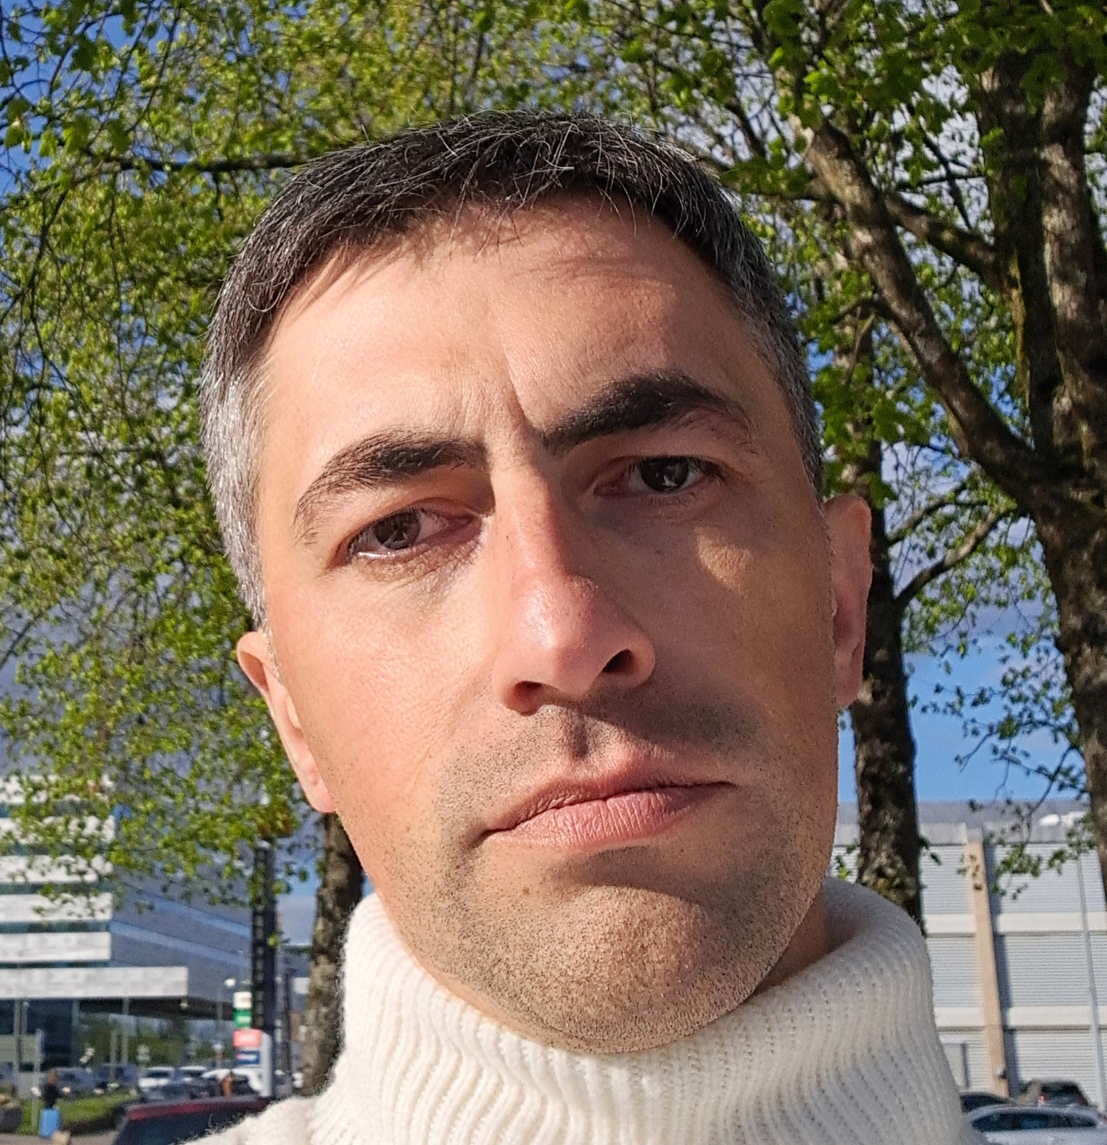
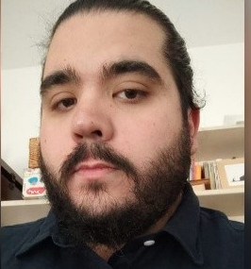
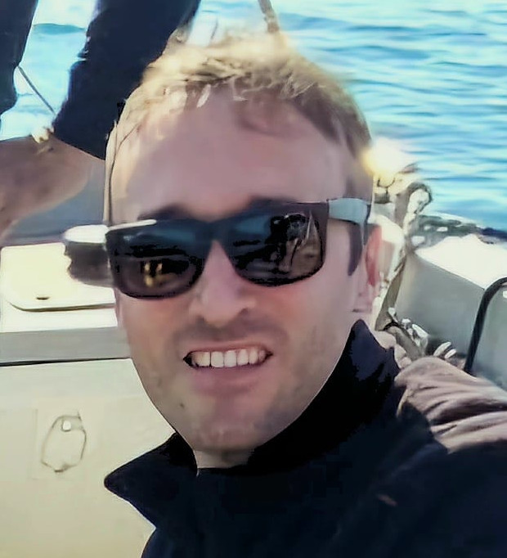
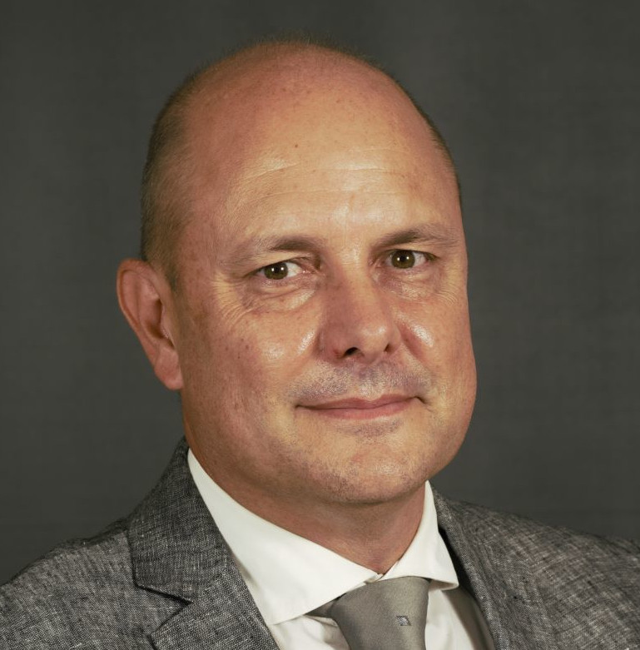
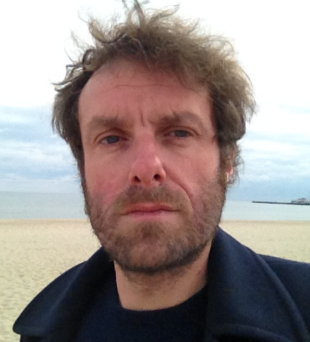
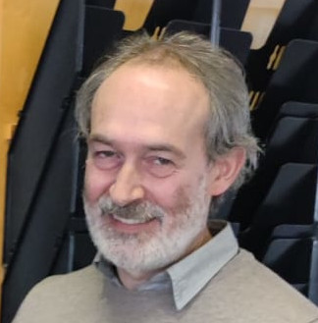
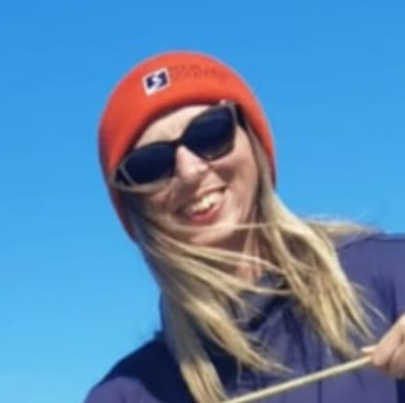
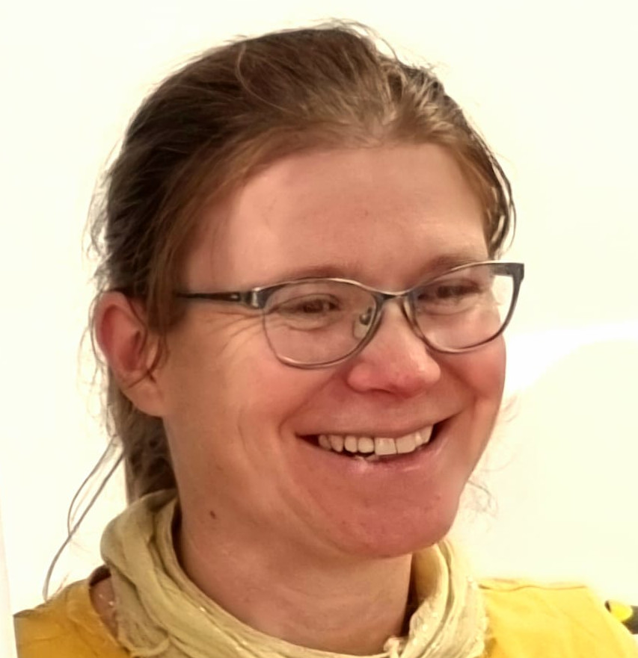
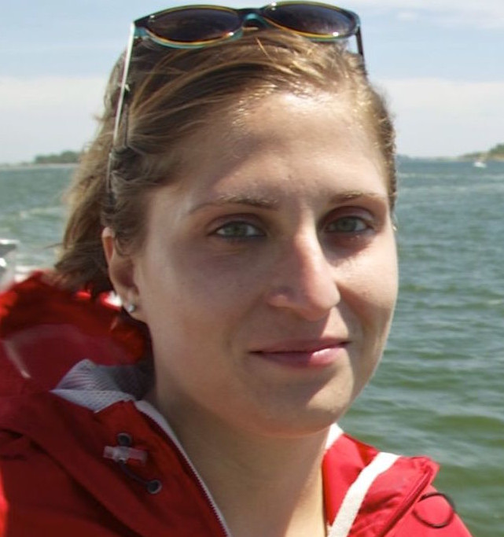
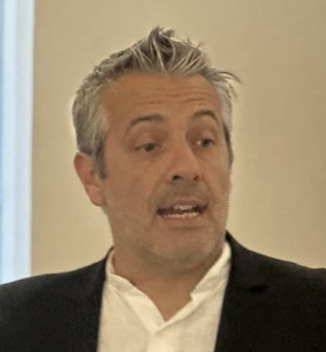
Our glider group !
Angelo Boccacci
Tecnico
Electronics, Maintenance,
Assembly, Piloting
Andrea Di Macco
Tecnico
IT, Maintenance, Piloting, Assembly, Data flow
Daniele Lagomarsino
Tecnologo
Artificial Intelligence, Data Flow,
Piloting, Data analysis
Riccardo Tagliavini
Tecnologo
System Engineer, Piloting, Assembly, Data Flow
Lorenzo Corgnati
Tecnologo
IT, Interoperability, Data Flow
Carlo Mantovani
Tecnologo
IT, Data Flow, Logistics
👥 10
Technicians & scientists (extended group)
⏳ 50%
On temporary contracts
🔬 8 → 5 Hands-on roles: 8 people involved
in practical activities
→ 5 contracts expiring soon (!)
Zoi Kokkini
Ricercatrice
Oceanography, Piloting, Assembly, Data analysis
Maristella Berta
Ricercatrice
Oceanography, Piloting, Data analysis
Roberta Sciascia
Ricercatrice
Oceanography, Piloting, Data analysis
Marcello Magaldi
Ricercatore
Oceanography, Piloting,
Data Flow, Data analysis
ITINERIS 3rd general meeting – Rome, 25-25/09/2025

