Slide 1
Towards Interoperable Ocean Observations:
Demonstrating Cross-Infrastructure Integration in the South Adriatic
V. Cardin¹, R. Martellucci¹, C. Dentico¹, E. Mauri¹, A. Pirro¹, J. Le Meur¹ , F. Paladini de Mendoza², A. Nogarotto^{2,}
¹Istituto Nationale di Oceanografia e di Geofisica Sperimentale – OGS, Sgonico (TS)
²Istituto di Scienze Polari, CNR, Bologna

Slide 2
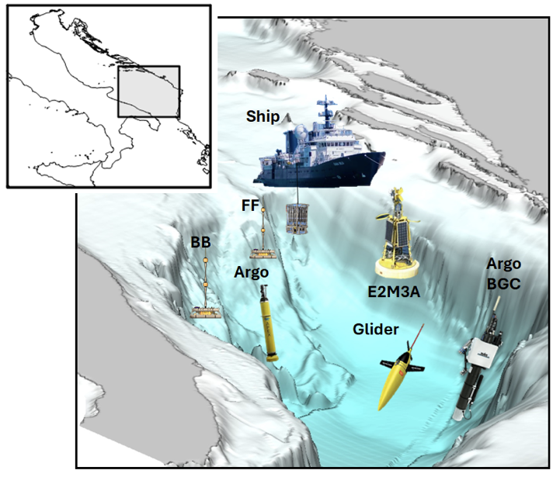
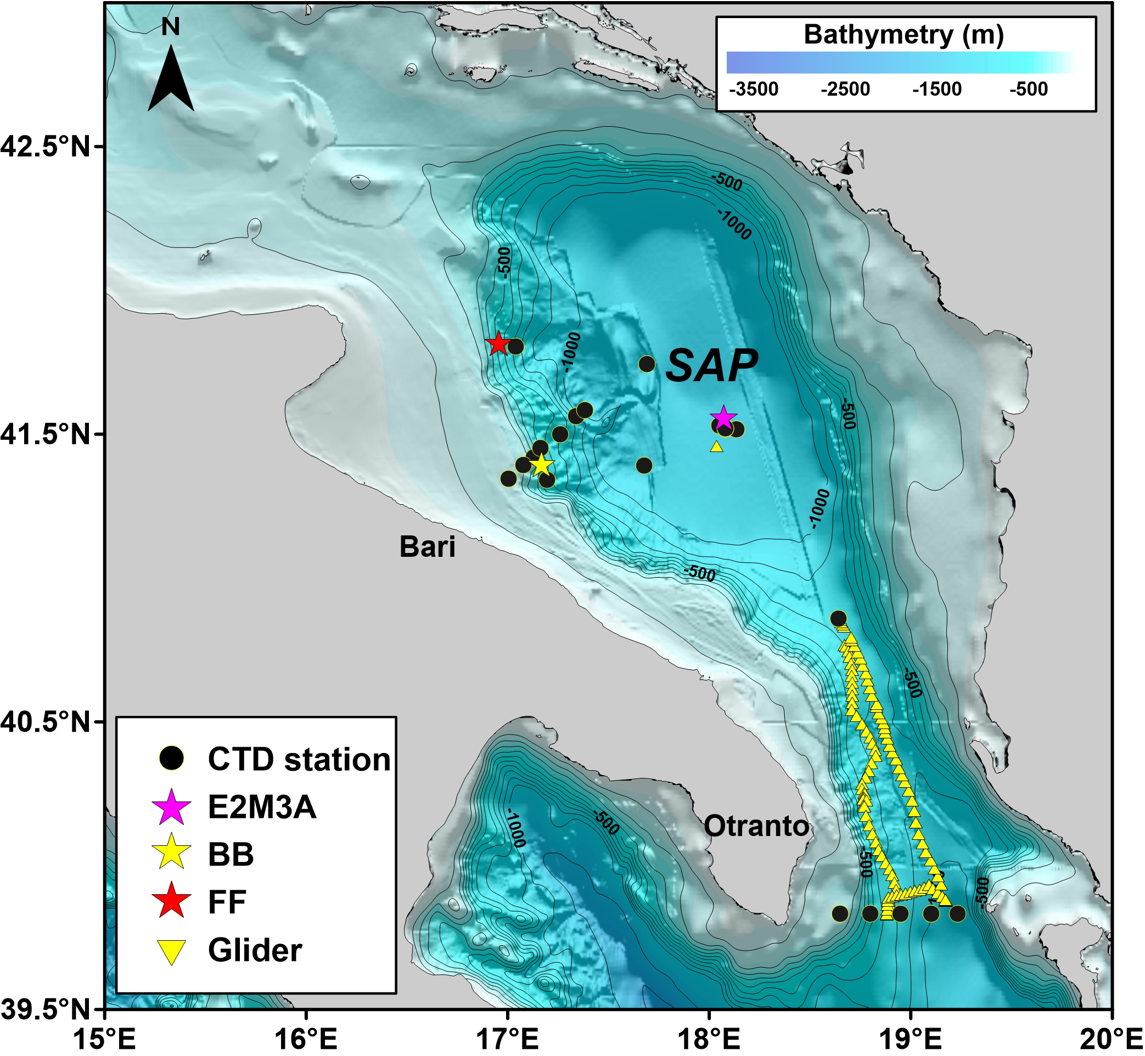
The EMSO-SA 2025 LB CRUISE (5-15 September, 2025)
This multidisciplinary campaign was designed and implemented in line with the objectives of Task 5.20 and Deliverable 5.16, and brought together major European RIs including EMSO, Euro-Argo, ICOS, and Eurofleets
Study Area
Activities
Glider Deployment and recovery
Surface Velocity Program Barometer (SVPB) drifter deployment
Biogeochemical Argo – Float deployment
EMSO-SA – site maintenance
  E2M3A-B buoy deployment
  Recovery, service and ri-deployment of the E2M3A-M deep mooring
  Calibration and cross validation CTD
Fix stations (CTDs + sampling):
  Otranto Strait transect
  Bari – Dubrovnik transect
  Floats, drifters and glider calibration
Cross - Validation Platforms
Ionian Sea
Otranto Strait
South Adriatic

Slide 3
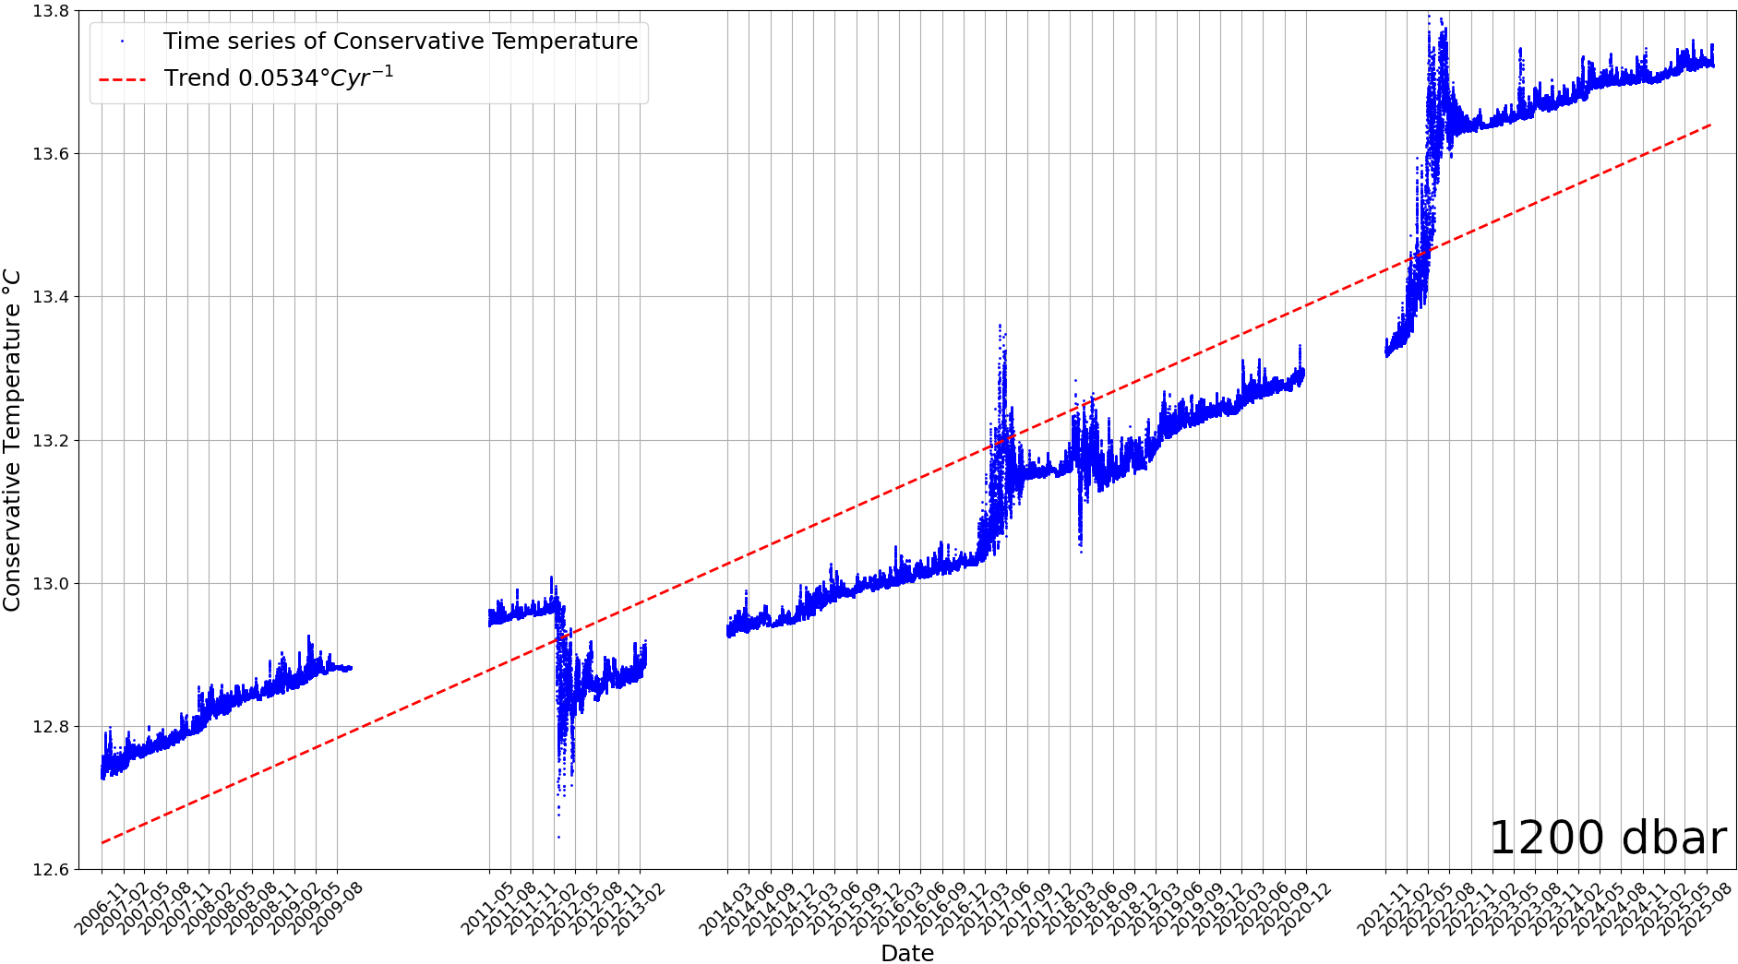
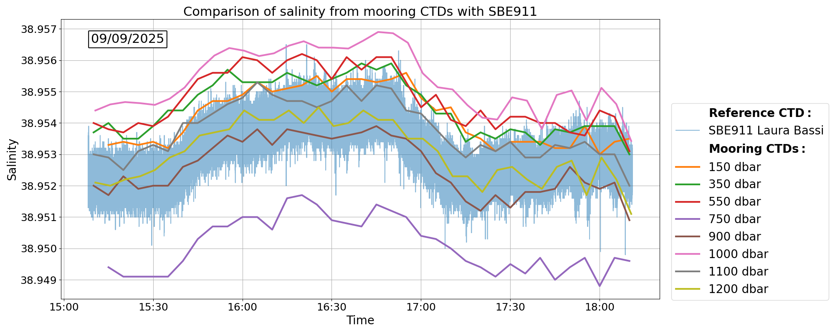
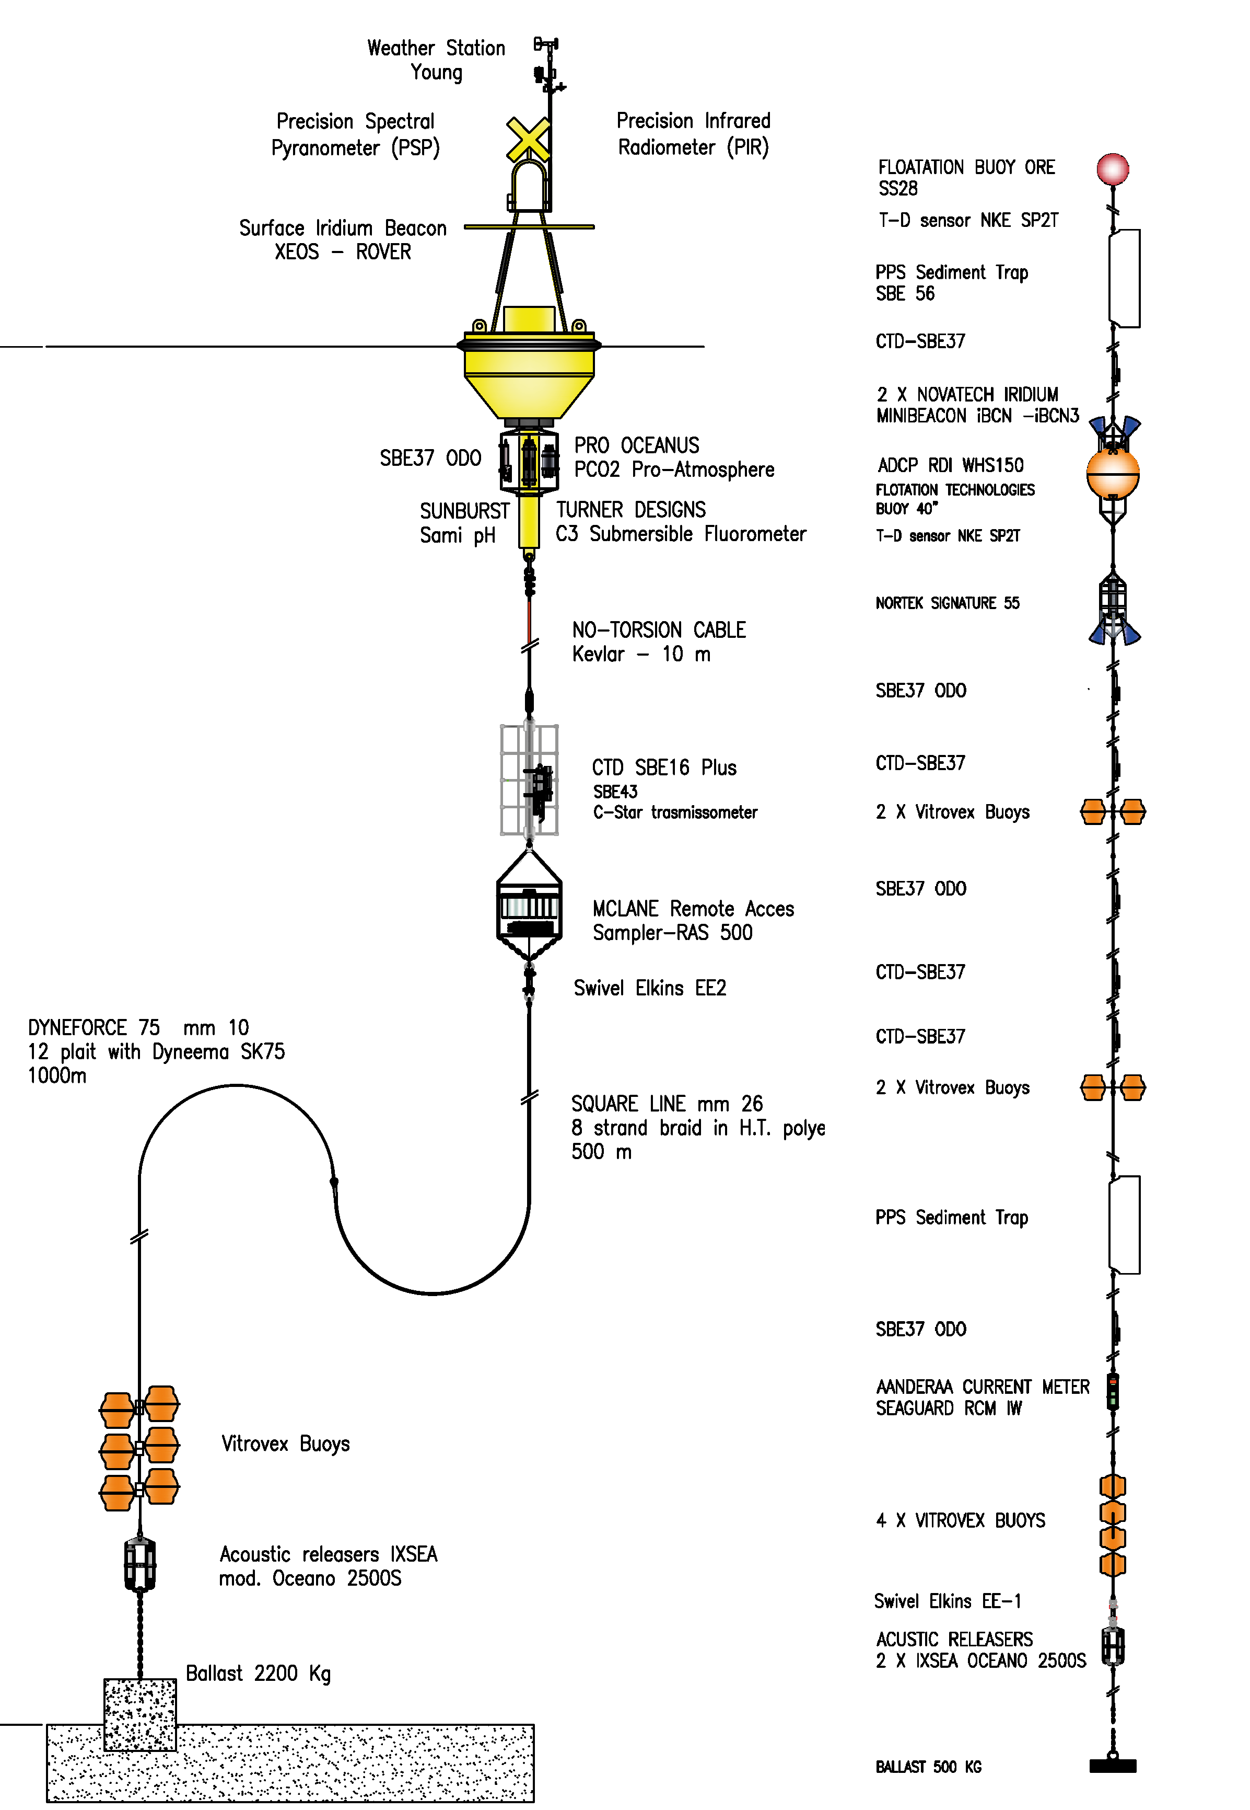
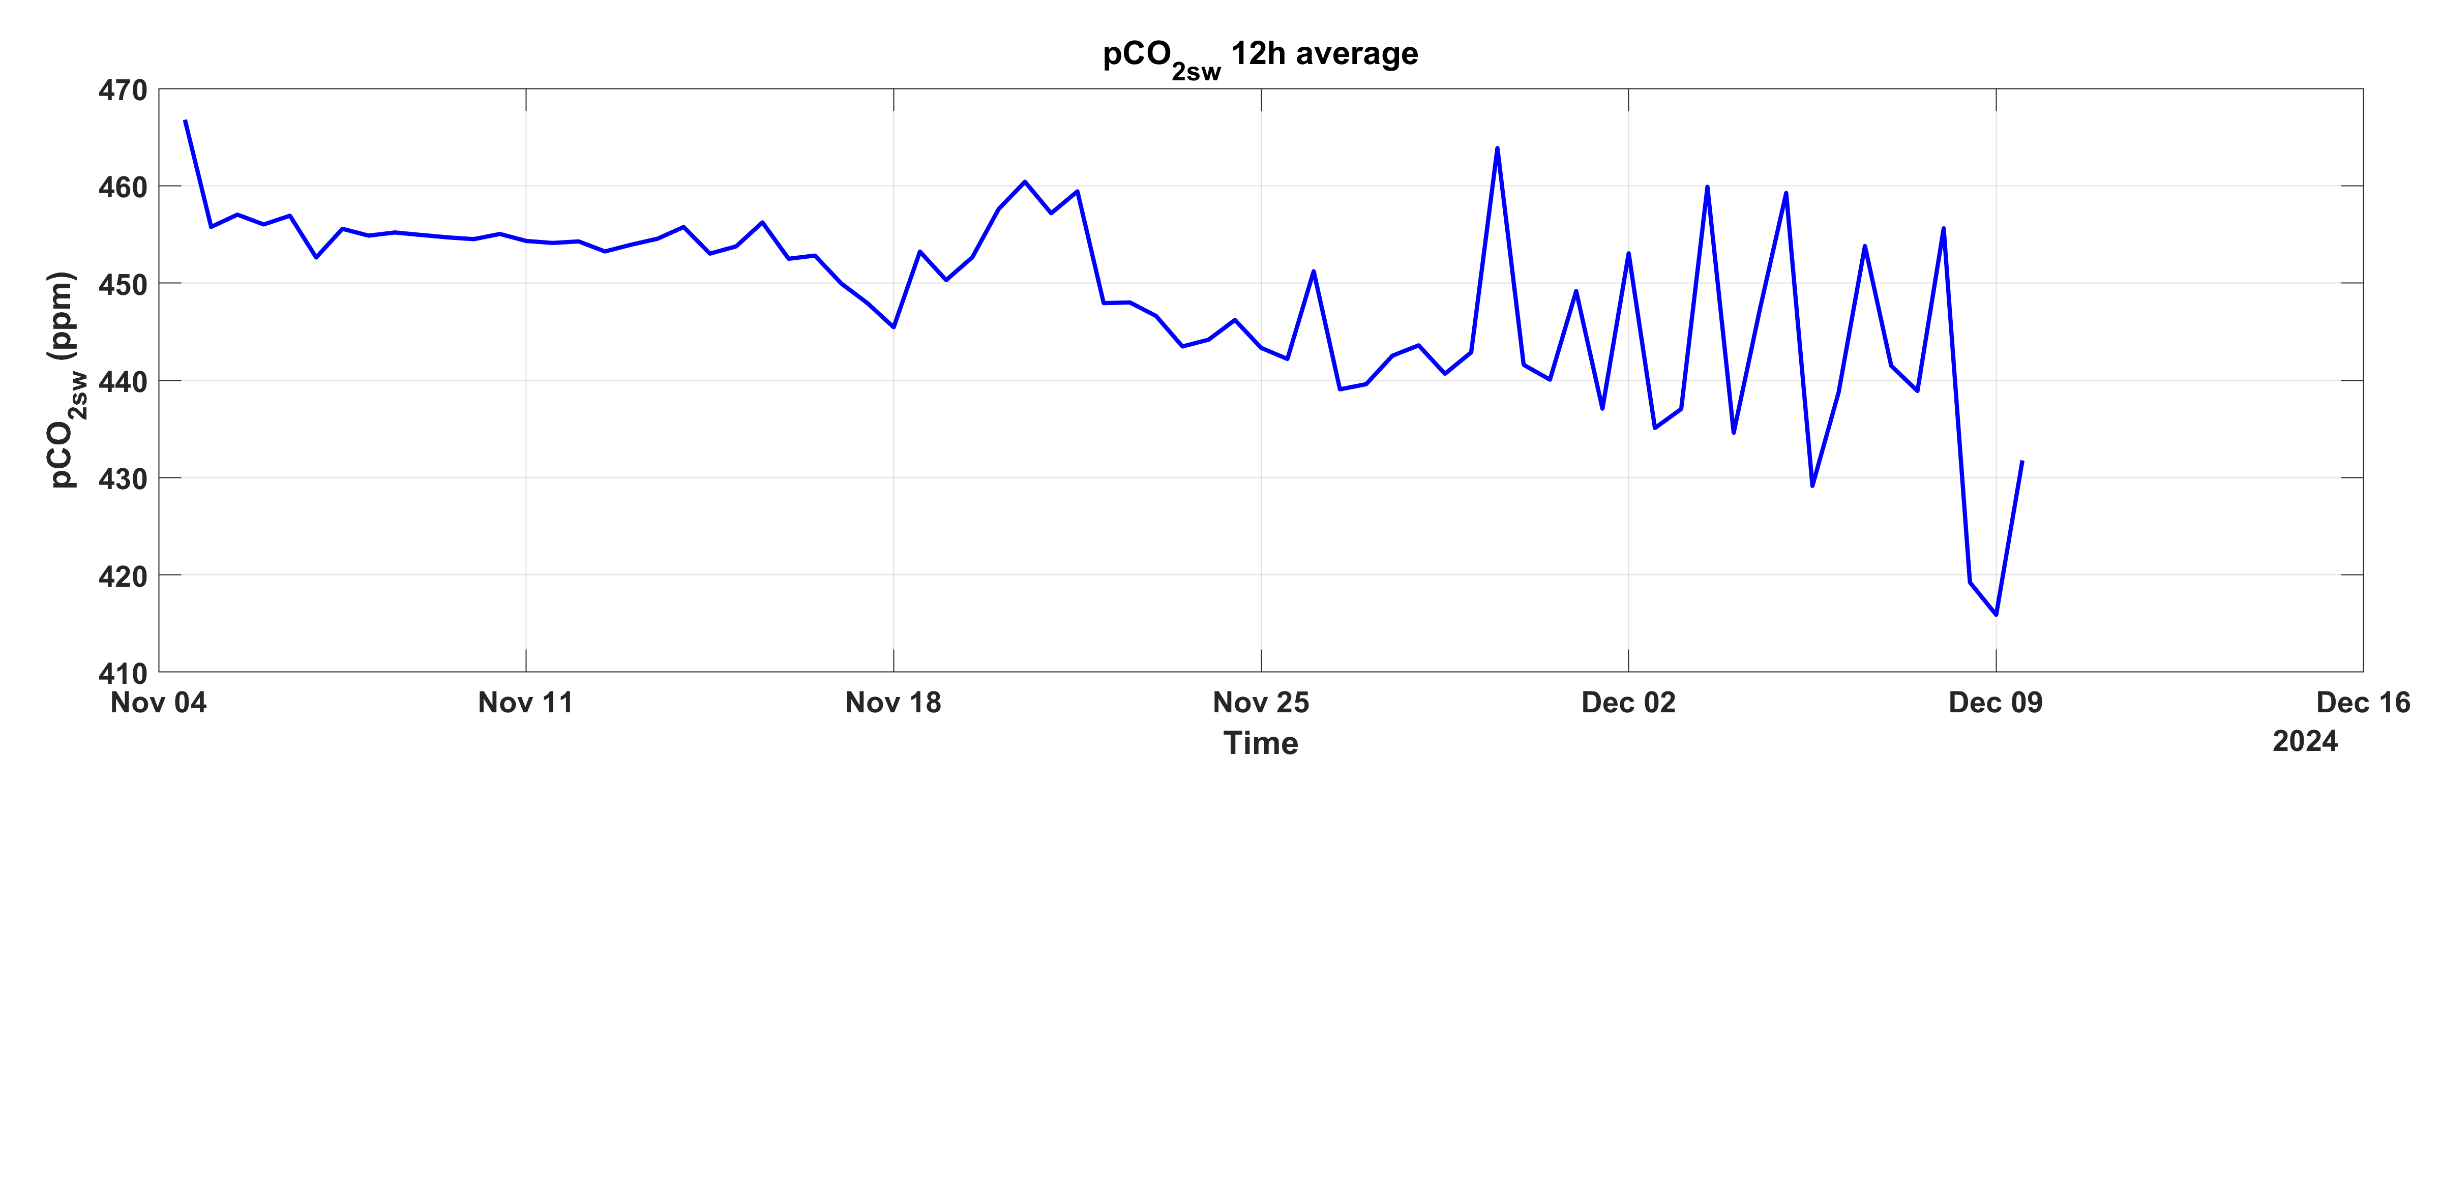
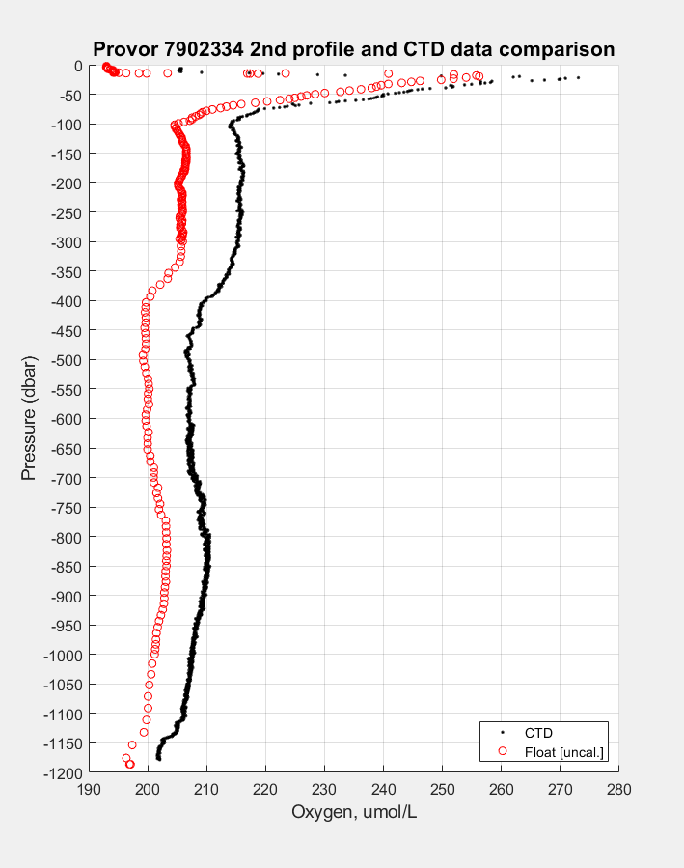
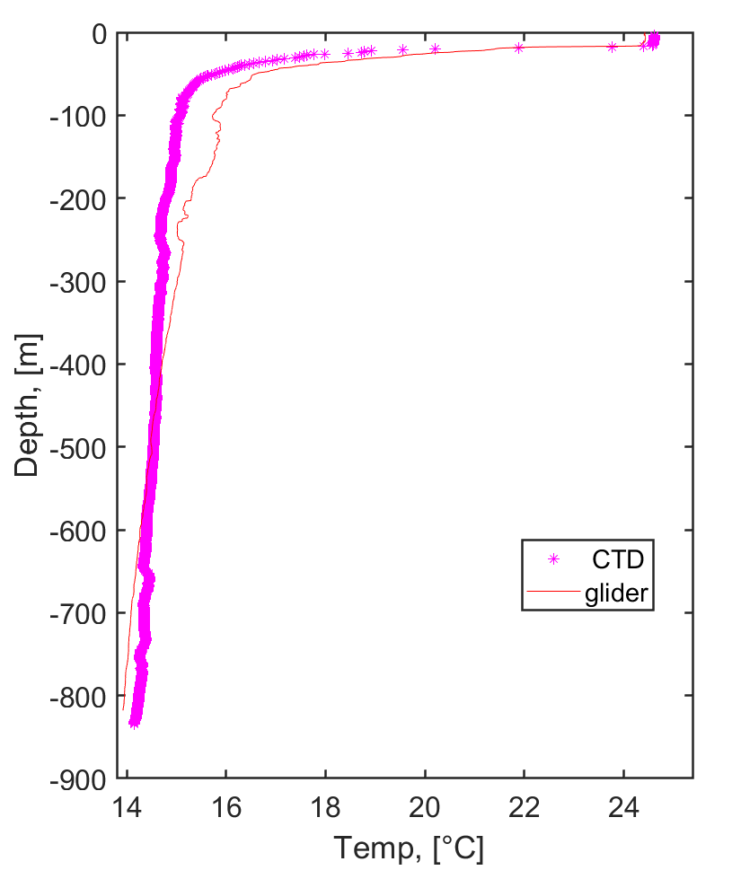
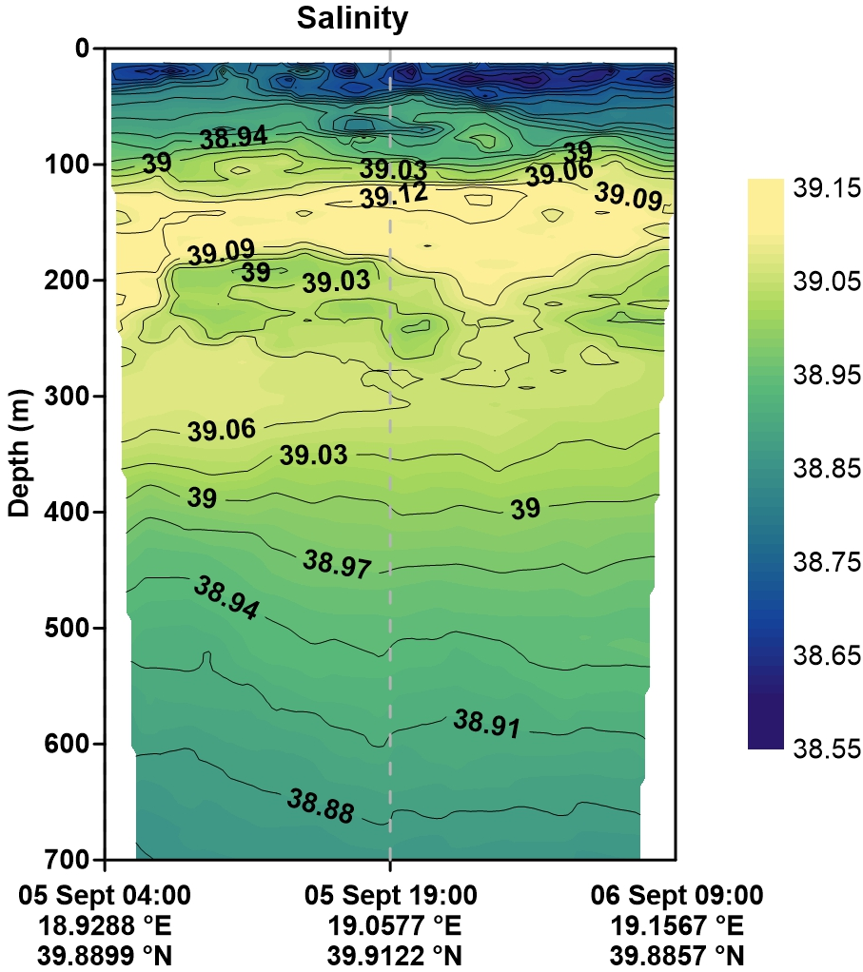
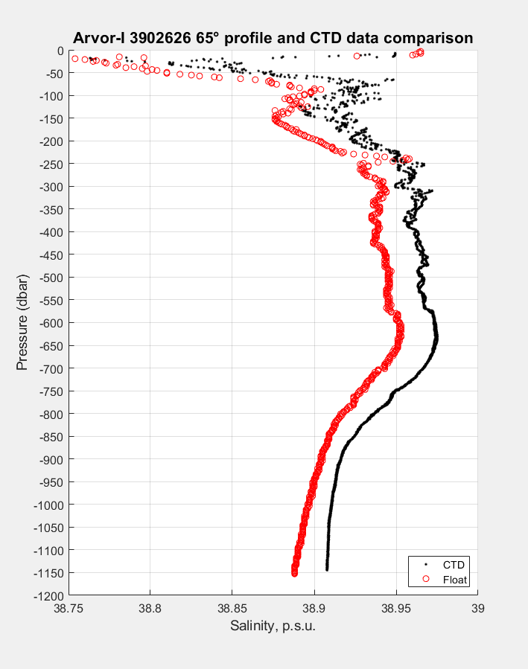
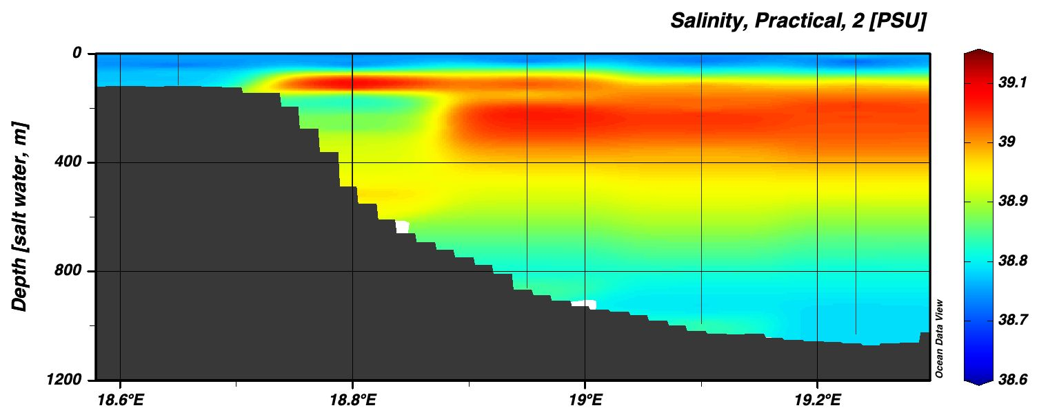
Cross- Calibration
2006 -2025 Temperature
Cross – Infrastructures intercomparison
Comparison of New pCO2 deep measurements with
Atmospheric data (licor)
BGC ARGO
Glider
Otranto Section
FLOAT
Glider
CTD

