Slide 1
Upgrades to the Italian Marine Research Observatory in the Arctic Region
Francesco Paladini de Mendoza⁽¹⁾, Stefano Miserocchi⁽²⁾, Marco Pansera⁽¹⁾, Gianmarco Ingrosso⁽³⁾, Francesco Filiciotto⁽¹⁾, Virginia Sciacca⁽¹⁾, Angelo Odetti⁽⁴⁾, Gabriele Bruzzone⁽⁴⁾, Francesco Smedile⁽¹⁾, Maria Papale⁽¹⁾, Angelina Lo Giudice⁽¹⁾, Manuel Bensi⁽⁵⁾, Patrizia Giordano⁽²⁾, Tommaso Tesi⁽²⁾, Federico Giglio⁽²⁾, Leonardo Langone⁽²⁾, Maurizio Azzaro⁽¹⁾
⁽¹⁾ CNR-ISP, Messina; ⁽²⁾CNR-ISP, Bologna; ⁽³⁾,CNR-IRET, Lecce; ⁽⁴⁾ CNR-INM, Genova; ⁽⁵⁾ OGS, Trieste

Slide 2
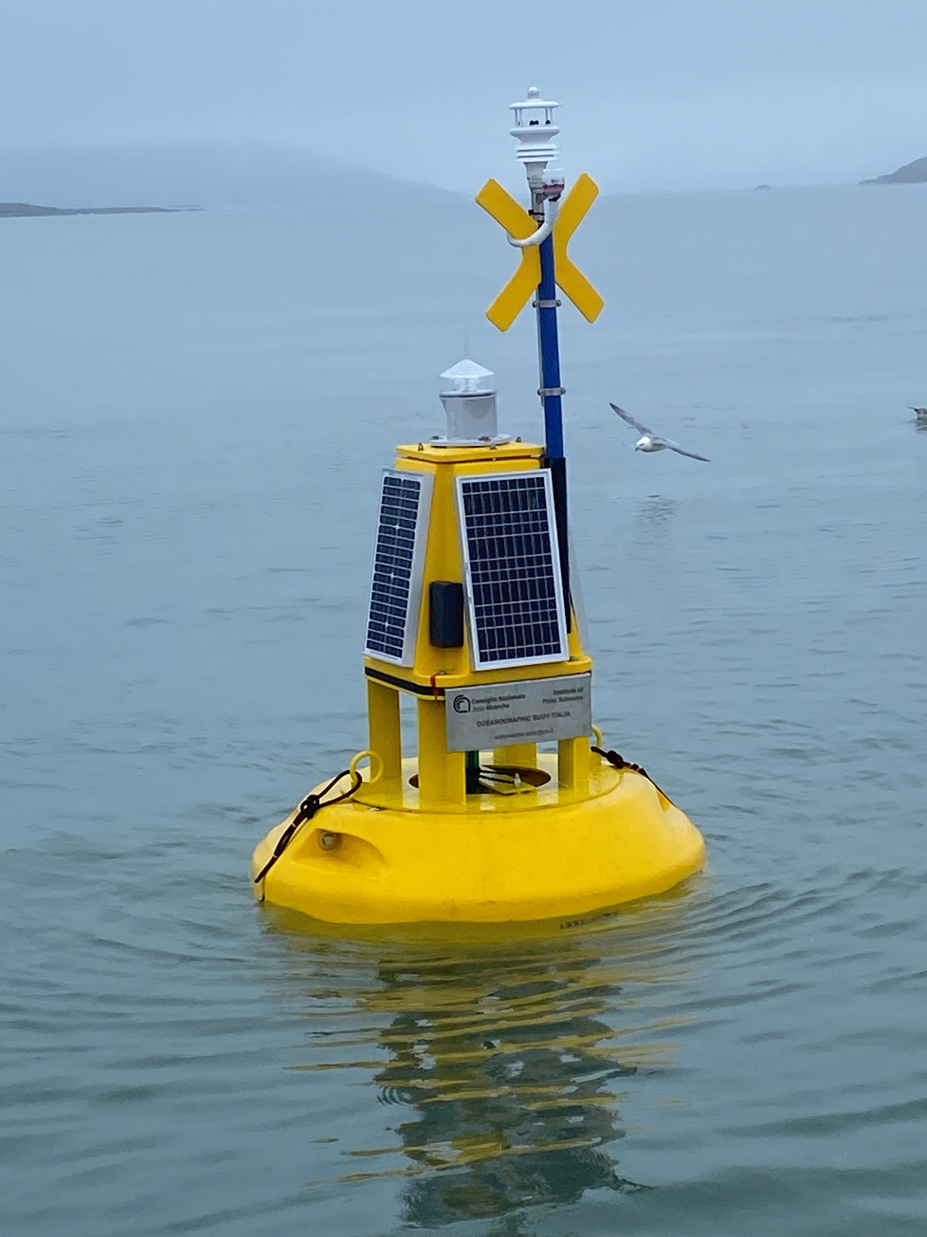
UPGRADING of IT-SIOS observatory platforms
100% on KIM mooring
- Oxy sensor
- PAR sensor
- ECO-FLNTU sensor
- Ocean sound
INSTALLED IN JUNE 25
-----------------------------
- ADCP currents
100% on MDI mooring
- CO₂ sensor installed in June 25
- Nitrate sensor
- PAR sensor
Svalbard Archipelago
75% on S1 mooring
- New CTDs and ADCP installed in July 2025
Marine RI in
Arctic region
New Surface buoy, data in IADC, but lost in April
Replaced by ARGO-FLOAT (planned for Spring 2026)
X
X
X
93% on THALASSOGRAPHIC BUOY
- Real-Time since June 25
- Meteorology
- Physical and Biogeochemical sensors
- Ocean sound installed in Sept 25
All datasets from sensors installed before June 2025
are archived in IADC – ERRDAP repository, federated with IT-IOOS

Slide 3
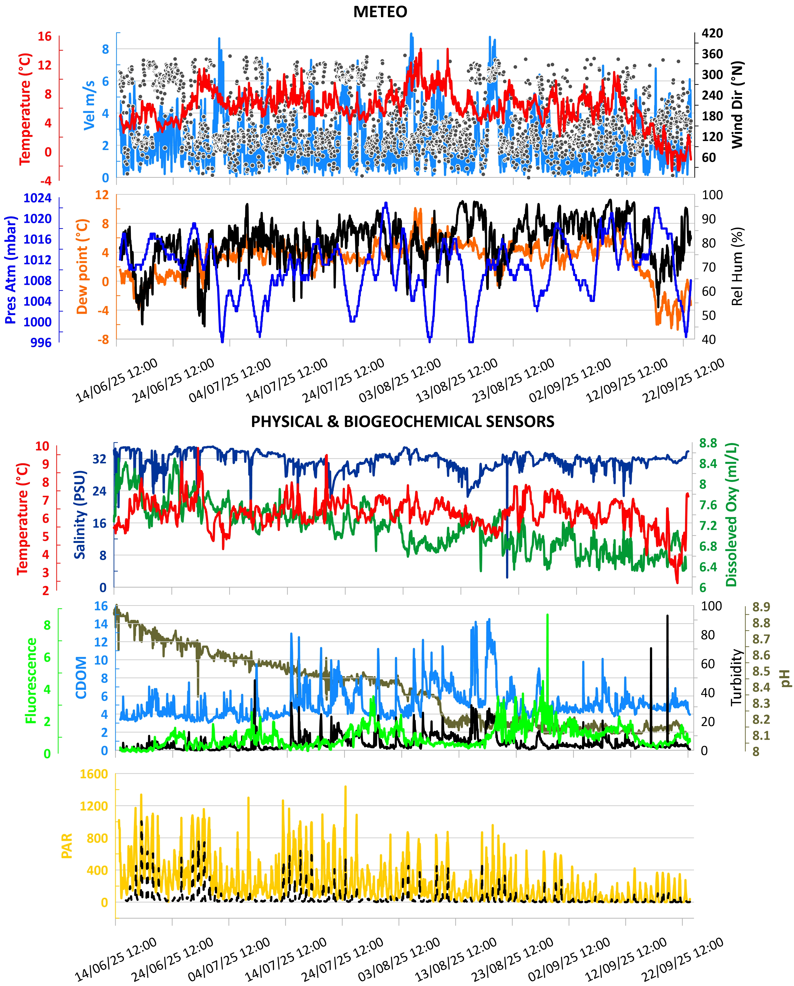
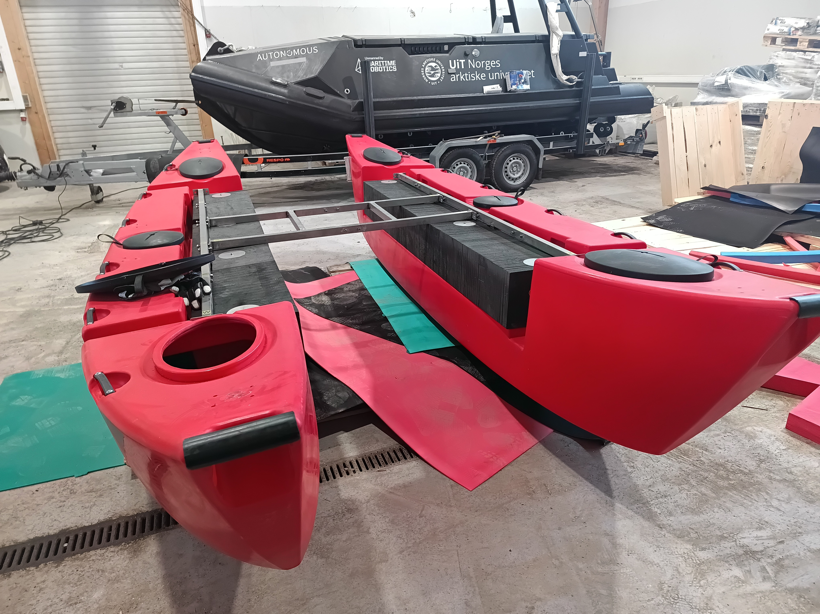
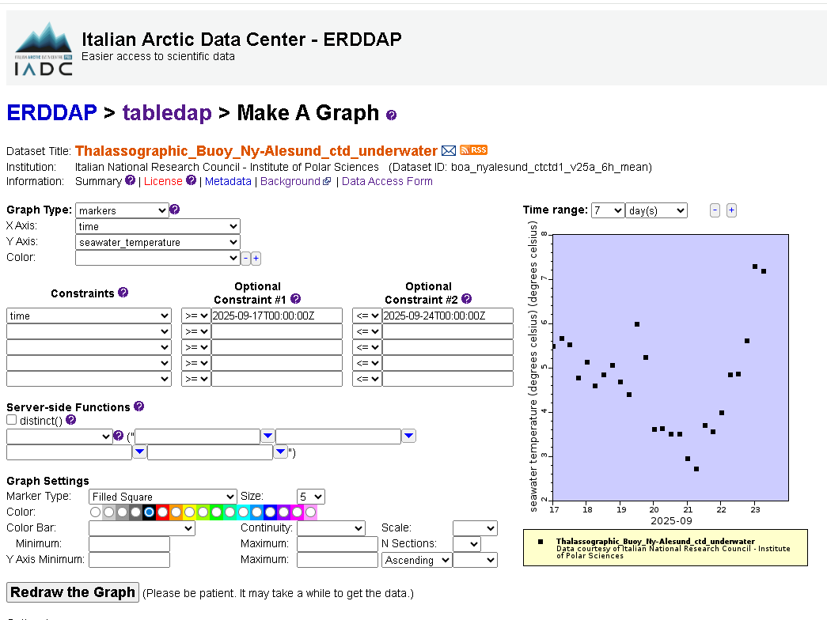
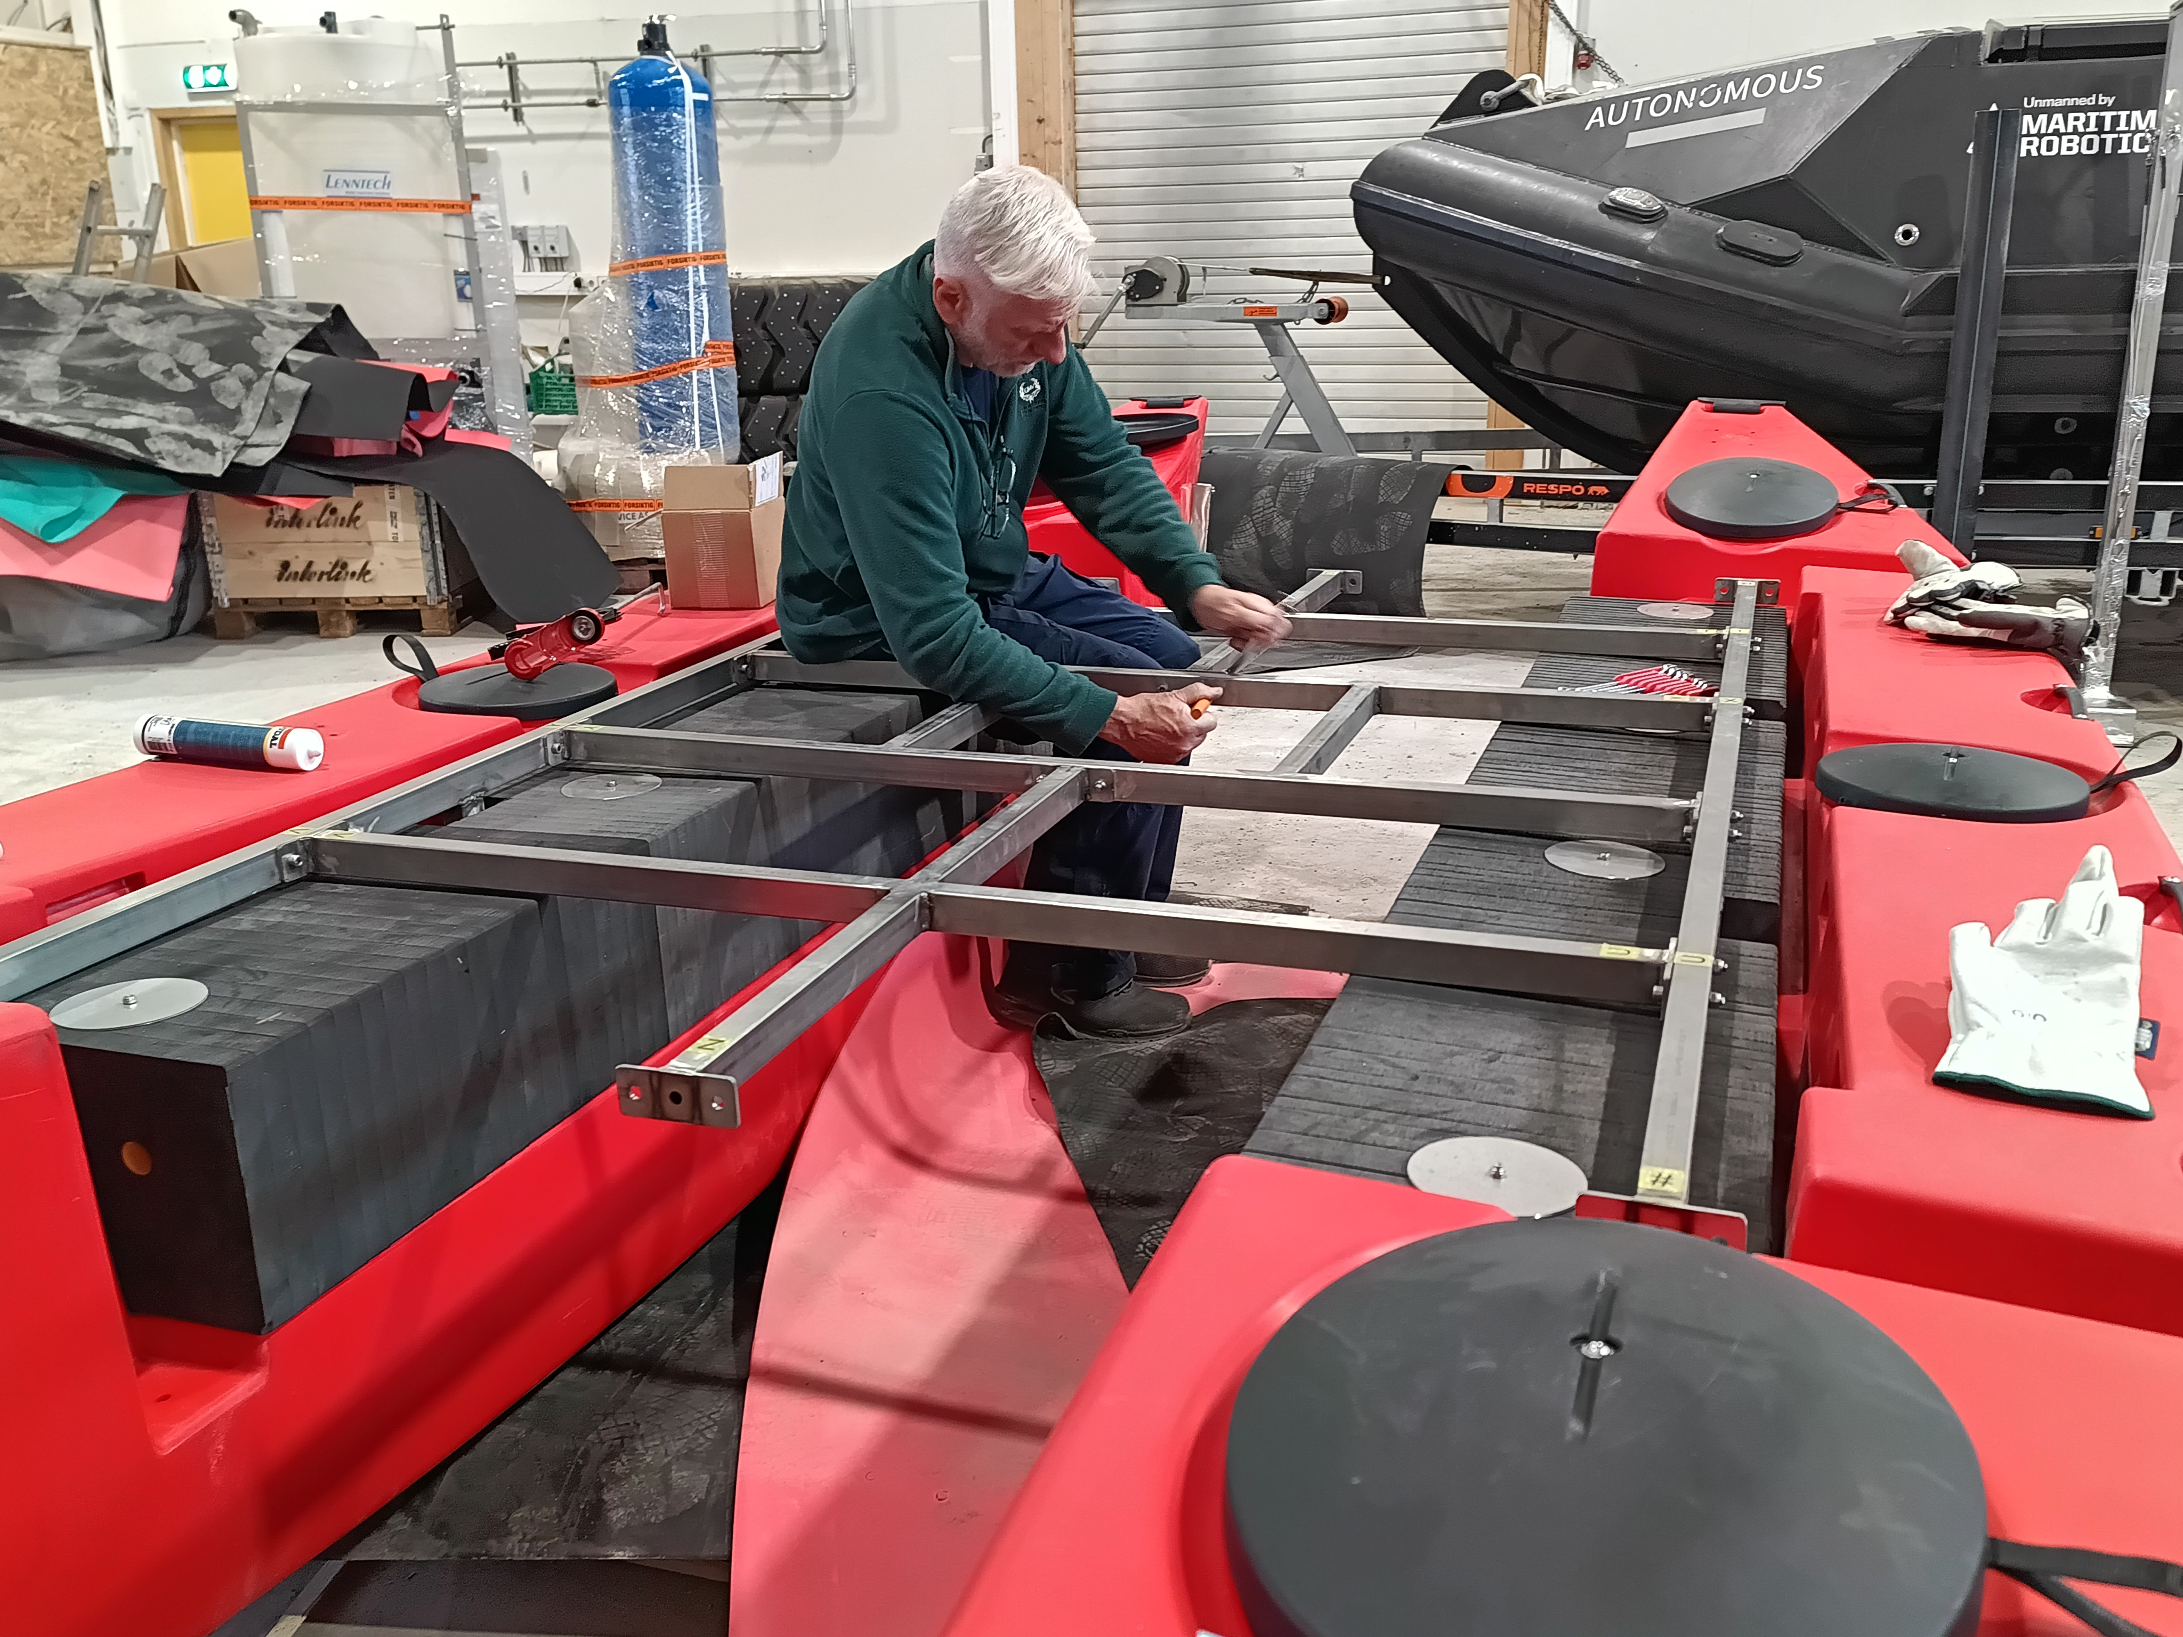
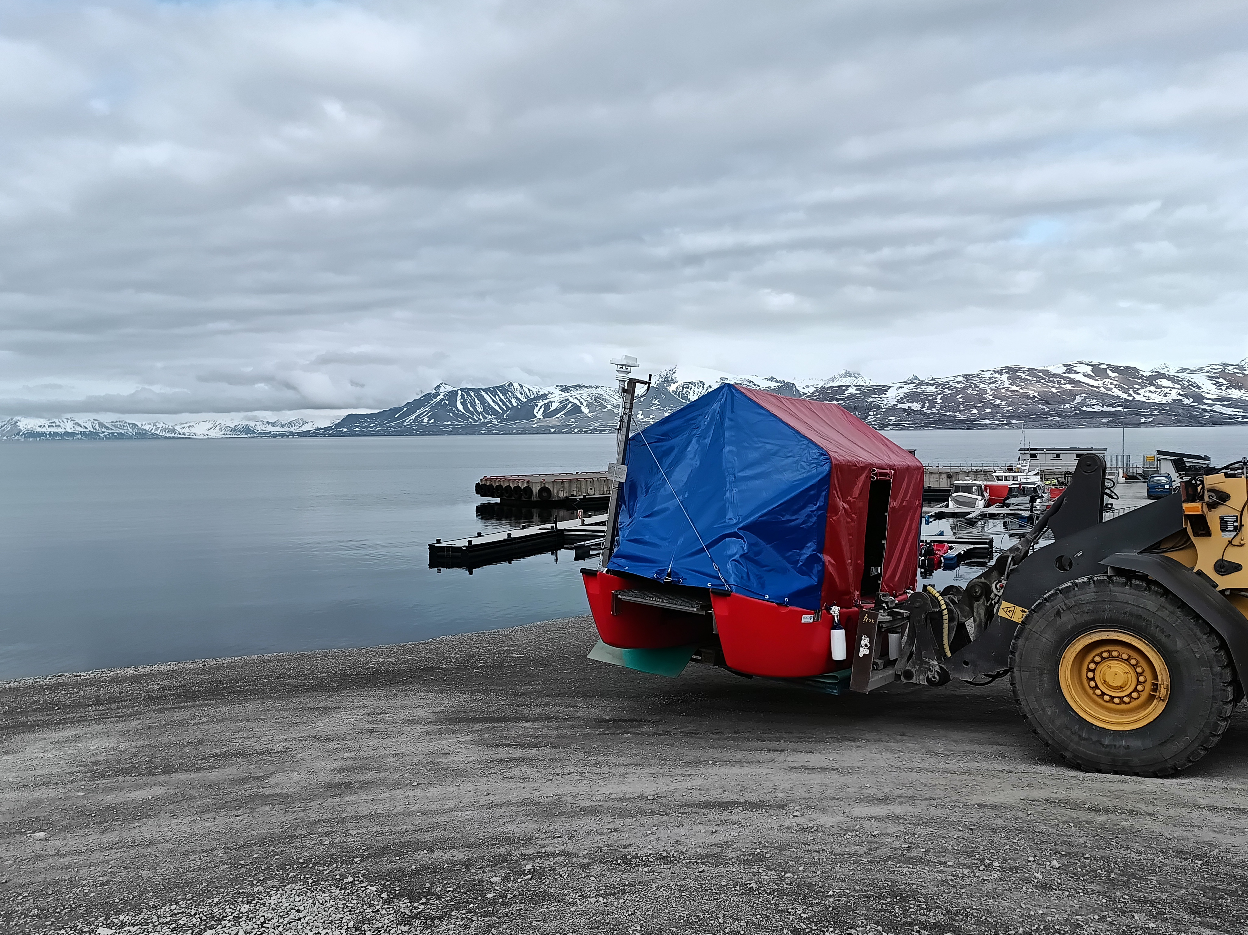
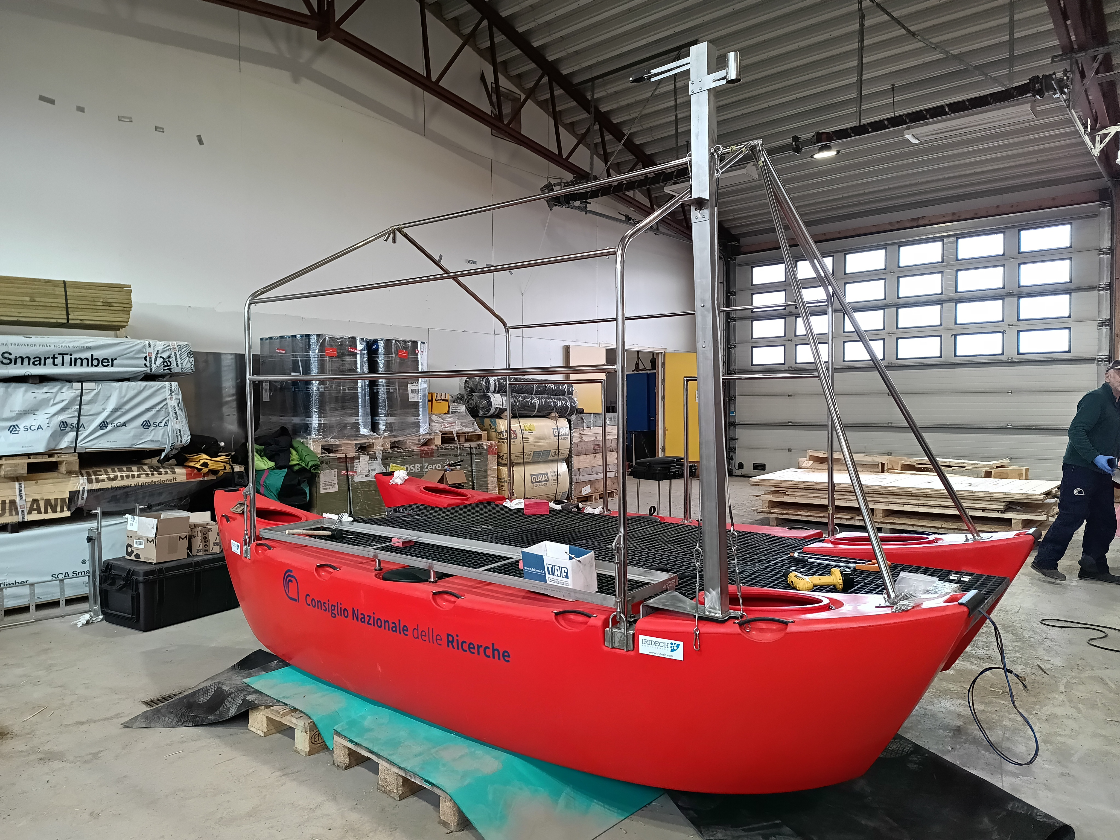
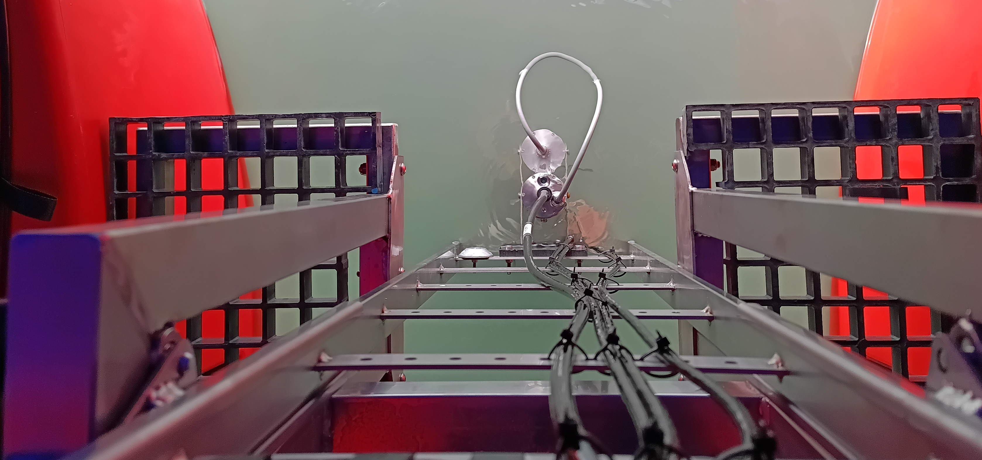
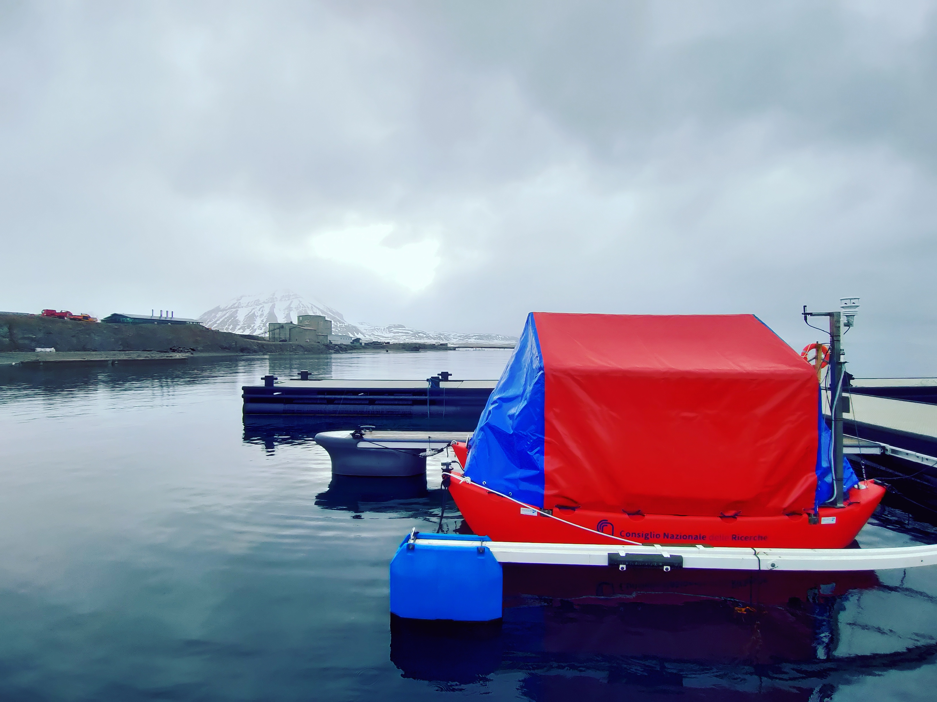
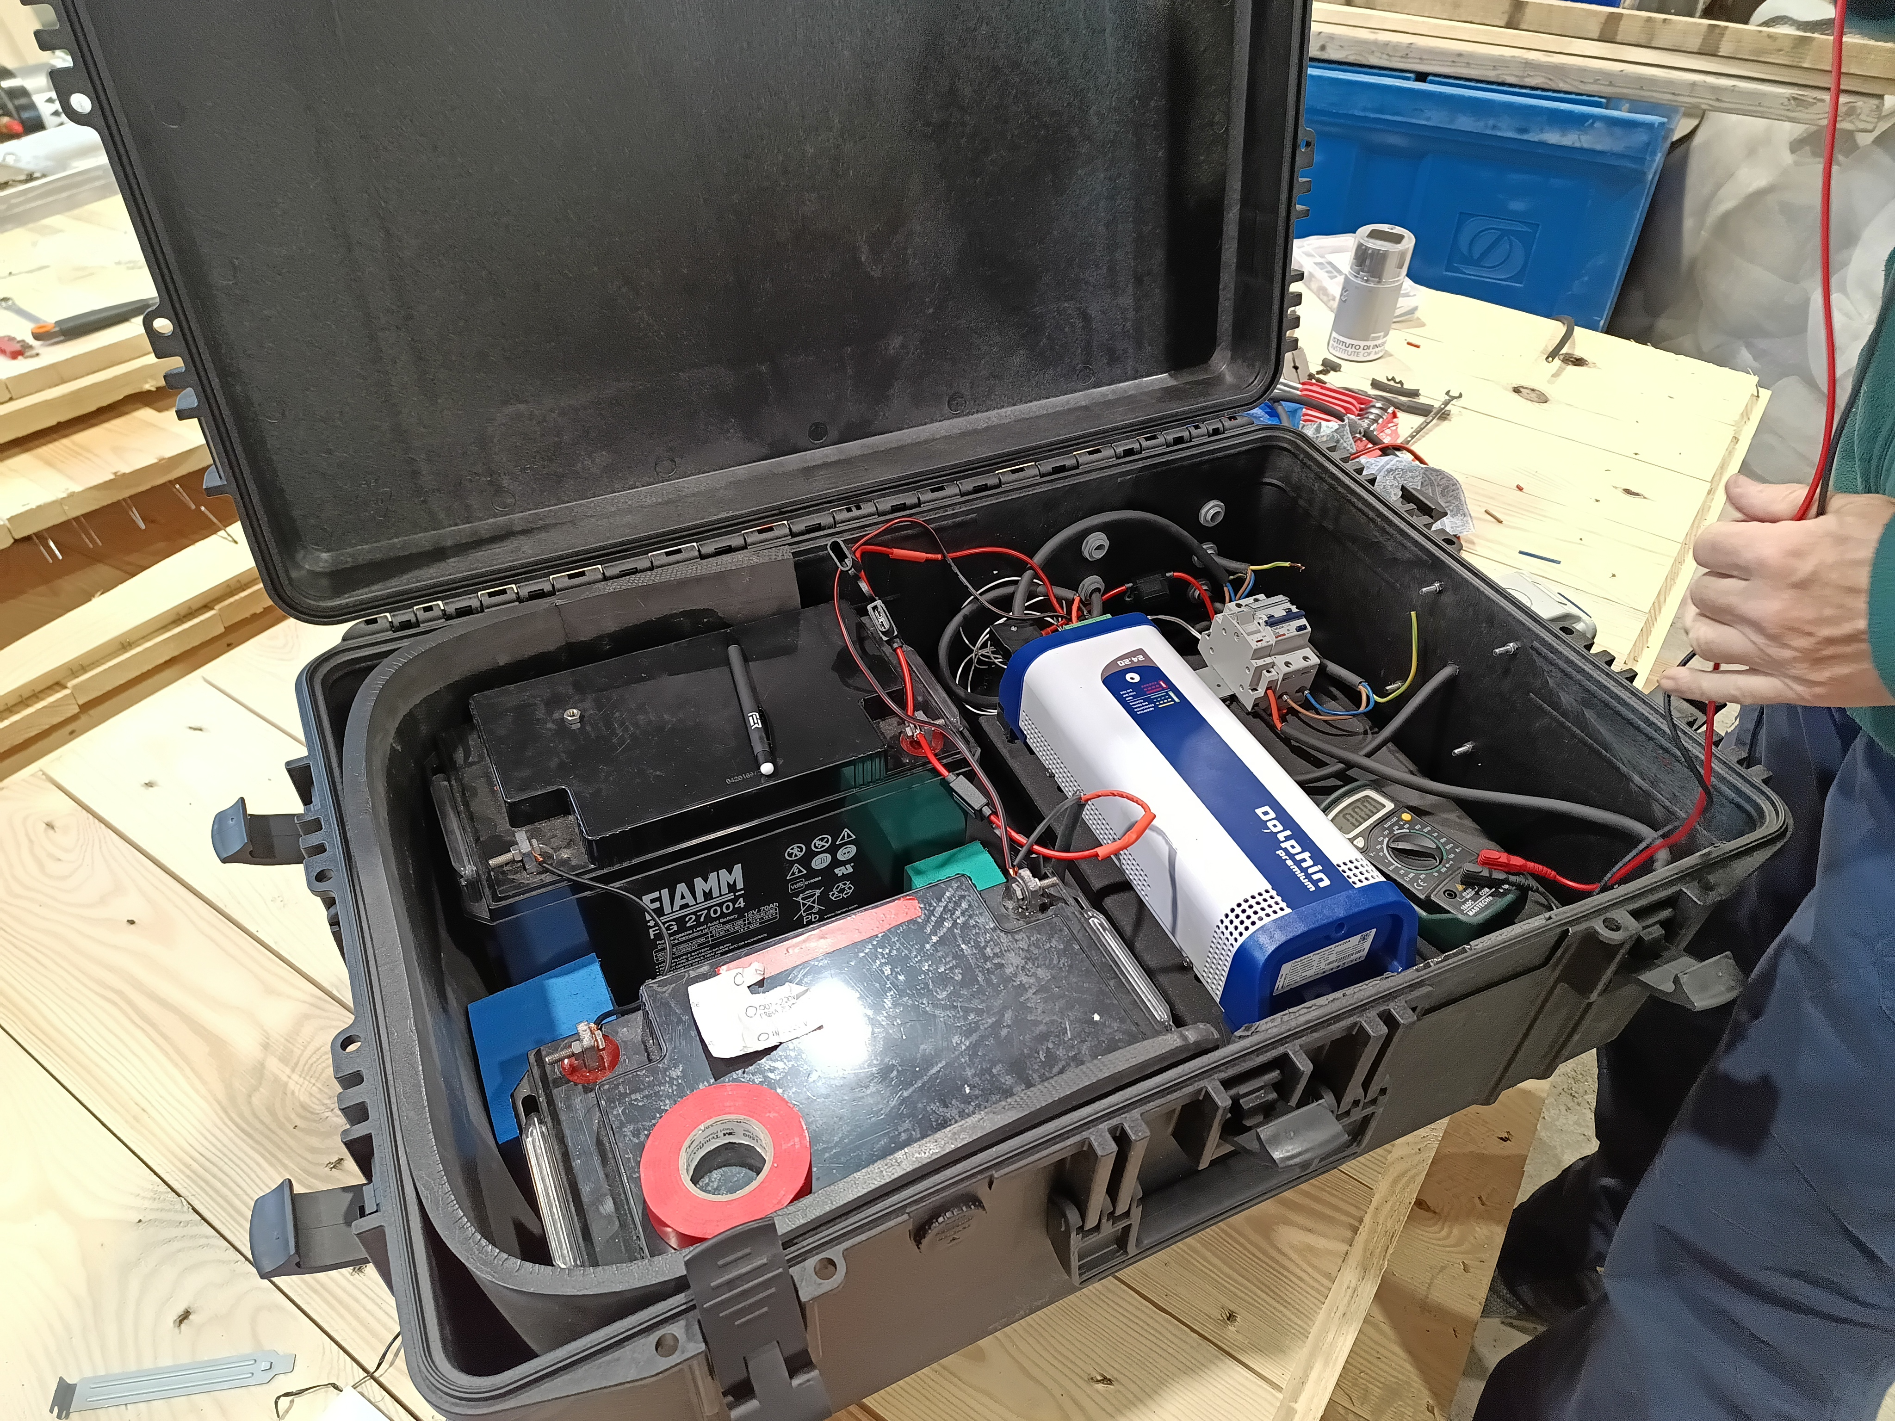
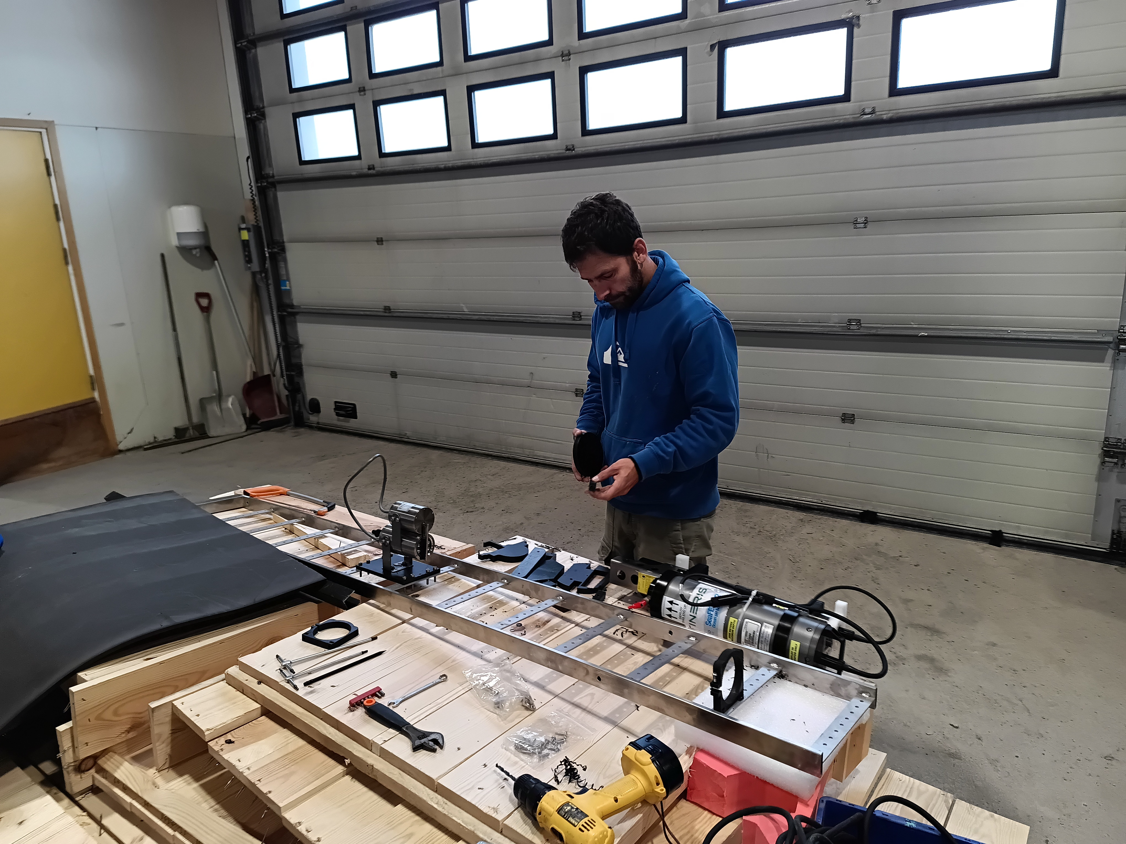
THALASSOGRAPHIC BUOY IN NY-ALESUND
Structure designed and realized
by CNR-INM
(Odetti & Bruzzone)
REAL-TIME DATA
https://data.iadc.cnr.it/erddap/tabledap/boa_nyalesund_ctctd1_v25a_6h_mean.html
7 Essential Climate
Variable - Atmosphere
8 Physical & Biogeochemical EOV s

Slide 4
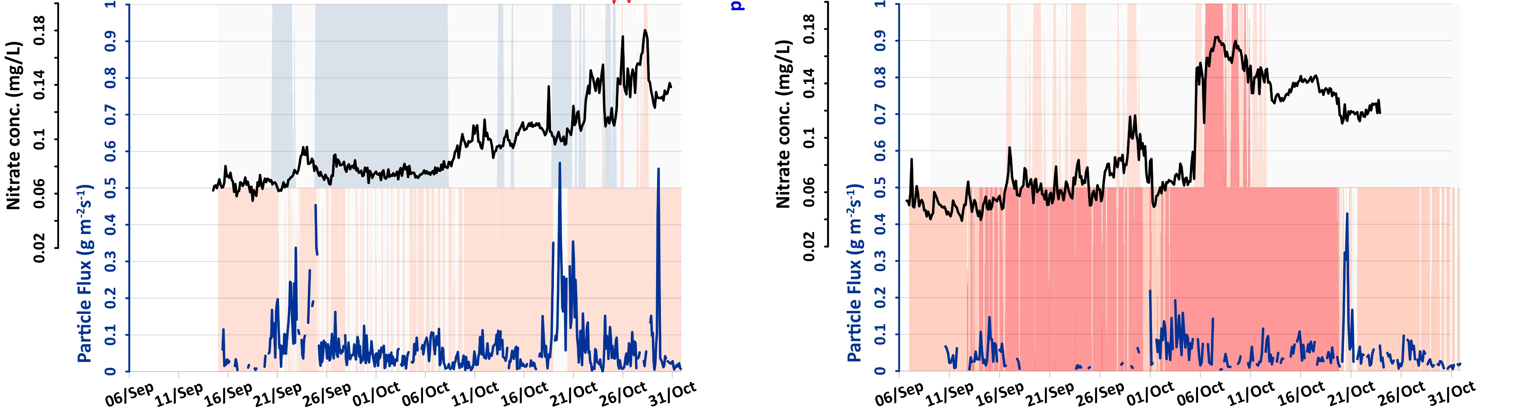
NEW BIOGEOCHEMICAL SENSOR UPGRADING ON MOORINGS
Increase of the knowledge about impact of climate change related processes (i.e. ATLANTIFICATION) on biogeochemical cycles (i.e NUTRIENT DYNAMIC)
Trasformed Atlantic Water
Atlantic Water
Surface Water
ATLANTIC WATER INTRUSION linked to FAST NITRATE REPLENISHMENT
2022
0.00024 mg l⁻¹ hr⁻¹
2023
0.0016 mg l⁻¹ hr⁻¹
27 m
89 m
IMPLEMENTATION OF SYNOPTIC OBSERVATION OF COASTAL ECOSYSTEM DYNAMICS IN THE ARCTIC REGION IN THE CONTEXT OF CLIMATE CHANGE

Slide 5
