Slide 1
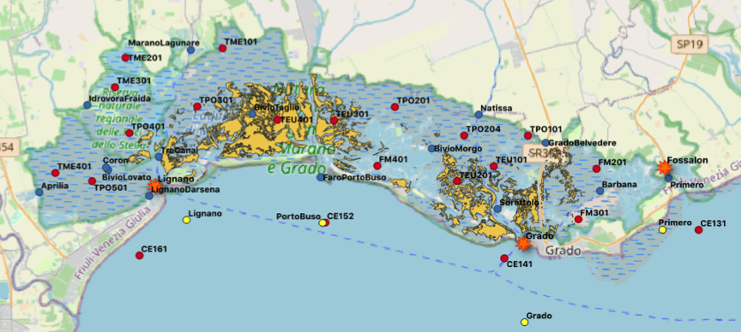
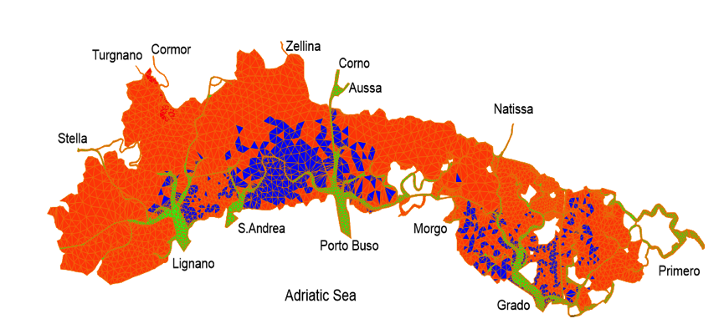
Advancing the integration of monitoring and modelling of the physico-chemical and biogeochemical state of the
Marano and Grado Lagoon
(Italy)
Isabella Scroccaro, Leslie Aveytua Alcazar, Fabio Brunetti, Alessandra Lanzoni, Celia Laurent, Simone Spada, Anna Teruzzi, Cosimo Solidoro, Georg Umgiesser, Donata Canu
OGS National Institute of Oceanography and Applied Geophysics

Slide 2
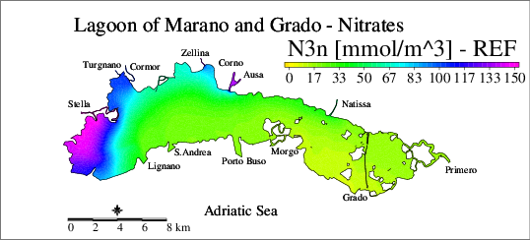
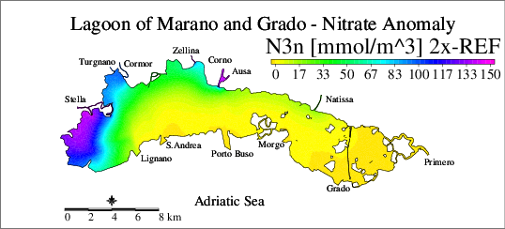
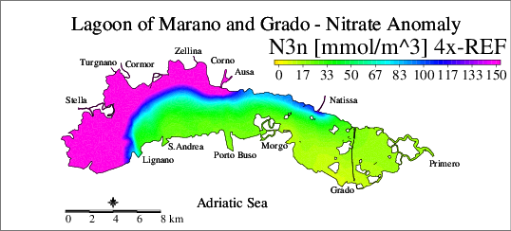
SHYFEM-BFM coupled modeling and scenarios
Model outputs ehibit strong agreement for water level and temperature, and good performance for salinity
Dissolved oxygen and nitrate also match observed spatial and seasonal patterns
Scenario simulations explored the lagoon’s response to nutrient load variations, particularly for nitrates.

Slide 3
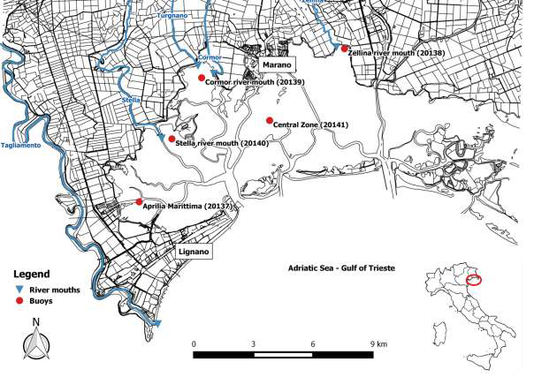
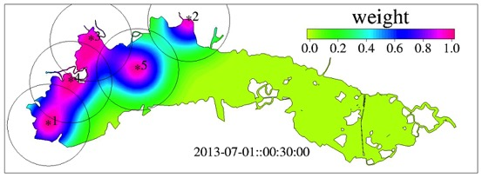
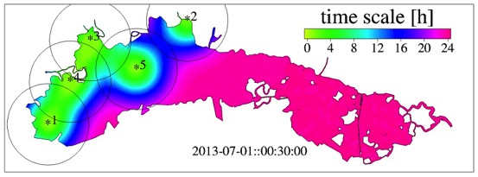
Implementation of the data assimilation for salinity
A modified nudging technique within SHYFEM can assimilate salinity data from existing probes in the western lagoon, originally installed for hypoxia/anoxia monitoring, improving model results.
Monitoring sites of the years 2013 and 2014 during the SHAPE project (from Scroccaro et al., 2015).

Slide 4
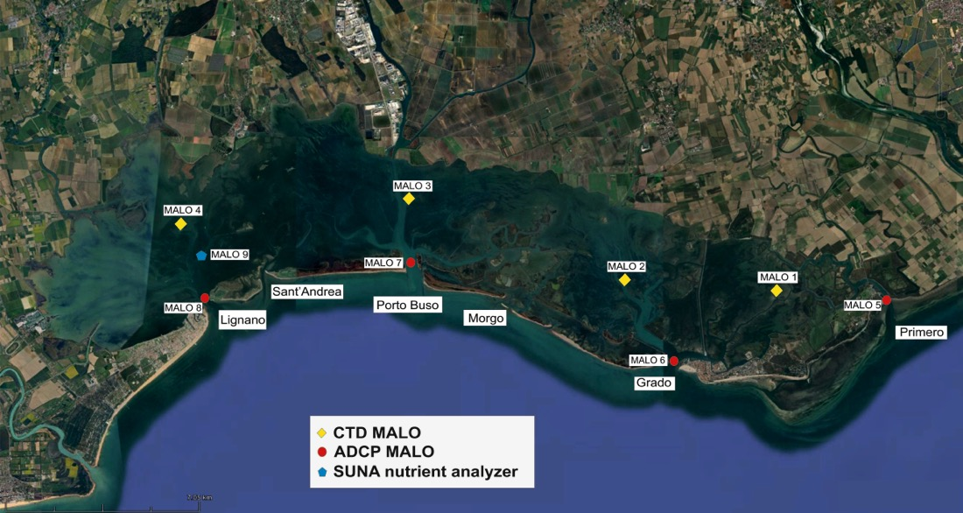
DANUBIUS infrastructure MALO including four instrumented buoys with CTDs measuring temperature, conductivity, pressure, chlorophyll-a, turbidity, and dissolved oxygen; five ADCPs at lagoon inlets providing current profiles, and a nutrient analyser with integrated CTD, offering continuous, high-frequency data to strengthen the integration of monitoring and modelling.

