Slide 1
Assessing Outdoor Thermal Comfort through Microclimatic Modeling: A Case Study in Lecce (Italy)
Author:
Dr. Francesco Giangrande (PhD Student XXXIX Cycle – University of Salento)
francesco.giangrande@unisalento.it

Slide 2
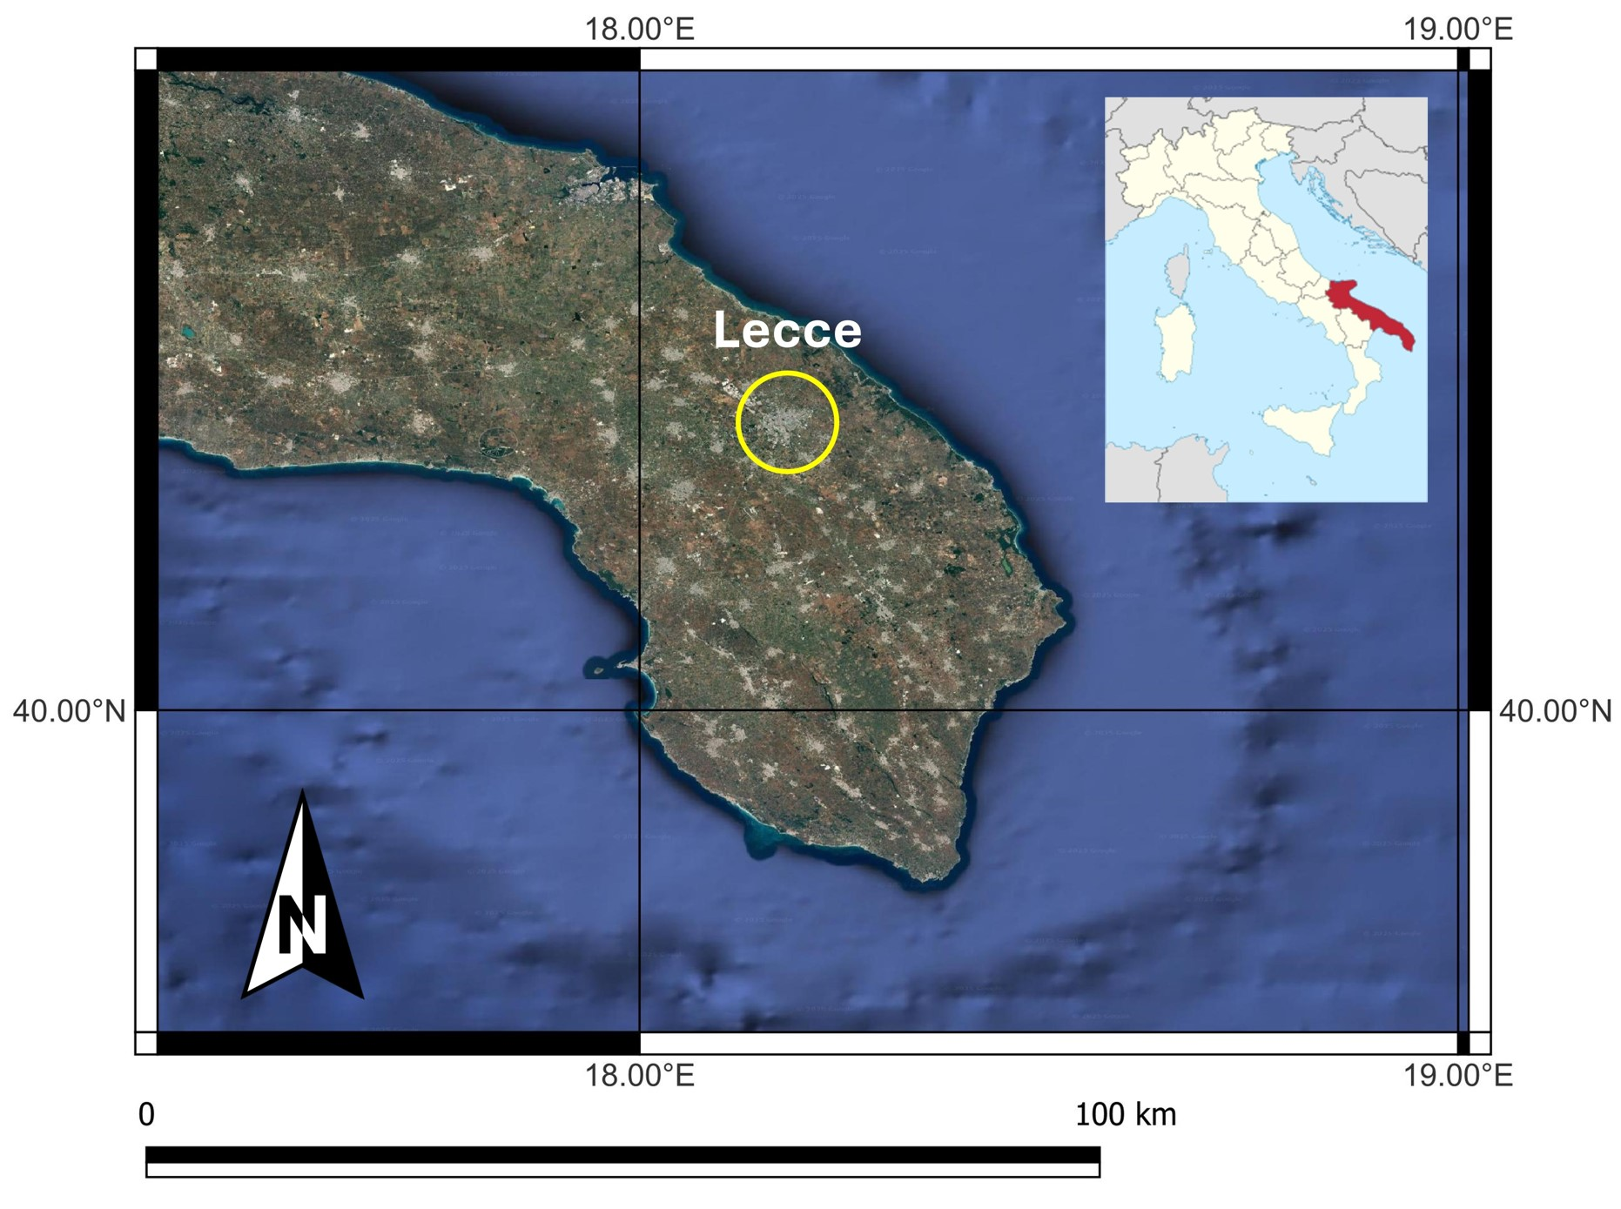
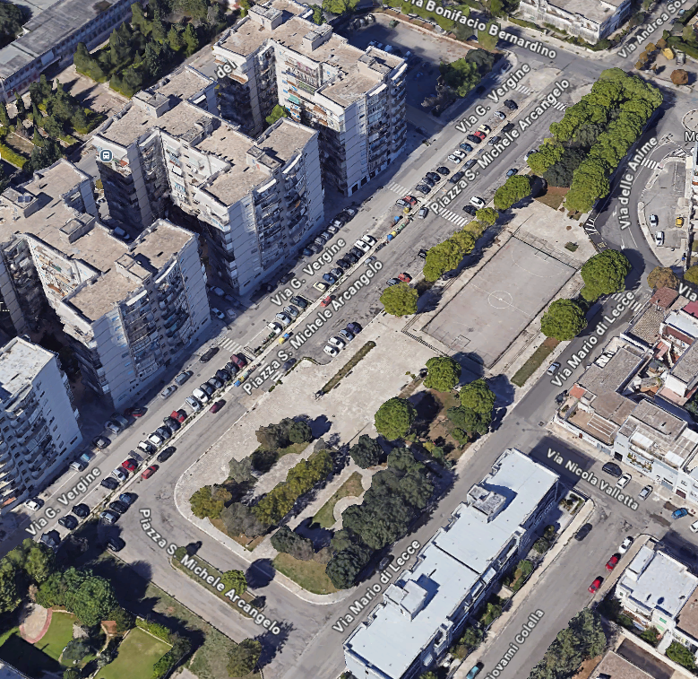
OBJECTIVE
The aim of this work is to analyze thermal comfort in terms of Universal Thermal Climate Index (UTCI), in a selected area of Lecce, a typical Mediterranean city, using a modelling approach to evaluate the microclimatic mitigation effects of urban greenery.
Piazzetta S. Michele Arcangelo – Lecce (Italy)

Slide 3
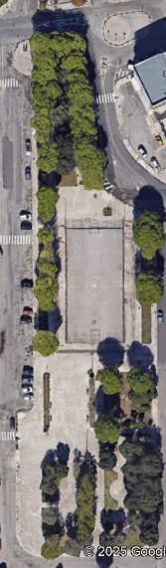
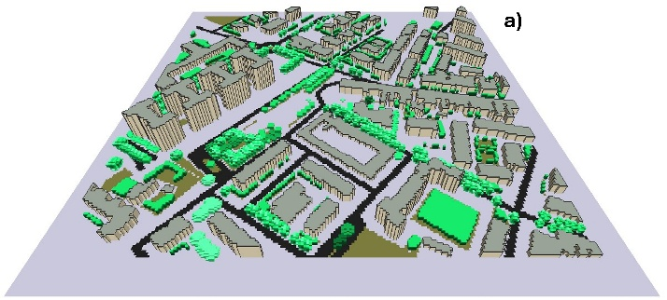
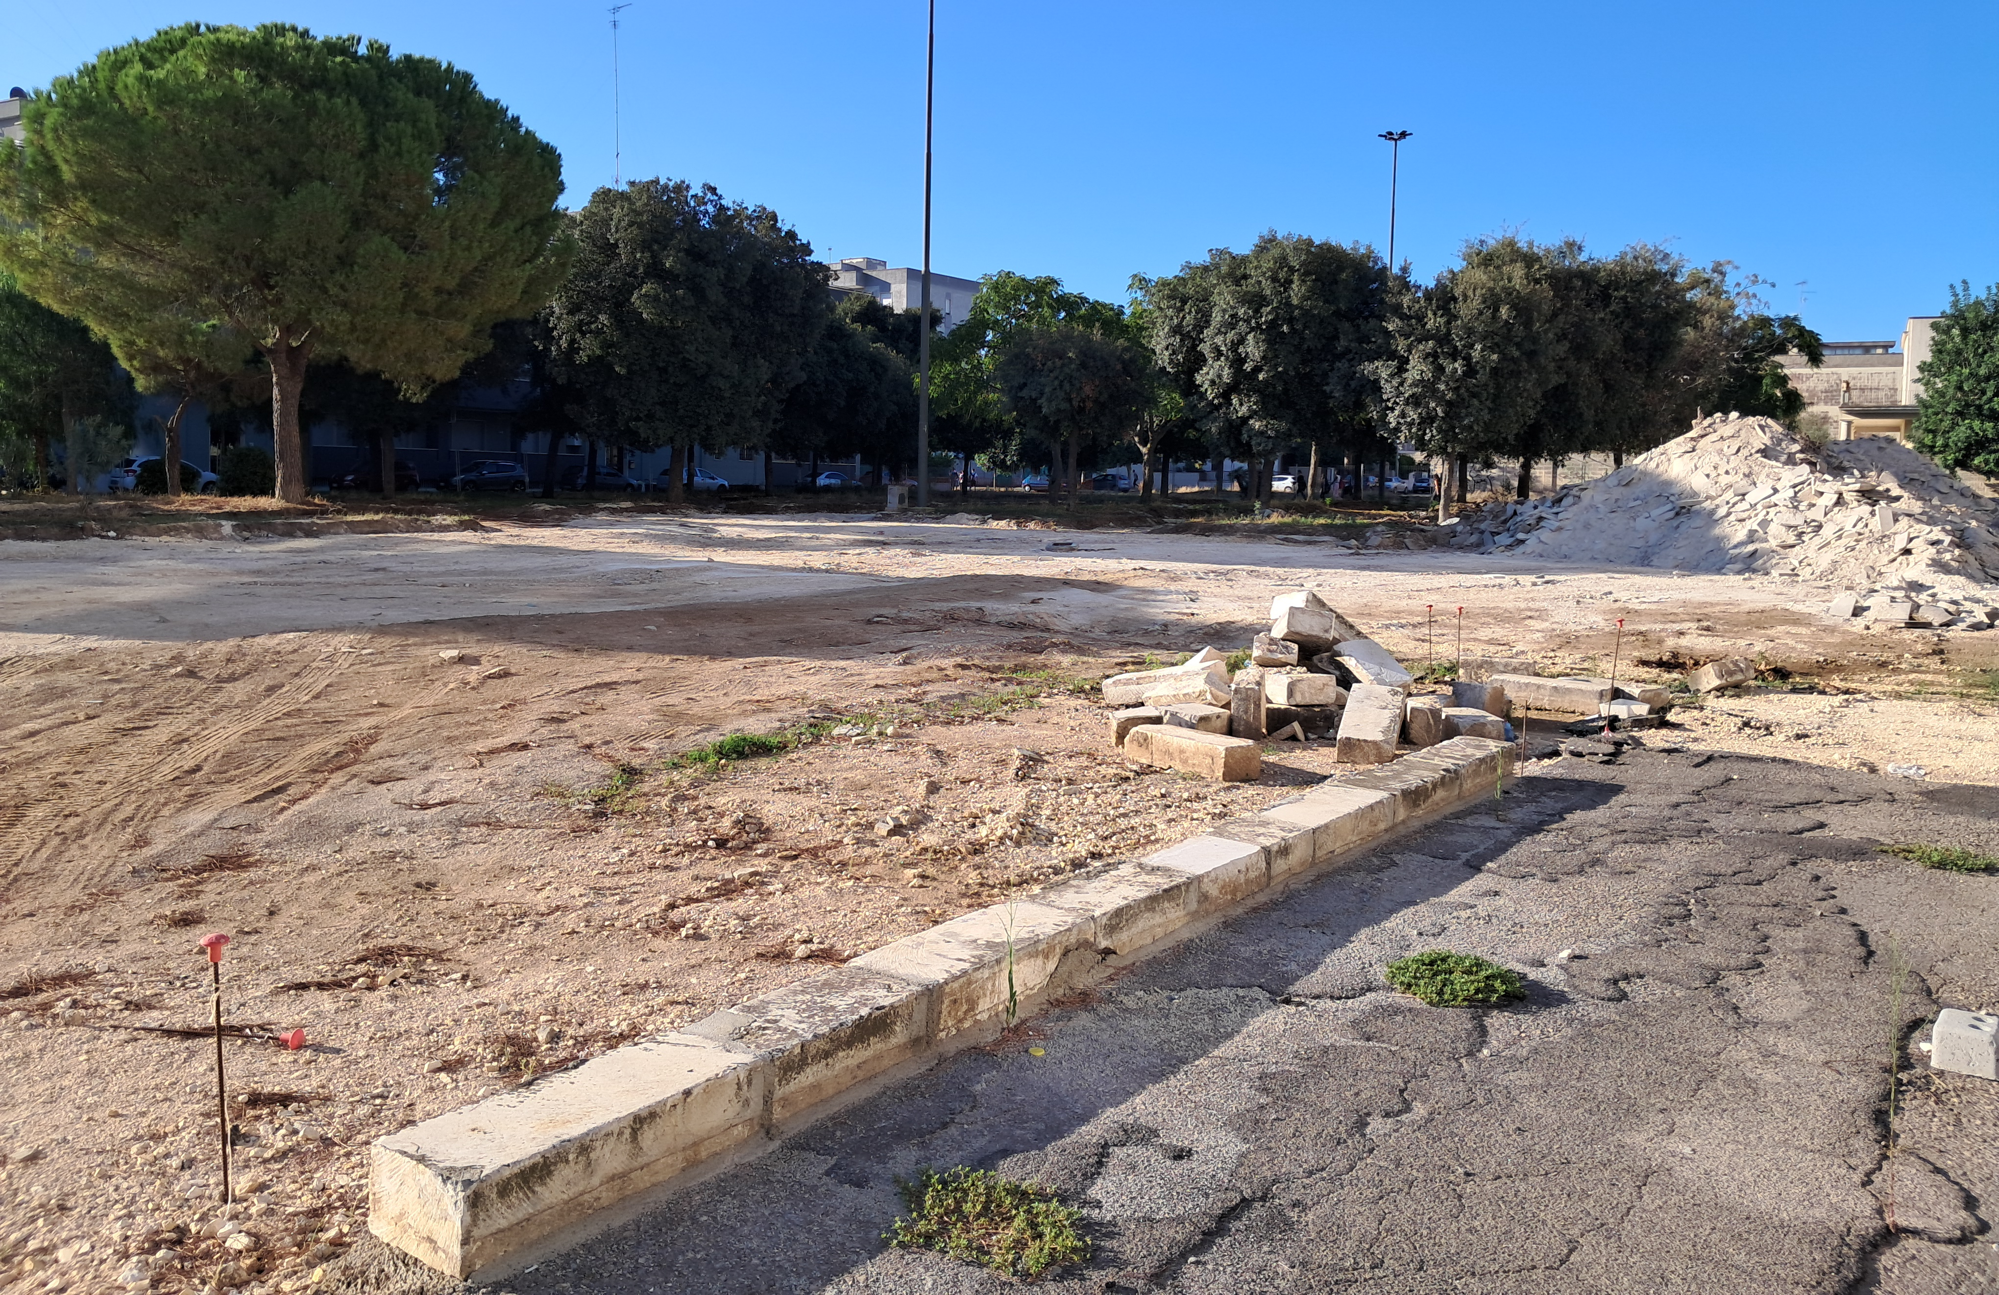
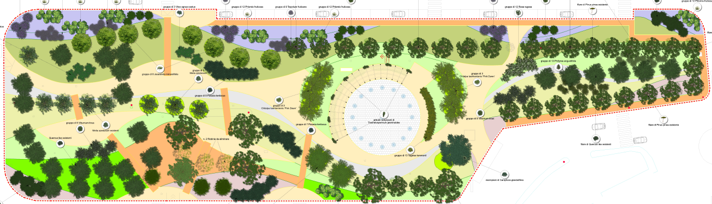

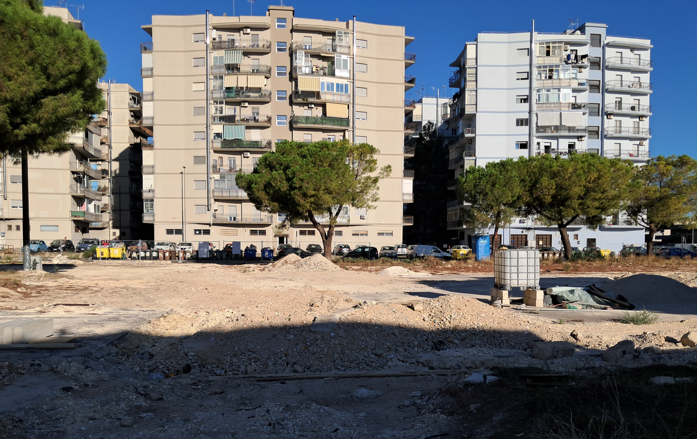
METHODOLOGY - Study area
CURRENT SCENARIO
MODIFIED SCENARIO

Slide 4
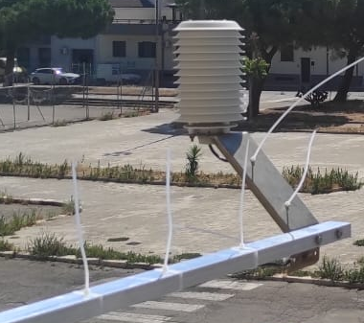
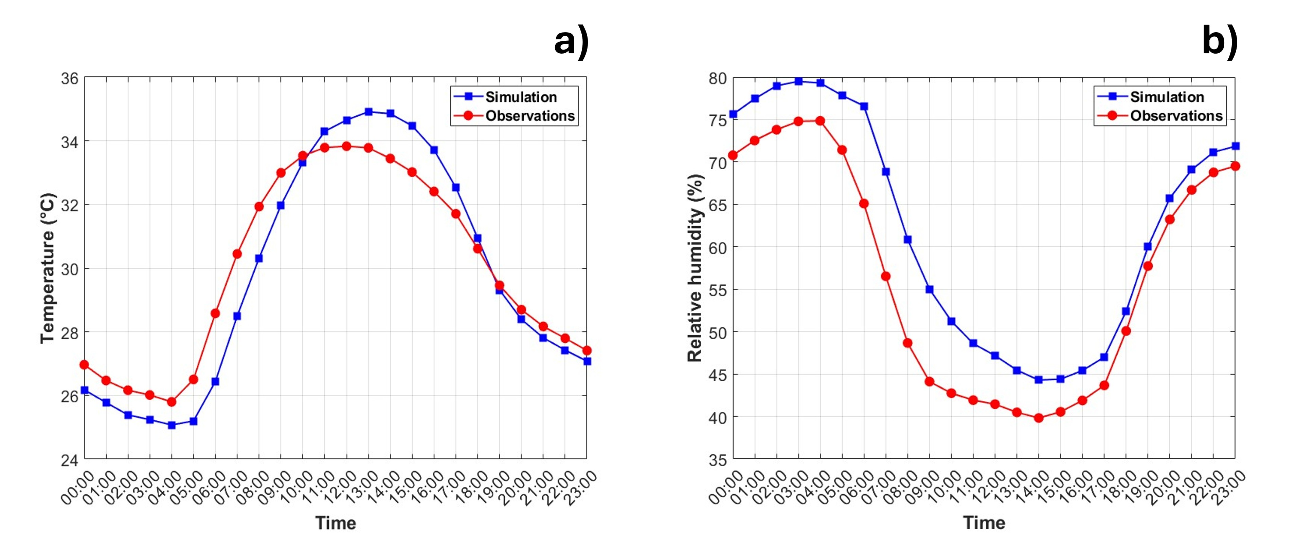
METHODOLOGY – Weather forcings
DATA COLLECTION
Air temperature (°C);
Relative humidity (%);
Wind speed (m/s);
Wind direction (°);
Precipitation (mm)
Weather station in the center of Lecce
Weather input in ENVI-met
(1st August 2024)
VALIDATION
 | RMSE | BIAS
T (°C) | 1.06 | 0.24
RH (%) | 6.4 | 5.5
Thermo-hygrometer

Slide 5
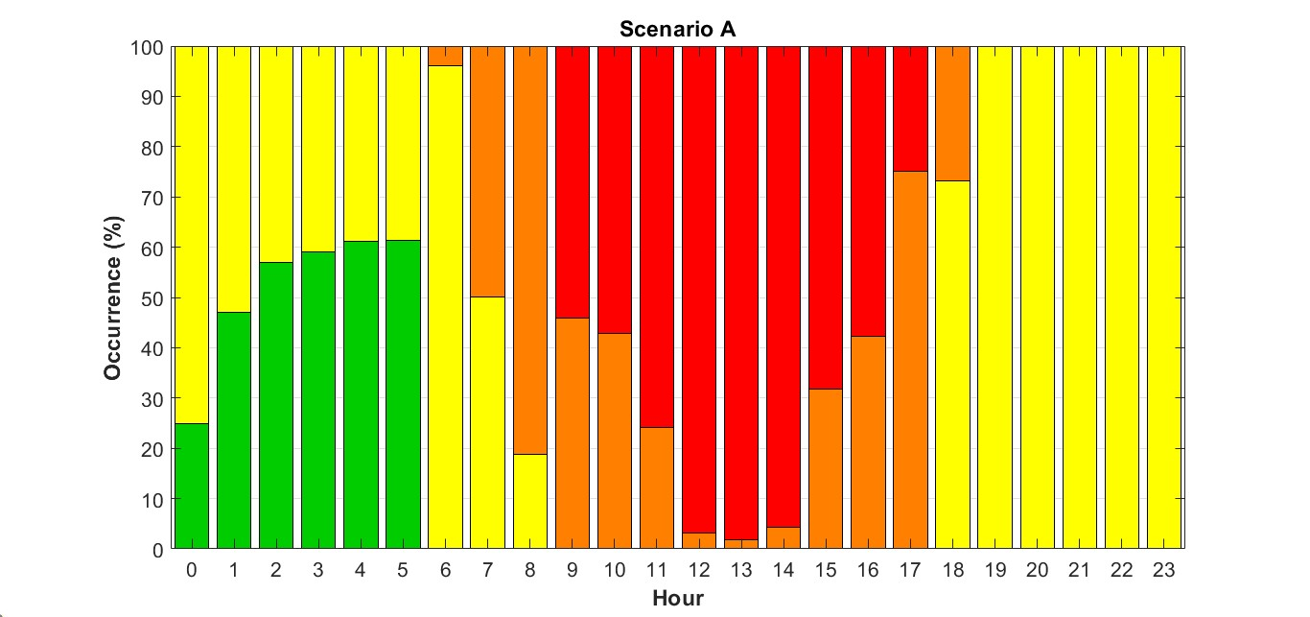
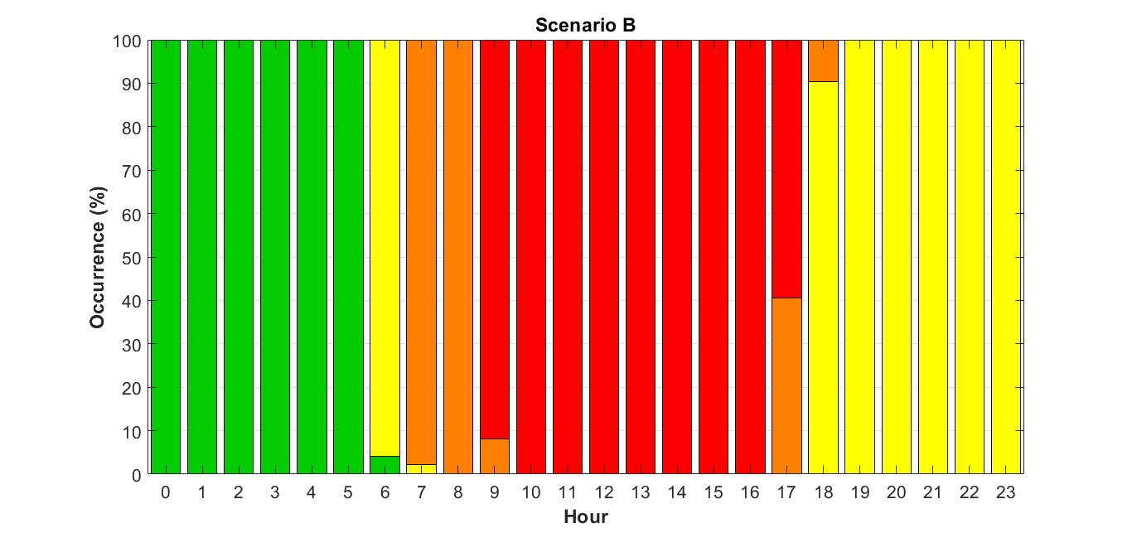

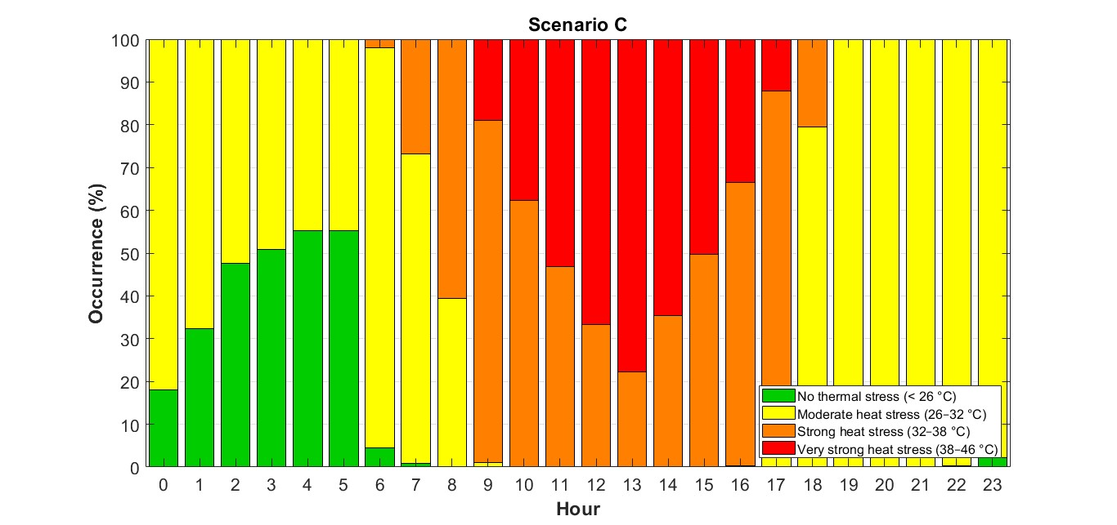
RESULTS - UTCI Occurence %
A
B
C
Reduction of 'very strong heat stress’ from 09:00 to 17:00
 | Average
B-A | 25%
B-C | 48%
A-C | 24%

Slide 6
RESULTS - UTCI Occurence %
A
B
C
Reduction of 'very strong heat stress’ from 09:00 to 17:00
 | Average
B-A | 25%
B-C | 48%
A-C | 24%

Slide 7
CONCLUSIONS
The modified scenario (C) presents an improvement in outdoor thermal comfort for citizens, especially in the central hours.
Future activities:
In the future, evaluate the effectiveness of mitigation measures under future climate scenarios using climate projections and the MLUCM BEP + BEM/ENVI-met modeling chain.

