Slide 1

On the discrimination between volcanic ash and desert dust leveraging photometer and depolarization lidar measurements
N. Papagiannopoulos, L. Mona, A. Amodeo, G. D’Amico, B. De Rosa, P. Gumà Claramunt, M. Mytilinaios, C.A Papanikolaou

Slide 2
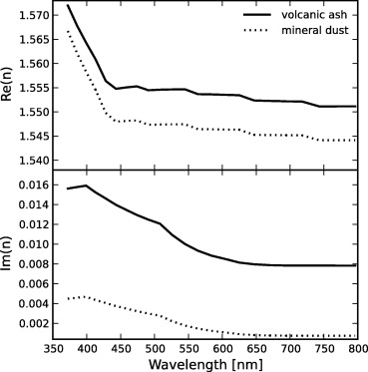


Motivation
Volcanic ash and desert dust are non-spherical, coarse-mode aerosols (e.g. Ansmann et al., 2011)
Several studies discuss slight differences in particle depolarization ratio and lidar ratio among these two aerosol types
It is therefore challenging for lidar-based aerosol typing to separate volcanic ash from desert dust
Conversely, microphysical properties of volcanic ash and desert dust are shown to have significant differences.
Weinzierl et al. (2012) showed a marked difference in the complex refractive index using airborne in situ

Slide 3
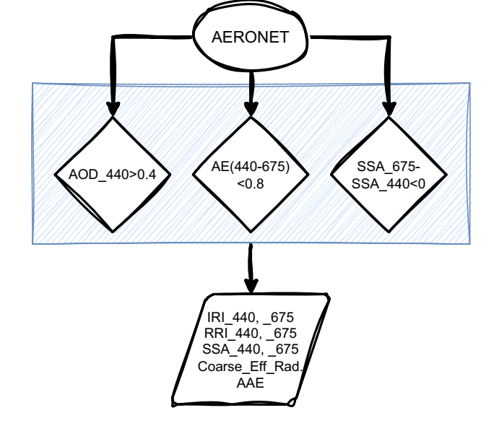
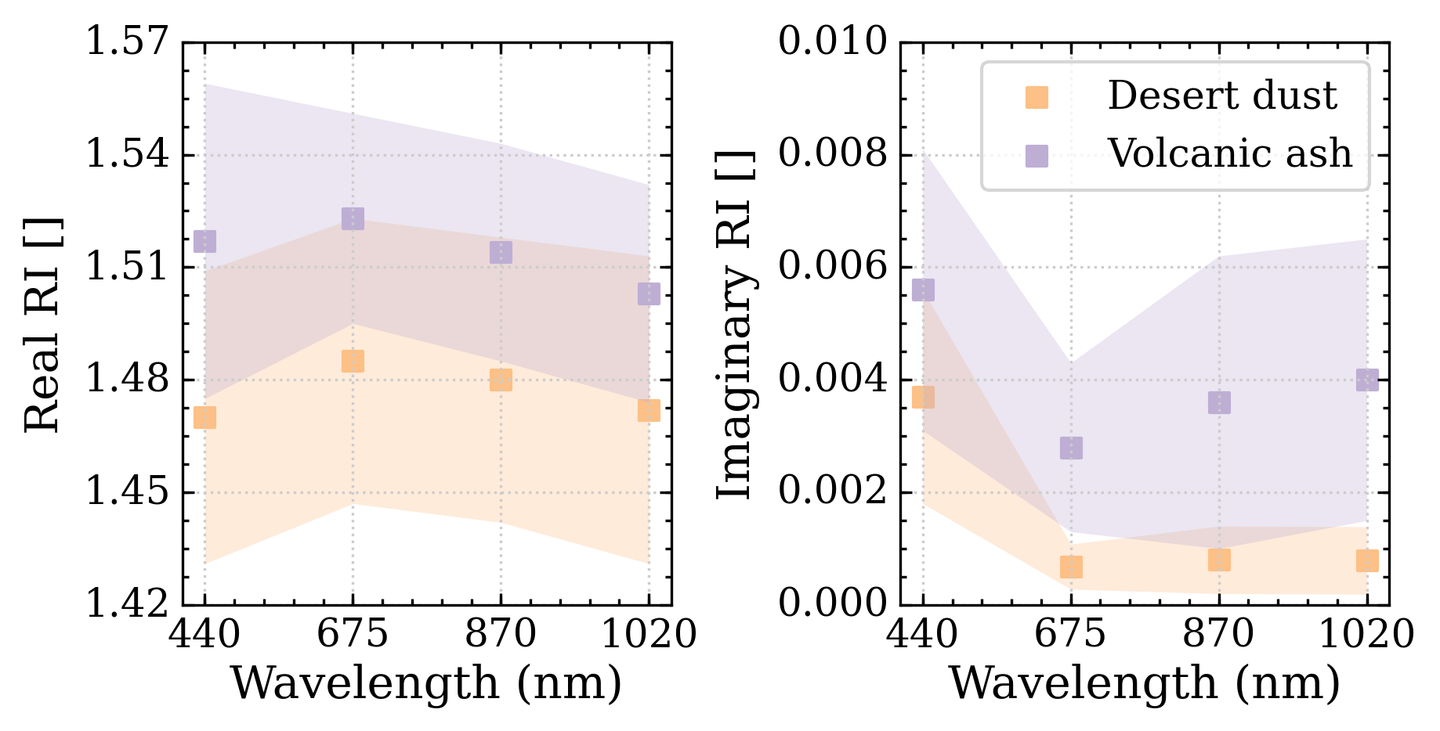
What does AERONET show?
AERONET’s global coverage and data quality allows for the compilation of a curated dataset of microphysical properties
Standard filtering techniques were followed to identify ash/dust
Volcanic ash: 79 instances during the eruptions of Eyjafjallajokull in 2010 and La Palma 2021 were used
Desert dust: 34 instances from the station of Potenza for the years 2017-2022

Slide 4
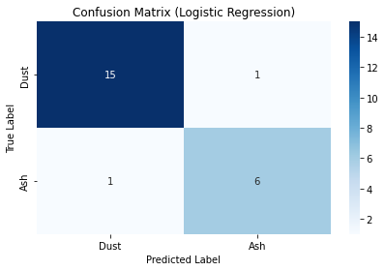
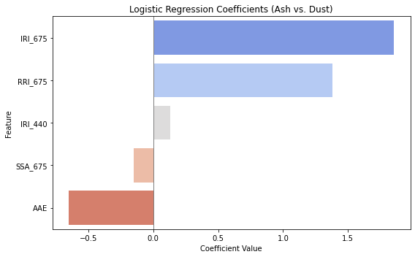
Machine learning classifier selection
A set of key optical and microphysical features was used to train and evaluate several machine learning techniques.
Need to be taken into account:
  few training instances, class imbalance, non-linear feature relationships, overfitting
Logistic regression
Random Forest
XGBoost
SVM
LightGBM
Achieved the best balance between interpretability and accuracy (mean CV F1: 0.85±0.08 and strong recall on the−weak−ash class)

Slide 5
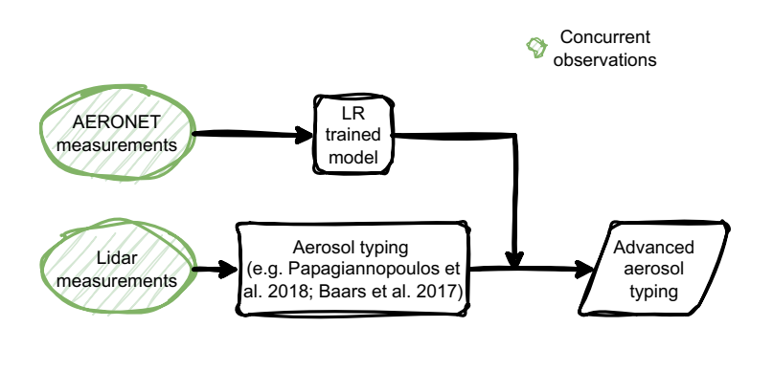
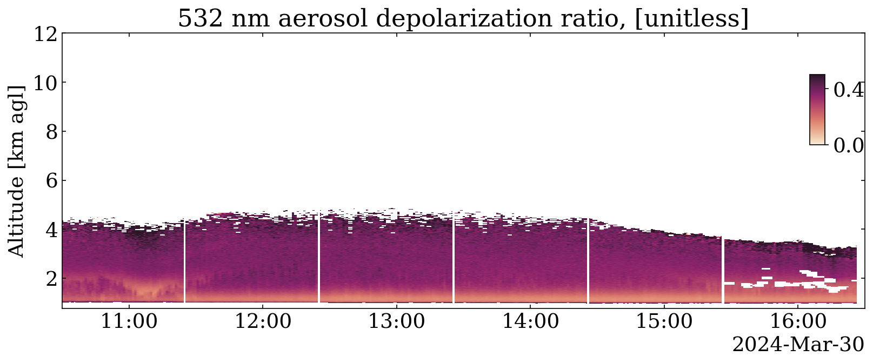
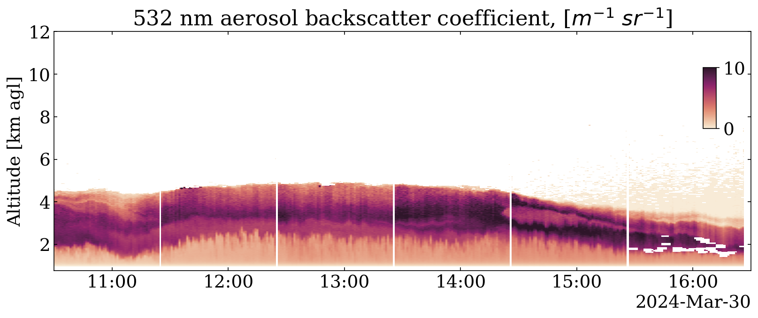
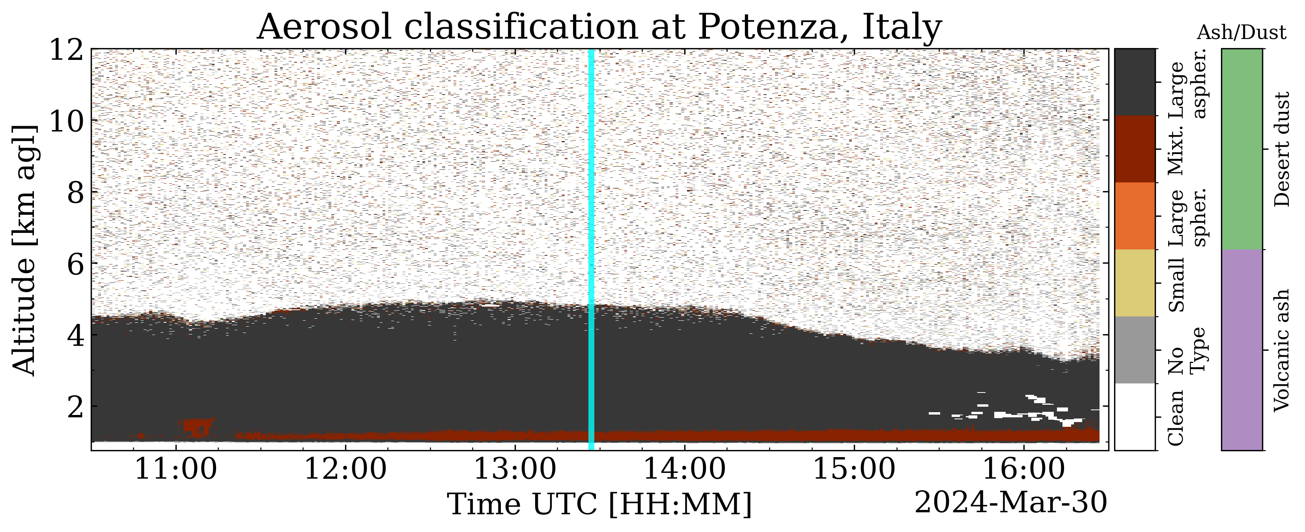
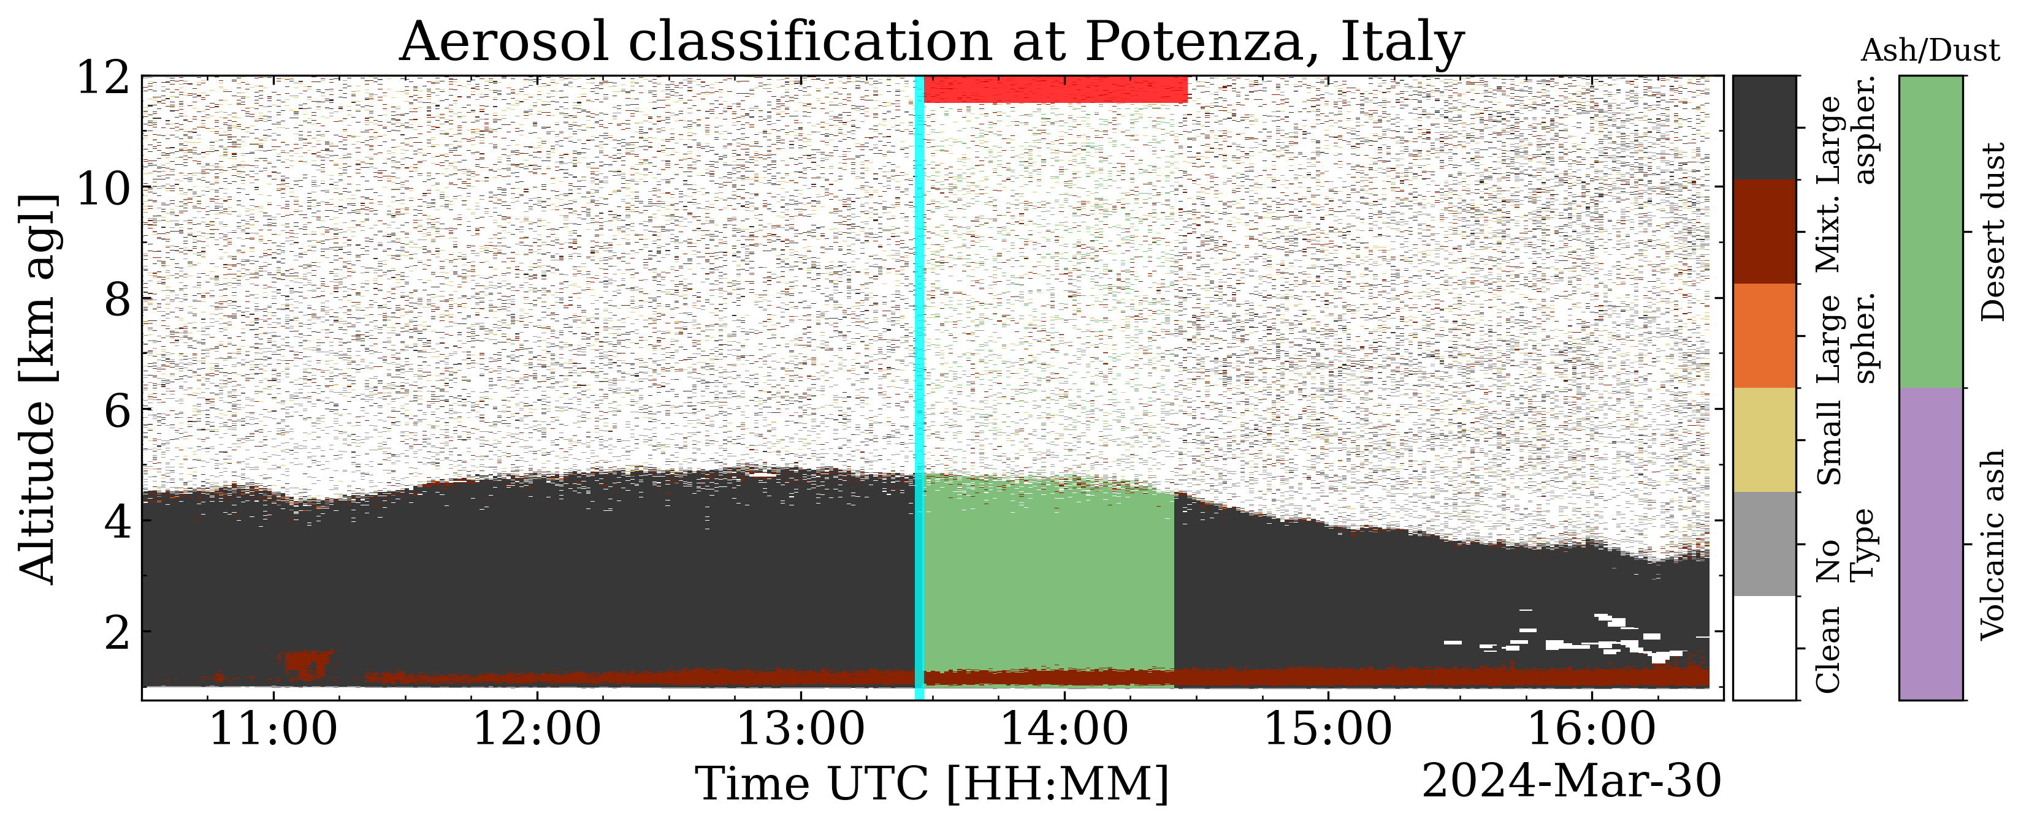
Application on lidar aerosol typing frameworks
Activity linked to ITINERIS Task 4.11
Methods and codes were fine-tuned during the campaign of Task 4.12
2 aerosol typing products are hosted in a post processing dedicated server and are routinely provided
AERONET
1-h

Slide 6
Conclusions (so far)
This approach
provides a promising avenue for integrating sun photometer data into aerosol typing frameworks
offers insights into the most discriminative spectral features separating ash from dust.
can/will be applied to lidar-based microphysical properties algorithms
Shows the strength of synergies.
The testing phase is on going (limited to dust cases)

