Slide 1


Experimental activities at ChAMBRe
V. Vernocchi¹
M. Brunoldi^{1, 2}, E. Gatta², M. Irfan², T. Isolabella^{1, 2}, D. Massabò^{1, 2}, F. Mazzei^{1, 2}, F. Parodi¹, P. Prati^{1, 2}
¹Istituto Nazionale di Fisica Nucleare, Sezione di Genova
²Università degli Studi di Genova, Dipartimento di Fisica

Slide 2
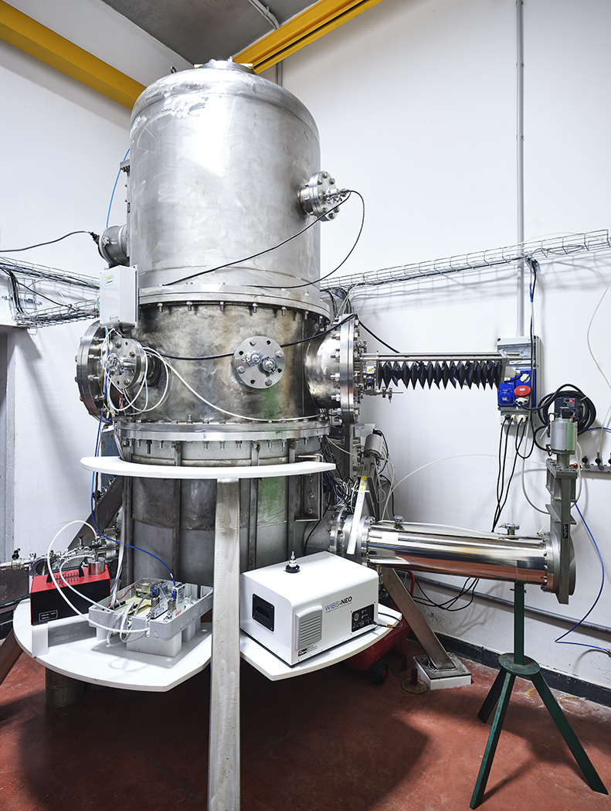

ChAMBRe: Chamber for Aerosol Modelling and Bio-aerosol Research
ChAMBRe ASC is installed at the National Institute of Nuclear Physics in Genoa in collaboration with the Environmental Physics Laboratory at the Physics Department of Genoa University. The facility is part of the ERIC-ACTRIS.
ASC
Study of atmospheric processes under realistic but controlled conditions
Conditions could be and monitored in real time
Volume ≈ 2.3 m³
Stainless steel
Massabò et al., (2018).
Atmos. Meas. Tech., 11, 5885-5900
Facility with high versatility!

Slide 3
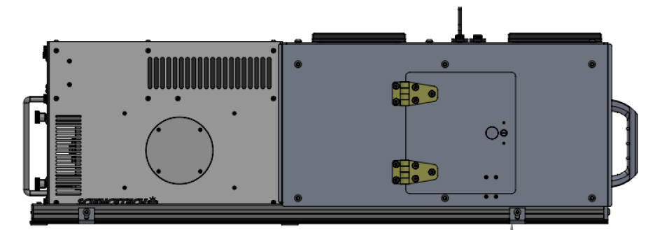
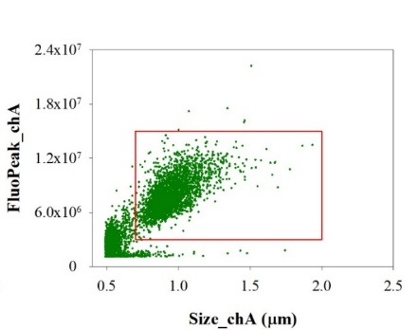
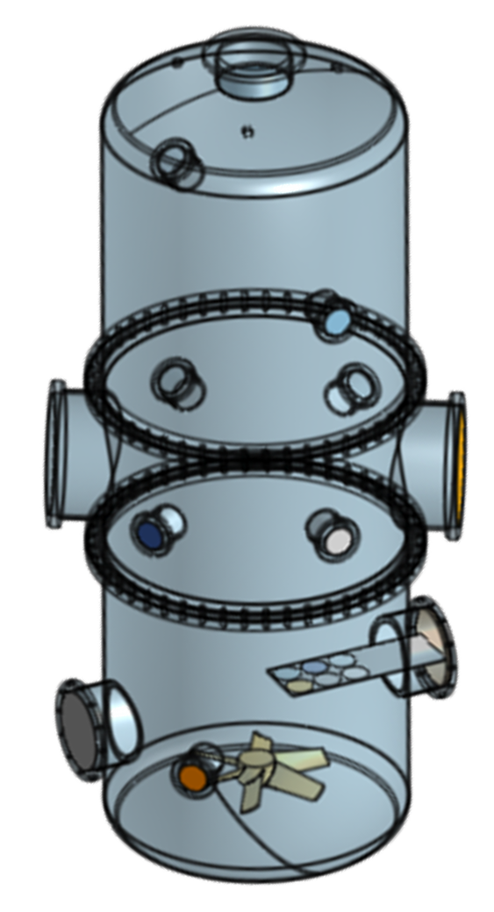
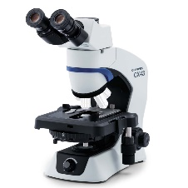
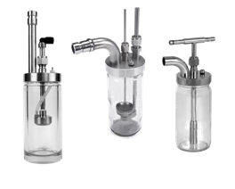
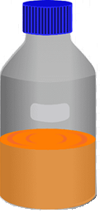
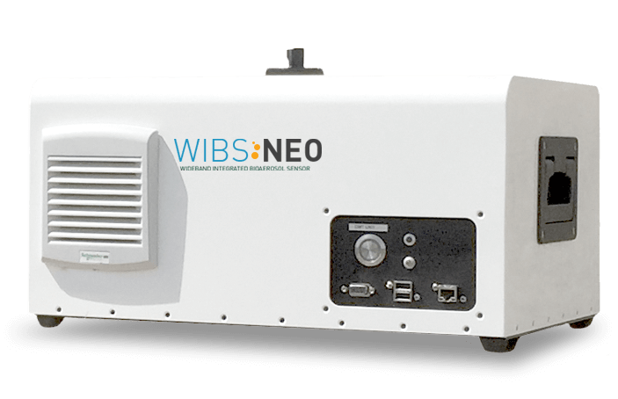
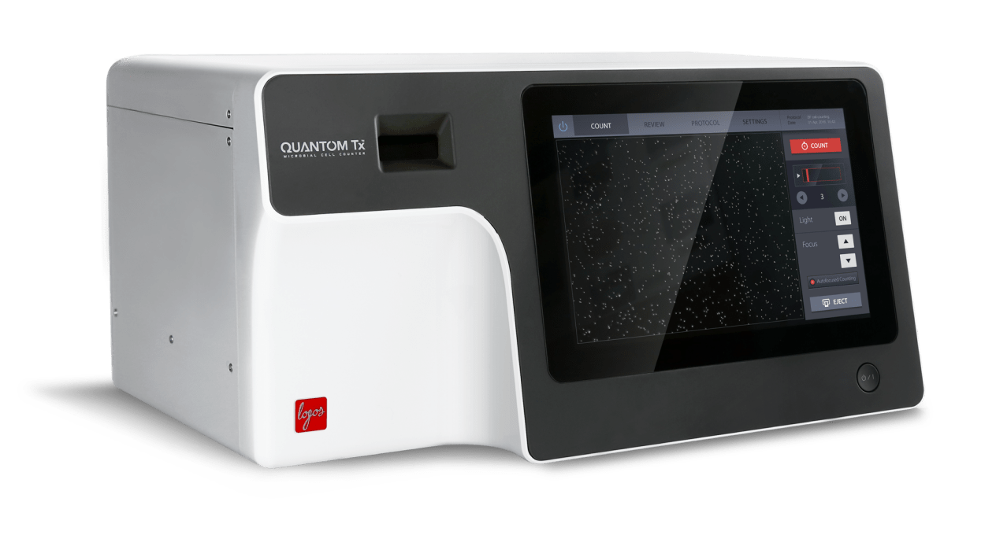
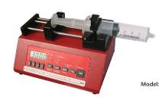
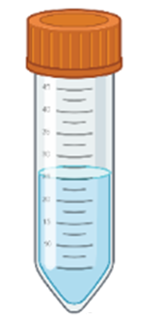
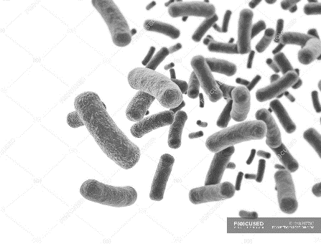
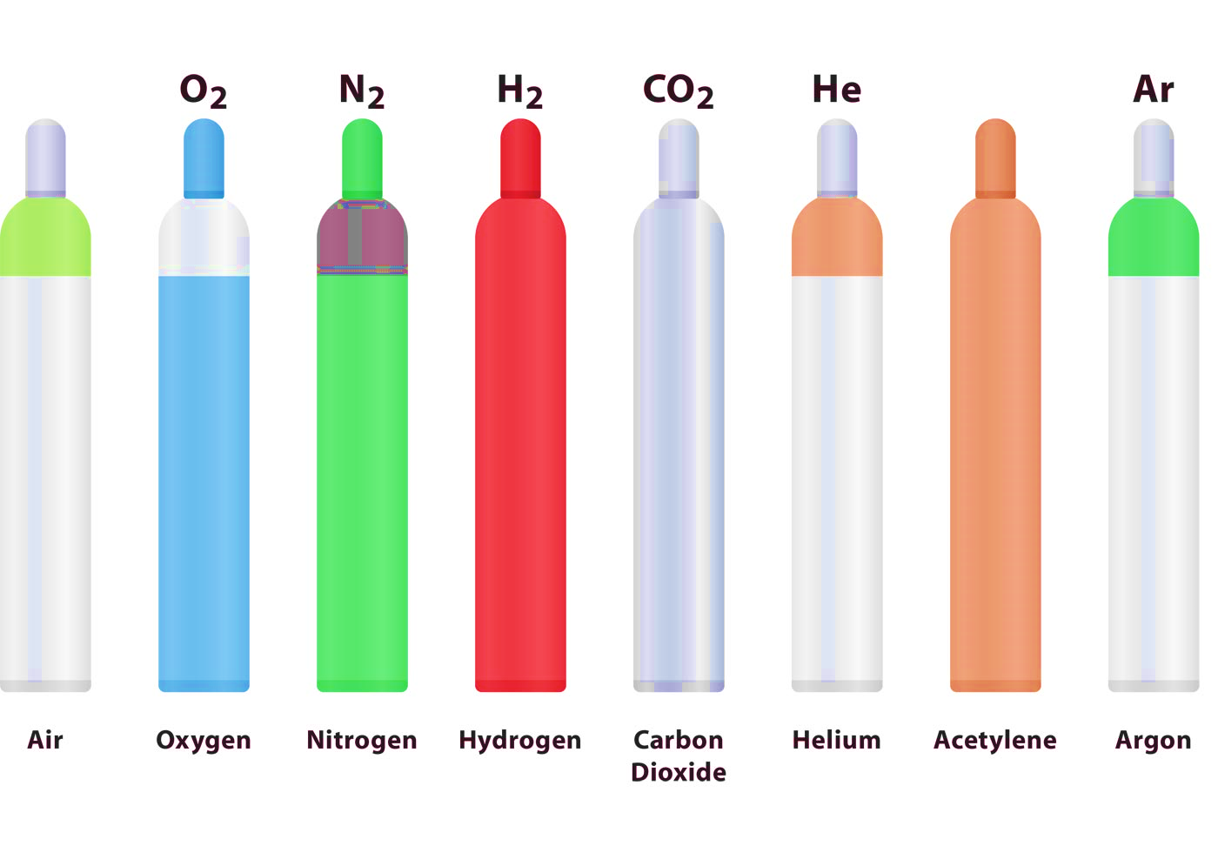
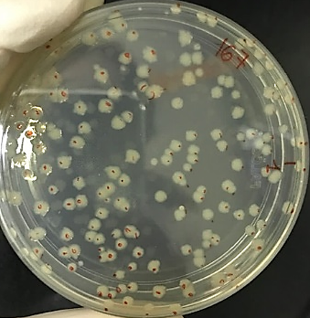
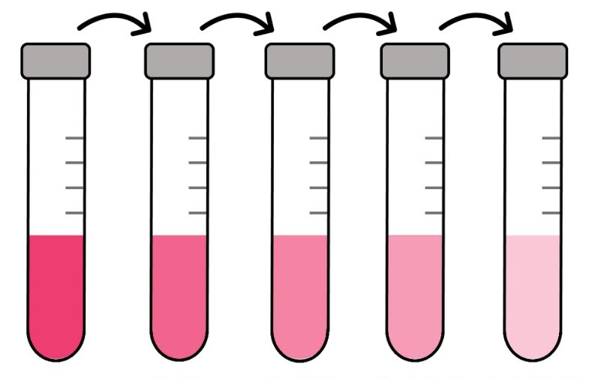
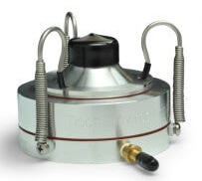

Bioaerosol studies
Bacteria total concentration (time)
Bacteria viable concentration (time)
2 h exposure
NO
NO₂
Impact of air quality on bacteria viability: effects of different atmospheric conditions and/or anthropogenic pollutants (standard-model bacteria)
Vernocchi et al., (2023).
Atmos. Meas. Tech., 16, 5479-5493
Gatta et al., (2025).
Sci. Rep., 15, 10320
28th ITINERIS WP4 meeting | Typing Pilots – 12/06/2025

Slide 4
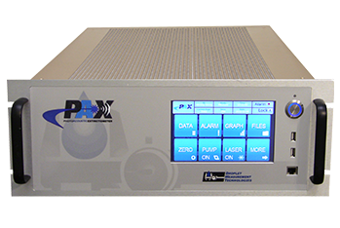
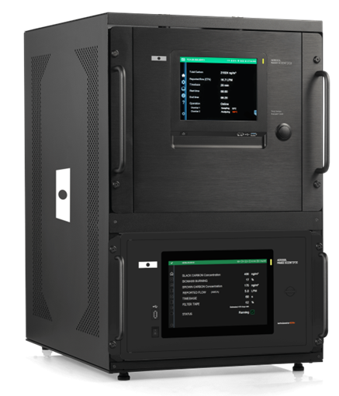

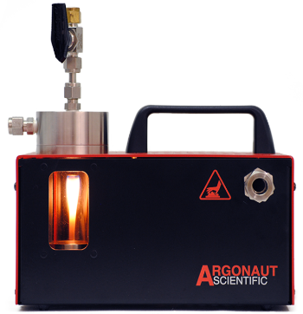
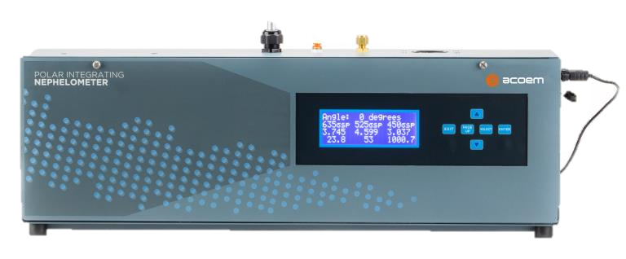
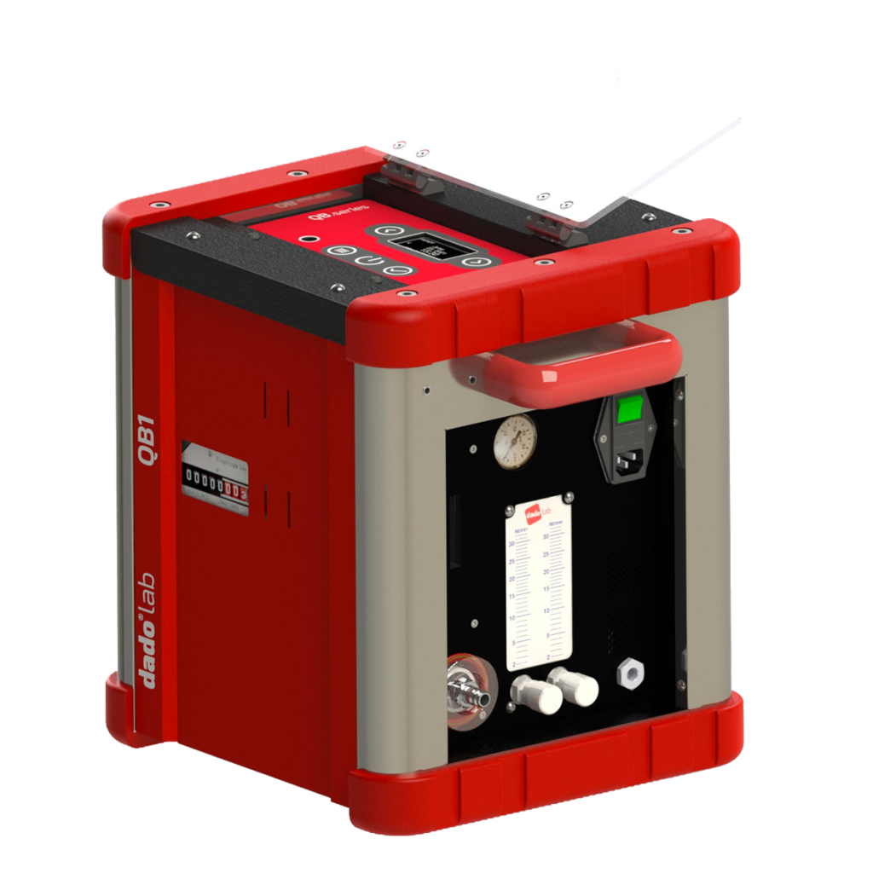
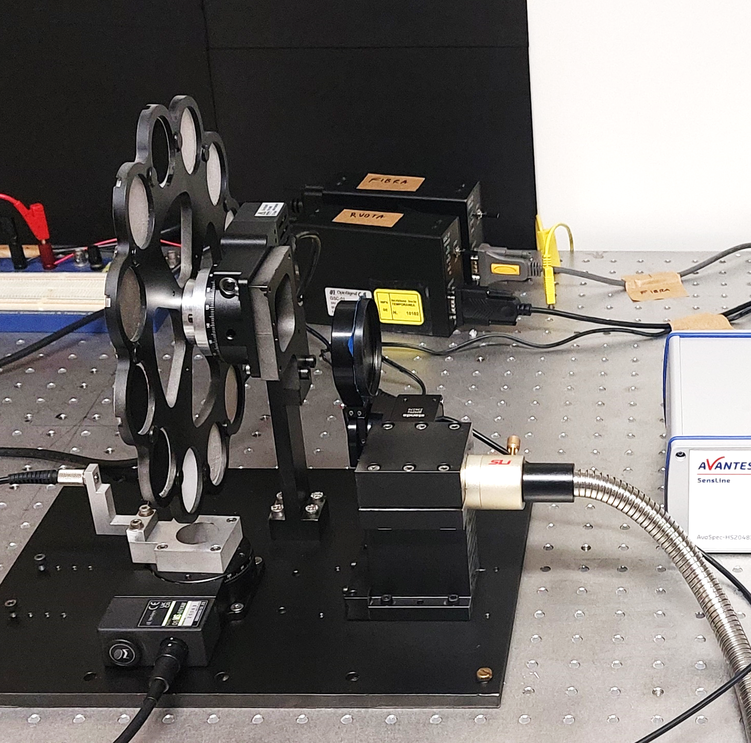
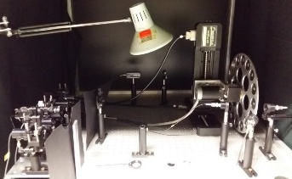
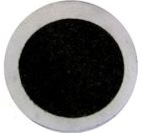
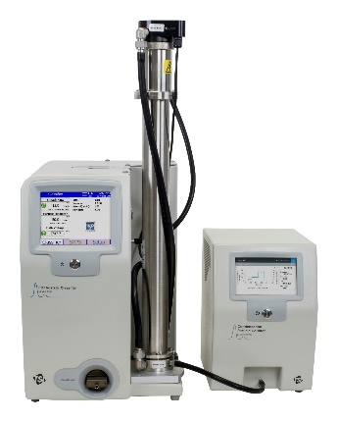
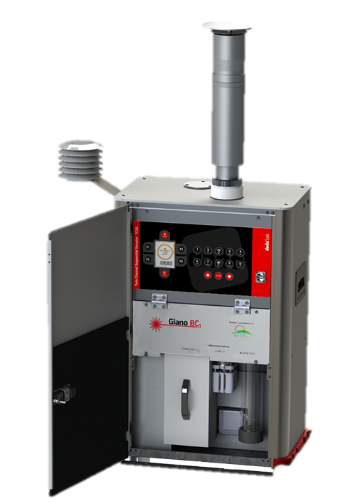
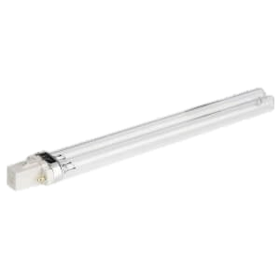
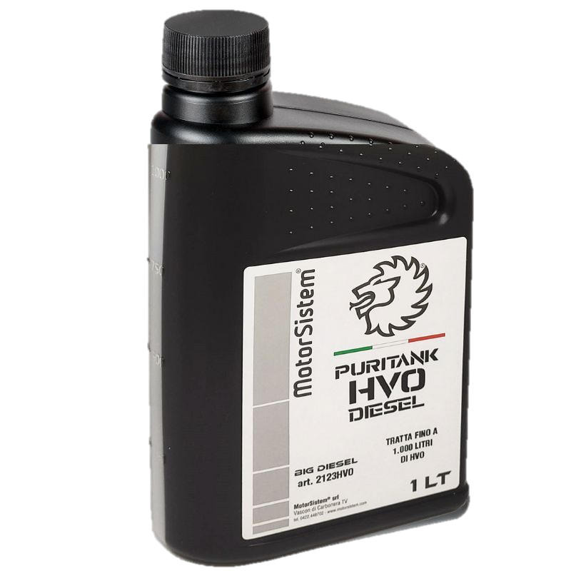
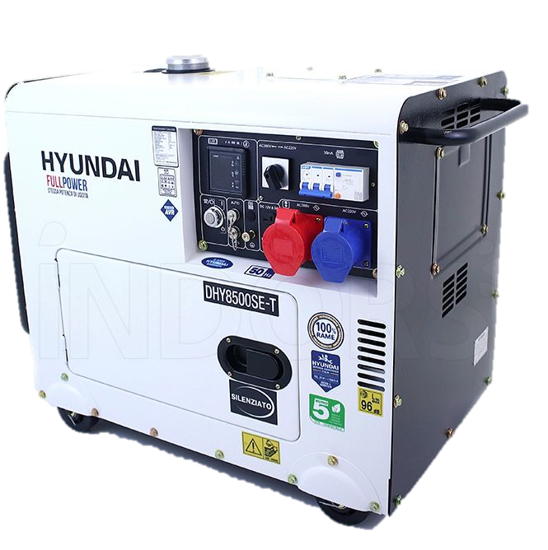
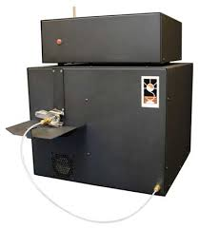
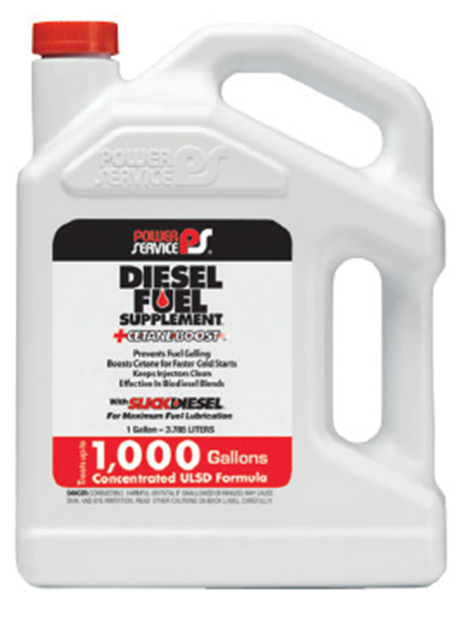
Carbonaceous aerosols
FUEL
Production of “aerosol standards”
AIR
Vernocchi et al., (2022). Atmos. Meas. Tech., 15, 2159-2175
Focus on optical properties
  Test of new instruments (online / offline)
  Comparison of different optical techniques (online / offline)
  Test of models for optical apportionment
AIR
C3H8
Isolabella et al., (2024). Atmos. Meas. Tech., 17, 1363-1373
O₃
Isolabella et al., (2025). Atm. Env., 121341
Comparison of different aerosols
  Combustion of different fuels
  Aging processes
Danelli et al., (2025). Atmos. Chem. Phys., 25, 9387

Slide 5
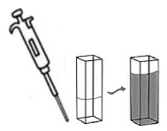

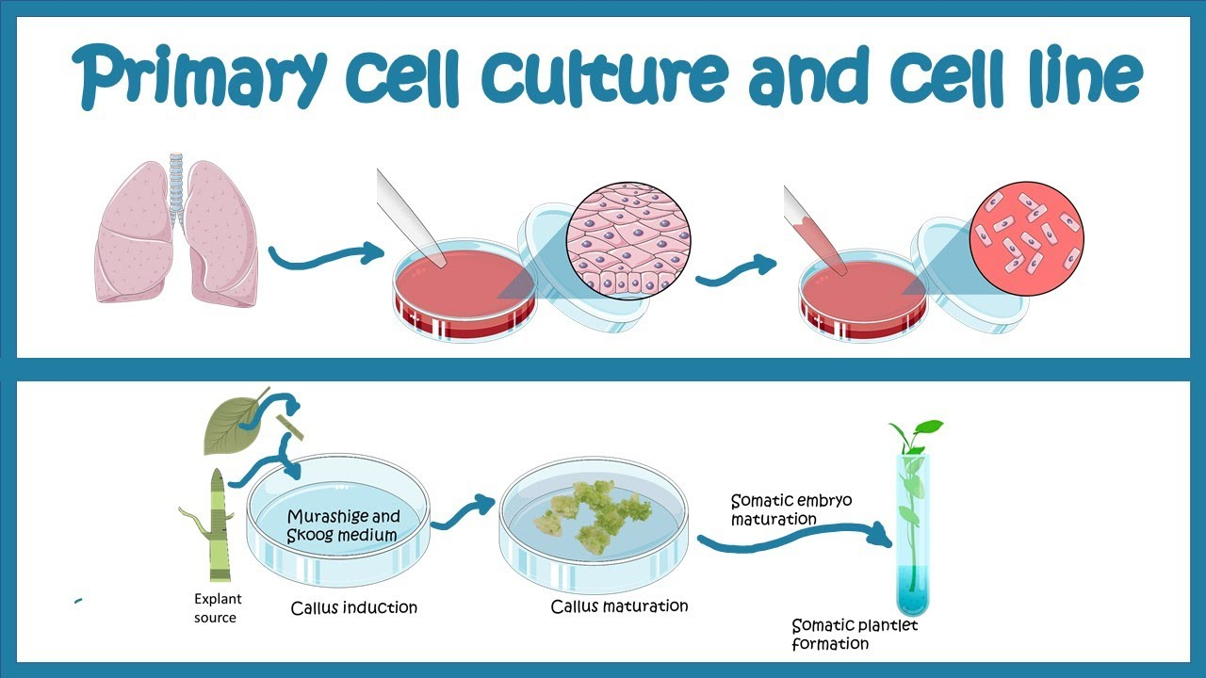
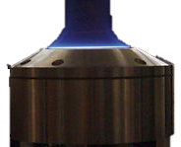
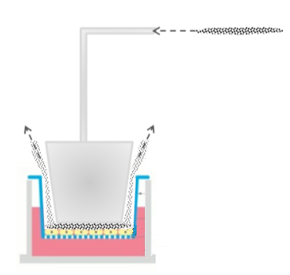
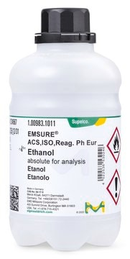
Standard samples for OP and Toxicological assays
RHAPS Collaboration
AIR
C3H8
OP
WINTER, BB emissions
SUMMER, TRAFFIC emissions
Cytotoxicity
Genotoxicity
Oxidative stress
Vernocchi et al., (2025).
Toxicol. Appl. Pharmacol, 505, 117573
O₃
Particles characterization by ChAMBRe instruments
AIR
C2H4
IT-BEST Collaboration
ULTRAFINE particles
Aging processes
Compare fossil fuels and biofuels blends emissions
Cells inflammatory response
Cells Oxidative stress

Slide 6
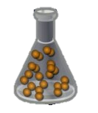
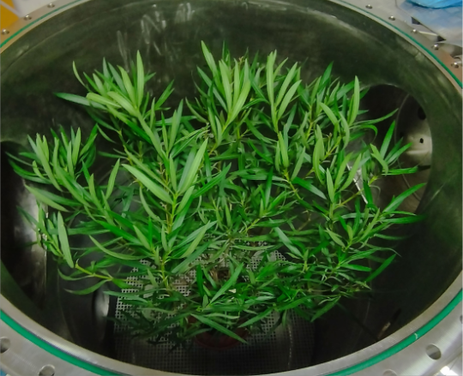



Plants interactions with airborne pollutants
NO₂ consumption
Capacity to capture airborne PM
NO₂
Bosio et al., (2025).
Atm. Env. X, 27, 100355
N. oleander
M. communis
T. baccata
SALPIAM Collaboration

Slide 7
ITINERIS-access to ChAMBRe
Multidisciplinary!
MICRObial adaptations and Antimicrobial Resistance Genes in the ocean-atmOsphere continuum - MICROARGO
Bioaerosols’ Evaluation And Machine-learning – BEAM
Toxicological hazard assessment of combustion emission under different aging processes by direct exposure of lung in vitro models at the air liquid interface - Tox-CEAPs
Characterization of Aerosols Emitted by the Burning of Textile Waste in Atacama and their Relevance to Air Quality - ATEXAQ
Single scattering albedo and asymmetry PARameter retrieval by photometric Analysis of atmospheric aerosol deposited on filters - SPARA
Degradation of Benzothiazoles: From Urban to Polar Atmosphere Conditions - UPAC-BTH
Calibration at varying relative humidity of the ACSM – CINEMA

Slide 8
vvernocchi@ge.infn.it

Slide 9

Bioaerosol studies
$$C\left(t\right)=C_{0}e^{−\frac{t}{\tilde{i}}}$$
Lifetime [min]
Bacteria | Baseline | NO 900 ppb | NO 1200 ppb | NO₂ 900 ppb | NO₂ 1200 ppb | Baseline dark | Light
E. coli | 31 ± 3 | 32 ± 1 | 21 ± 2 | 21.8 ± 0.5 | 10 ± 2 | 31 ± 3 | 6.0 ± 0.5
B. subtilis | 36 ± 4 | 37 ± 6 | 29 ± 4 | 14 ± 3 | 17 ± 2 | 36 ± 4 | 9 ± 2
P. fluorescens | 19 ± 1 | 14 ± 3 | 14 ± 2 | 6 ± 1 | 6 ± 1 | 19 ± 1 | 1.6 ± 0.1
Vernocchi et al., (2023). Atmos. Meas. Tech., 16, 5479-5493
Gatta et al., (2025). Sci. Rep., 15, 10320
ITINERIS 3rd general meeting – Rome, 25-26/092025

Slide 10
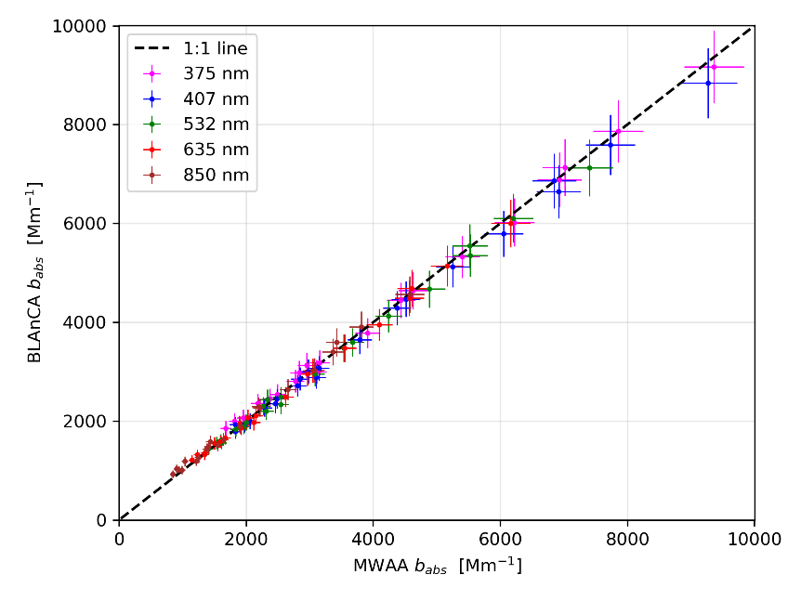
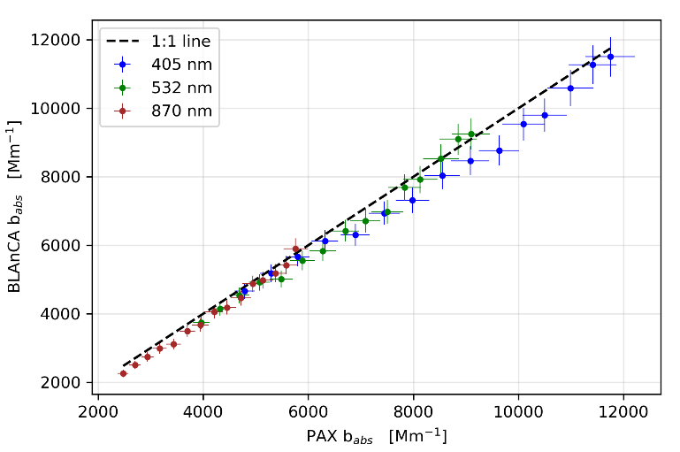
Test of new instrument
Broadband
Light
Analyzer of
Complex
Aerosol
Measure aerosol light absorption: from 375 to 1000 nm, with a 5 nm resolution
Automatic laboratory instrument for offline measurement of aerosol collected on suitable media
Comparison with validated instruments:
  MWAA (λ = 375, 407, 532, 635, 850 nm)
  PAXs (λ = 405, 532, 870 nm)
Isolabella et al., (2023)
Il Nuovo Cimento C, 46
Isolabella et al., (2025).
Atm. Env., 121341
ITINERIS 3rd general meeting – Rome, 25-26/092025

Slide 11

Carbonaceous aerosols produced by the combustion of different fuels
Carbonaceous composition
 | Propane - MISG | Diesel - Hyundai | HVO - Hyundai
EC:TC | 0.7 ± 0.1 | 0.15 ± 0.05 | 0.4 ± 0.2
Danelli et al., (2025).
Atmos. Chem. Phys., 25, 9387
Mass Absorption Coefficient
Instrument | Wavelength | Propane - MISG | Diesel - Hyundai | HVO - Hyundai
MWAA | 635 nm | 6.1 ± 0.2 | 9.4 ± 0.3 | 8.0 ± 0.3
Giano_BC1 | 635 nm | 8 ± 1 | 9.4 ± 0.4 | 8.4 ± 0.6
MWAA | 850 nm | 5.2 ± 0.5 | 6.8 ± 0.2 | 6.0 ± 0.3
PAX | 870 nm | 5.5 ± 0.1 | 6.2 ± 0.5 | 5.8 ± 0.2
𝑏_{𝑎𝑏𝑠} = 𝑀𝐴𝐶 × [𝐸𝐶]
b_{abs} (Mm⁻¹)
EC (µg m⁻³)
MAC (m² g⁻¹)
Absorption coefficients - online (7 λ)
$$b_{abs}∝λ^{−AAE}$$
Diesel | Diesel + Solar | Diesel + O₃
1.10 | 1.15 | 1.18
HVO | HVO + Solar | HVO + O₃
1.02 | 0.91 | 1.06
ITINERIS 3rd general meeting – Rome, 25-26/092025

Slide 12

Standard samples for OP and Toxicological assays
RHAPS Collaboration
WINTER – BB emissions
SUMMER – TRAFFIC emissions
BC, dark condition
BC + NO₂ + O₃, Dark
BC + NO₂ + O₃ + ammonium nitrate, Dark
BC + NO₂ + O₃ + 2,5-dimethylfuran, Dark
BC + NO₂ + O₃ + ammonium nitrate + 2,5-dimethylfuran, Dark
BC + solar radiation (light condition)
BC + HONO, Light
BC + HONO + ammonium sulphate, Light
BC + HONO + toluene, Light
Traffic component, particularly under light conditions and in the presence of HONO and toluene, exhibited high OP and induced significant biological responses.
Ammonium sulfate appeared to modulate effects, sometimes reducing the OP and most of the assessed toxicological parameters.
Results
Vernocchi et al., (2025).
Toxicol. Appl. Pharmacol, 505, 117573
IT-BEST Collaboration
Particle sources | Aging processes
Ethylene | No aging | Solar radiation | O₃
Ethylene + 20% Ethanol
Analysis
In progress
ITINERIS 3rd general meeting – Rome, 25-26/092025

Slide 13
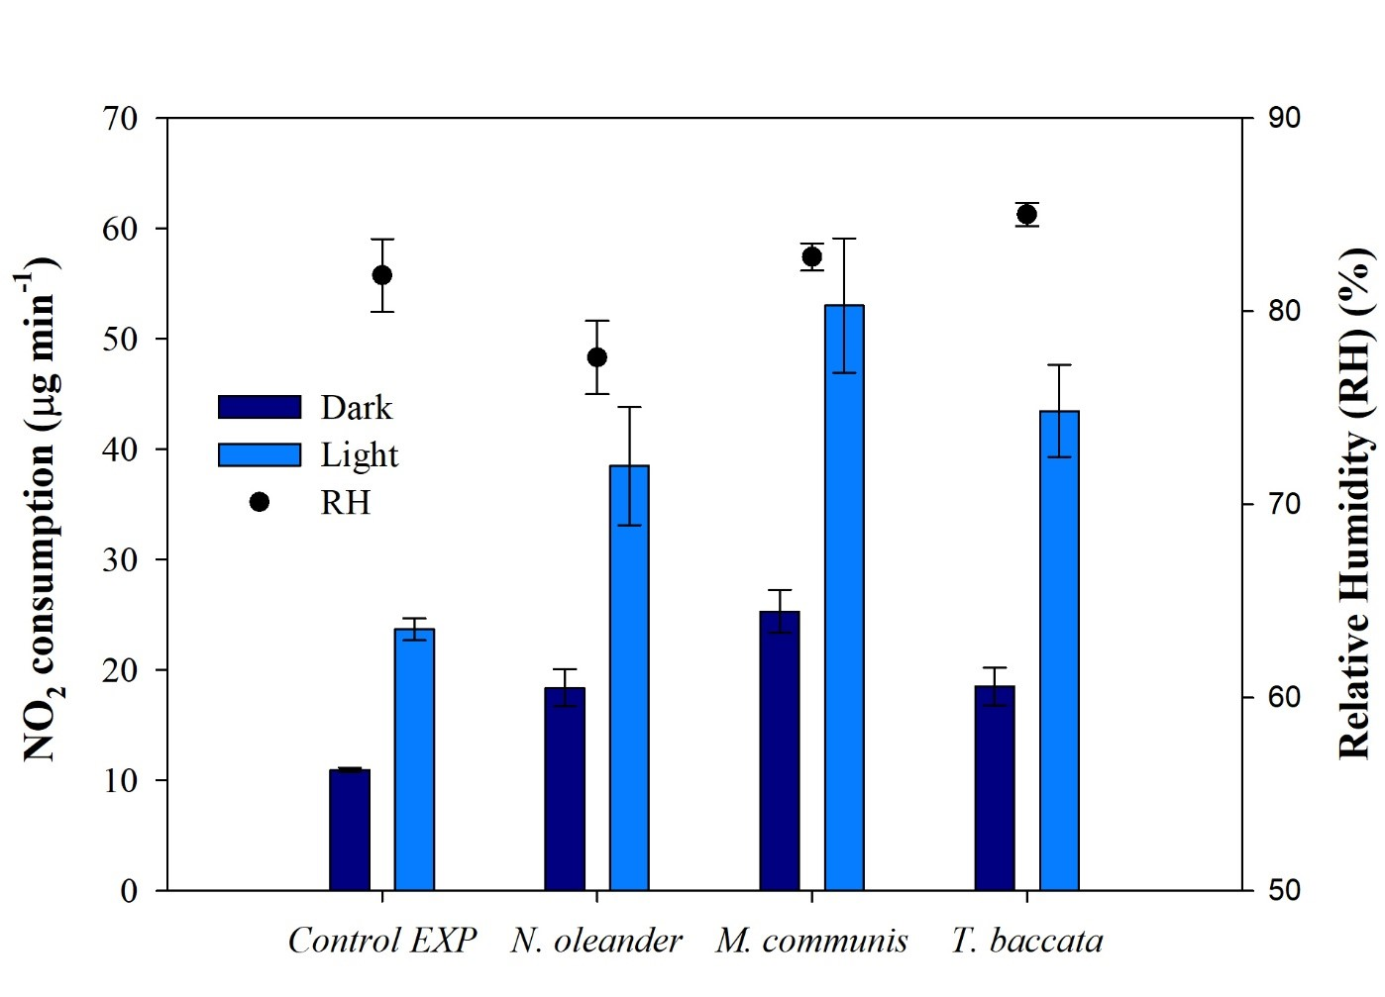
Plants interactions with airborne pollutants
% of capture efficiency relative to the lowest value for each pollutant
Bosio et al., (2025).
Atm. Env. X, 27, 100355
NO₂ consumption during light time: influence of photosynthesis
Species-specific differences in the capacity to capture airborne particulate matter
ITINERIS 3rd general meeting – Rome, 25-26/092025

