Slide 1
A lifetime effort at Cimone to understand the black carbon climatology though observations and modelling
M. Zanatta1, P. Bonasoni1, P. Cristofanelli1, S. Eckhardt2, N. Evangeliou2, C. Magnani1, D. Putero1, L. Renzi1, F. Vogel 1, and A. Marinoni1
1Institute of Atmospheric Sciences and Climate – National Research Council of Italy, Bologna, Italy, 2Norwegian Institute for Air Research (NILU), Kjeller, Norway
Email of communicating author m.zanatta@isac.cnr.it

Slide 2
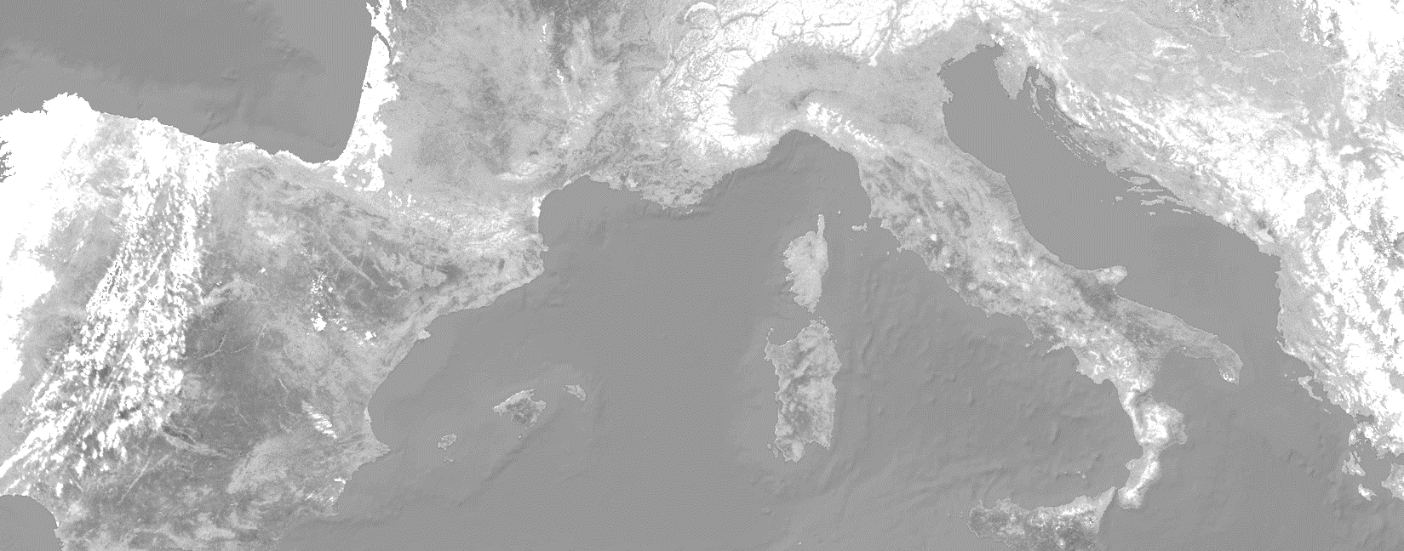
Merging 20 years of observations with modelling
Black carbon concentration
Black carbon sources
Atmospheric dynamics
Mt. Cimone observations
FLEXPART model
Anthropogenic vs natural
ERA5
Height of the boundary layer

Slide 3
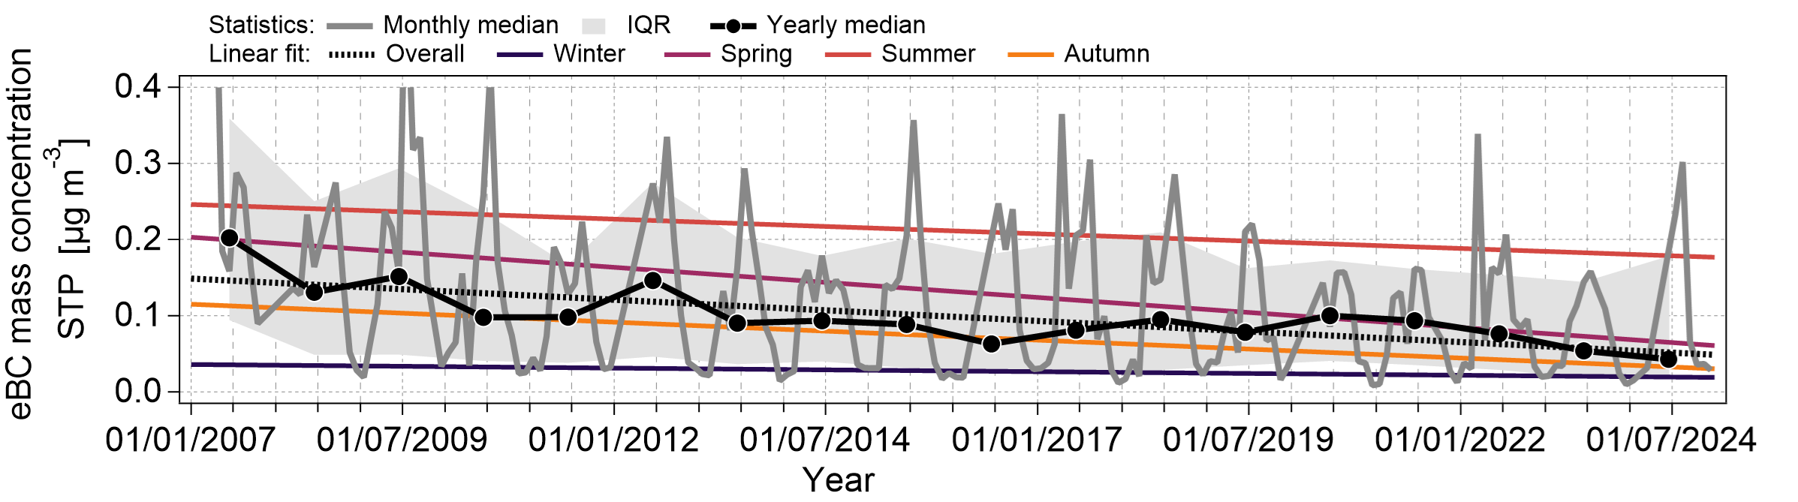
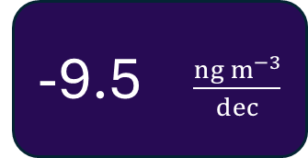
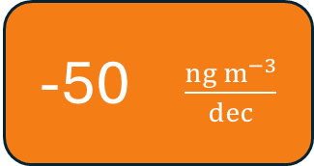
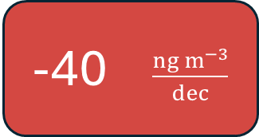
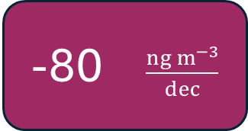
BC decreasing trend from observations
Winter
Spring
Summer
Autumn
-9.5 $\frac{ng m^{−3}}{dec}$
-80 $\frac{ng m^{−3}}{dec}$
-40 $\frac{ng m^{−3}}{dec}$
-50 $\frac{ng m^{−3}}{dec}$

Slide 4
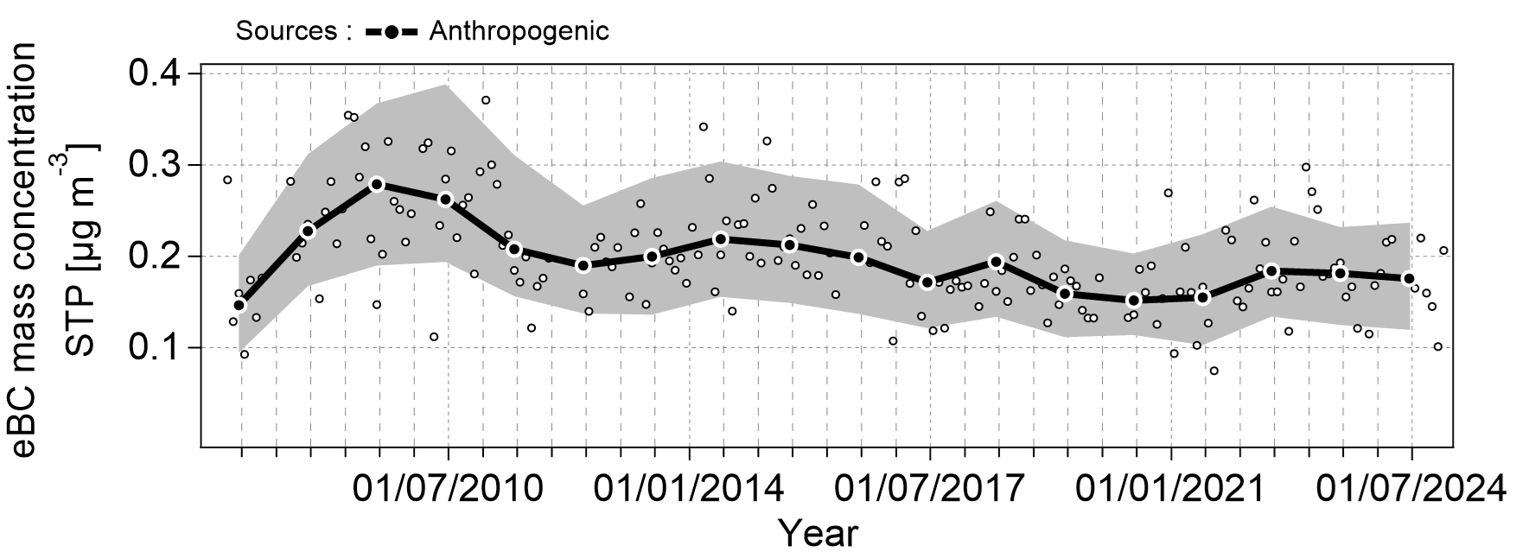
Anthropogenic decreasing trend from FLEXPART

Slide 5
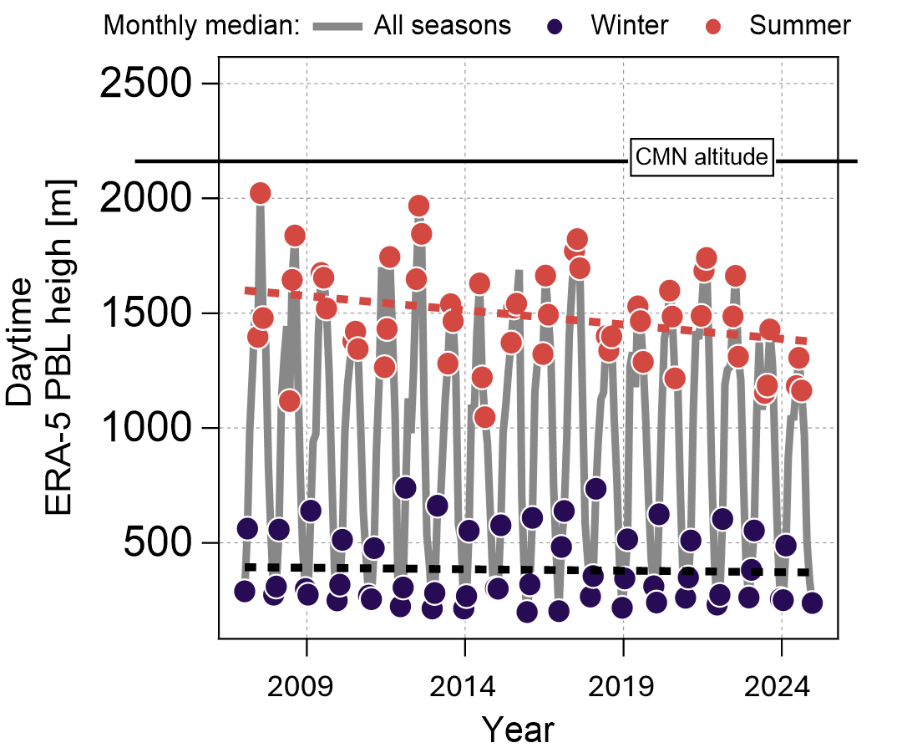
FLEXPART sensitivity to atmospheric dynamics
FLEXPART overestimation compared to observations
+11 %
Summer
+865 %
Winter

Slide 7



Black carbon aerosol (BC) in a nutshell
BC properties
BC sources
BC properties
Human
Natural
Light absorber
Short-lived
Revision of BC effective radiative forcing (aerosol radiation interaction)
Emission decrease
Absorption parametrization
0.60
W m⁻²
-76%
0.14
W m⁻²
IPCC-R5
(1750-2011)
IPCC-AR6
(1750-2019)
Contribution from ACTRIS based studies

