Slide 1
Aerosol Characterization Through Combined Depolarization and Fluorescence Lidar Observations at CIAO
Benedetto De Rosa¹, Aldo Amodeo¹, Donato Summa¹, Giuseppe D'Amico¹, Jens Reichardt²,Michail Mytilinaios¹, Nikolaos Papagiannopulos¹,Lucia Mona¹

Slide 2
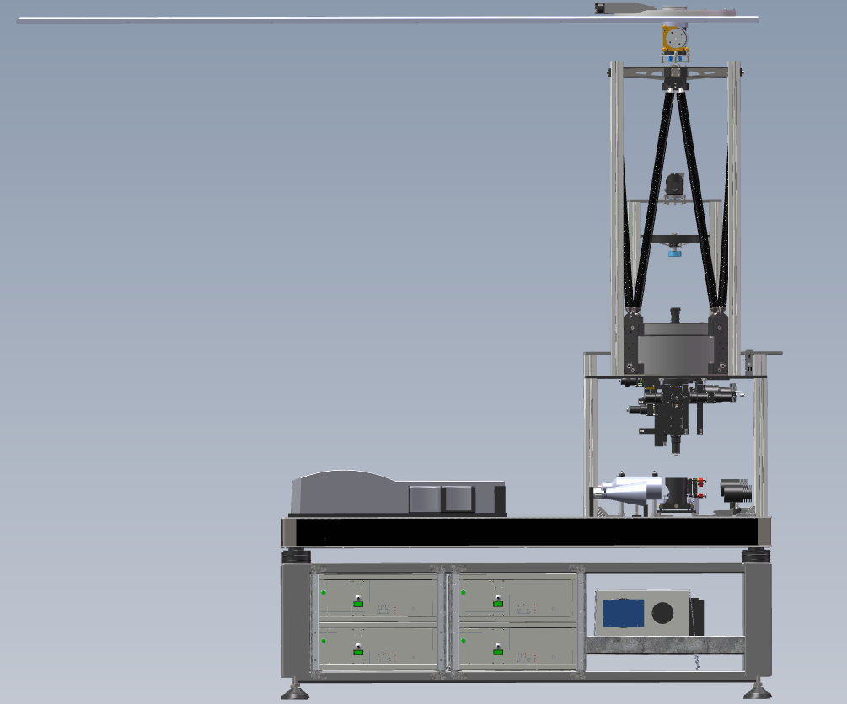
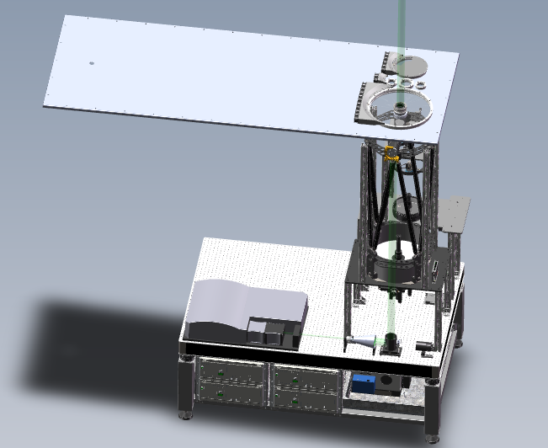
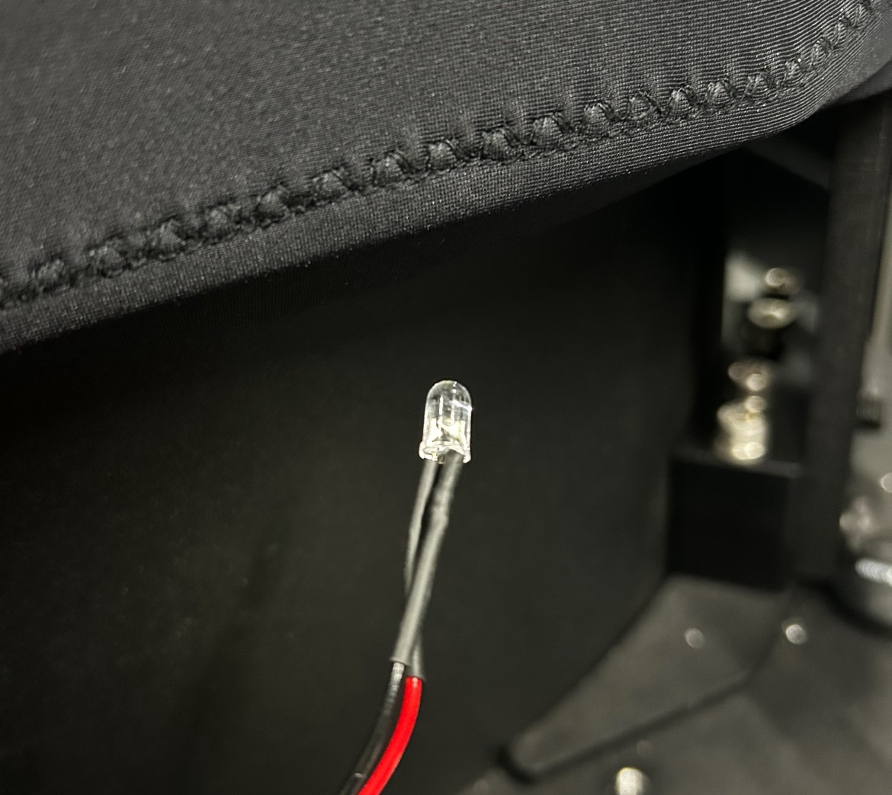
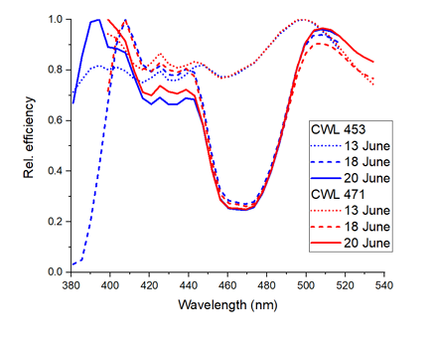
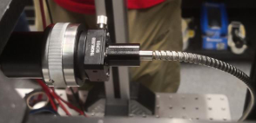
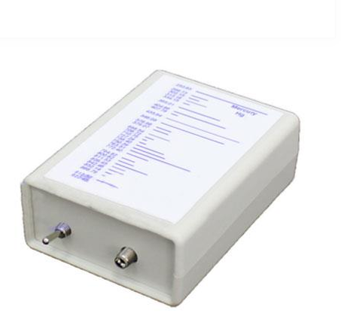
Fluorescence measurements at CIAO observatory
Relative calibration
3 LEDs calibrated at DWD
ITINERIS TNA Project – “Aerosol Fluorescence Characterization at CIAO Observatory”by Jens Reichard DWD: enabled system tuning and scientific application.
CIAO Observatory: long-standing expertise in aerosol characterization with advanced Raman lidar. Now POLPO is one of reference systems in ACTRIS (depolarization at 355–532–1064 nm), Now uniquely combining calibrated spectrometric fluorescence with multi-wavelength Raman lidar
Fluorescence Lidar measurements adding a new dimension in aerosol characterization
Offers unique advantages in detecting and analyzing aerosols beyond the capability of conventional lidar methods.
Lidar laboratory at CIAO: operational since 2023, allows for the implementation of various experimental lidar configurations.
Three different gratings are currently available:
(1) 300 gr/mm: this grating provides a bandpass of about 130 nm, e.g., 380 – 510 nm. It is the best choice for fluorescence measurements because it covers a fairly large range of the fluorescence spectrum of atmospheric aerosols.
(2) 1200 gr/mm. The overall bandpass is 28 nm, well suited for water Raman measurements.
(3) 2400 gr/mm. Here the bandpass is about 13 nm, so it could be used for, e. g., quartz Raman measurements. measurements.
Optical fiber with x,y,z translation
Telescope
Classical Cassegranian with 400 mm aperture and F#10
Laser Q-smart 1500
Wavelength 355 nm
Pulse energy > 550 mJ
Beam divergence < 0.25 mrad
Wavelength calibration
Pencil lamp

Slide 3

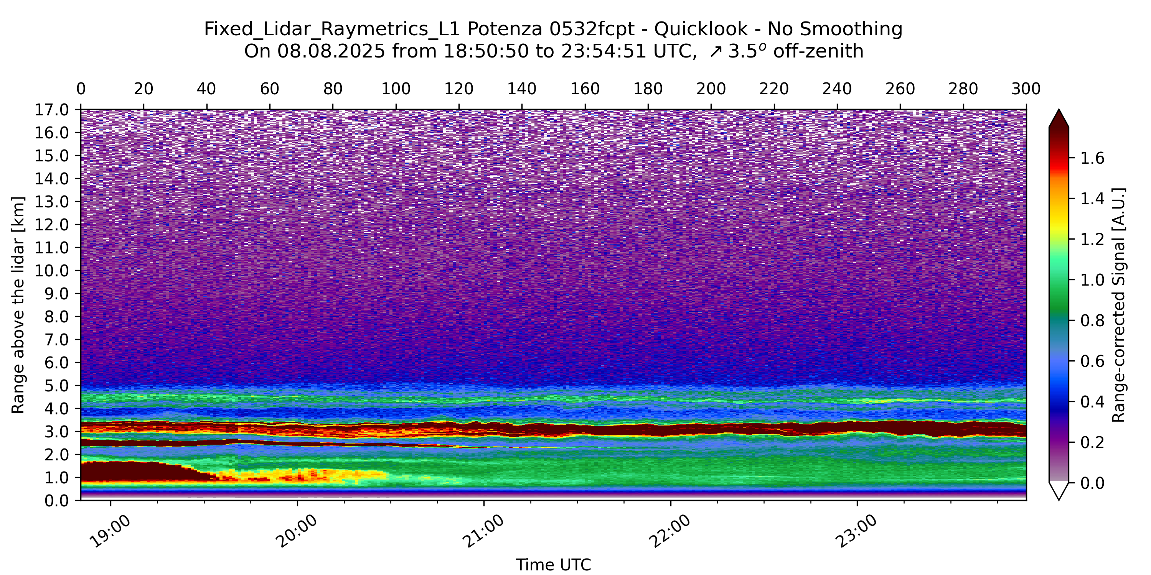
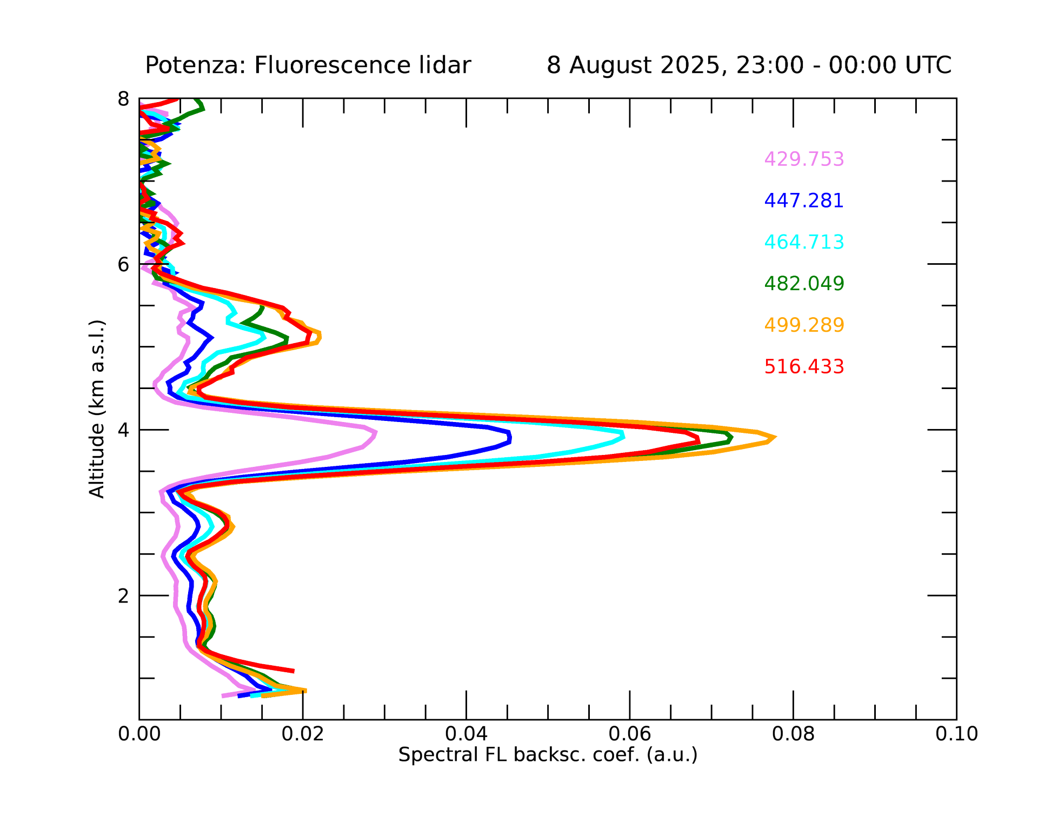
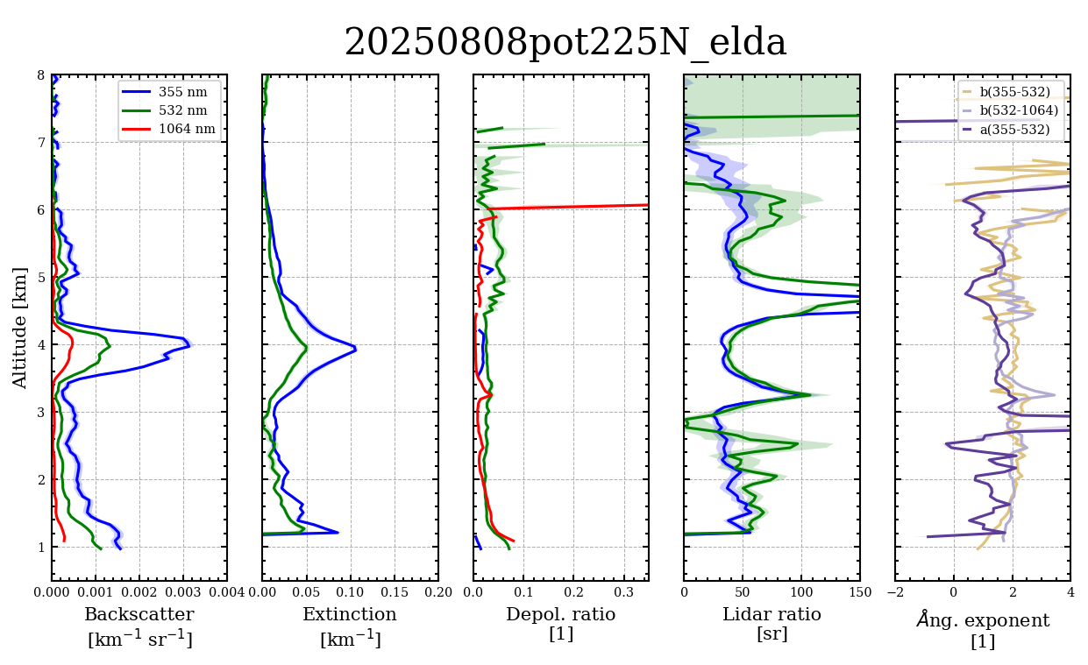
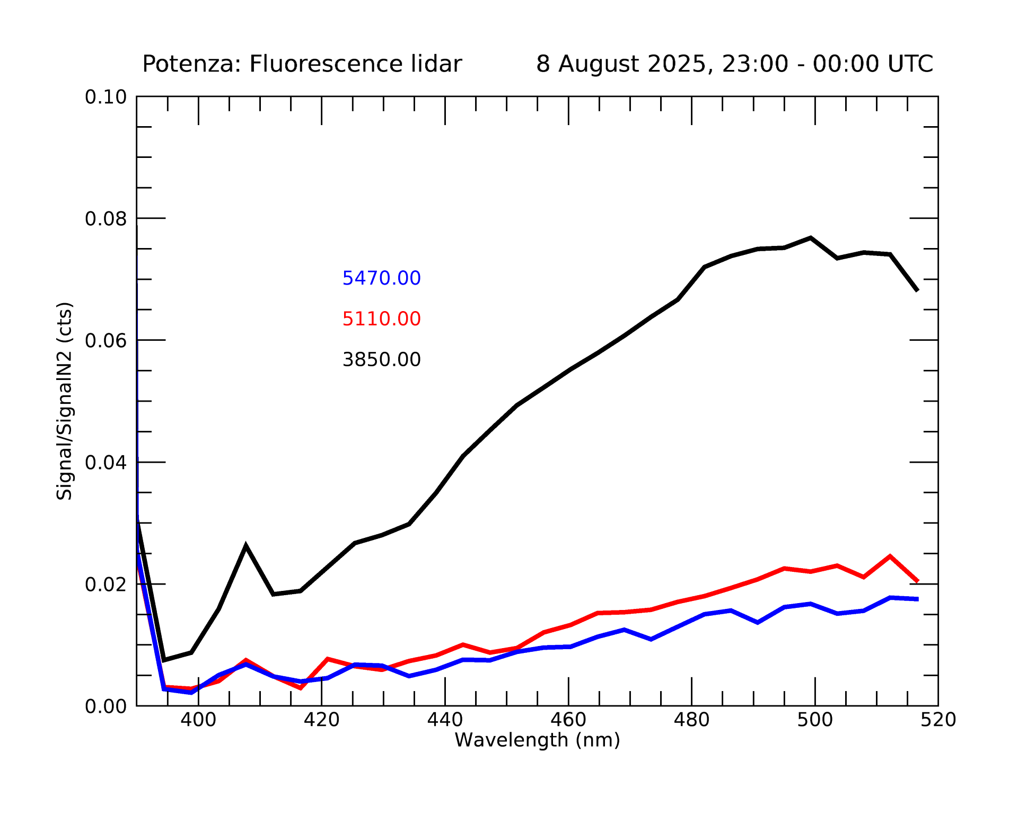
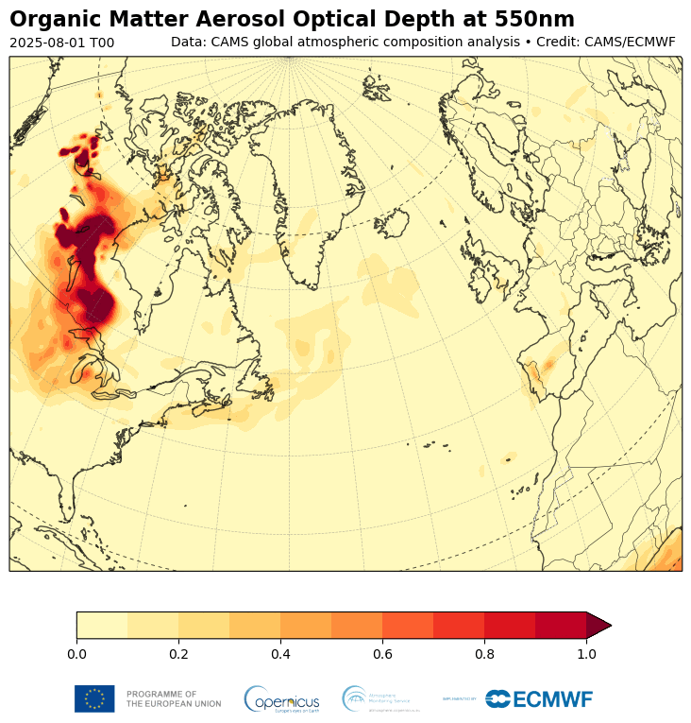
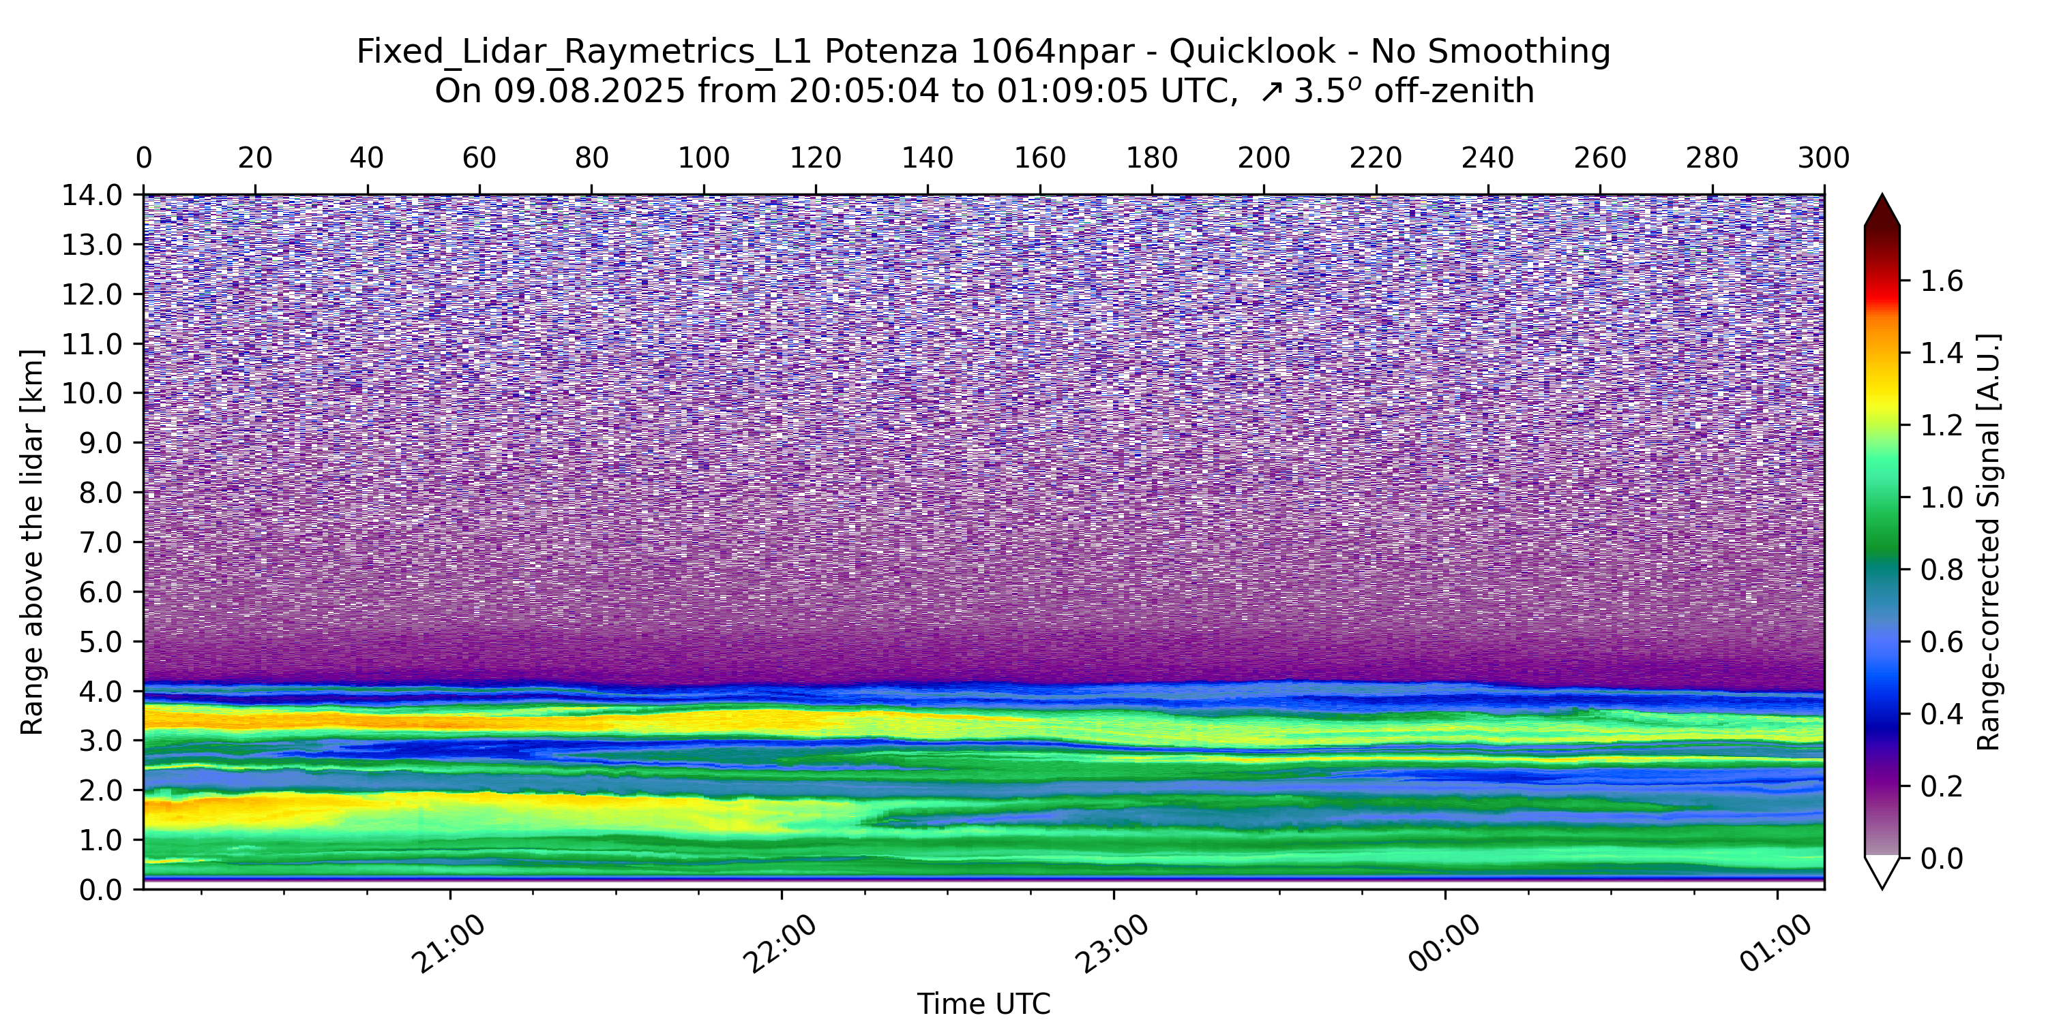
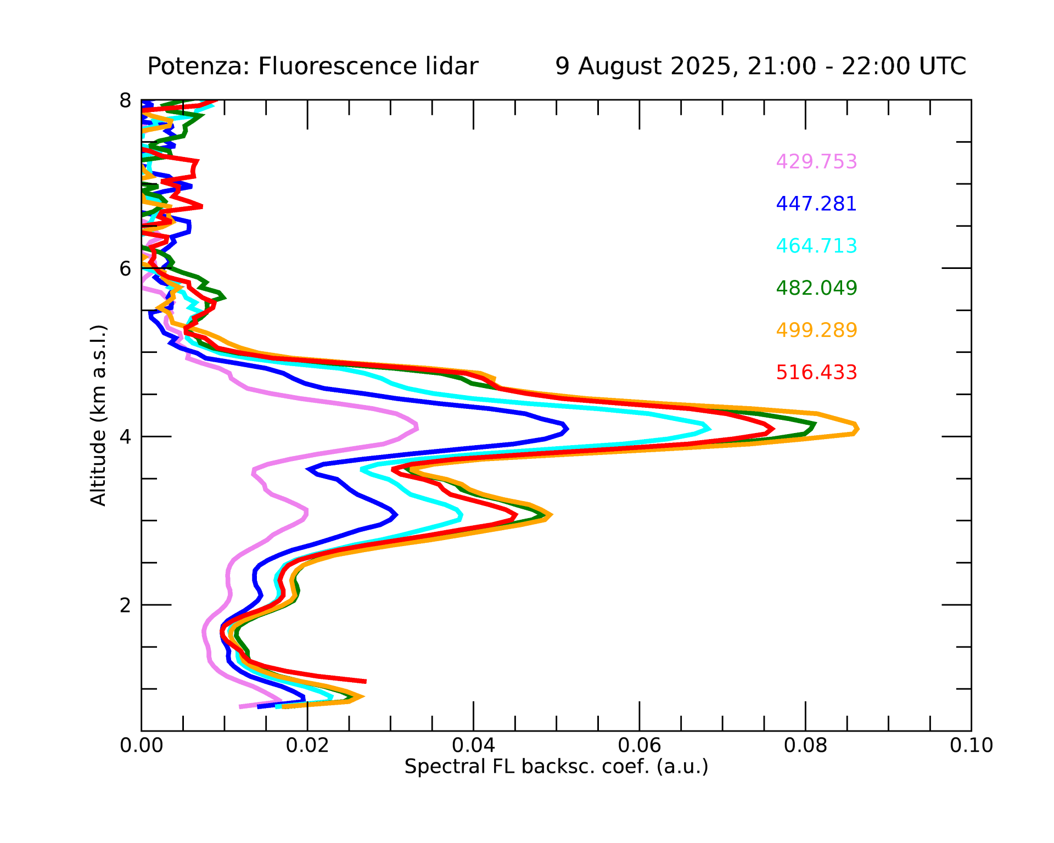
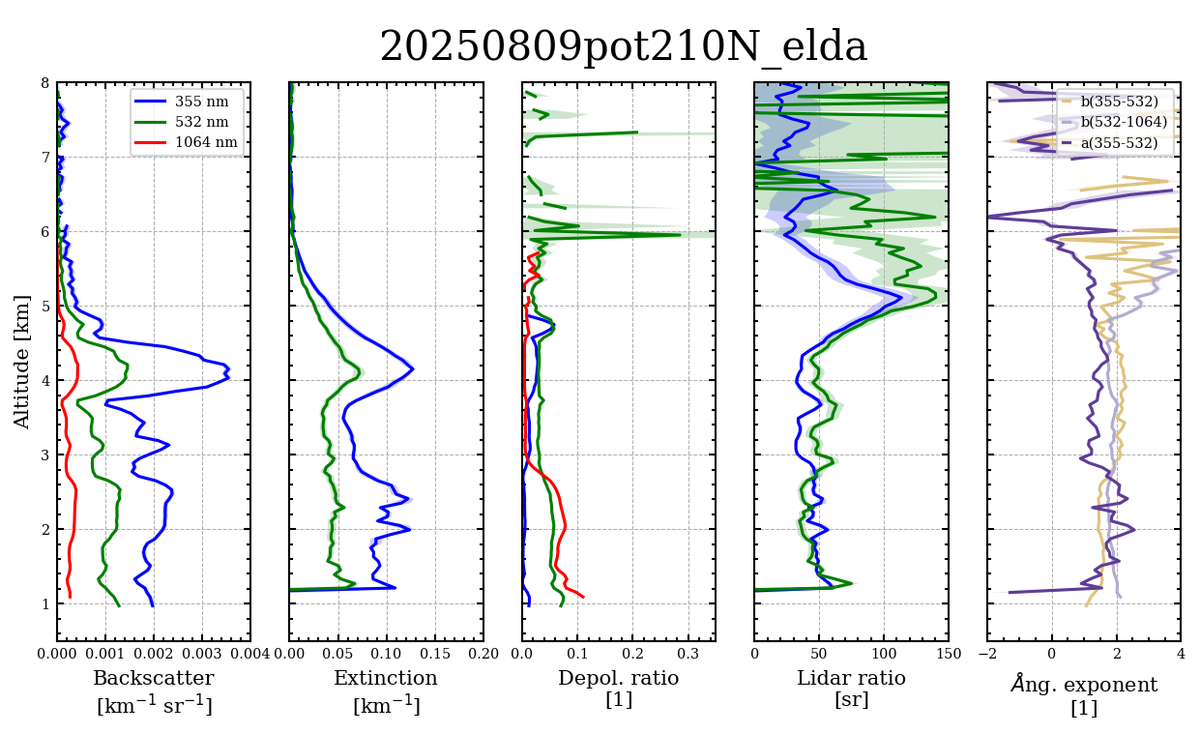
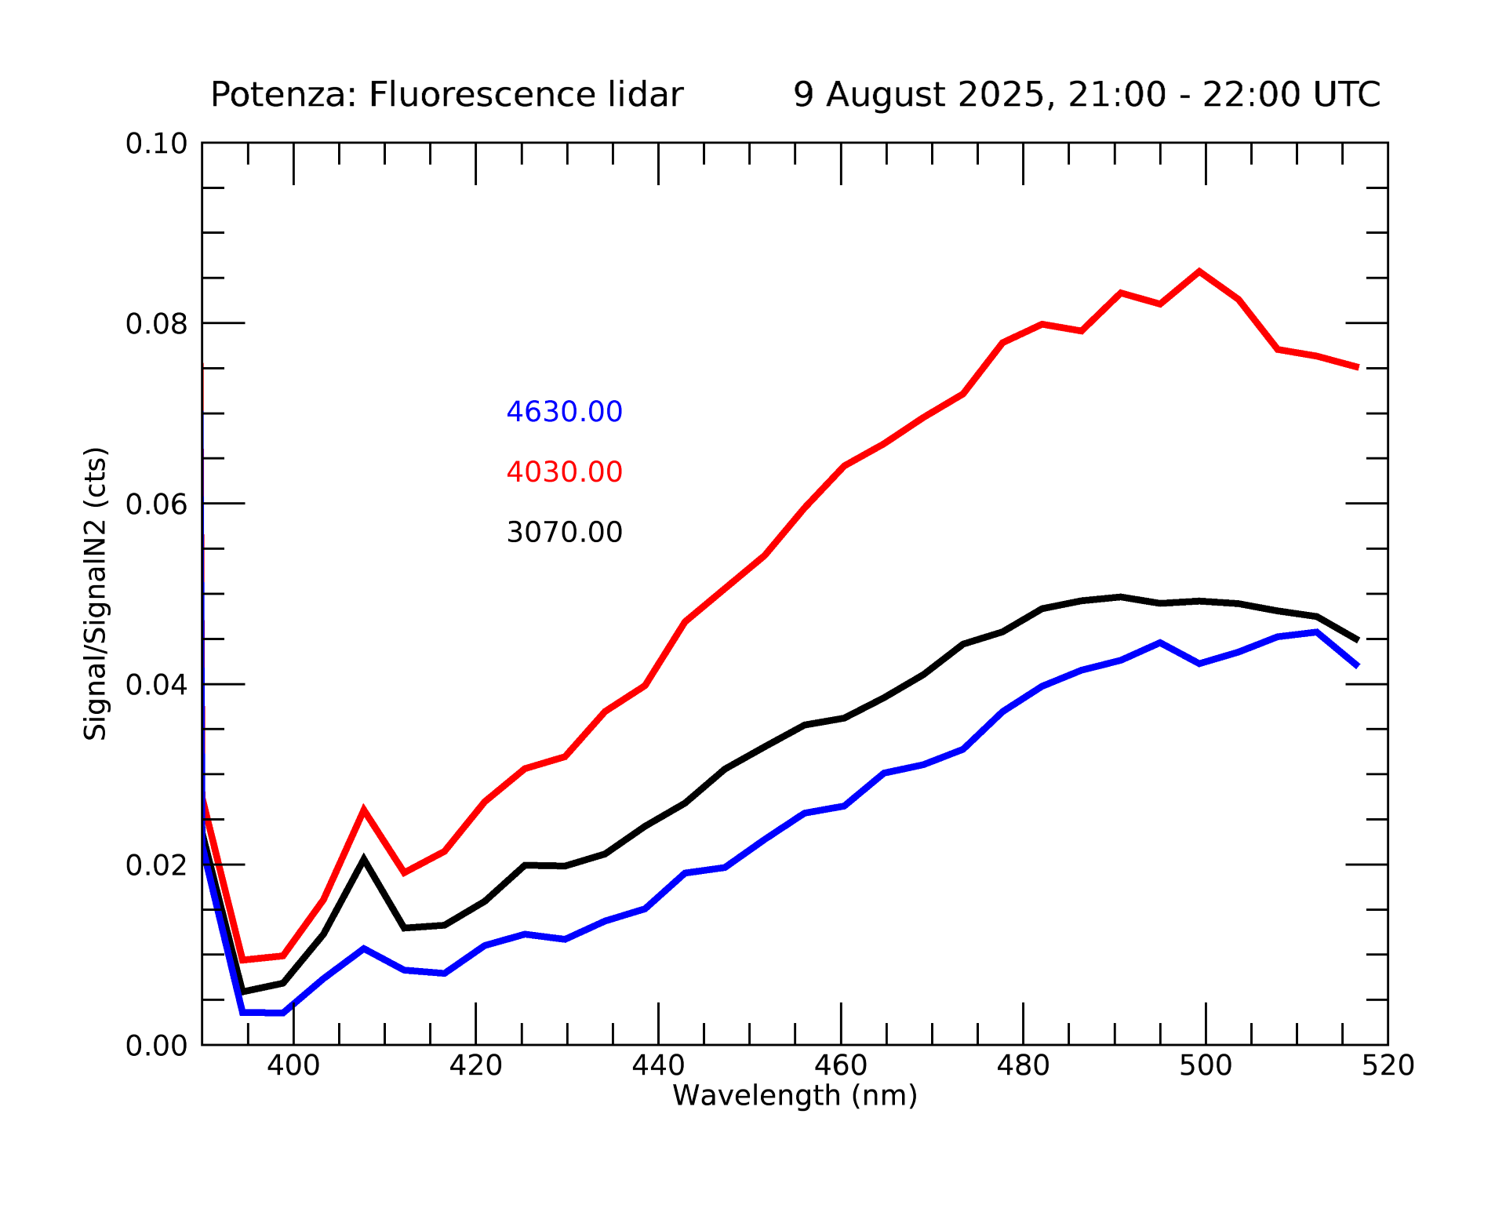
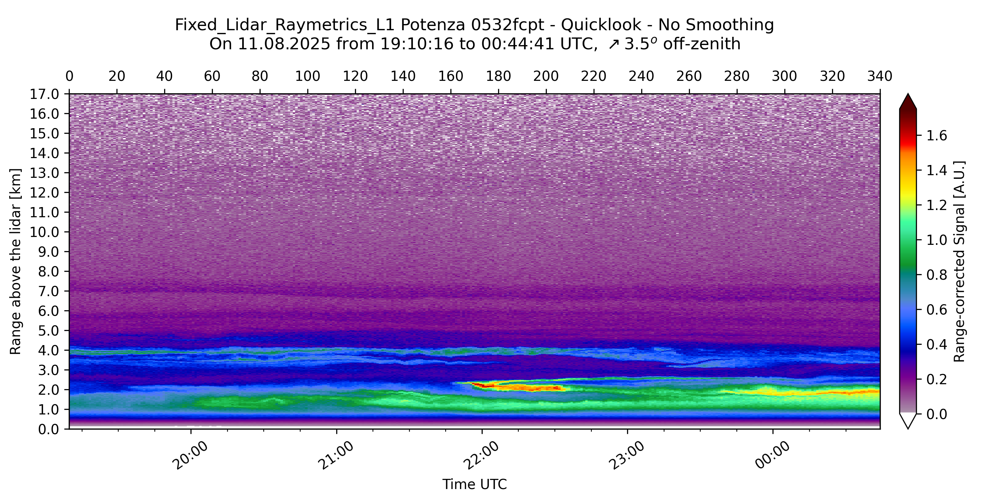
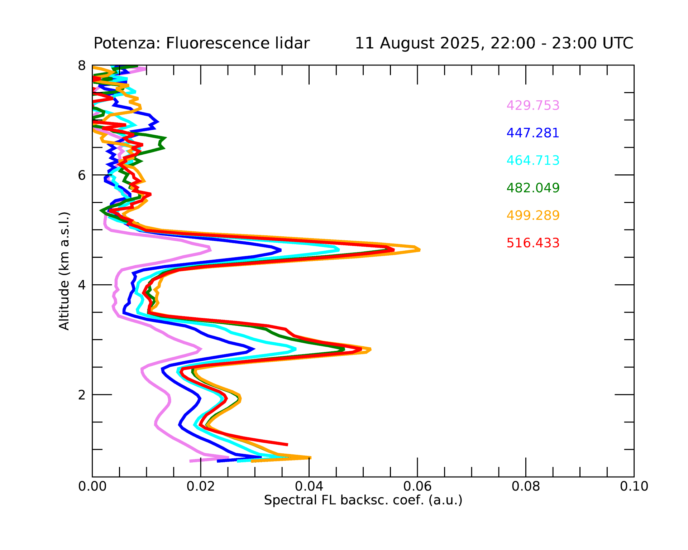
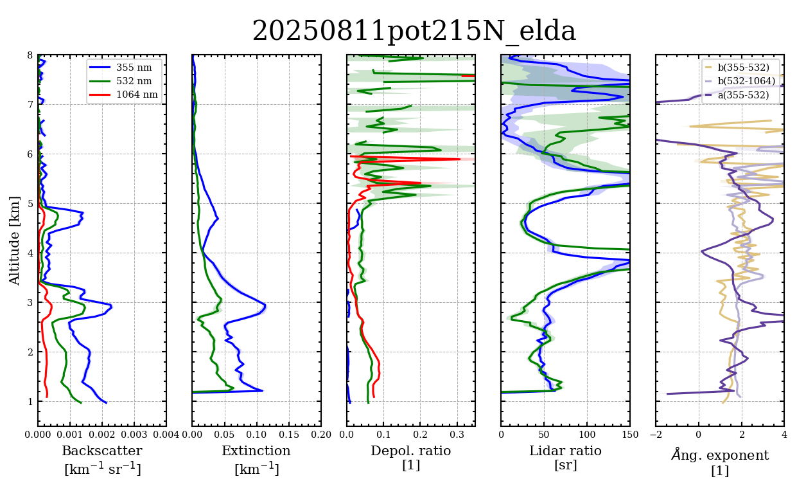
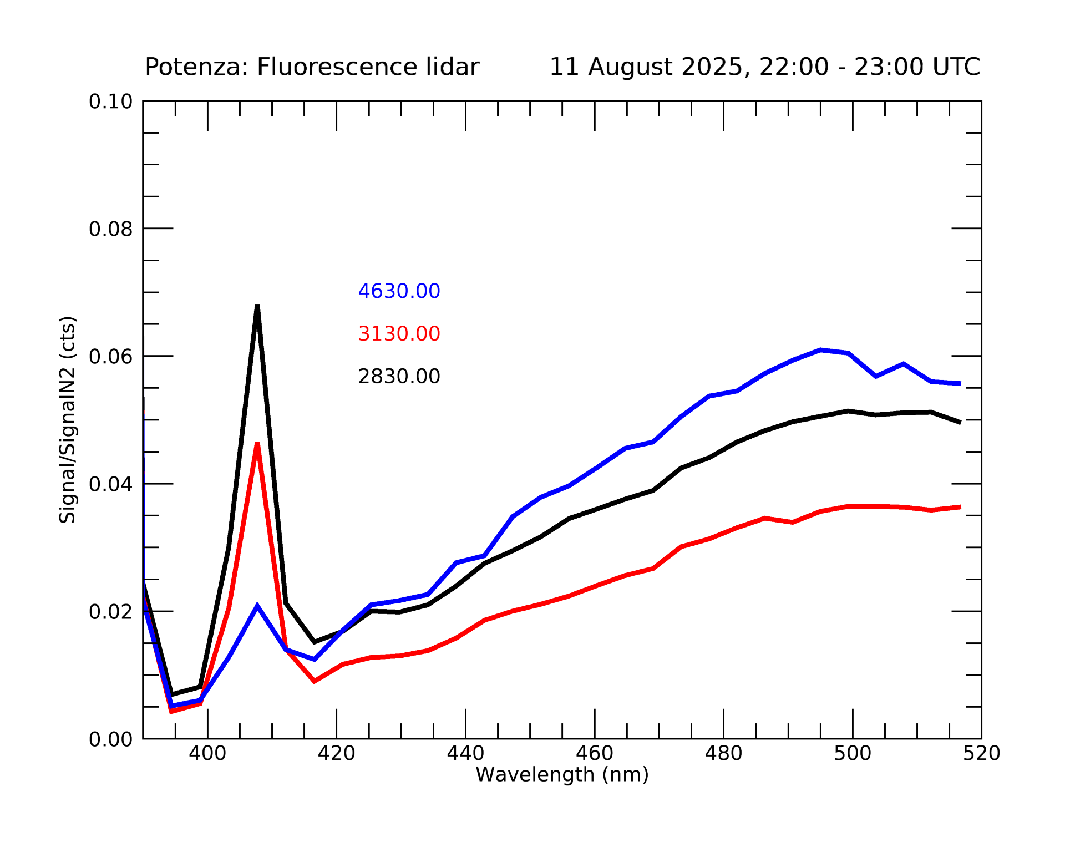
Case studies
CANADIAN FIRE
Fluorescence
Fluorescence
POLPO 532 par-08/08/2025, 18:50-23:54 UTC
08/08/2025, 22:54-23:54 UTC
POLPO 1064 par-09/08/2025, 20:05-01:09 UTC
09/08/2025, 21:05-22:05 UTC
11/08/2025, 21:57-22:53 UTC
POLPO 1064 par-11/08/2025, 19:10-00:44 UTC
Spain: from below average to record wildfire emissions in just one week | Copernicus

Slide 4
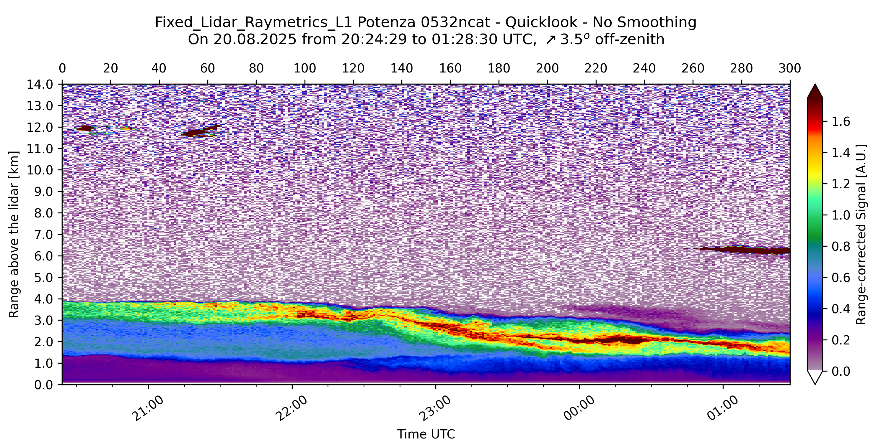
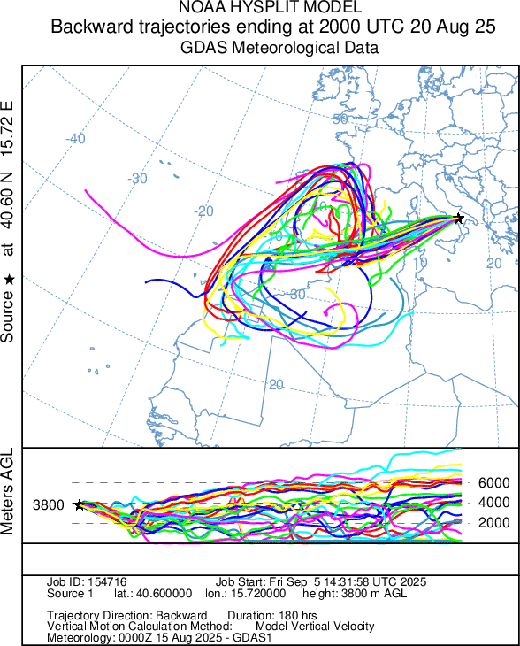
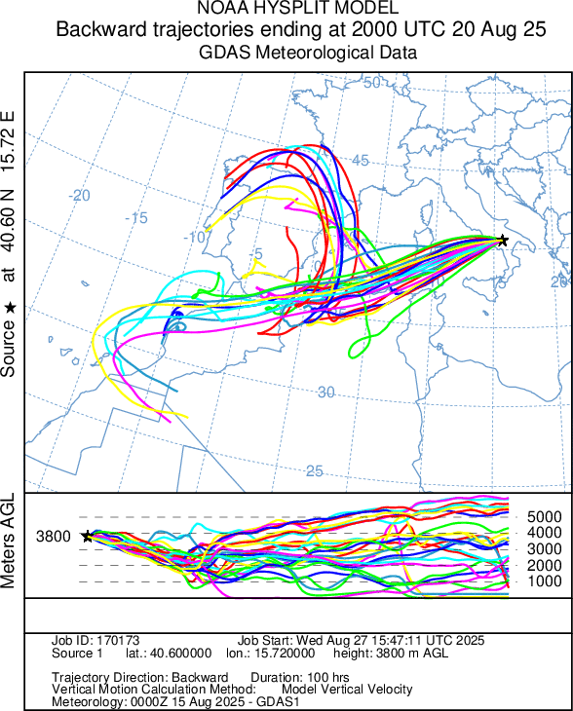
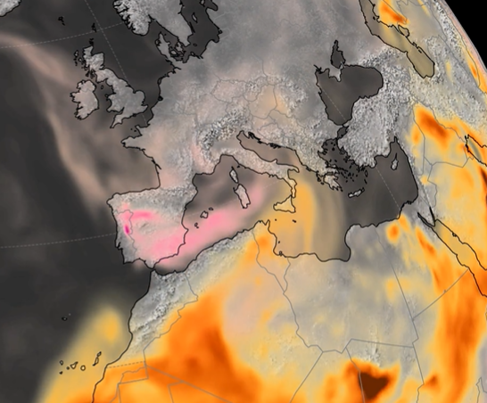
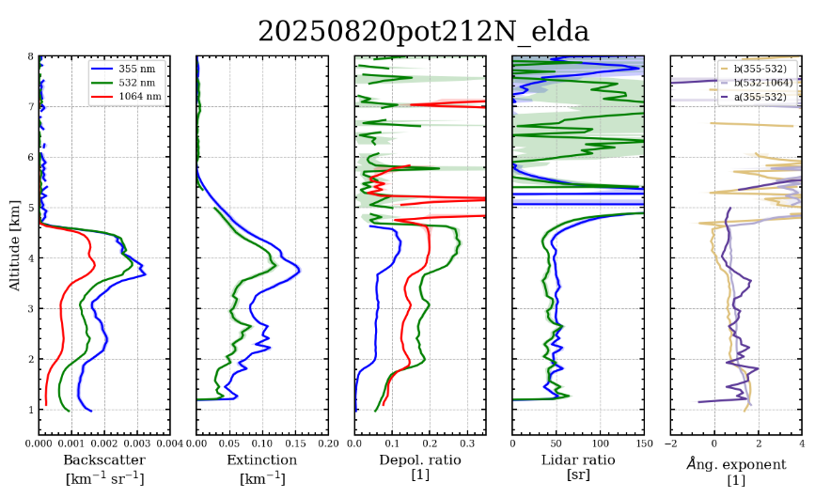
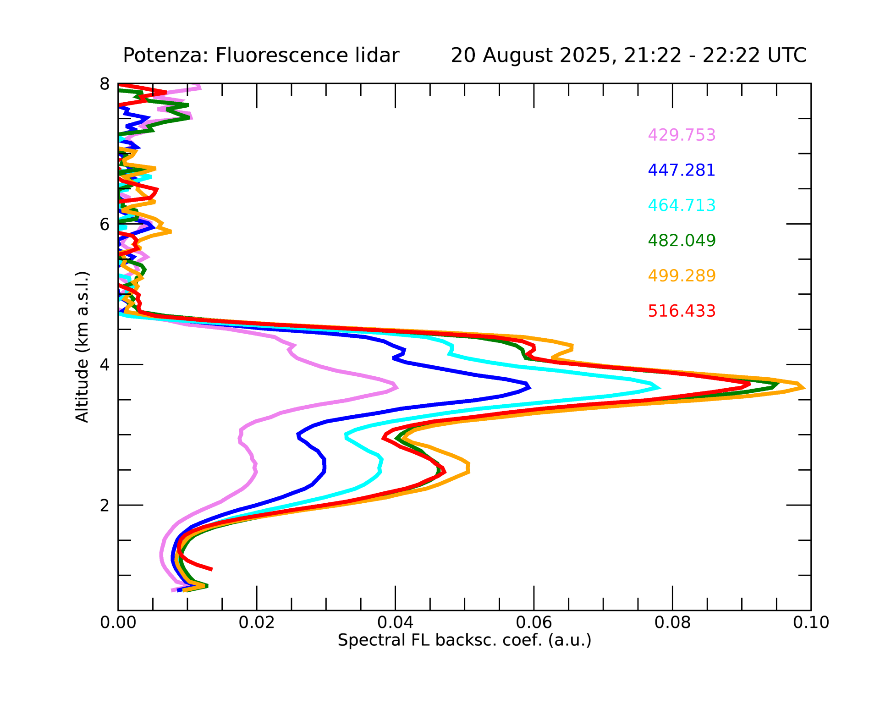
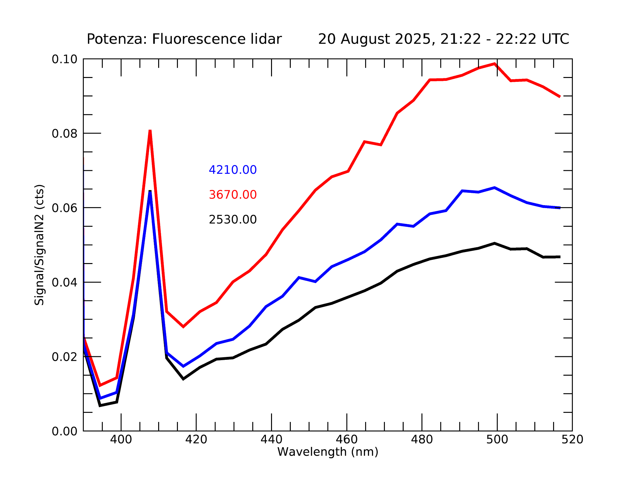
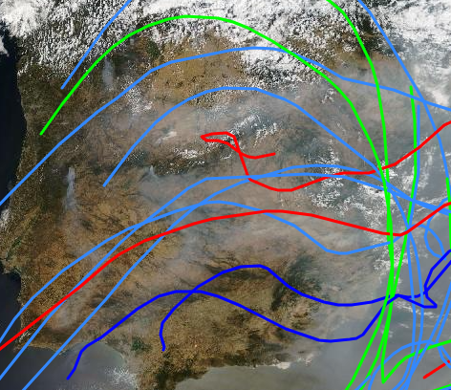
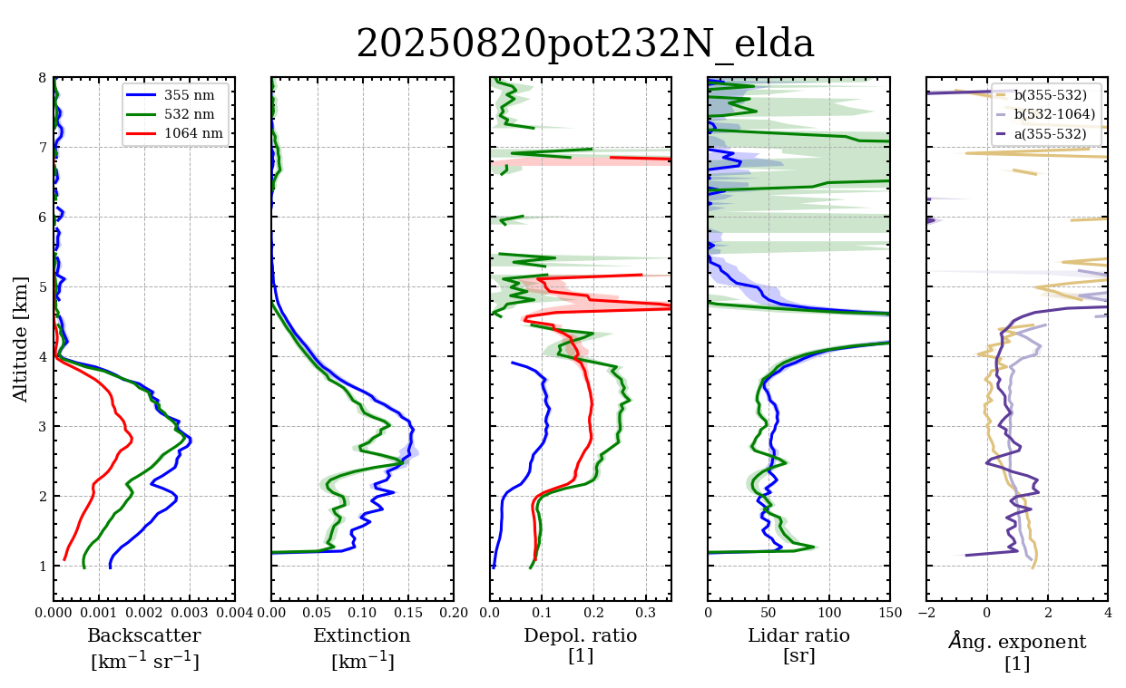
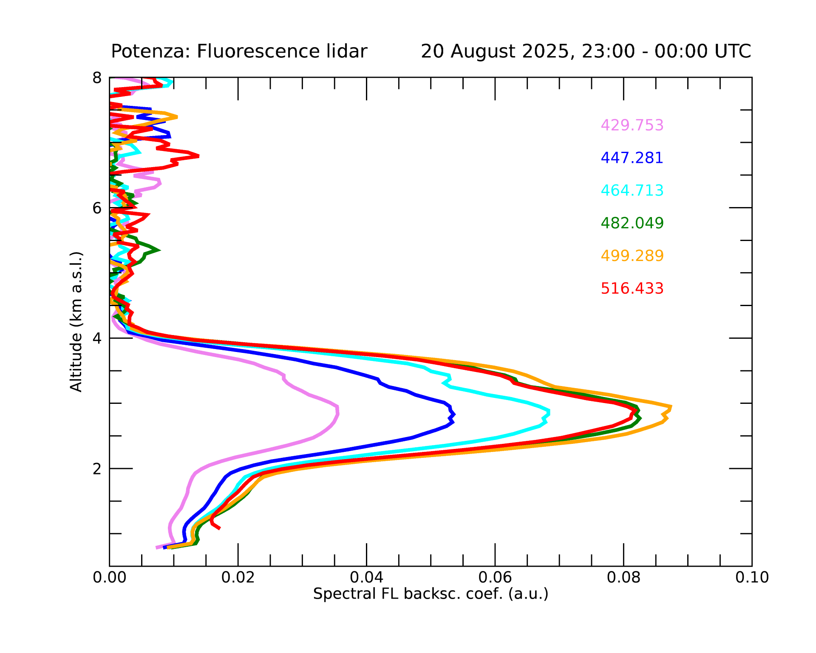
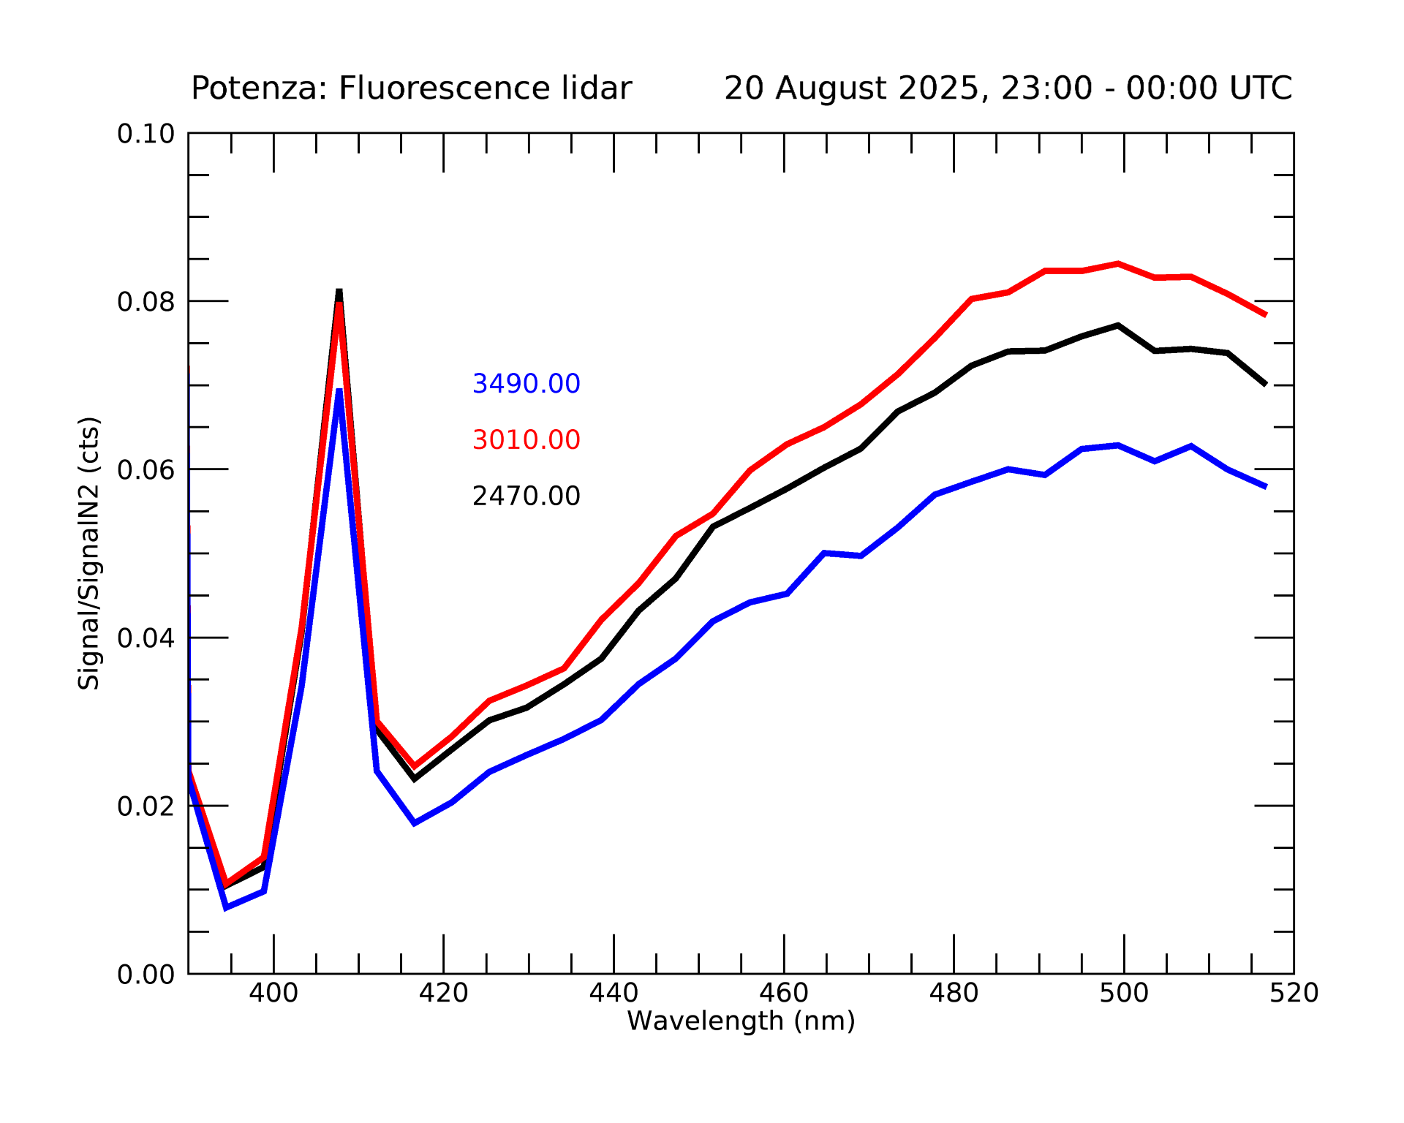
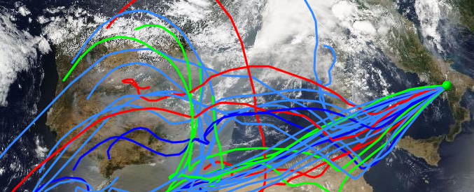
Spain: from below average to record wildfire emissions in just one week | Copernicus
Case studies
DUST?
DUST+BIOMASS BURNING
POLPO 1064 par-20/08/2025, 20:24-01:28 UTC
BIOMASS BURNING
Dr. ISABELLA ZACCARDO (CNR-IMAA) presentation
DUST
20 /08/2025, 21:21-22:21
Highest wildfire emissions in at least 23 years for Europe after a hectic summer | Copernicus
20 /08/2025, 23:26-00:27

Slide 5
Conclusions
Emerging technique: fluorescence has the potential to revolutionize the understanding of atmospheric processes (as shown in the August 20 measurement), providing information not accessible with traditional elastic or Raman lidar.
ACTRIS relevance: fluorescence is of high interest within ACTRIS- A dedicated working group in the National Facility Forum
International interest for aerosol investigaton with fluorescence measurements as demonstrated by a devoted task in the COST Action EARLIcost CA24135 European Atmospherc Research LIdar COoperation on Science and Technology.
CIAO uniqueness: the only observatory currently providing both calibrated spectrometric fluorescence lidar and optical parameters from Raman lidar at 355, 532, and 1064 nm (POLPO system).
Extraordinary potential: this unique configuration is especially powerful for aerosol characterization from wildfires and Saharan dust events at our site.

Slide 6
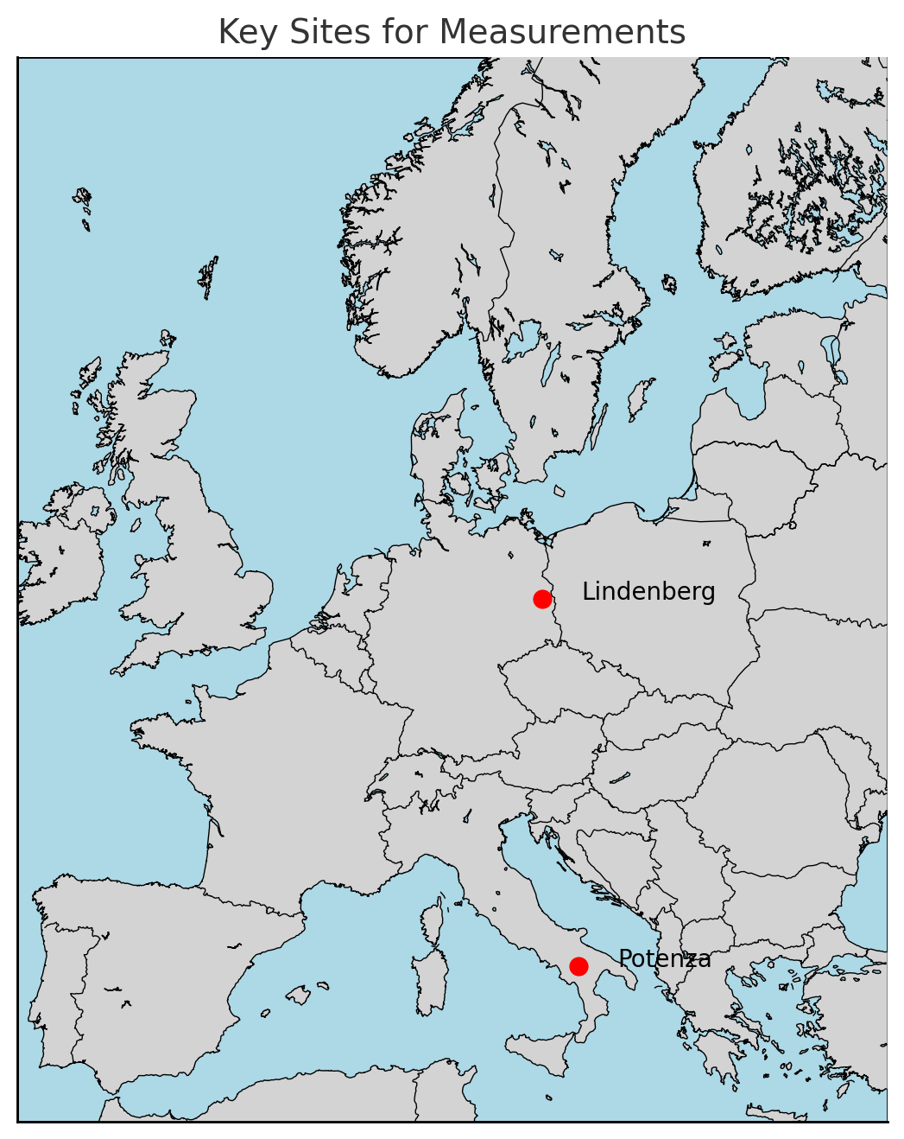
Future steps
1) Development of dedicated software for advanced data analysis
2) Replace 1200 grating with 150 grating → full spectral coverage
3) Characterization of dust fluorescence spectra
Compare large dataset with 3 depolarization measurements
Aim: correlate spectra with dust origin regions
Study fluorescence spectra and depolarization (POLPO)
Improve aerosol typing (Case 20 August 2025)
Focus on local vs. North American wildfire events spectrum
Strengthen collaboration with Lindenberg Observatory
4) MEDUSA at Lindenberg → fluorescence + 3 depolarizations for fire studies
Potenza site → dust-focused measurements with our system and POLPO
Biomass burning
Dust

