Slide 1
Comparison of Online and Offline ED-XRF Techniques for Atmospheric PM10 Measurement
G. Deluca¹, E. Bloise¹, D. Cesari¹, A. Dinoi¹, A. Pennetta¹, S. Potì¹⁻², P. Semeraro¹, F. Unga¹, D. Contini¹
¹ Institute of Atmospheric Sciences and Climate, ISAC-CNR, Lecce, 73100, Italy
² Department of Engineering for Innovation, University of Salento, Lecce, 73100, Italy

Slide 2
INTRODUCTION
EXPERIMENT | ED-XRF (offline) | XACT (online)
SITE | ECO (*) (LAB-BASED XRF ANALYSIS) | ECO (IN SITU)
COLLECTED FILTERS | (*)samples was collected on filters using a dual-channel sampler at 2.3 m³ h⁻¹ | instrument automatically samples and analyses spots
SUBSTRATE | quartz | teflon
PM | PM 10
TIME RESOLUTION | 24 h | 3h
# OF ELEMENT | 19 elements from Al to Pb | 36 elements from Al to Bi
(*) Unga, F., et al., Determination of aerosol composition by ED-XRF on Teflon and quartz substrates: potentialities and limits. Aerosol Research, 2025. 3(2): p. 405-415

Slide 3
METHODS
METHOD | ED-XRF (offline) | XACT (online)
TIME | From December 2024 to June 2025 (76 sample)
ELABORATION DATA | Data < MDL replaced with 0.5 x MDL | 3-h samples were averaged to 24-h to match daily filters. less than 6 valid 3-hourly values available. Data < MDL replaced with 0.5 x MDL
INTERCOMPARISON | 13 elements with concentrations consistently above the MDL for both online and offline techniques: (S, Cl, K, Ca, Ti, Cr, Mn, Fe, Cu, Zn, Br, Sr, Pb)
STATISTICAL ANALYSIS | Linear regression, R²

Slide 4
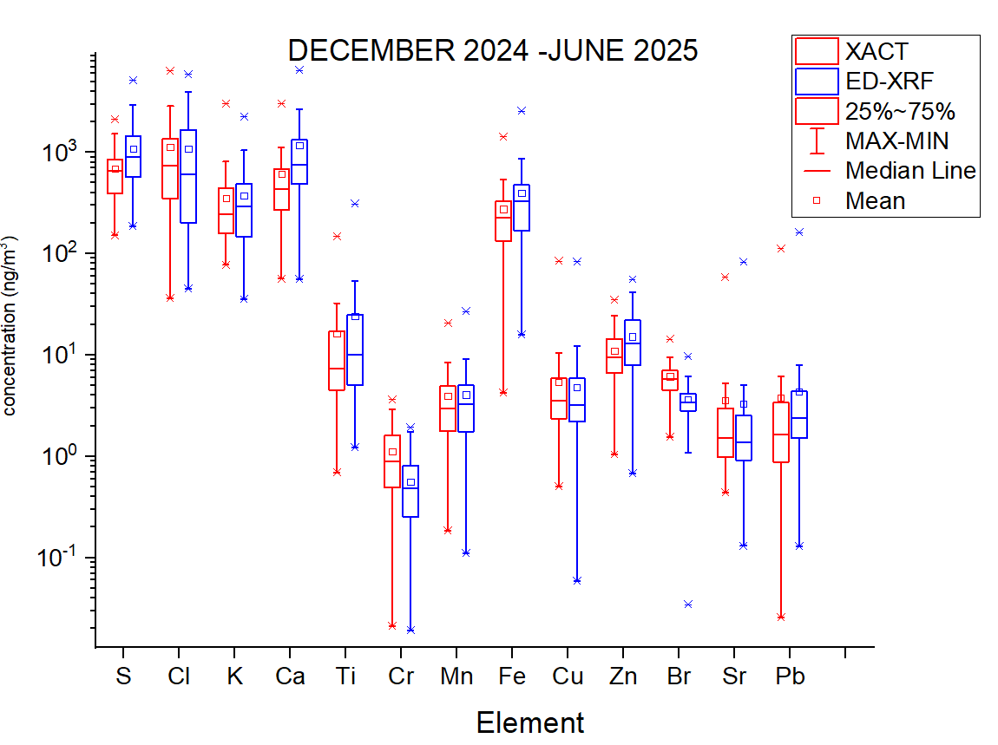
RESULTS: intercomparison of Xact and ED-XRF
ELEMENT | LINEAR REGRESSION (SLOPE) | R²
SULPHUR | 0.75 | 0.79
CHLORINE | 0.62 | 0.69
POTASSIUM | 0.75 | 0.85
CALCIUM | 0.89 | 0.97
TITANIUM | 1.13 | 0.99
CHROMIUM | 0.69 | 0.91
MANGANESE | 1.01 | 0.92
IRON | 0.77 | 0.99
COPPER | 0.96 | 0.82
ZINC | 1.05 | 0.84
BROMIUM | 0.68 | 0.60
STRONTIUM | 1.02 | 0.95
LEAD | 1.05 | 0.96

Slide 5
RESULTS: intercomparison of Xact and ED-XRF

Slide 6
TIME RESOLUTION OF XACT
BOUNDARY LAYER FIREWORKS 1 JANUARY

Slide 7
CONCLUSION
Results obtained with the two XRF techniques were compared in order to verify the goodness and reliability of the analyses of XAct;
Different substrates were used for comparison (Teflon and quartz) and 13 elements were compared;
The concentrations of the elements compared show overall good correlation (best correlations for Ti, Mn, Sr, Pb);
Participation in the MITRAP project.
FUTURE OBJECTIVES
Investigating possible underestimation of ED-XRF during high pollution events;
Intercomparison in which the same filters will be analysed by both system.

Slide 8
