Slide 1
Integrating remote sensing and in-situ measurements to assess the impact of PBL dynamics on air pollution in Milan,
Po valley
Camilla Perfetti^{1,2}, Annachiara Bellini^{3,4}, Laura Renzi¹, Marco Zanatta¹, Luca Di Liberto¹, Ferdinando Pasqualini¹, Alessandro Bracci¹, Francesca Barnaba¹ and Angela Marinoni¹
Contact: c.perfetti@isac.cnr.it
1 ISAC-CNR, 2 UNIBO, 3 UNISAPIENZA, 4 ARPA VDA

Slide 2


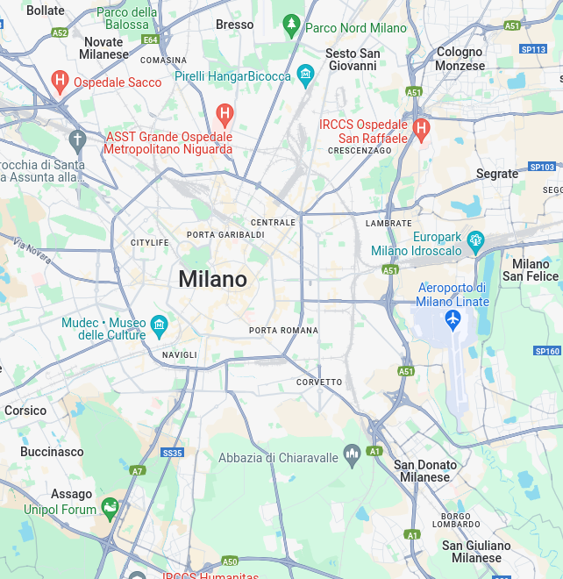


ITINERIS campaign in MILAN - 2023*
Milan is the most populated and polluted metropolis in the Po valley
Objective Milan 2023:
Integrate remote sensing and in-situ measurements to improve the understanding of urban air quality
Assess how vertical atmospheric dynamics affect ground-level pollutant concentrations
Provide insights into air pollution impacts on human health
REMOTE
IN-SITU
Period:
January-September 2023 at Linate airport (hotspot site)
Instruments:
Remote: for aerosol vertical profiles
In-situ: for aerosol physics and gas
*Conducted in sinergy with the RI-URBANS EU H2020 project

Slide 3
ITINERIS campaign in MILAN - 2023*
Milan is the most populated and polluted metropolis in the Po valley
Objective Milan 2023:
Integrate remote sensing and in-situ measurements to improve the understanding of urban air quality
Assess how vertical atmospheric dynamics affect ground-level pollutant concentrations
Provide insights into air pollution impacts on human health
REMOTE
IN-SITU
Period:
January-September 2023 at Linate airport (hotspot site)
Instruments:
Remote: for aerosol vertical profiles (Ceilometer MAL height)
In-situ: for aerosol physics and gas (AE33 eBC mass concentration)
For this presentation
*Conducted in sinergy with the RI-URBANS EU H2020 project

Slide 4
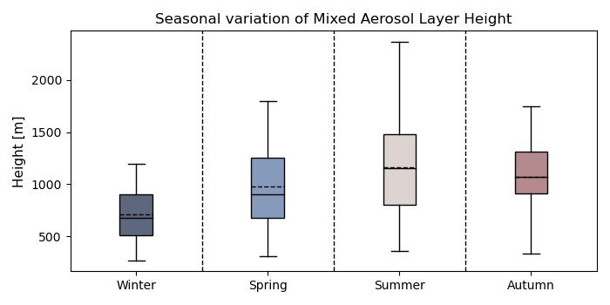
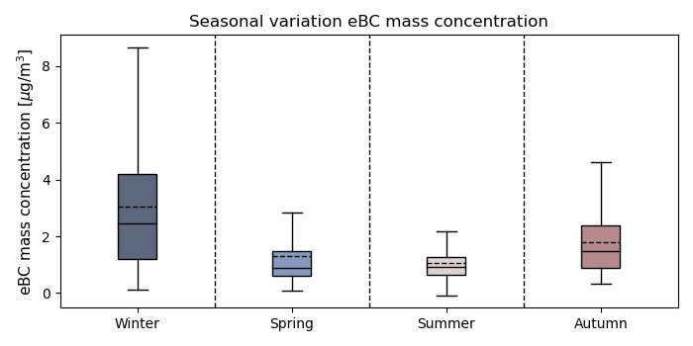
In-situ & vertical measurements:
Seasonal variation
Typical seasonal variation of mixed aerosol layer (MAL) and equivalent black carbon (eBC) mass concentration
Marked PBL and ground concentrations seasonality

Slide 5
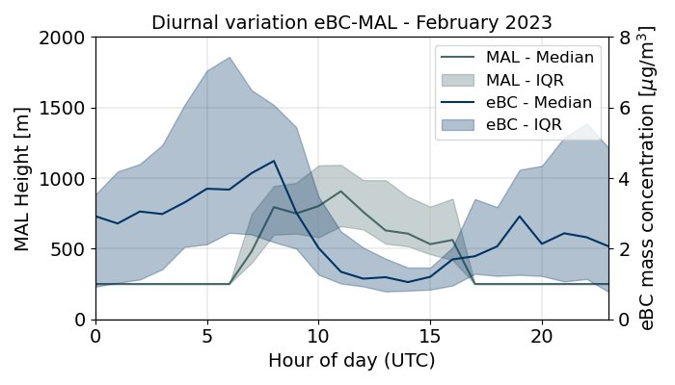
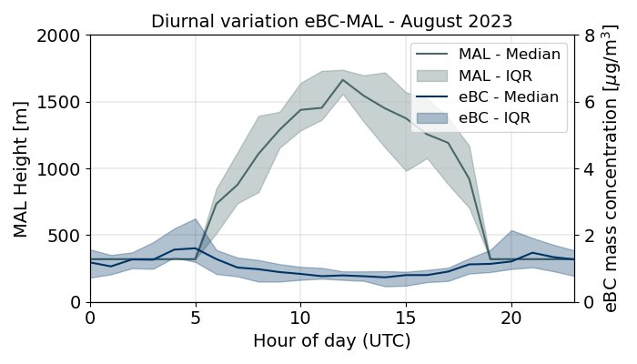
Relationship between MAL Height and in-situ pollutants concentrations
eBC primary pollutant:
Typical diurnal cycle → two peaks (morning and evening)
Mid-day minimum → dilution due to higher MAL
Summer: deeper MAL → lower concentrations

Slide 6
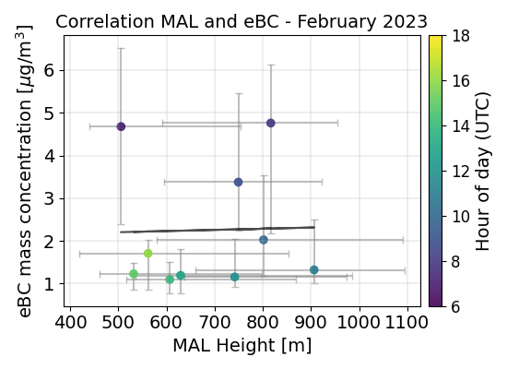
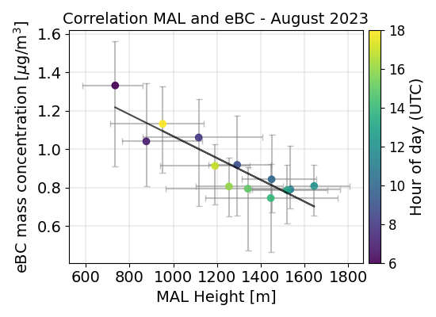
Relationship between MAL Height and in-situ pollutants concentrations
eBC primary pollutant:
Typical diurnal cycle → two peaks (morning and evening)
Mid-day minimum → dilution due to higher MAL
Summer: deeper MAL → lower concentrations
Correlation with MAL height:
Winter: R² = 0.00* → no correlation
Summer: R² = 0.81* → strong correlation
eBC strongly influenced by atmospheric dilution (Summer)

Slide 7
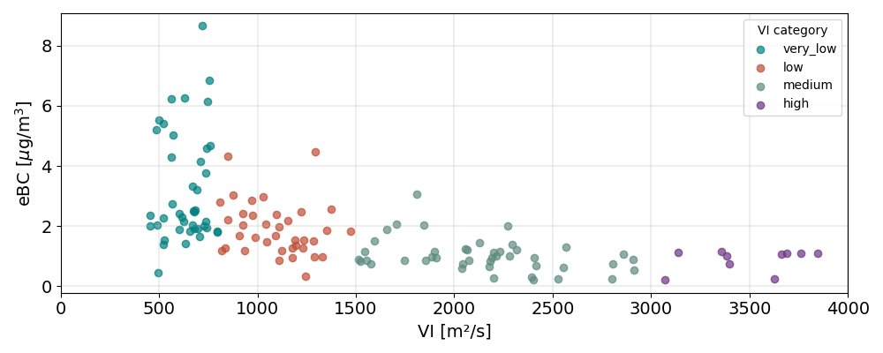
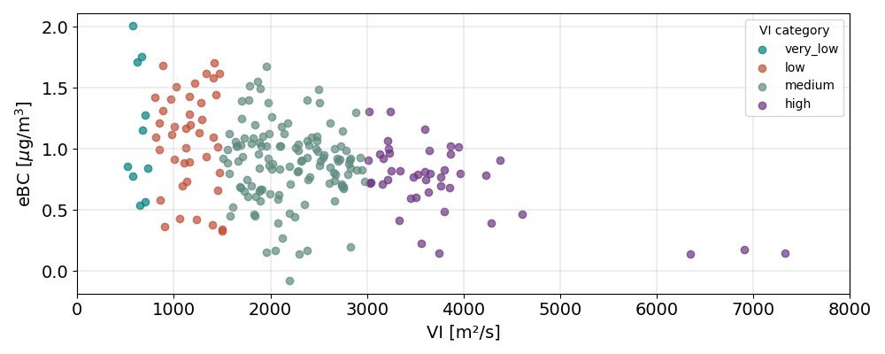
Ventilation Index
VI = MAL x WS [m/s²]
February
To quantify the atmospheric dilution efficiency
Winter: VI correlates well with pollutants → when MAL is low, wind becomes the key driver of dilution
Summer: despite high MAL, VI shows no clear relation with pollutants → dispersion is already efficient and concentrations mainly reflect emissions
August
(Work in progress..)

Slide 8

Conclusions
Marked PBL and ground concentrations seasonality
Correlations:
  Winter: no significant linear dependence between MAL and pollutants → other factors dominate (thermal inversions, weak winds, and local emissions)
  Summer: strong MAL–pollutant correlations for primary pollutants → vertical dilution processes play a key role
Ventilation Index is site and season dependent:
  Winter: captures role of wind under shallow MAL
  Summer: predictive power weakens → dilution already efficient, emissions reduced
Implication: vertical mixing and horizontal ventilation both contribute to explain seasonal variation of air pollution in Milan

