Slide 1
High time resolution measurements of equivalent black carbon in an urban background site of Italy
D. Cesari¹, E. Bloise¹, M. Conte², A. Dinoi¹, G. Deluca¹, A. Pennetta¹, P. Semeraro¹, D. Contini¹
¹Institute of Atmospheric Science and Climate, ISAC-CNR, Str. Prov. Lecce-Monteroni km1.2, 73100, Lecce, Italy
²Institute of Atmospheric Science and Climate, ISAC-CNR, Via Fosso del Cavaliere, 100 - 00133 Roma, Italy

Slide 2
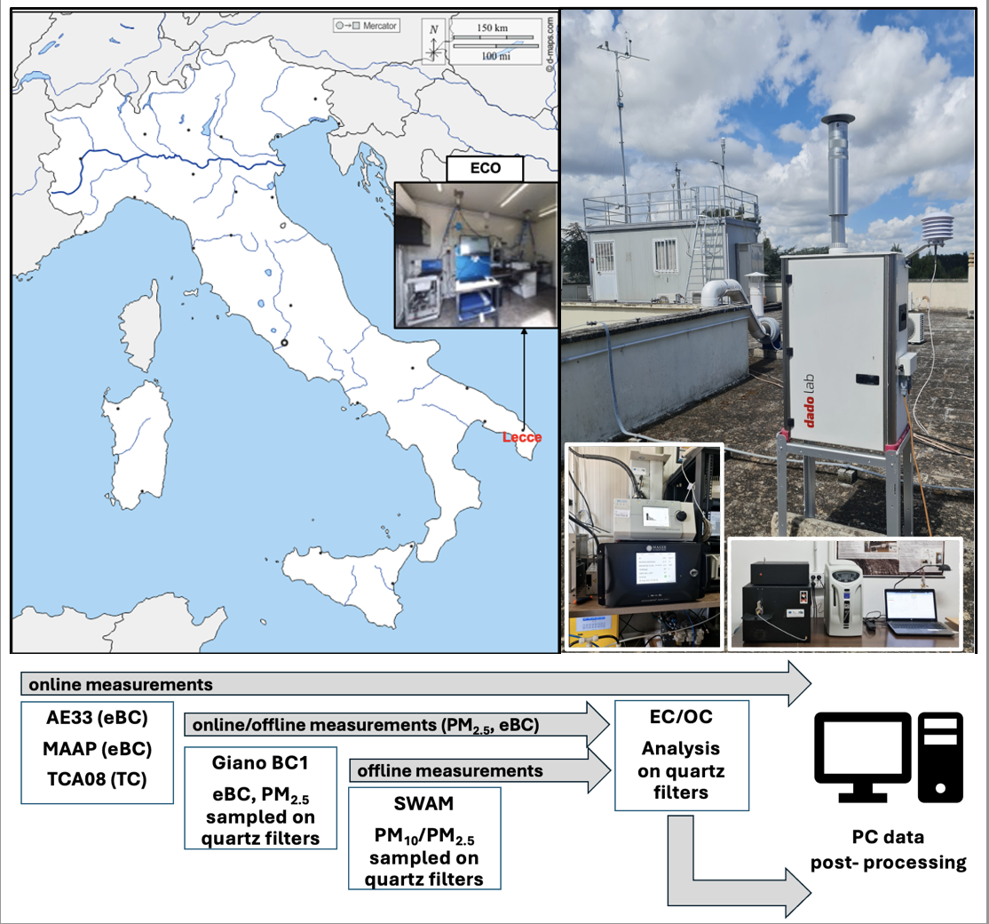
Introduction
The specific objectives of this study are:
combining daily and high-time-resolution measurements to provide an in-depth characterization of carbonaceous aerosol and its sources;
performing an intercomparison of different instruments measuring eBC and TC;
determining a new in situ MAC value (an important parameter to describe the optical properties of EC) for the ECO site
Off-line: In the period March - April 2023, 86 aerosol samples (57 PM₁₀ and 29 PM2.5) were collected, using two low volume samplers: a SWAM (by FAI) for PM₁₀ and PM_{2.5} samples. A Giano BC1 (by Dado Lab), for PM₁₀ samples and eBC online measurements.
EC and OC determined with a Sunset OC/EC analyser (EUSAAR2 protocol).
On-line: eBC measurements with 3 instruments: a MAAP (by Thermo Scientific); an AE33 (by Magee Scientific); the black carbon analyser Giano BC1 (by Dadolab). Total carbon measurement with a TCA08 (by Magee Scientific).
ITINERIS 3rd general meeting – Rome, 25-26/09/2025

Slide 3
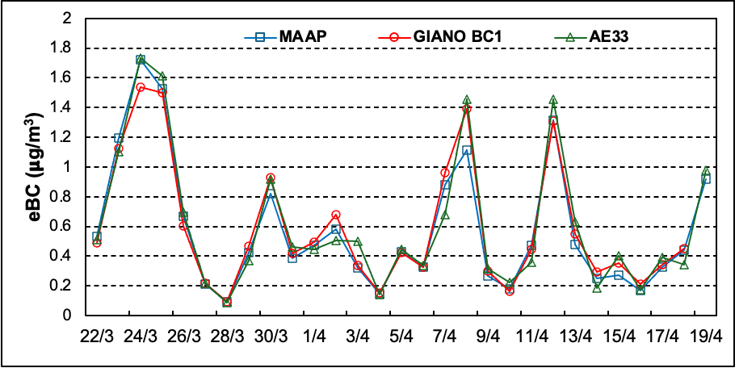

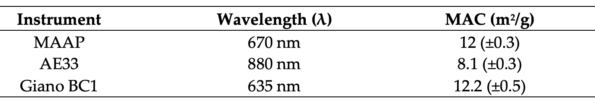
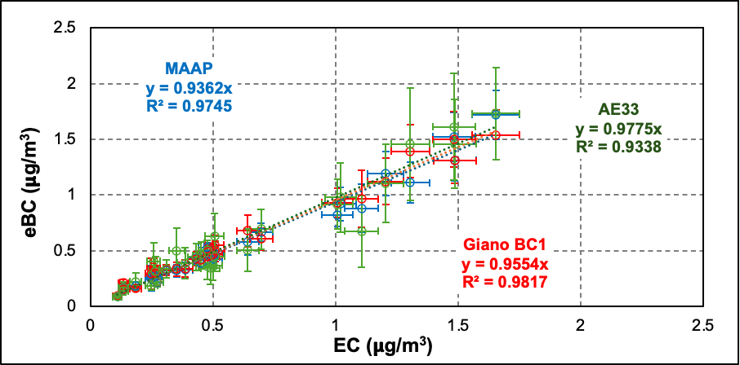
Results (1): Evaluation of In-Situ MAC and EC vs. eBC
The average concentrations: 17.1 (±1.1) μg/m³ for PM₁₀ and 10.4 (±1.0) μg/m³ for PM_{2.5}.
OC and EC: 16.5% and 3.6% of PM₁₀ in mass, and 22.6% and 5.5% of PM_{2.5}.
Measurements from MAAP, AE33, Giano BC1 and Sunset analyser used for re-calculating MAC.
(6.6)*
(7.77)*
(10)*
In situ MAC values in agreement with values found for other different typologies of sites in Europe: limited spatial variability !!!
e.g.: in Zanatta et al.[1]: 8.9 (±1.7) m²/g < MAC <17 (±1.7) m²/g
[1] Zanatta et al. Atmos. Environ. 2016, 145, 346–364.
* predefined constant MAC value of the instrument
The comparison between daily eBC (from MAAP, AE33 and Giano BC1) and EC (from Sunset) demonstrated good agreement (R²> 0.97), especially after using in situ MAC values.
ITINERIS 3rd general meeting – Rome, 25-26/09/2025

Slide 4
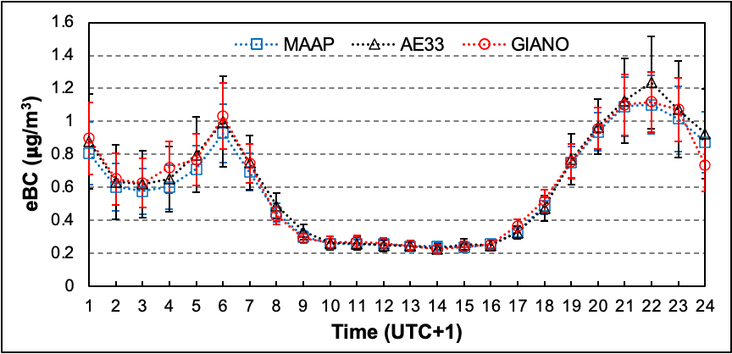
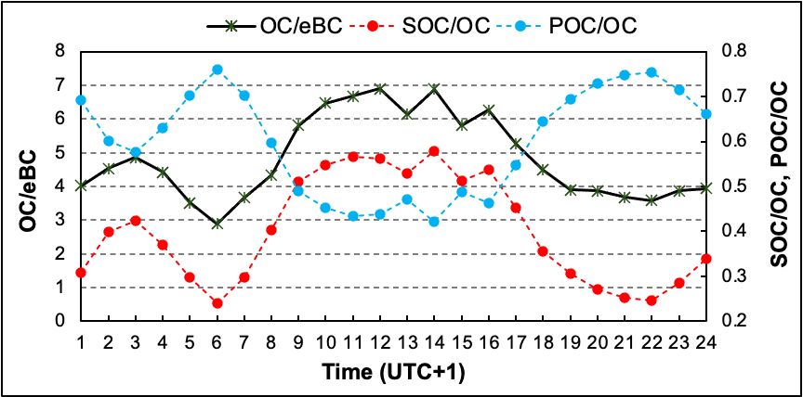
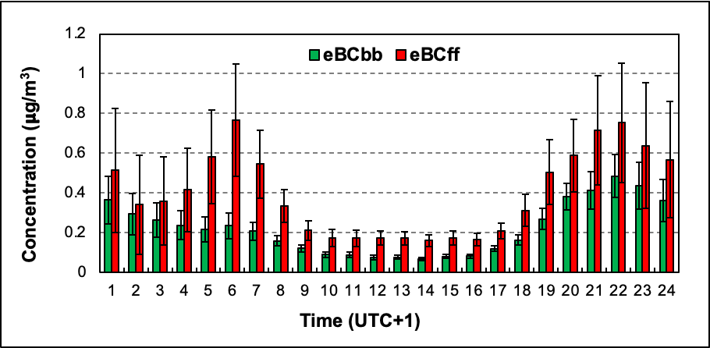
Results (2): Daily Pattern of Carbonaceous Aerosol
The diurnal variations in eBC and POC concentrations highlighted the strong influence of local sources at ECO site, modulated by local meteorological dynamics.
biomass burning
traffic
primary combustion emissions
SOC contributions, accounting for 36% of the measured OC, were more prominent during midday hours, reflecting the enhanced photochemical activity in this part of the day.
increased contributions from secondary organic aerosols
The fossil fuel combustion was the dominant source of eBC at ECO site (contributing to the eBC for 64%) , even if biomass burning also played a relevant role, especially during evening and early morning hours (contributing to the eBC for 36%).
ITINERIS 3rd general meeting – Rome, 25-26/09/2025

Slide 5
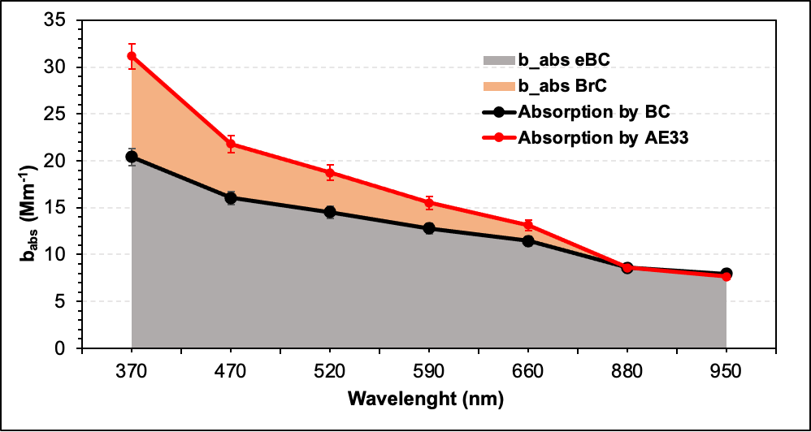
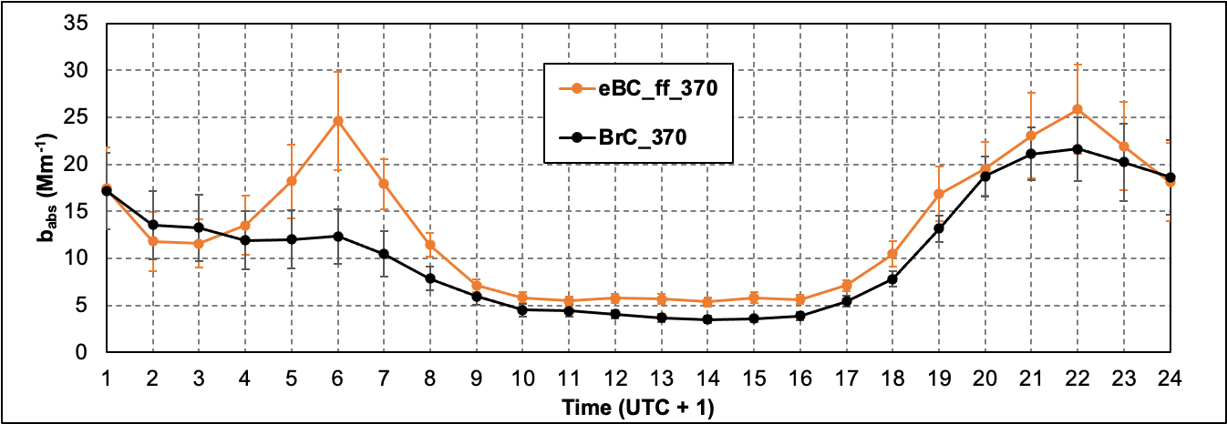

Results (3): Absorption by BrC
The average AAE for aerosols collected at the ECO site was 1.46, suggesting the presence of brown carbon (BrC).
The BrCabs diurnal pattern at 370 nm was higher during the nighttime and decreased in the diurnal hours, suggesting that this parameter was mainly influenced by the biomass-burning source (or domestic heating) at ECO site.
INTEGRATING ONLINE MEASUREMENTS ALLOWS FOR A BETTER SOURCE APPORTIONMENT OF CARBONACEOUS AEROSOL
ITINERIS 3rd general meeting – Rome, 25-26/09/2025

Slide 6
