Slide 1
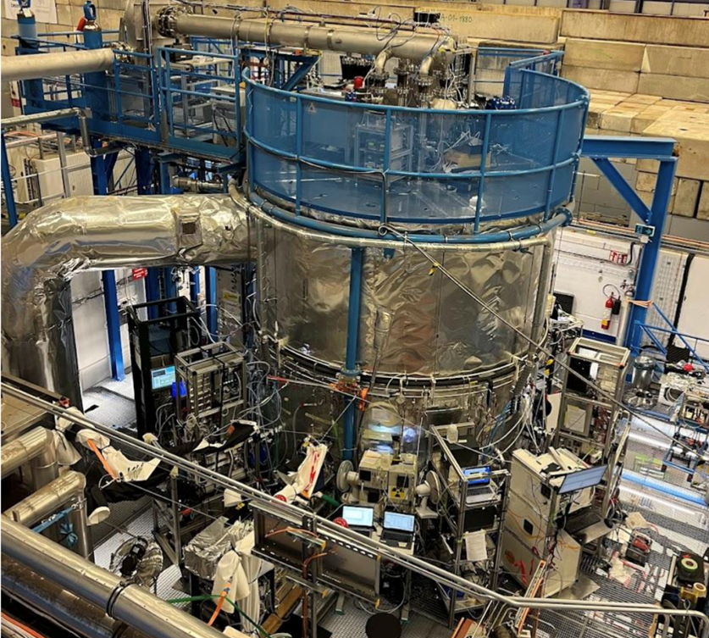
Unraveling the Synergistic Impact of Anthropogenic and Biogenic Emissions on New Particle Formation:
Evidence from the CERN CLOUD Chamber
Alessia Pignatelli, UniNa

Slide 2
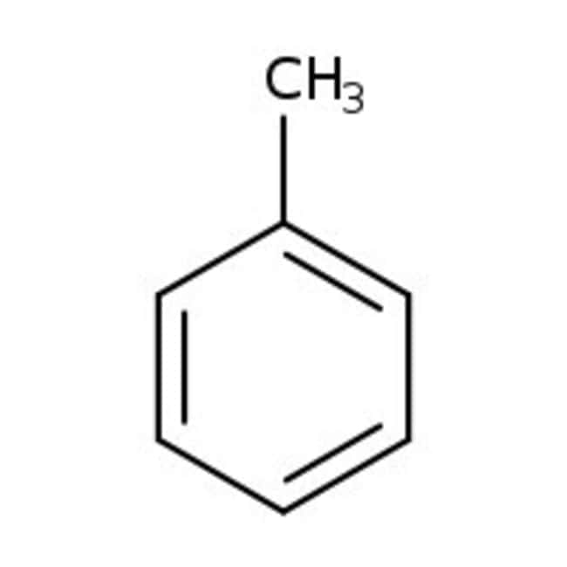
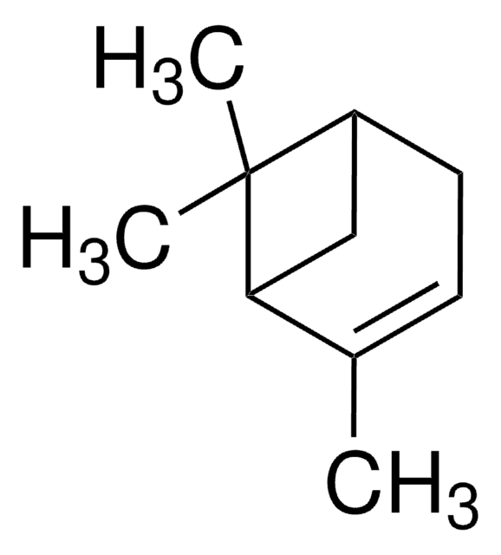
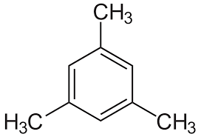
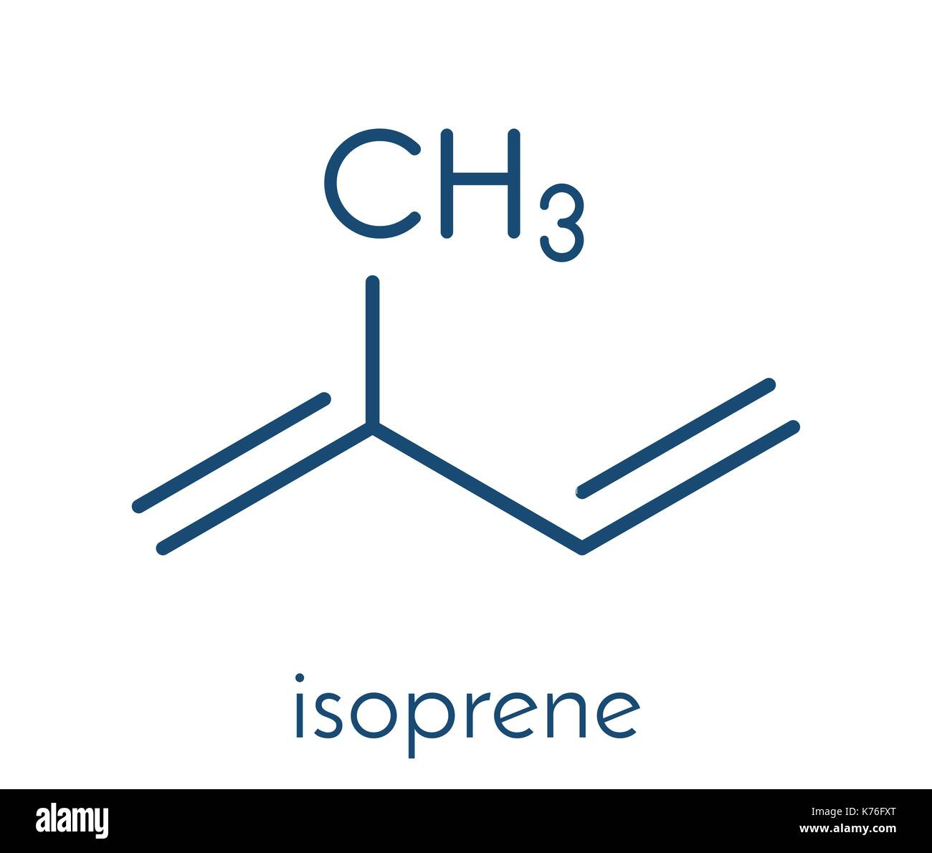



Aim of the study
VOCs
+Oxidants
+O₂
RO₂
Understanding the role of RO₂ in the atmosphere;
Evaluating if RO₂ from different precursors have different behaviour;
Investigating the main RO₂ + RO₂ reaction mechanisms.
Biogenic Emissions

Slide 3
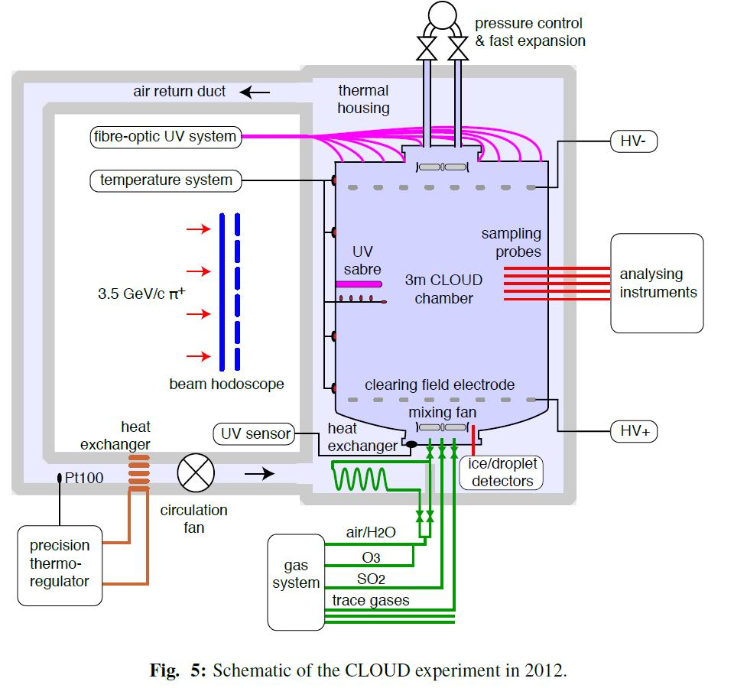
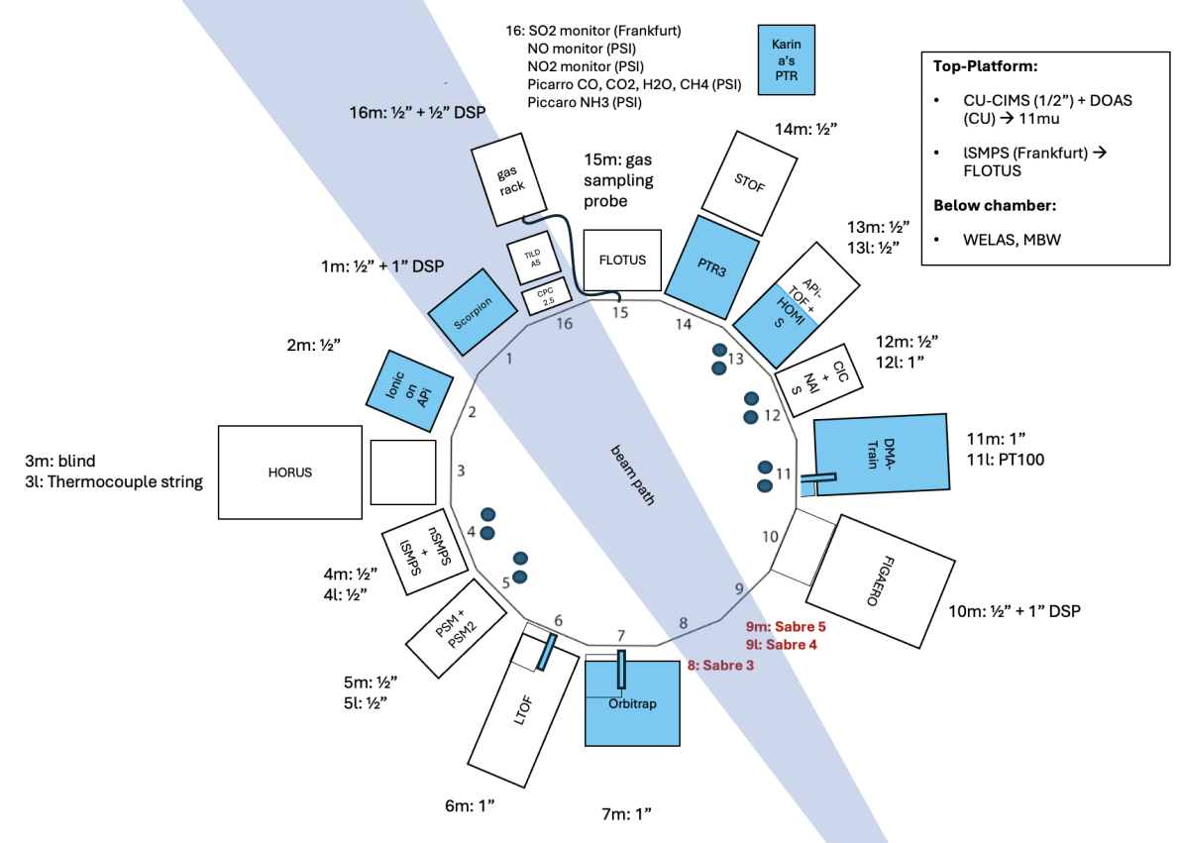
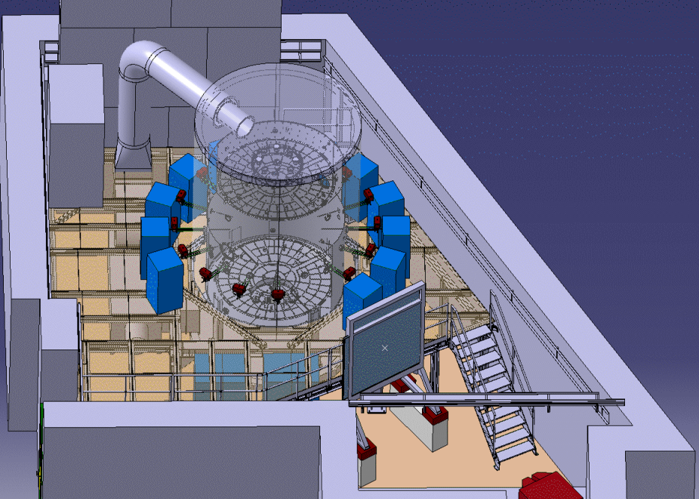

Experimental Setup
The study was realized at Cloud (Cosmic Leaving OUtdoor Droplets) Chamber at Cern, Geneva.
The chamber is a 26.1 m³ , well-controlled, stainless-steel cylinder with electro-polished walls.

Slide 4













Experimental Conditions
Pure BVOC
AVOC/BVOC
Pure AVOC
αpinene (AP), Isoprene (IP)
AP:IP ratios 2:4 and 1.4:8
OH =[1.6-4.9$] ∙{10}^{6}$ [$mol/{cm}^{3}$]
NO=0 to 0.8ppb
Temperature=25°C
αpinene (AP),Isoprene (IP)
and Trimethylbenzene (TMB)
AP:IP ratios 2:4 and 1.4:8
+5 or 10ppb TMB
OH =[1.6-4.9$] ∙{10}^{6}$
[$mol/{cm}^{3}$]
NO=0 to 0.8ppb
Temperature=25°C
Trimethylbenzene (TMB), naphtalene (NAFT) and toluene (TOL).
OH =[1.6-4.9$] ∙{10}^{6}$
[$mol/{cm}^{3}$]
NO=0 to 0.8ppb
Temperature=20°C

Slide 5
alessia.pignatelli@unina.it

