Slide 1
Analysis And Characterization Of Wind Circulation In A Central Mediterranean Site During Heatwave event
Ilaria Gandolfi¹, Fabio Madonna^{1,2}, Marco Rosoldi¹,
Donato Summa¹, Simone Gagliardi¹, and Benedetto De Rosa¹
1 CNR Institute of methodologies for environmental analysis (IMAA) Tito, Italy
2 University of Salerno, Department of Physics "E.R. Caianiello"

Slide 2
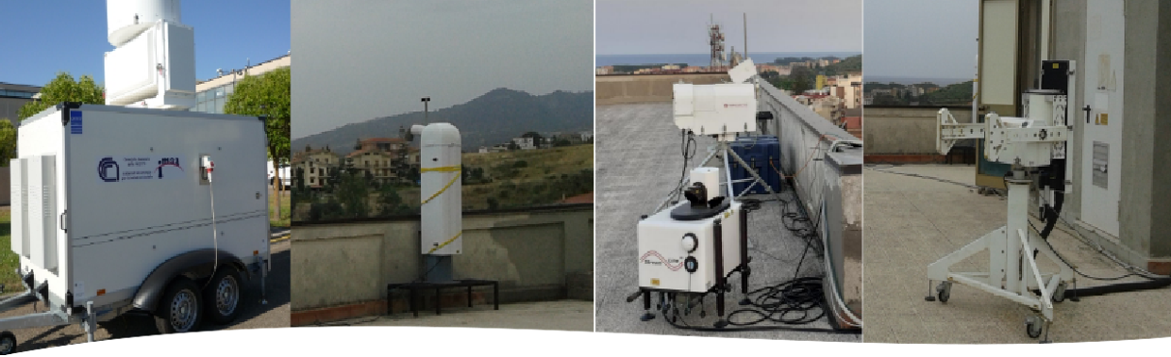
MESSA-DIN CAMPAIGN
The campaign, organized by the CNR-IMAA Atmospheric Observatory (CIAO), part of the Italian component of the European research infrastructure ACTRIS (Aerosol Clouds Trace gases Research InfraStructure): Site: Soverato (25 m asl, 38.69° N, 16.54° E), South-Eastern coast of Italy, Central Mediterranean Period: June - November 2021.
Ka-band Doppler Radar (Metek MIRA 36) , Ceilometer (Vaisala CL51), Microwave radiometer (Radiometrics MP3014), Polarization Raman lidar (Raymetrics LR111-D200), Sun photometer: (CIMEL CE 318) , Doppler lidar (Halo Photonics Stream LineXR)
Horizontal wind speed and direction were obtained through the VAD (velocity-azimuth display) scanning technique: a conical scan operated by a laser beam every 5 minutes at constant elevation angle of 75° which moves in six different directions every 60°.

Slide 3
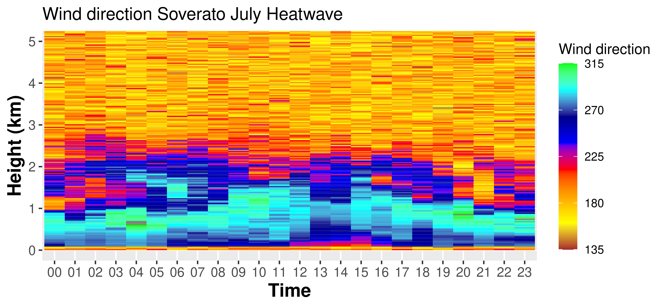
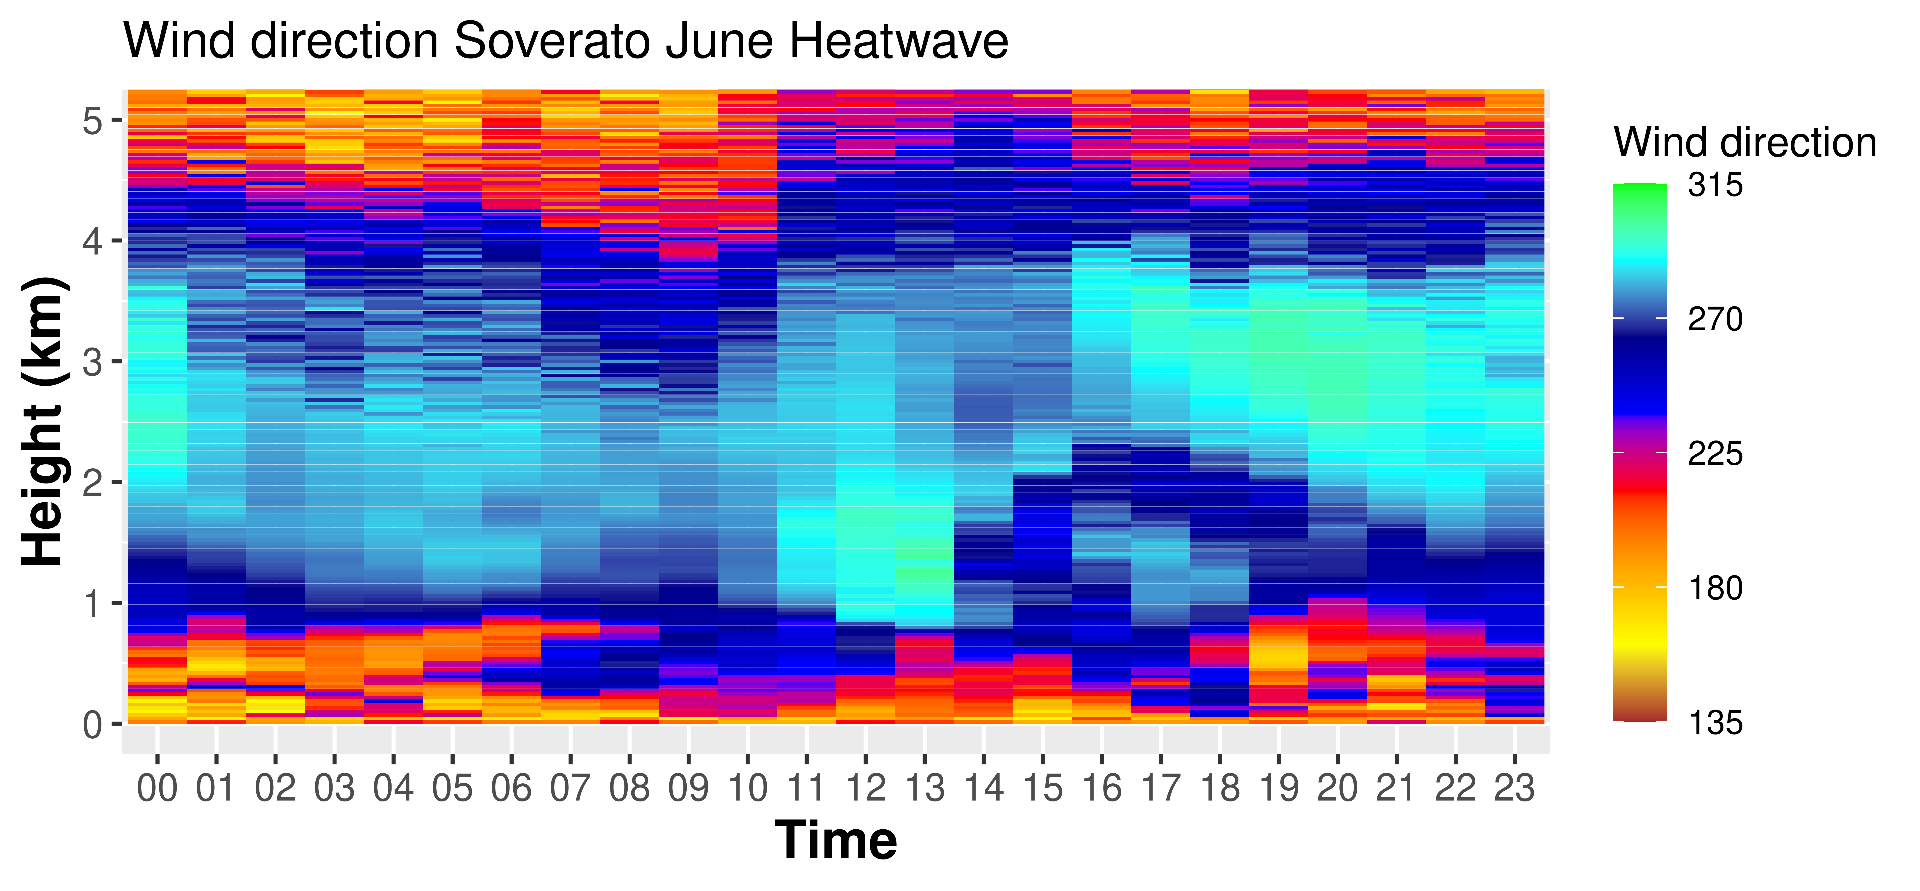
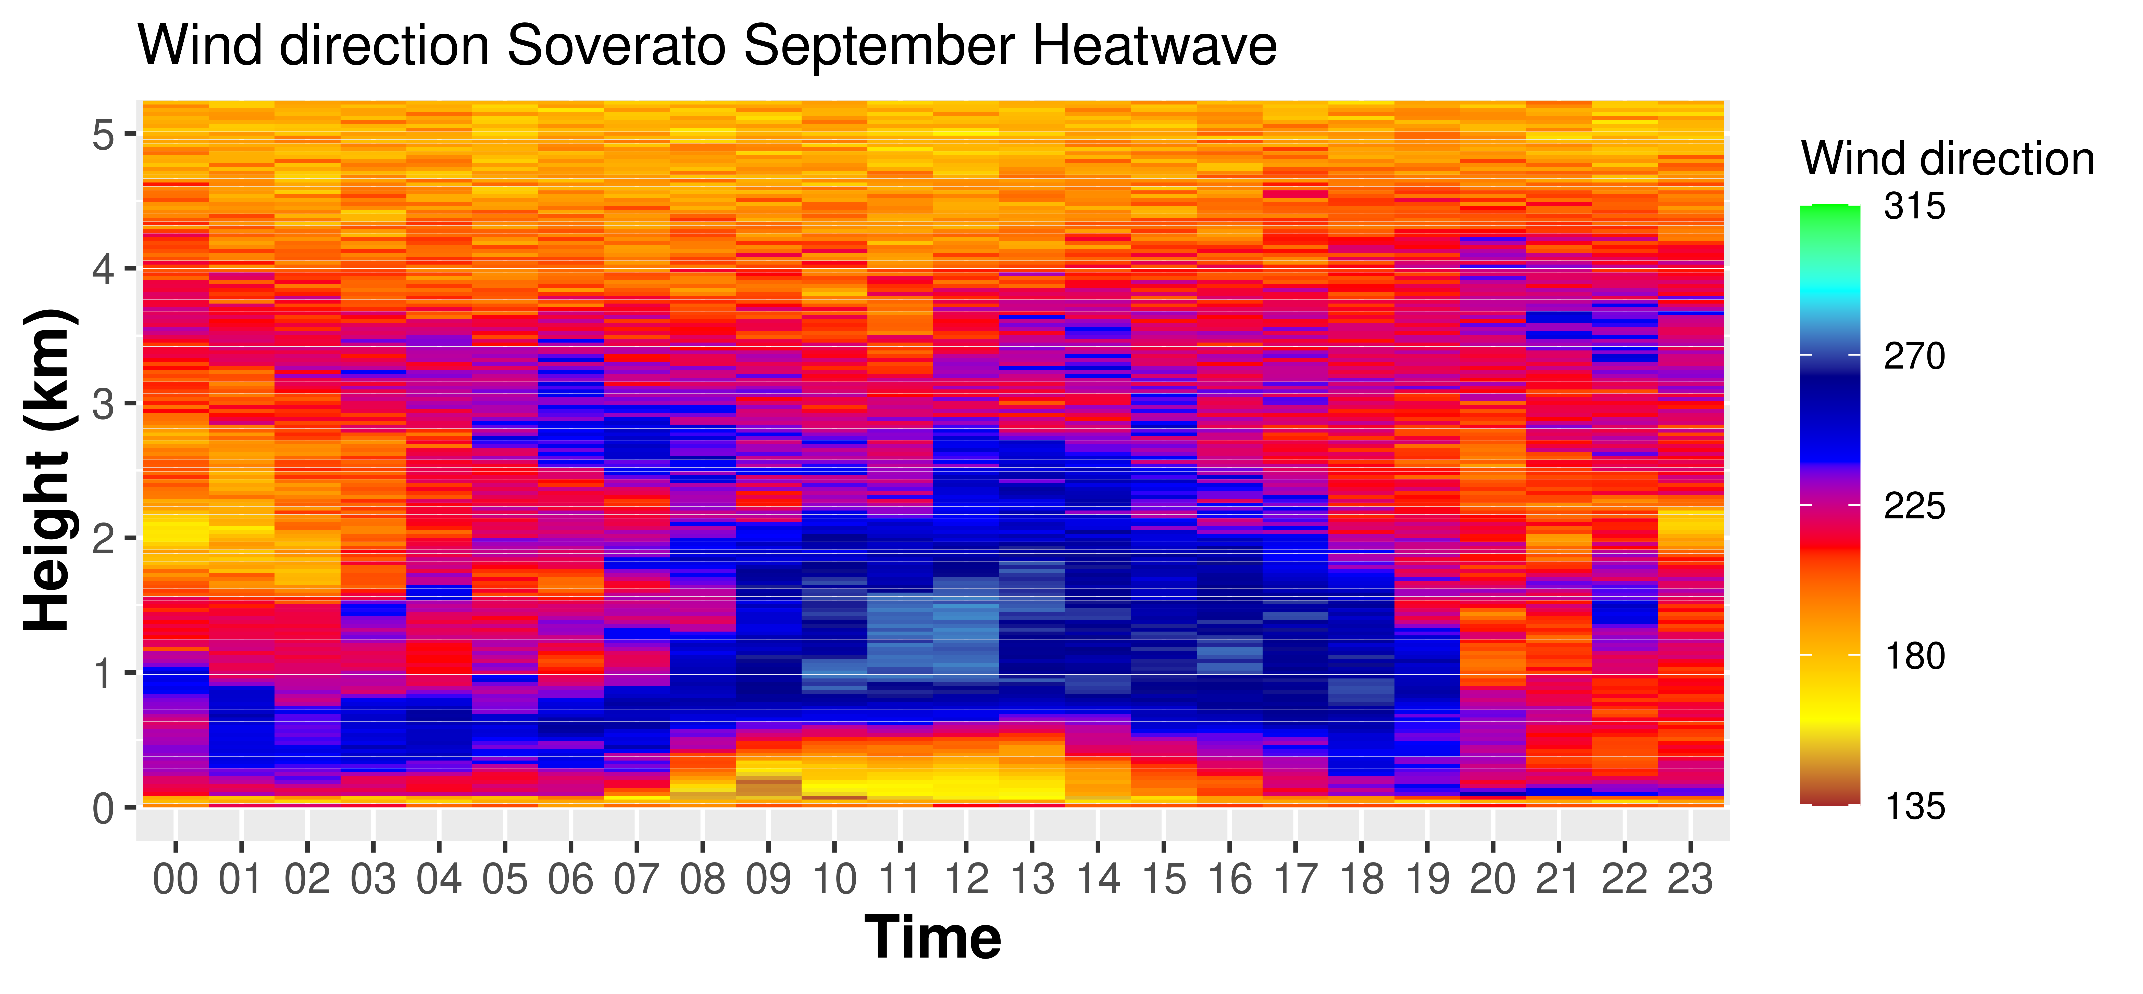
Selected cases: Heatwave
We indentify three different periods comparing the maximum daily temperatures recorded during the campaign with the Tx90* resulting from the reference period for the same day.
In June and July the synoptic circulation dominates over the land-sea breeze circulation.
In September the land-sea breeze regime acts as an element that mitigates the effect of the heatwave.
TX90 is a climate index representing the 90th percentile of daily maximum temperatures (TX) over a specific period, such as a year or a season, often calculated for a baseline climate period (e.g., 1961-1990). Heatwave is defined like a period during which the daily maximum temperature exceeds for more than five consecutive days the Tx90 by 5°C

Slide 4
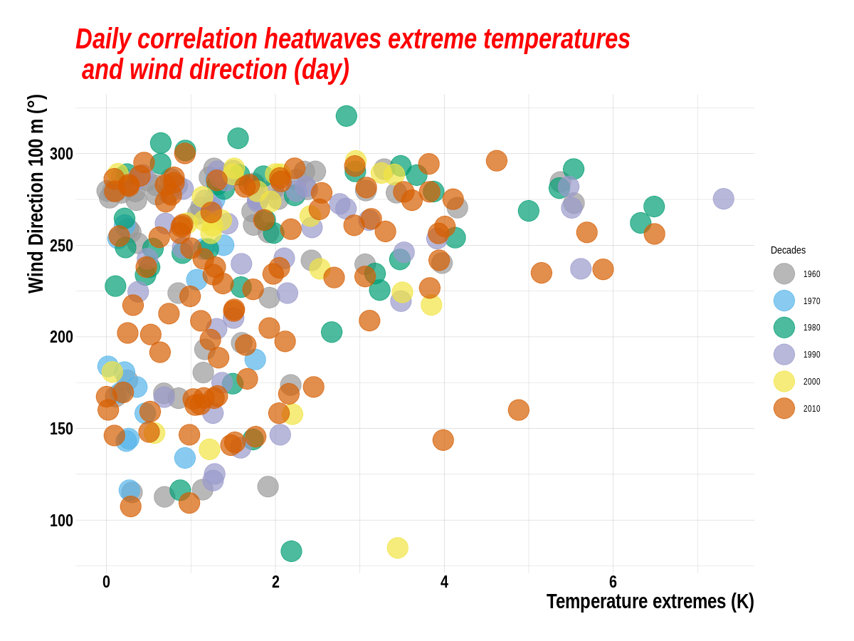
Temperature extremes: all days, including those not classified as heatwave periods, during which the temperature exceeds the 90th percentile threshold (Tx90) by more than 5 °C
During daytime the temperature extremes are distributed mainly from the NW and E-SE directions.
The magnitude of temperature extremes shows no differences across the decades
The highest values for wind from W-NW

Slide 5
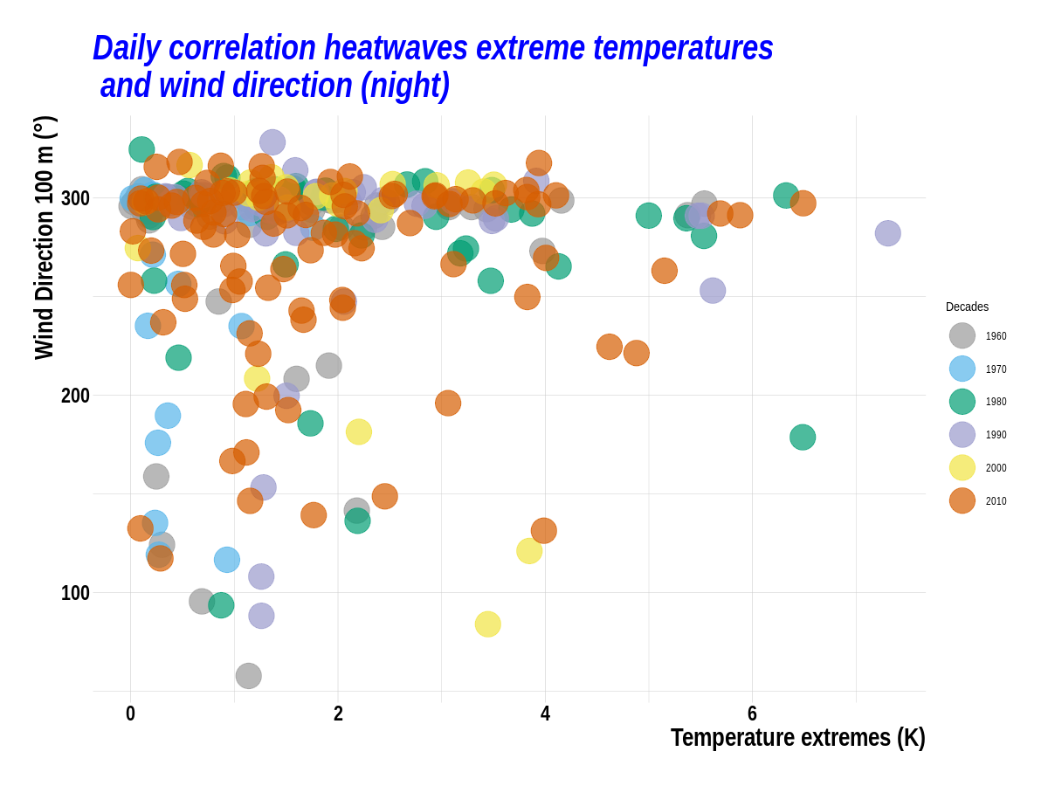
During nighttime the correlations with the NW direction is even more marked because in addition to the anticyclonic circulation, the local dynamic of land -sea breeze is overlapping.
Winds from SE-SW are related to less marked and less frequent temperature extremes.

Slide 6
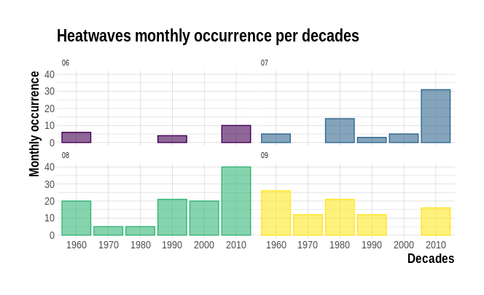
Soverato's Climatological study
Marked increase in the frequency of extremes in the decade 2010-2020, especially during July and August
This is in agreement to the increase of general temperature in the last decade on the Mediterranean basin.
(IPCC, 2021)
Temperature extremes monthly occurrence per decades
1960-1970 n° cases = 57
1970-1980 n° cases = 17
1980-1990 n° cases = 40
1990-2000 n° cases = 40
2000-2010 n° cases = 25
2010-2020 n° cases = 97
All the temperature extremes,TX90 and wind direction at 100m are calculated from ERA5 reanalysis.
Copernicus Climate Change Service, Climate Data Store, (2023): ERA5 hourly data on single levels from 1940 to present.
Copernicus Climate Change Service (C3S) Climate Data Store (CDS). DOI: 10.24381/cds.adbb2d47

Slide 7

Conclusions
More marked and frequent extremes when wind direction came from NW
Highest extremes in 1980 and 1990 with NW wind
Increase in heatwave frequency over the last 10 years (2010-2020)
In September the African ridge is less intense and so the strength of the local land-sea breeze act as a mitigation in extreme temperatures.
Next step
Extend the period of the study of the local land-sea breeze
Extend this type of study to the CIAO Observatory, where all this instrumentation is always present and operational
Extend the analysis to the Italian sites that have a wind lidar (e.g. Lampedusa and L'Aquila)
In addition, the availability of mobile instruments makes it possible to perform the same type of study and analysis at different sites across the Italian territory, which is increasingly affected by heatwaves.

Slide 8
ilaria.gandolfi@cnr.it​
​
www.ciao.imaa.cnr.it

