Slide 1


Tracing Carbon in the Sky: CO₂ and CH₄ Isotope Signatures under Dust and Fire Events at the POT Station,
Part of the CIAO Observatory (CNR-IMAA)
I.Zaccardo^{1,2}, A. Buono¹, E. Lapenna¹, F. Cardellicchio¹, T. Laurita¹, D. Amodio¹, C. Colangelo¹, G. Di Fiore¹, S. Trippetta¹, G. Masiello², L. Mona¹
¹ National Research Council – Institute of Methodologies for Environmental Analysis (CNR-IMAA), Contrada S. Loja, I-85050, Tito Scalo, Potenza, Italy,
² Department of Engineering, University of Basilicata, Via dell’ Ateneo Lucano, 10, I-85100 Potenza, Italy

Slide 2

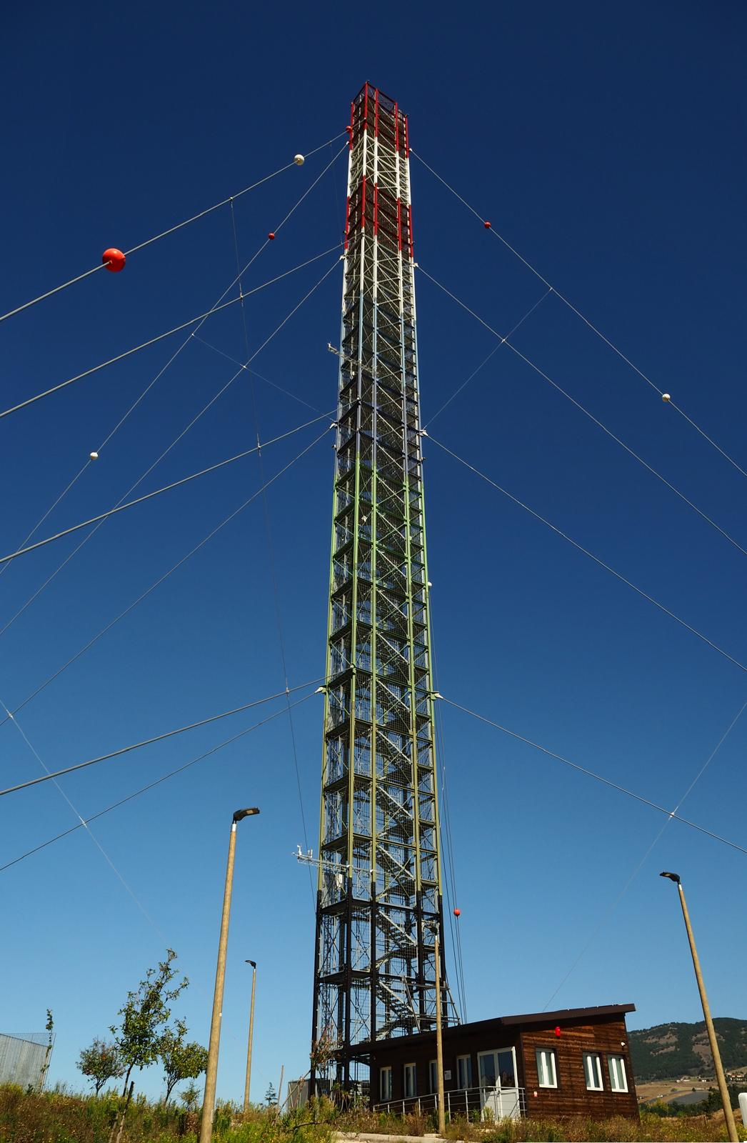
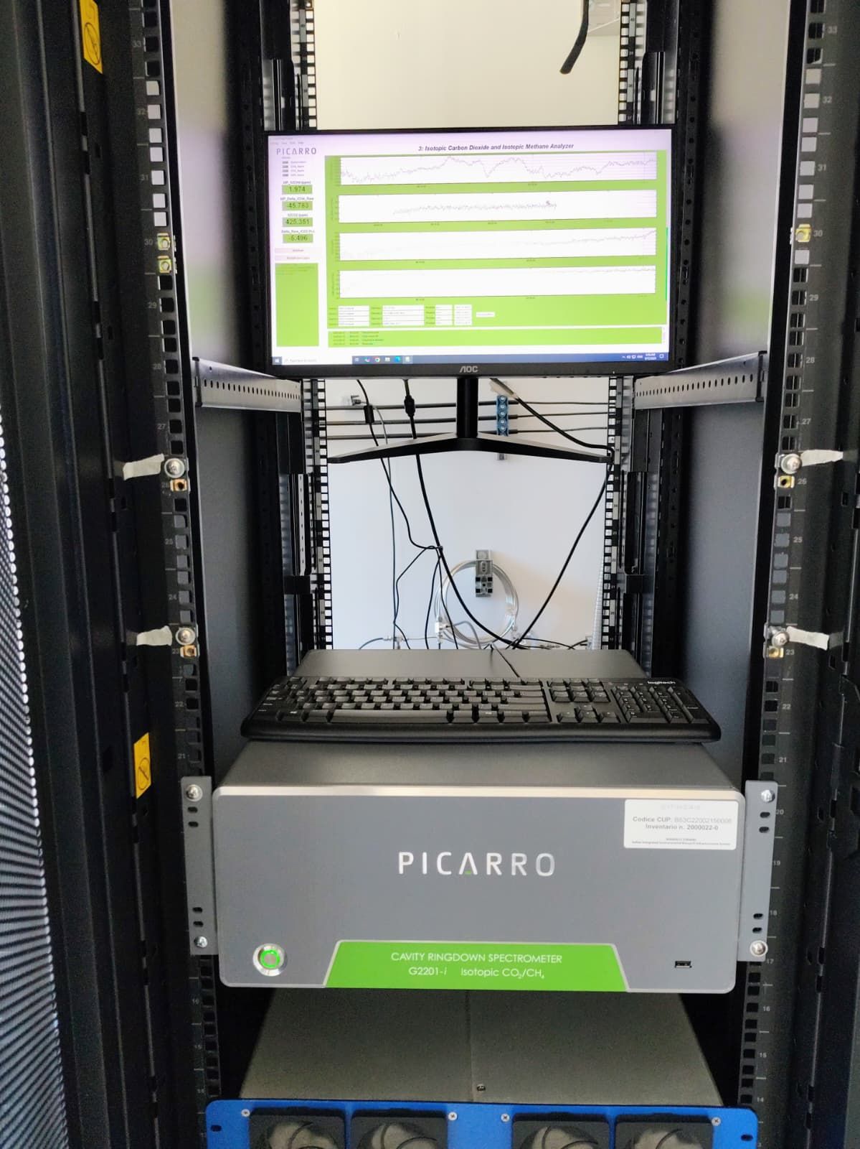
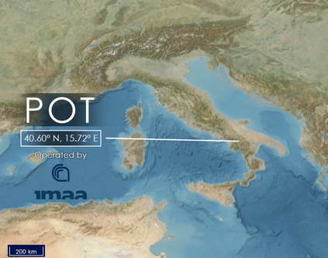
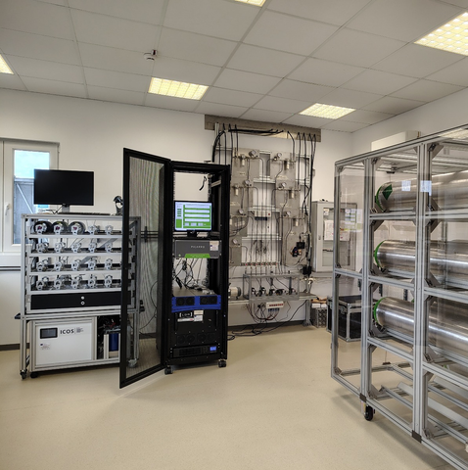
ISOTOPIC CARBON MONITORING
Instrument for stable carbon isotope analysis of CO₂ and CH₄, purchased with ITINERIS
ICOS tower and lines used for the instrument implementation
2 ITINERIS TNAs for gaining expertise on isotope analysis
1 high-resolution isotopic dataset
2 papers
Buono, A. et al. (2025). Dataset. ITINERIS HUB
Buono, A. et al. Atmosphere, 2025
Lapenna, E. et al. Atmosphere, 2025
Zaccardo, I. et al. In preparation
ITINERIS 3rd general meeting-Rome, 25-26/09/2025

Slide 3
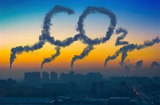
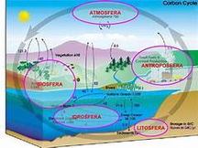
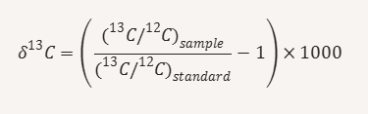
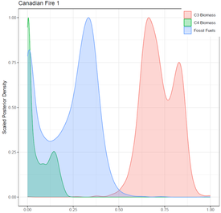
Which Are Stable Carbon Isotopes?
  Carbon atoms with different neutron numbers but the same atomic number
  Non-radioactive and do not decay over time
  Useful for source apportionment
The Role of Isotopic Analysis in Atmospheric Research
Identifying Emission Sources
Ratio of ¹³C to ¹²C (¹³C/ ¹²C)in a sample
Vienna Pee Dee Belemnite (VPDB) Reference standard
Delta values δ¹³C–CH₄, δ¹³C–CO₂ (‰)
  ¹²C (about 98.9%)
  ¹³C (about 1.1%)
Studyng Carbon Exchange between Atmosphere, Biosphere and Oceans
Improving Climate Models for Source Apportionment and Greenhouse Gas Inventories
ITINERIS 3rd general meeting-Rome, 25-26/09/2025

Slide 4
Isotopic Fingerprints of Natural and Anthropogenic Emissions
δ¹³C–CH₄
δ¹³C–CO₂
  Atmospheric background: ~ –47‰
  Biogenic sources:
  wetlands, rice paddies, ruminants → –65‰ to –55‰
  Fossil fuel sources:
  fugitive emission→ –55‰ to –25‰
  incomplete combustion (natural gas, coal, oil)→ –29‰ to –13‰
  Biomass burning (CH₄):
Variable depending on vegetation type → –30‰ to –20‰
  Atmospheric background: ~ –7.5‰
  Fossil fuel combustion:
Coal, gasoline, natural gas → –30‰ to –28‰
  Biomass burning:
  -C₃ vegetation (e.g., trees, shrubs) → –35‰ to –25‰
  -C₄ vegetation (e.g., savanna grasses) → –16‰ to –12‰
ITINERIS 3rd general meeting-Rome, 25-26/09/2025

Slide 5
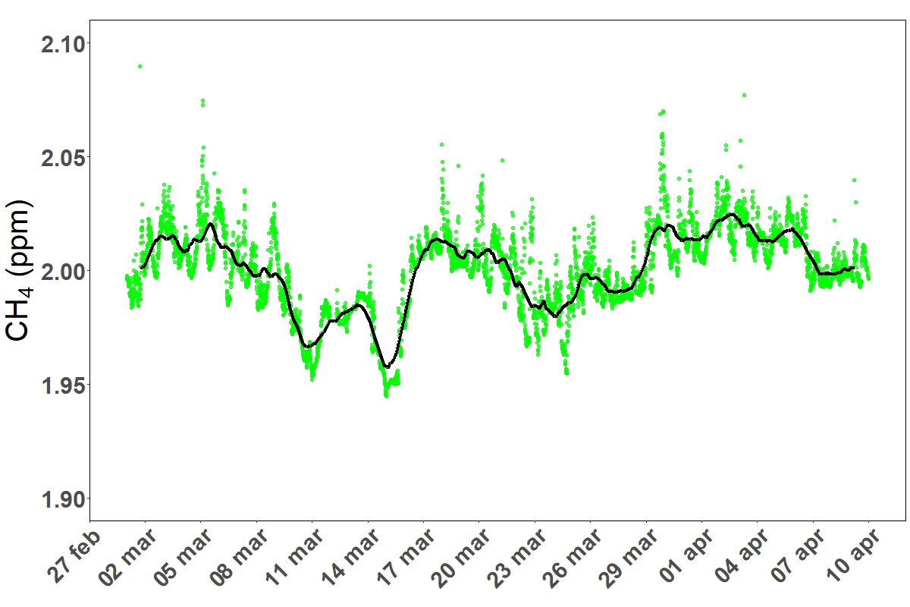
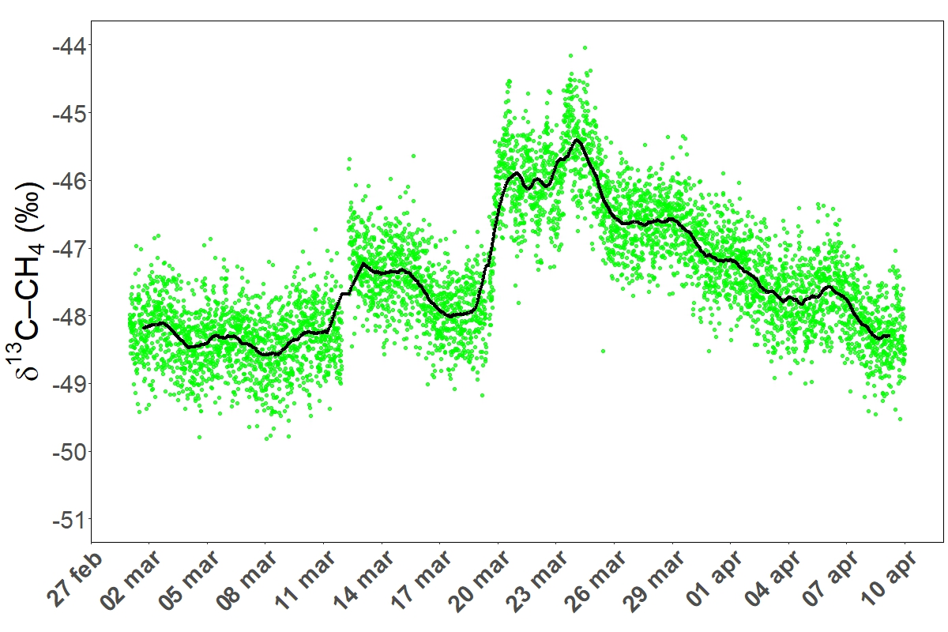
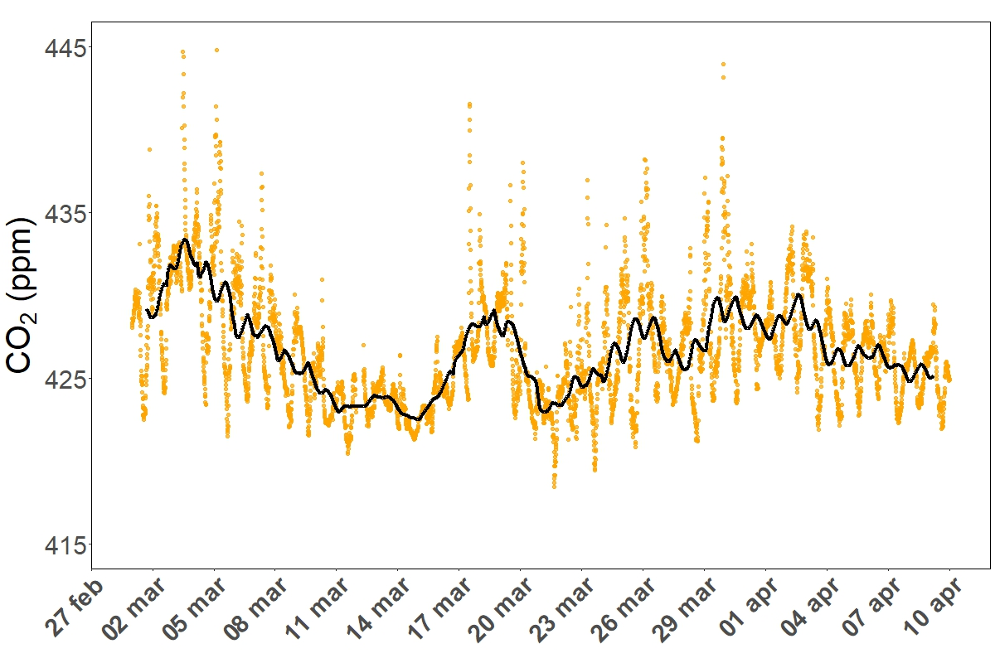
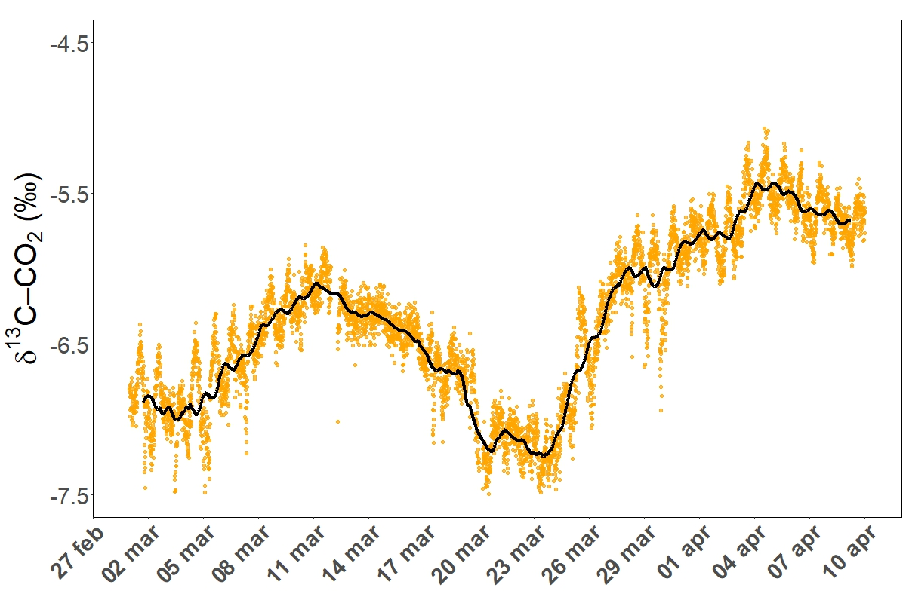
Can Saharan Dust Intrusions Alter the Isotopic Composition of CH₄ and CO₂?
  CH₄ ↓ → Decrease in mole fractions suggests isotopic fractionation
  δ¹³C–CH₄ ↑ → Enrichment indicates enhanced oxidation linked to mineral aerosols.
  MDSA mechanism by Marten et al. (2023)
  CO₂ ↑ → Increased concentrations due to reduced photosynthesis (radiative suppression).
  δ¹³C–CO₂ ↓ → Decline reflects lower ¹²CO₂ uptake during dust events.
  Kinetic Isotopic Effect
  Paper under review
1
2
3
1
2
3
1
2
3
1
2
3
ITINERIS 3rd general meeting-Rome, 25-26/09/2025

Slide 6
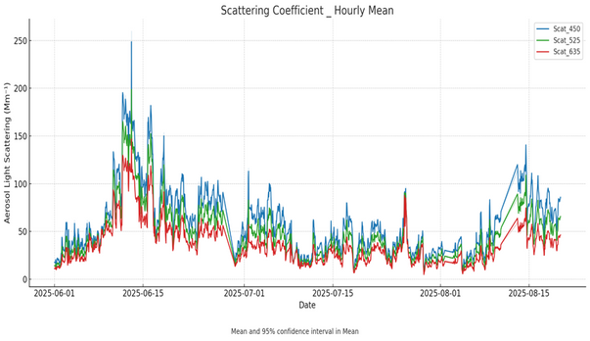
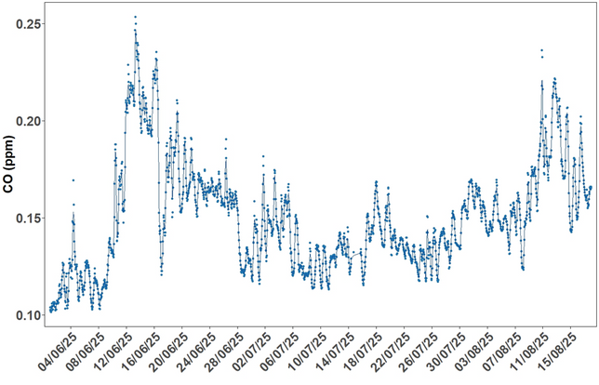
Wildfires Observations, Isotopic Tracers and Source Apportionment
-Methodology-
– CO Peak Detection
2. – Peaks in scattering coefficients
Canadian Fire
Canadian Fire
ITINERIS 3rd general meeting-Rome, 25-26/09/2025

Slide 7
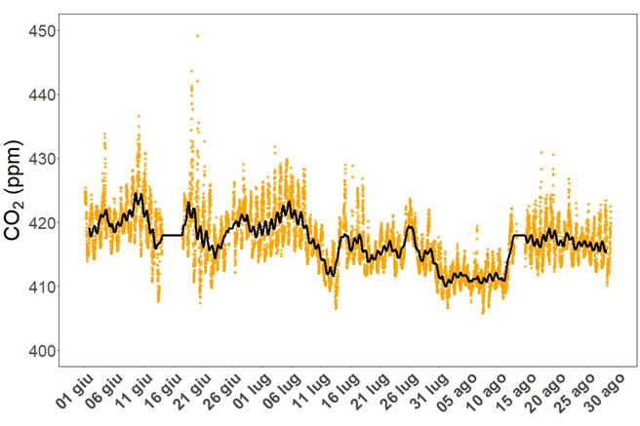
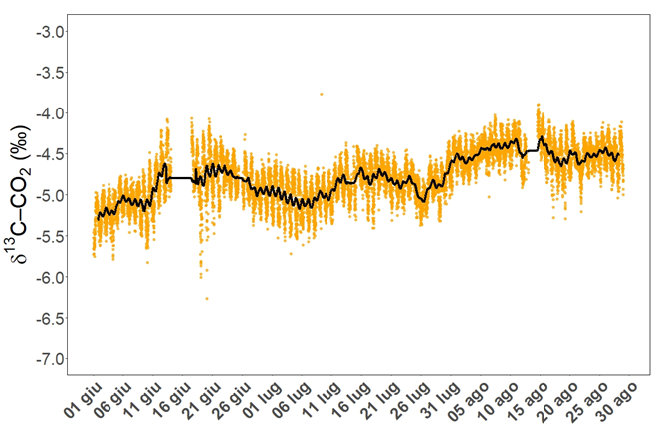
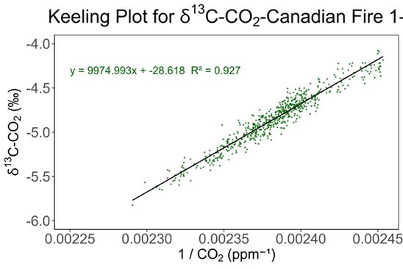
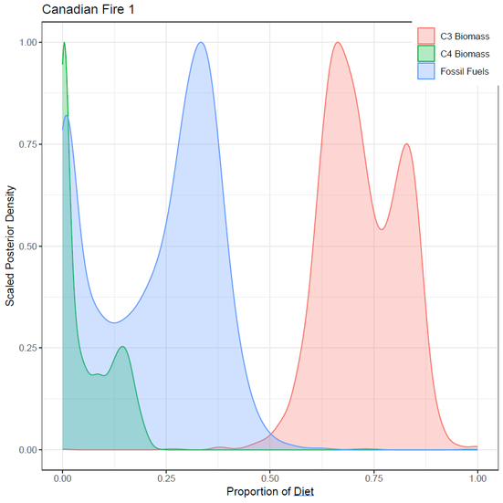
3. High-Frequency Isotopic Monitoring
4. Keeling Plot Construction
5. Bayesian Mixing Model (MixSIAR)
ITINERIS 3rd general meeting-Rome, 25-26/09/2025

Slide 8
Perspectives
Expand Temporal Coverage Extend isotopic monitoring across multiple seasons to capture long-term trends and variability.
Model Coupling Combine isotopic data with atmospheric transport models to improve spatial resolution of source apportionment.
Policy Relevance Translate findings into actionable insights for climate mitigation strategies and emission inventories.
Cross-Station Collaboration Enhancing collaborative efforts within the emerging national consortium for isotope monitoring
ITINERIS 3rd general meeting-Rome, 25-26/09/2025

