Slide 1
Comparison of reference upper-air GRUAN and homogenized RHARM data with GNSS-RO.
F. Marra, E. Tramutola, I. Gandolfi, G. Cosimato, M. Rosoldi and F. Madonna.
Corresponding author e-mail: fabrizio.marra@cnr.it

Slide 2
Objective
Compare data from spatially complete global upper-air measurements with:
  GCOS Upper-Air Reference Network (GRUAN, www.gruan.org), for evaluating the accuracy of a novel bias-adjustment algorithm for temperature profiles;
  Global Navigation Satellite Systems - Radio Occultation (GNSS-RO, https://rom-saf.eumetsat.int/) to assess performances of GNSS-RO temperature profiles in the UT/LS and relative humidity profiles.
For the comparison, data from the Integrated Global Radio Sounding Archive (IGRA), available from NOAA NCEI and the bias-adjusted Radiosounding HARMonization (RHARM) dataset, available from Copernicus Data Store (https://cds.climate.copernicus.eu/cdsapp#!/dataset/insitu-observations-igra-baseline-network?tab=overview), are considered.
This study focuses on a subset of 100 RHARM stations with longest data records (since 2006).
The use of datasets like GRUAN and RHARM, where bias correction and uncertainty quantification are applied, enhances the reliability of comparisons and supports the development of robust climate indicators.

Slide 3
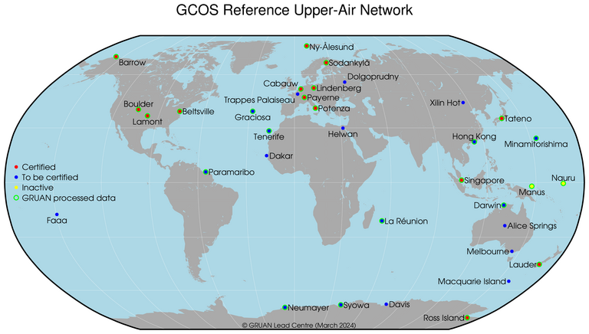


GRUAN
The GRUAN archive provides high-quality upper-air measurement data since 2008, including raw data and related metadata.
33 sites worldwide, of which 14 are GRUAN-certified. In Italy: Potenza (CIAO observatory) active since 2011 and certified in 2015, 2019 and 2024. In addition, Potenza hosts the backup of the GRUAN radiosonde database within its IT infrastructure.
GRUAN observation processing is designed to adjust systematic errors in radiosonde measurements and to quantify how the uncertainties related to these error sources are derived.

Slide 4
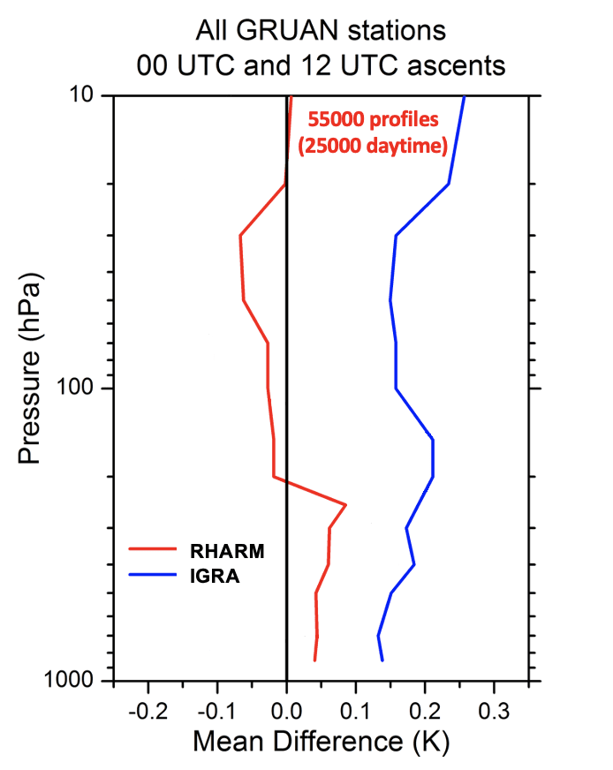
Temperature comparison: IGRA and RHARM with GRUAN
The figure shows the comparison between the average differences of the GRUAN, IGRA and RHARM temperature profile data (full period from 2008 to 2022) at the mandatory levels from 850 hPa to 10 hPa.
Result: the comparison reveals that the profile of RHARM (in red) has smaller differences, up to 0.1 K, than IGRA (in blue), up to 0.25 K. This is due to the use of bias-adjustment algorithms in RHARM.

Slide 5
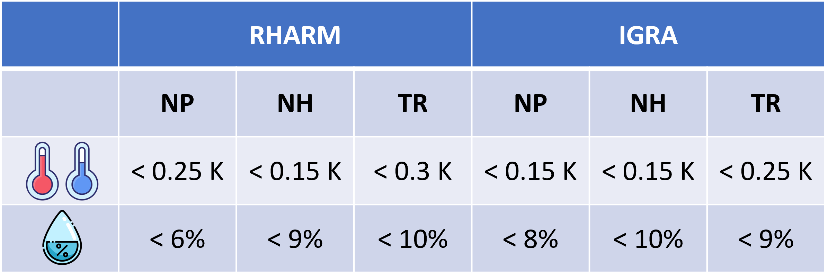
Other results and outlooks
GNSS-RO data have been compared with RHARM and IGRA data by latitudinal sector (NP, 60°N-90°N; NH, 25°N-60°N; TR, 25°S-25°N), showing a bias for temperature and relative humidity, in the Upper Troposphere/Lower Stratosphere (UT/LS) up to:
Comparison of GNSS-RO with IGRA shows an additional bias, in the GNSS-RO temperature and relative humidity profiles, up to 0.1 K and 6% for the NH, up to 0.2 K and 6% for the NP and up to 0.3 K and 12% for the TR.
GNSS-RO is closer to IGRA, while GRUAN is closer to RHARM. GRUAN is the reference for reliable upper-air measurements; RHARM matches GRUAN, while GNSS-RO is not a reference dataset.
A scientific paper on these results is in preparation.
The comparison will be extended to all RHARM stations, investigating also seasonal differences at all latitudes.

Slide 7
BACKUP SLIDES

Slide 8
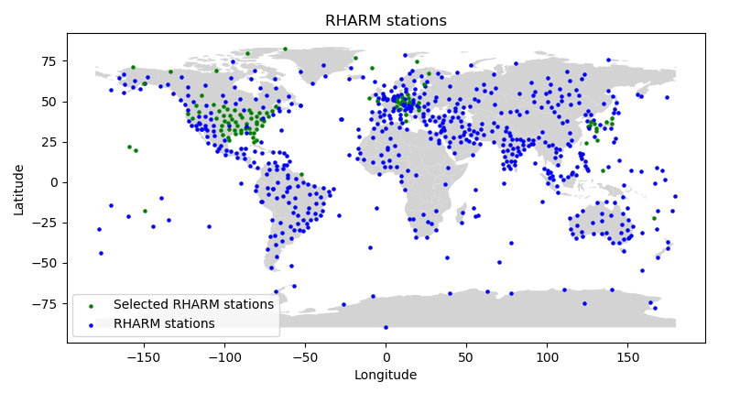

IGRA – RHARM Radiosounding Archive
IGRA is one of the largest data archive of global radiosounding profiles to which quality assurance procedures apply. However, data on uncertainties are not available (Durré et al., 2018).
The measurements available in RHARM (Madonna et al., 2022) are bias-adjusted for approximately 700 IGRA stations, using an approach mimicking the GRUAN data processing (Dirksen et al., 2014). Furthermore, measurement uncertainties are also provided.
In this work, a subset of 100 RHARM stations (which also belong to the IGRA network), those with the longest data record since 2006 (green dots), have been considered. In future, the comparison will be extended to all the RHARM stations (blue dots).

Slide 9
GNSS-RO
The GNSS-RO data used for the comparison with IGRA and RHARM belongs to the mission COSMIC and METOP B-C (provided by EUMETSAT ROM SAF).
A collocation spatial-temporal criteria of 200 km / 3 h is used (GRUAN Task Team (TT) satellite recommended).
The figure illustrates the locations to which radio occultation profiles from all satellites are provided on June 7, 2021.

Slide 10
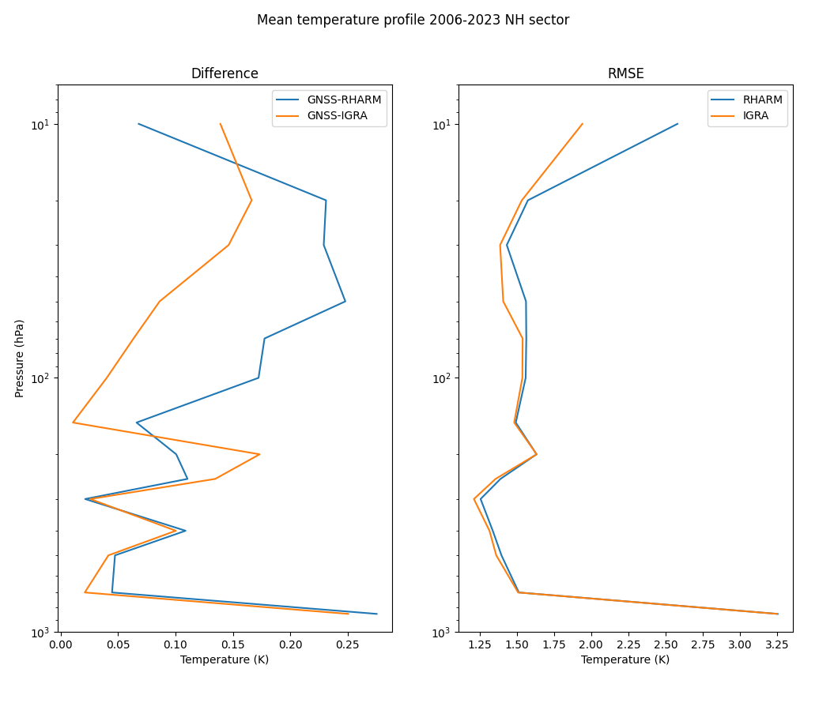
Temperature comparison: IGRA and RHARM with GNSS-RO
As for relative humidity, the comparisons were carried out at different latitude ranges on the average annual profile. The differences and RMSE for stations in the Northern Hemisphere mid-latitudes (NH, 25°N-60°N) are shown in the figure.
The figure highlights a similar difference up to 250 hPa, while, at lower pressure, the IGRA difference (in orange) is less than the RHARM difference (in blue).
The bias of GNSS-RO and IGRA is enhanced in the comparison with RHARM. This indicates an additional 0.1 K bias in the GNSS-RO temperature profile.

Slide 11
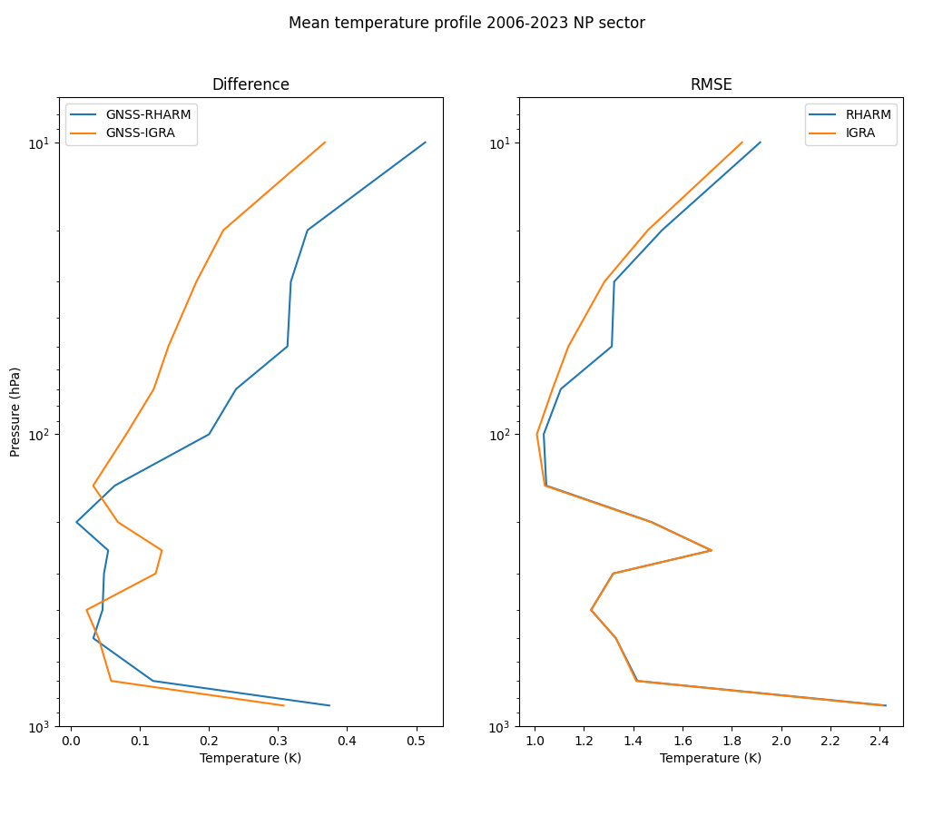
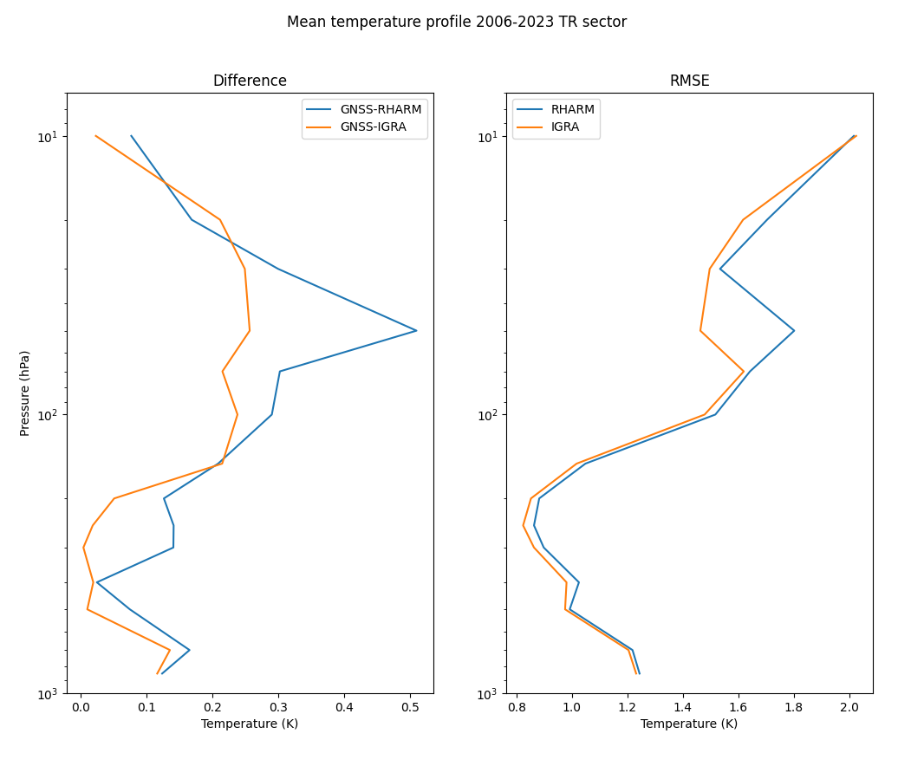
Temperature comparison: IGRA and RHARM with GNSS-RO
On the left, the difference for the Northern Hemisphere polar latitudes (NP, 60°N-90°N) and on the right for the Tropics (TR, 25°S-25°N). The bias of GNSS-RO and IGRA is enhanced in the comparison with RHARM, indicating an additional 0.2 K bias for NP and 0.3 K for TR in the GNSS-RO temperature profile.

Slide 12
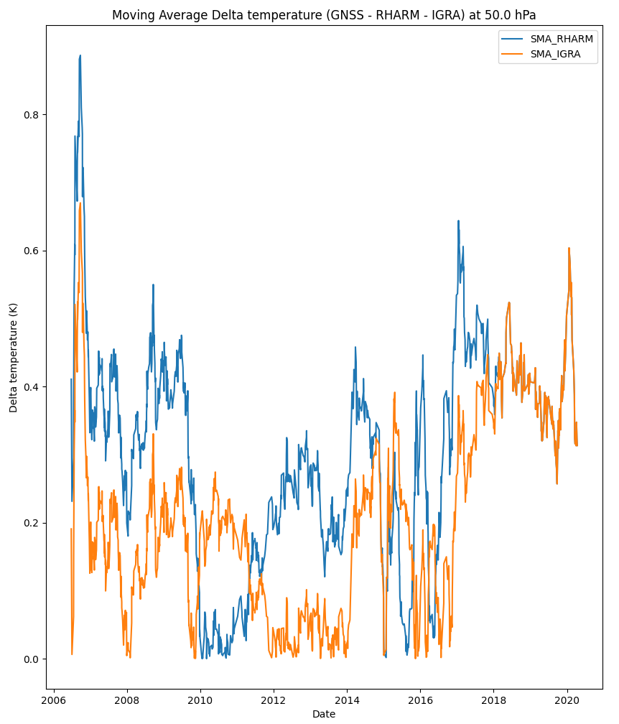
Temperature comparison: IGRA and RHARM with GNSS-RO
The figure shows an example of the moving average temperature differences for the Sodankyla station (67.37°N, 26.63°W) for the 50-1 hPa atmospheric level.
The Figure shows smaller differences for IGRA measurements, except for the periods 2010-2012 and 2015-2016, compared to RHARM, compared to GNSS-RO.
Furthermore, for the 2018-2021 period, the RHARM differences overlap with those of IGRA due to the smaller amount of available data.

Slide 13
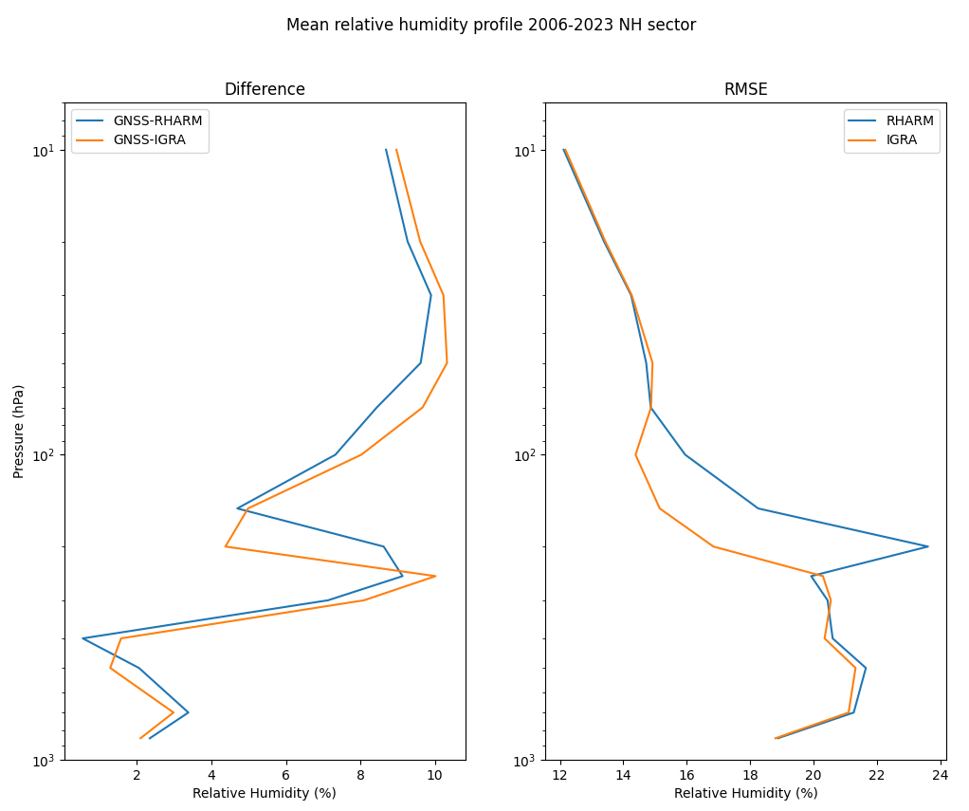
Relative Humidity comparison: IGRA and RHARM with GNSS-RO
As for the temperature, the comparisons were carried out at different latitude ranges on the average annual profile. The differences and RMSE for stations in the Northern Hemisphere mid-latitudes (NH, 25°N-60°N) are shown in the figure.
The figure highlights a similar difference for the whole profile, except for 200 hPa, where the differences of IGRA (in orange) and RHARM (in blue) with GNSS-RO differ by 4%. Typically, the RHARM difference is less than the IGRA difference.
The bias of GNSS-RO and IGRA is enhanced in the comparison with RHARM. This indicates an additional 6% bias in the GNSS-RO relative humidity profile.

Slide 14
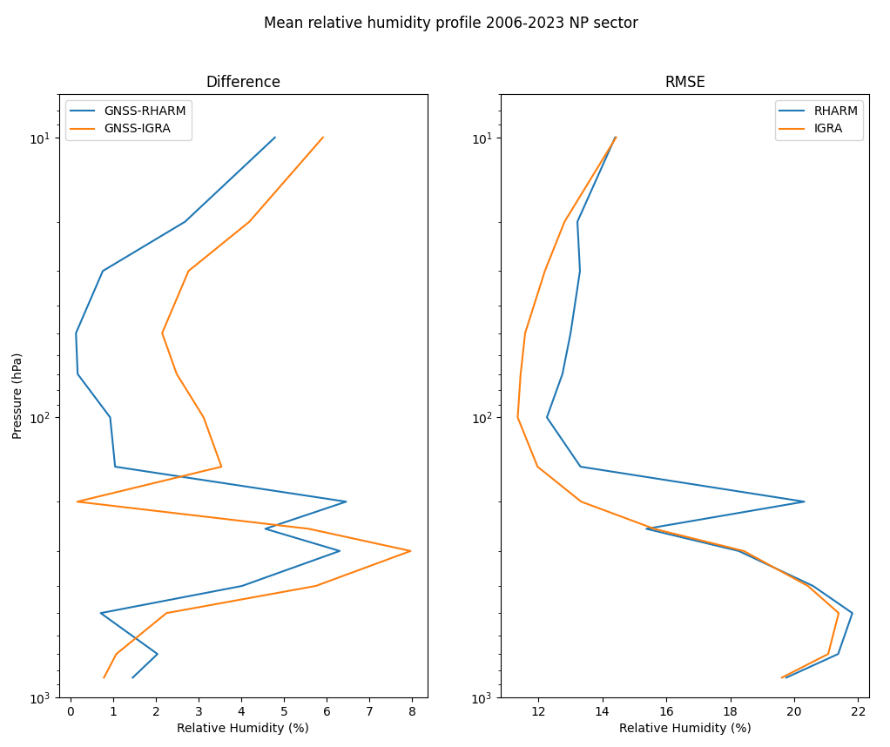
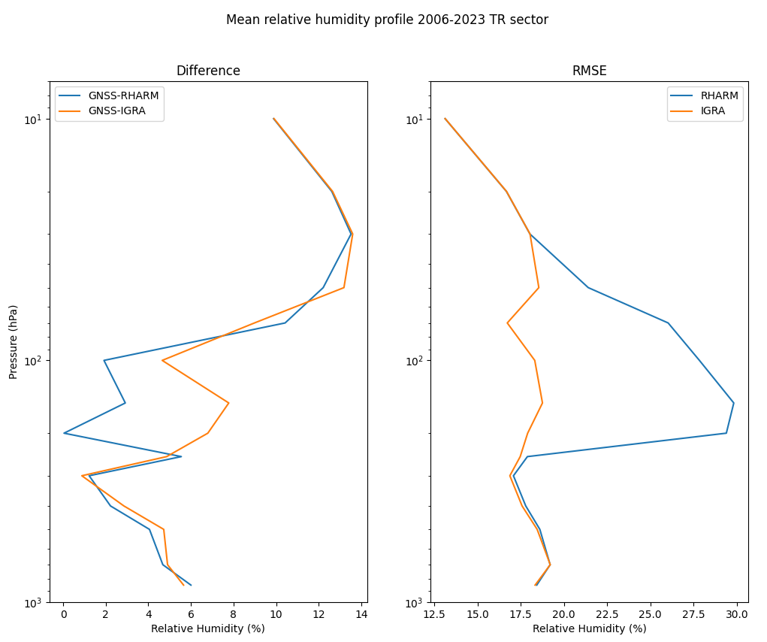
Relative Humidity comparison: IGRA and RHARM with GNSS-RO
On the left, the difference for the Northern Hemisphere polar latitudes (NP, 60°N-90°N) and on the right for the Tropics (TR, 25°S-25°N). The bias of GNSS-RO and IGRA is enhanced in the comparison with RHARM, indicating an additional 6% bias for NP and 12% for TR in the GNSS-RO relative humidity profile.

Slide 15
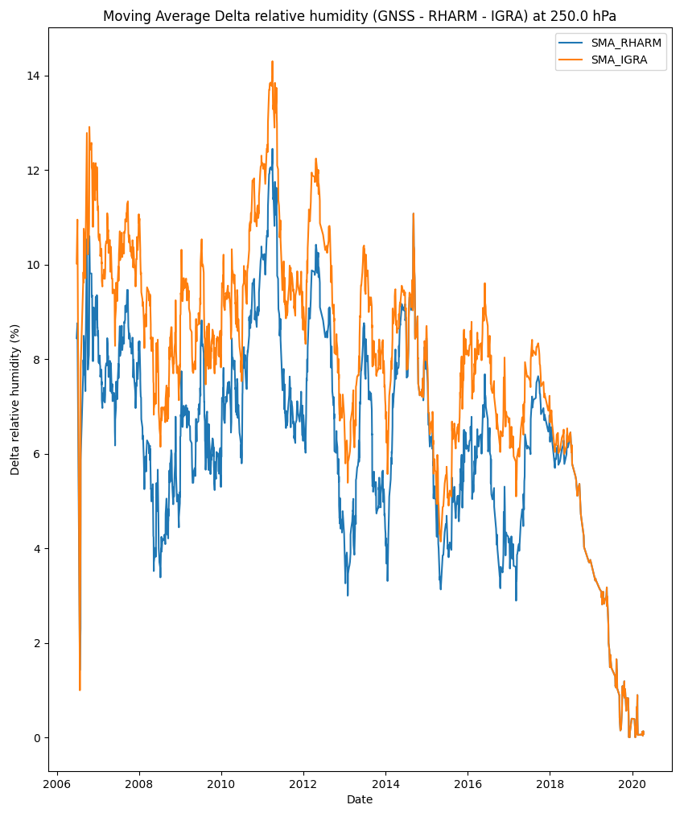
Relative Humidity comparison: IGRA and RHARM with GNSS-RO
The figure shows an example of the moving average relative humidity differences for the Sodankyla station (67.37°N, 26.63°W) for the 250 hPa atmospheric level.
The Figure shows smaller differences for RHARM measurements (in blue), compared to IGRA (in orange), compared to GNSS-RO.
Furthermore, for the 2018-2021 period, the RHARM differences overlap with those of IGRA due to the smaller amount of available data.

