Slide 1
Enhanced atmospheric observation capacity of the Seneca III airborne platform
F. Cairo, F. Pasqualini, M. Zanatta, S. Pignatti, A. Marinoni,
L. Di Liberto, F. Ferraccioli
CNR OGS

Slide 2
Scientific relevance of airborne observations in the Mediterranean
Mediterranean Basin = climate-change hotspot
  +1.5 °C vs. pre-industrial (≈ +35 % above global mean rise)
Key aerosol classes influencing radiative budget
  Mineral dust - Biomass-burning smoke – Marine and biogenic aerosol - Urban/industrial
Goal
  Understand, quantify, and predict climate impacts of Mediterranean aerosol anomalies
Platform
  Piper Seneca 3 with advanced aerosol instruments
  Prior Italian campaigns: limited (balloons, zeppelins, IAGOS transits) → poor temporal coverage
Benefits
  High-precision in-situ measurements (3D observations)
  Better knowledge of aerosol properties and their effect on Mediterranean climate
Focus
  Mid and upper troposphere processes, poorly known and misrepresented in climate models

Slide 3
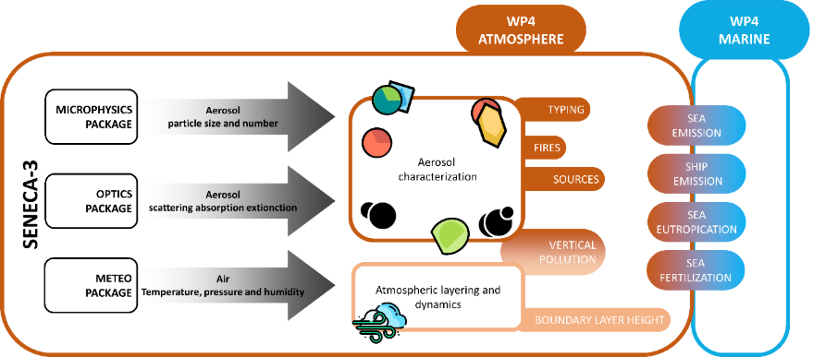
AIRBORNE measurements within ITINERIS
WP5

Slide 4
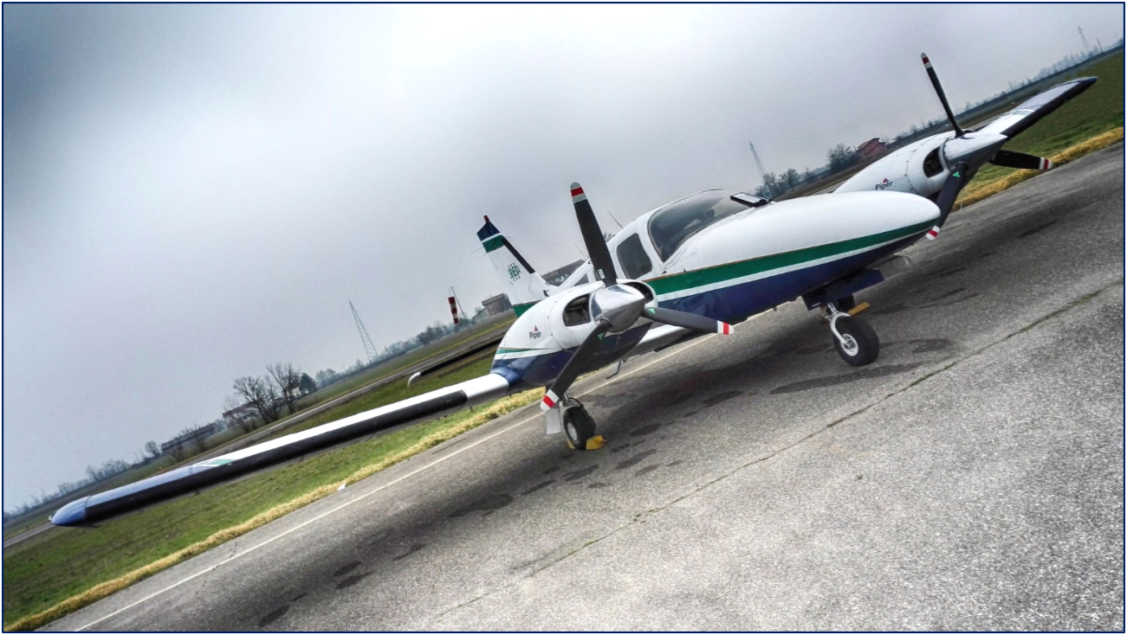


PIPER SENECA III
Cruise Speed 188 kts
Stall Speed (dirty) 61 kts
Gross Weight 2165 kg
Empty Weight 1457 kg
Range 870 nmi (1611 Km)
Service Ceiling 25000 ft
Seats 6
PIPER SENECA III – PA 34-220T

Slide 5
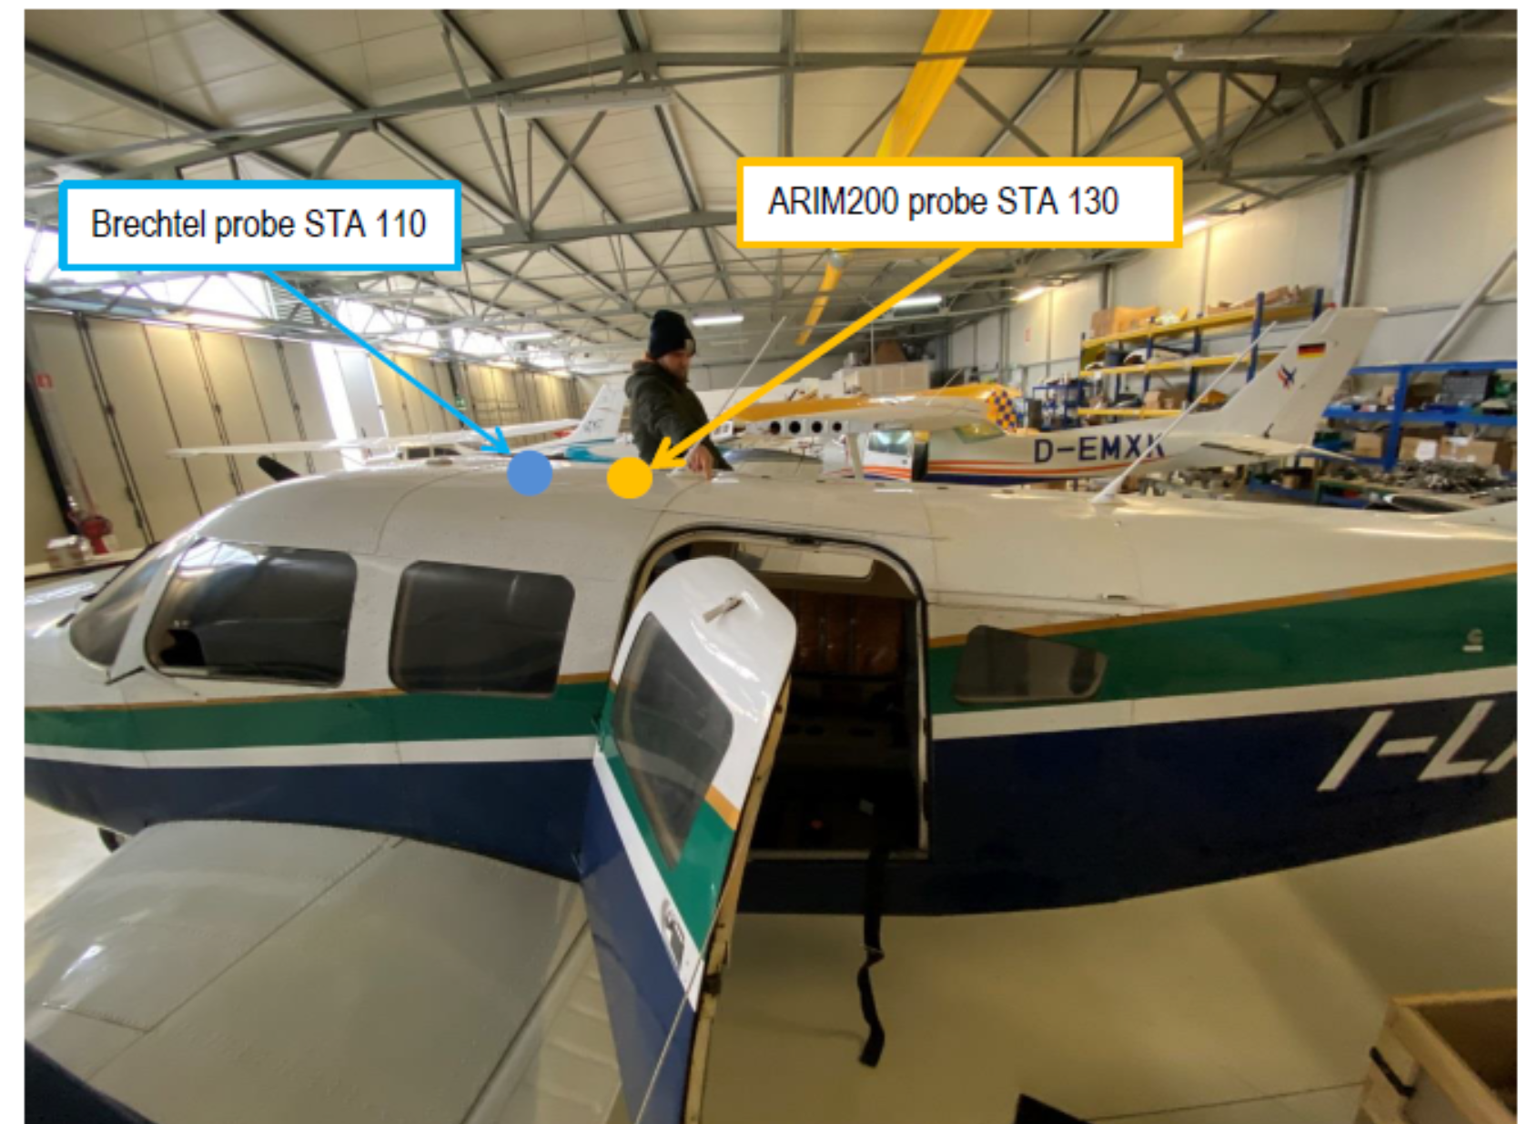
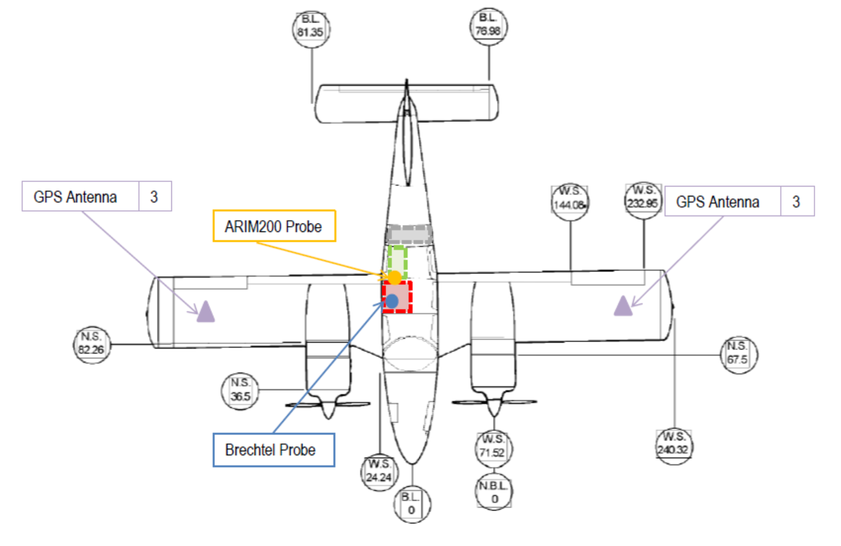

Sampling System
The Brechtel ISO‑1200 isokinetic inlet (delivery due Q4 2024) guarantees representative transmission from < 10 nm to 4 µm across 40–90 m s⁻¹ true‑air‑speed. An ISO‑90 bend and SP025 splitter distribute flow to cabin racks.

Slide 6
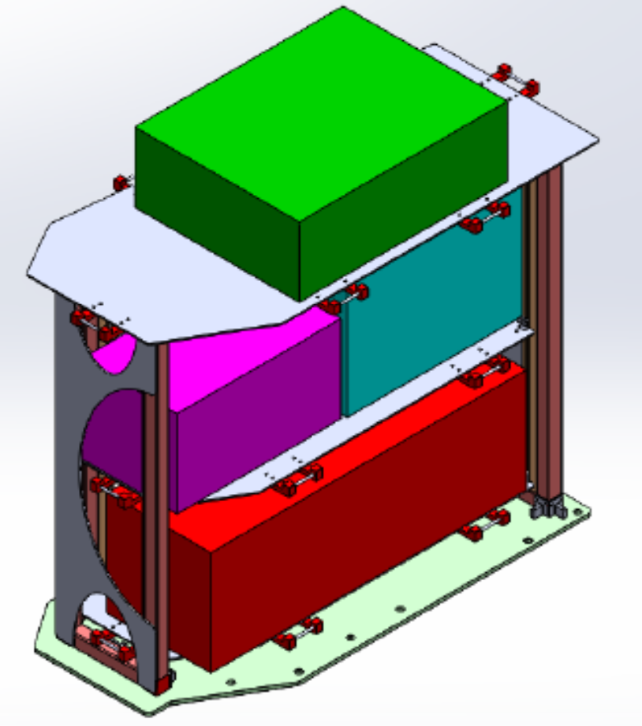
Instruments
Three aluminum racks, certified for airborne operations, have been installed to host the scientific instrumentation
Meteorological package
Aventech AIMMS‑30 probe delivers 50 Hz wind vectors, turbulence, T, P, RH and true air speed, enabling eddy‑covariance aerosol flux calculations.
Microphysics package
Instrument | Size/Range | Output
TSI WCPC 3789 | 2 nm – 3 µm | CN concentration
TSI FMPS 3091 | 5.6 – 560 nm | 1 Hz size dist. (32 bins)
TSI APS 3321 | 0.5 – 20 µm | PM mass & counts
TOPAS OPC LAP‑323 | 0.25 – 32 µm | Optical size dist.
Optical package
Magee AE33 aethalometer provides black carbon concentration and wavelength‑dependent aerosol absorption coefficient
Ecotech Aurora 3000 nephelometer obtains the aerosol scattering coefficient at 450/525/635 nm
Combining these two instruments the single‑scattering albedo will be calculated.

Slide 7
Ongoing Activities
DELIVERY AND COMMISSIONING TESTS
CERTIFICATION
ENHANCING ITALY’S AIRBORNE RESEARCH CAPACITY
All tenders have been finalized, all the equipment has been delivered and tested.
The certification pathway has been defined, and an application for Major Change was submitted to EASA in May 2025, paving the way for full approval and flight testing beyond the project’s timeframe.
This work represents a substantial step forward in reinforcing Italy’s capacity to contribute high-resolution, vertically resolved aerosol observations to the European airborne research infrastructure.
The observation capacity could be extended to gas and cloud components in the future.
The collaboration between CNR-ISAC and OGS ensures continuity towards operational deployment and scientific exploitation in international campaigns.

