Slide 1




Emissions of climate-altering species from open vegetation fires in the Mediterranean region -A review on methods and data
Rabia Ali Hundal^{1,2,3}, Saurabh Annadate^{1,2,3}, Rita Cesari,⁴ Alessio Collalti^{5,6} , Michela Maione^{1,2}, Paolo Cristofanelli^{1,}
Contact: rabia.hundal@iusspavia.it
1 Institute of Atmospheric Sciences and Climate (ISAC), National Research Council, 73100, I-40129 Bologna, Italy
2 University of Urbino - Department of Pure and Applied Sciences, I-61029, Urbino, Italy
3 Scuola Universitaria Superiore Pavia (IUSS), I-27100, Pavia, Italy
4 Institute of Atmospheric Sciences and Climate (ISAC), National Research Council, 73100, Lecce, Italy
5 Forest Modelling Lab., Institute for Agriculture and Forestry Systems in the Mediterranean (ISAFOM), National Research Council of Italy, 06128, Perugia, Italy
6 National Biodiversity Future Center (NBFC), 90133, Palermo, Italy

Slide 2
Introduction
Since the 19th century, GHG emissions have risen sharply, driving climate change.
Wildfires are a relevant source (~17.5%) of the main GHGs (CO₂, CH₄, N₂O) and contribute ~30–40 % of global BC. The Mediterranean is a climate hotspot: rising aridity, heatwaves, extreme fire years (2007, 2012, 2017).
Despite global progress, few studies target the Mediterranean; fire emissions here remain poorly quantified.
This work fills the gap by reviewing methods & inventories (2003–2020) for GHG & BC emissions in the region.

Slide 3
Objective
Emission estimates from four inventories (GFED, GFAS, FINN, EDGAR) were aggregated for the Mediterranean region (2003–2020), analyzing multi-annual and inter-annual variability, identifying major country contributors, and assessing discrepancies across datasets. GFED, GFAS, and FINN include all open vegetation fires (natural + anthropogenic), whereas EDGAR accounts only for anthropogenic emissions.
Study Region – Mediterranean Basin
Defined using HydroSHEDS catchments draining into the Mediterranean Sea (+ lower Nile).
Represents ~1.5% of global land surface.
Western/northern Iberian Peninsula not fully included in HydroSHEDS Mediterranean domain. Including it increases relative emission
Contributes ~0.2–0.4% of global wildfire CO₂ emissions (2003–2020).

Slide 4
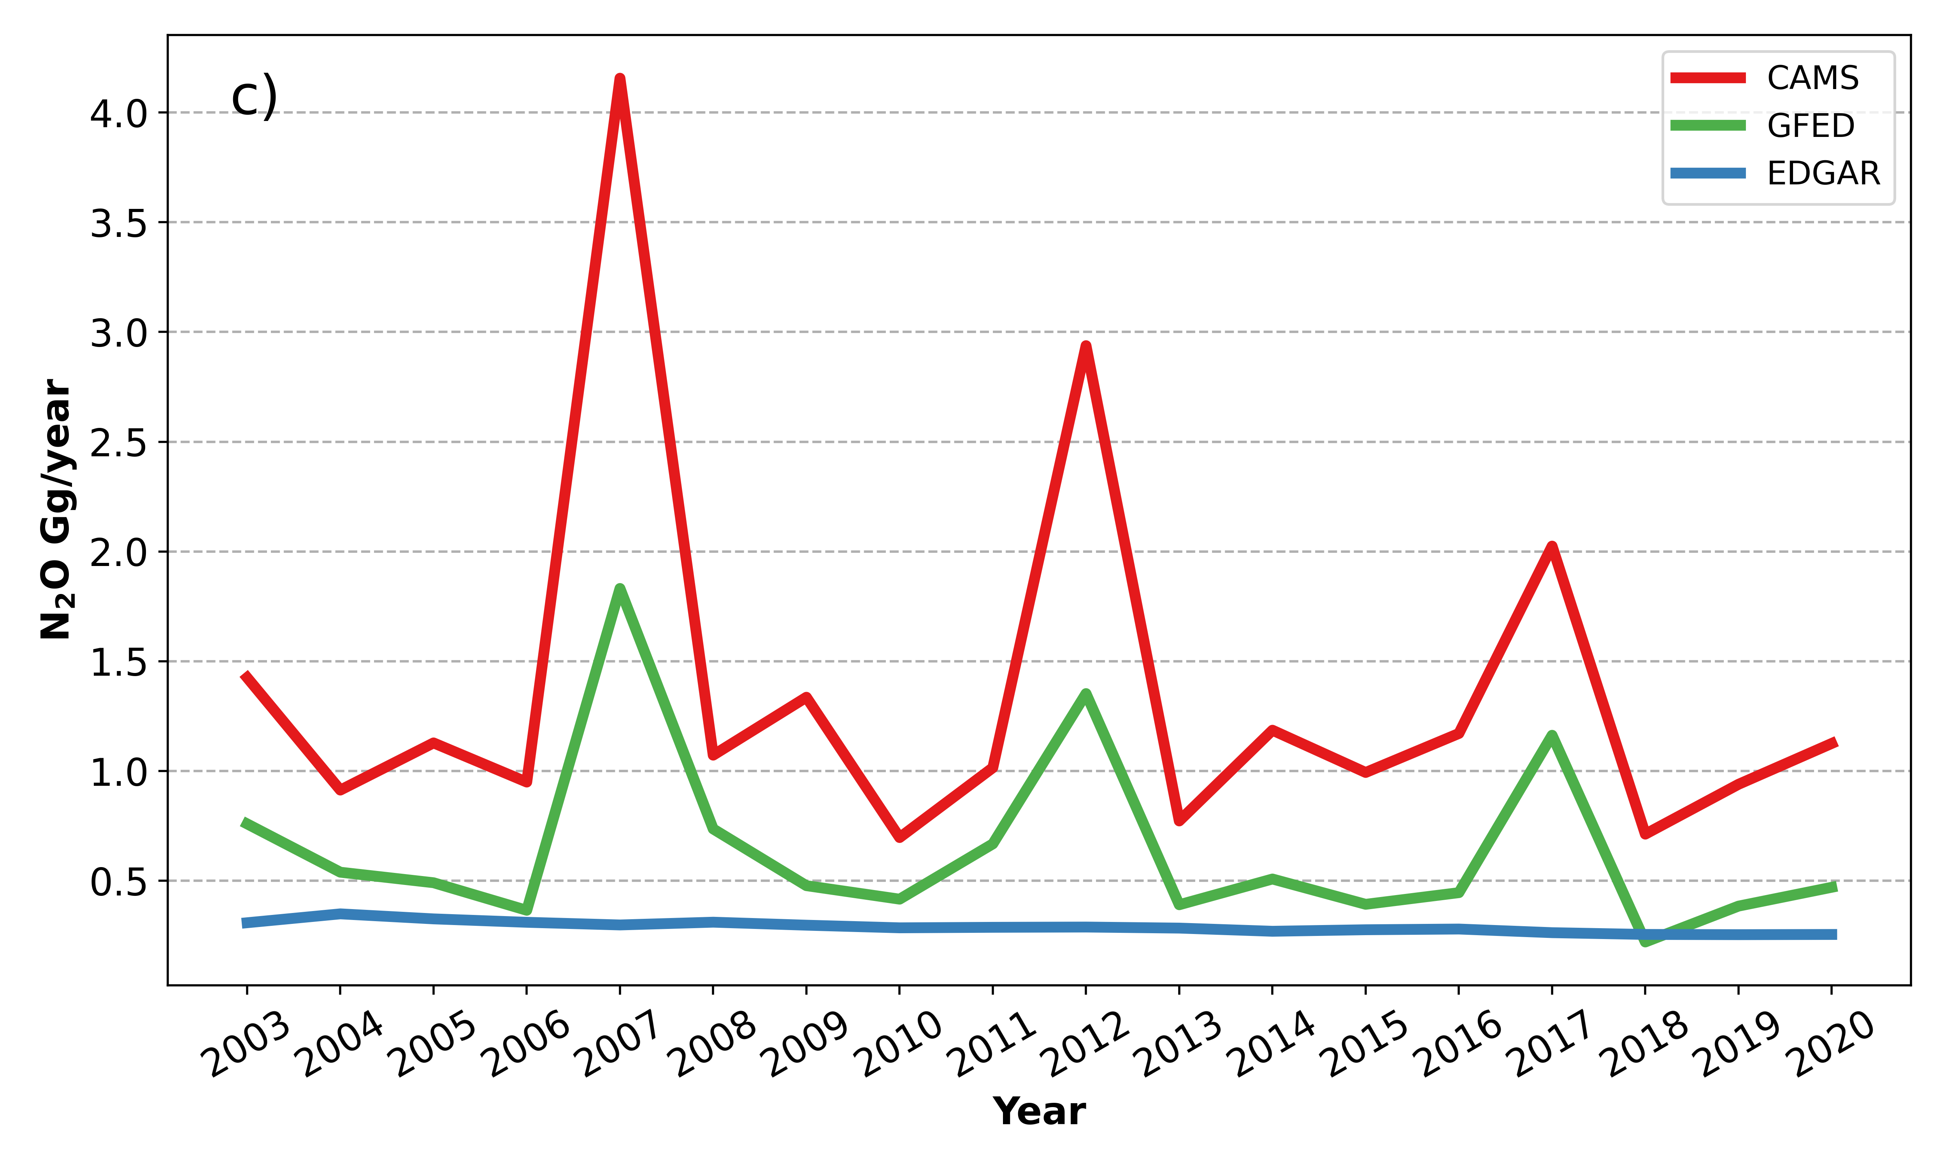
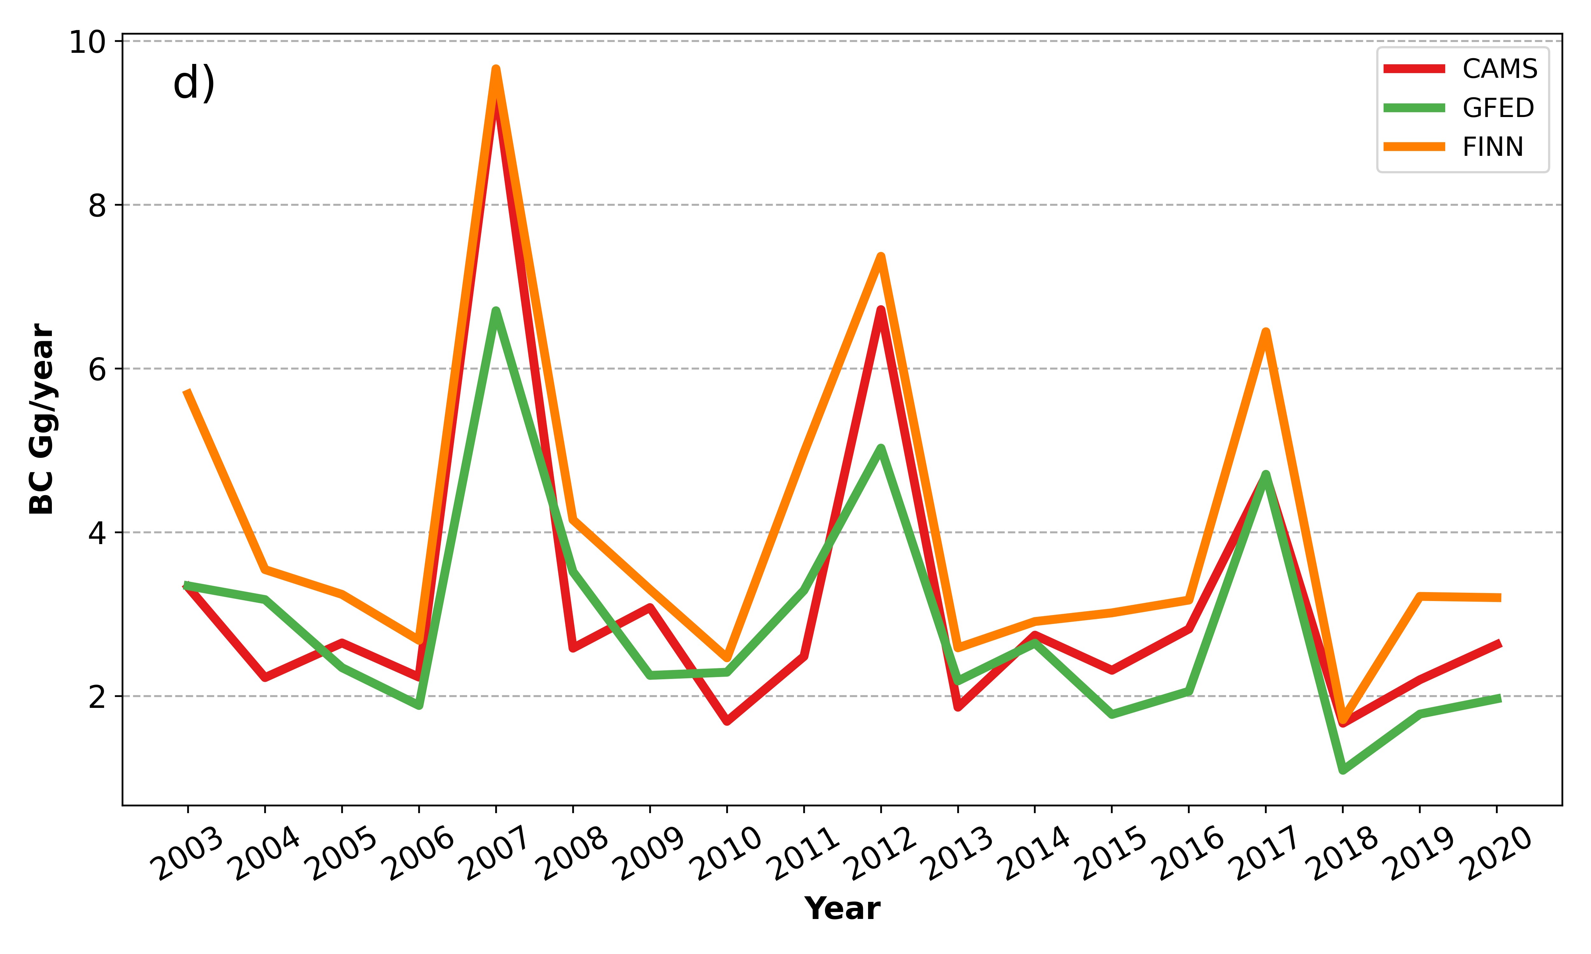
Results

Slide 5
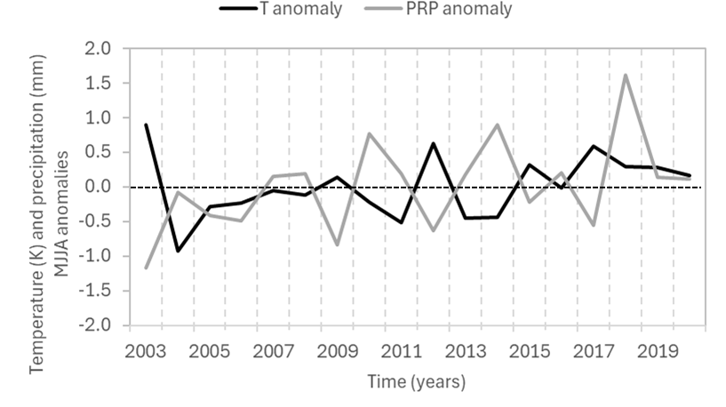

Possible Role of La NinA in Peak Emissions
ERA5
Emission peaks in 2007, 2012, 2017 coincided with La Niña events.
ERA5 anomalies (May–Aug):
  2012 → hot & dry summer (positive T, negative P)
  2017 → severe drought, driest spring in 60 years
  2007 → no clear basin-scale anomalies; peaks driven by local extreme fires in Italy & Greece
La Niña may enhance droughts via teleconnections, but antecedent droughts & human management also critical.
Role of La Niña is possible but not conclusive → further studies needed.

Slide 6
Conclusion
Wildfire emissions in the Mediterranean peaked in 2007, 2012, and 2017, possibly linked to La Niña.
Other factors (e.g., weather conditions preceding actual fire seasons, human management, fuel availability and type/condition) can affect the occurrence of the emission peaks.
More studies are needed to better understand the role of climate variability (e.g. La Niña) in peak fire years.
The four inventories agree on peak years but differ in magnitude: FINN gives the highest estimates, GFED the lowest.
EDGAR only includes agriculture and waste burning. Sometimes its CO₂ values are higher than GFED.
Anthropogenic emissions are declining: CO₂ decreases by −0.09 Tg/yr, CH₄ by −0.16 Gg/yr, and N₂O by −4.2 Mg/yr. Turkey shows the largest decrease.
Current reliance on bottom-up inventories creates uncertainties. Top-down methods with observation data from environmental RIs are essential to improve estimates.

