Slide 1
Simultaneous advection of volcanic ash and desert dust in Naples Mediterranean aera
Salvatore Spinosa,
M. Manzo, S. Amoruso, L. Mereu, A. Sannino, S. Scollo, A. Boselli

Slide 2
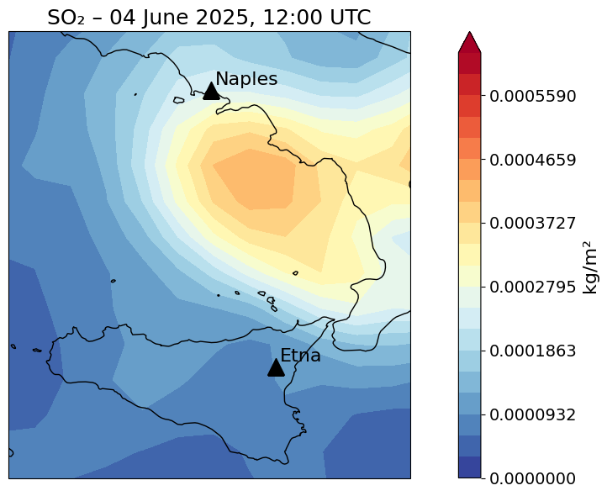
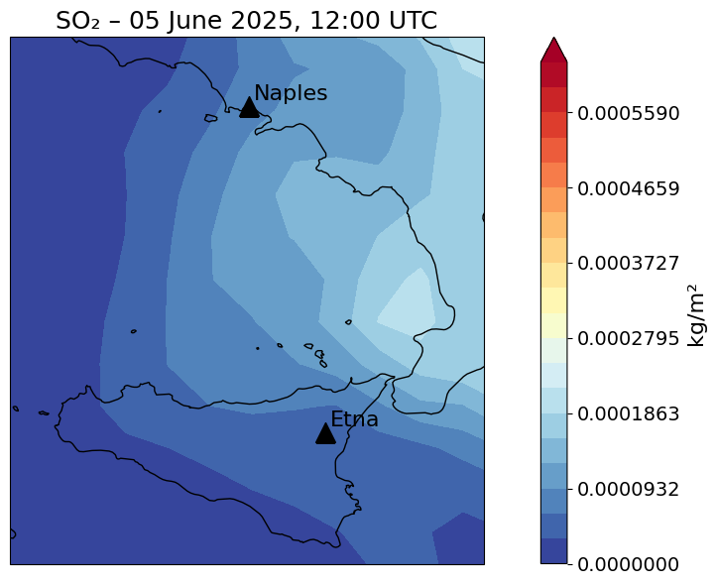
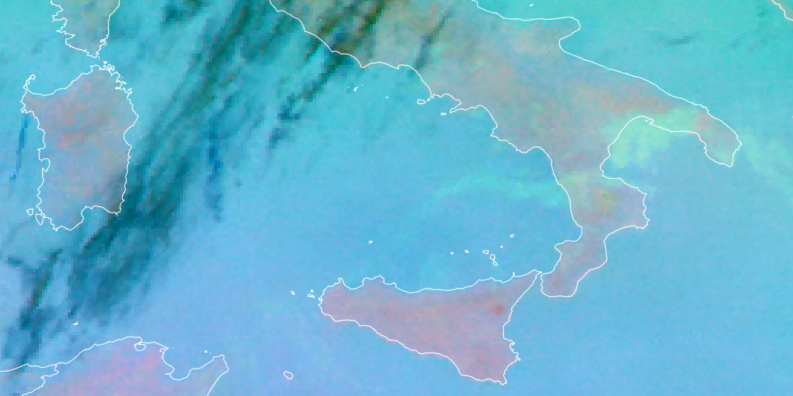
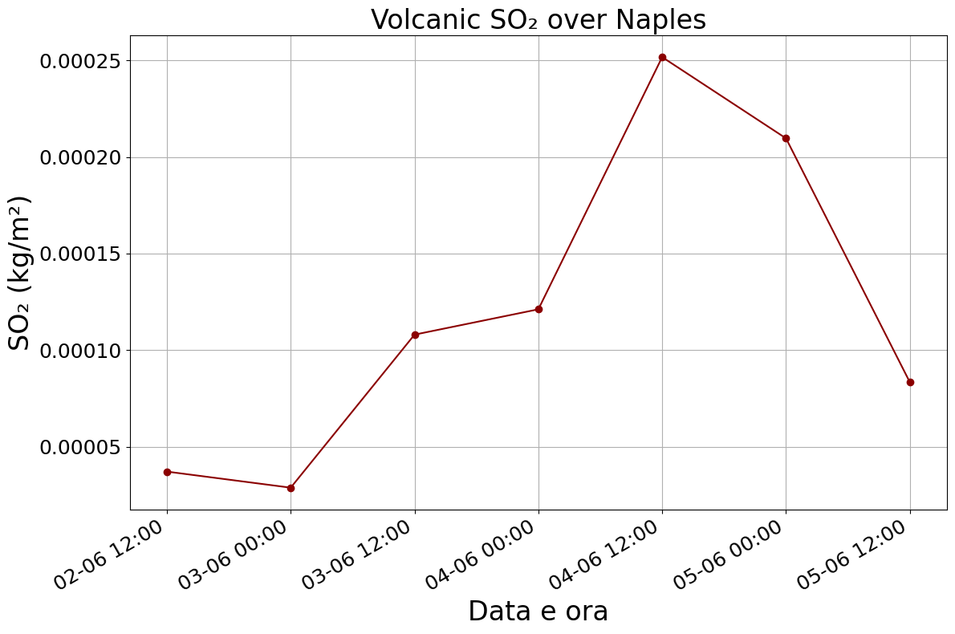
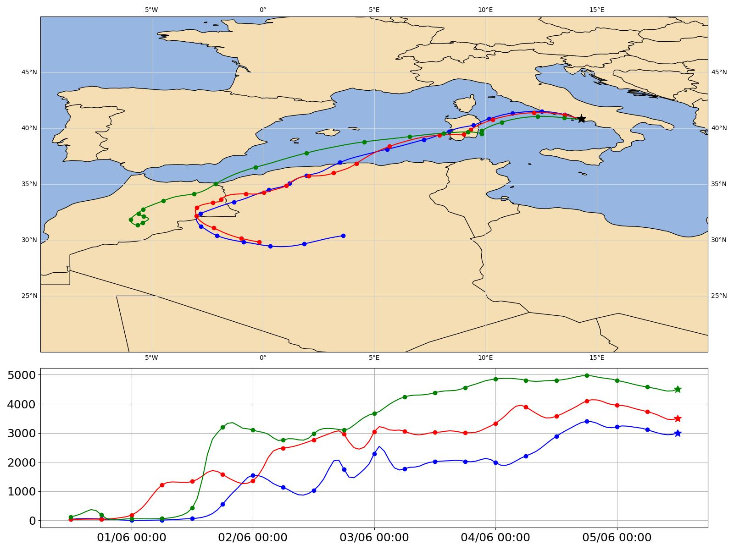
Copernicus Satellite Data and HYSPLIT Model
On June 2, a volcanic eruption occurred at Mount Etna.
On June 4, the volcanic plume reached the Naples National Facilities.
On June 5, Saharan dust arrived over Naples, ranging between 3 and 5 km in altitude.
ITINERIS 3rd general meeting - Rome, 25-26/09/2025

Slide 3
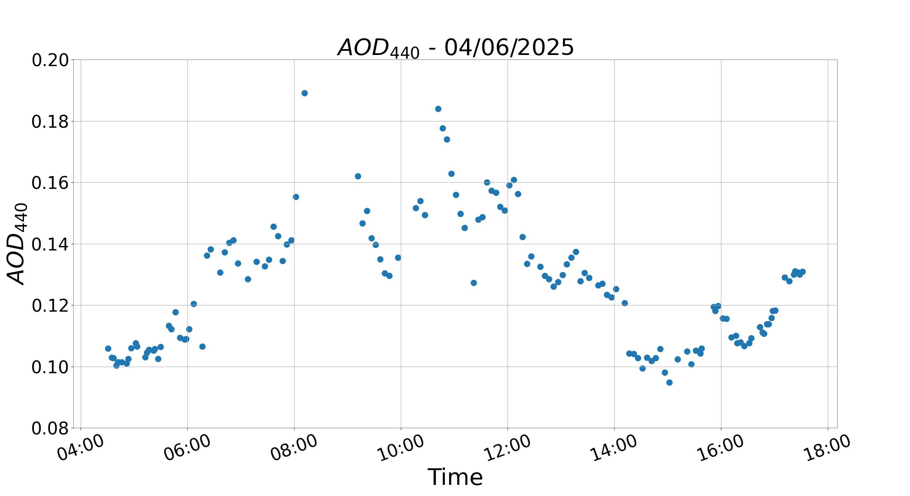
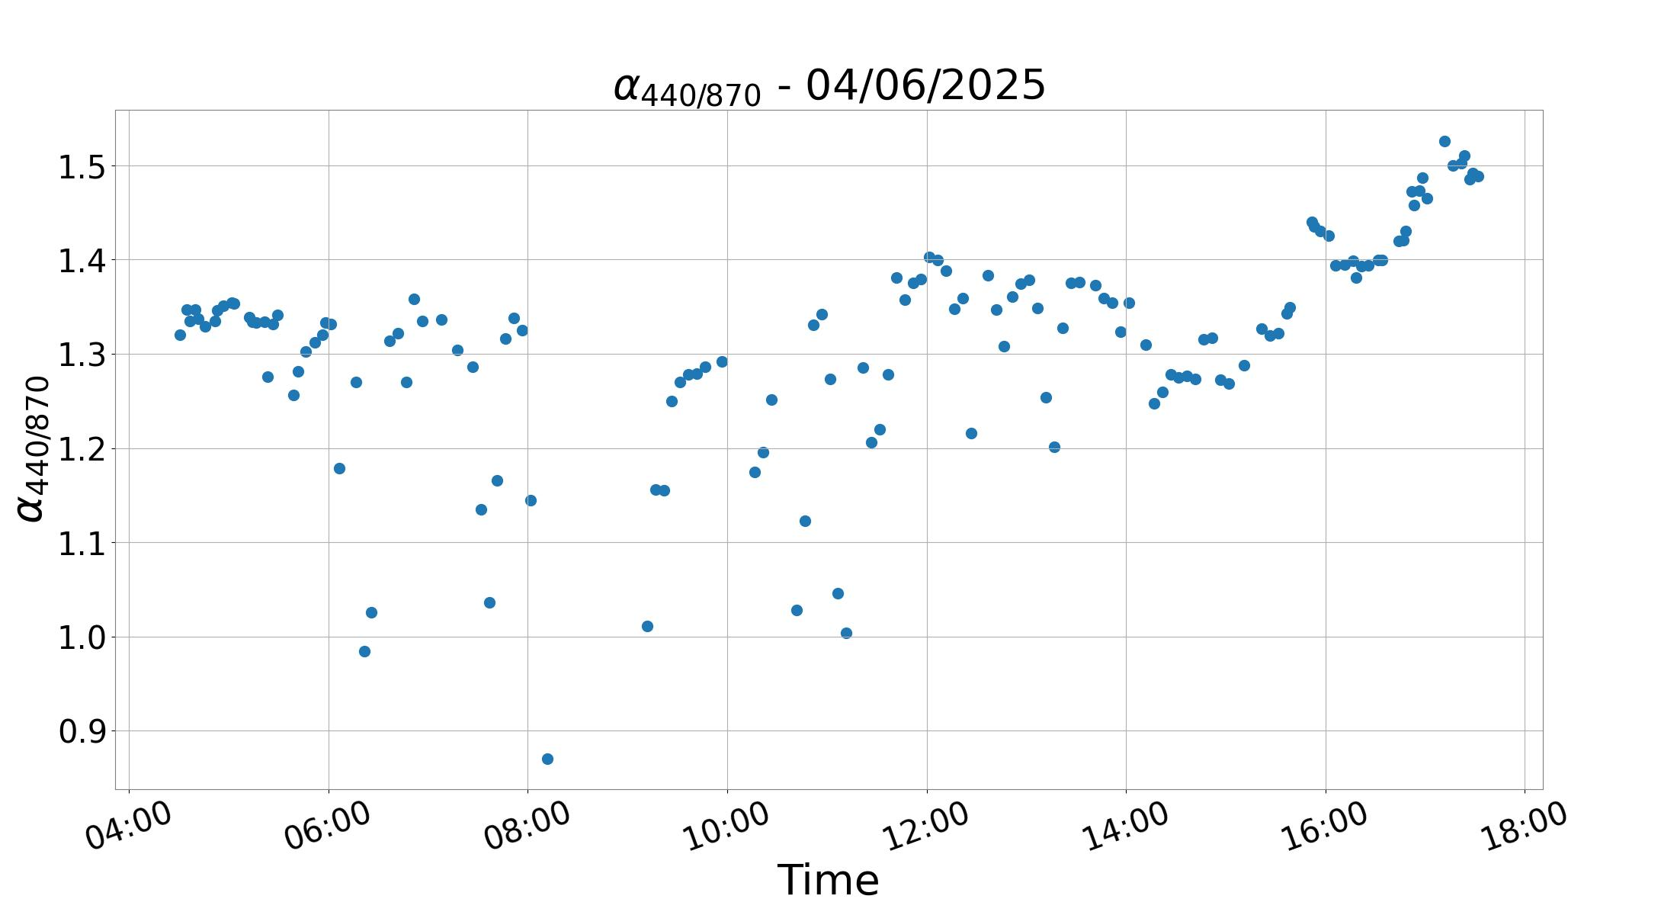
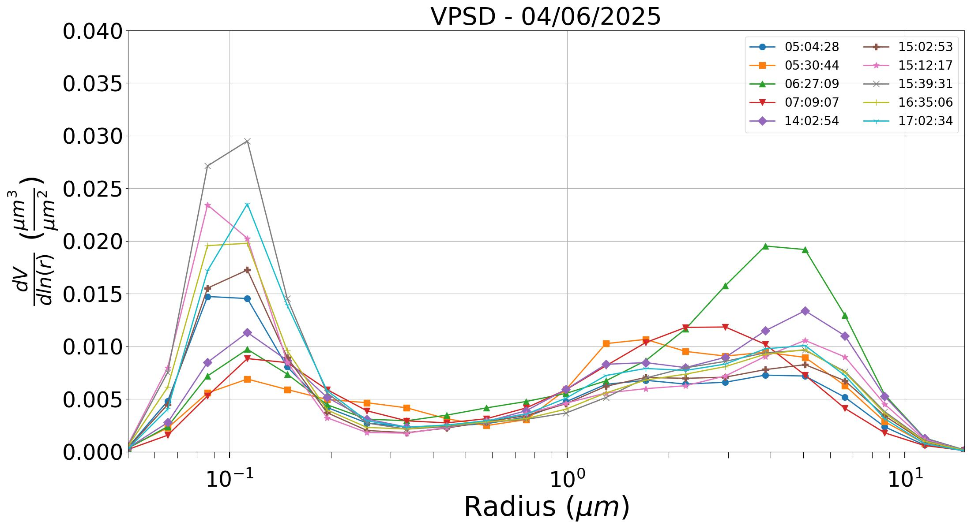
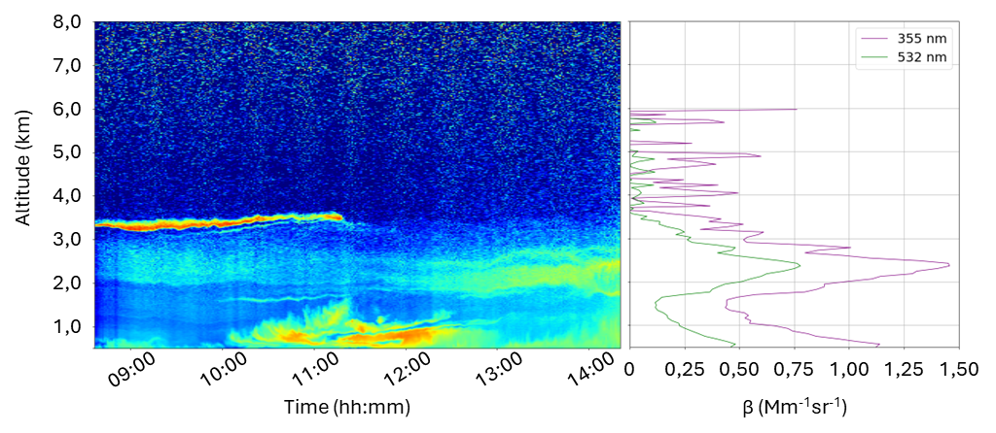
04/06/2025 – PHOTOMETER & LIDAR DATA
Photometer
<AOD> = 0,14 ± 0,02
<α> = 1,28 ± 0,10
Lidar
13:47 – 14:16
 | Volcanic Layer
Range (km) | 1,6 – 3,6
Lidar Ratio | 67 ± 20
Linear Depolarization (%) 532 nm | 5,1 ± 1,4
BAE = 1,67 ± 0,15
ITINERIS 3rd general meeting - Rome, 25-26/09/2025

Slide 4
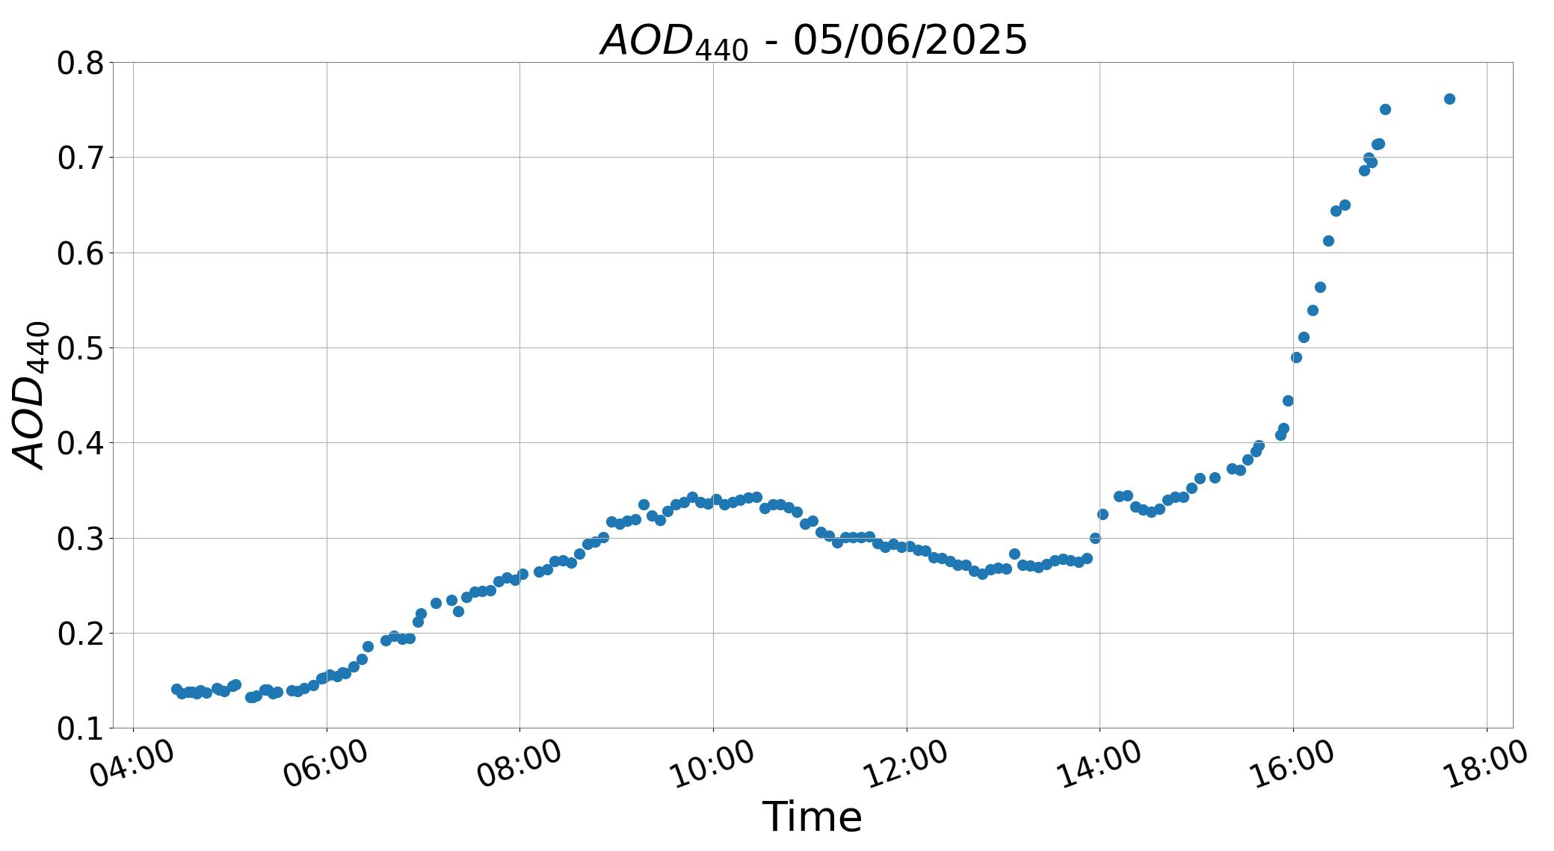
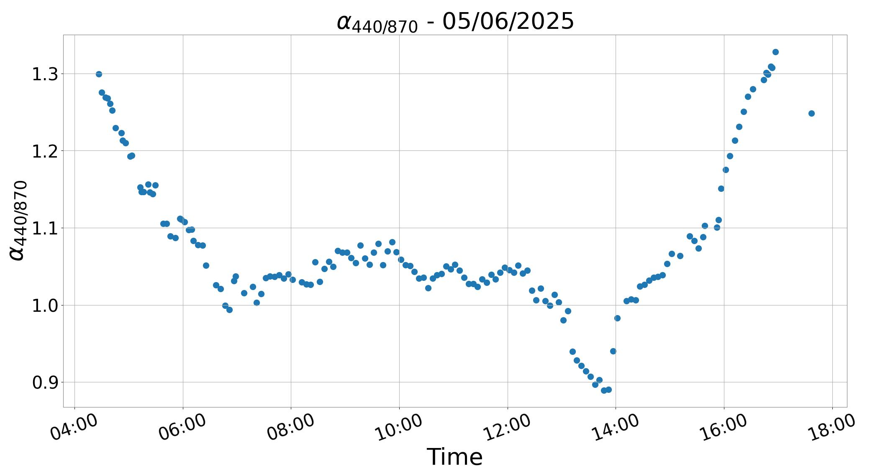
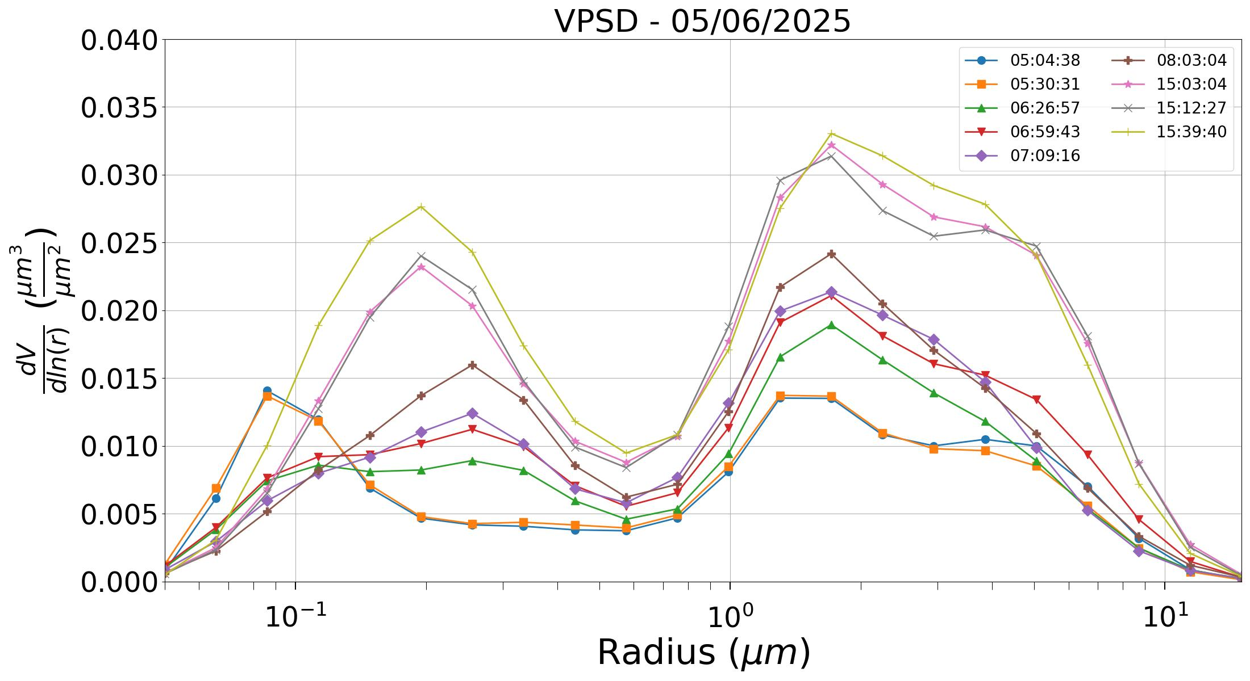
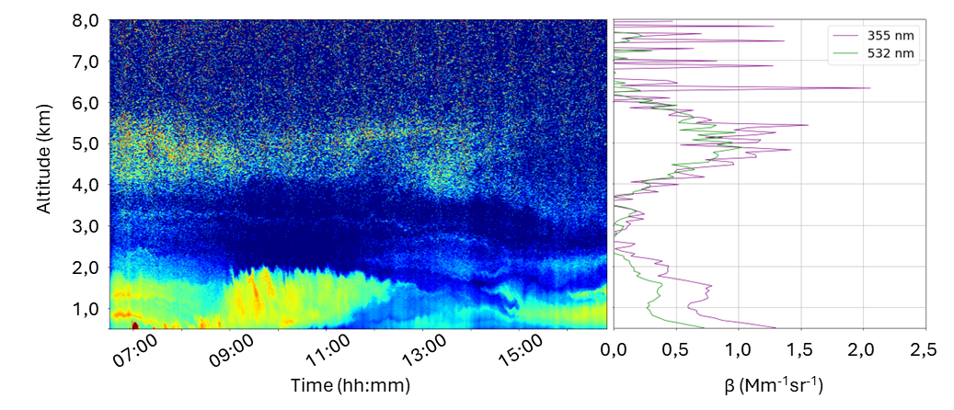
05/06/2025 – PHOTOMETER & LIDAR DATA
Photometer
<AOD> = 0,33 ± 0,10
<α> = 1,05 ± 0,08
Lidar
07:33 – 08:32
 | Volcanic Layer | Saharan Dust
Range (km) | 0,3 – 1,7 | 2,7 – 7,4
Lidar Ratio | 67 ± 20 | 47 ± 15
Linear Depolarization (%) 532 nm | 6.4 ± 2.3 | 10.4 ± 8.9
BAE = 0.54 ± 0.35
BAE = 1.82 ± 0.05
ITINERIS 3rd general meeting - Rome, 25-26/09/2025

