Slide 1



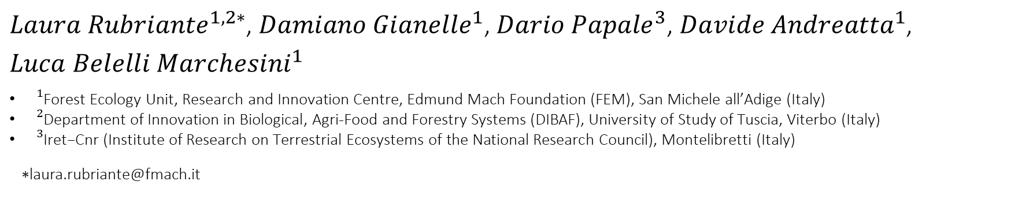
Monitoring of GHG fluxes at "Le Viote" alpine peatland (Italy) by smart chamber system in a climate change context.
${Laura Rubriante}^{1,2∗}$, ${Damiano Gianelle}^{1}$, ${Dario Papale}^{3}$, ${Davide Andreatta}^{1}$, ${Luca Belelli Marchesini}^{1}$
${}_{}^{1}{\text{Forest} \text{Ecology} \text{Unit}\text{, }\text{Research} \text{and} \text{Innovation} \text{Centre}\text{, }\text{Edmund} \text{Mach} \text{Foundation}\text{ (}\text{FEM}\text{), }\text{San} \text{Michele} \text{all}\text{’}\text{Adige}\text{ (}\text{Italy}\text{)} }$
${}_{}^{2}{\text{Department} \text{of} \text{Innovation} \text{in} \text{Biological}\text{, }\text{Agri}\text{-}\text{Food} \text{and} \text{Forestry} \text{Systems}\text{ (}\text{DIBAF}\text{), }\text{University} \text{of} \text{Study} \text{of} \text{Tuscia}\text{, }\text{Viterbo}\text{ (}\text{Italy}\text{)}}$
${}_{}^{3}{\text{Iret}\text{−}\text{Cnr}\text{ (}\text{Institute} \text{of} \text{Research} \text{on} \text{Terrestrial} \text{Ecosystems} \text{of} \text{the} \text{National} \text{Research} \text{Council}\text{), }\text{Montelibretti}\text{ (}\text{Italy}\text{)}}$
${}_{}^{}∗$laura.rubriante@fmach.it

Slide 2
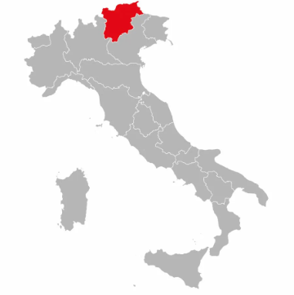
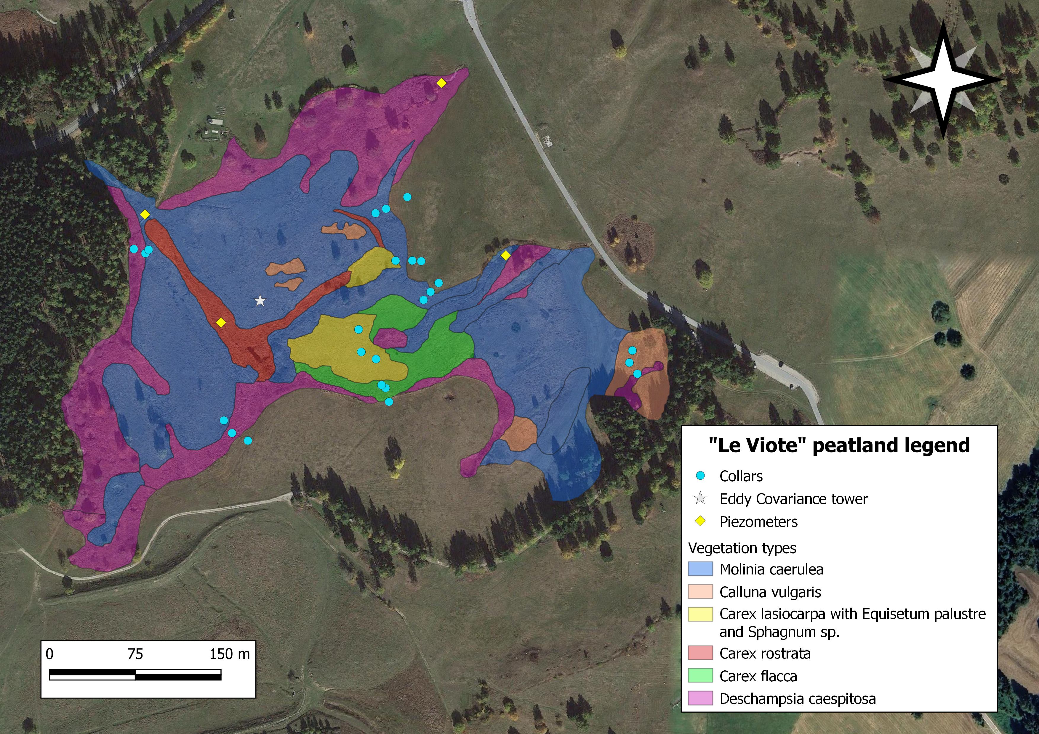
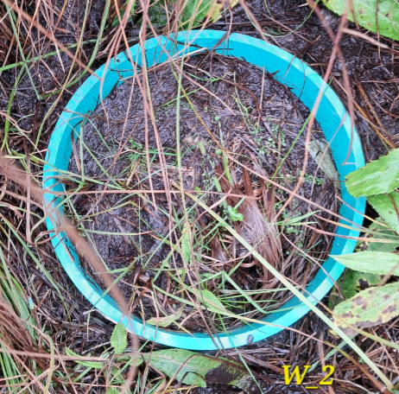
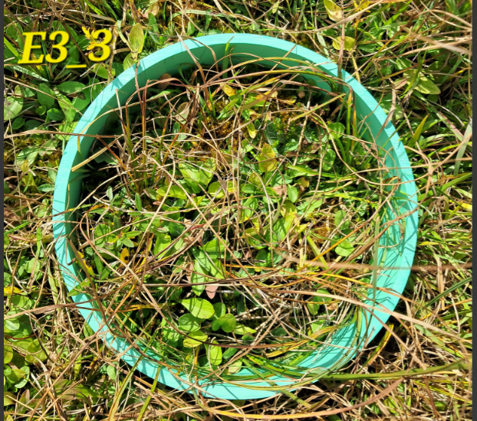
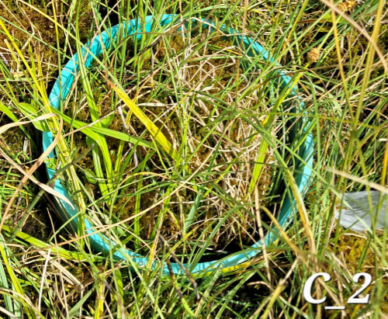
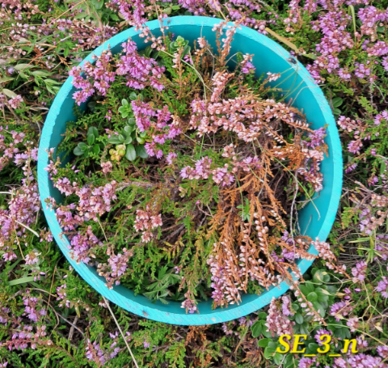
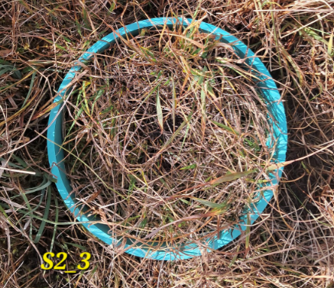
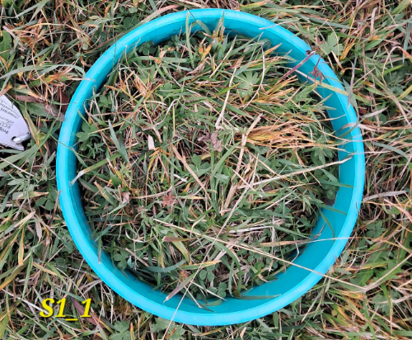
Introduction
“Le Viote” alpine peatland (46°01′07” N, 11°02′34″ E) is located in the middle of a plateau in the Mt. Bondone area (eastern Alps, Italy), at a mean altitude of 1560 m a.s.l..
The aim of the study is to analyze the response of “Le Viote” alpine peatland to ongoing climate change, in relation to the main climatic and ecological drivers of greenhouse gases (GHG) fluxes and their variability in space and time.
“Le Viote” peatland is characterized by various micro-topographic and soil moisture levels and high biodiversity in vegetation coverages (from the alpine grassland to sedges in the wettest areas).

Slide 3
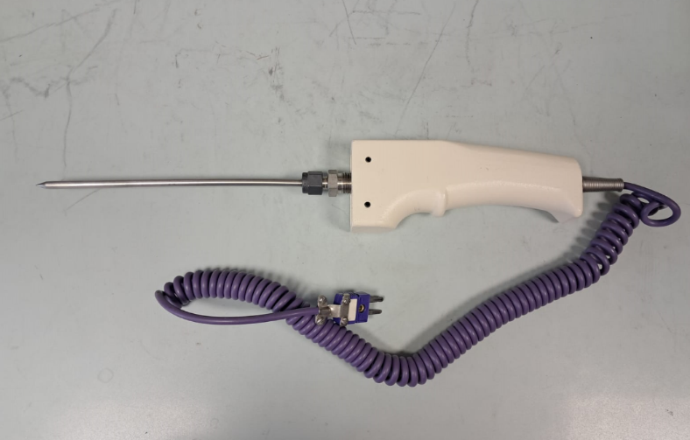
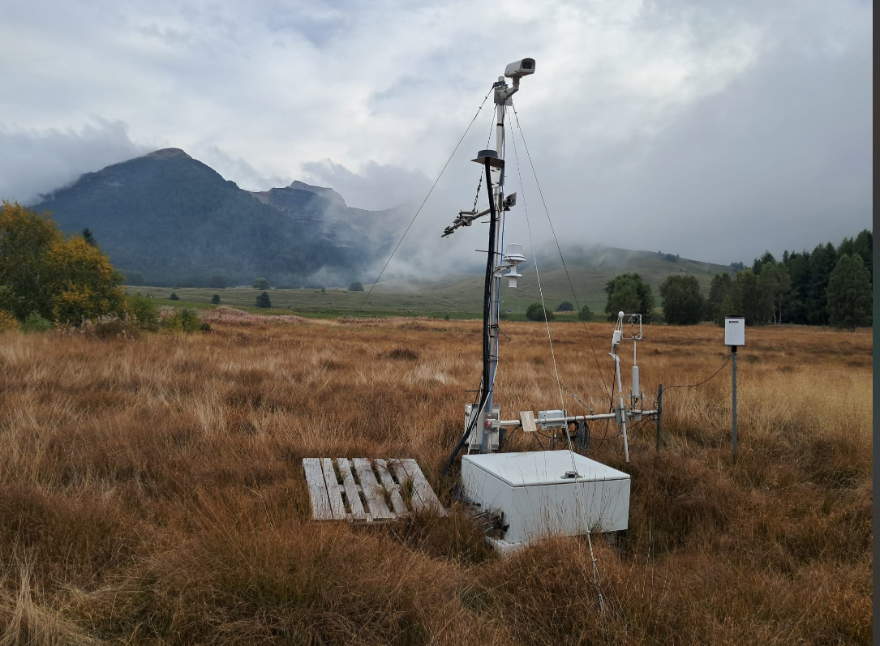
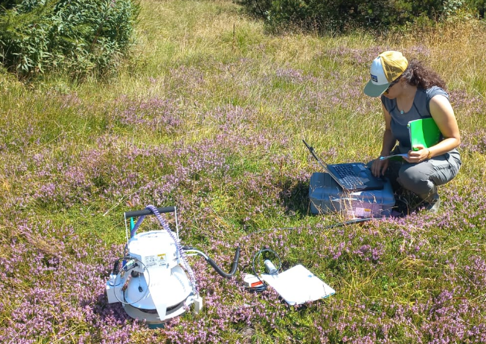
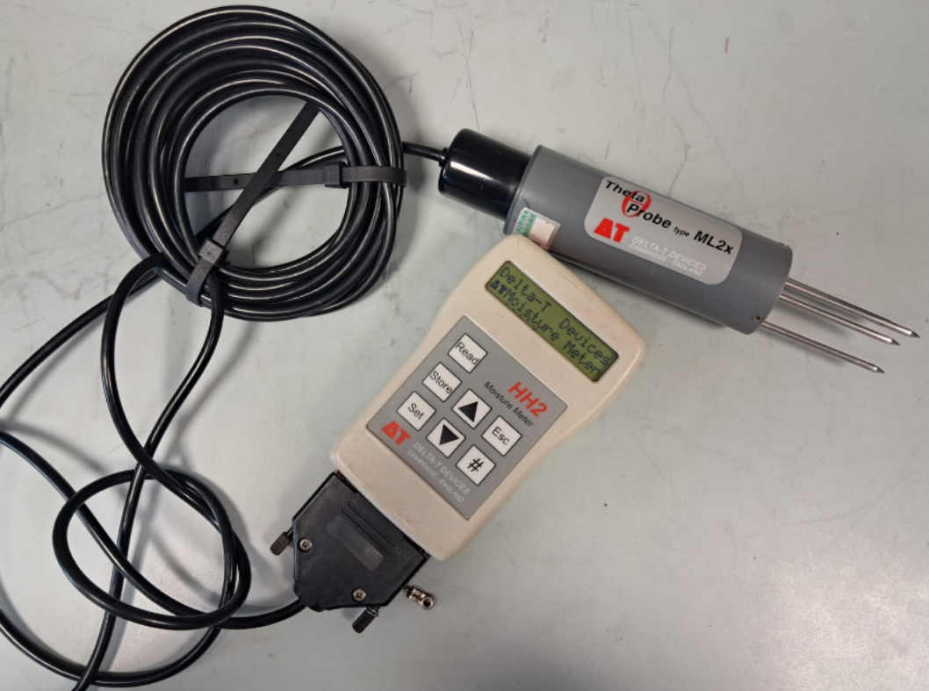
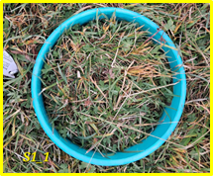
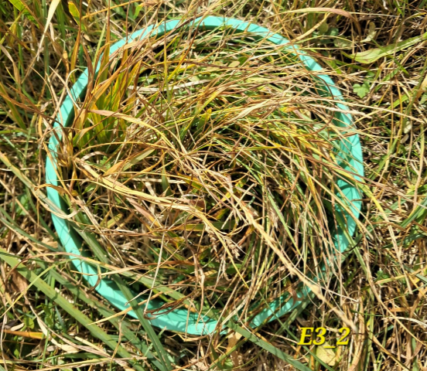
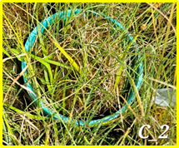

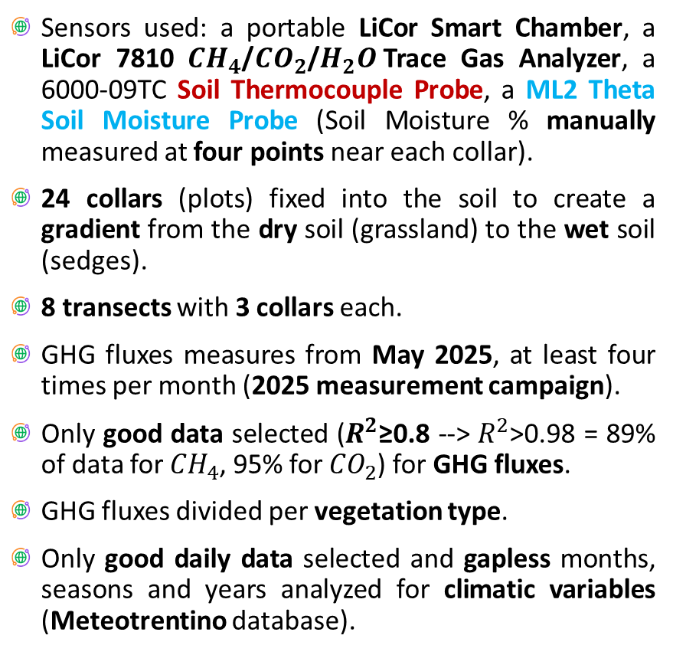
Materials and Methods
Sensors used: a portable LiCor Smart Chamber, a LiCor 7810 ${CH}_{4}$/${CO}_{2}$/$H_{2}O$Trace Gas Analyzer, a 6000-09TC Soil Thermocouple Probe, a ML2 Theta Soil Moisture Probe (Soil Moisture % manually measured at four points near each collar).
24 collars (plots) fixed into the soil to create a gradient from the dry soil (grassland) to the wet soil (sedges).
8 transects with 3 collars each.
GHG fluxes measures from May 2025, at least four times per month (2025 measurement campaign).
Only good data selected ($R^{2}$≥0.8 --> $R^{2}$>0.98 = 89% of data for ${CH}_{4}$, 95% for ${CO}_{2}$) for GHG fluxes.
GHG fluxes divided per vegetation type.
Only good daily data selected and gapless months, seasons and years analyzed for climatic variables (Meteotrentino database).
DRY
WET

Slide 4
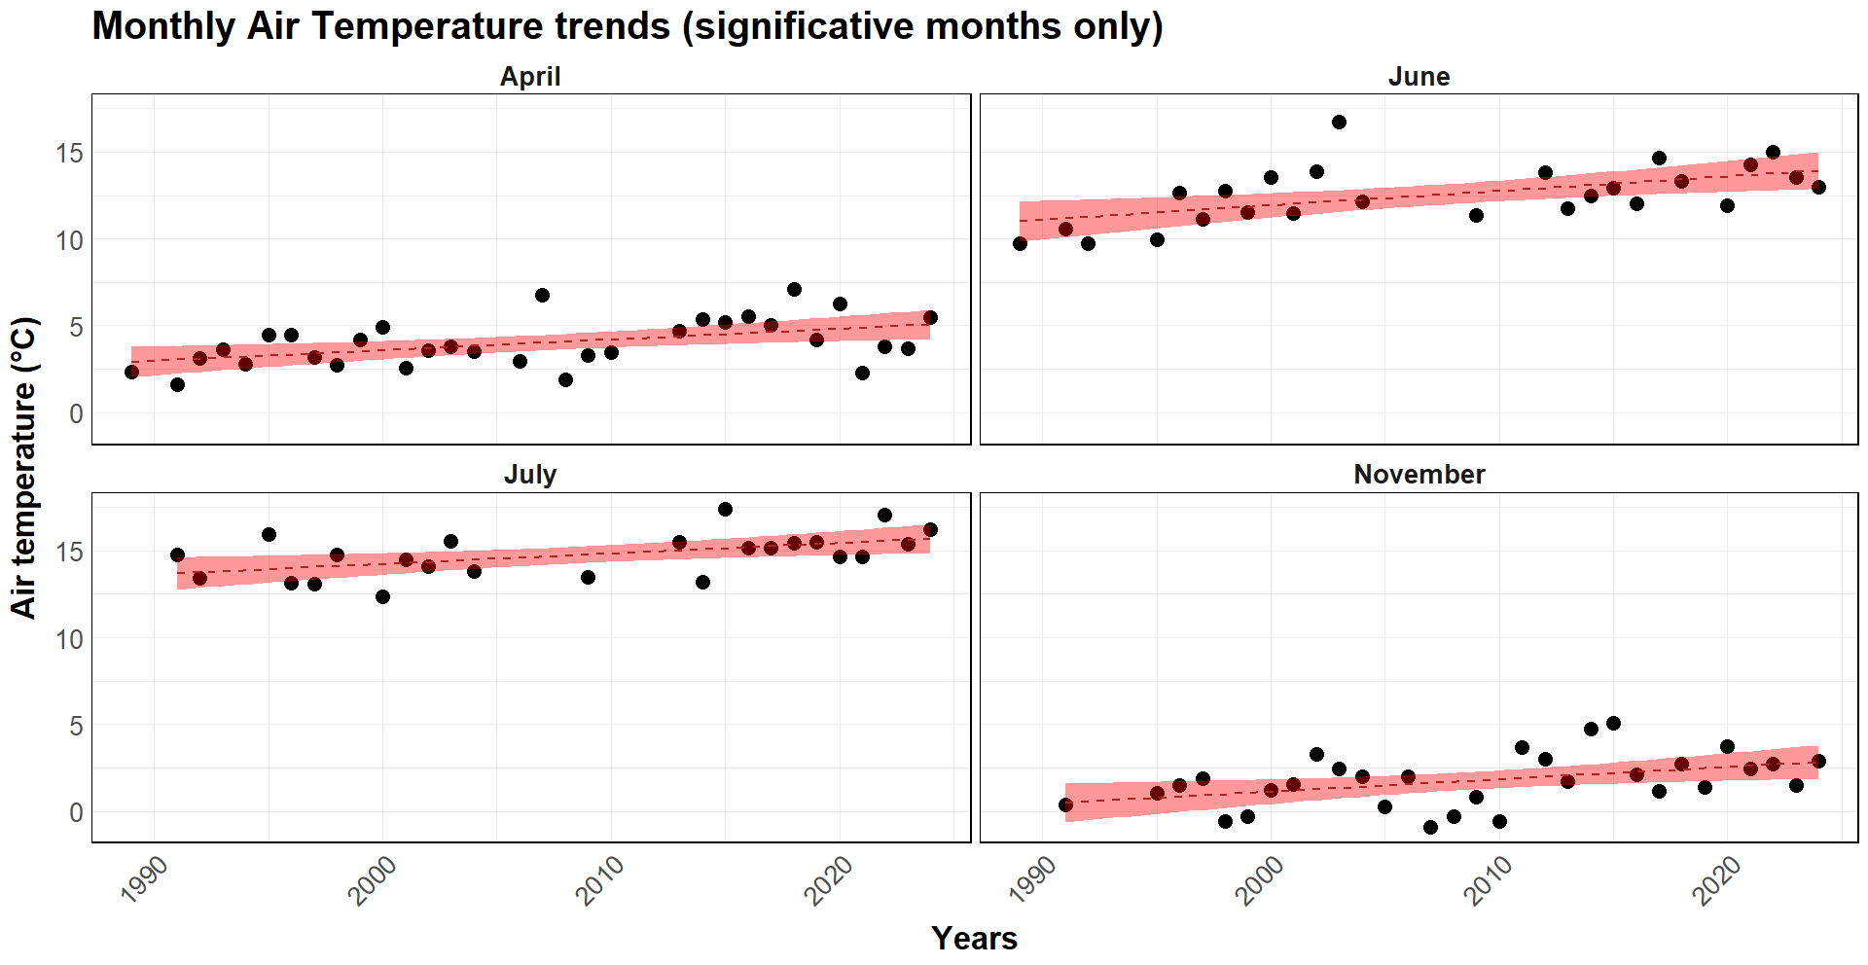

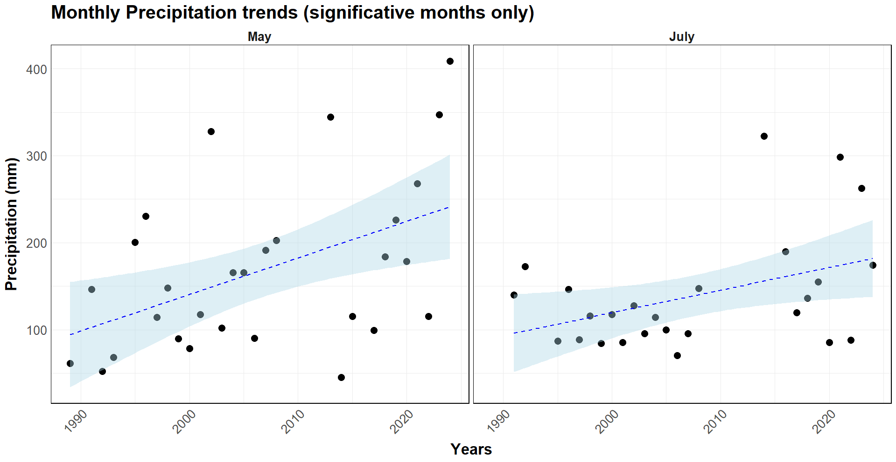


Meteo Data
Mean Annual Temperature (MAT)
MAT --> 6.16 °C ± 0.72.
MAT increasing trend --> 0.06 °C/year.
Mean Annual Precipitation (MAP)
MAP --> 1473.13 mm ± 395.96
MAP increasing trend --> 9.68 mm/year.
High variability through years, annual trend not significative.

Slide 5
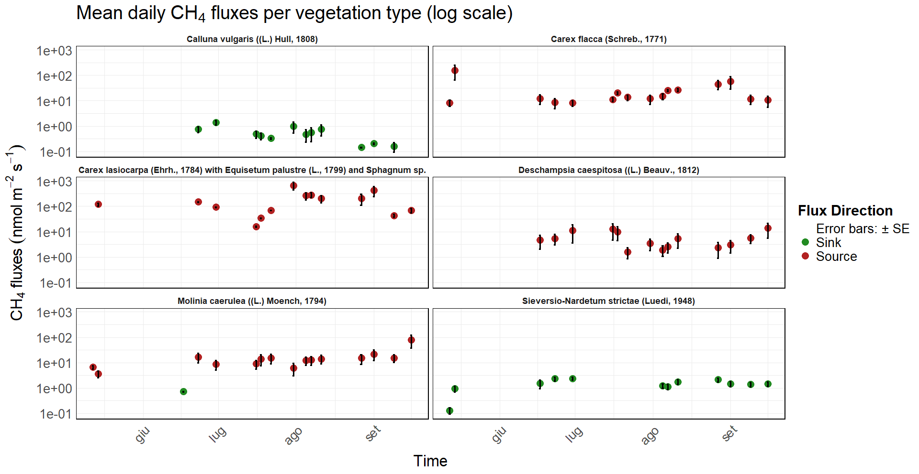
Results – GHG Fluxes
${CH}_{4}$ fluxes – Time series

Slide 6
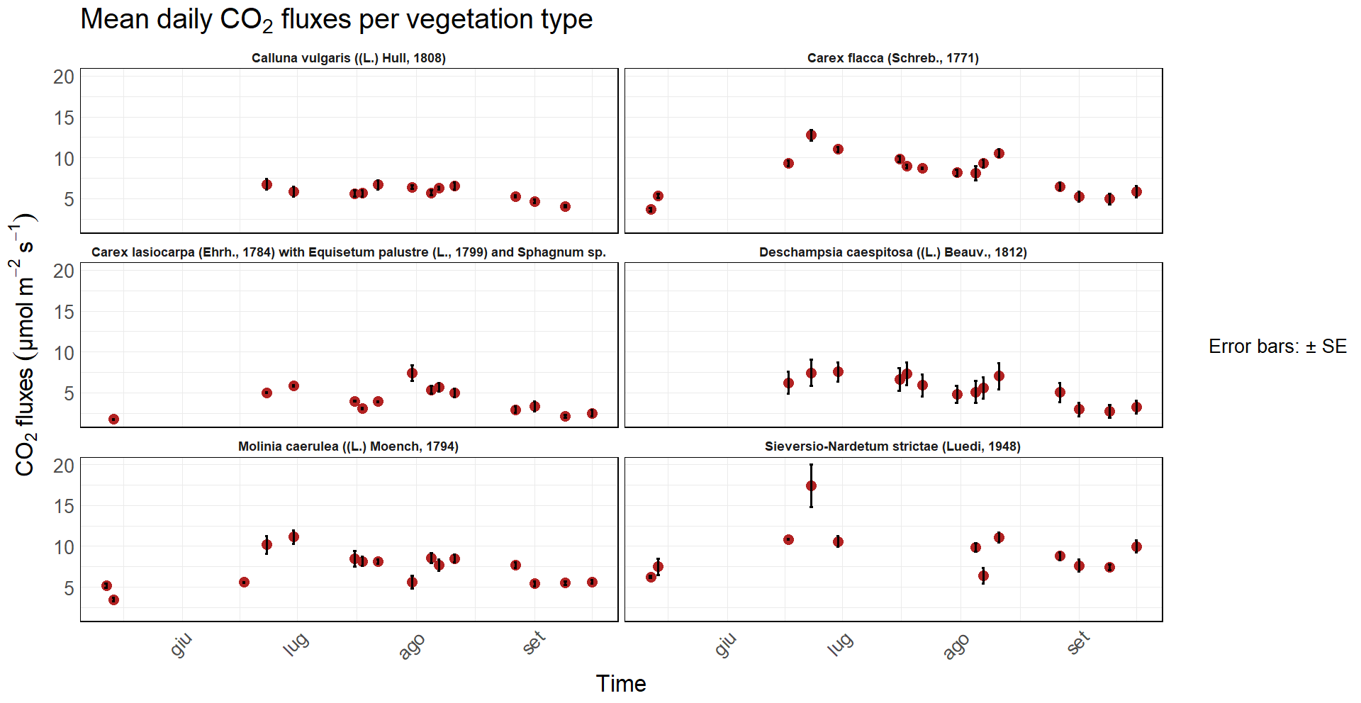
Results – GHG Fluxes
${CO}_{2}$ fluxes – Time series

Slide 7
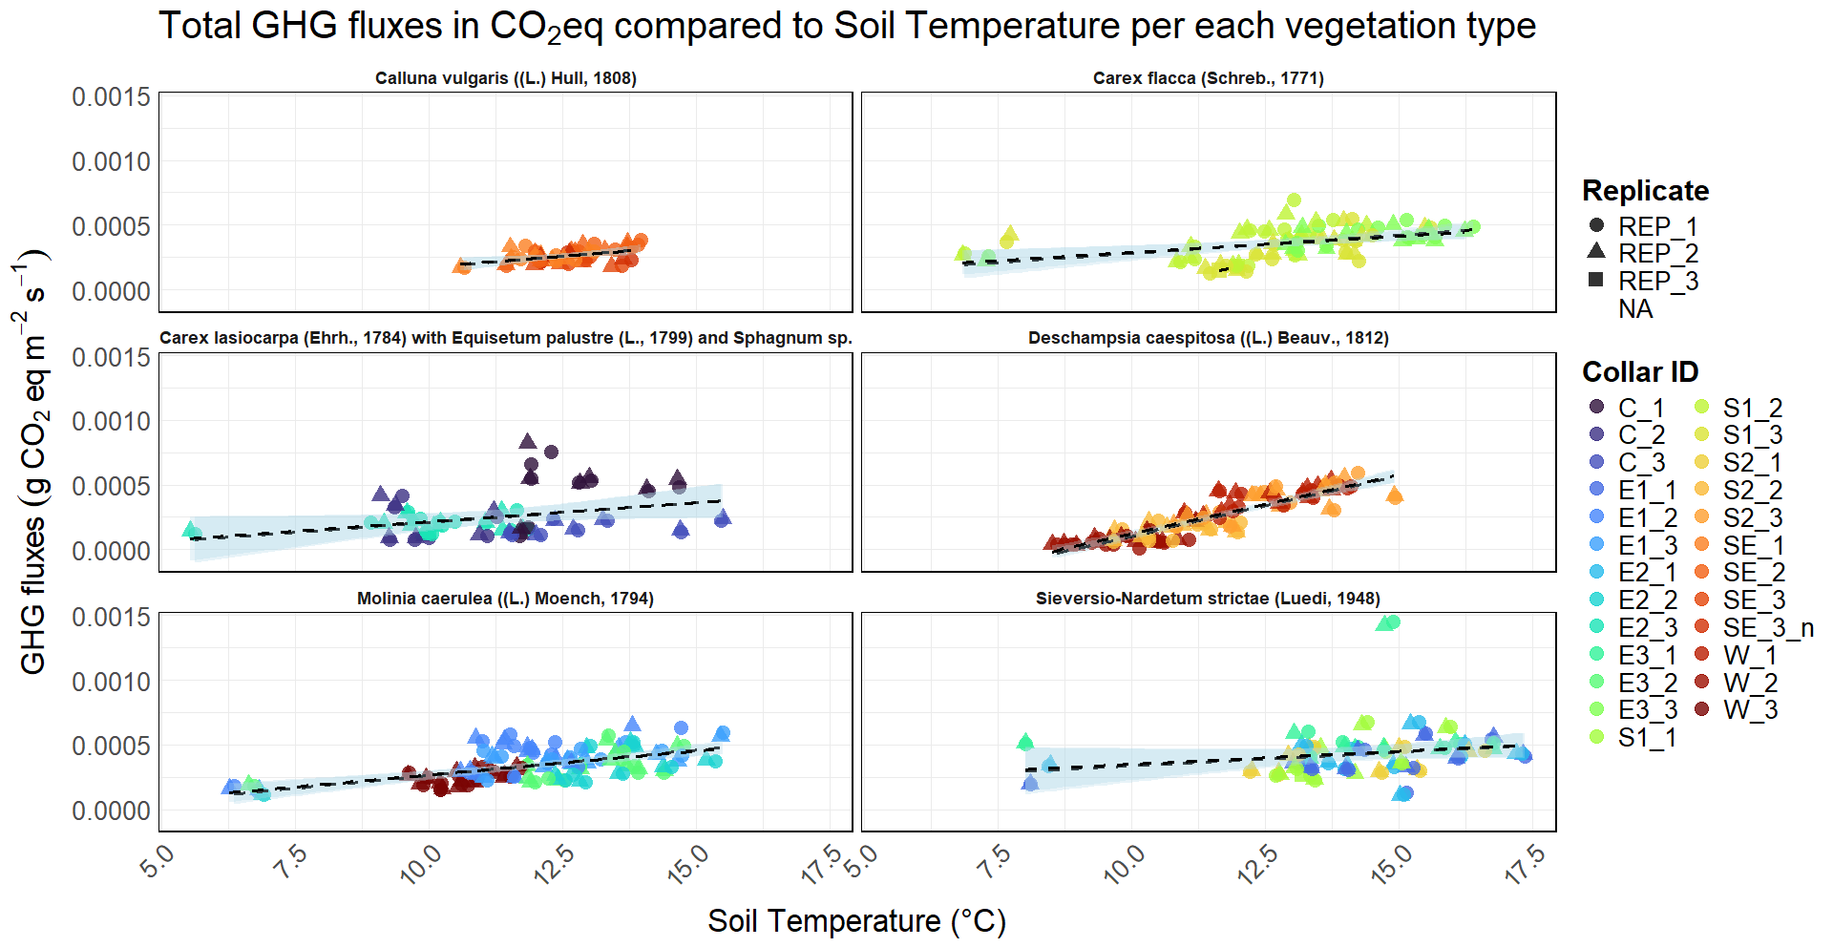






Results – GHG Fluxes
Tot GHG fluxes – Soil Temperature
p<0.001
$R^{2}$=0.246
p<0.001
$R^{2}$=0.223
p<0.01
$R^{2}$=0.113
p<0.001
$R^{2}$=0.790
p<0.001
$R^{2}$=0.370
p<0.05
$R^{2}$=0.049

Slide 8
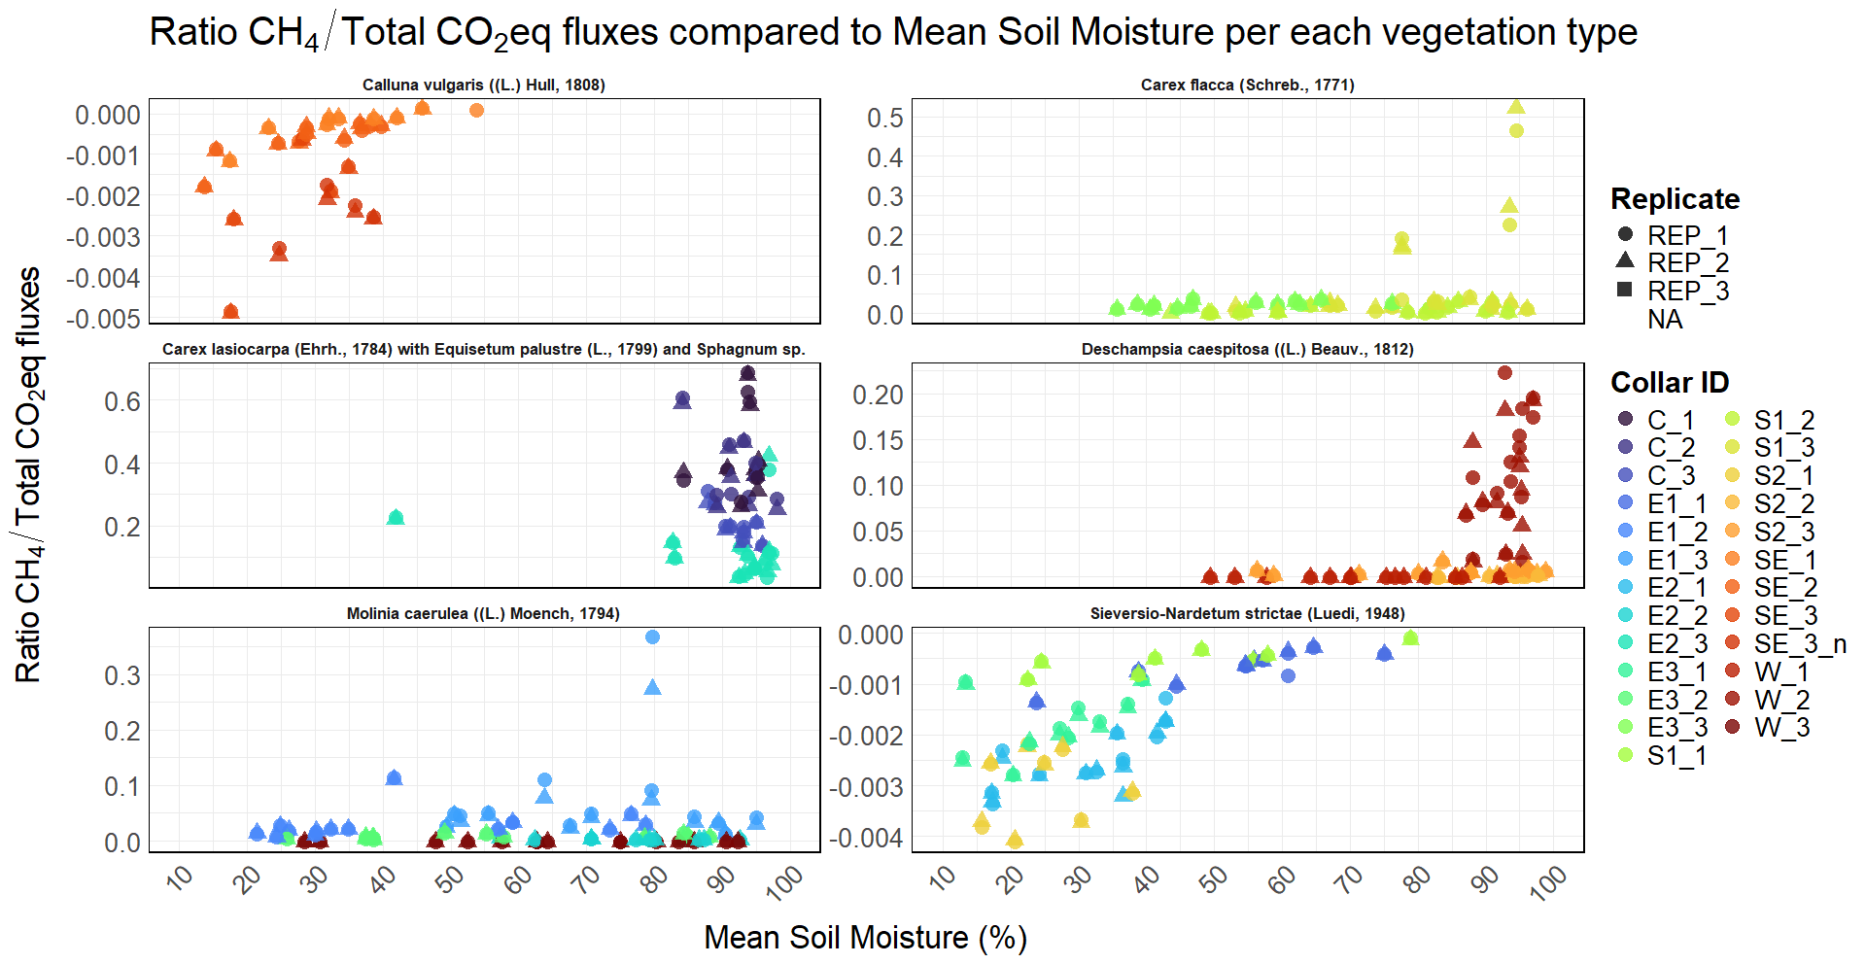
Results – GHG Fluxes
${CH}_{4}$ fluxes/Tot GHG fluxes – Soil Moisture

Slide 9
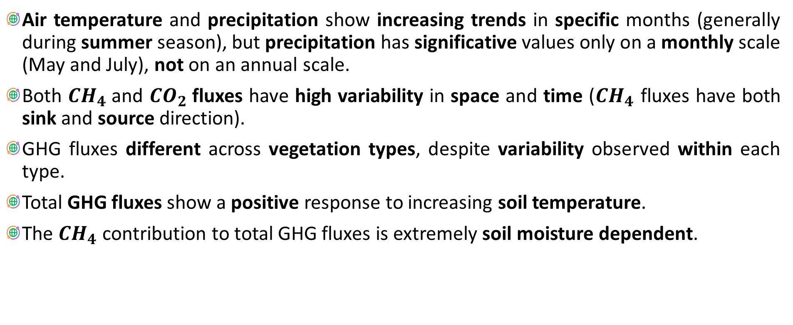
Conclusions
Air temperature and precipitation show increasing trends in specific months (generally during summer season), but precipitation has significative values only on a monthly scale (May and July), not on an annual scale.
Both ${CH}_{4}$and ${CO}_{2}$fluxes have high variability in space and time (${CH}_{4}$ fluxes have both sink and source direction).
GHG fluxes different across vegetation types, despite variability observed within each type.
Total GHG fluxes show a positive response to increasing soil temperature.
The ${CH}_{4}$ contribution to total GHG fluxes is extremely soil moisture dependent.

Slide 10
