Slide 1
Assisted Regeneration of Quercus robur (L.) From Laboratory to the Field in the Castelporziano Presidential Estate (Roma, Italy).
PhD student: Nour Zaher ¹ (nour.zaher@unitus.it)
Tutors: Paolo De Angelis ¹, Dario Papale ¹, Elena Kuzminsky ¹.
¹ University of Tuscia, Viterbo, Italy.
ITINERIS 3rd general meeting- Roma, 25-26/09/2025.

Slide 2
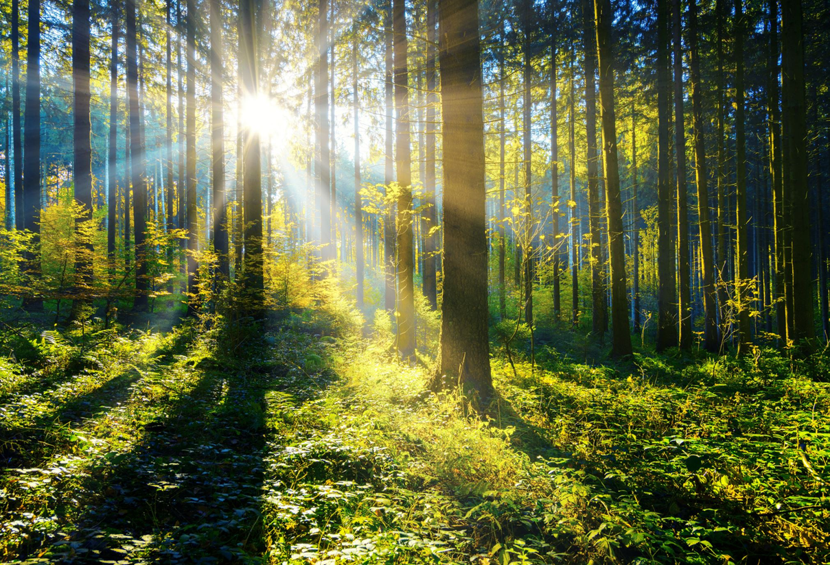
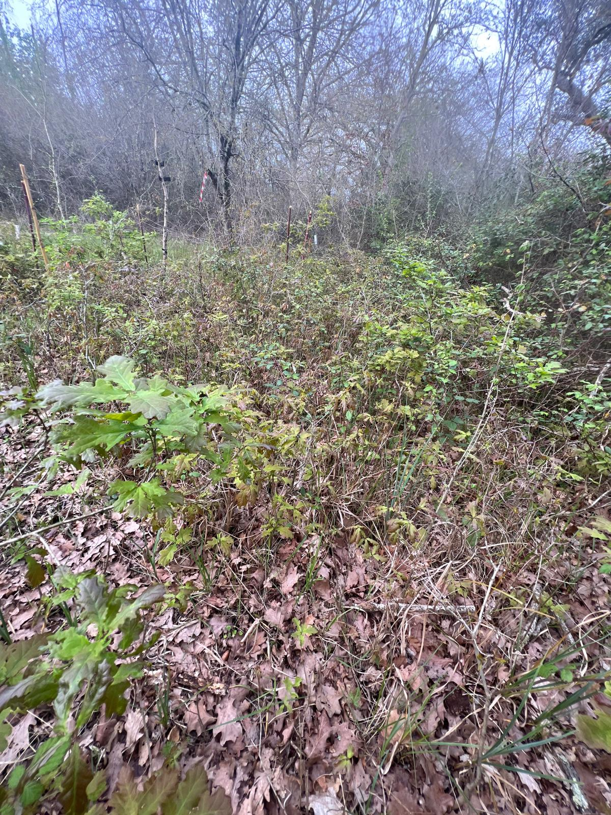

Introduction
Mediterranean Oak Forests are Declining
  Climate change
  Oak dieback
  Challenges and low natural regeneration rates
Restoring Mediterranean Ecosystems is Crucial
  Biodiversity
  Resilience, Conservation and Regeneration
  Ecological stability, Sustainability

Slide 3
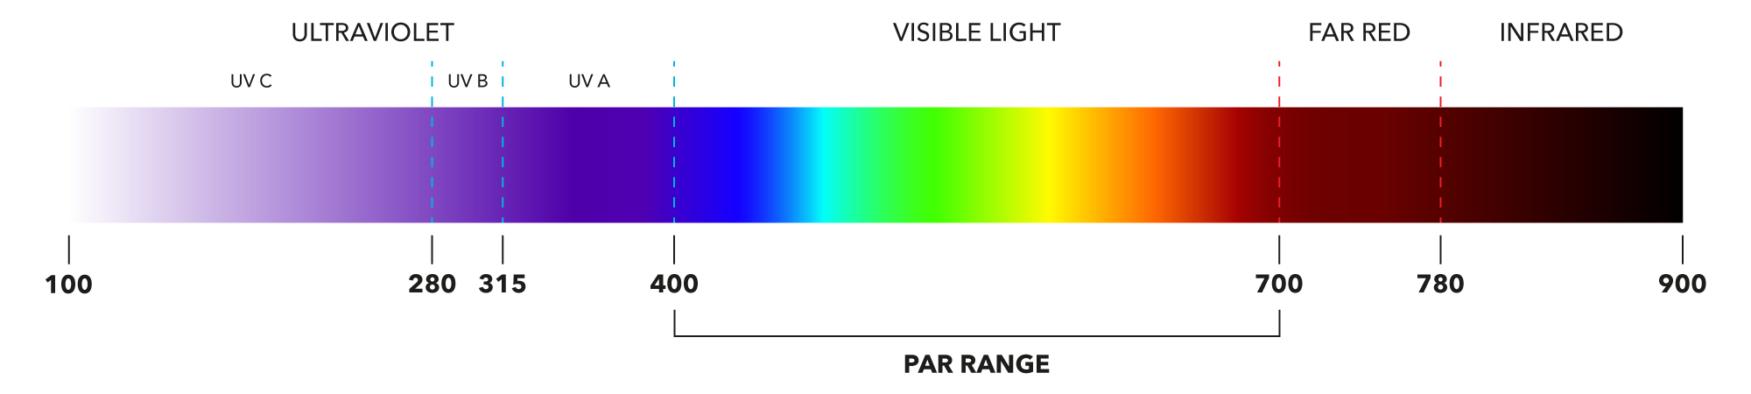
Objectives
Vegetative Propagation Techniques through epicormic shoot induction from Quercus robur branches.
Eco-physiological Monitoring and responses to the dynamic light regime (sunflecks) on Quercus robur regeneration in Castelporziano (Roma, Italy).
Monitoring Radiation Dynamics
  One of the most important meteorological variables measured in terrestrial ecosystems.
  Photosynthetically active radiation (PAR), 400 to 700 nm.

Slide 4
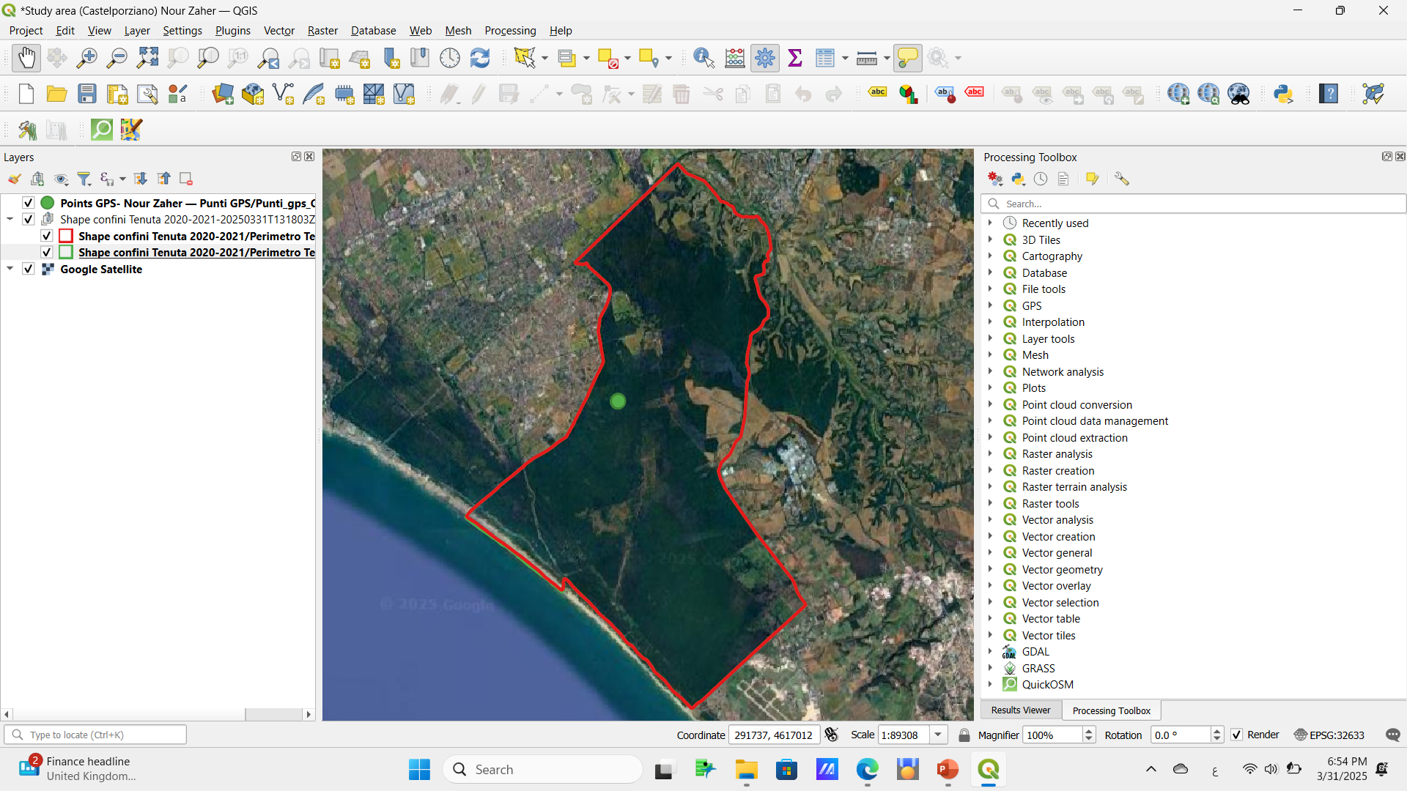
Materials and Methods
Study area: Presidential Estate of Castelporziano (Roma, Italy).
Mediterranean biodiversity hotspot, located 25 km from the center of Rome.
Typical Mediterranean ecosystems, Nature reserve listed among protected areas.
The Mediterranean forest of Castelporziano is dominated by oak species.
Castelporziano
borders (red line)
Study Area (Campo di Rota)
Study area (Castelporziano), on the right, a general description of the Study Area Castelporziano (yellow), Municipality of Rome (dark gray), City of Rome (light gray and black) (Recanatesi et al., 2020).
On the left, Castelporziano borders (red line), Campo di Rota (green point).

Slide 5
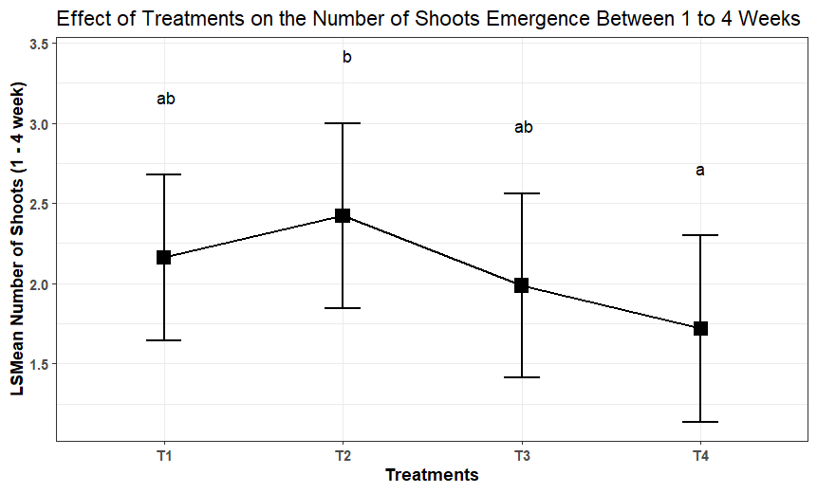
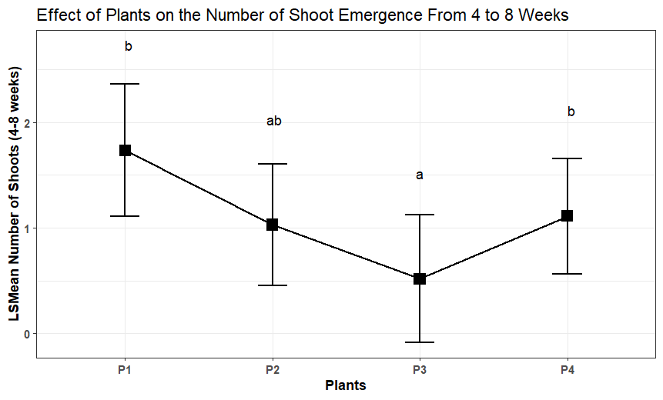
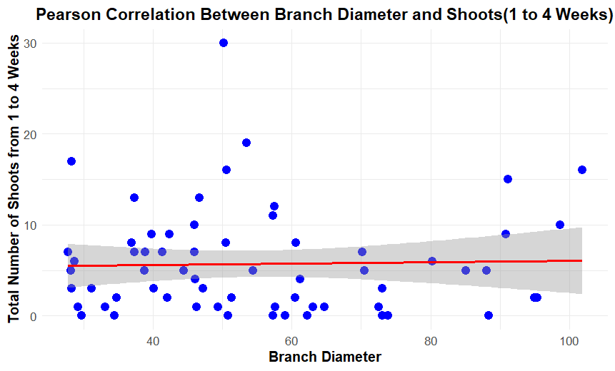
Results: Vegetative Propagation Experiment
Weak Positive
Not Significant
(T1) Hydro-Alcoolique solution, (T2) BAP + Sterile water,
(T3) Sterile water, (T4) Hydro-Alcoolique + BAP
Significant Treatment Effect (ANOVA : p-value = 0.00483)
Significant Plant Effect (ANOVA: p-value = 1.68e-07)
𝑟 = 0.026
Post-Hoc Analysis (Tukey’s HSD Test)

Slide 6
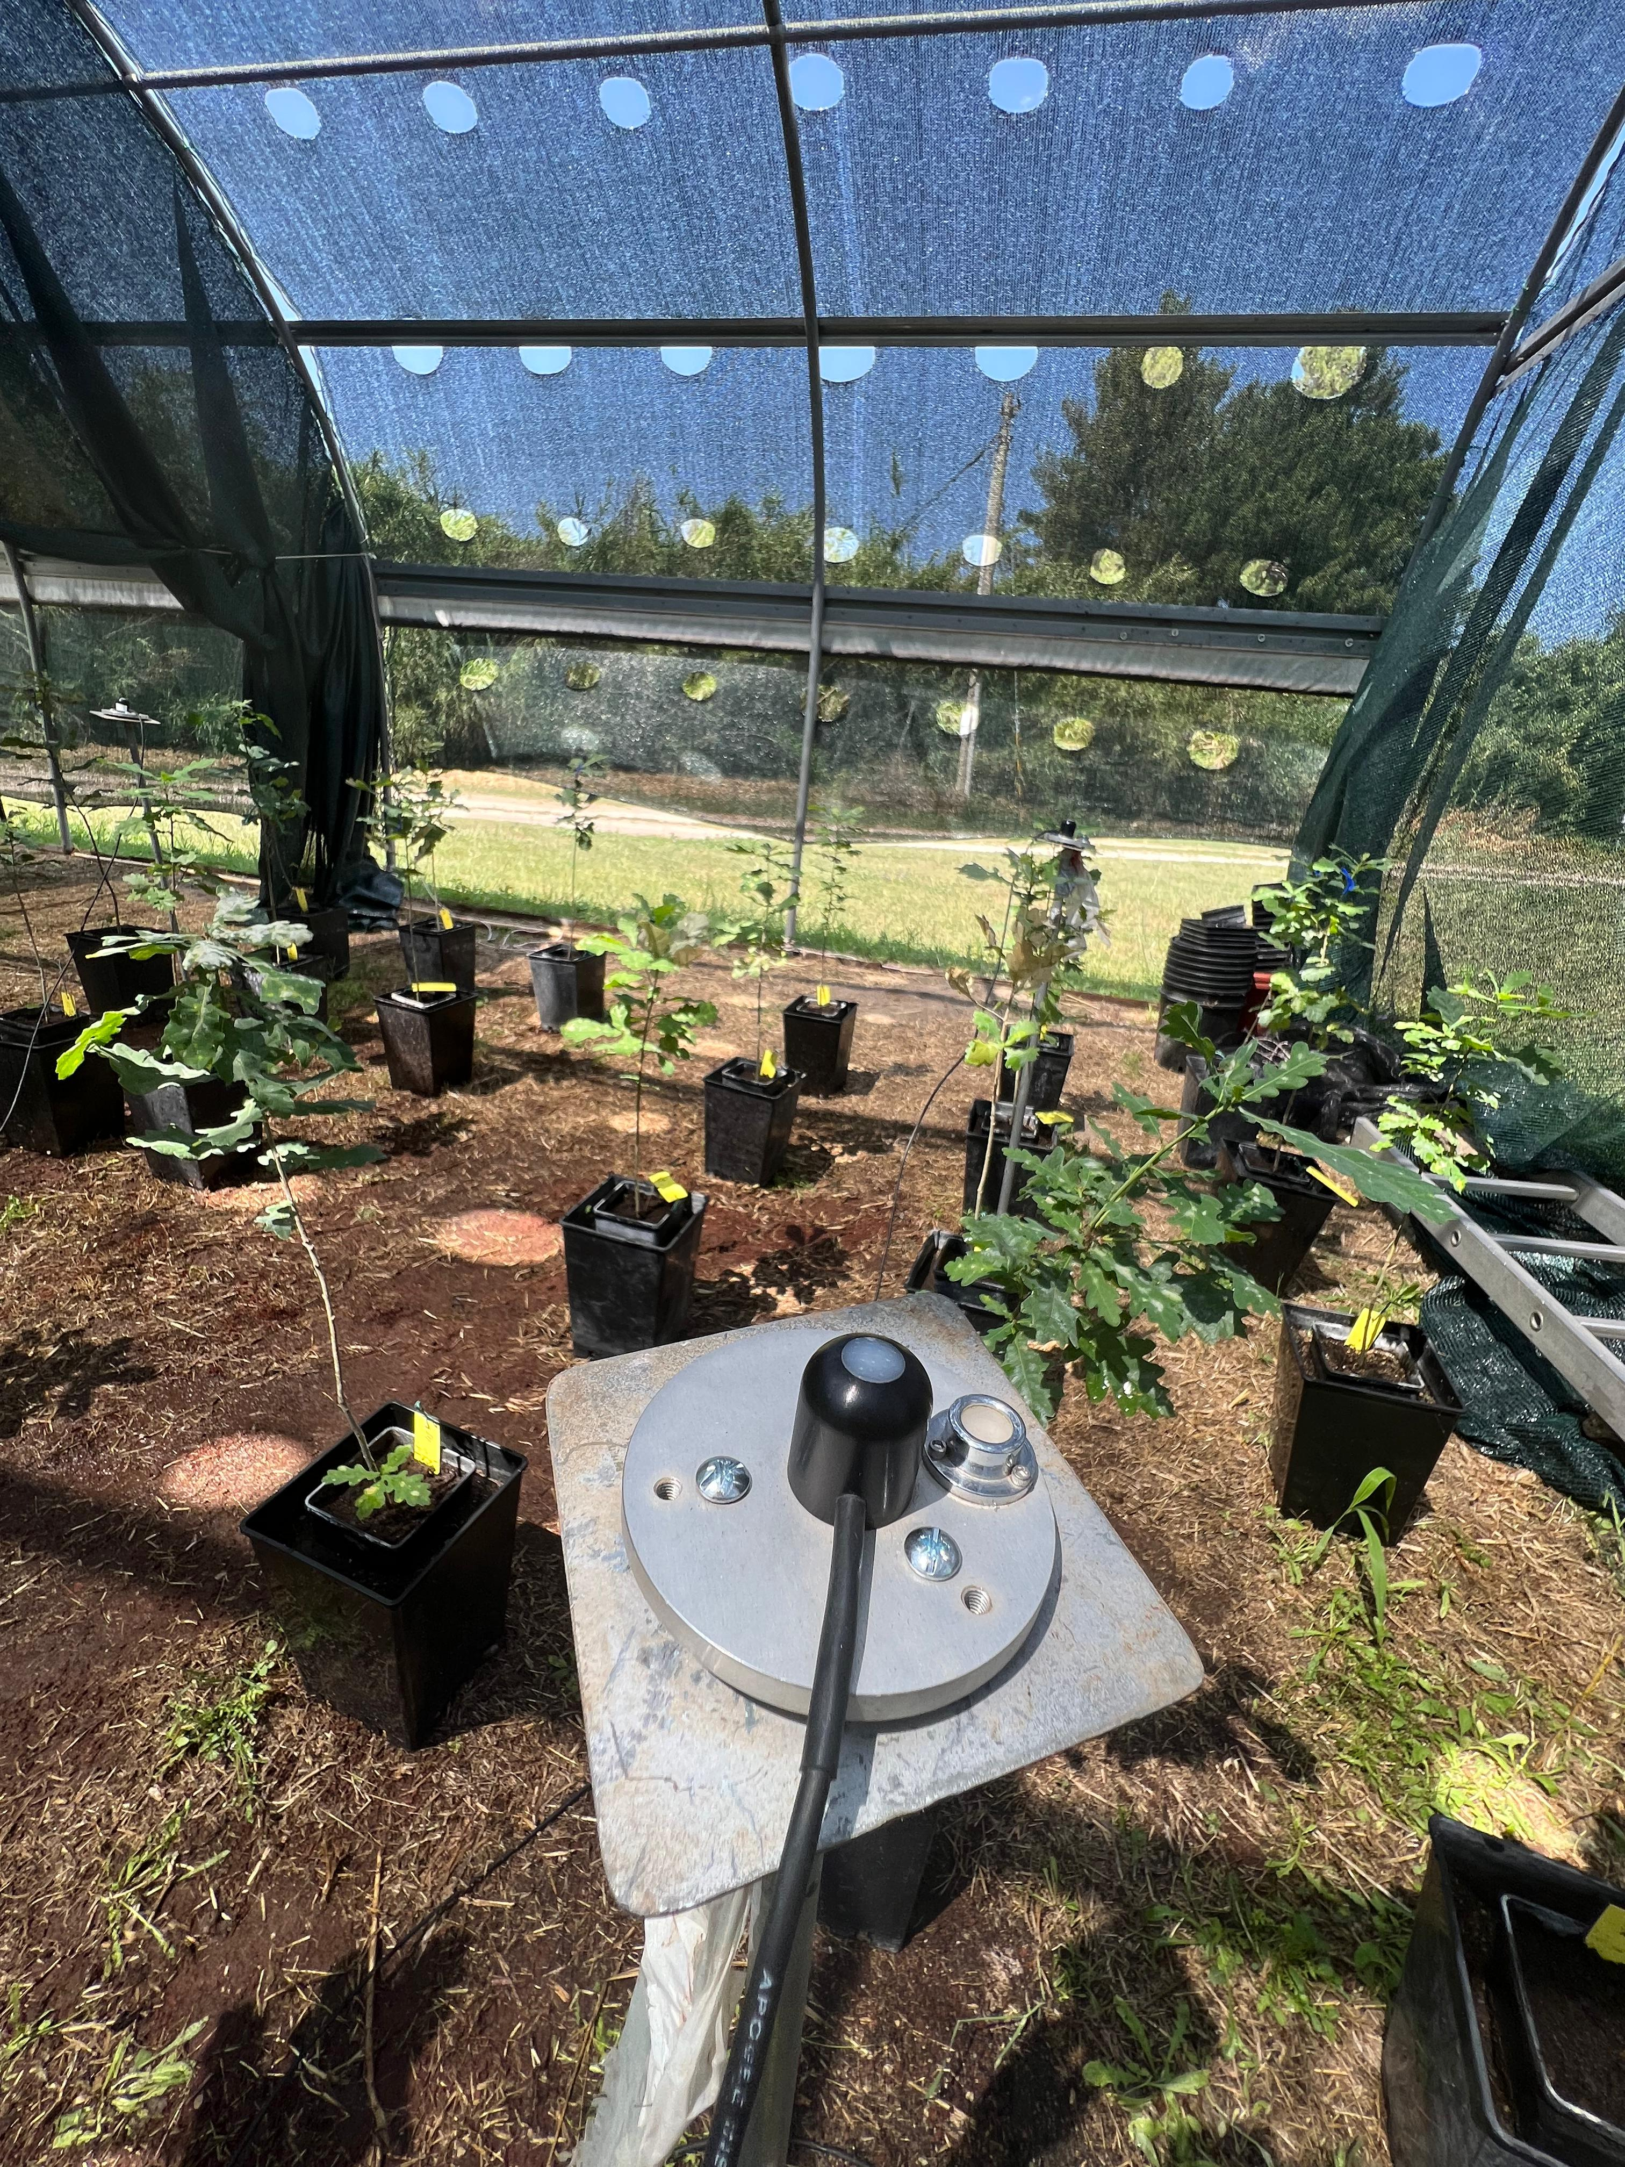
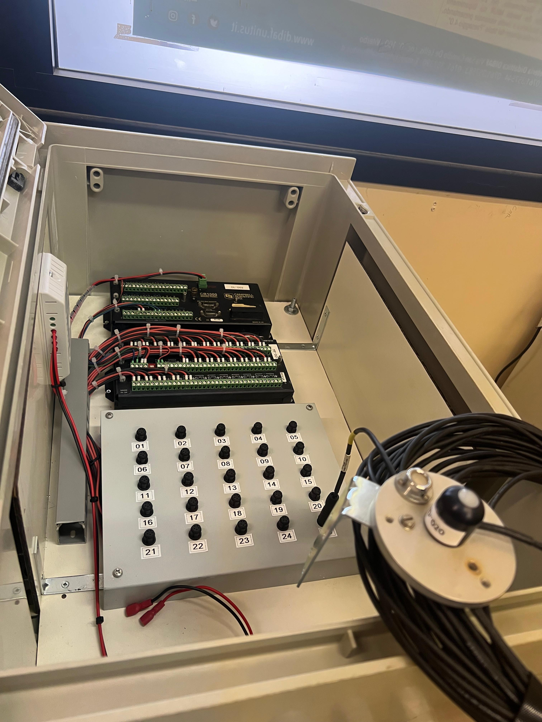
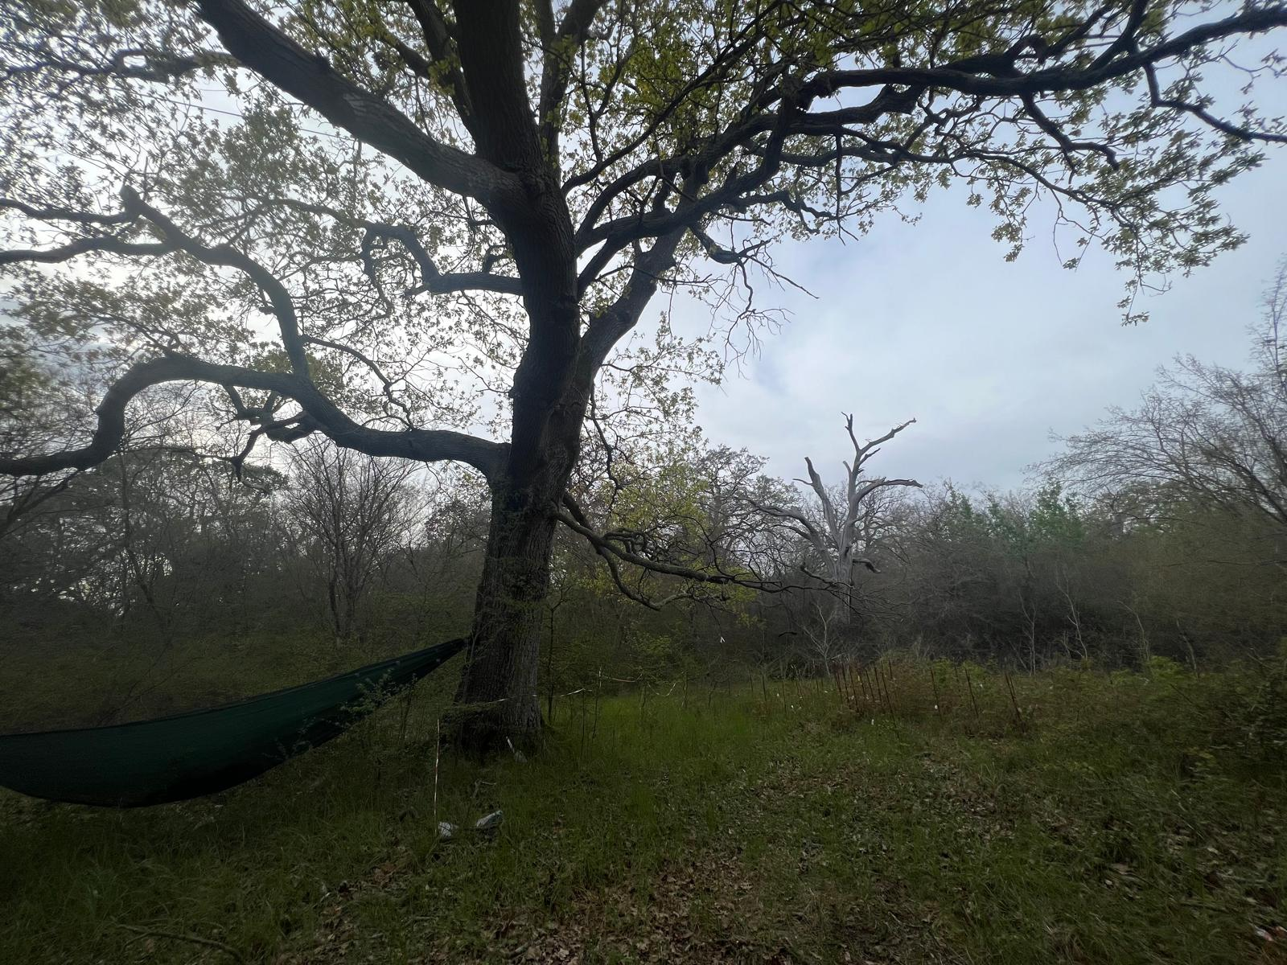
Radiation Dynamics Measurements (PAR)
Light monitoring: radiation dynamics measurements in Castelporziano and greenhouse at Tuscia University.
Using a network of calibrated quantum sensors.
Quantification of sunflecks dynamics (duration, frequency, and cumulative PAR) required for successful regeneration.
Evaluate the impact of light dynamics on Quercus regeneration in Castelporziano.
Quantum sensors installed in Castelporziano (Campo di Rota), and the greenhouse at Tuscia University

Slide 7
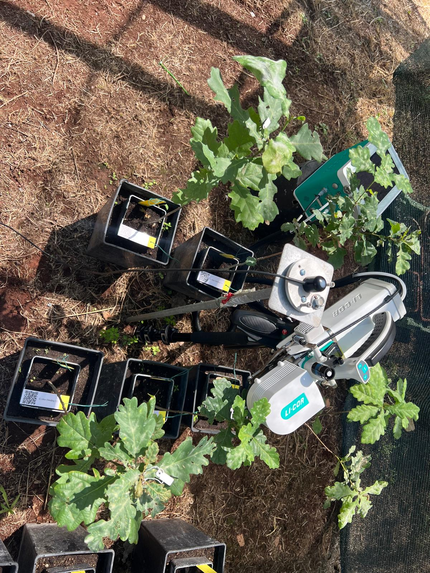
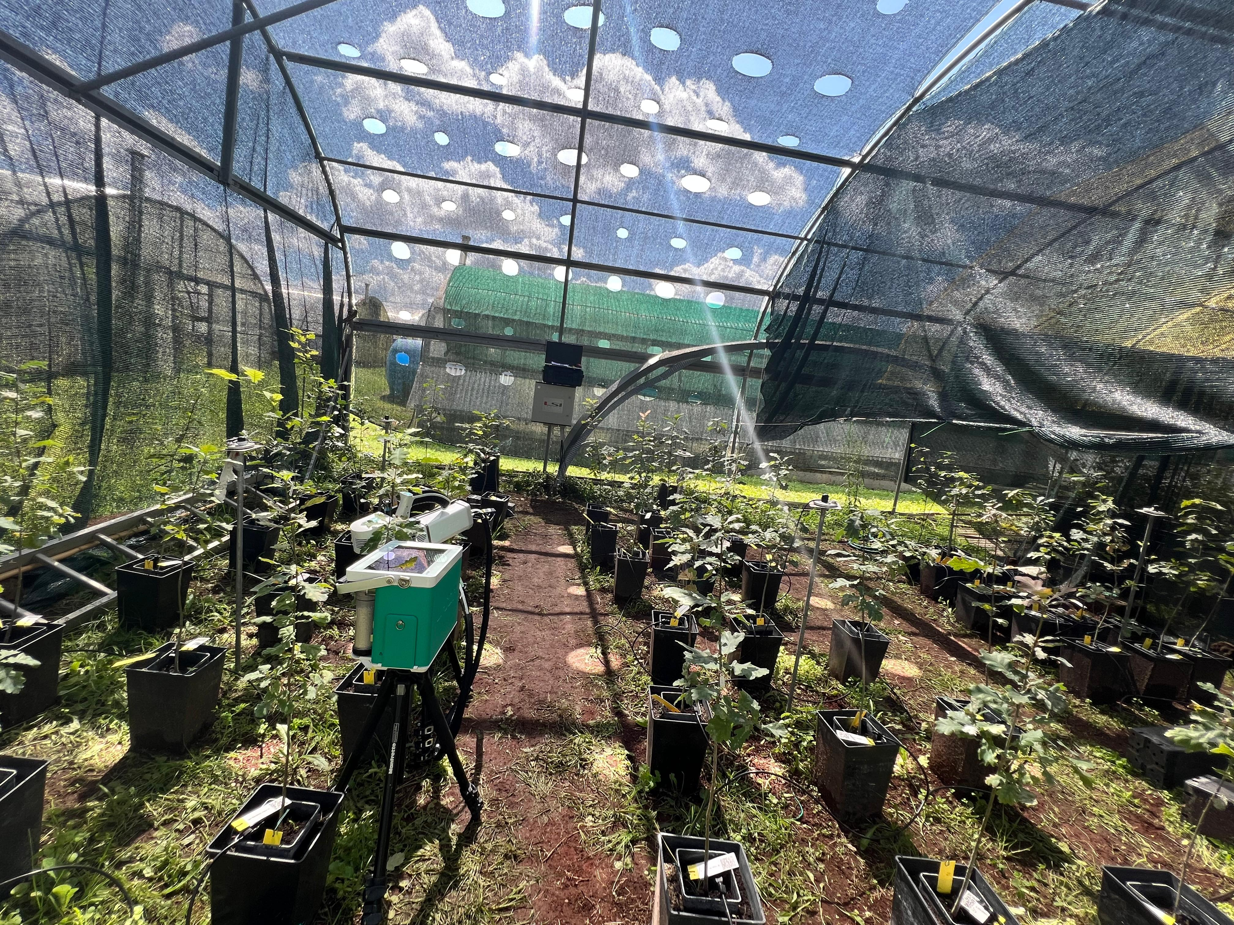
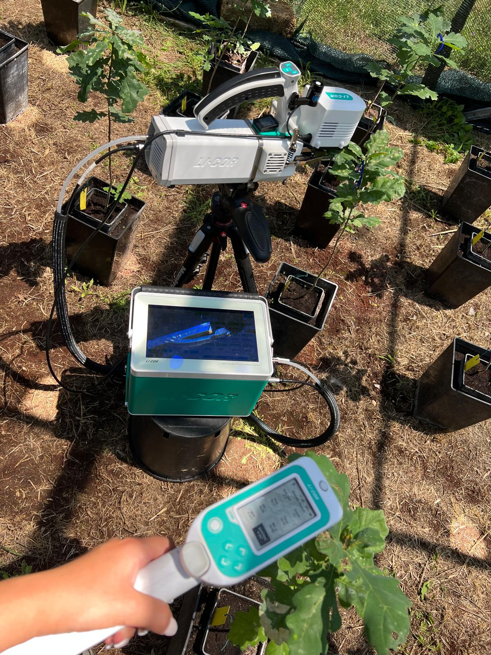
Eco-physiological Measurement
Gas exchanges and Fluorescence measured with (LI-6800 Portable Photosynthesis System), under contrasting light conditions (homogeneous shadow vs. sunflecks).
Evaluate the dynamic response of the photosynthetic, water use efficiency, interactions with water stress.
Preliminary Results:
Seedlings exposed to dynamic light conditions exhibited improved photosynthetic and water-use efficiency compared to those under shade.

Slide 8
Conclusions
This integrated approach, combining biotechnological techniques, Eco-physiological measurement and radiation dynamics monitoring, aims to provide guidelines for assisted regeneration in Castelporziano (Roma, Italy).
Our findings will contribute to adaptive forest management, conservation, and reforestation strategies, enhance resilience of Mediterranean oak ecosystems, and support regeneration efforts at Castelporziano under climate change.

Slide 9
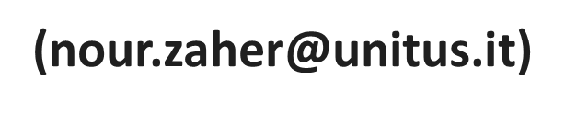
Nour Zaher ¹, Paolo De Angelis ¹, Dario Papale ¹, Elena Kuzminsky ¹.
¹ University of Tuscia, Viterbo, Italy.

