Slide 1



Monitoring climate and land-use change impacts on Alpine vegetation dynamics and carbon sinks
D. Ferraris¹, M. Galvagno², L. Oddi³, G. Filippa², E. Cremonese⁴, P. Pogliotti², F. Grosso², U. Morra di Cella^{2,4}, S. Koliopoulos², C. Guarnieri², G. Wohlfahrt⁵, G. Leitinger⁵, M. Migliavacca⁶, A. Hammerle⁵, D. Papale^{1,7}
¹ Università degli Studi della Tuscia, Viterbo, Italy. ² Environmental Protection Agency of Aosta Valley (ARPA VdA), Climate Change Dept., Aosta, Italy. ³ Department of Life Sciences and Systems Biology, University of Turin, Italy. ⁴ CIMA Research Foundation, Savona, Italy. ⁵ Department of Ecology, University of Innsbruck, Austria. ⁶ European Commission, Joint Research Centre (JRC), Ispra, Italy. ⁷ National Research Council (CNR) - IRET, Rome, Italy.

Slide 2
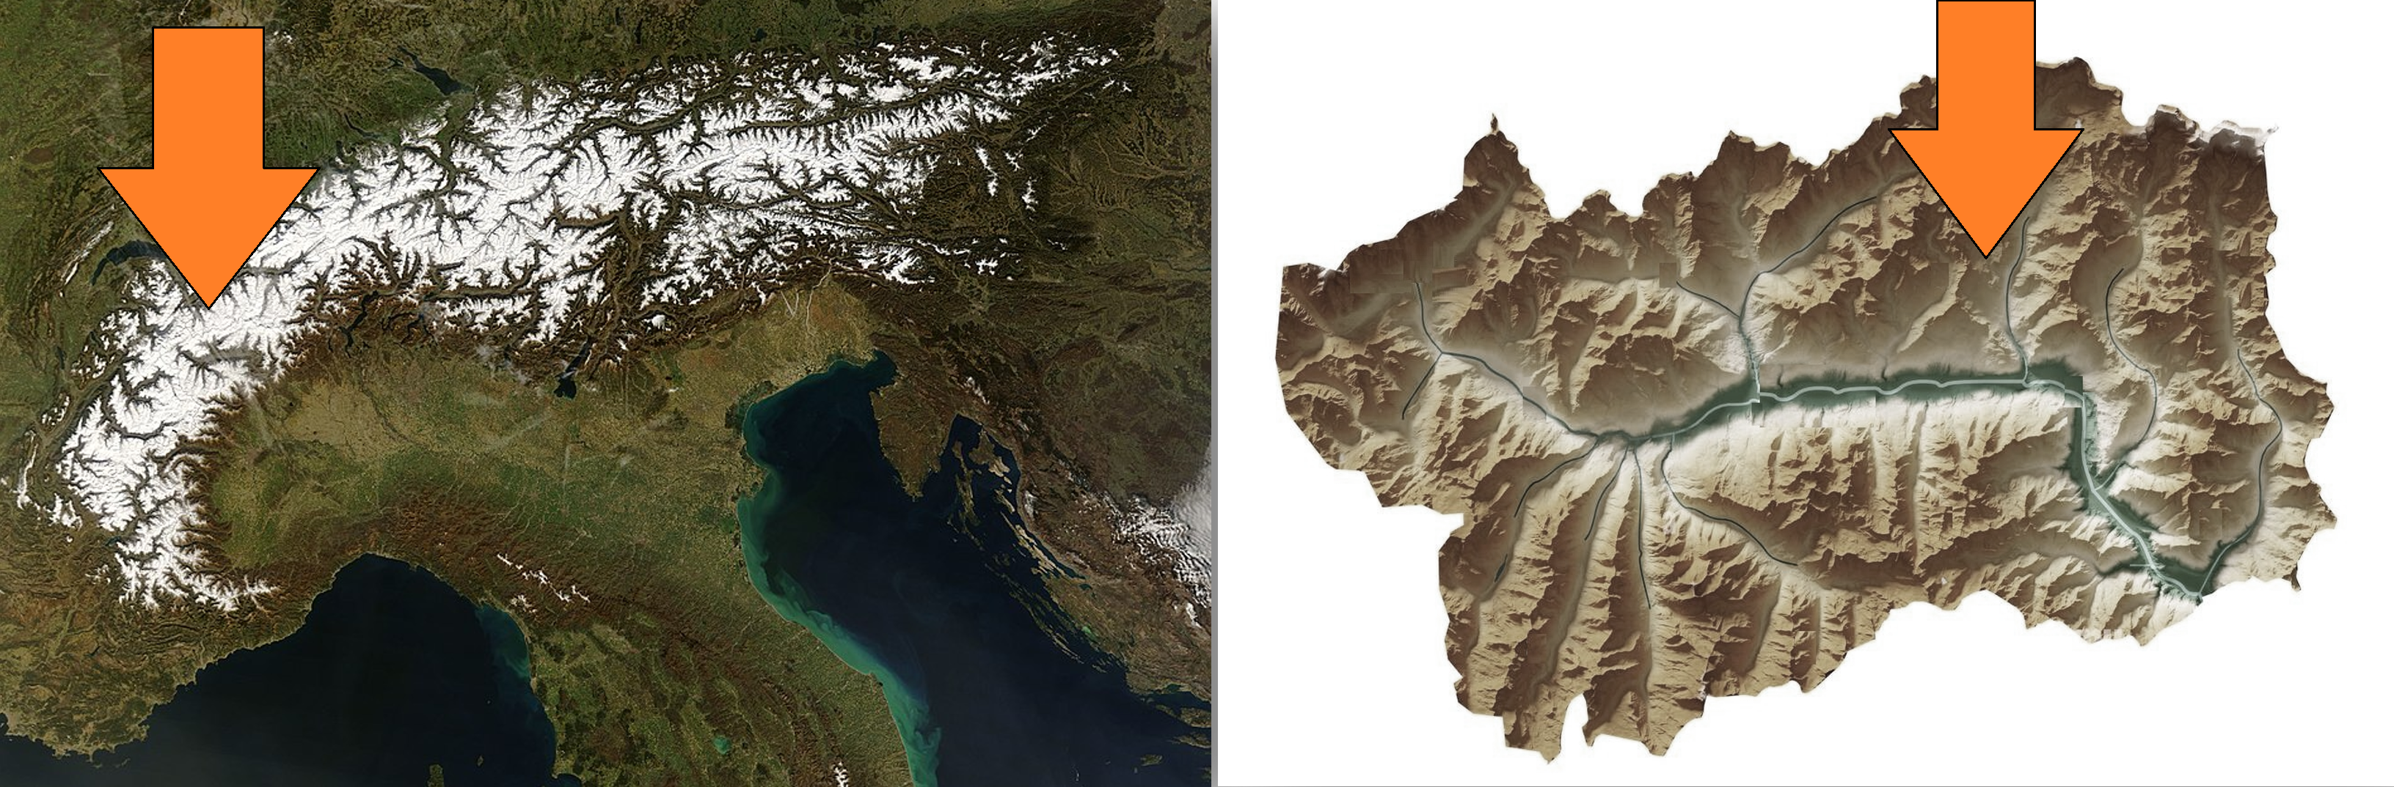
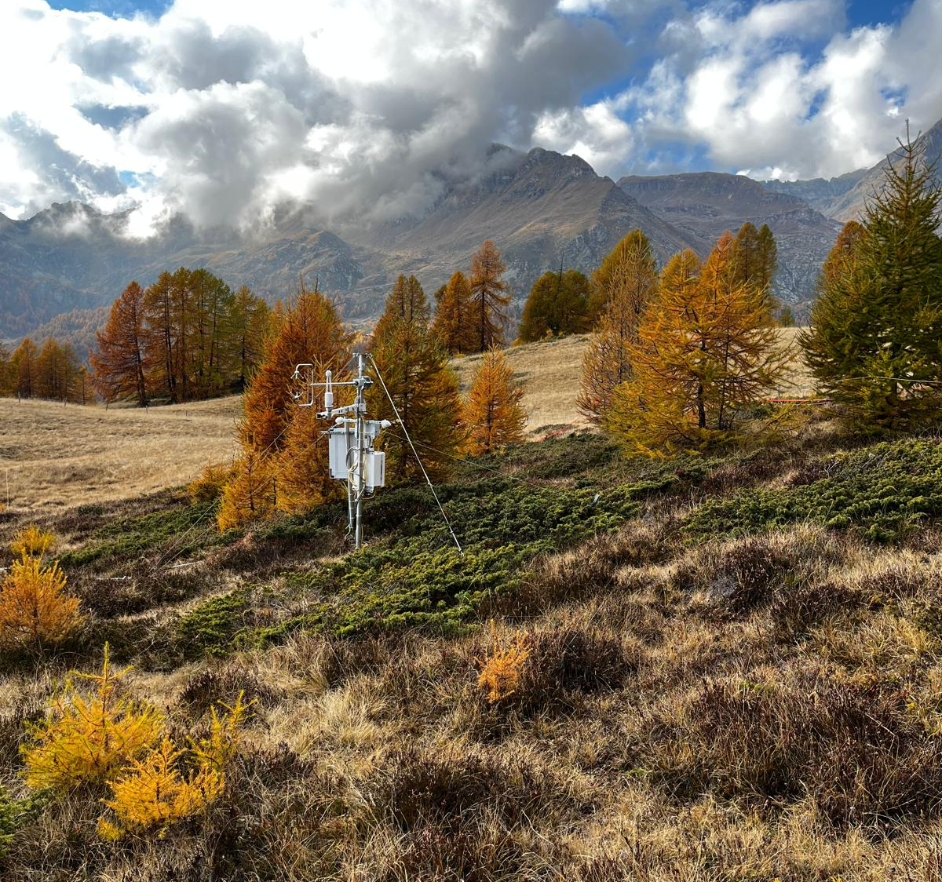
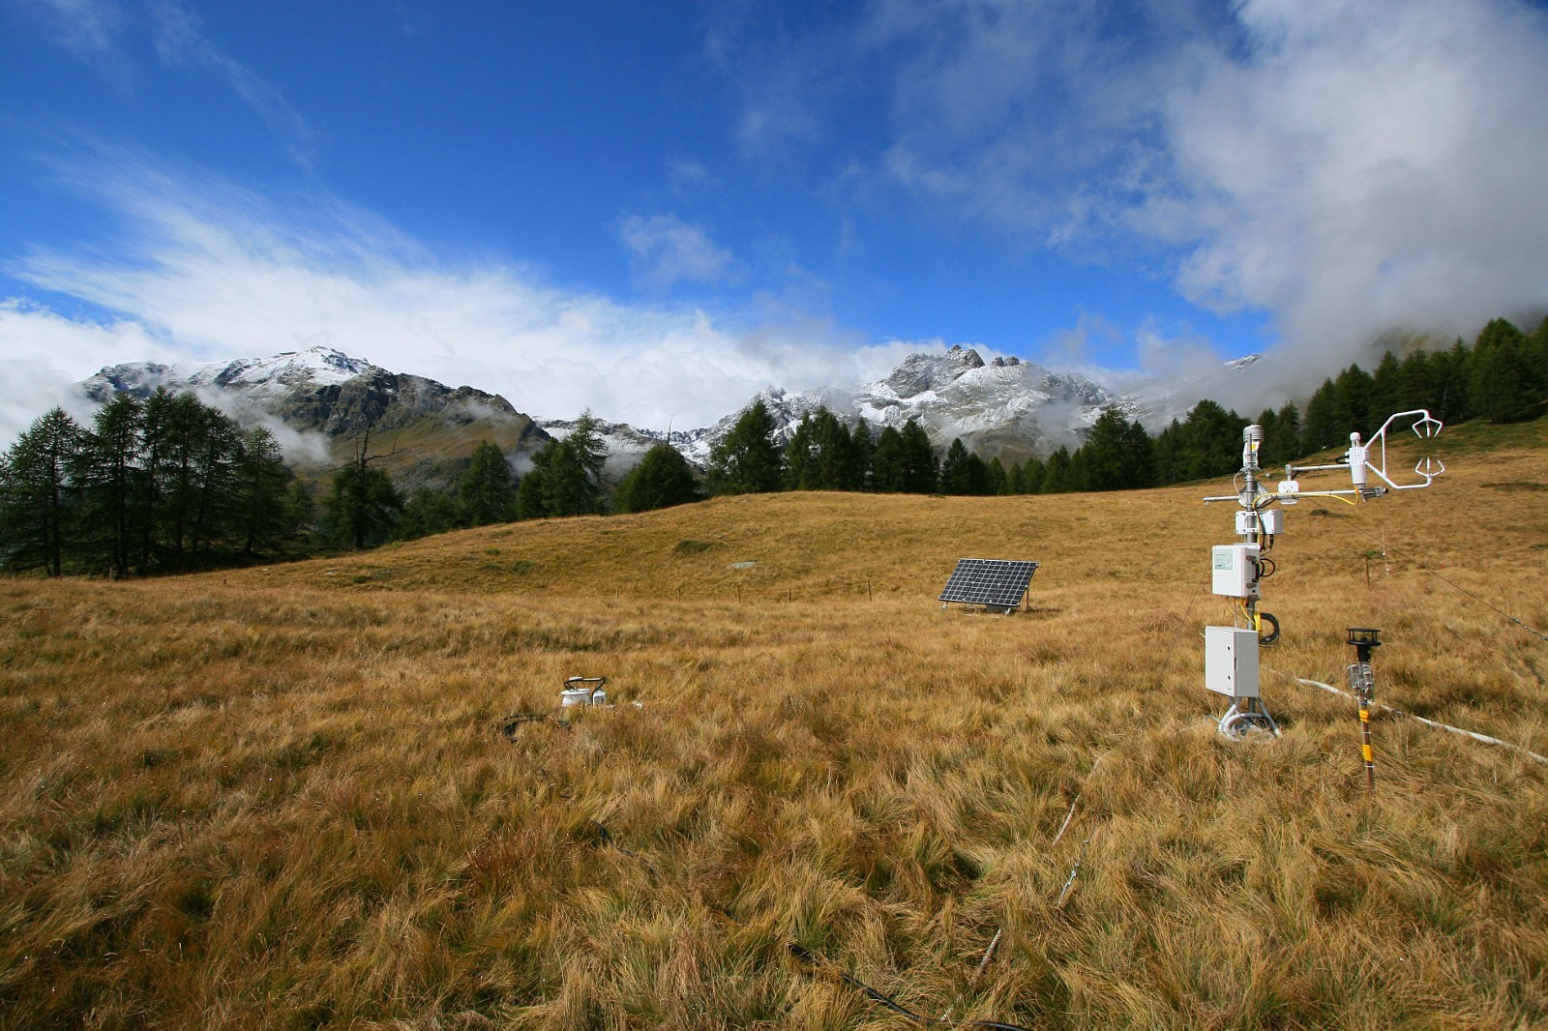
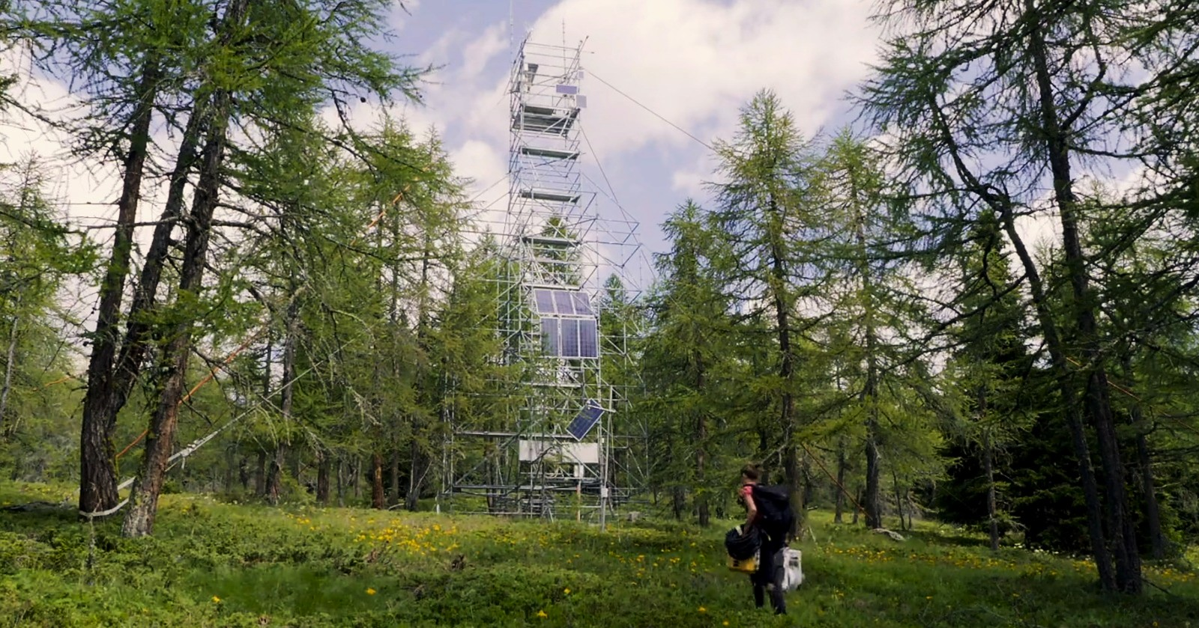

Introduction: monitoring sites
Aosta Valley region,
northwest Italian Alps,
2100 m asl
ICOS Associated site Torgnon (IT-Tor)
Transition from the abandoned pasture to a mature larch forest

Slide 3
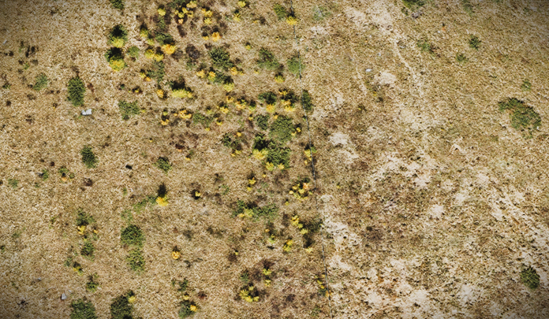
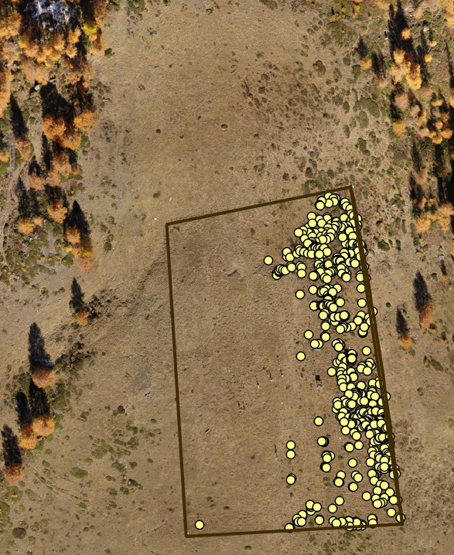
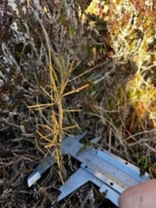
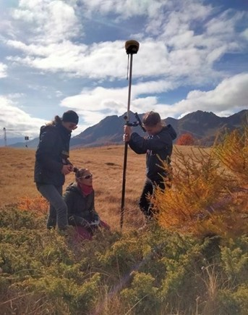
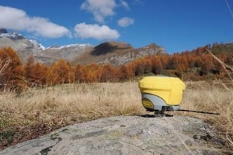
Methods: to estimate vegetation growth
Abandoned subalpine pasture (total exclusion since 2010)
Area of 15000 m2
Field surveys on larches and shrub species
GNSS mapping (5 cm accuracy)
Annual UAV images (since 2012)
New installed eddy covariance station in November 2024 on encroached area

Slide 4
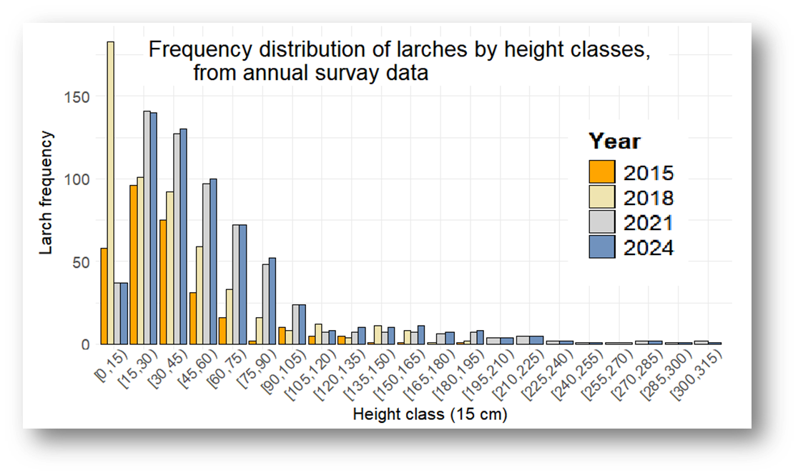
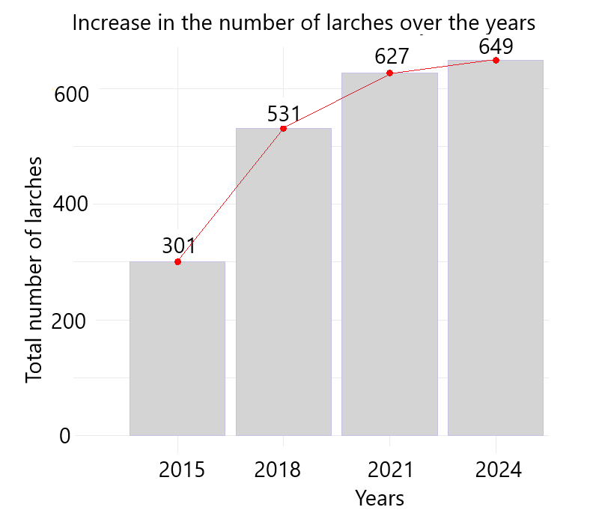
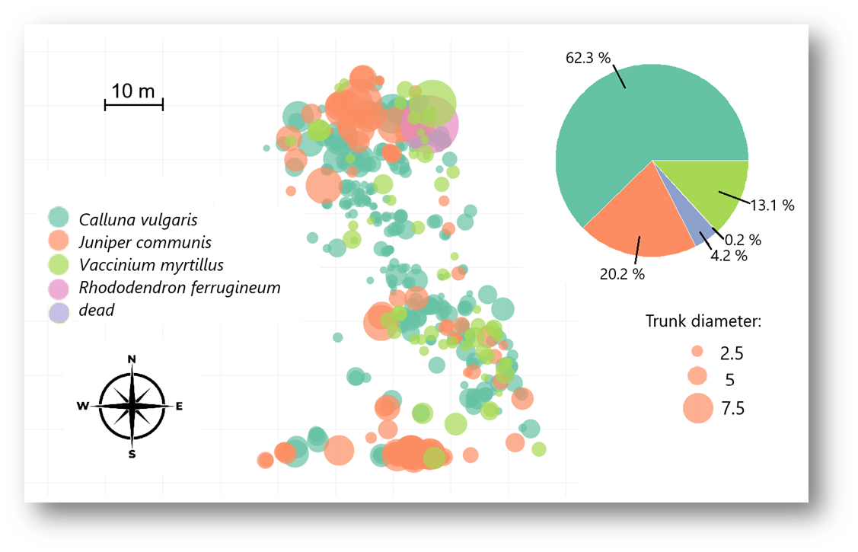
Survey results
In recent years, an increase in size rather than in number has been observed.
The presence of shrubs at the base of the trunk seems to be a requisite condition.

Slide 5
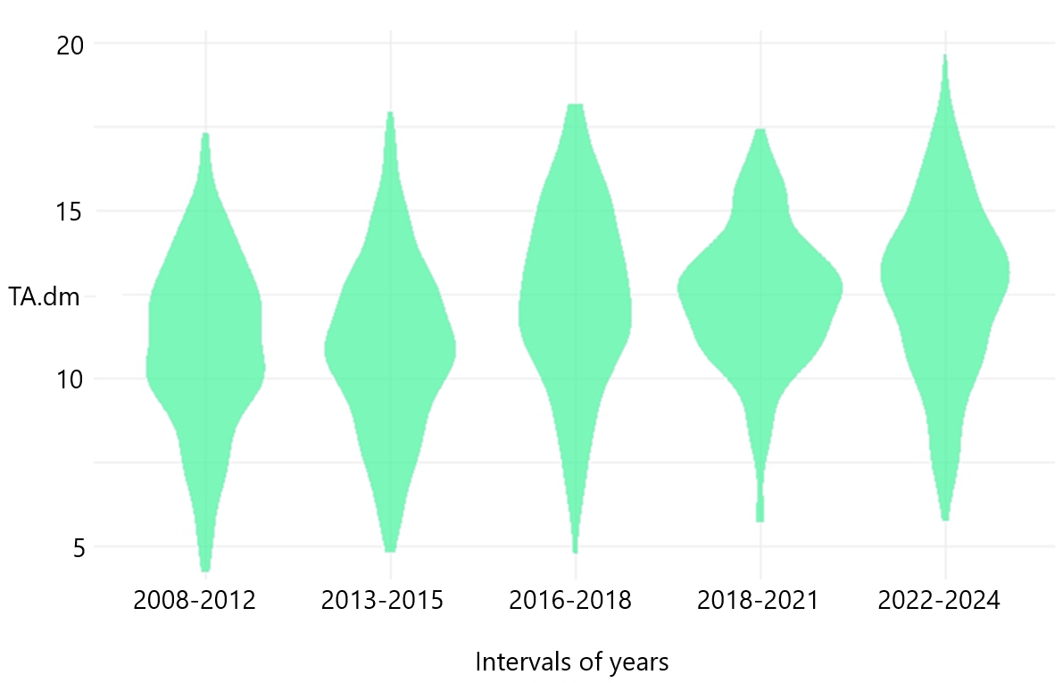
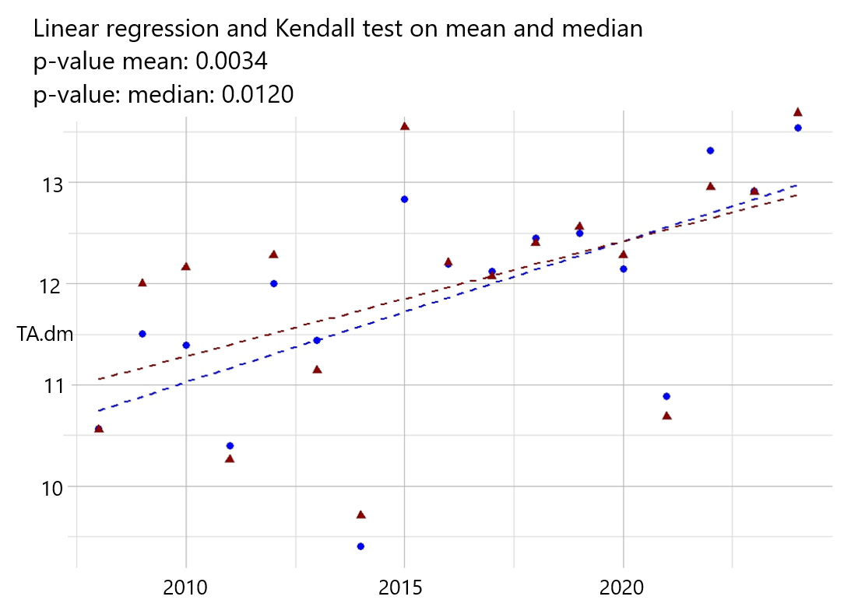
Growing season mean temperature, INCREASING TREND
Temperature (°C)
Temperature (°C)
Daily mean air temperature data July and August (peak of the growing season)

Slide 6
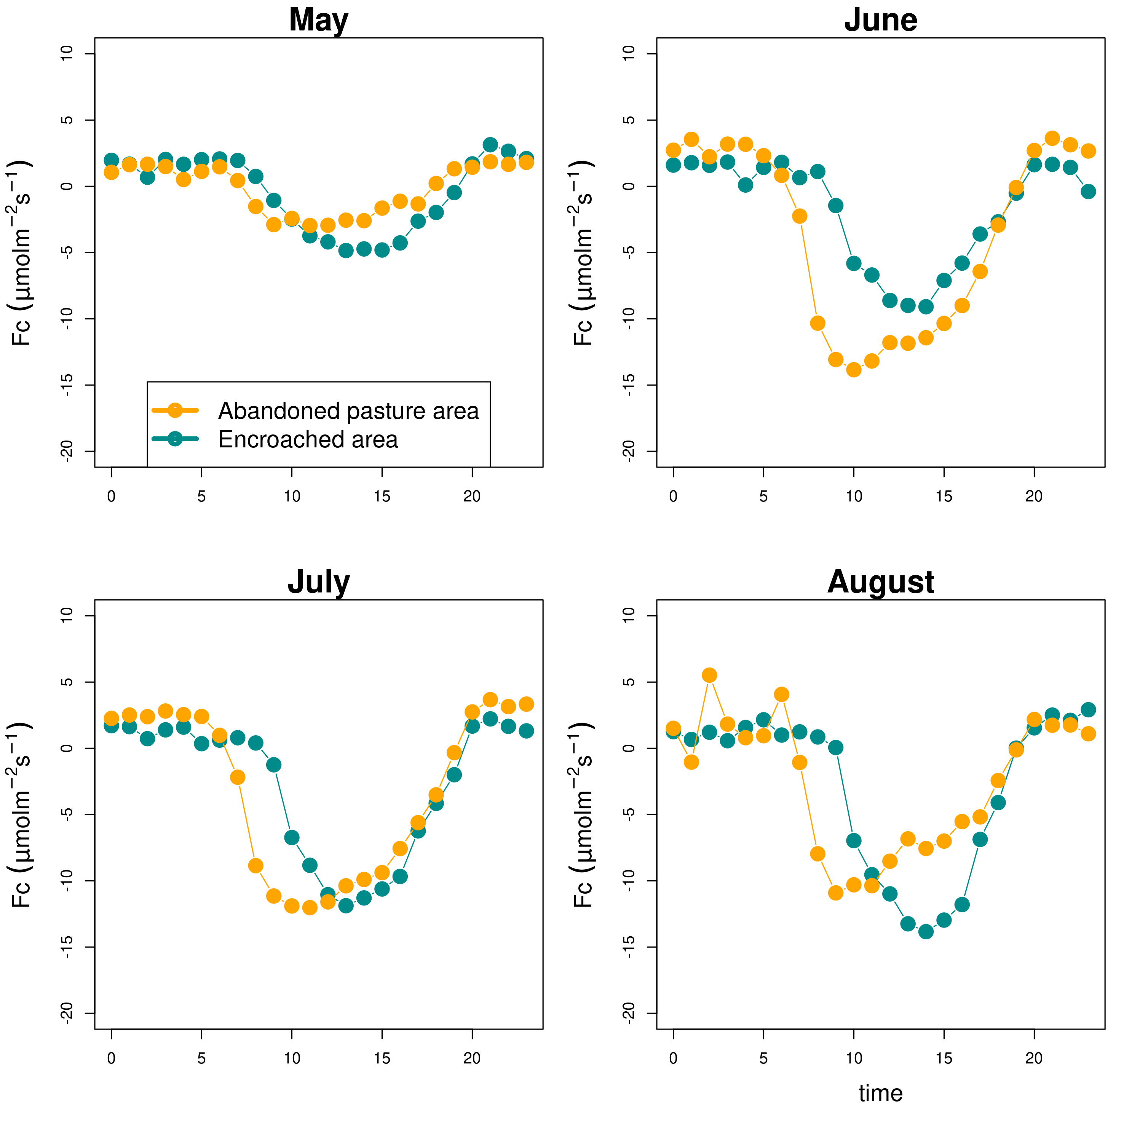
CO₂ fluxes from the new installed eddy covariance station
Year 2025: mean diurnal variations
Grassland area
Encroached area
Disentangling the effects of grazing abandonment and climate change
on vegetation dynamics
and carbon sequestration

Slide 7
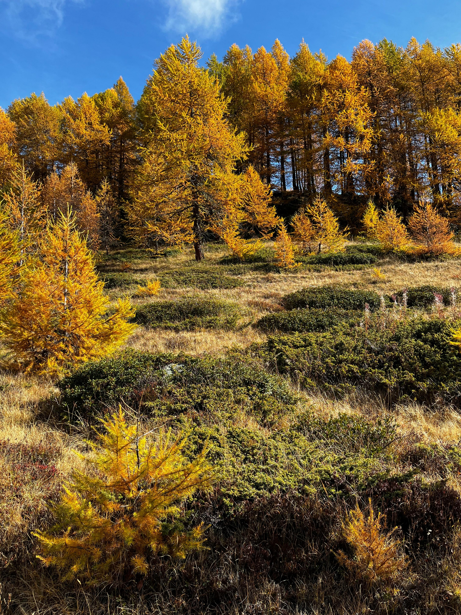
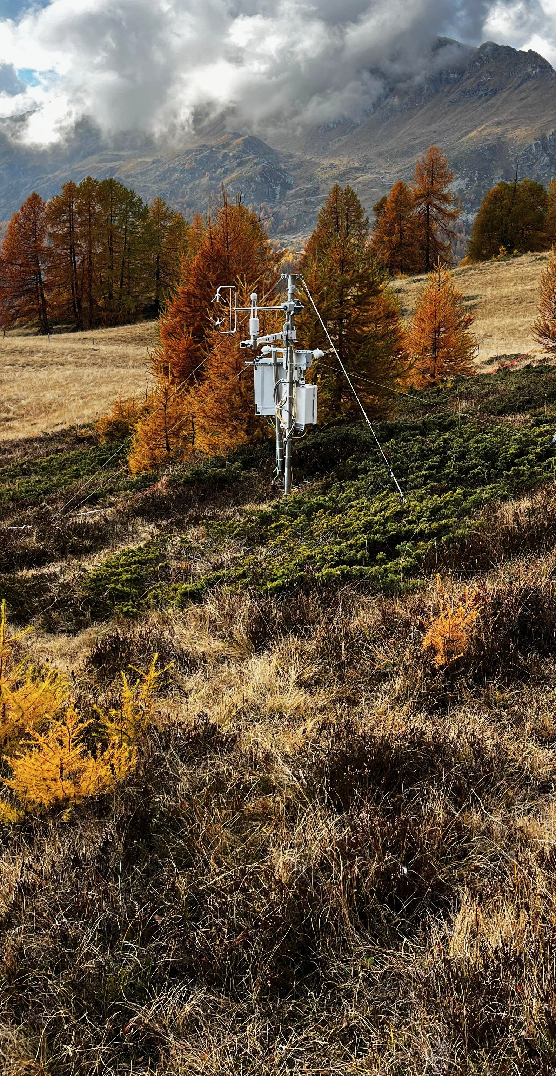
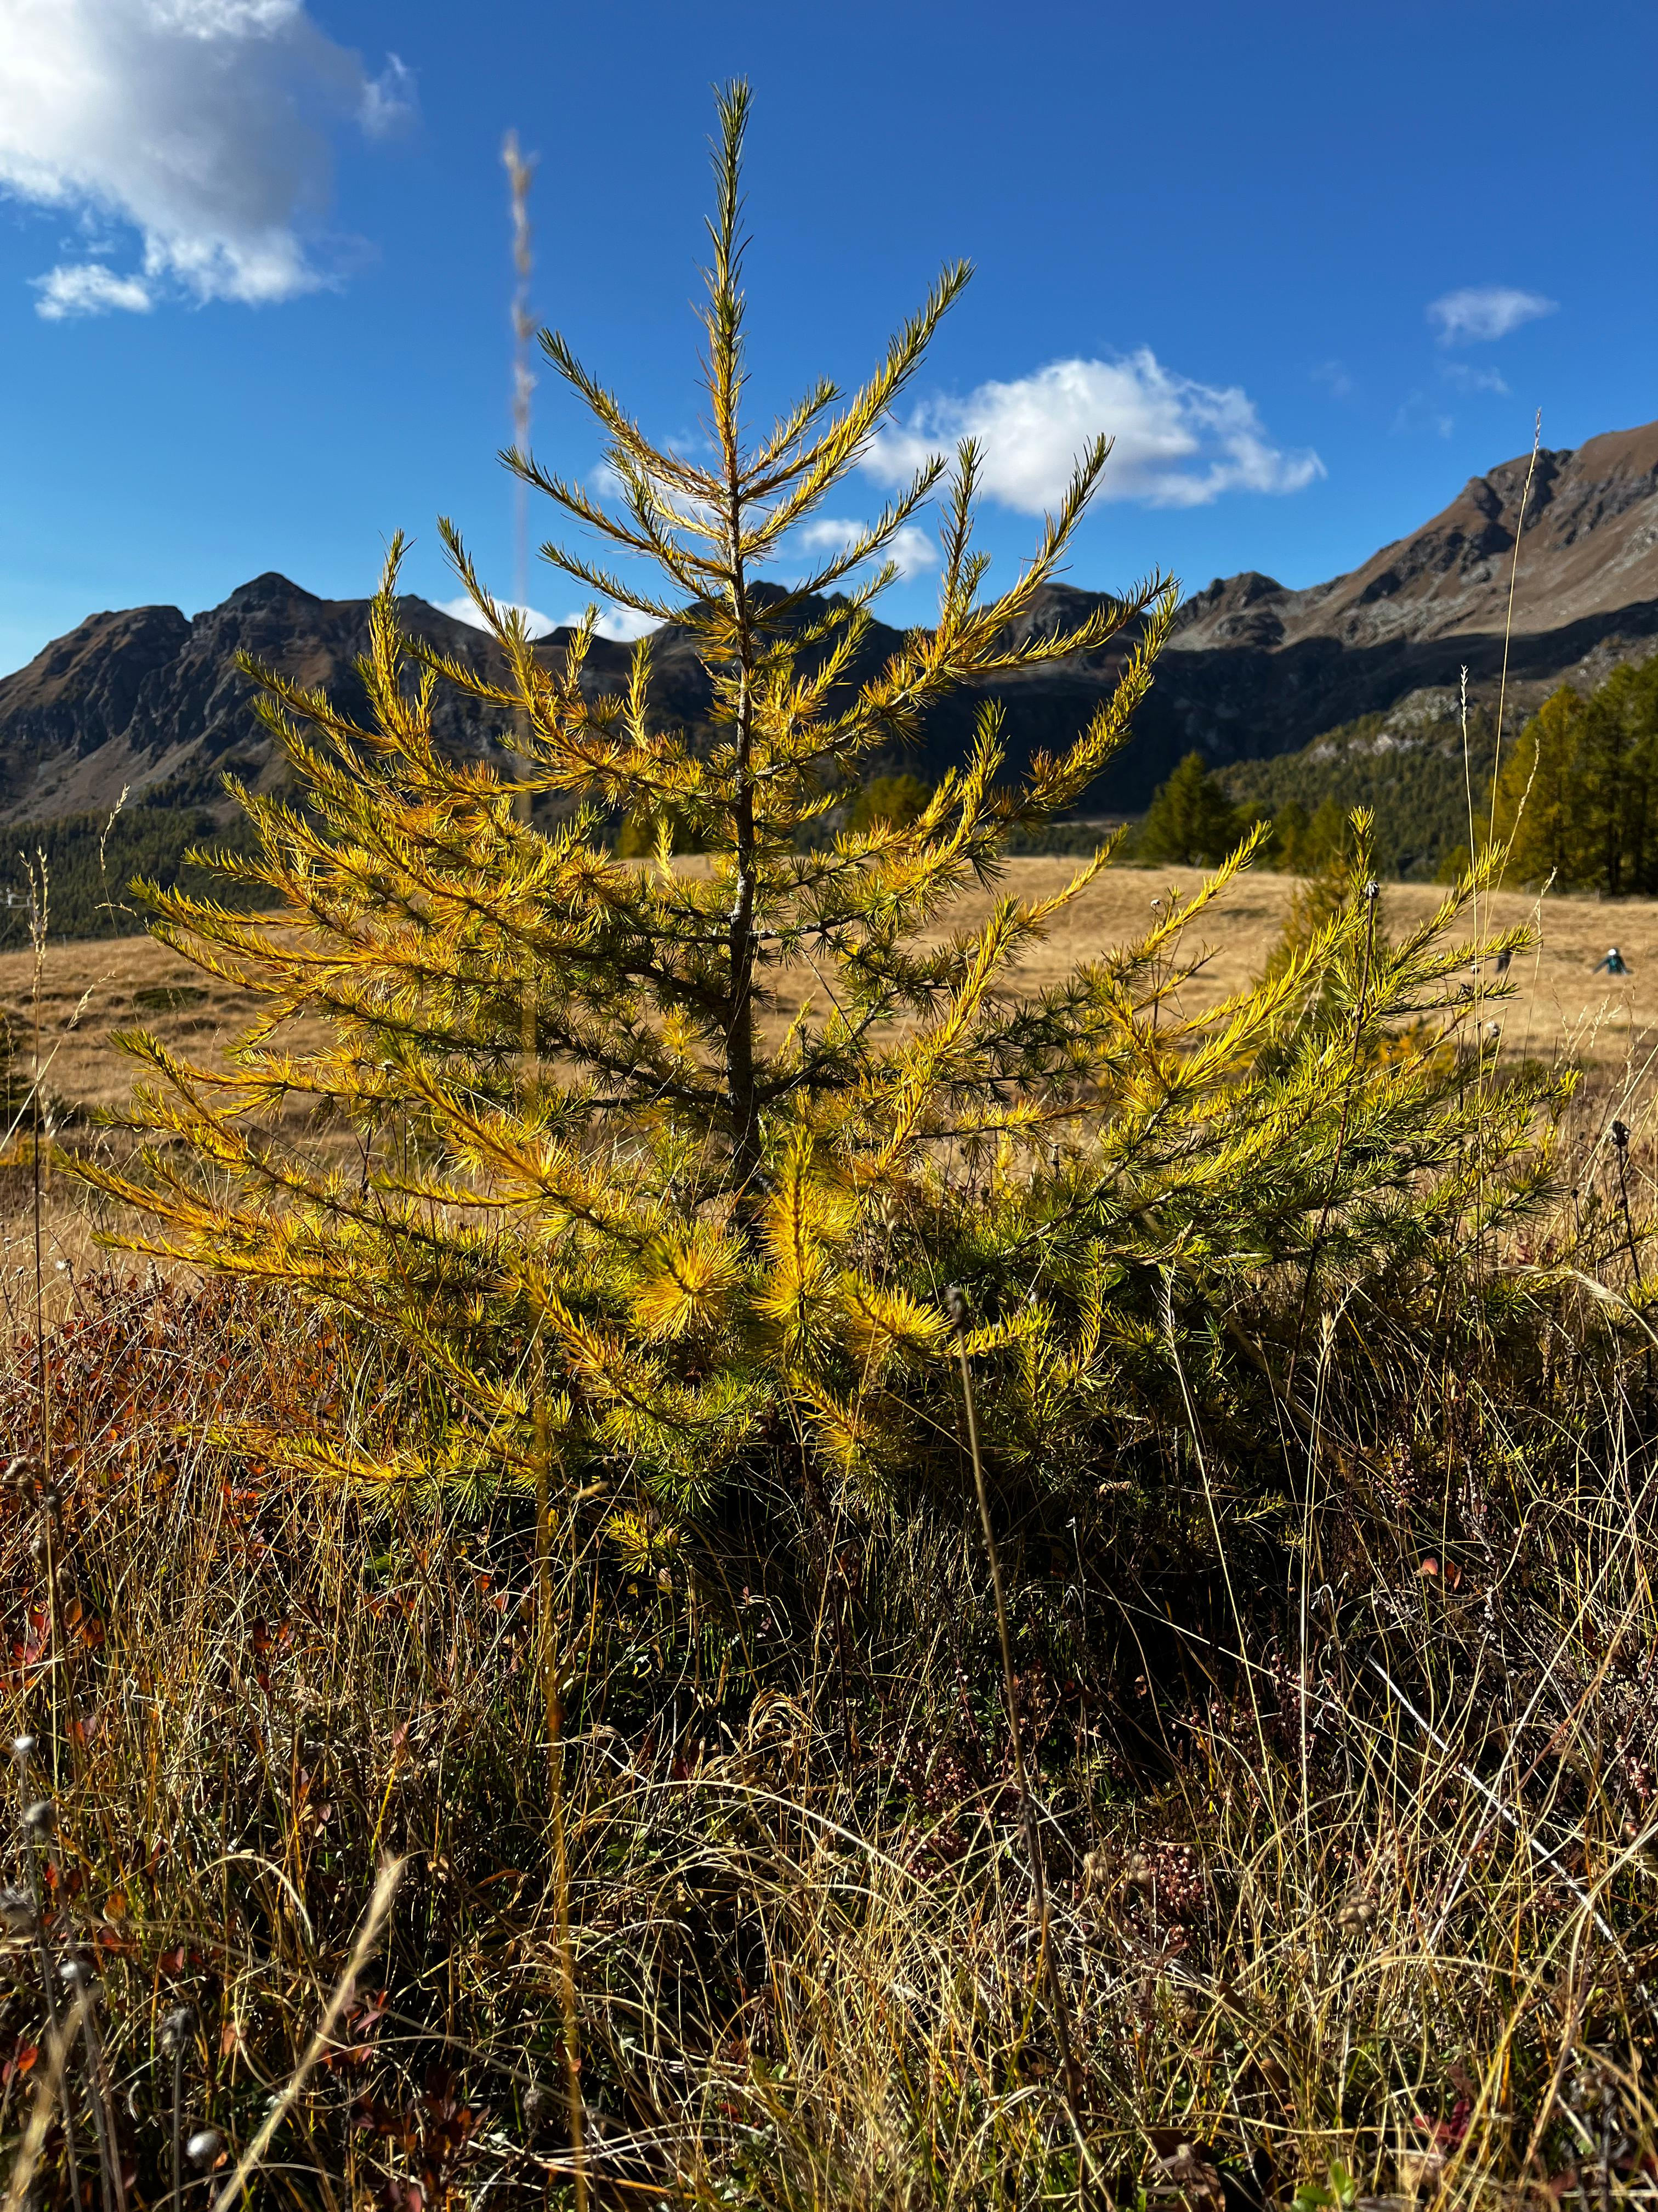
Thank you for your attention !
Do you have any questions, comments, thoughts or suggestions… ?
daria.ferraris@unitus.it

