Slide 1


WP 6.20: Cross-RI dataset provision of UAV multi platform hyperspectral data and site level measurements over different RI ecosystem sites (eLTER, ICOS, ANAEE) and comparison with satellite products
Jose Luis Pancorbo¹, Giandomenico De Luca¹, Federico Carotenuto¹, Lorenzo Genesio¹, Alessandro Montaghi², Beniamino Gioli¹
¹CNR-IBE, National Research Council of Italy, Institute of Bioeconomy, Via Madonna del Piano 10, 50145 Sesto Fiorentino, Italy
²CNR-IRET, National Research Council of Italy, Institute of Research on Terrestrial Ecosystems, Via Madonna del Piano 10, 50145 Sesto Fiorentino, Italy
joseluis.pancorbodeonate@cnr.it

Slide 2
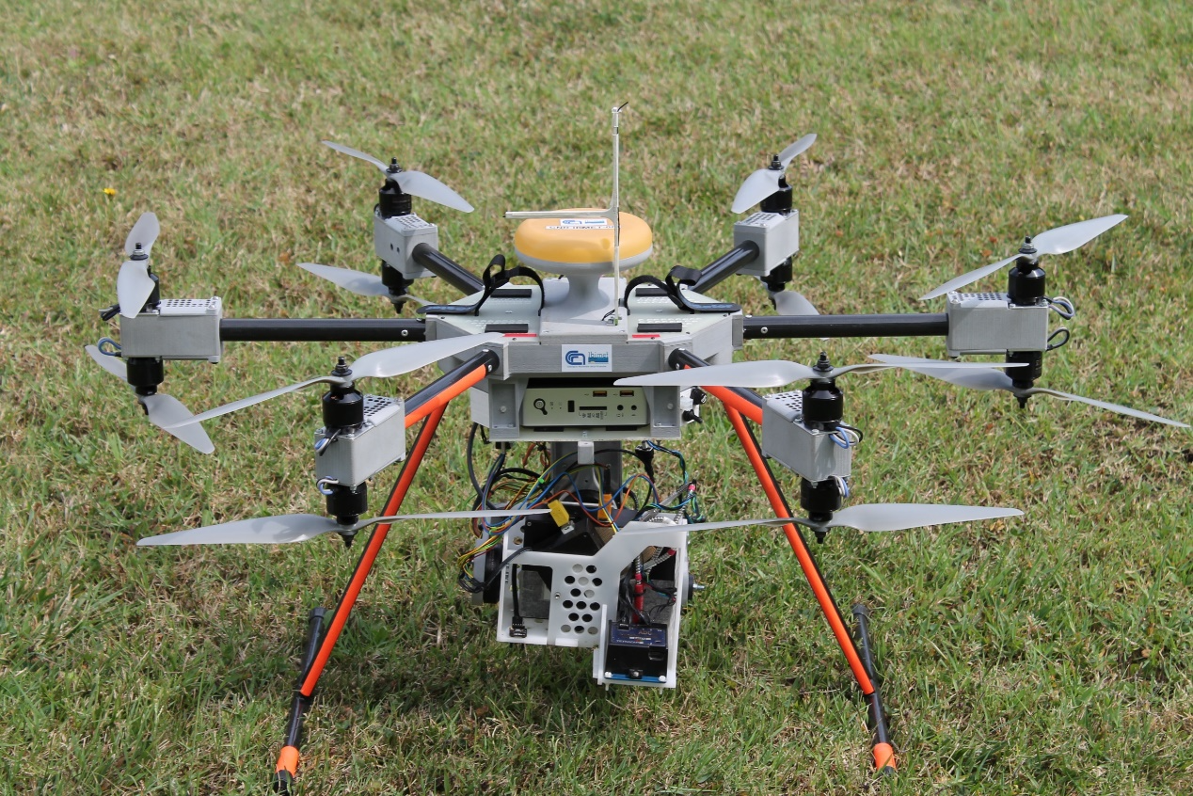
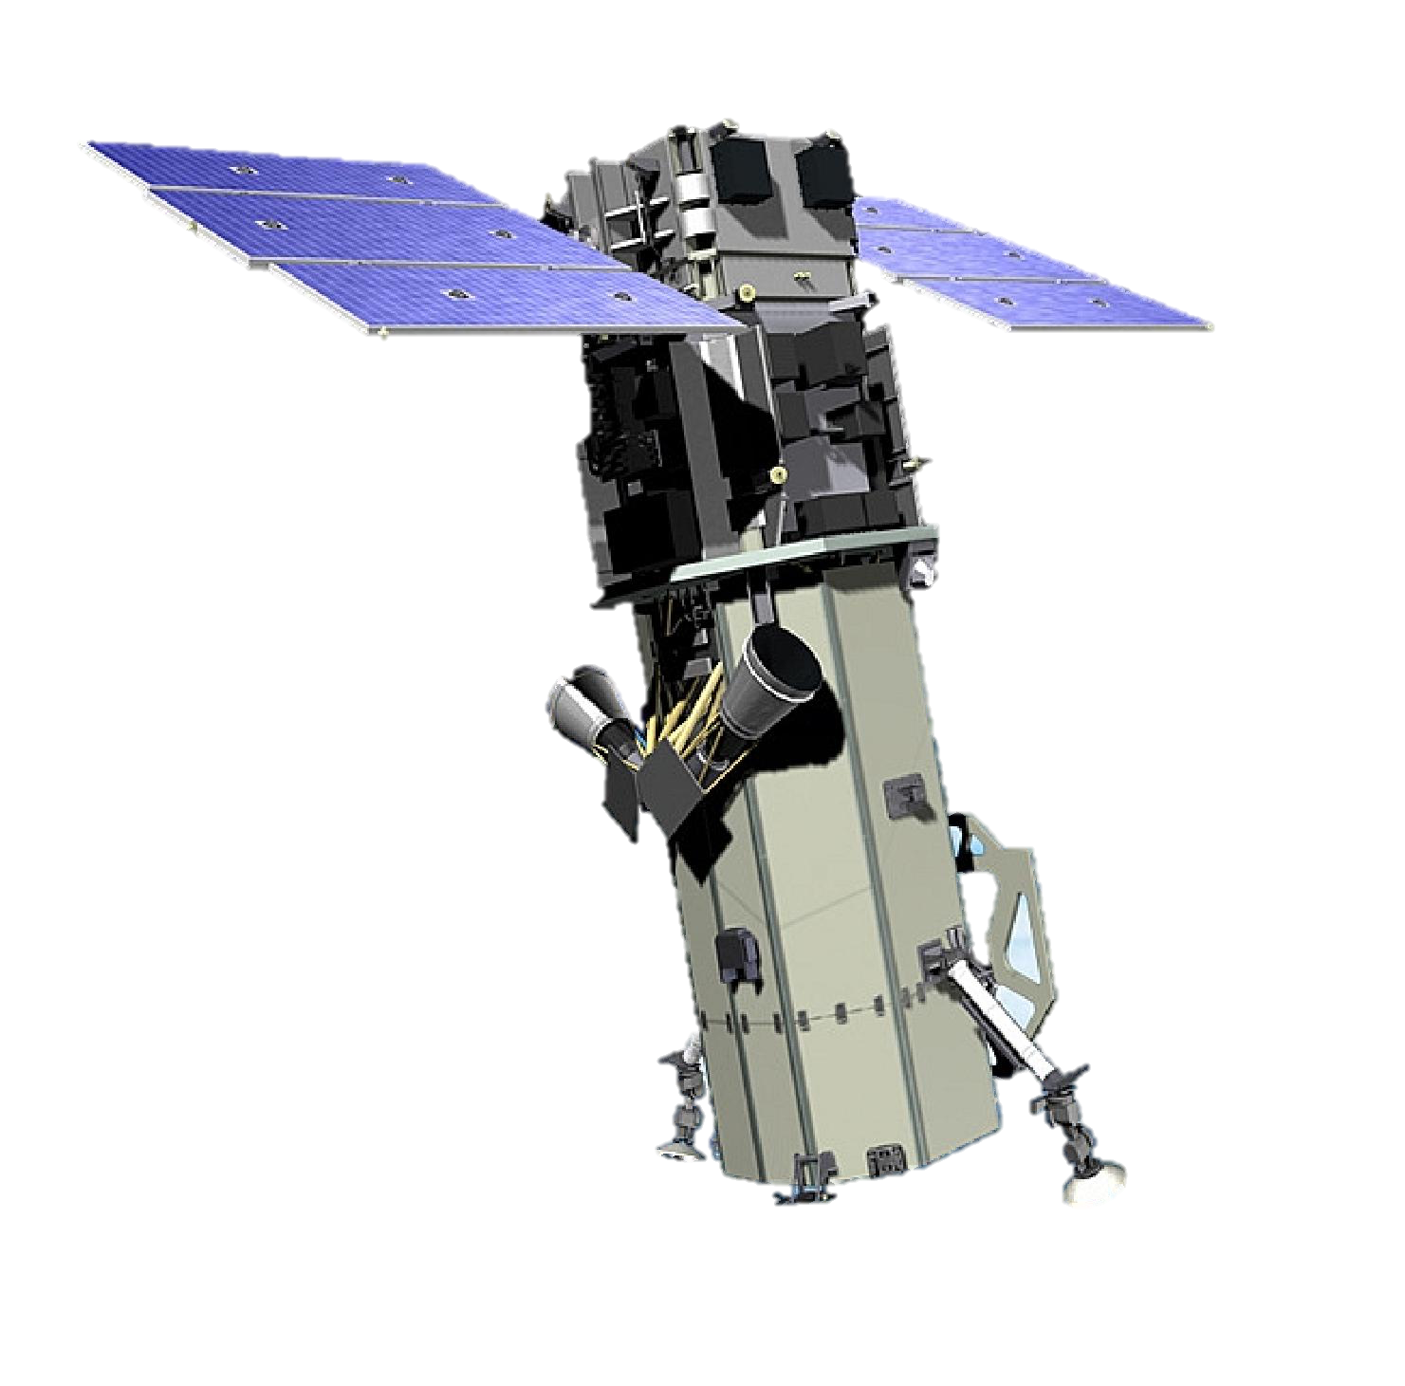
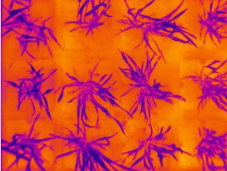
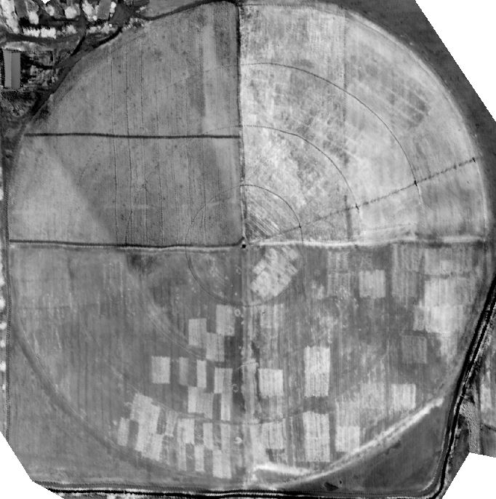
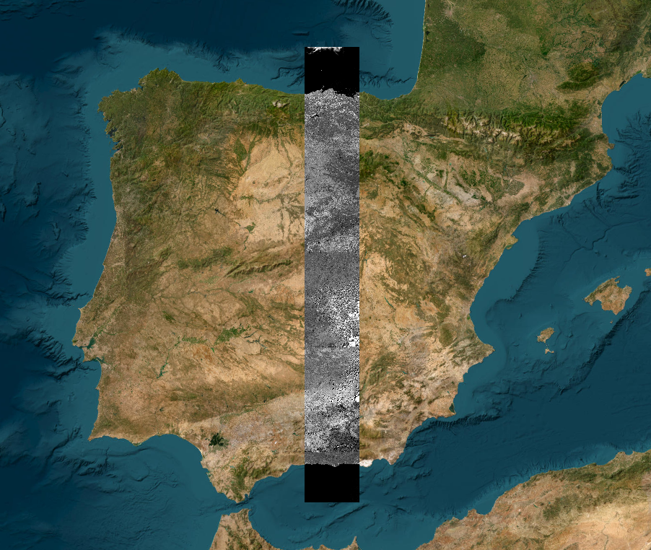
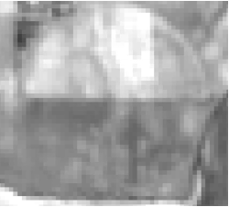
Introduction to remote sensing
Platforms
Aerial | Satellite
Higher spatial resolution
Calibration/Validation
Repeated observations
Large spatial coverage

Slide 3
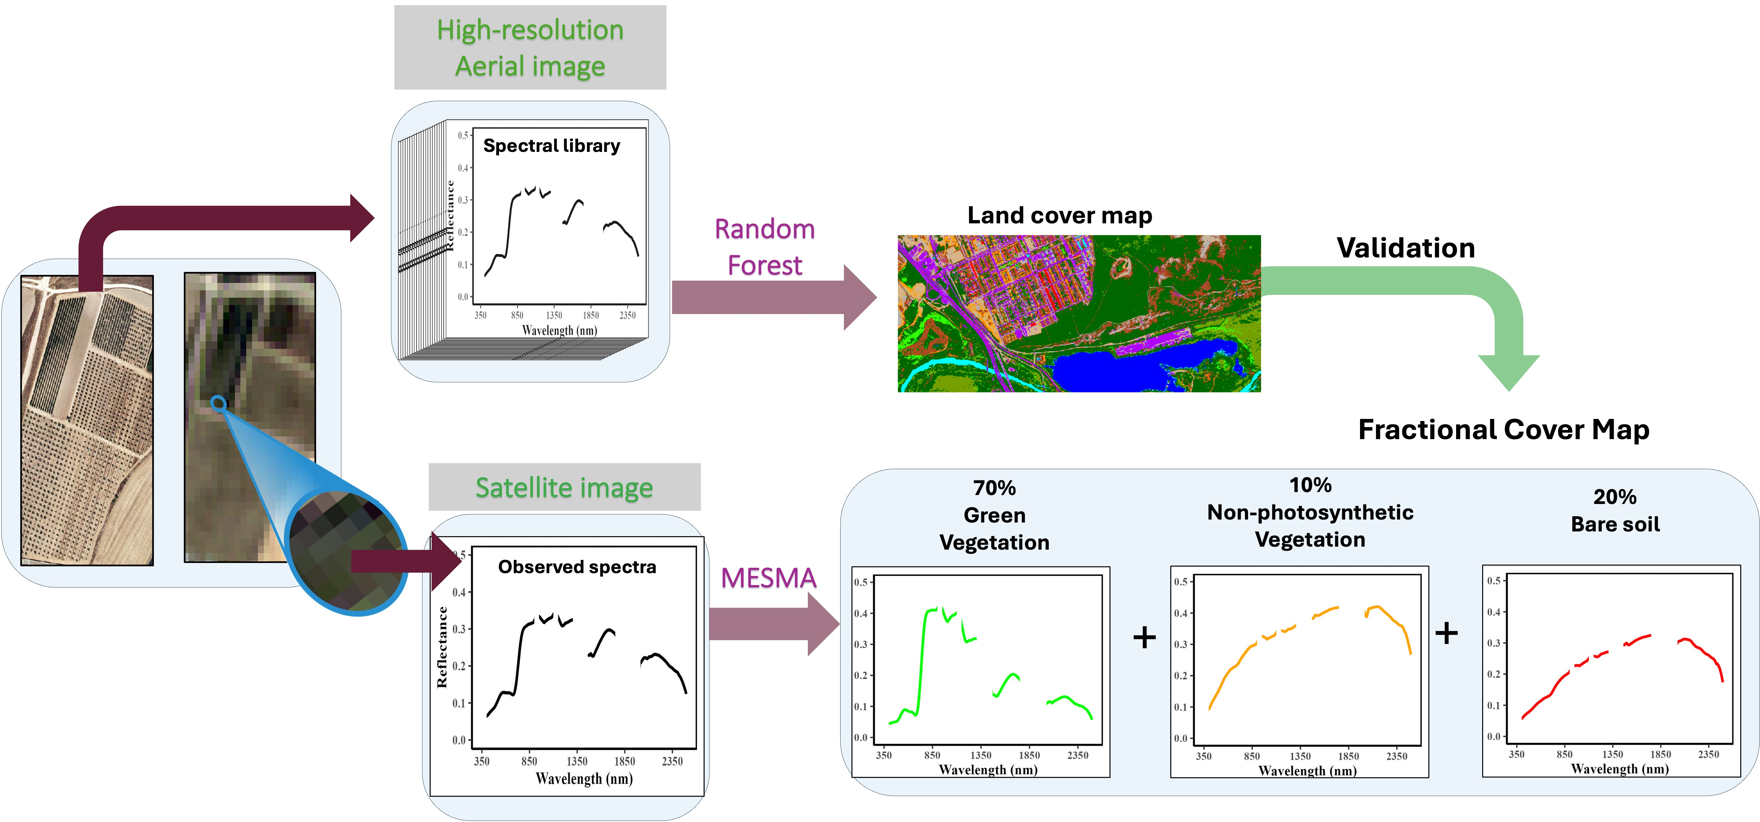
Multiple Endmember Spectral Mixture Analysis

Slide 4
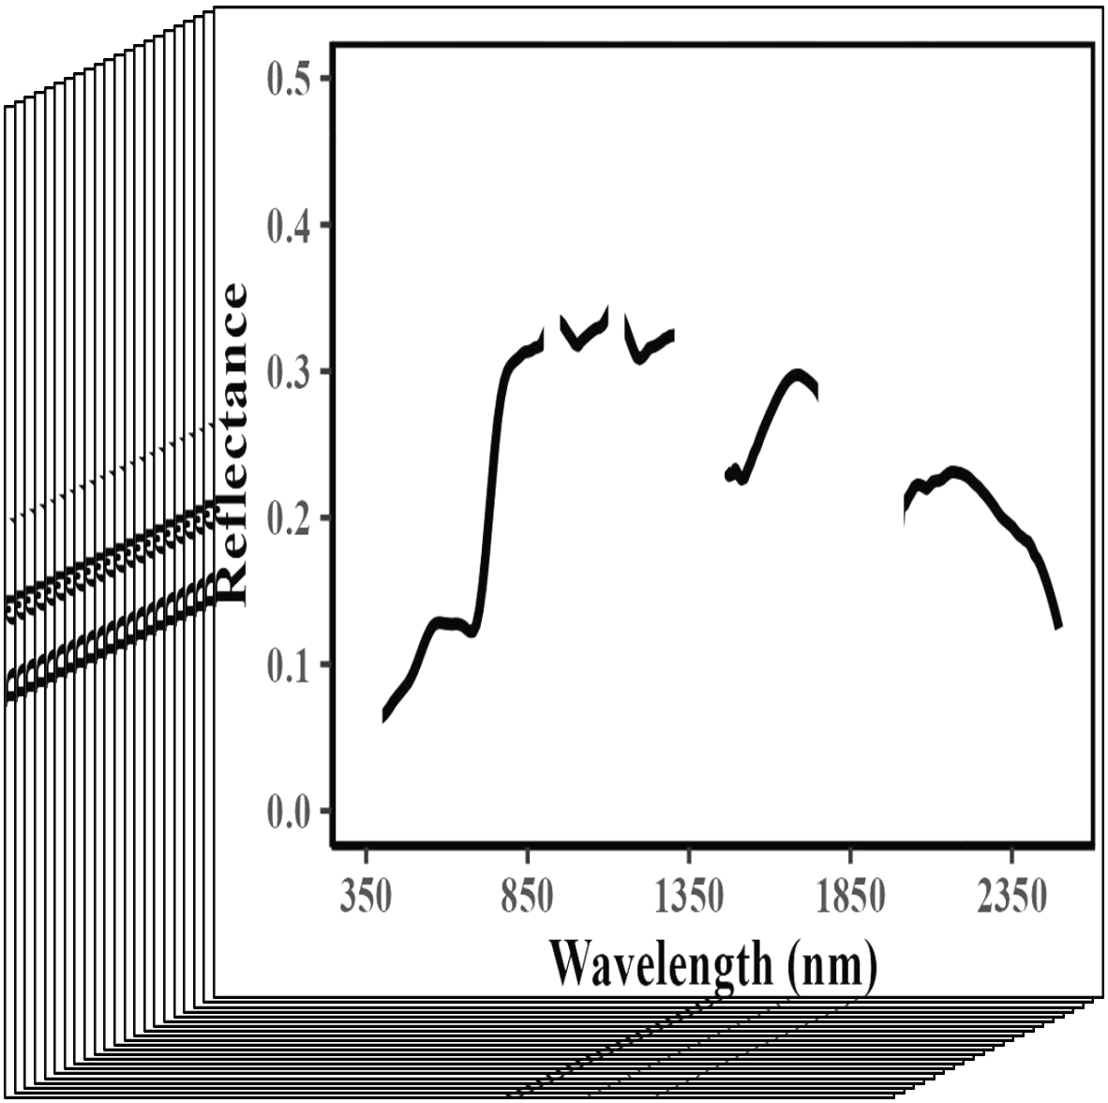
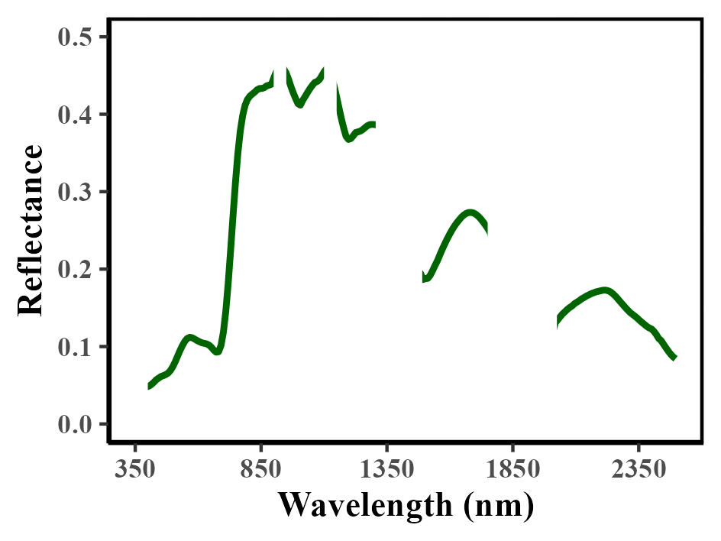
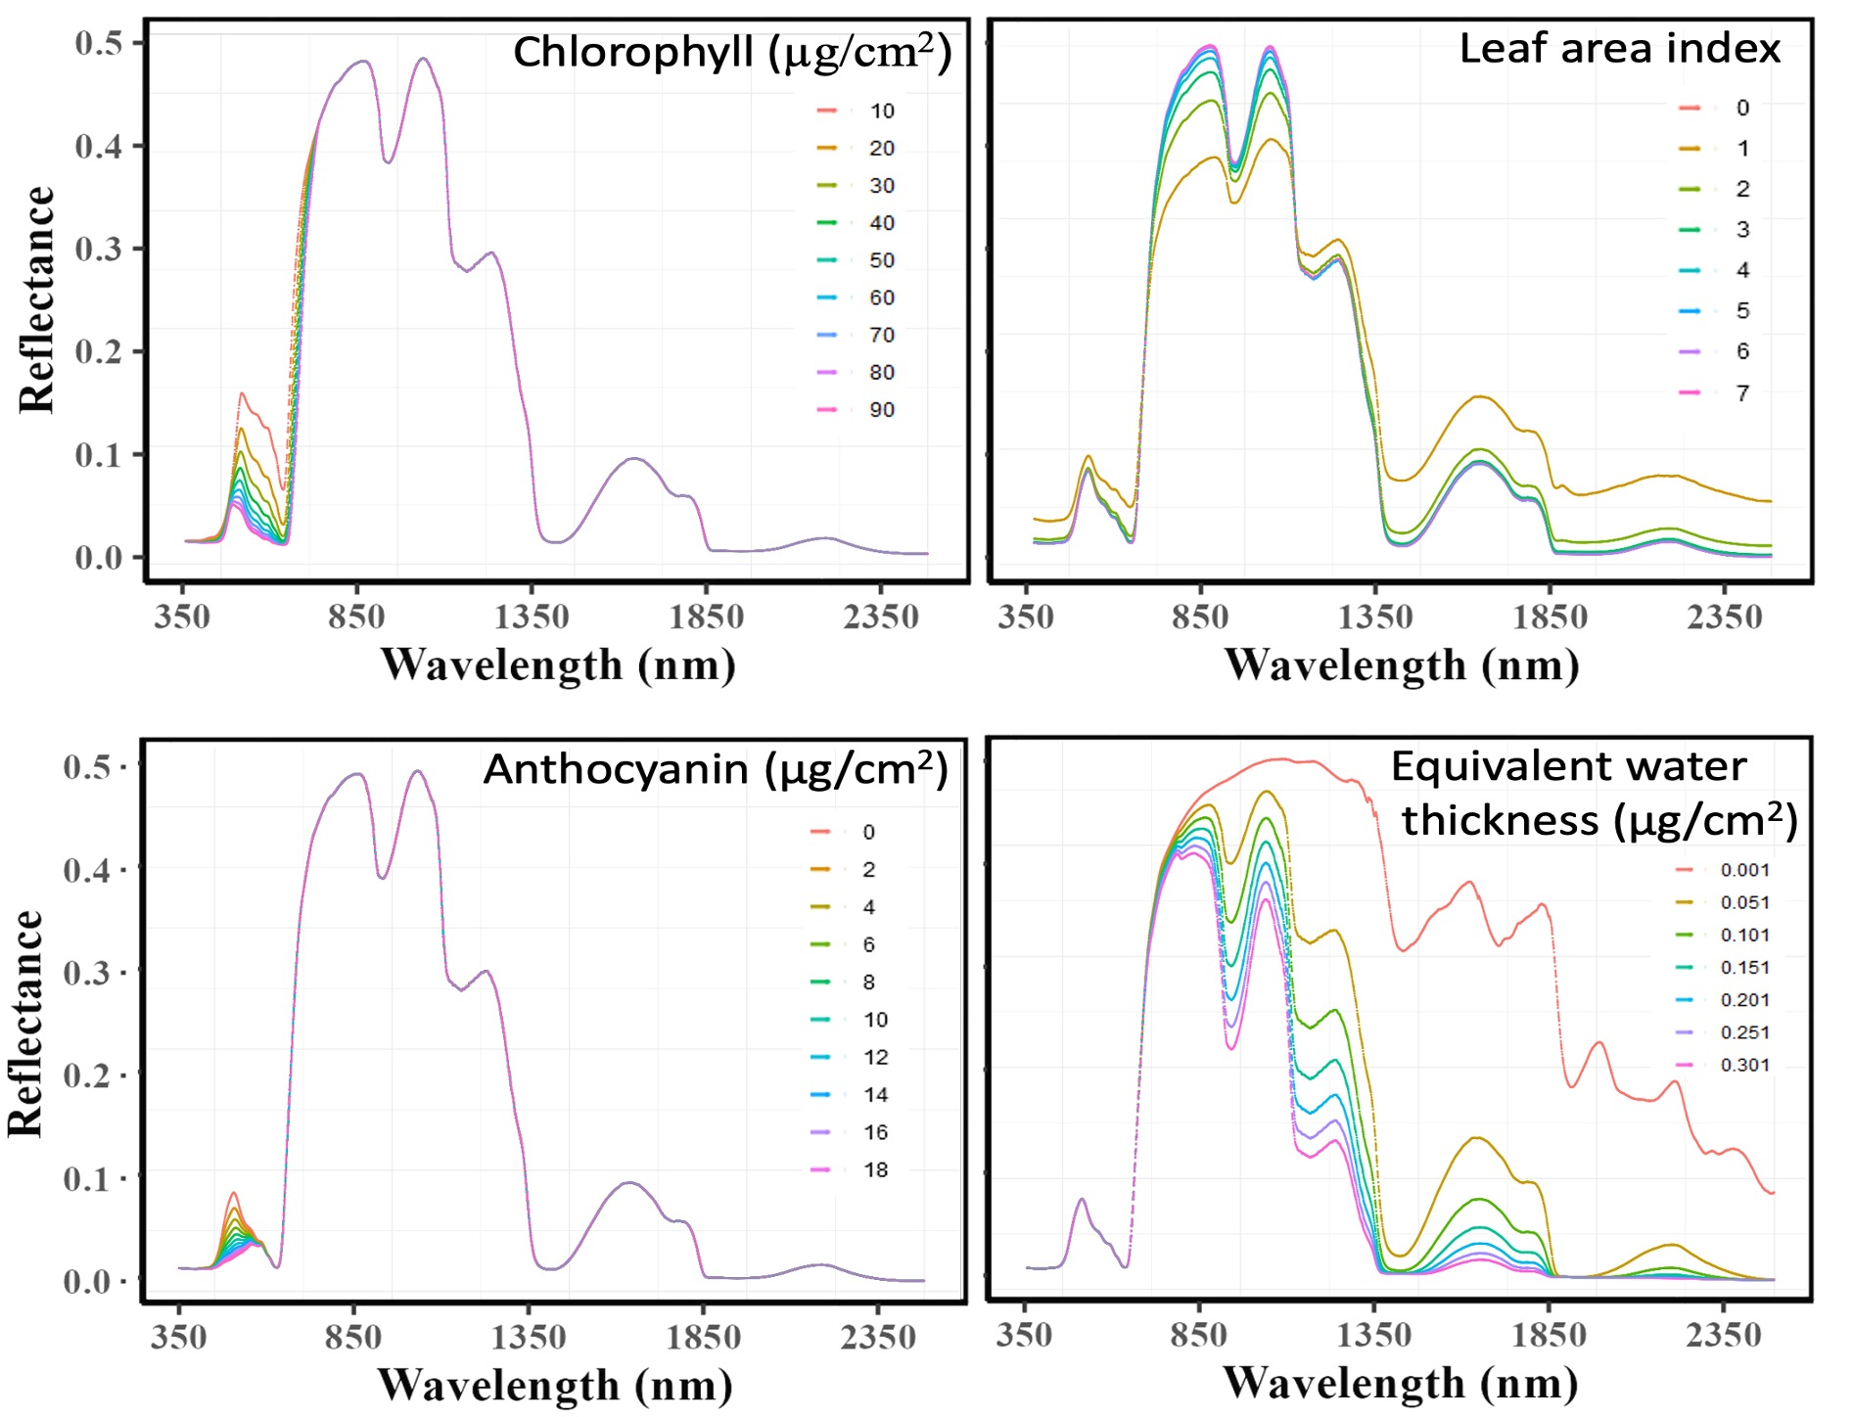
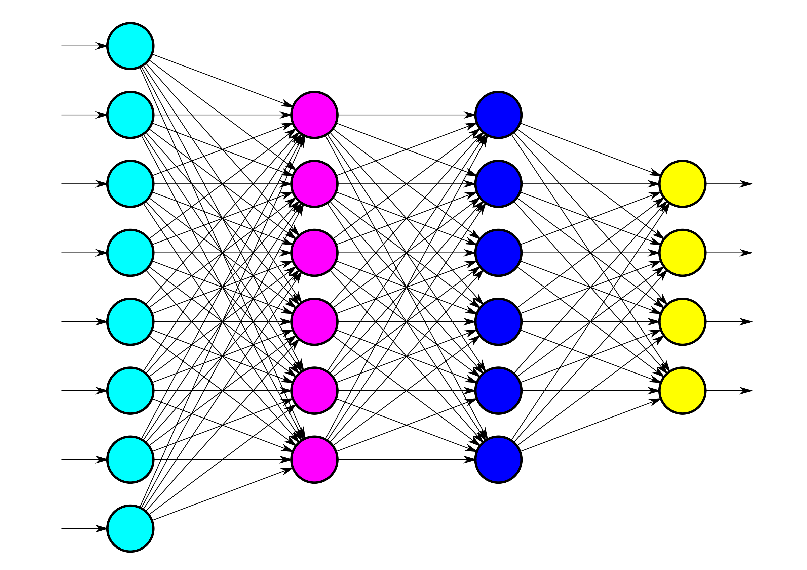
Hybrid Machine Learning – Radiative Transfer Model
i) Simulate spectra with RTM | ii) Train Machine Learning Model | iii) Estimation of plant traits
Plant traits
Chlorophyll = 10 (μg/cm²)
Leaf area index = 2
Anthocyanin = 4 (μg/cm²)
Water content = 0.001 (g/cm²)
…

Slide 5
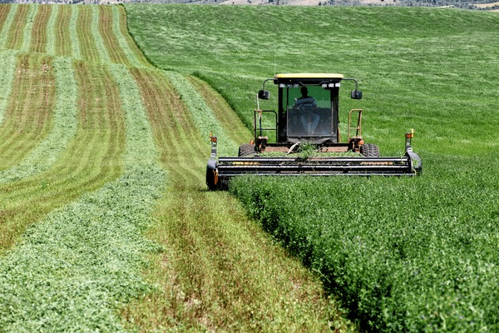
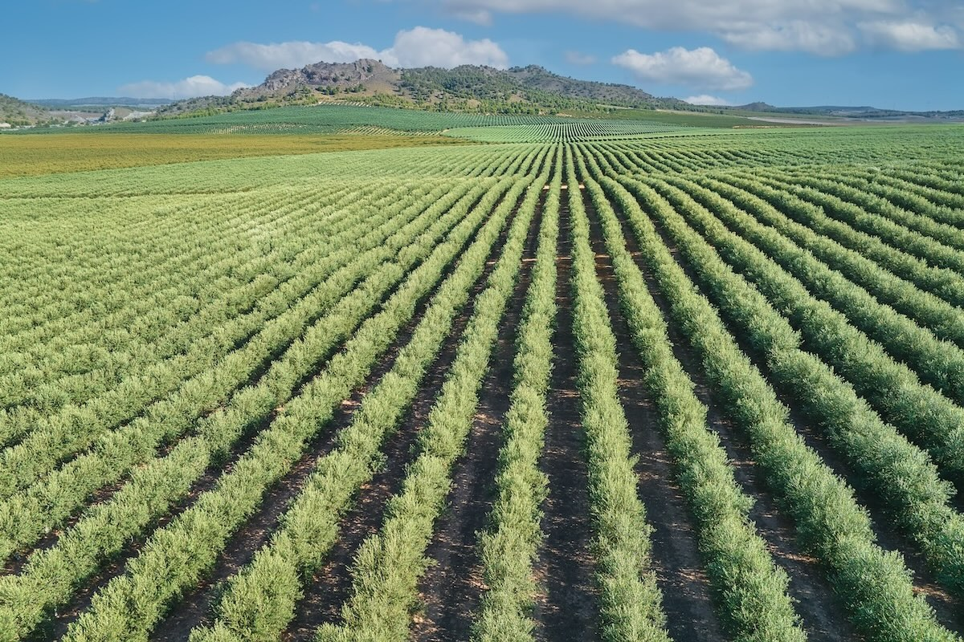
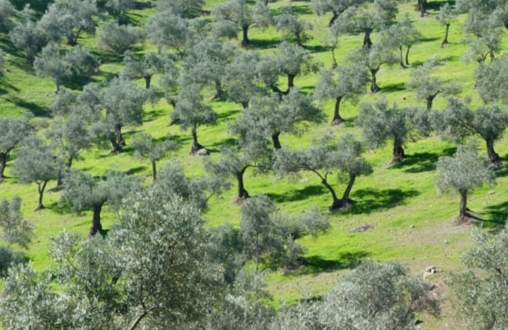
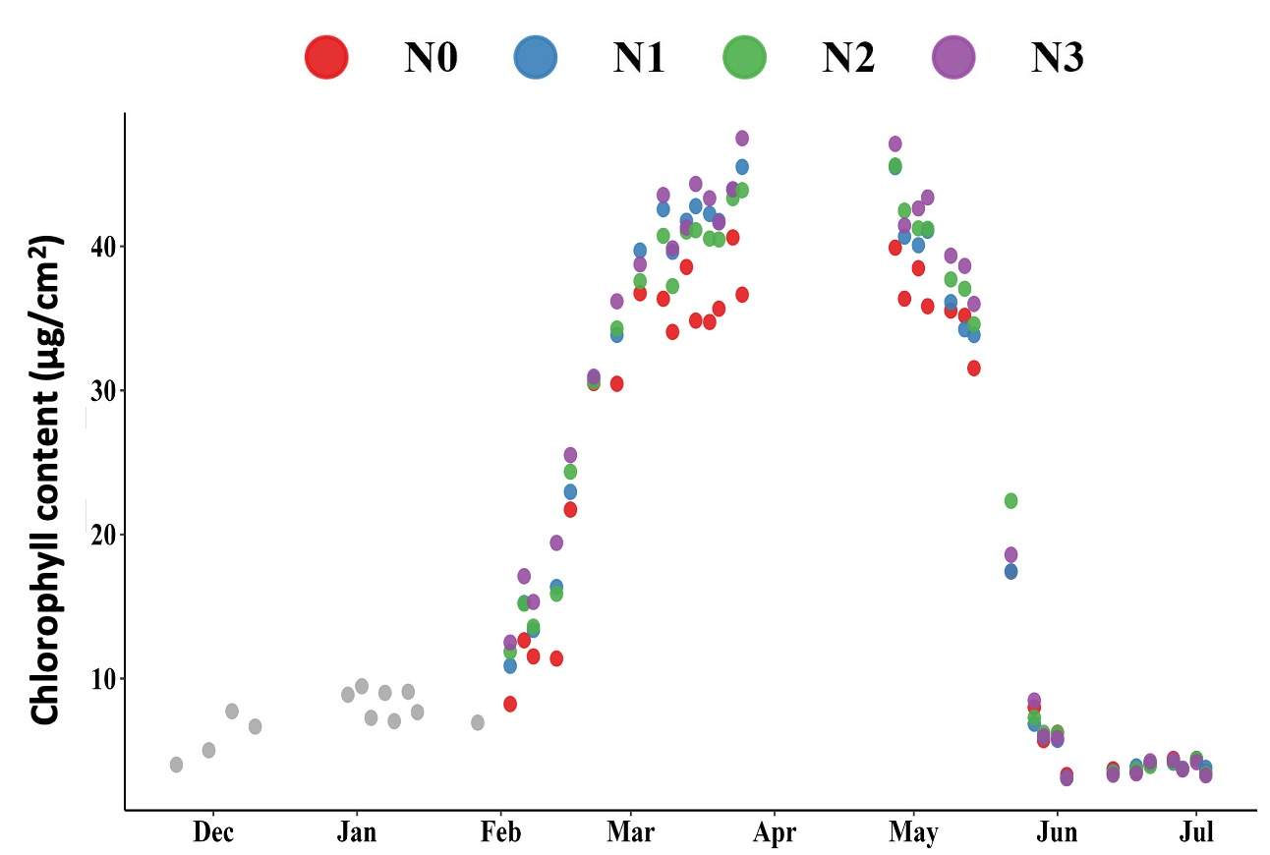
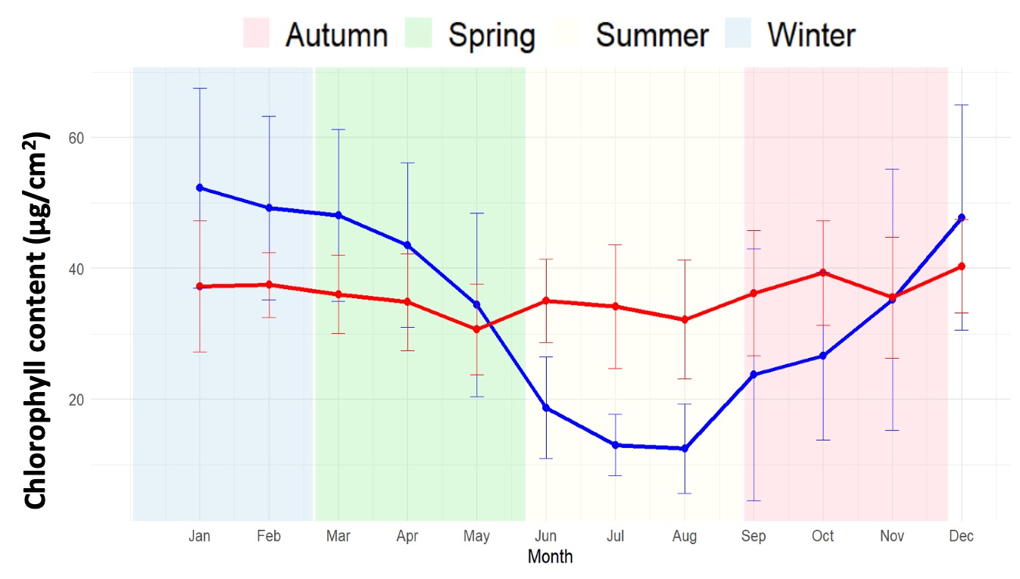
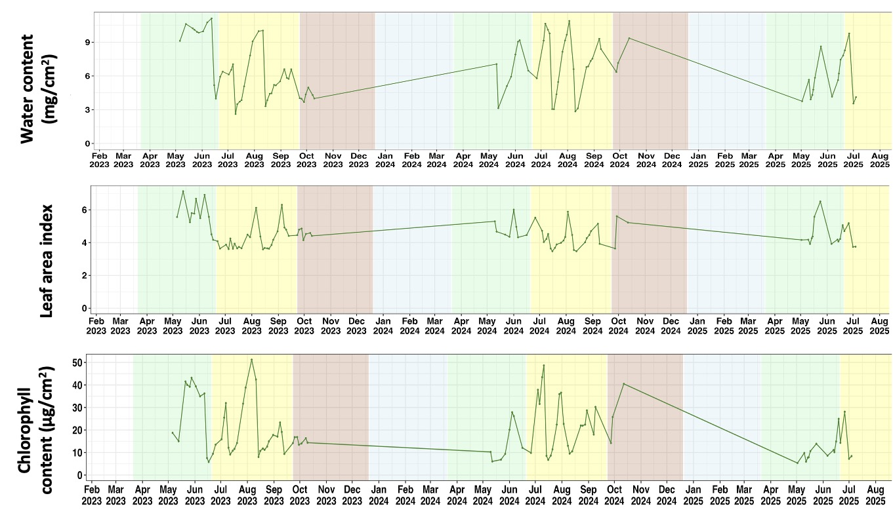
Hybrid Machine Learning – Radiative Transfer Model
Agriculture (model and data collected with Aerolab instrumentation)
Winter wheat N Fertilization adjustment | Identification of olive management practices | Alfalfa canopy dynamics for optimizing yield
Intensive
Extensive

Slide 6
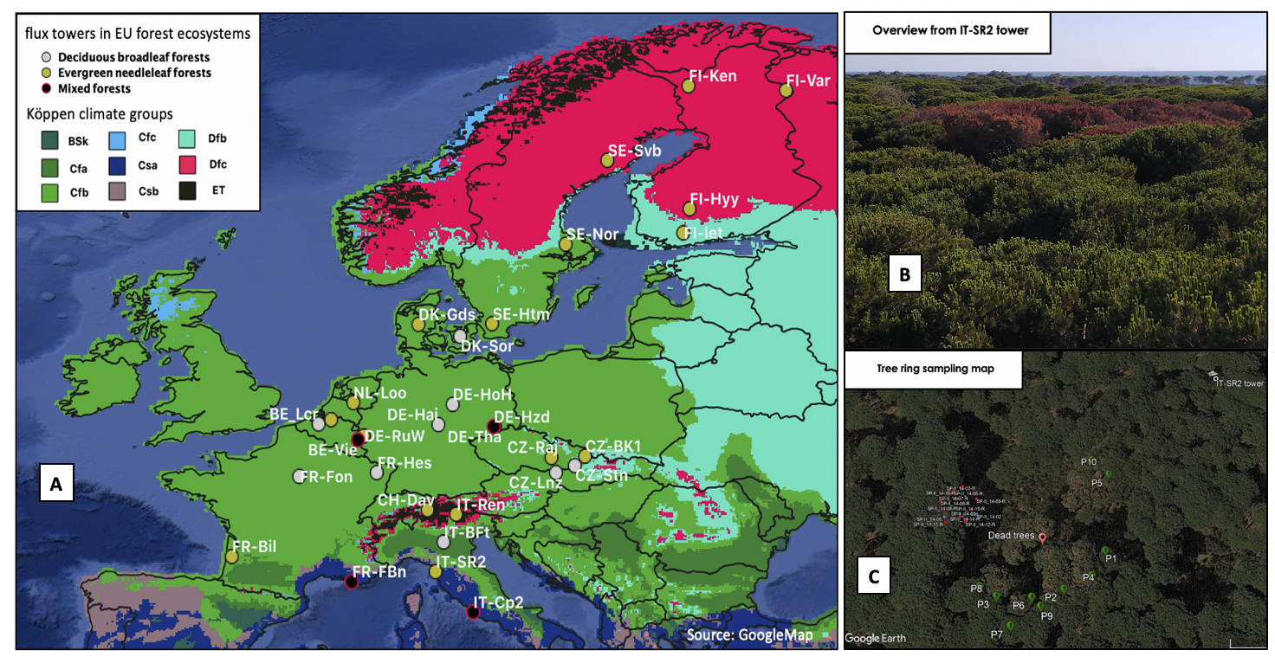
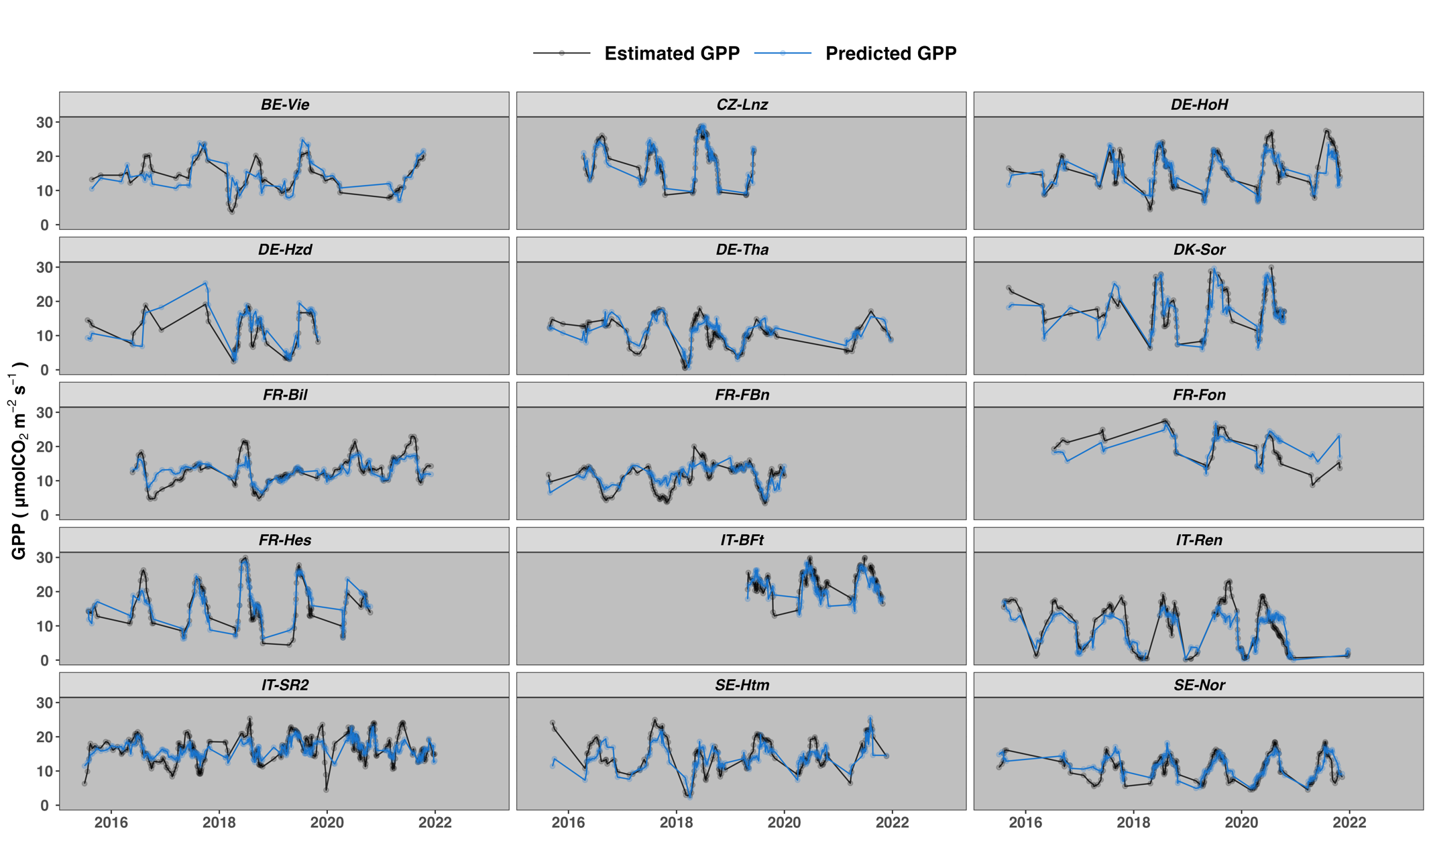
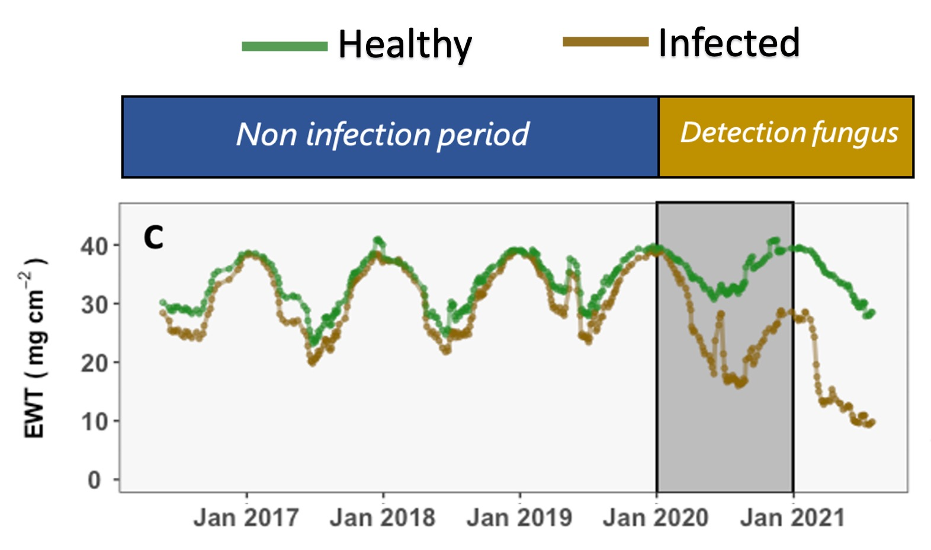
Hybrid Machine Learning – Radiative Transfer Model
Forest (model tested on sites of the ICOS and eLTER infrastructure
Gross Primary Production in European forest | Early fungus infection detection in pine forest
Water content (mg/cm²)

Slide 7
Jose Luis Pancorbo¹, Giandomenico De Luca¹, Federico Carotenuto¹, Lorenzo Genesio¹, Alessandro Montaghi², Beniamino Gioli¹
¹CNR-IBE, National Research Council of Italy, Institute of Bioeconomy, Via Madonna del Piano 10, 50145 Sesto Fiorentino, Italy
²CNR-IRET, National Research Council of Italy, Institute of Research on Terrestrial Ecosystems, Via Madonna del Piano 10, 50145 Sesto Fiorentino, Italy
joseluis.pancorbodeonate@cnr.it

