Slide 1


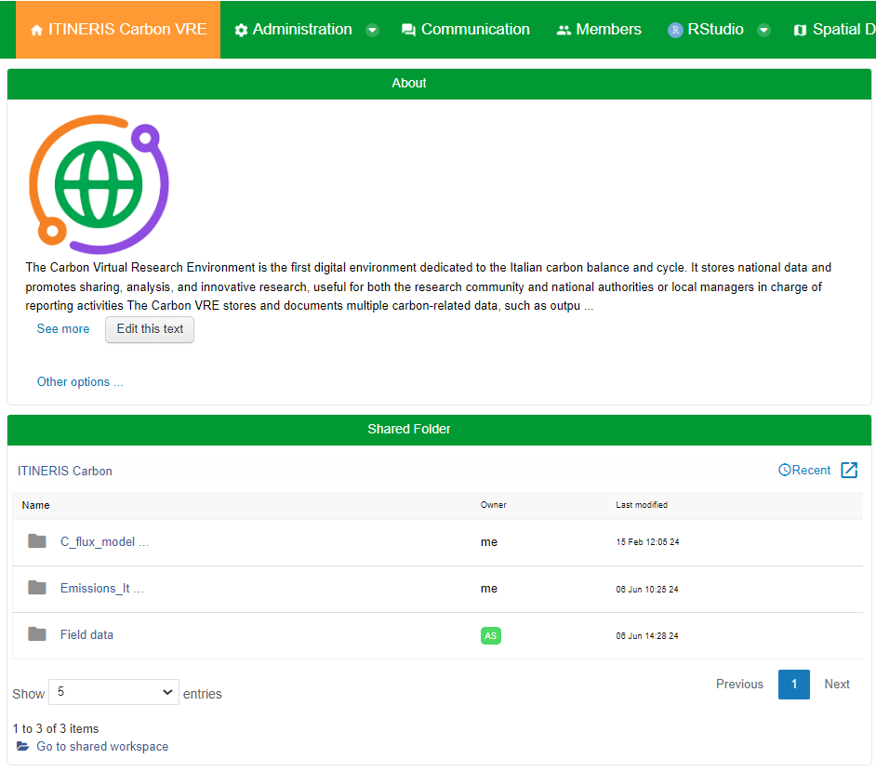
The first Italian digital environment for Carbon-related data and dynamics
The service was delivered and includes:
Italian Carbon and ecosystem fluxes
Italian emission data
Tools and facilities for analyses
Research field data and models
Promotes data sharing, analysis, innovative research
End user-oriented: facilitates reporting for administrations
https://itineris.d4science.org/group/itineris_carbon

Slide 2
(i) Above Ground Biomass: carbon stocks for Trento province, Tuscany, and maps for the Pantropical biome;
(ii) Amospheric Inversion Models: sample products from 6 models, infographics, and R code;
(iii) Carbon Fluxes Models: sample products from 3 models plus infographics and R code;
(iv) GHG Emissions Italy: sample products from EDGAR and ISPRA with code and infographics
(v) Local Research: data from local level research;
(vi) SOCAT Ocean Data: sample products and references;
(vii) Test Isoscape: isotope data and code, under development. In addition the
An Instruction folder provides info on how to manage and upload contents in the VRE.
The main VRE Carbon sections:

Slide 3

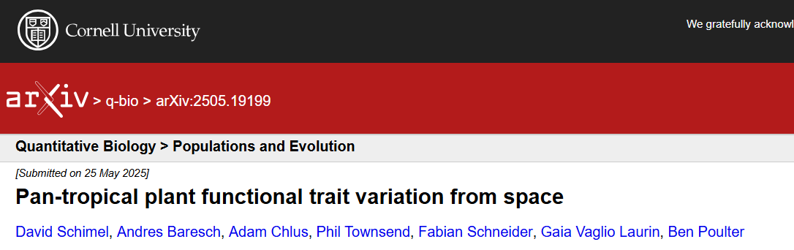
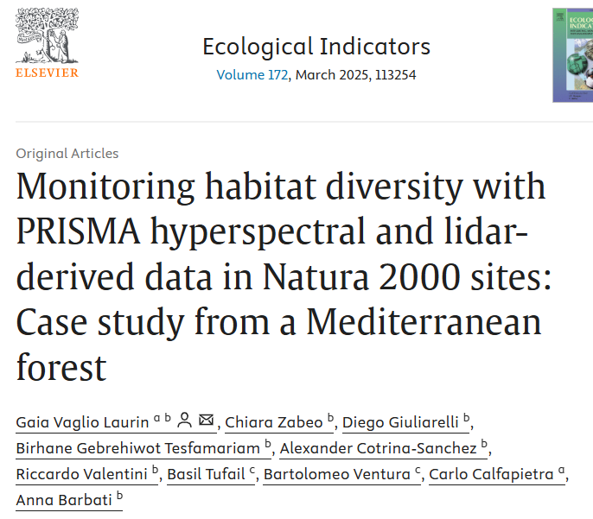
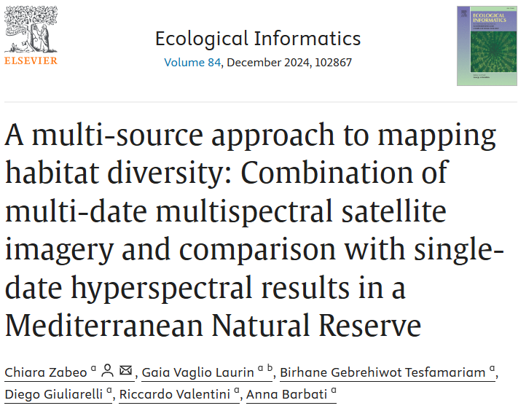
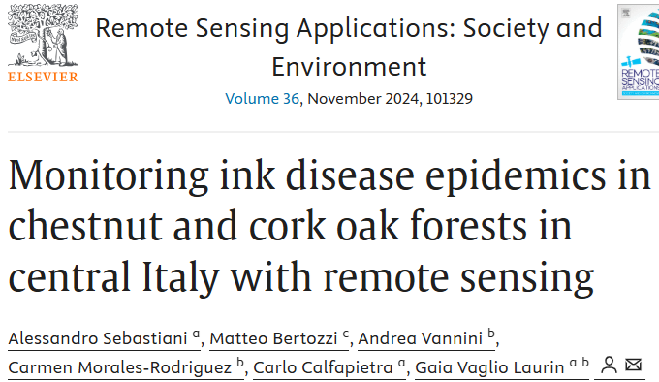
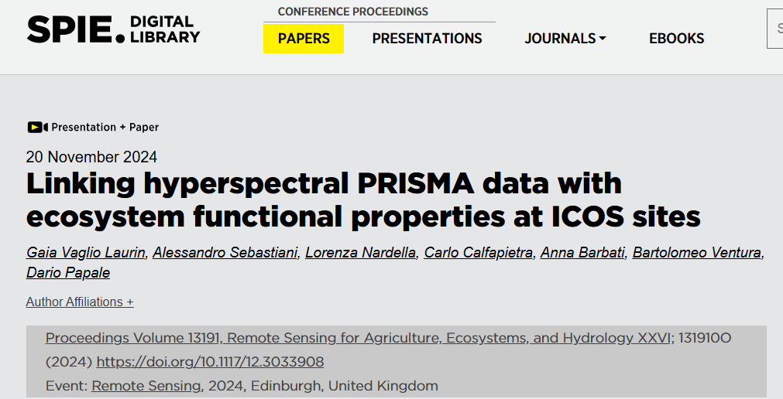
The VRE C supported several research activities, e.g. linking Carbon-related resources with:
Habitat Biodiversity
Ecosystem Functional Properties at ICOS sites
Pan-tropical forest trait variations
Forest health

Slide 4
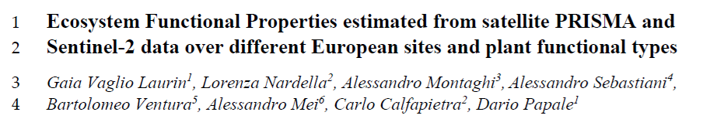
Ecosystem Functional Properties (EFPs), computed from flux tower data, provide a dynamic view of ecosystem carbon and energy related processes (GPP, LUE, WUE, NEE etc.)
EFPs from 15 sites, with different plant function types, were modeled using PRISMA hyperspectral and Sentinel-2 multispectral satellite data.
EBF = Evergreen Broadleaf Forest (2 sites);
ENF = Evergreen Needleleaf Forest (5 sites); DBF = Deciduous Broadleaf Forest (3 sites); GRA = Grassland (3 sites);
WET = Wetland (2 sites)

Slide 5
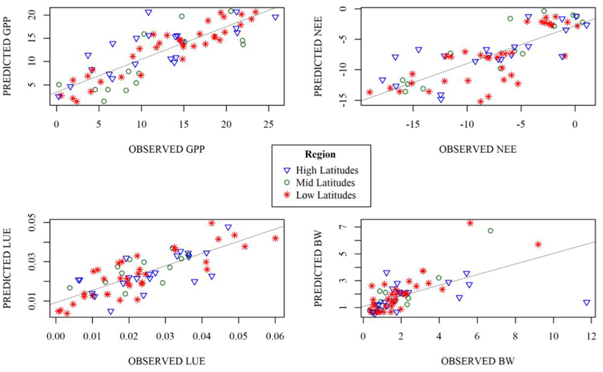
Comparisons:
Random Forests vs. XGBoost
PRISMA vs. S2 as input data
Best models with PRISMA (R2: GPP 0.71; NEE 0.61; LUE 0.62; BW 0.37; WUE 0.03)
XGBoost similar results but many parameters to be tuned
Sentinel-2 lower results (R2: GPP 0.65; NEE 0.55; LUE 0.58; BW 0.5; WUE 0.03)
No impact of PFT: model is independent from ecosystem type
No impact of latitude
SWIR bands are relevant especially for LUE; WUE is an issue also in other studies
Next tests on larger datasets; with mixed effects models to recheck PFT role; after disturbance

