Slide 1
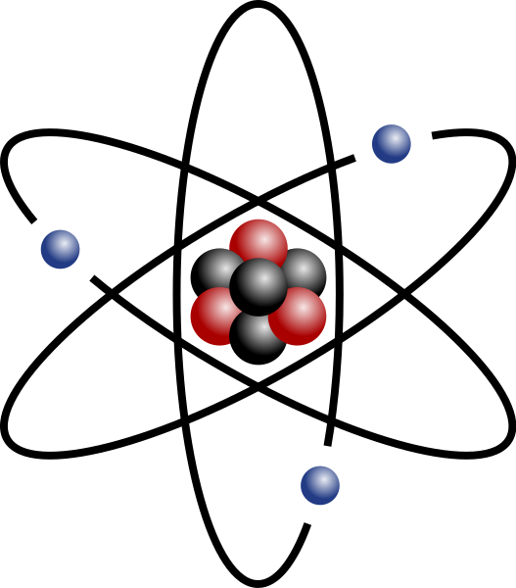



ISOTOPE STUDIO:
A FAIR-Compliant VRE for Harmonized Isotope Data and Modelling within the ITINERIS Framework
Paolo Di Giuseppe¹*, Simona Gennaro¹, Erico Perrone¹, Marco Procaccini¹, Samuele Agostini¹, Andrea Rielli¹, Eugenio Trumpy¹, Irene Tunno², Ilaria Baneschi¹, Simone Vezzoni¹, Irene Cornacchia³, Chiara Boschi¹, Eleonora Regattieri¹, Matteo Salvadori¹, Maddalena Pennisi¹, Andrea Dini¹, Antonello Provenzale¹
1
2
3

Slide 2
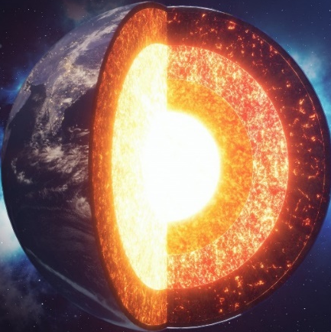
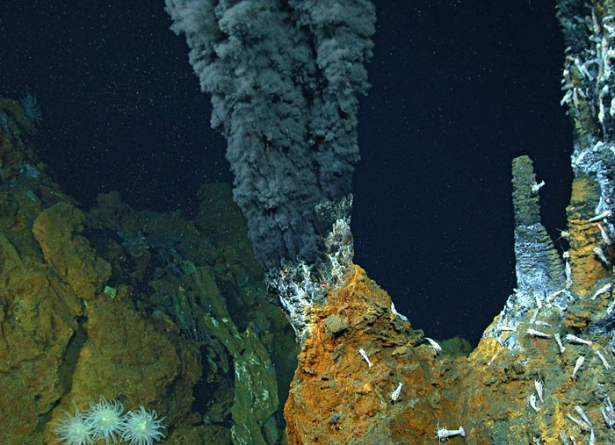
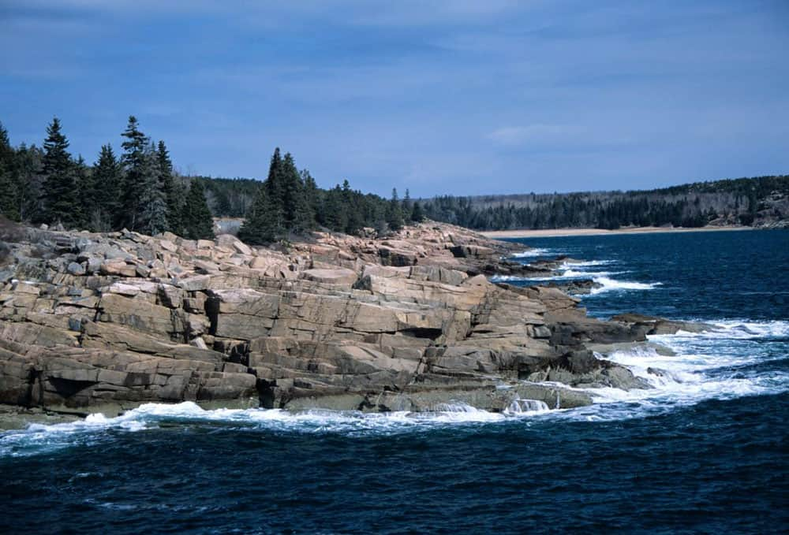


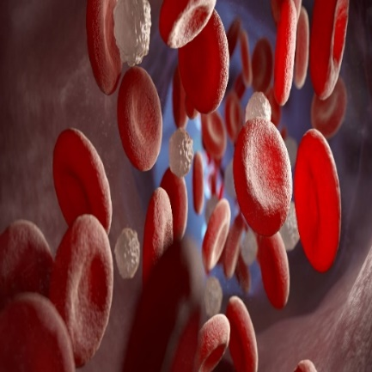
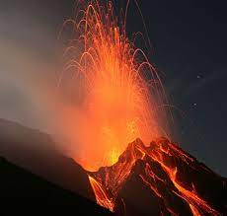
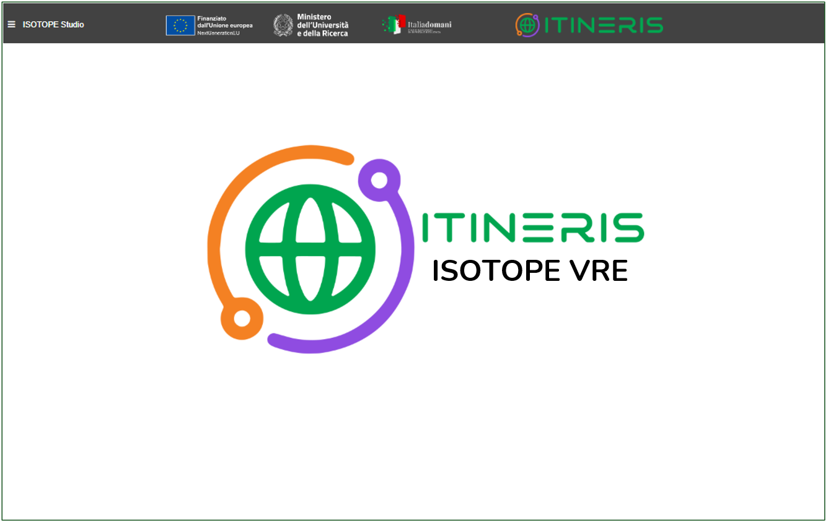
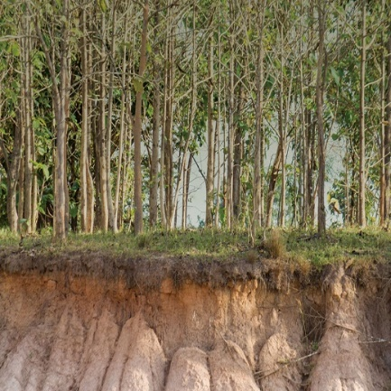
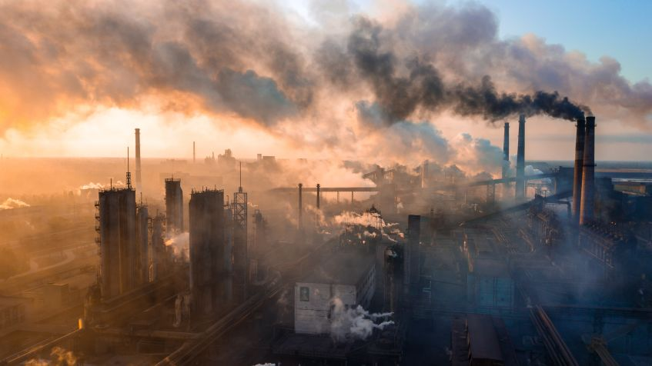
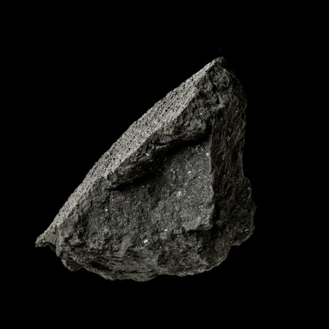
ISOTOPE VRE
RESEARCH INFRASTRUTURE
D4SCIENCE
WEB APPLICATION
INTEROPERABILITY
SOFTWARE
DATA MINING
VRE
ISOTOPES
ATOMS
INFORMATION
DATABASE
STORAGE
DATA
REPOSITORY
MODELLING
SERVER
MANAGEMENT
COLLECTION
ANALYSIS
HALF-LIFE
RADIOGENIC
BIG DATA
MOLECULES
STABLE
QUERY
ELEMENTS
DECAY
RECORD
RECORDS
ACCESS
OPEN SCIENCE
Develop a Virtual Research Environment dedicated to stable, unconventional stable, and radiogenic isotopes
ITINERIS 3° general Meeting – Rome, 25/26-09-2025

Slide 3
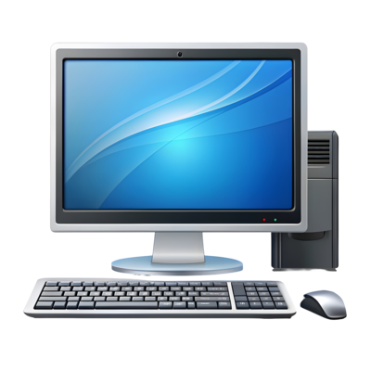
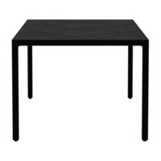

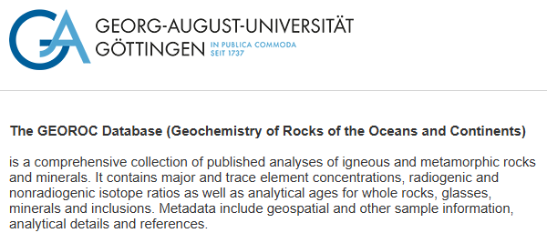
ISOTOPE STUDIO
data upload
data harmonizer
mODELLING
Published data
PREVIOUSLY PUBLISHED DATA
new data
EXTERNAL SITES
ITINERIS 3° general Meeting – Rome, 25/26-09-2025

Slide 4
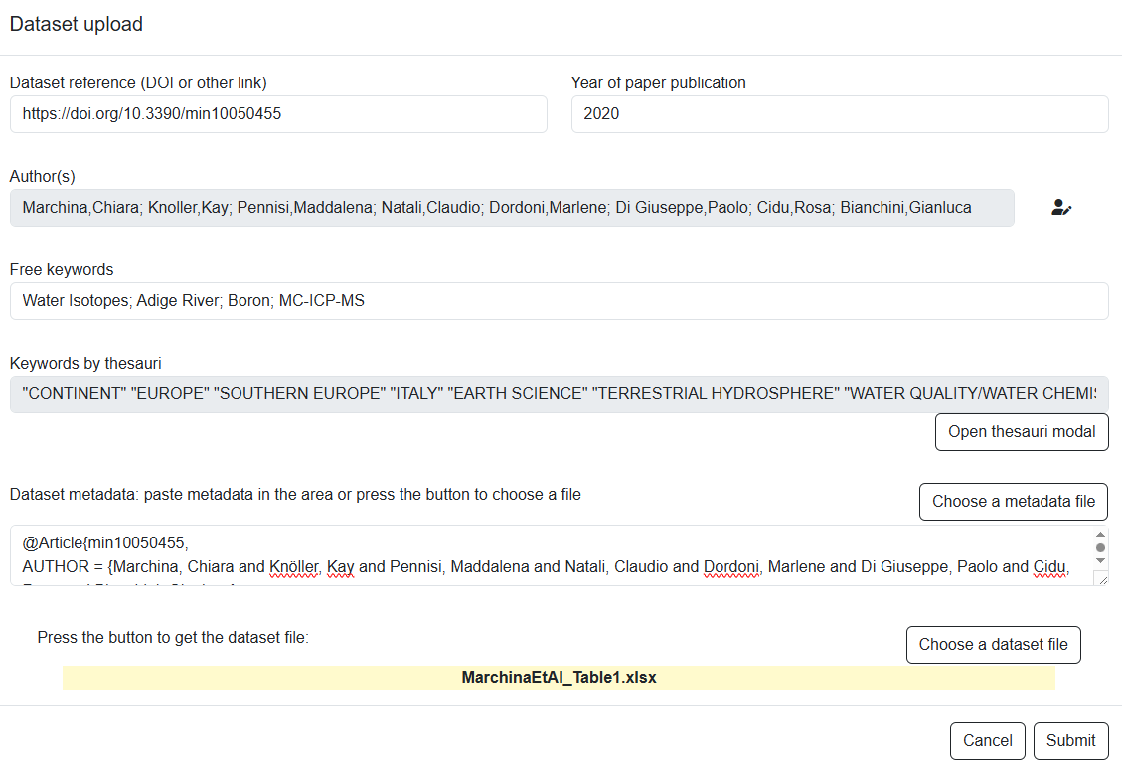
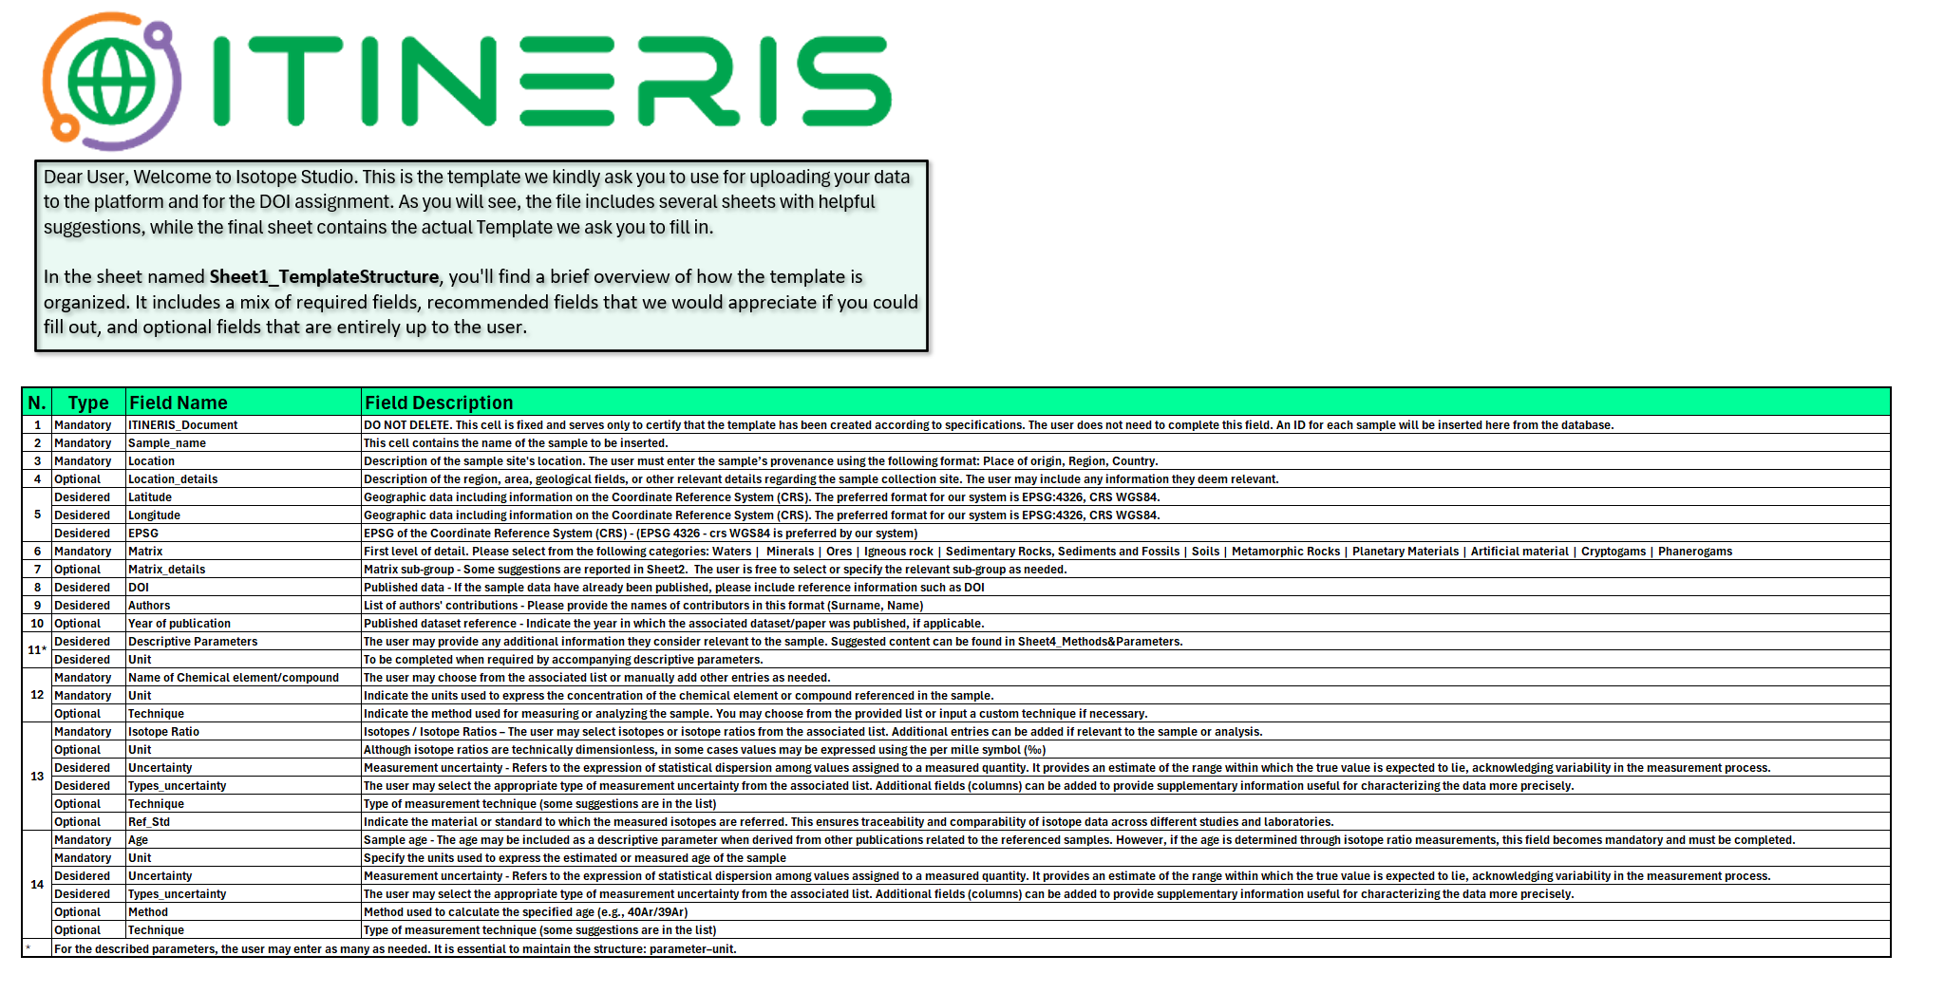
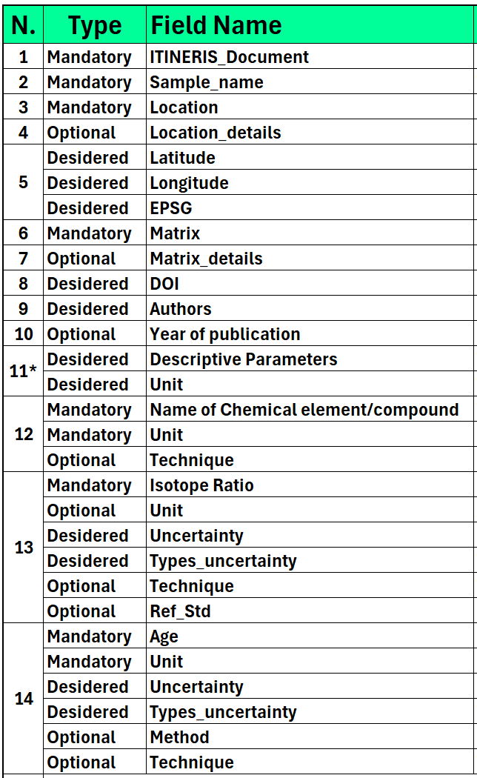

ISOTOPE STUDIO
DATA UPLOAD
DATA HARMONIZATION
DATA MODELLING
PREVIOUSLY PUBLISHED DATA
unPUBLISHED DATA
TEMPLATE
ITINERIS 3° general Meeting – Rome, 25/26-09-2025

Slide 5

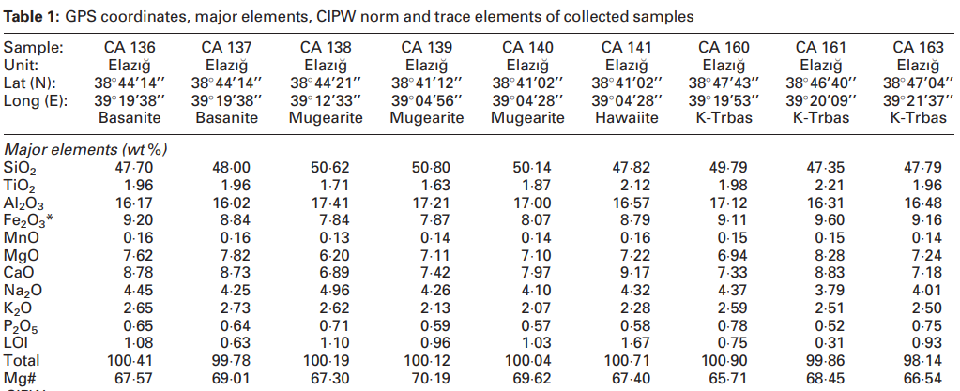
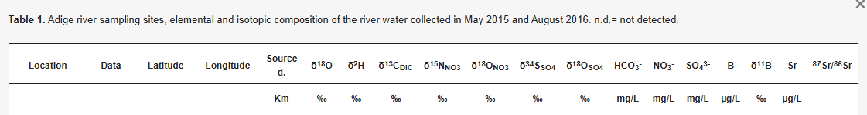
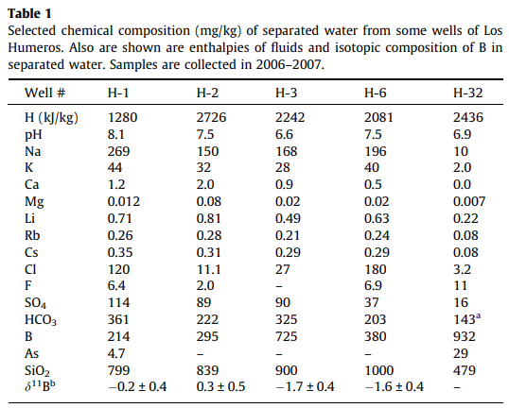
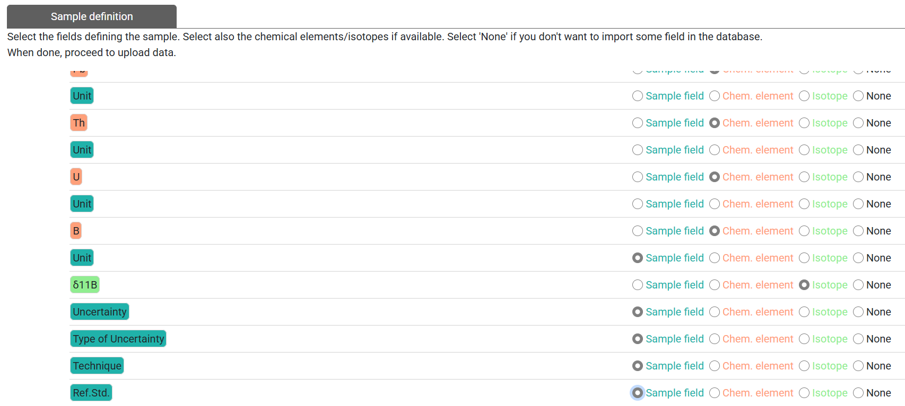
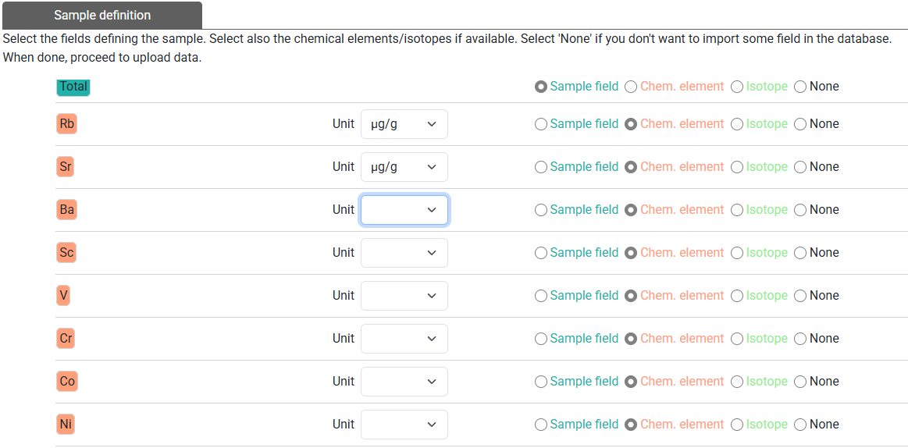
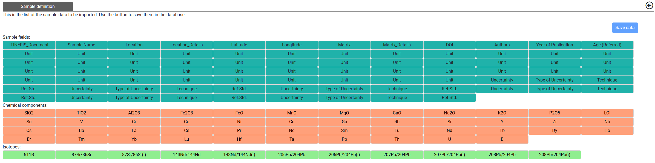
ISOTOPE STUDIO
DATA UPLOAD
Attenti!!! Alle tabelle piace cambiare
DATA HARMONIZATION
DATA MODELLING
Sample field
Chemical element
isotope
ITINERIS 3° general Meeting – Rome, 25/26-09-2025

Slide 6
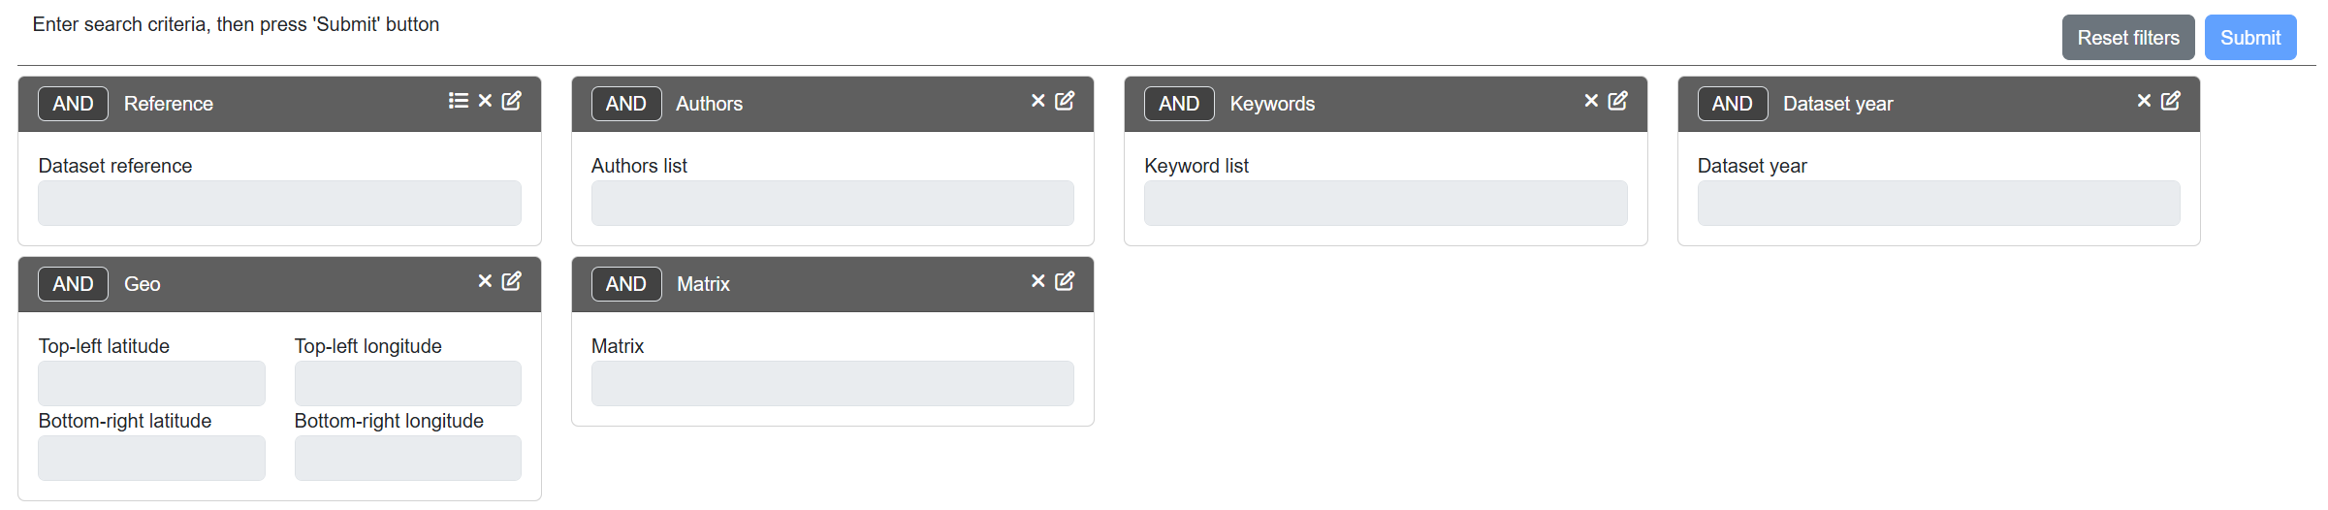
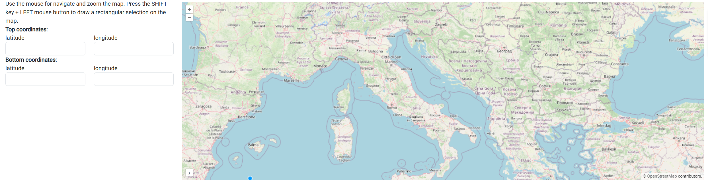
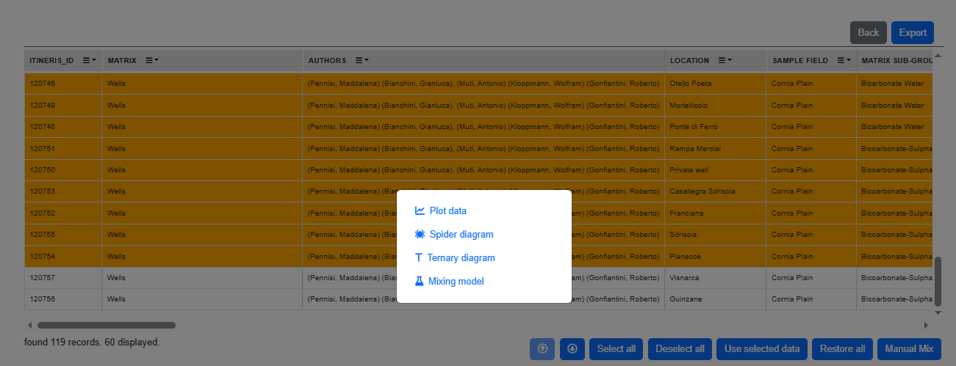
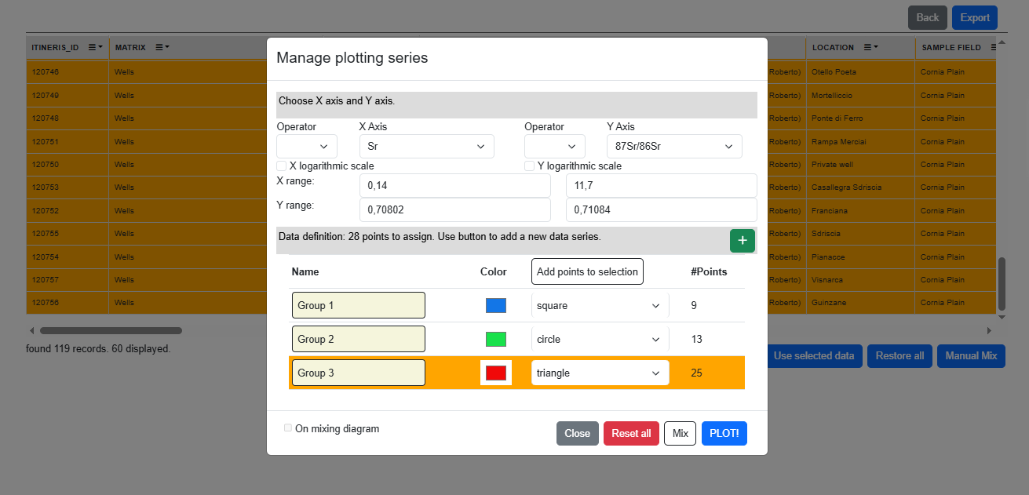
ISOTOPE STUDIO
DATA UPLOAD
DATA HARMONIZATION
DATA MODELLING
Data search
ITINERIS 3° general Meeting – Rome, 25/26-09-2025

Slide 7
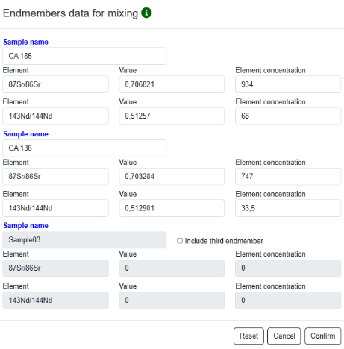
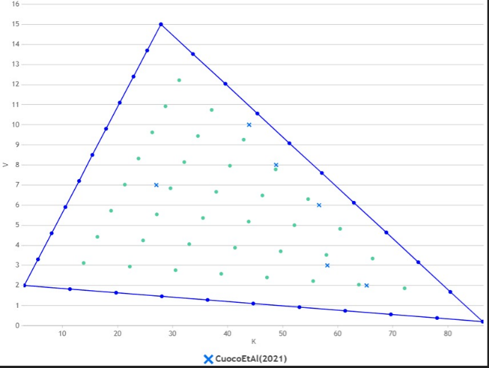
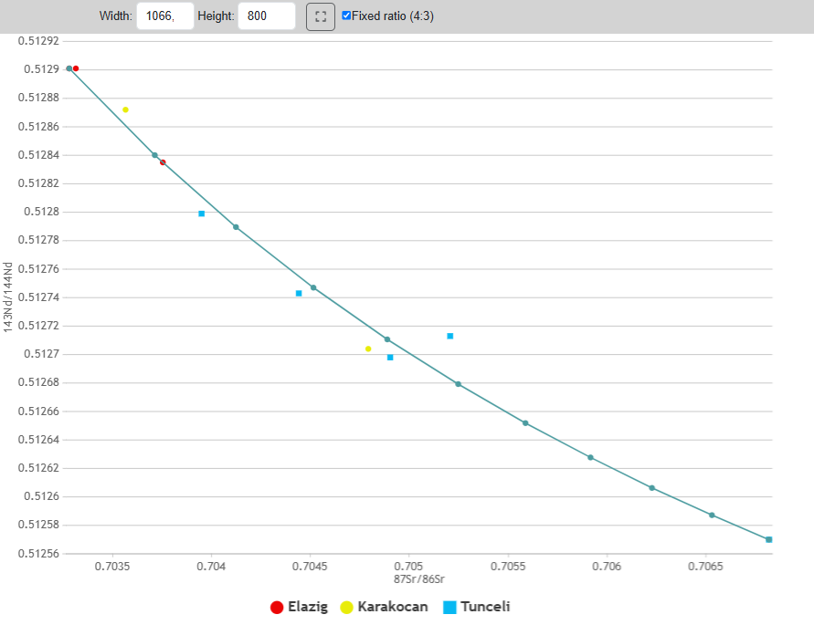
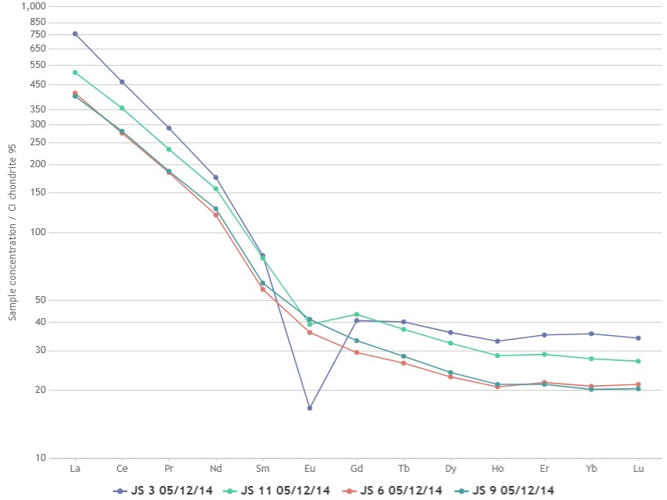
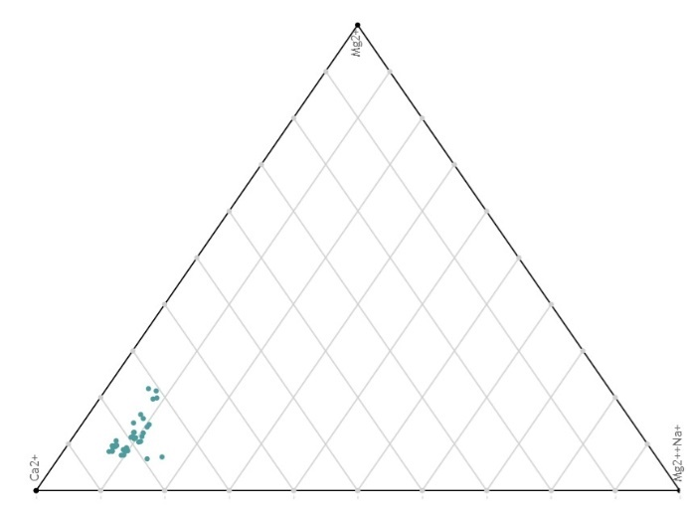
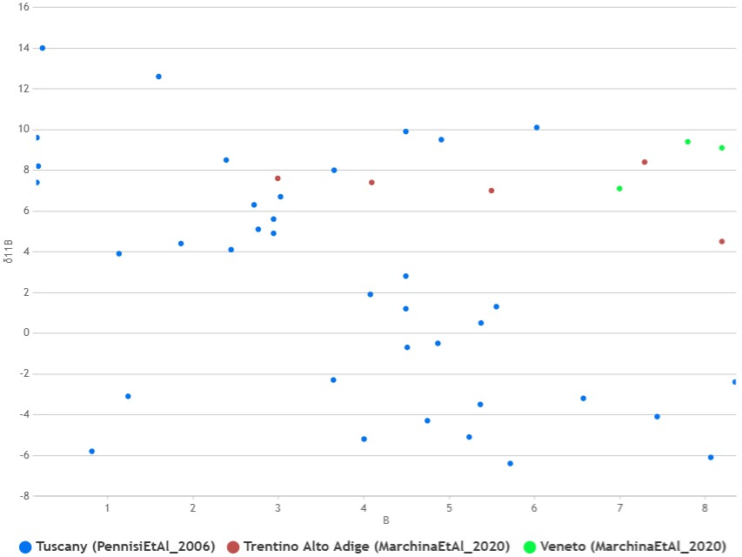
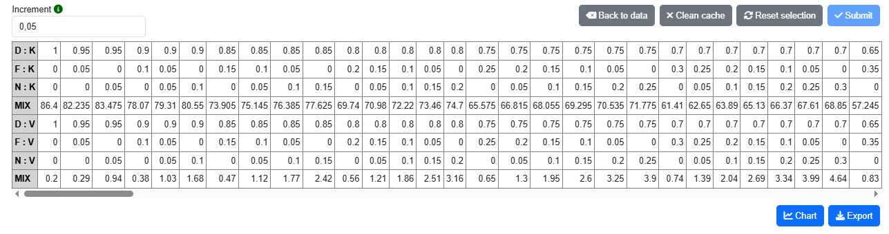

ISOTOPE STUDIO
DATA UPLOAD
DATA HARMONIZATION
DATA MODELLING
BINARY
TERNARY MIXING
TERNARY plot
MIXING
Normalized diagram
Binary plot
#20
#16
#17
#26
#25
#27
We are enhancing the image quality, improving symbols, and implementing other upgrades.
ITINERIS 3° general Meeting – Rome, 25/26-09-2025

