Slide 1
Enhancing Aerosol characterization through a Virtual Research Environment
3nd ITINERIS General Project Meeting
Rome, September 25th - 26th, 2025
Emilio Lapenna, Michail Mytilinaios, Benedetto De Rosa, Nikolaos Papagiannopoulos, Ermann Ripepi, Lucia Mona
CNR-IMAA

Slide 2


AERO-VRE
A user-friendly tool for Desert dust and Typing visualization based on reliable and accessible datasets
Building on existing datasets available on international datahub
Pointing on the visualization added value for communication
Including on top of it ITINERIS produced datasets
The visual interface allows the users to select:
  Spatio-temporal domain.
  Topics of interest to be explored.
  Specific data product to be visualized.
  Possibility to download numerical data.
https://itineris.d4science.org/group/itineris_aero

Slide 3
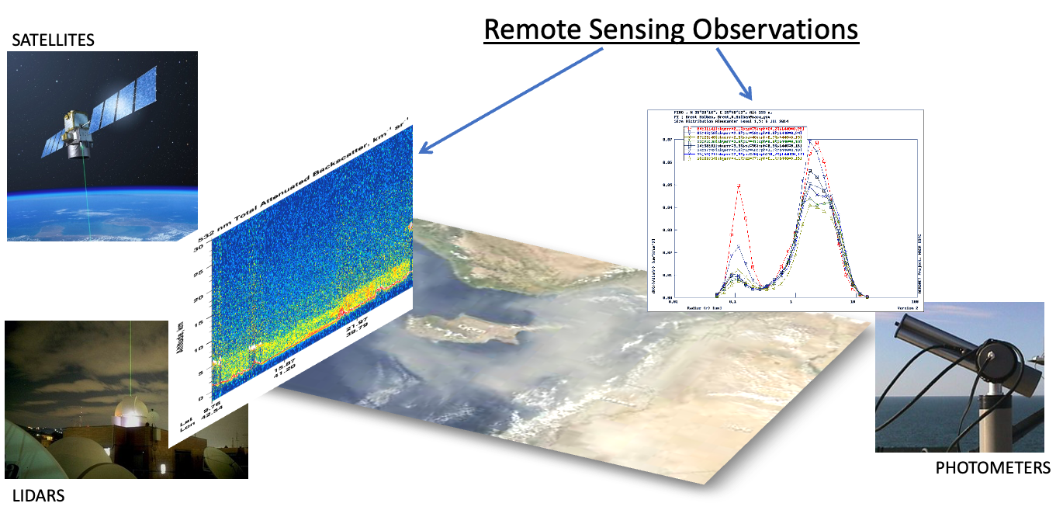
AERO-VRE potential impacts and use
Interesting tool for researchers for accessing and visually analysing reference datasets providing:
  Regional insight (WMO-SDS WAS, MONARCH and CAMS models)
  Columnar information (AERONET measurements + models )
  Vertical profiles (ACTRIS/EARLINET data and derived products + models)
The aerosol speciation is also relevant for Air Quality impacts.
The new Air Quality directive calls for the identification and quantification of dust (and other natural sources) contribution to the PM at the ground.
AERO VRE can support the analysis by the air quality managers.

Slide 4
Structure of AERO-VRE
The AERO VRE is divided in two main branches, the Desert Dust and the Aerosol Typing.
Eight codes have been implemented and released.
Developed with Python, Open Source and implemented via CCP (Cloud Computing Platform)
DESERT DUST
AEROSOL TYPING
DOD (Dust Optical Depth)
PROFILES
SINGLE CASE

Slide 5
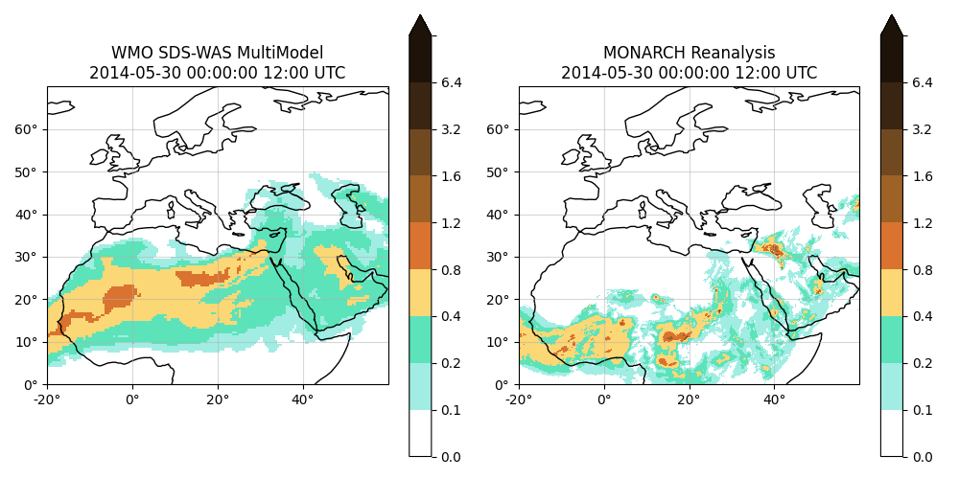
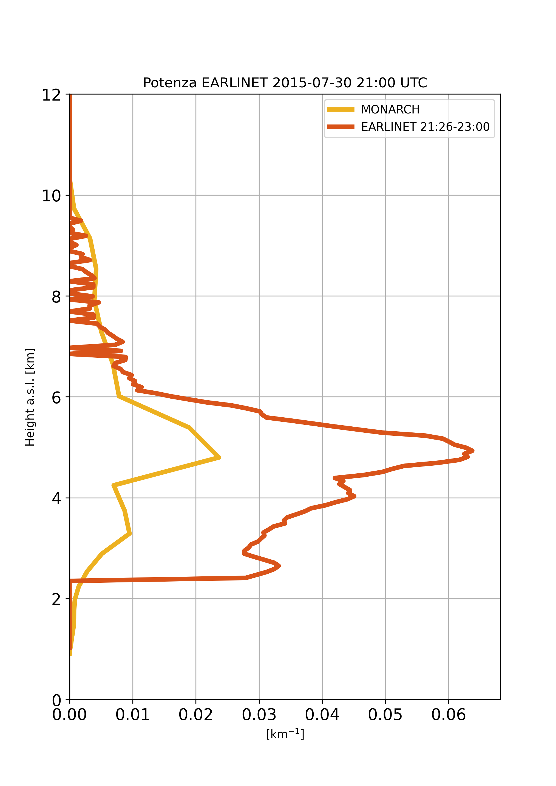
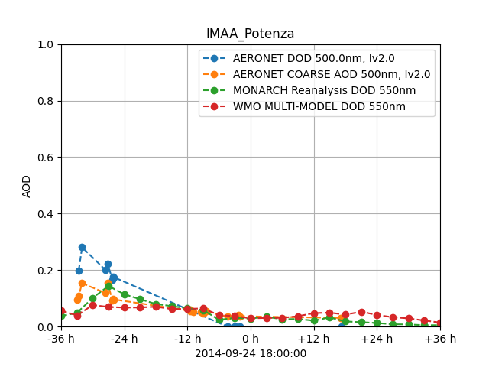
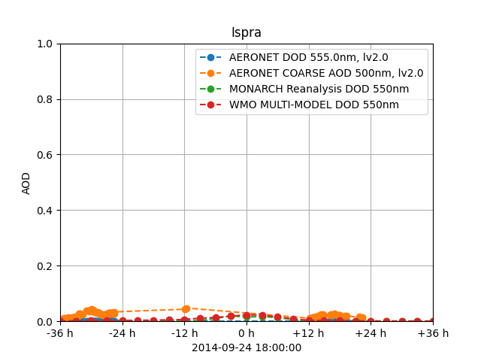



WMO SDS-WAS Multi-Model dust product
Climate data to generate aerosol evolution snapshot on a specific area.
Data from WMO SDS-WAS Multimodel analysis and MONARCH Reanalysis (Di Tomaso et al. ESSD 2022).
DESERT DUST
Dust profiles by ACTRIS/EARLINET and MONARCH
Desert dust profiling dataset produced by CNR-IMAA to obtain vertical profiles at 532nm at Potenza and Ispra stations between the years 2015 and 2021.
Desert dust profiling product data collection, Italy 2015-2021 by ITINERIS, available at: https://doi.org/10.71763/CNR-IMAA/ITINERIS/DESERT_DUST_PROFILING_PRODUCT/2015-2021/ALL
WMO SDS-WAS + MONARCH + AERONET Dust Optical Depths
Data from AERONET photometric measurements to generate DOD over time, are compared with data from WMO and MONARCH.

Slide 6
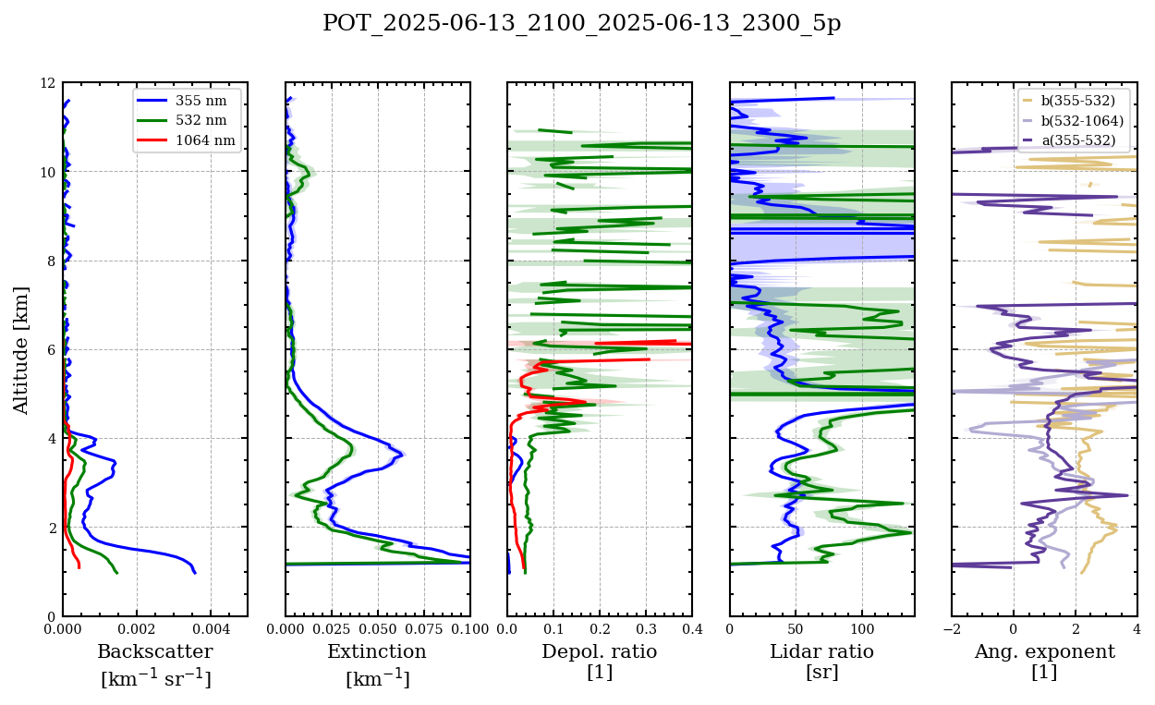

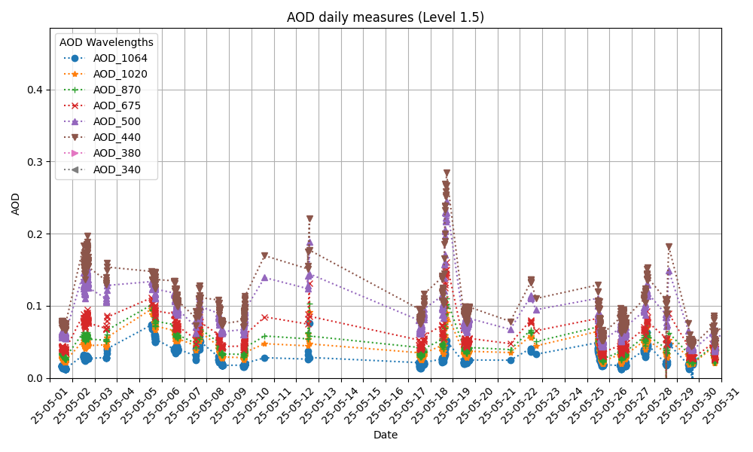
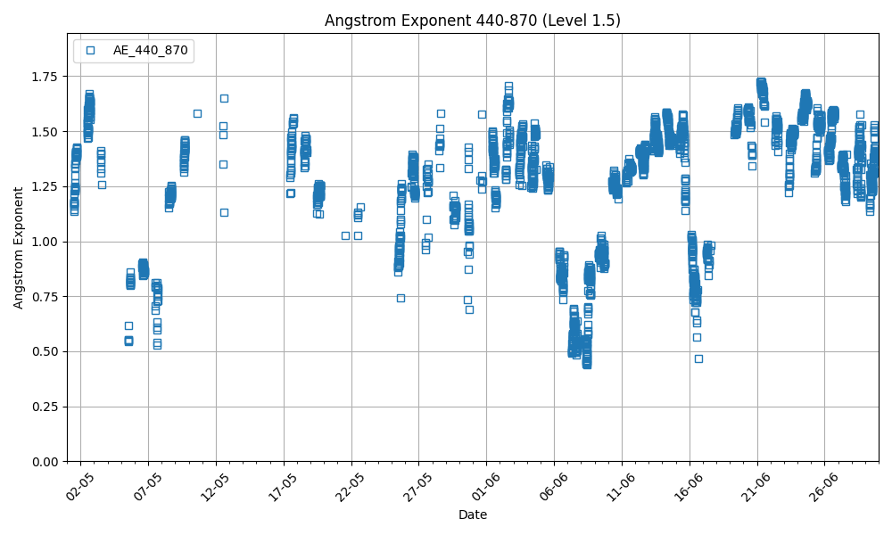
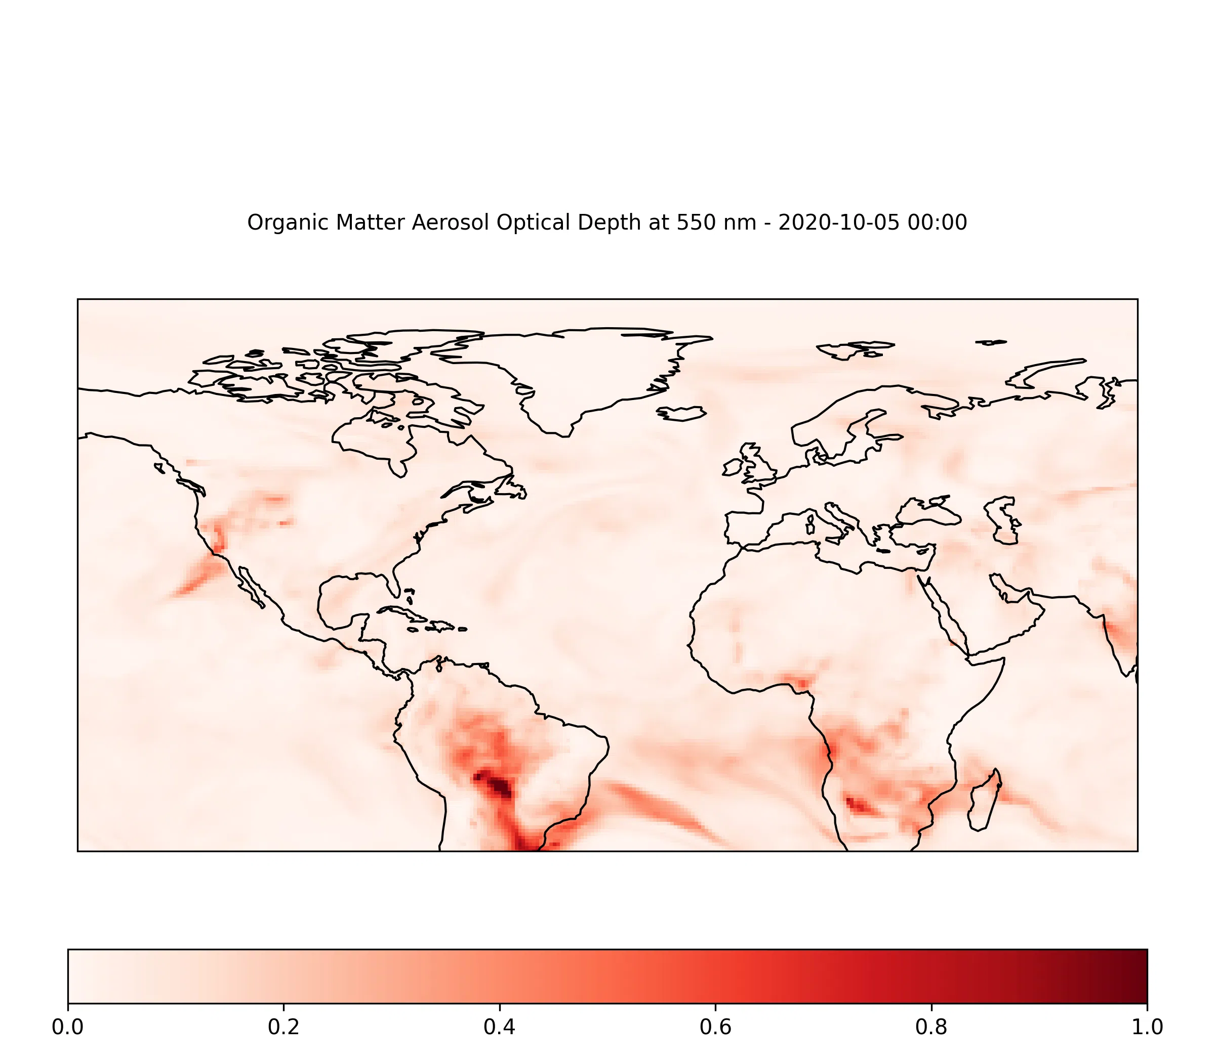
Profiles by ACTRIS/EARLINET
ACTRIS/EARLINET data to produce Backscatter, Extinction, Depolarization Ratio, Lidar ratio and Angstrom Exponent plots for a specific site, date and time range.
Data for a specific station are retrieved automatically from ACTRIS/EARLINET database via dedicated API.
AEROSOL TYPING
Aerosol Optical Depths by AERONET
Regional maps by CAMS
CAMS model to generate global-scale high quality 2D maps for the time evolution of Observables. The users will be able to produce their own maps and/or animations by choosing a specific date and adjusting map boundaries.
These utilities use AERONET data to produce daily AOD values at wavelengths 340, 380, 440, 500, 675, 870, 1012, 1064 nm as single measure or daily averages and Angstrom Exponent (440-870).

Slide 7
3nd ITINERIS General Project Meeting
Rome, September 25th – 26th, 2025
Emilio Lapenna, Michail Mytilinaios, Benedetto De Rosa, Nikolaos Papagiannopoulos, Ermann Ripepi, Lucia Mona
CNR-IMAA

