Slide 1
A VRE-based analysis of the influence of atmospheric circulation types on seasonal C fluxes in a Mediterranean beech forest
S. Costafreda-Aumedes, P. Tagliolato, R. Giusti, M. Iannuccilli, G. Matteucci, F. Mazzenga, A. Messeri, G. Messeri, A. Oggioni

Slide 2
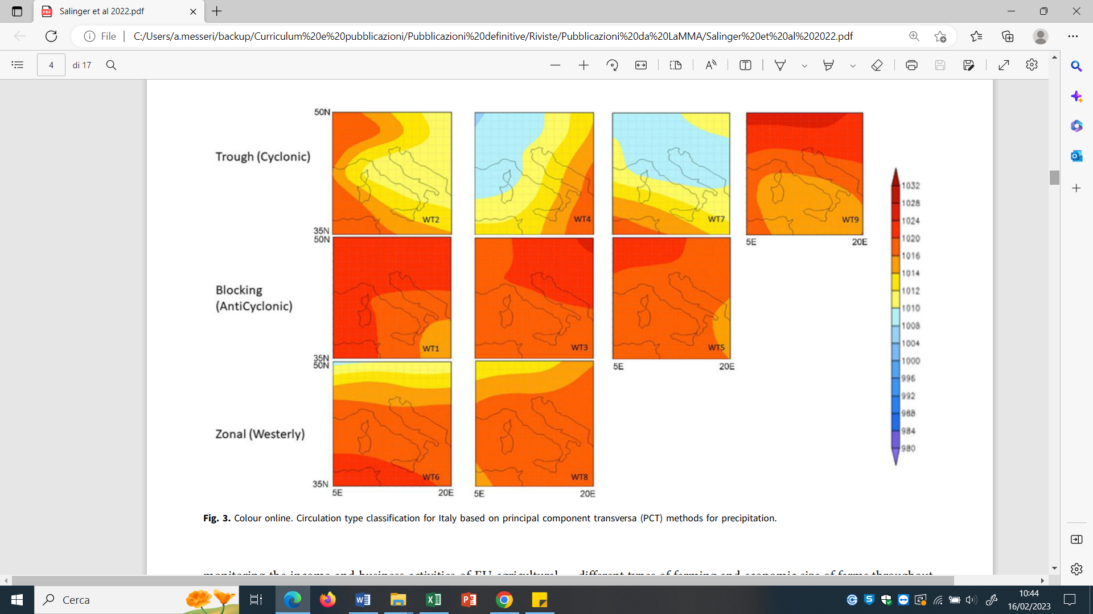



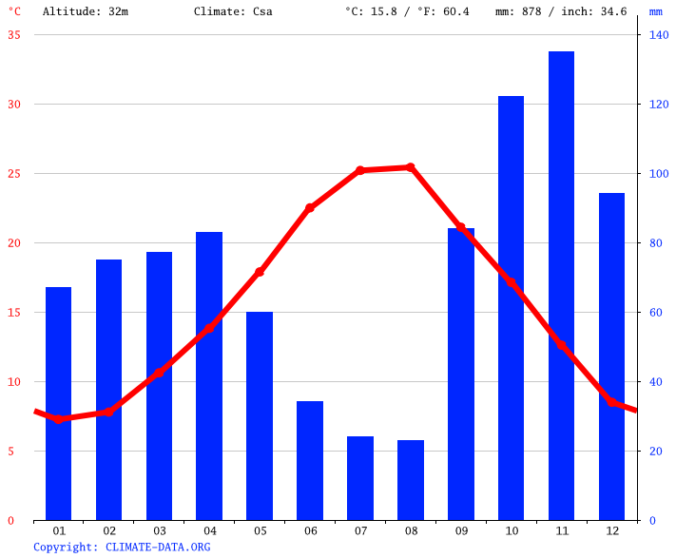
Background
Carbon exchange
Atmospheric weather types as proxy for estimating C fluxes
Weather
types
Objective:
to investigate how the seasonal frequency of each circulation type affected the seasonal variability of carbon dynamics in beech forests
Disturbances
Drivers
Local weather is influenced by global conditions

Slide 3
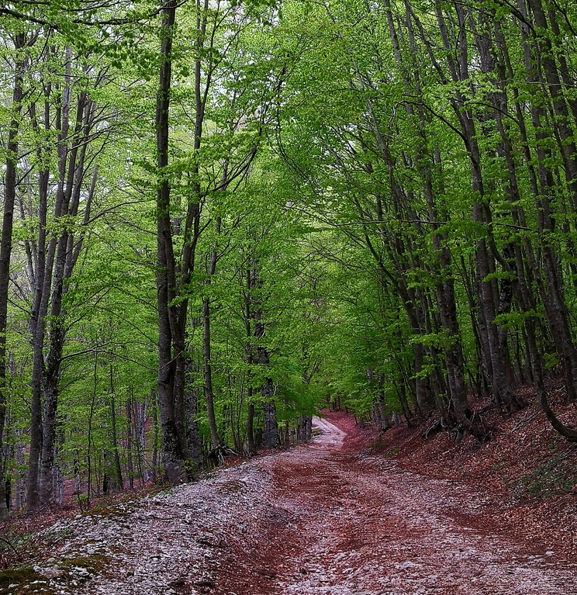








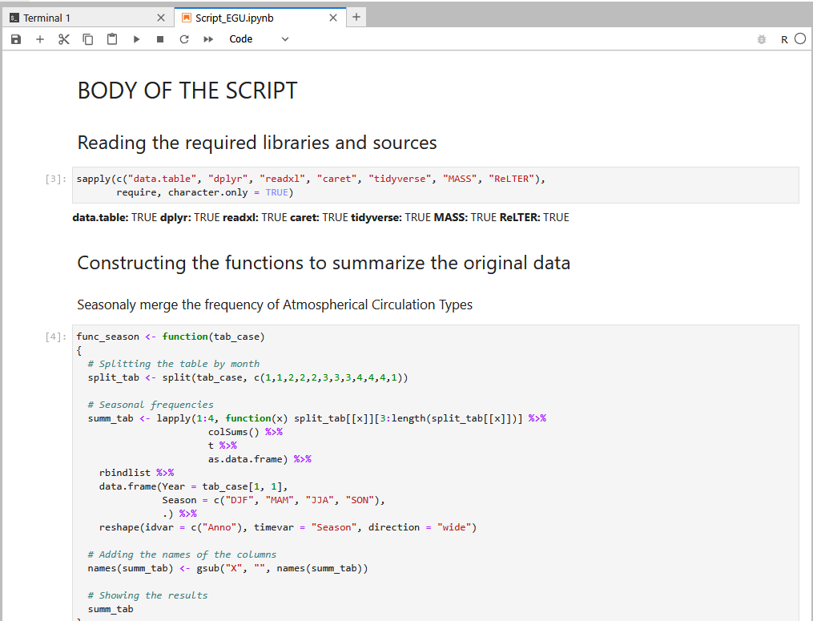


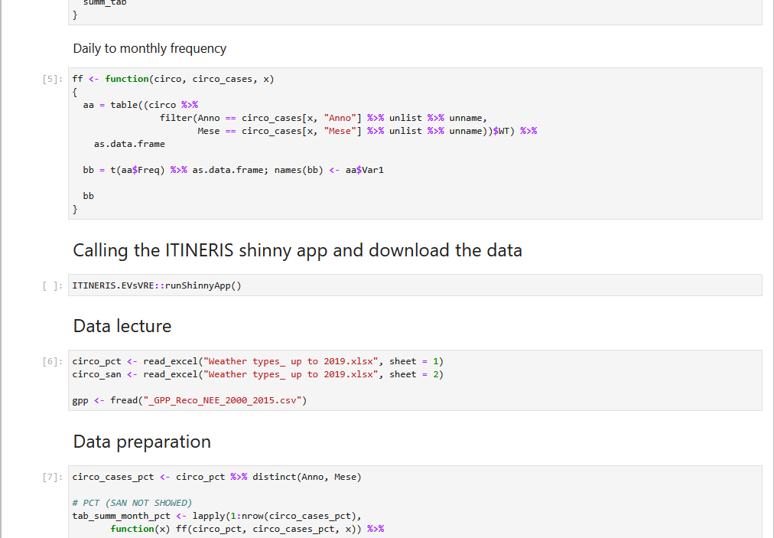
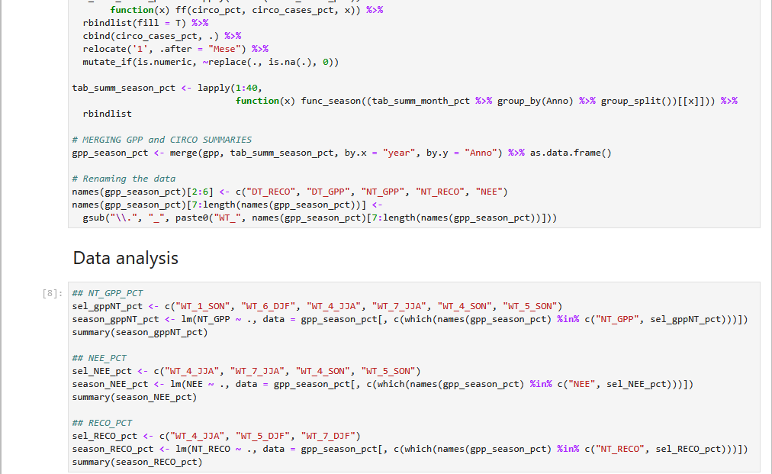




Methodology
Study area
General procedure
Collelongo - Selva Piana
Daily T and P
Statistical analysis
(classification)
Circulation types
Macroclasses:
  Cyclonic (4 WTs)
  Anticyclonic (3 WTs)
  Zonal (2 WTs)
Weather types - methods:
  Simulated annealing (SAN)
  Principal components (PCT)
Weather types
(Vallorani et al., 2017)
3000 ha beech forest (+125 years)
Period: 1995 – 2014
Measurements:
  DBH growth
  Carbon fluxes
  (GPP, NEE , RECO)
Carbon fluxes
ITINERIS.EVsVRE
ReLTER

Slide 4
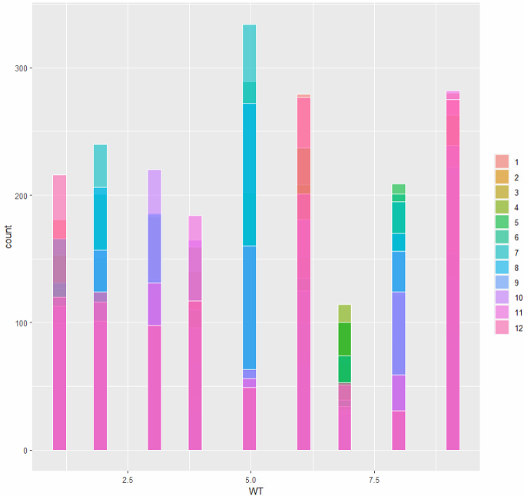
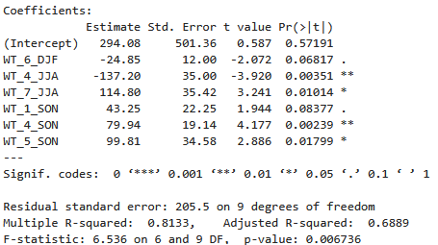
Preliminary results
Weather types
Seasons
Cyclonic: WTs 2, 4, 7 and 9
Anticyclonic: WTs 1, 3 and 5
Zonal: WTs 6 and 8
DJF: December - February
MAM: March - May
JJA: June - August
SON: September - November

