Slide 1
Downstream VRE: Land and Marine domain toolboxes
R. Franceschini¹, N.C. Reyes Suárez¹, A. Altenburger¹, G. Rossi¹, and A. Giorgetti¹
¹National Institute of Oceanography and Applied Geophysics – OGS, Italy

Slide 2
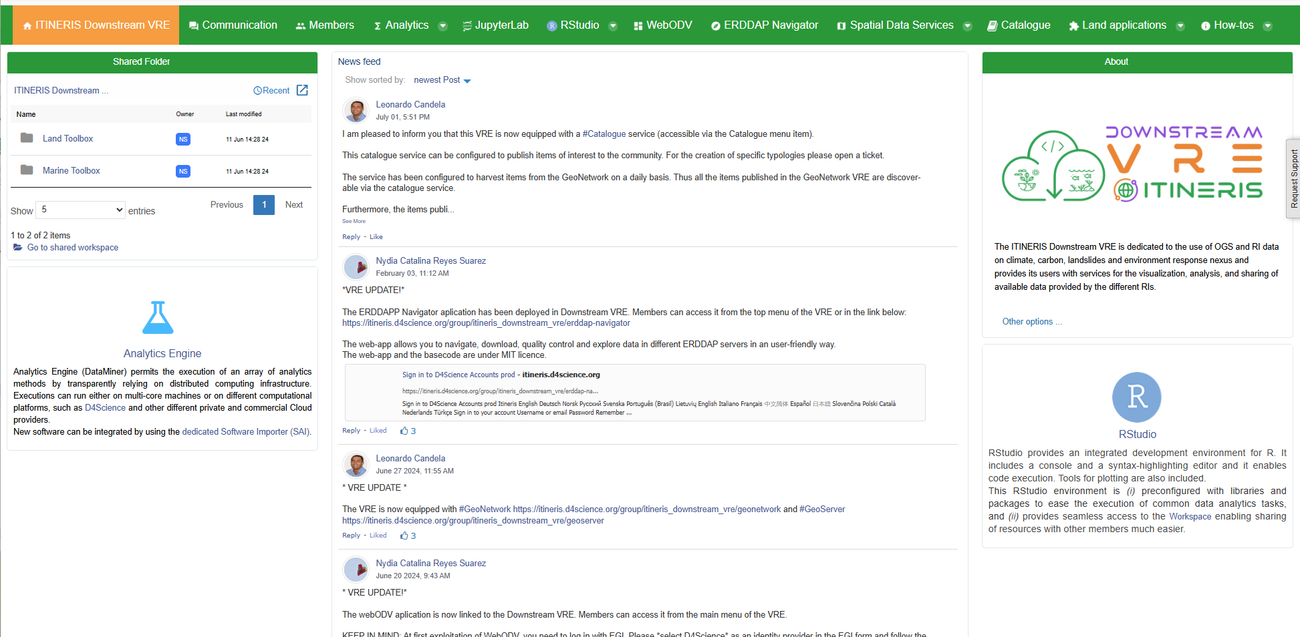

Collection Data and Platform - Downstream VRE
Marine toolbox
Land toolbox
Post
News
Text
Usefull info
….

Slide 3
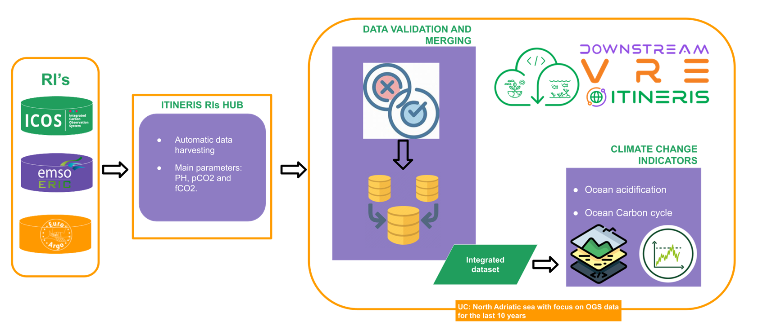
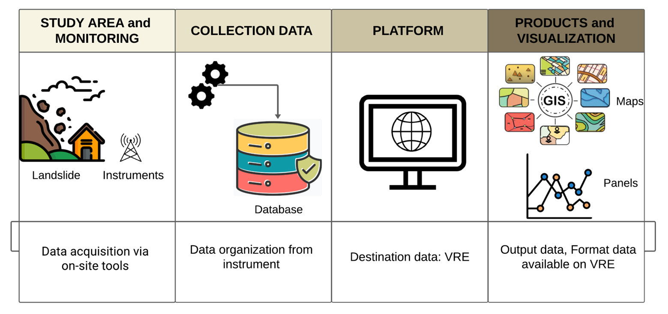
Marine and Land domain toolbox
Marine domain toolbox
The marine domain toolbox focalizes in carbon cycling and acidification data available in the North Adriatic Sea mainly pH, pCO2, fCO2, temperature and salinity within the different Ris in the ITINERIS project.
Land domain toolbox
The land domain aims to analysis areas exposed to hydrogeological hazards, in particular landslides. The focus is on the potential impact of climate change on pilot test sites. Data from the test site is collected using monitoring systems.

Slide 4
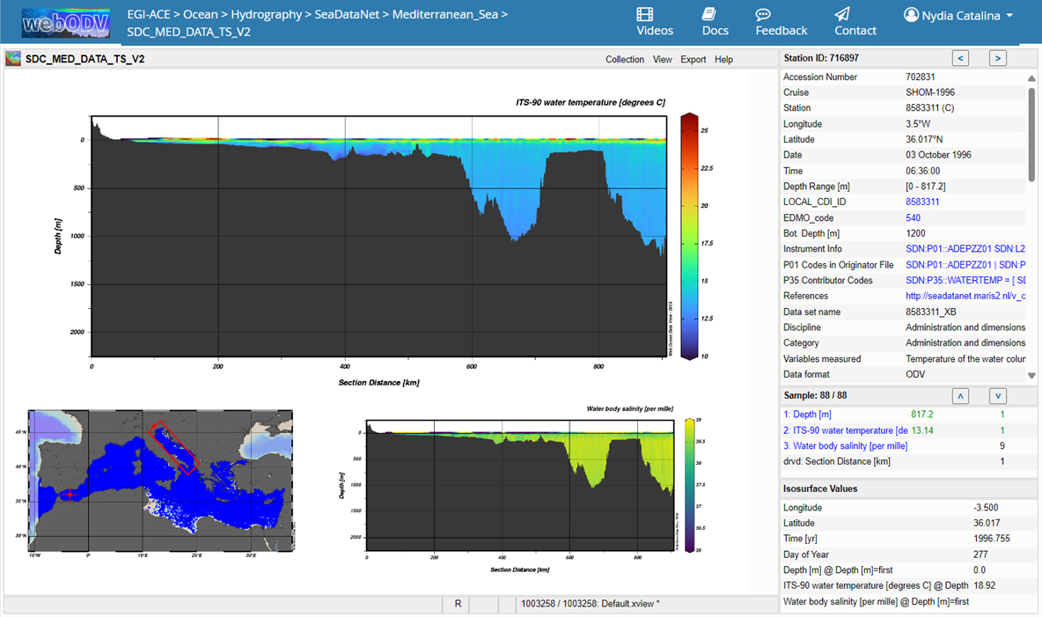
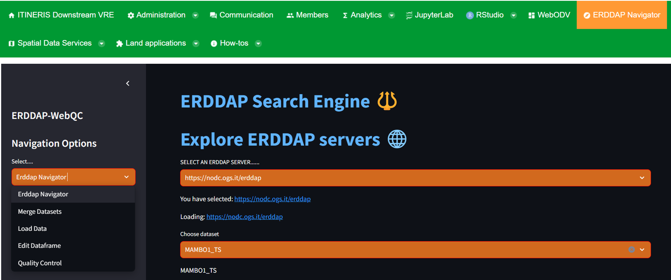
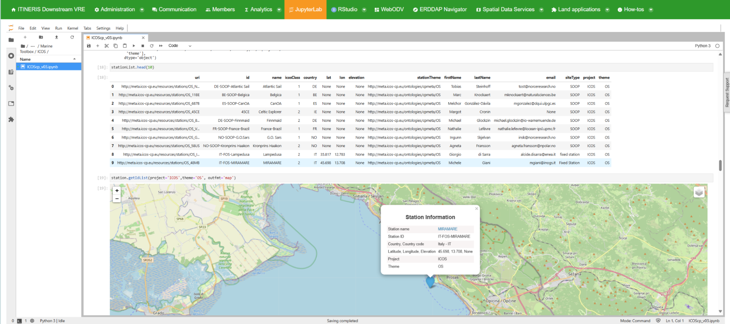
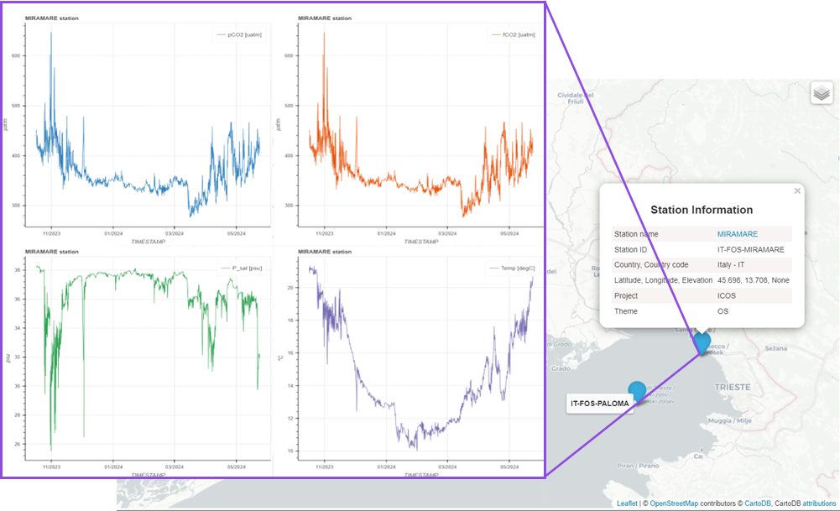
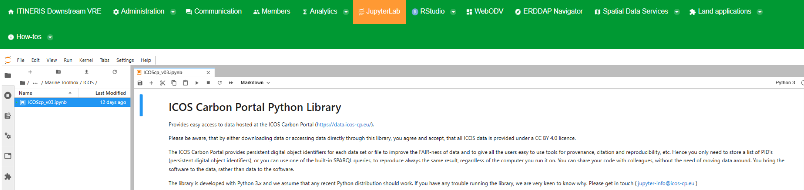
Marine domain
Three user driven tools have been made available based on different user skills and the most common tools for marine domain users: WebODV access, jupyter notebooks to access ICOS data and the ERDDAP navigator.
Allows the user to navigate within different ERDDAP servers giving the freedom of exploring, merge, load, edit and manually quality control (QC) datasets by exploiting ERDDAP RESTful API
Notes:
Three user driven tools have been made available based on different user skills and the most common tools for marine domain users: WebODV access, jupyter notebooks to access ICOS data and the ERDDAP navigator.
1) The webODV application has been linked to the Downstream VRE for the extraction, analysis, exploration and visualization of oceanographic and other environmental data. This version is restricted for Argo (TS & BGC) and SeaDataNet (TS) products.
2) This open-source web application (https://github.com/nodc-it/ERDDAPNavigator) allows the user to navigate within different ERDDAP servers giving the freedom of exploring, merge, load, edit and manually quality control (QC) datasets by exploiting ERDDAP RESTful API.
3) Implementing the ICOScp python library in the VRE by means of jupyter notebooks allows the user to explore ICOS data

Slide 5
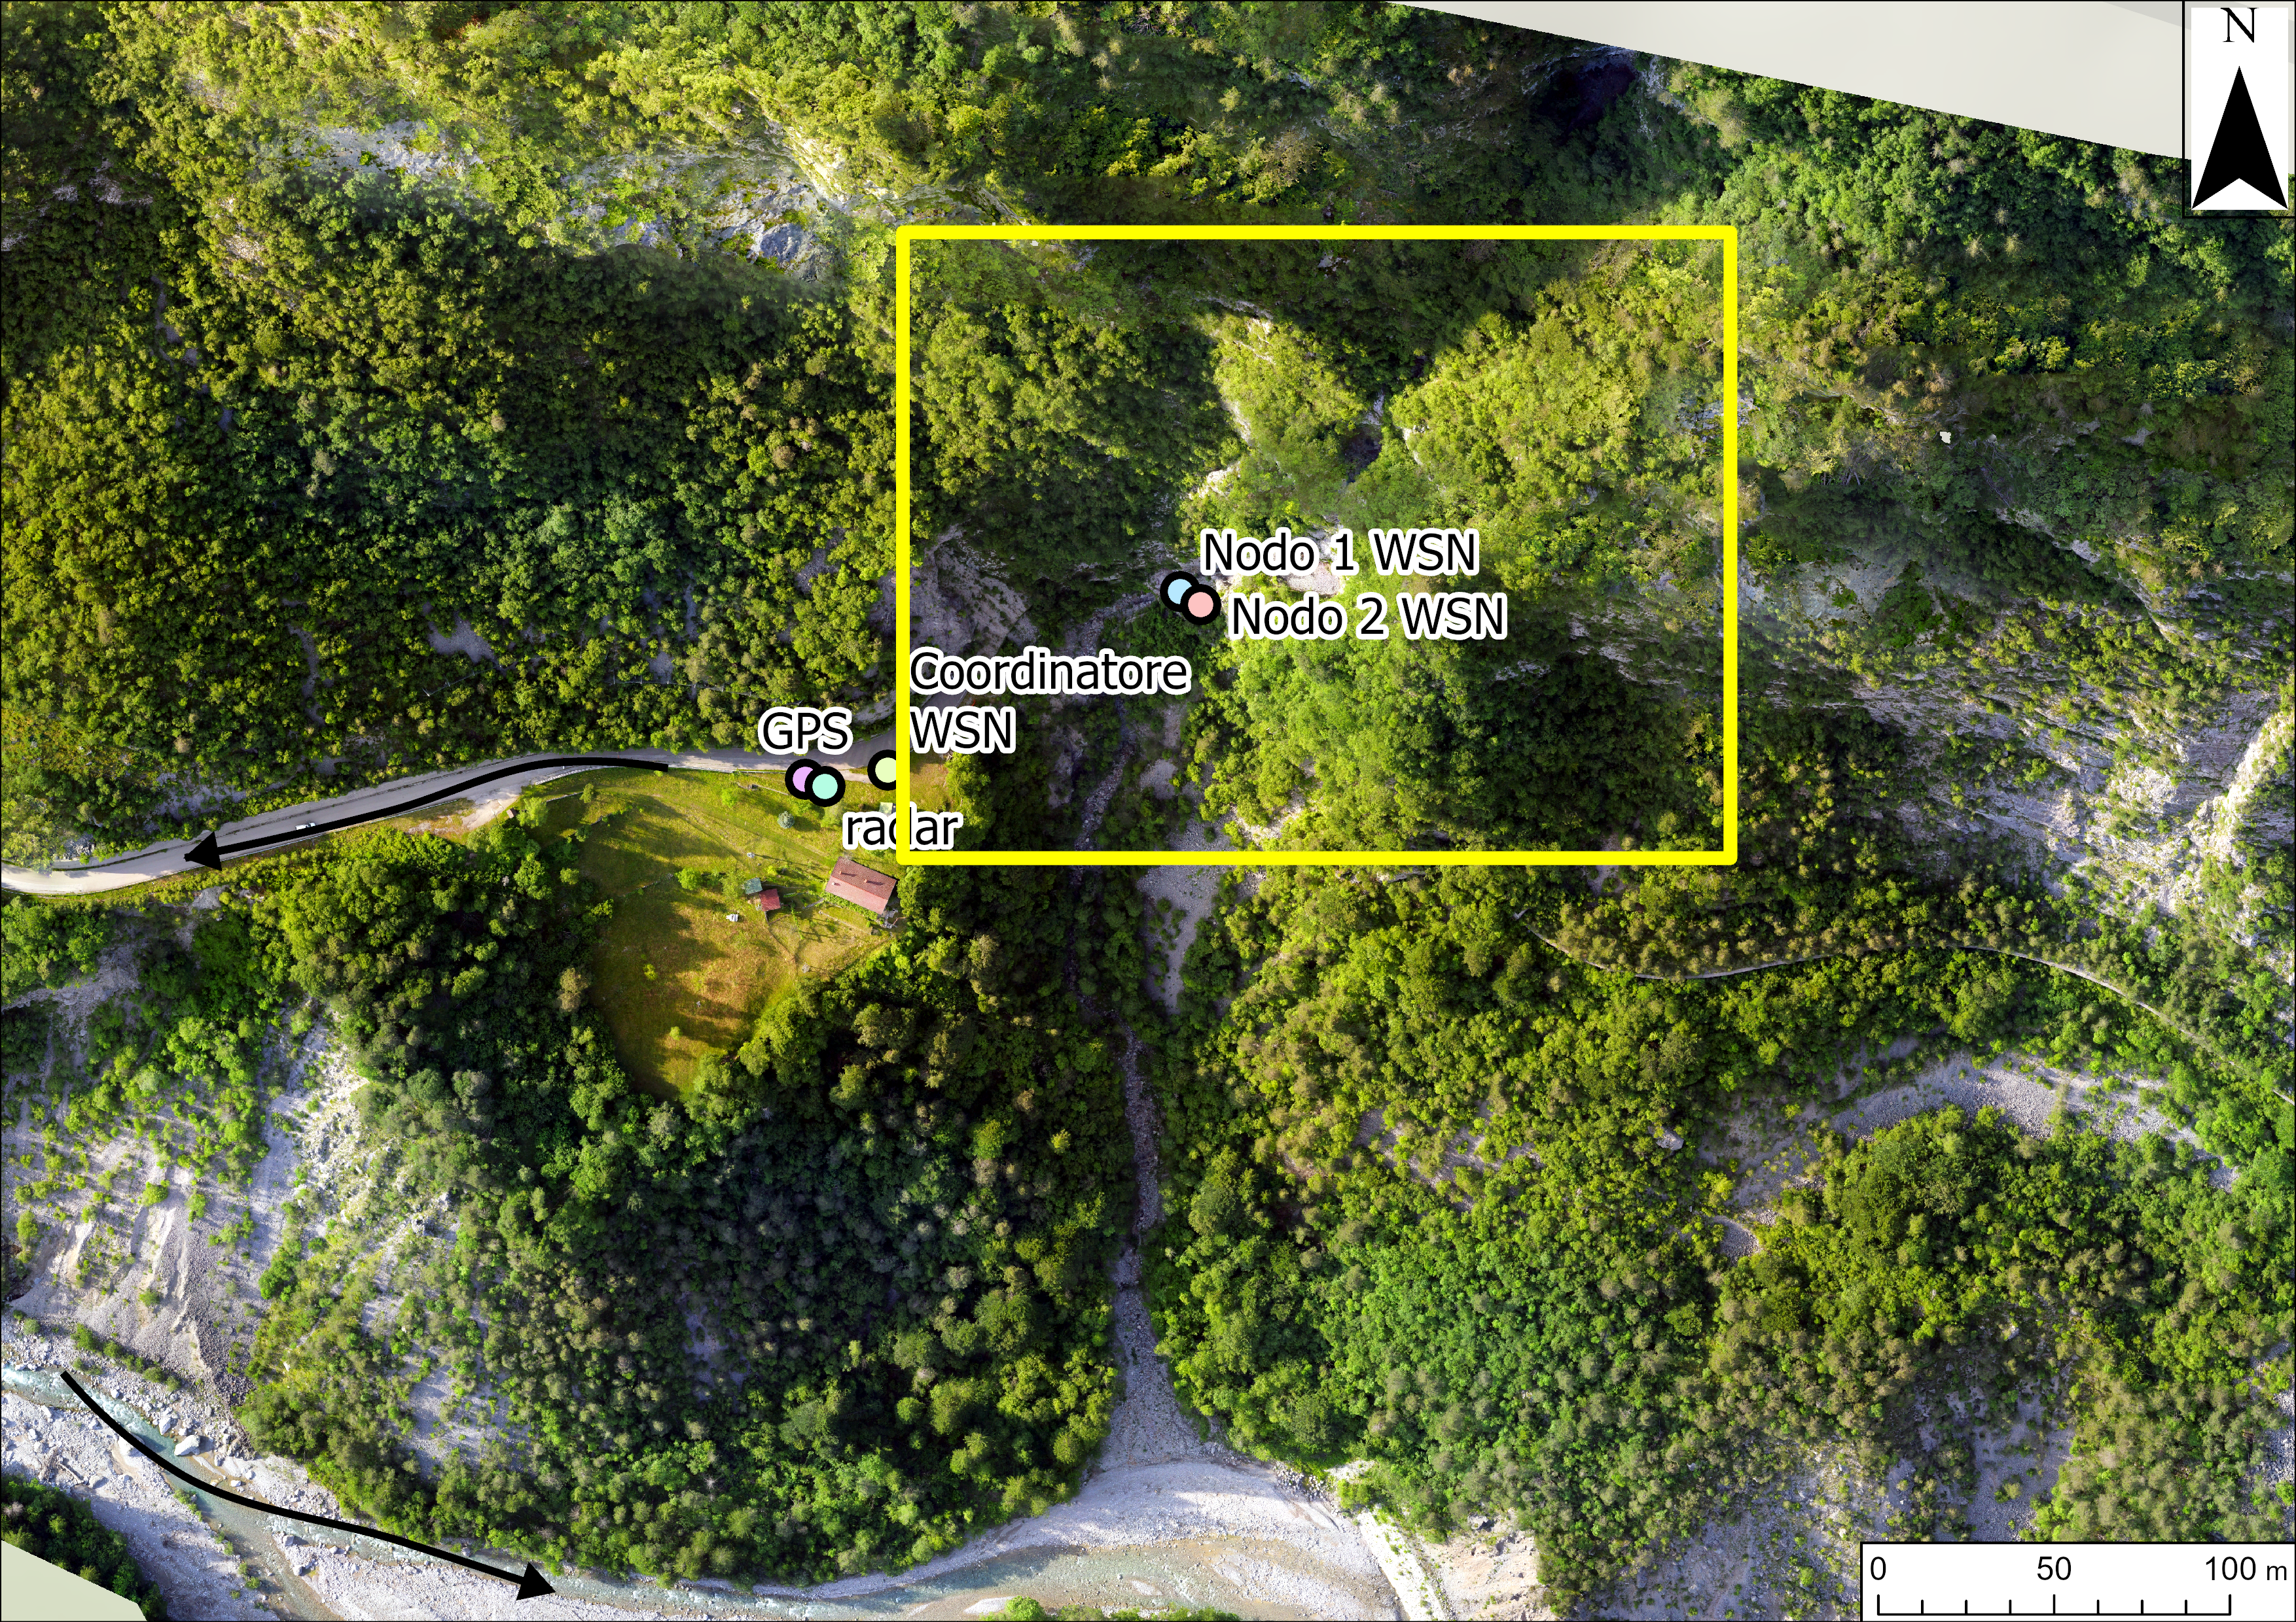
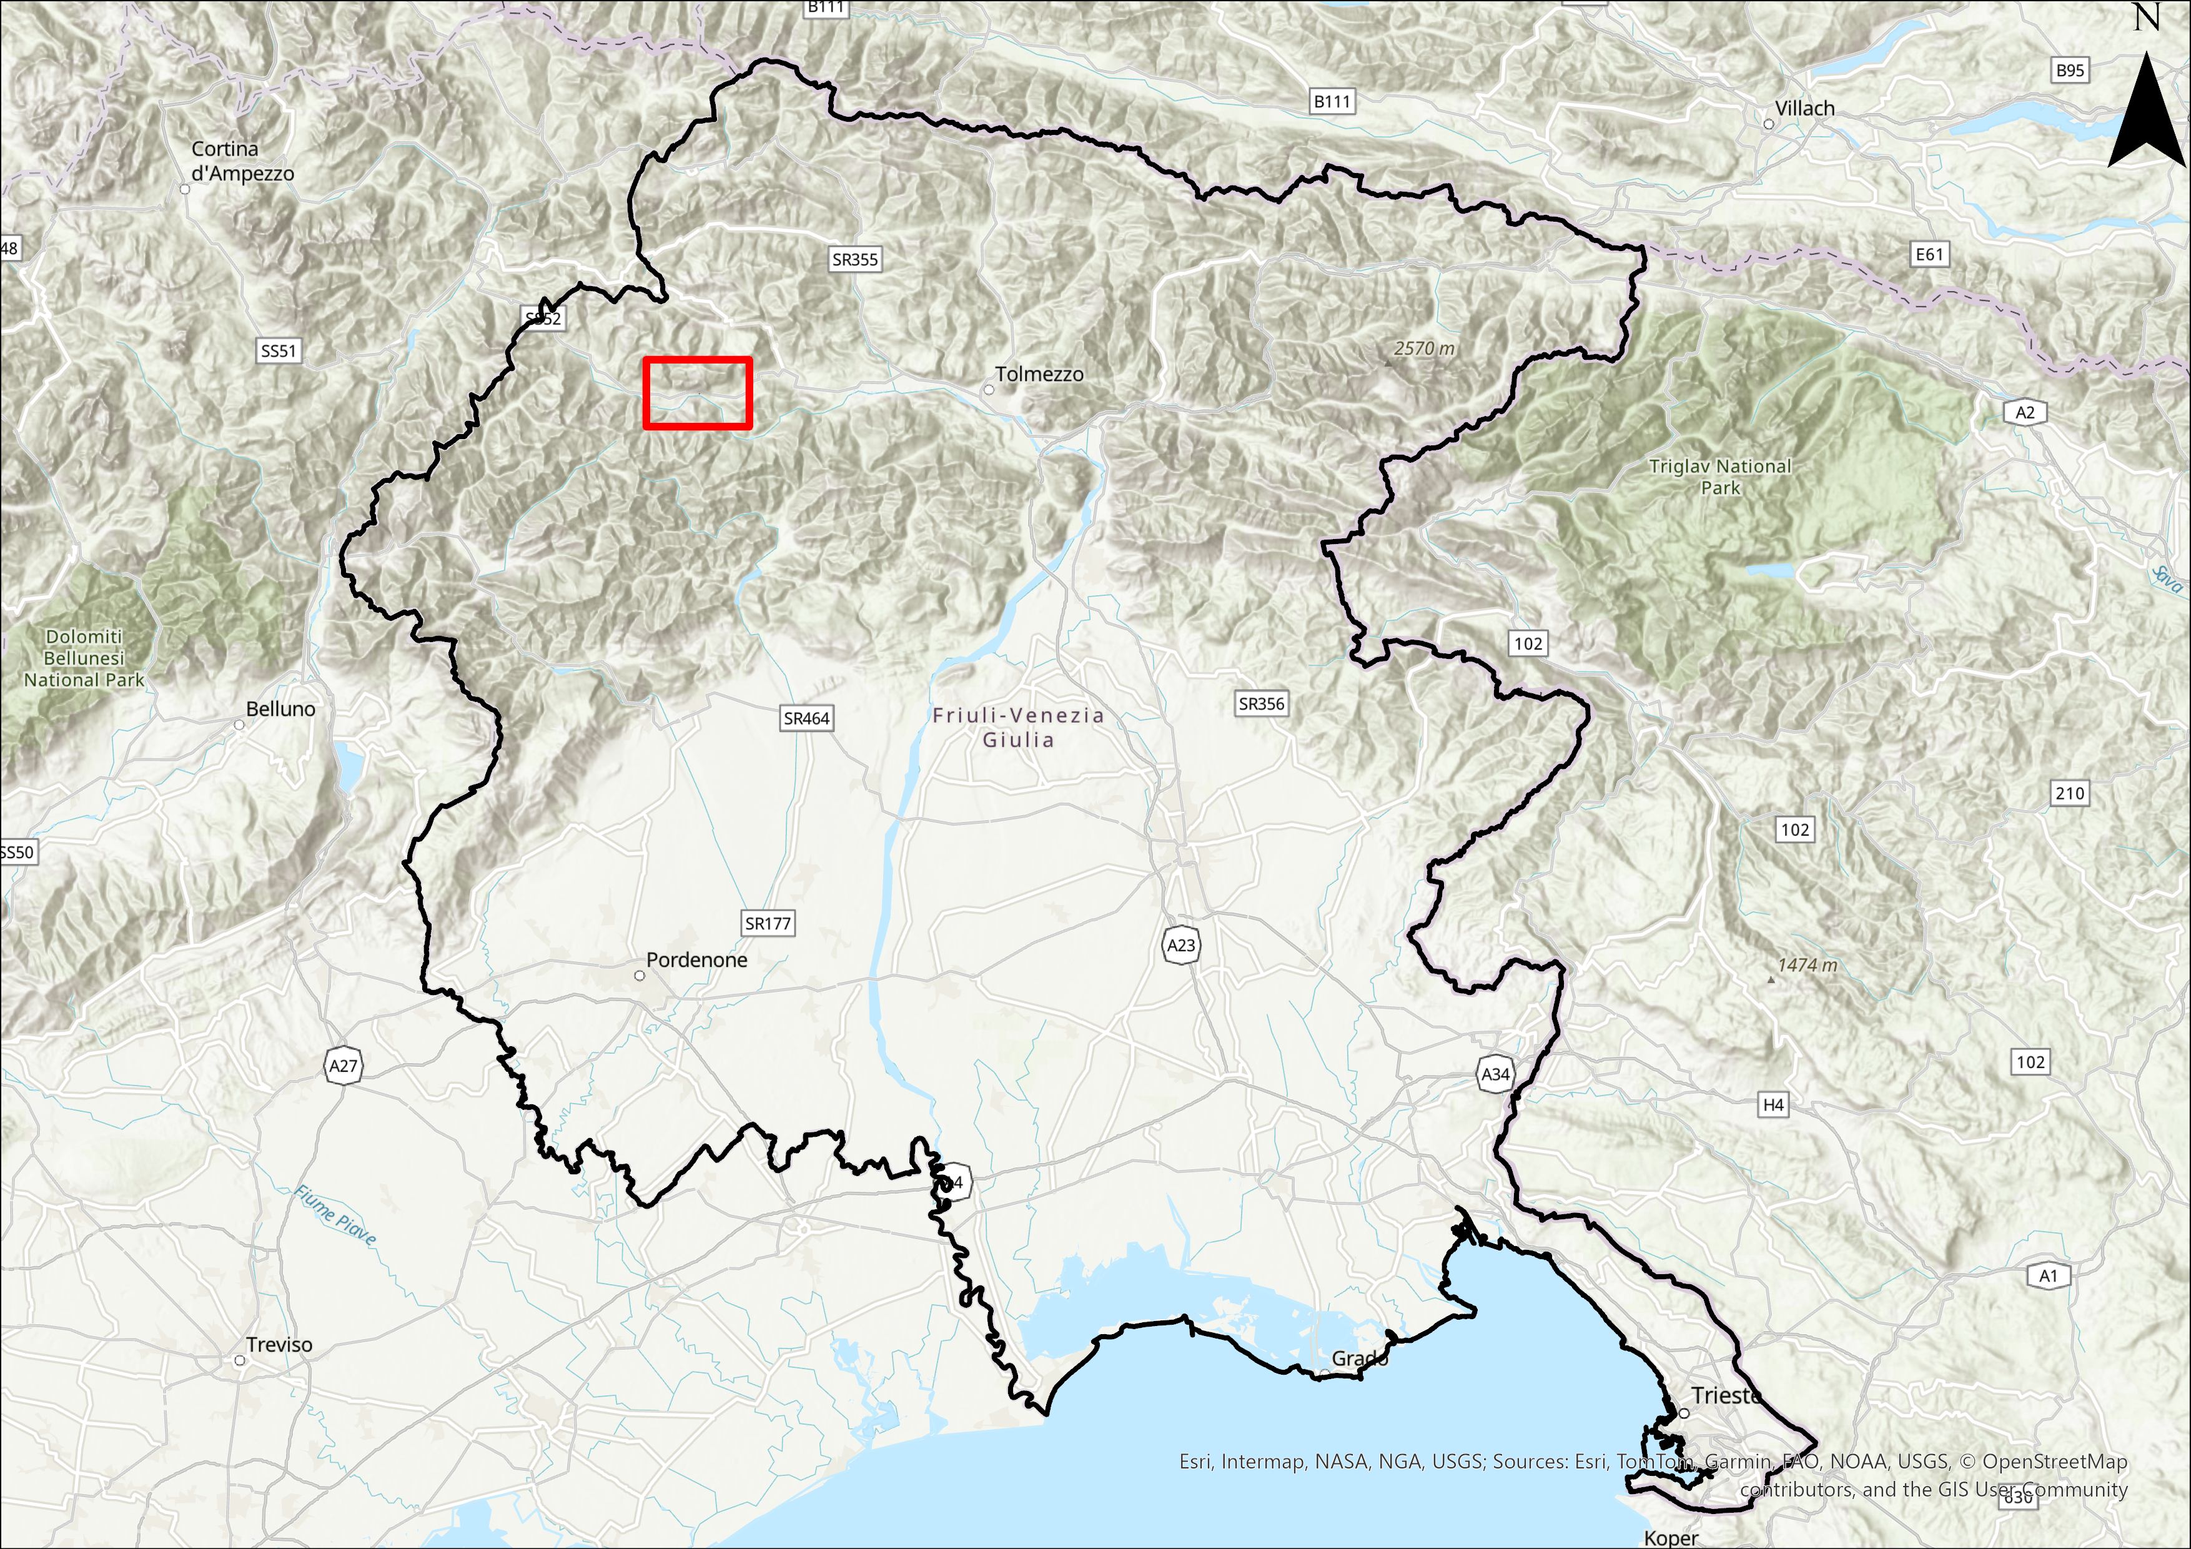
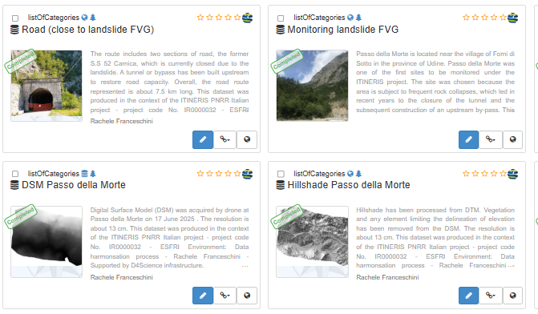
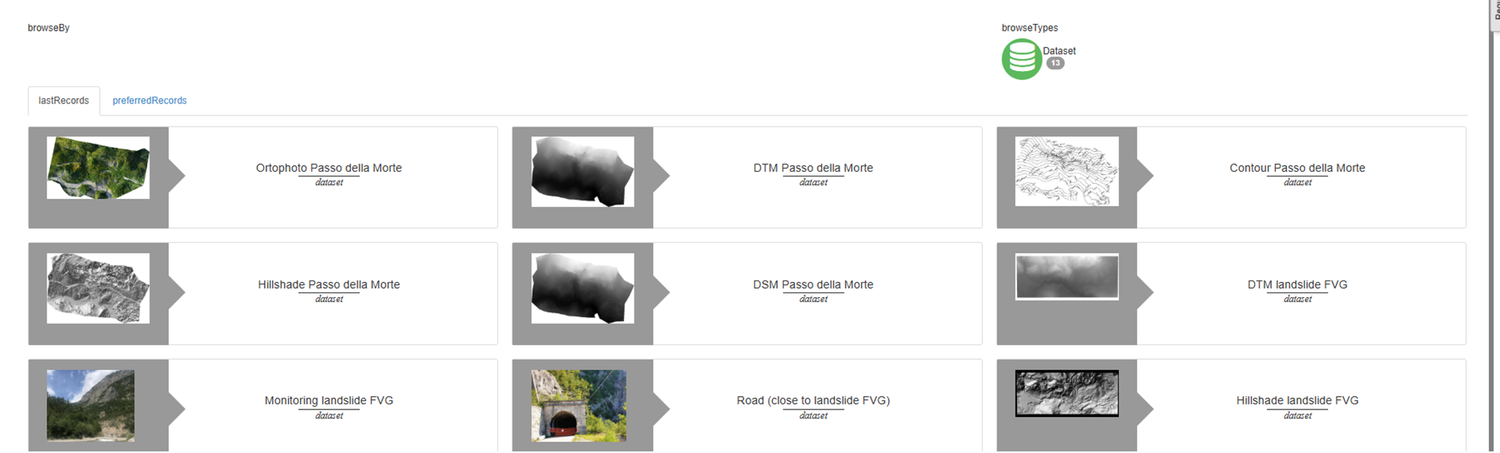
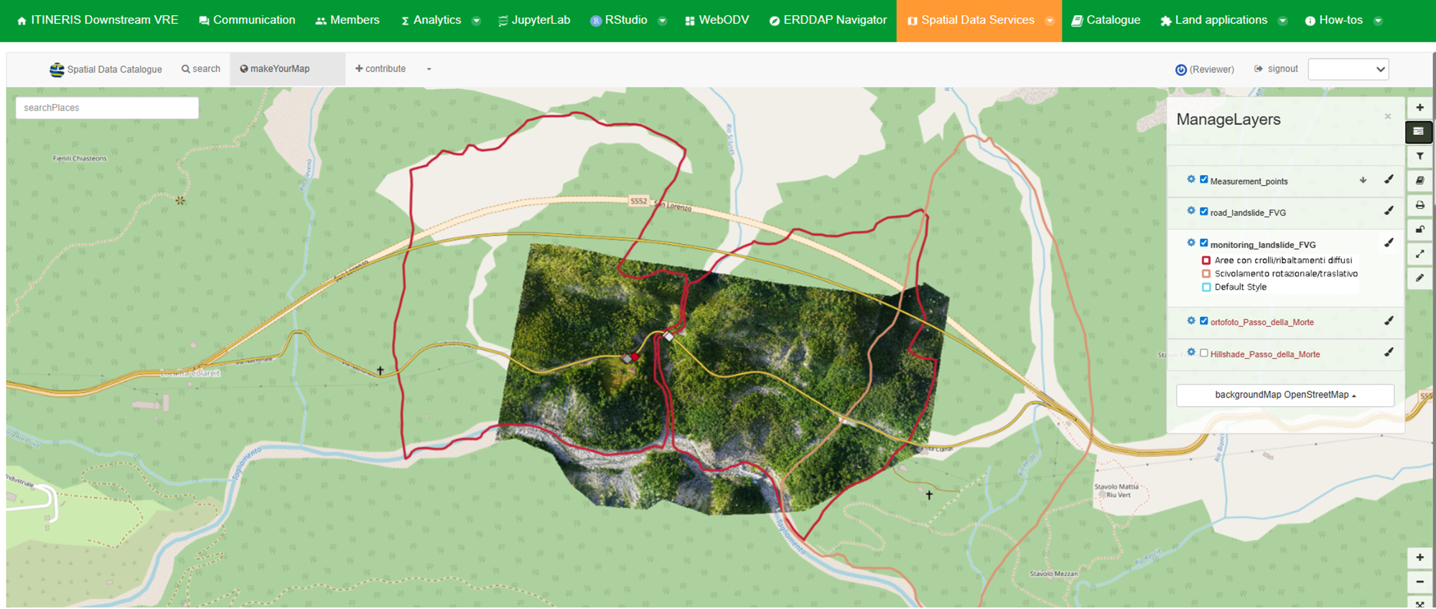
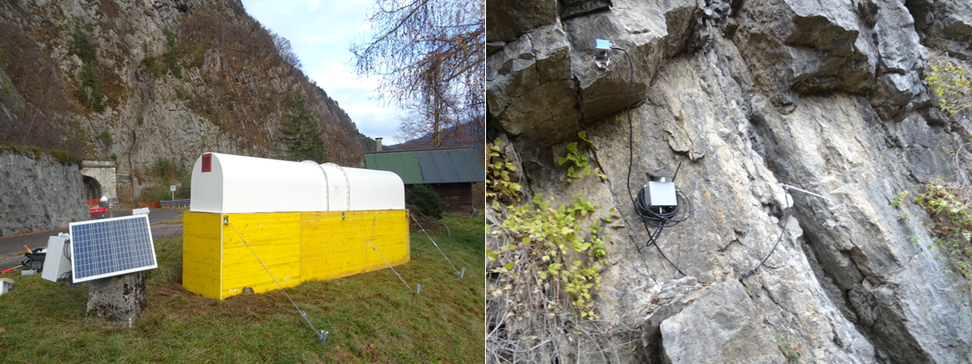
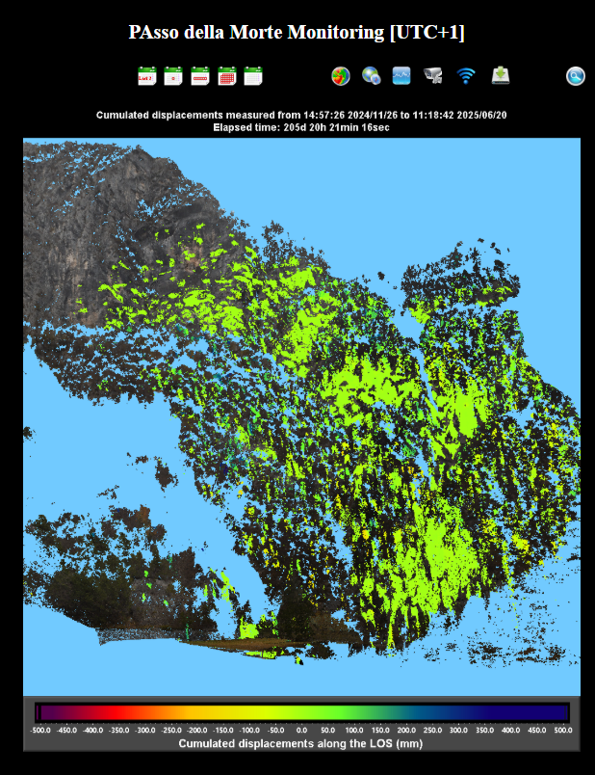
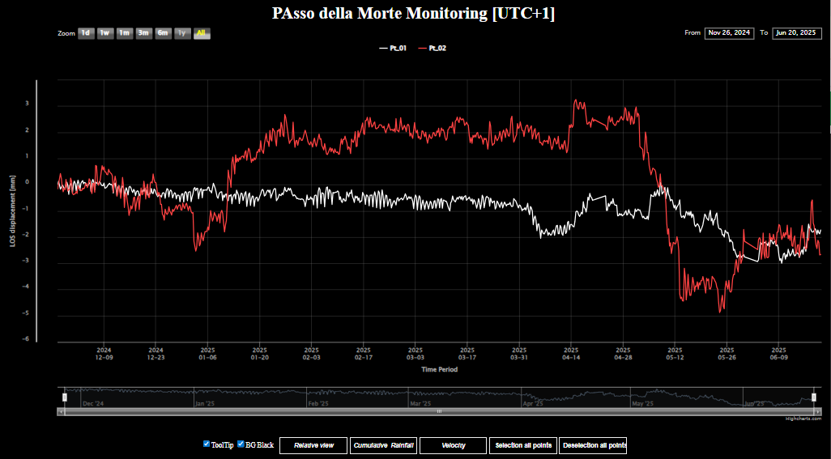
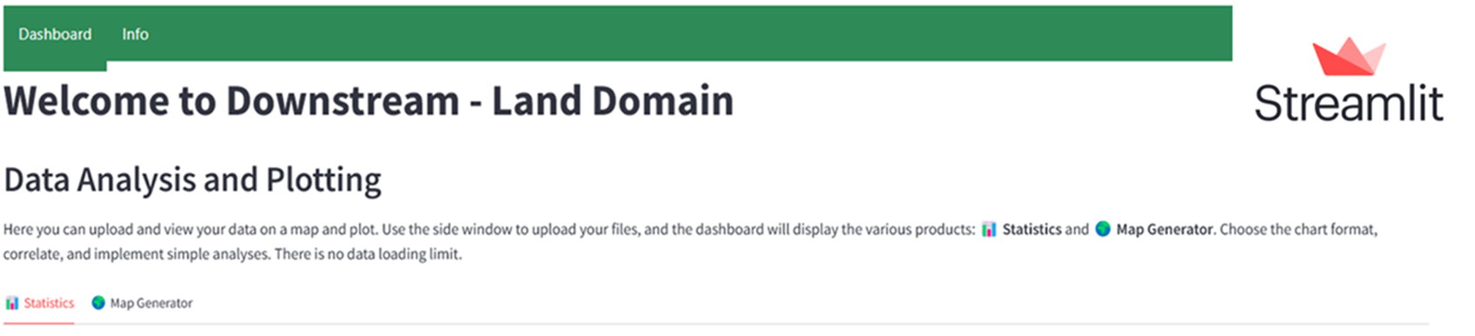
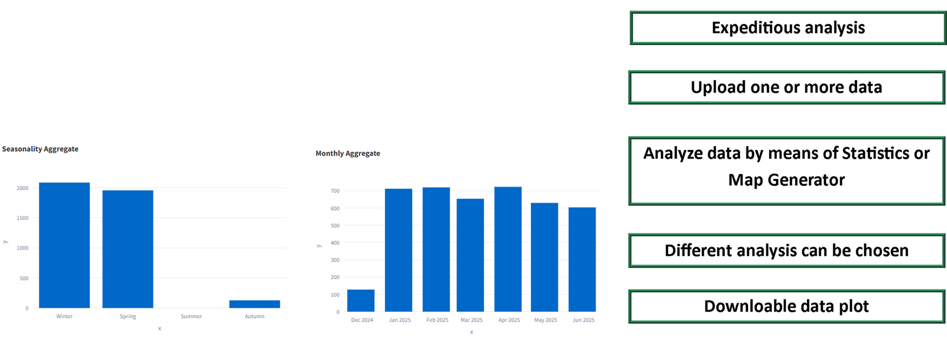
Land domain
Study area
Spatial Data Services with Geoserver and Geonetwork
Ampezzo
Monitoring system: GB-Insar has been installed, in November 2024, and every 1 h it captures an interferogram
“Land instability” application allows you to create graphs, make

