Slide 1
Advances in Seismic Risk Assessment of the city of Potenza (Southern Italy)
Giovanni Gangone ^{1,2}, Maria Rosaria Gallipoli ¹, Marco Vona ²
¹ National Research Council of Italy (CNR-IMAA), Tito Scalo (PZ), Italy
² Department of Structures, Geotechnics and Geology Applied to Engineering, University of Basilicata, Potenza, Italy

Slide 2
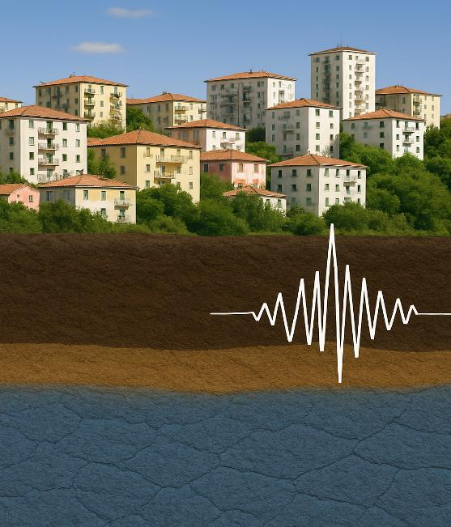
SUMMARY - URBAN SEISMIC RISK
Holistic approach
1.1 Experimental characterization of all urban soils
Topic 1:
Soil-structure interaction
1.2 Experimental characterization of all buildings
1.3 Soil-structure resonance maps
2.1 Numerical modelling for the main building’s typological classes
Topic 2:
Building dynamic response
2.2 Experimental constraints for capacity curves
2.3 Construction of capacity curves for all buildings

Slide 3
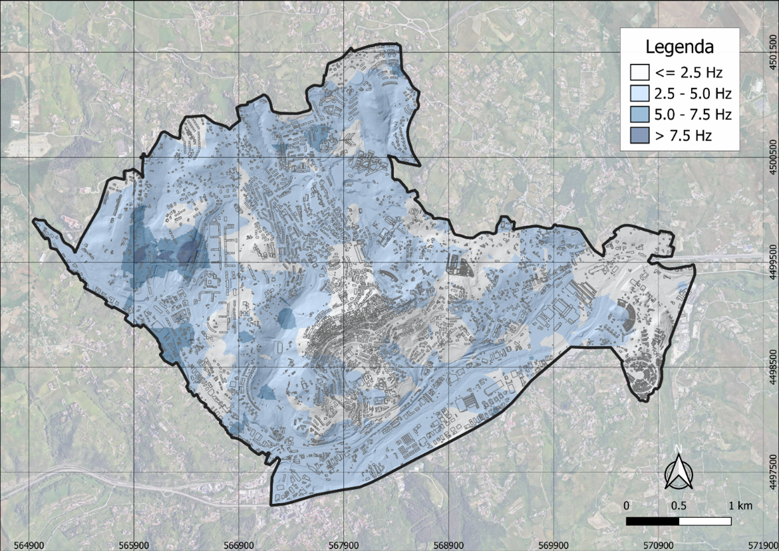
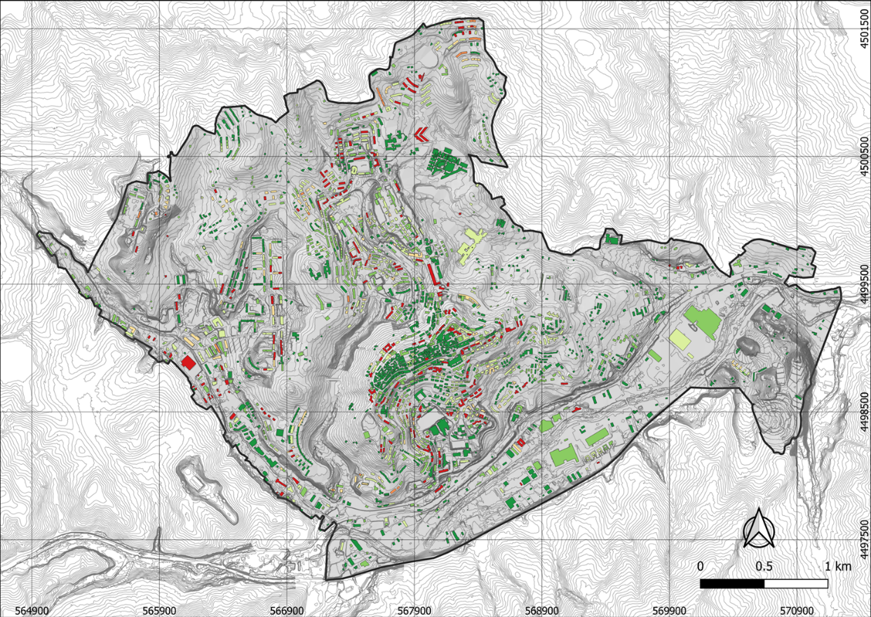
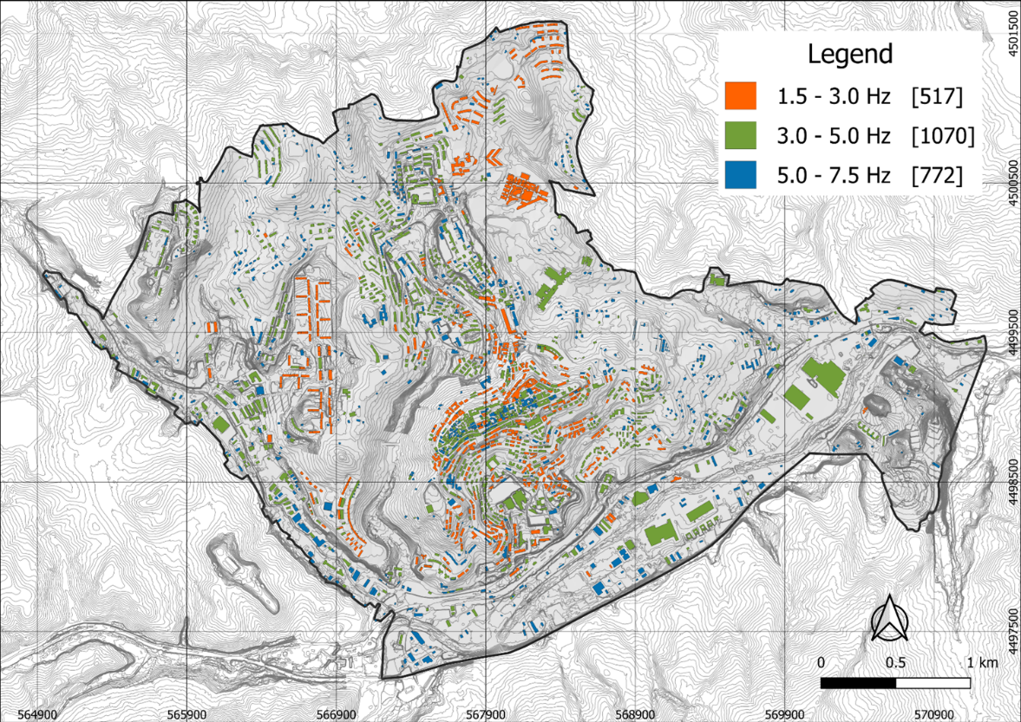

Topic 1: Soil-building resonance effects
Resonance Level
0% [1081 - 45.8%]
0-25% [575 – 24.4%]
25-50% [354 – 15.0%]
50-75% [100 – 4.2%]
75-99% [21 – 0.9%]
100% [229 – 9.7%]
$$T=0.018∗H^{0.877}∗A^{0.074}$$

Slide 4
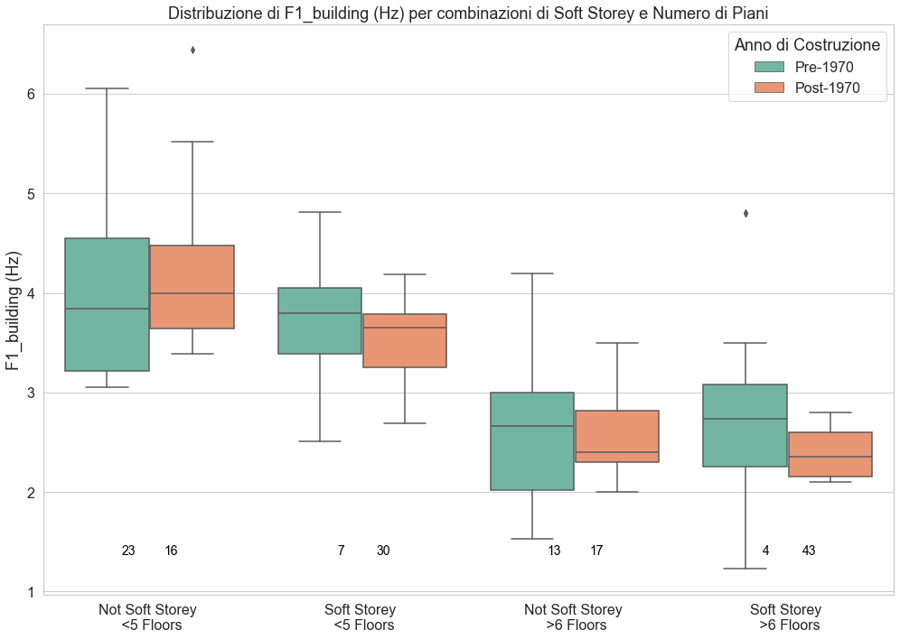
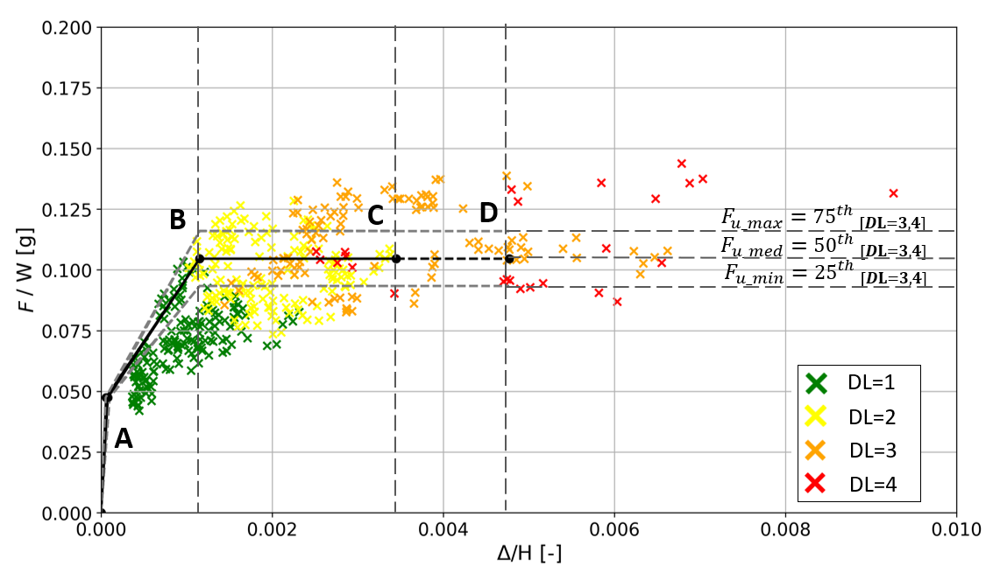






Topic 2: Building dynamic response
$∆_{y}$=$5^{th}{[∆}_{DL=2}]$
$∆_{max}$=${50}^{th}{ [∆}_{DL=3,4]}$
YEAR OF CONSTRUCTION
PRE 1971
POST 1971
MEDIUM
HIGH
INFILL-
FRAME
PILOTIS-
FRAME
INFILL-
FRAME
PILOTIS-
FRAME
$$∆_{e}=F_{e}/K$$
$$F_{e}={5^{th} }_{[DL=1]}$$
$∆_{u}$=${75}^{th}{ [∆}_{DL=3,4}]$
Urban Geophysics: A New Ground-Airborne Geophysical instrumental facility, CNR Tito scalo, 13/06/2025

Slide 5
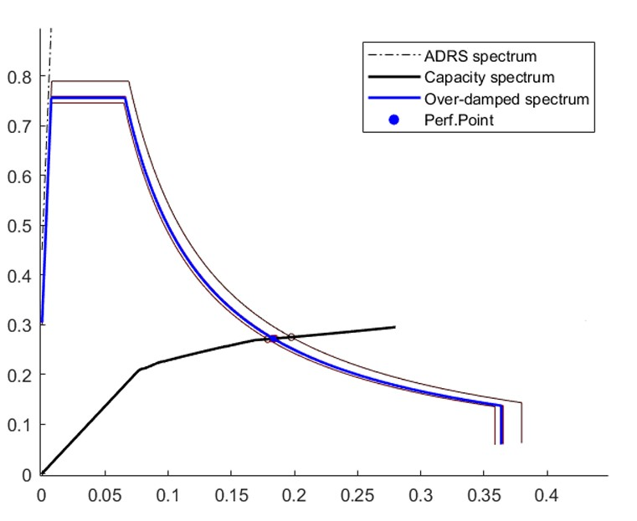
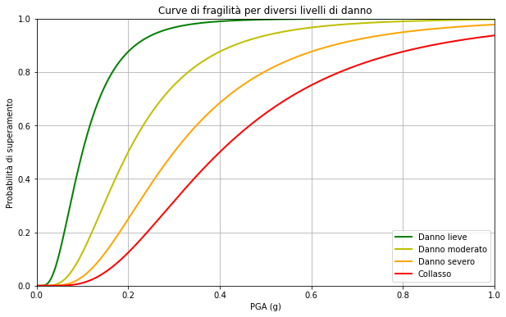
Future work
Sa (g)
Sd (m)

