Slide 1
Integrated Geophysics and Data Science for Soil Moisture Characterization and Hydrogeological Risk Assessment in Urban and Peri-Urban Areas
L. Martino^{1,2}, G. Calamita¹, G. De Martino¹, E. Guegen¹, I. G. Lando³, V. Cioffi⁴, S. Uhlemann⁵, F. Canora², A. Perrone¹
¹Institute of Methodologies for Environmental Analysis, National Research Council (CNR-IMAA), 85050 Tito Scalo (PZ), Italy. ²Department of Engineering, University of Basilicata, 85100 Potenza, Italy. ³Department of Science, University of Basilicata, 85100, Potenza (PZ), Italy. ⁴Department of Geosciences, University of Padua, 35131 Padova (PD), Italy. ⁵Faculty of Geosciences, University of Bremen, 28359 Bremen, Germany.

Slide 2
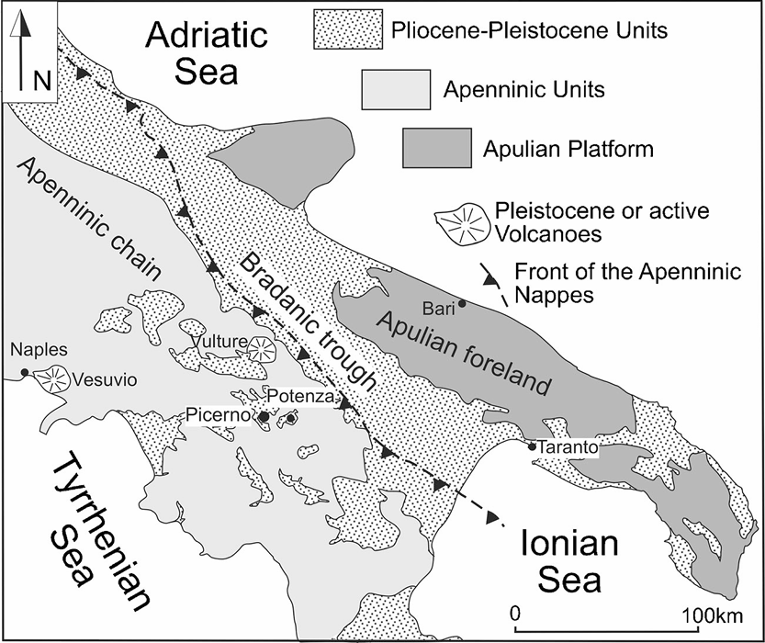
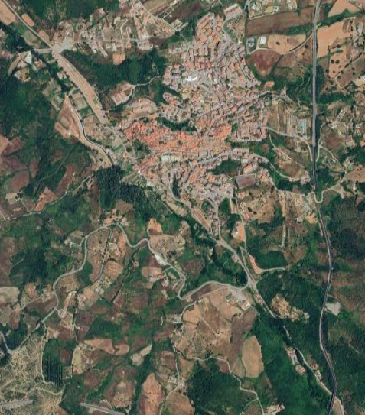
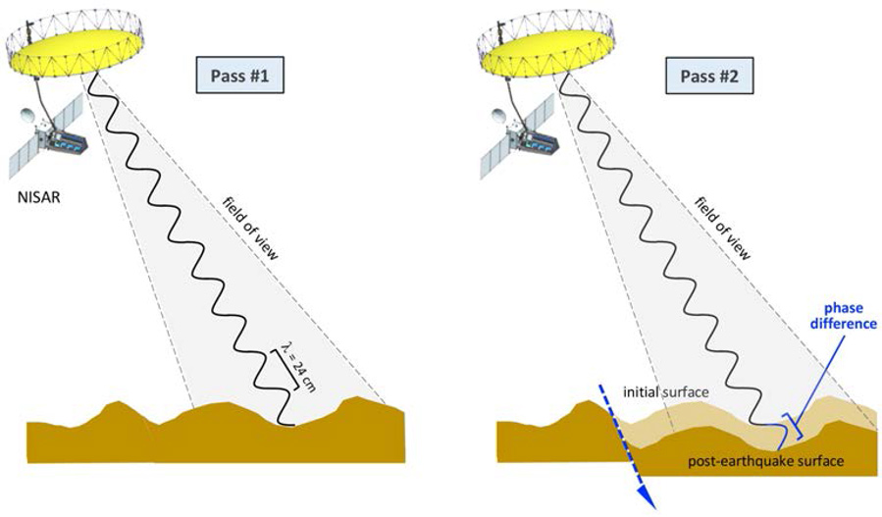
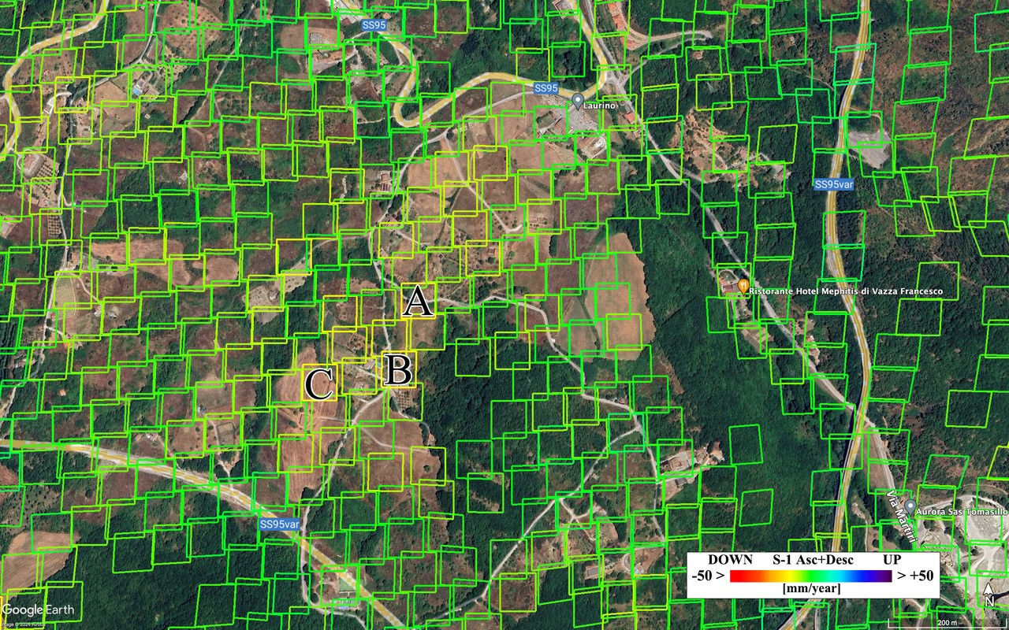
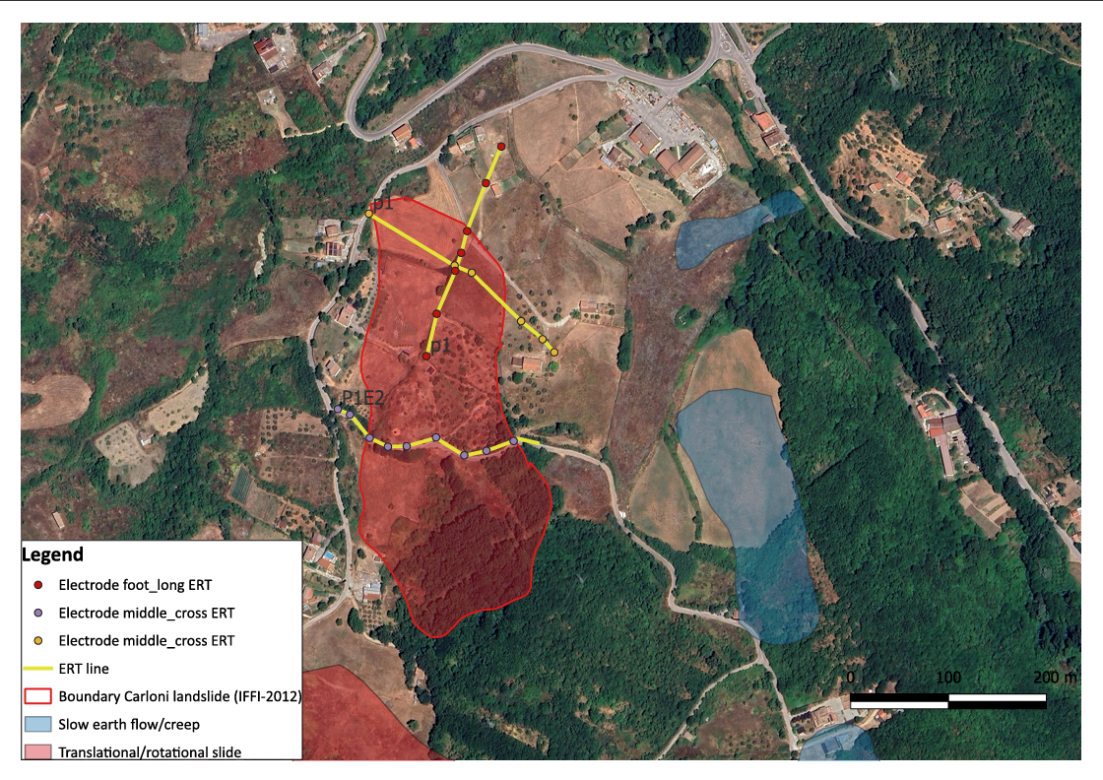
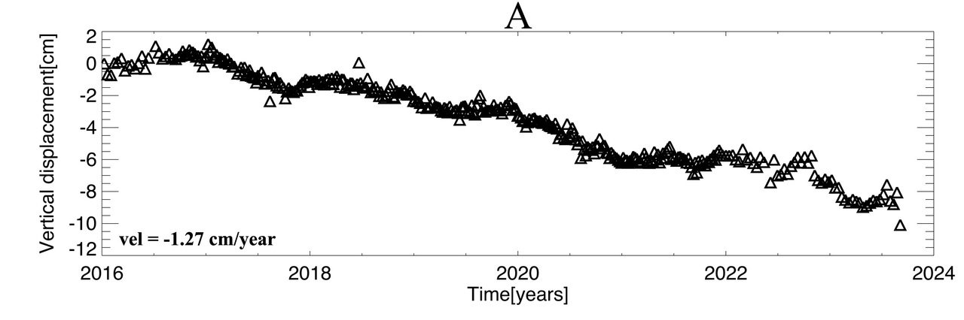
Study area shaping the research methodology
N
Tito
In-SAR data
N
C.da Carlone
Tito
Basin
500 m
C.da Carlone
250 m
Adapted from Bentivenga et al. 2021
Key messages
Peri-Urban area
Hydrogeologic risk
Logistical ease and feasibility
Low velocity
Setup of an open-air laboratory
Multidisciplinary, multiscale, multiparametric approach
Geophysical, hydrologic and metereological data at lab, site scale
Methodology

Slide 3
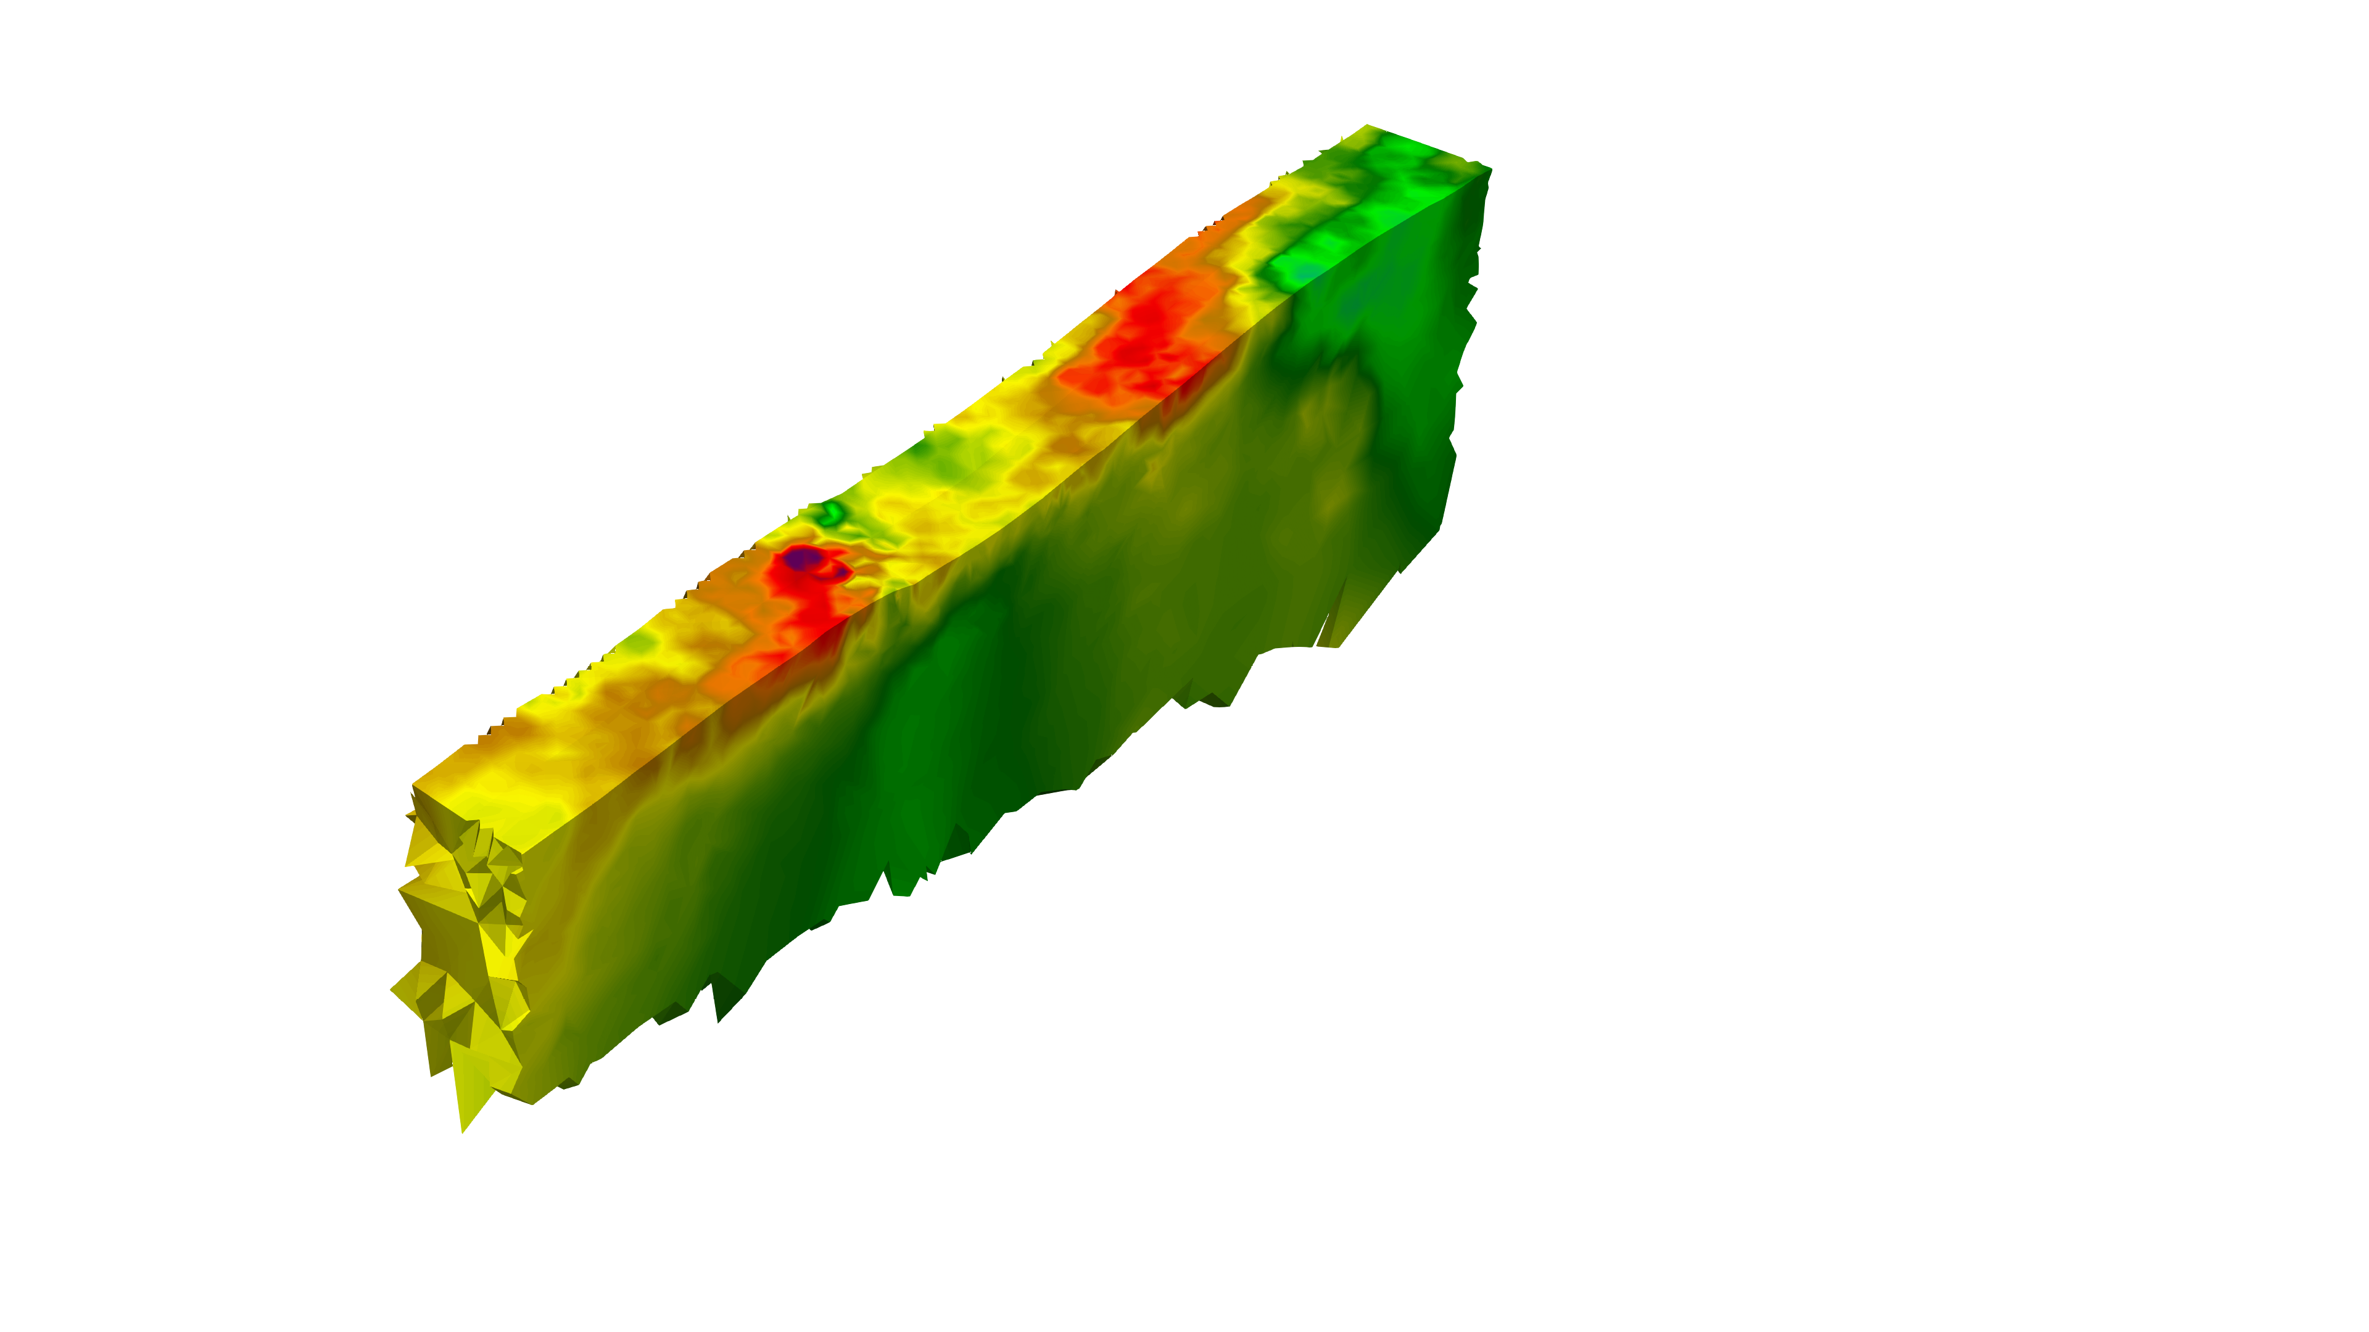
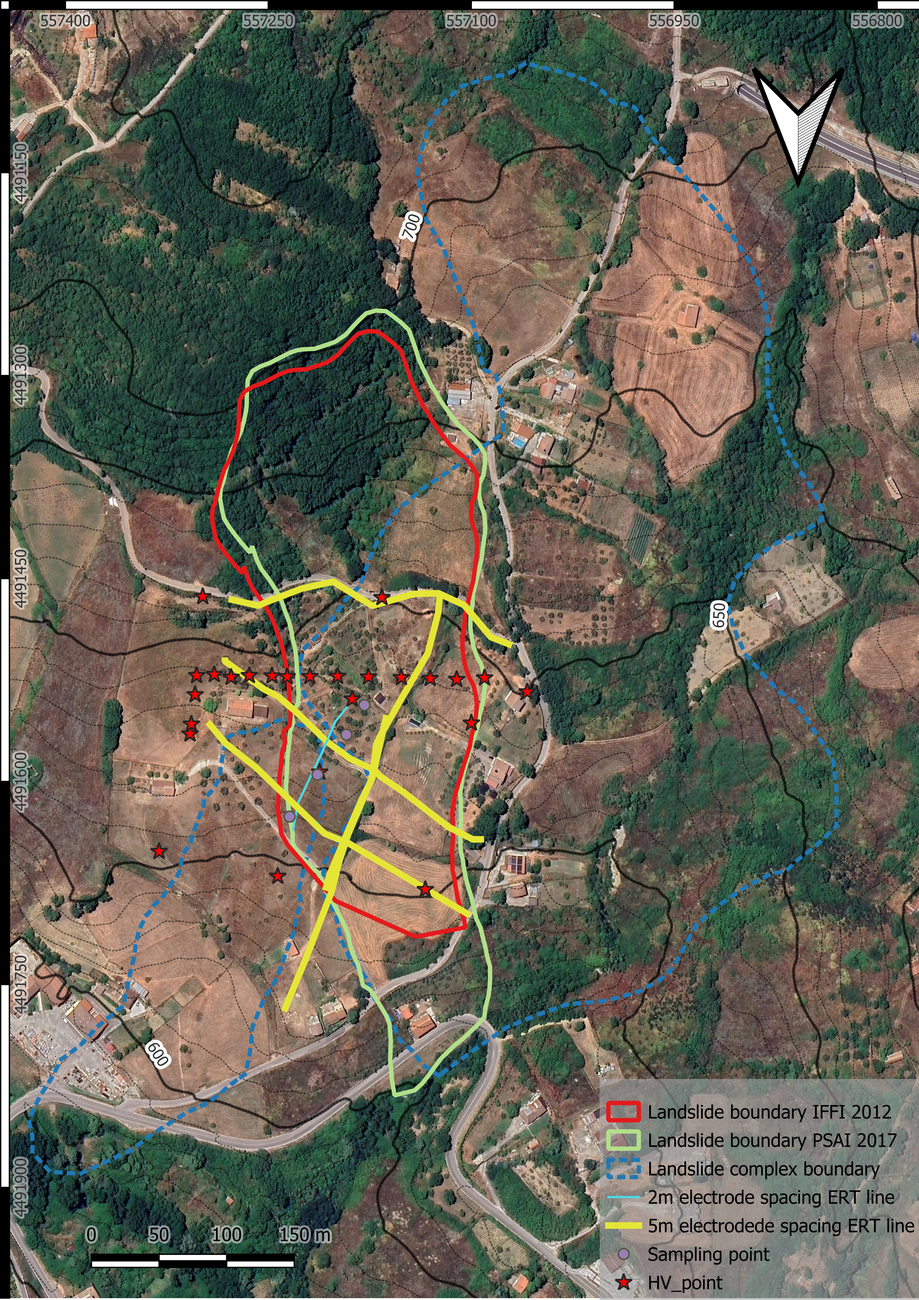
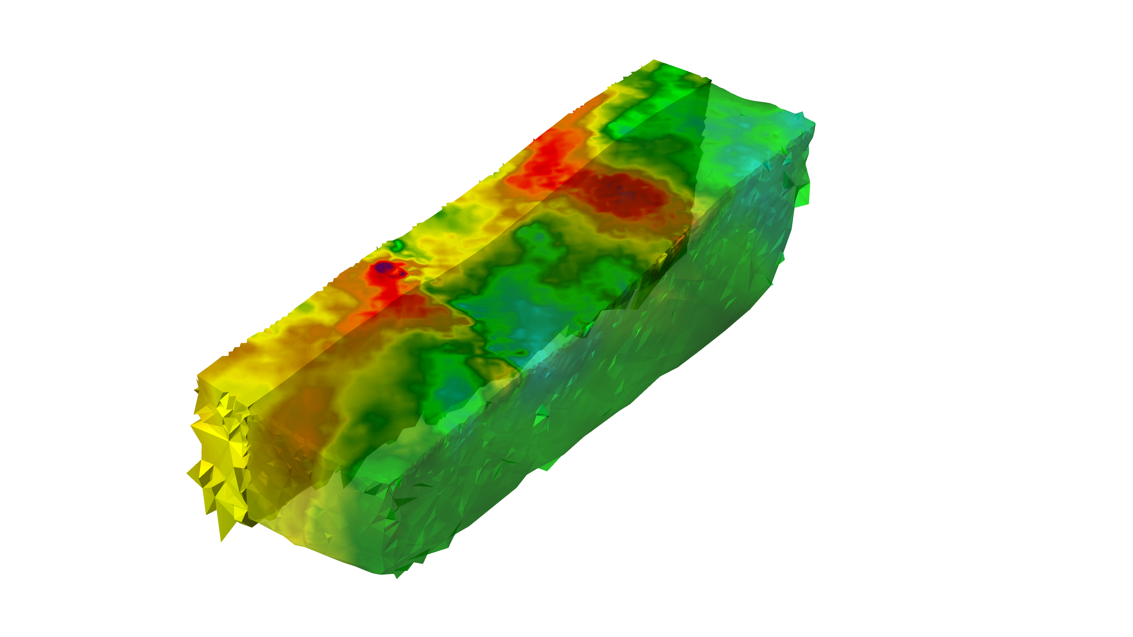
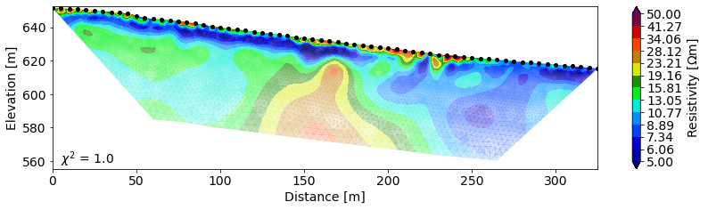
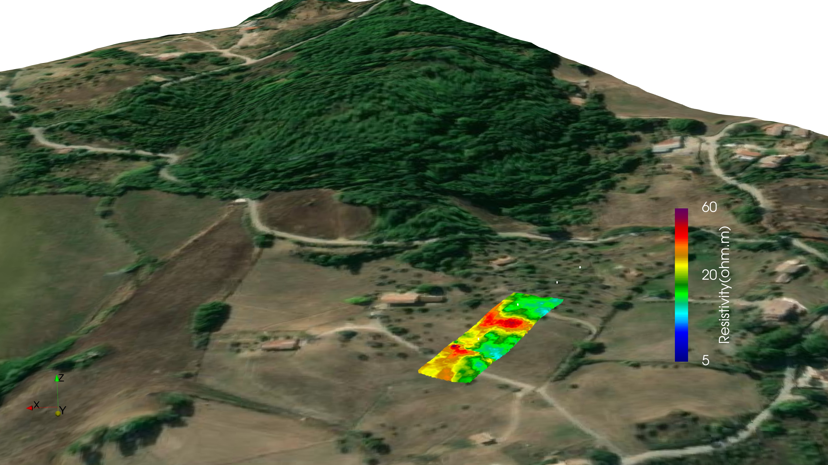
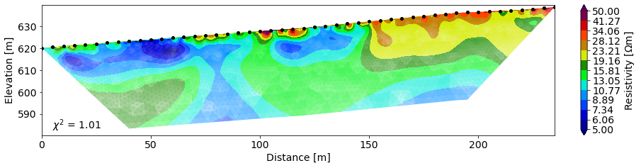
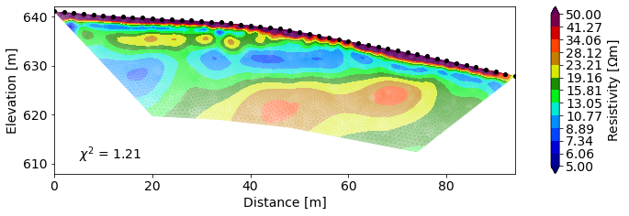
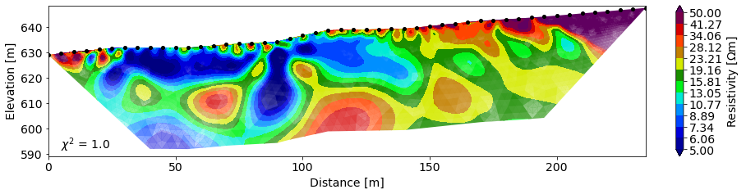
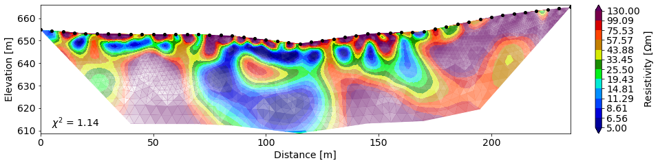
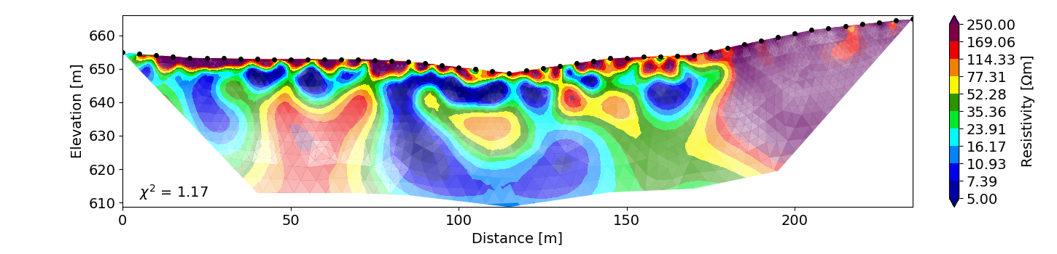
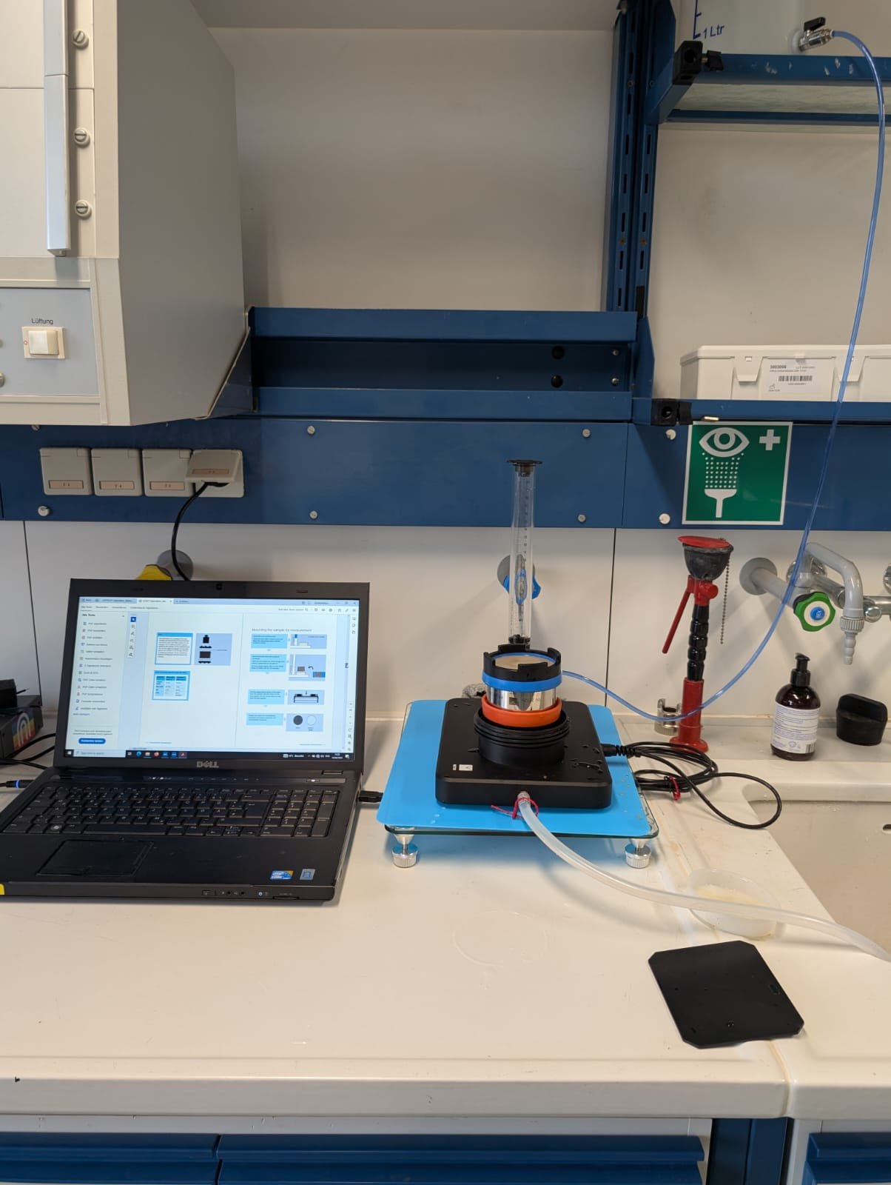
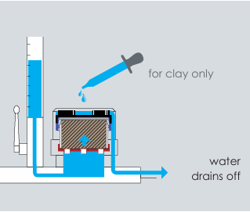
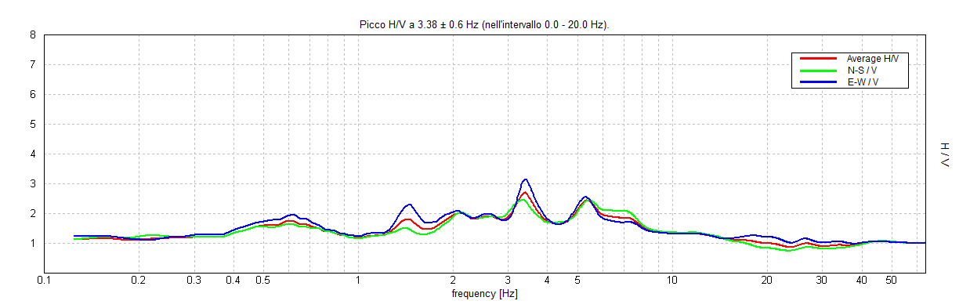
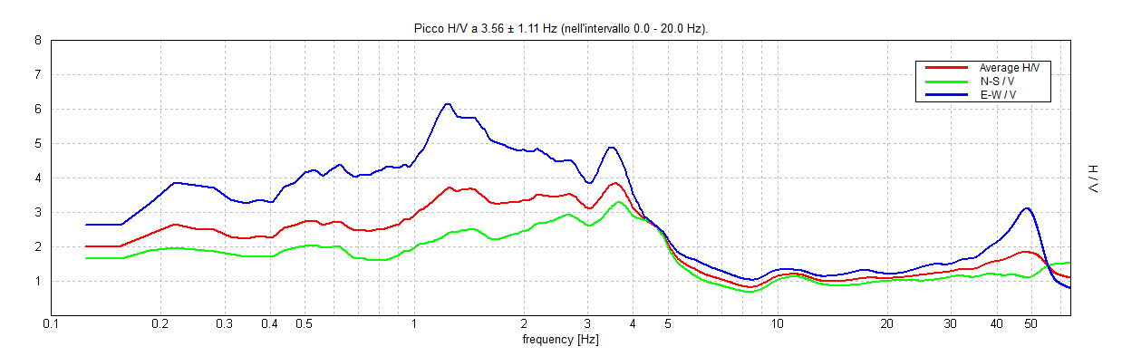
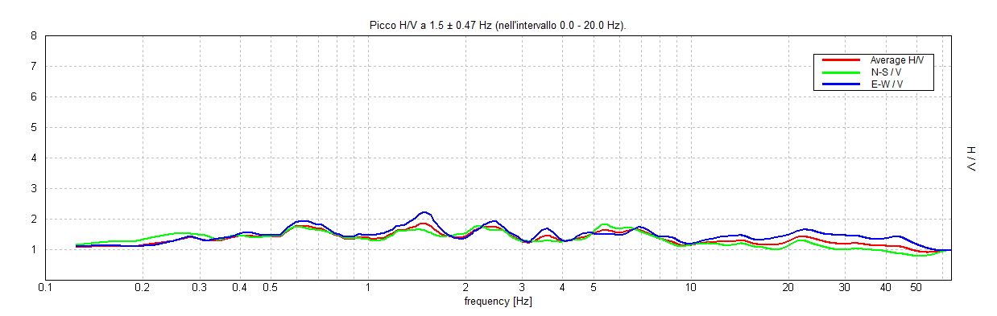
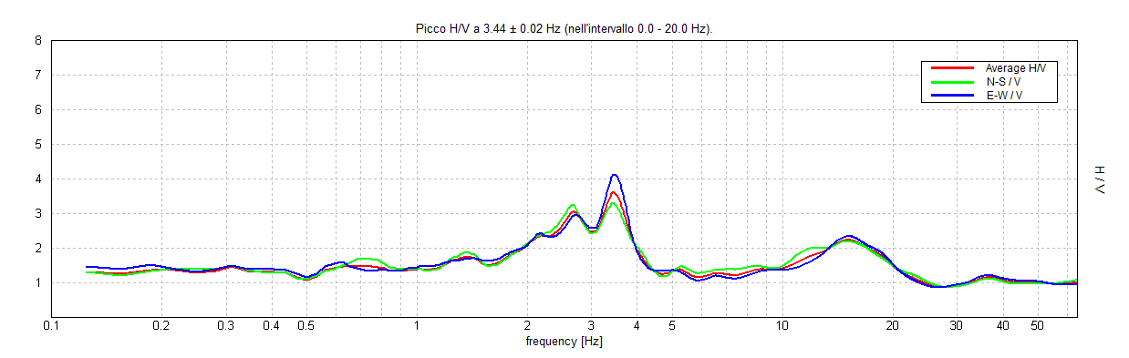
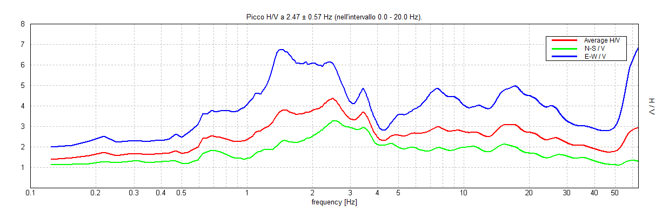
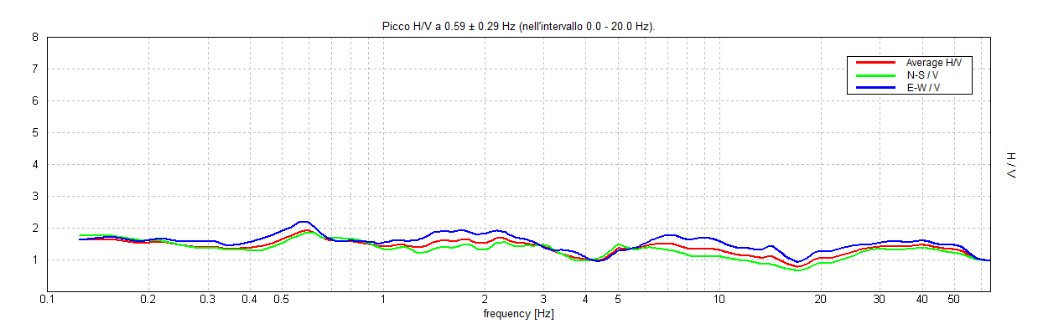
Key Results so far field and lab strategies for site characterization
Geomorfological survey
2D ERT modeling
3D ERT modeling
Landslide boundary IFFI 2012
N
S
1
2
N
S
2
1
5
W
4
4
E
3
3
1) 1×10⁻⁷ m/s
2
3
1
2
2) 1×10⁻⁹ m/s
W
3) 1×10⁻⁶ m/s
4
E
4) 1×10⁻ ⁵ m/s
1
W
Hydraulic conductivity
Key messages
Landslide Geometry
Heterogeneity Mapping
Channeling bedrock
Building Prior Knowledge
5
E
KSAT
Poorly sorted
conglomerate
H/V Microtremor Surveys

Slide 4

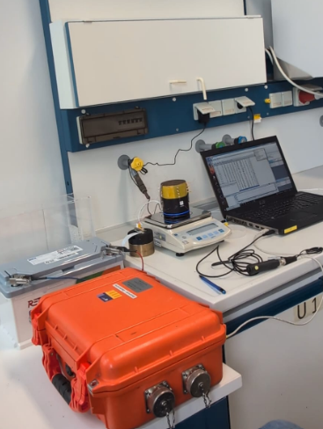
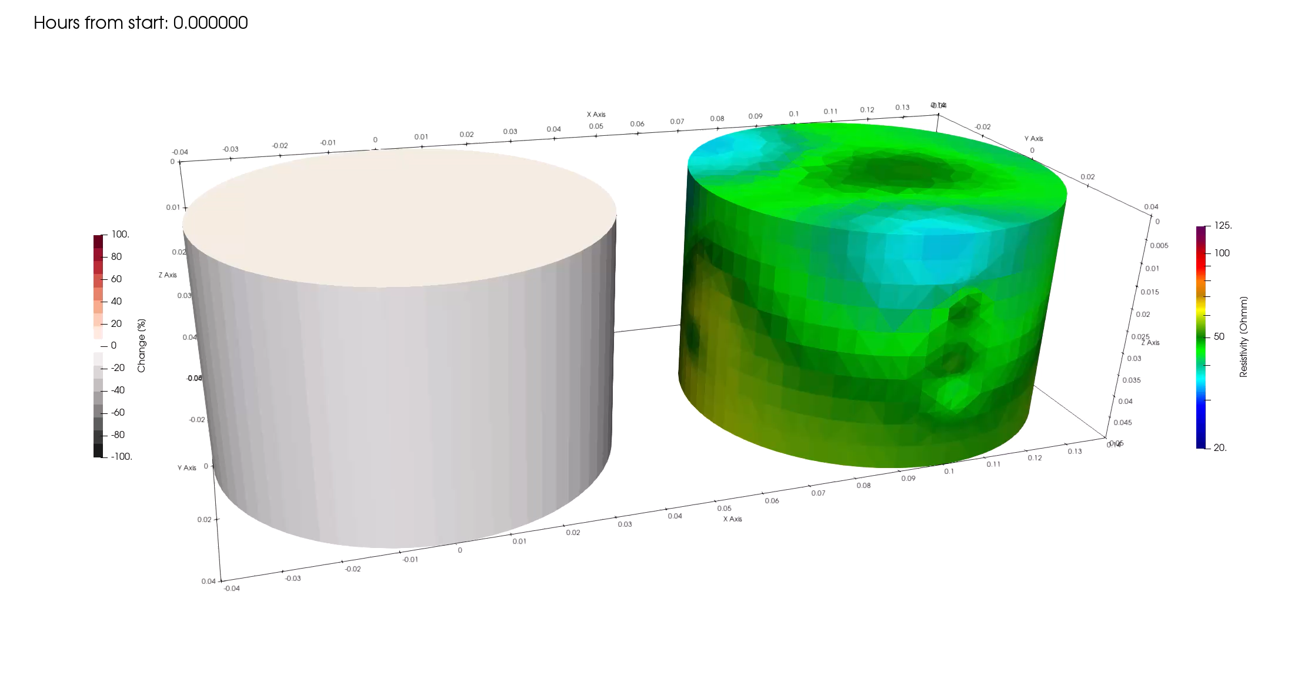
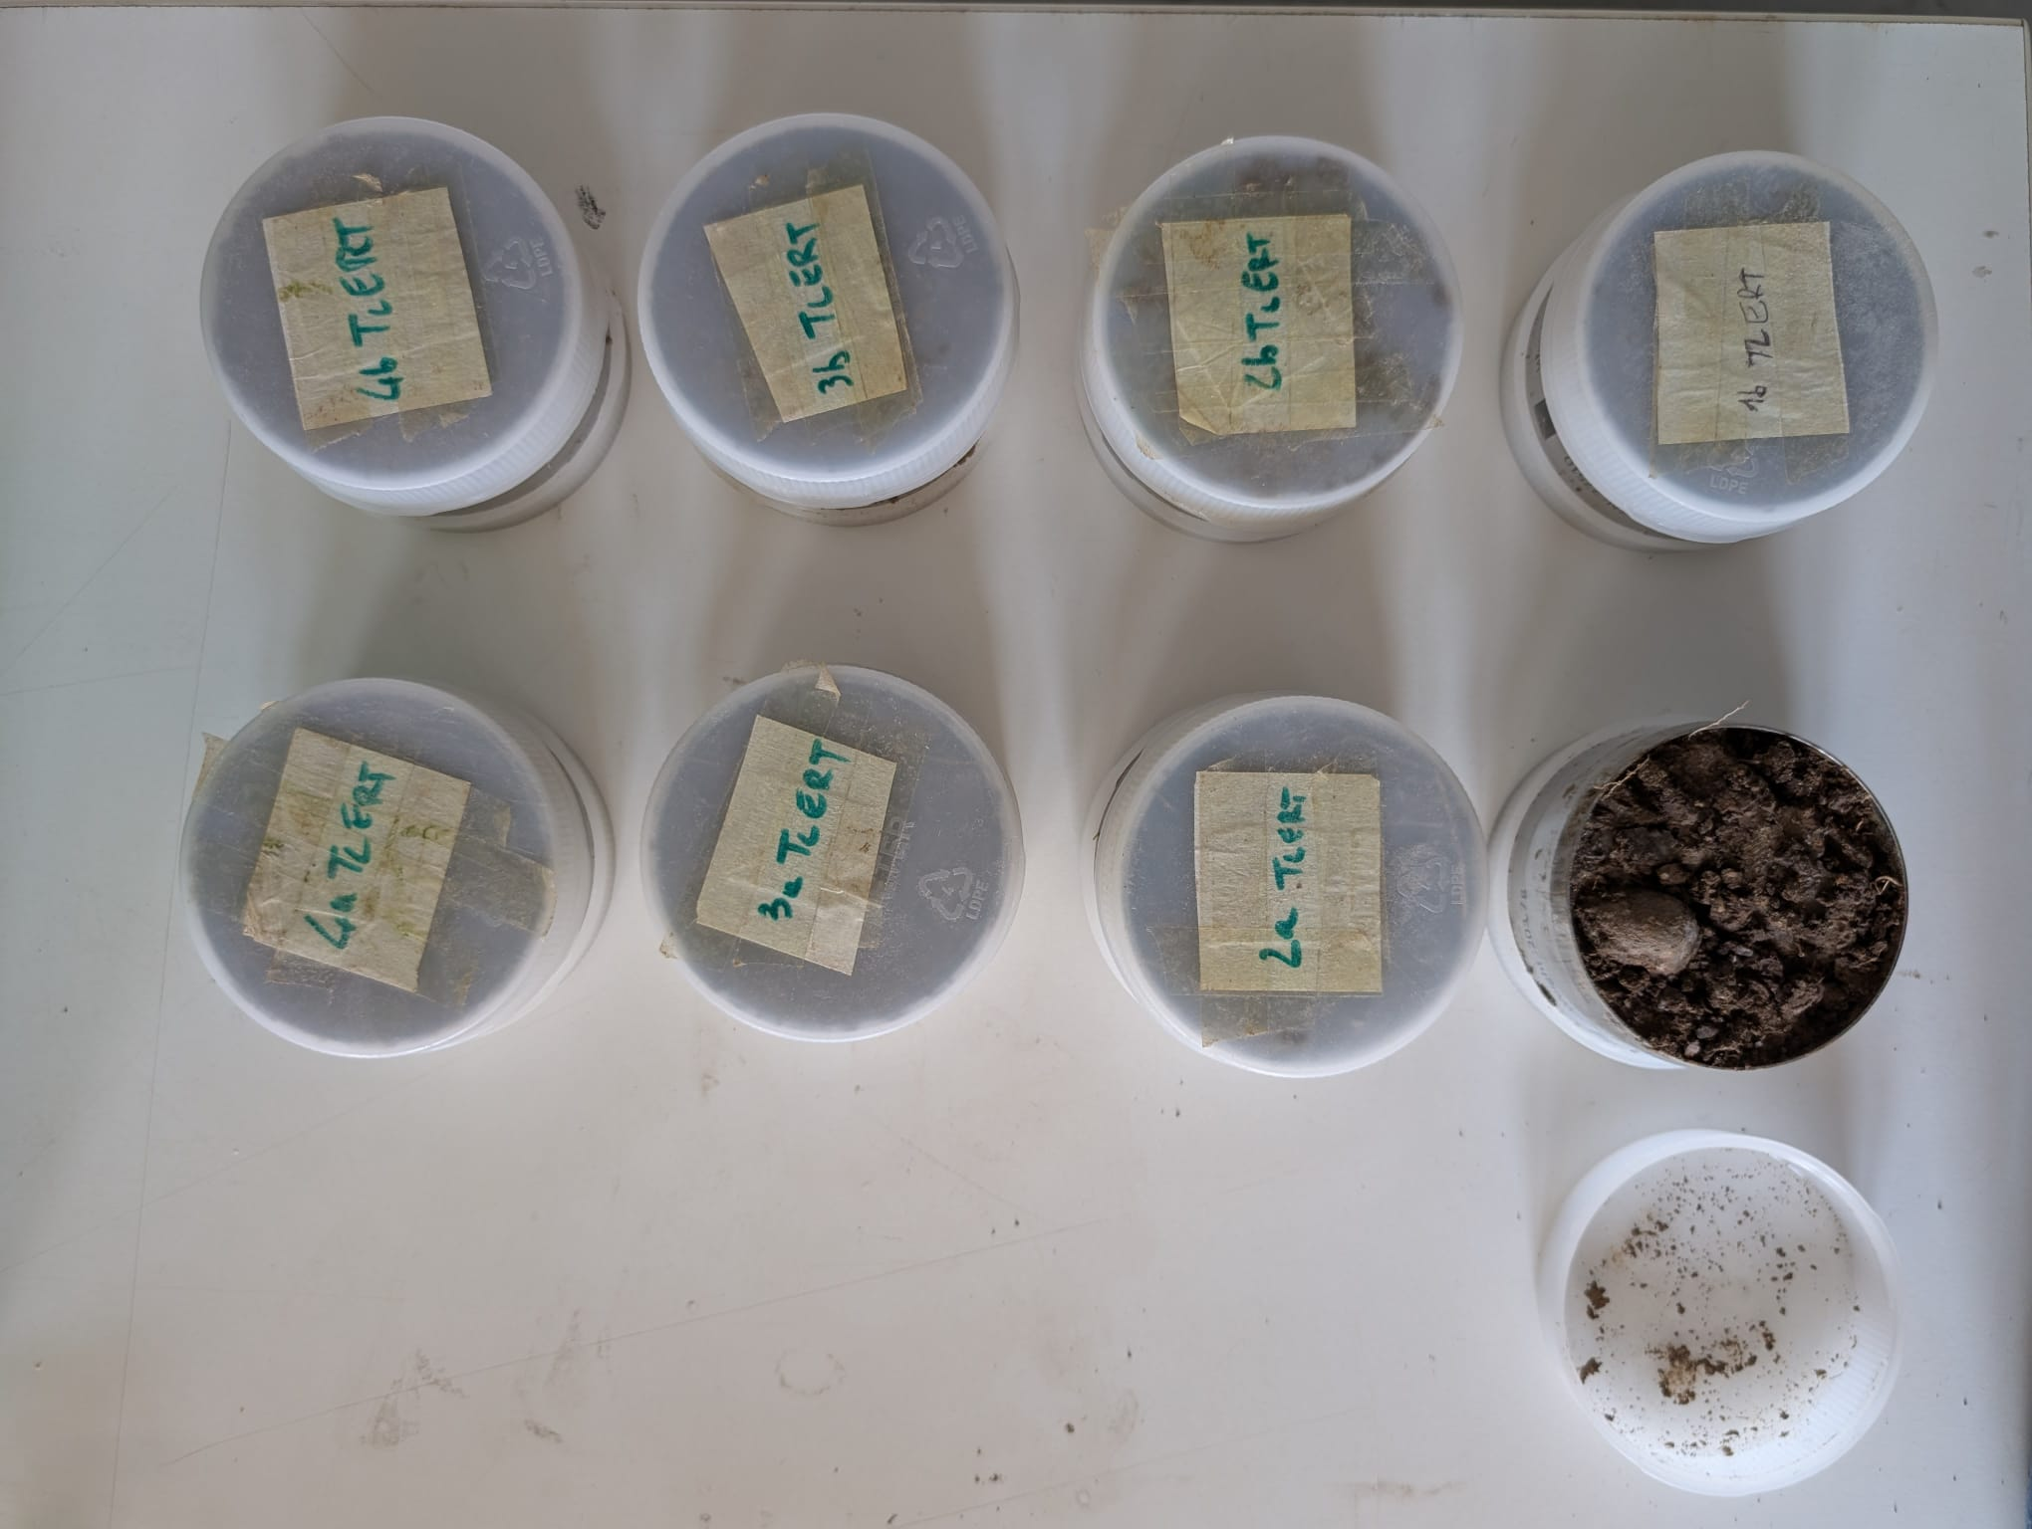
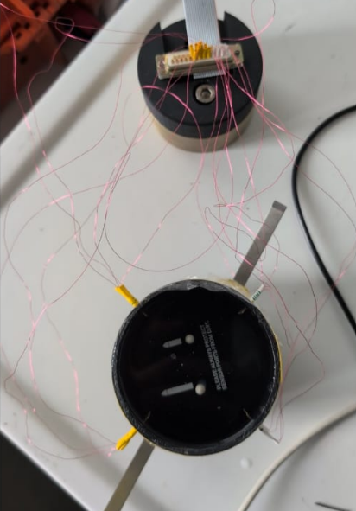
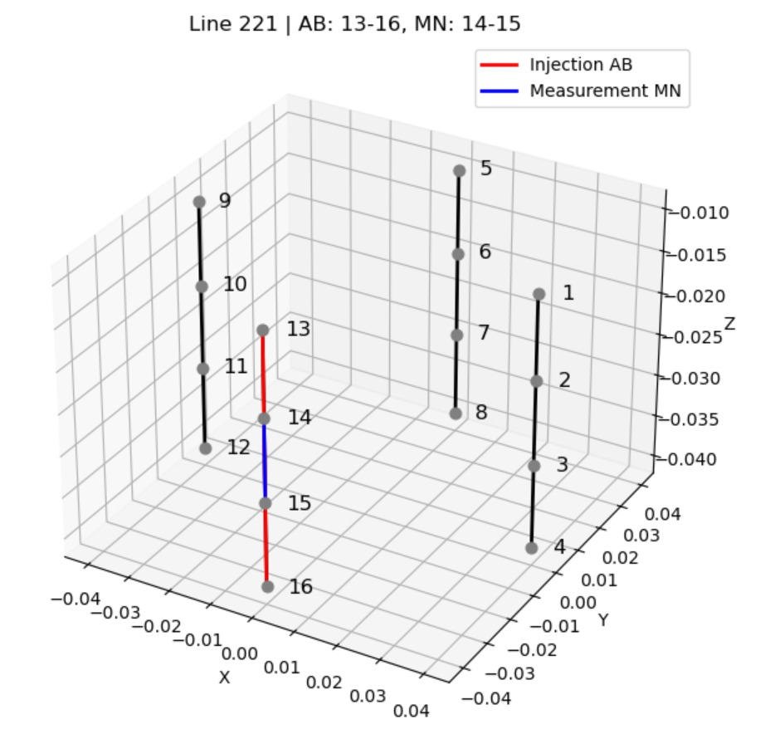
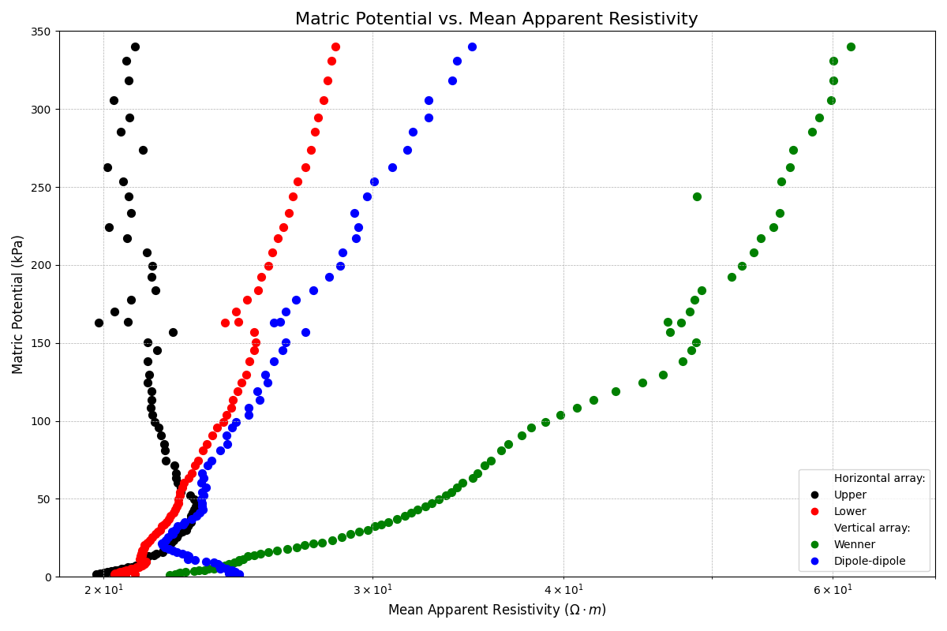
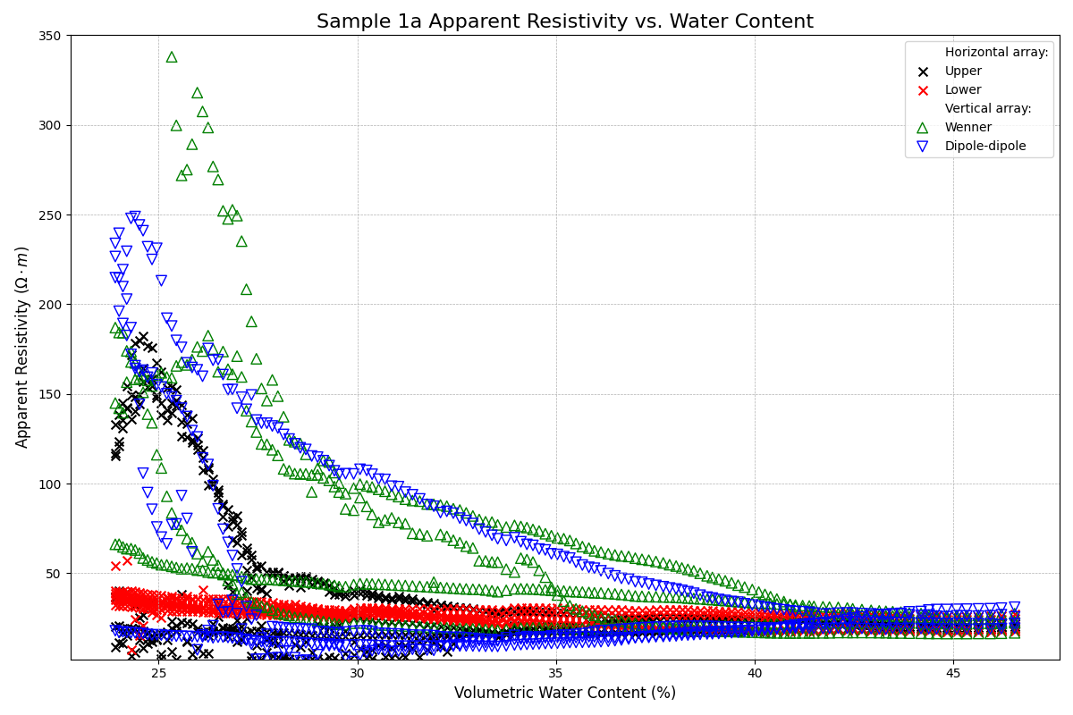
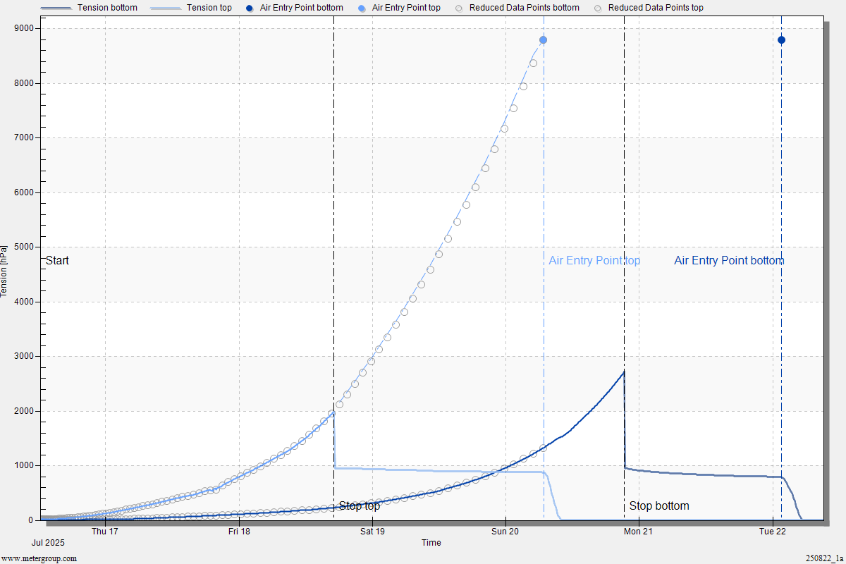
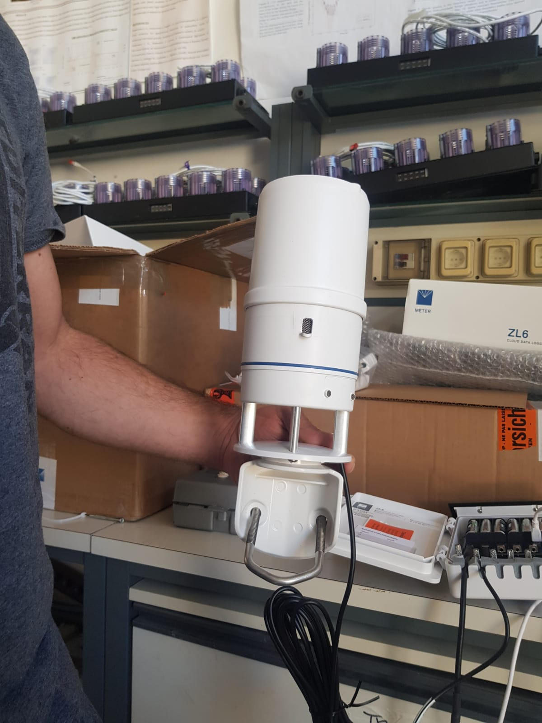
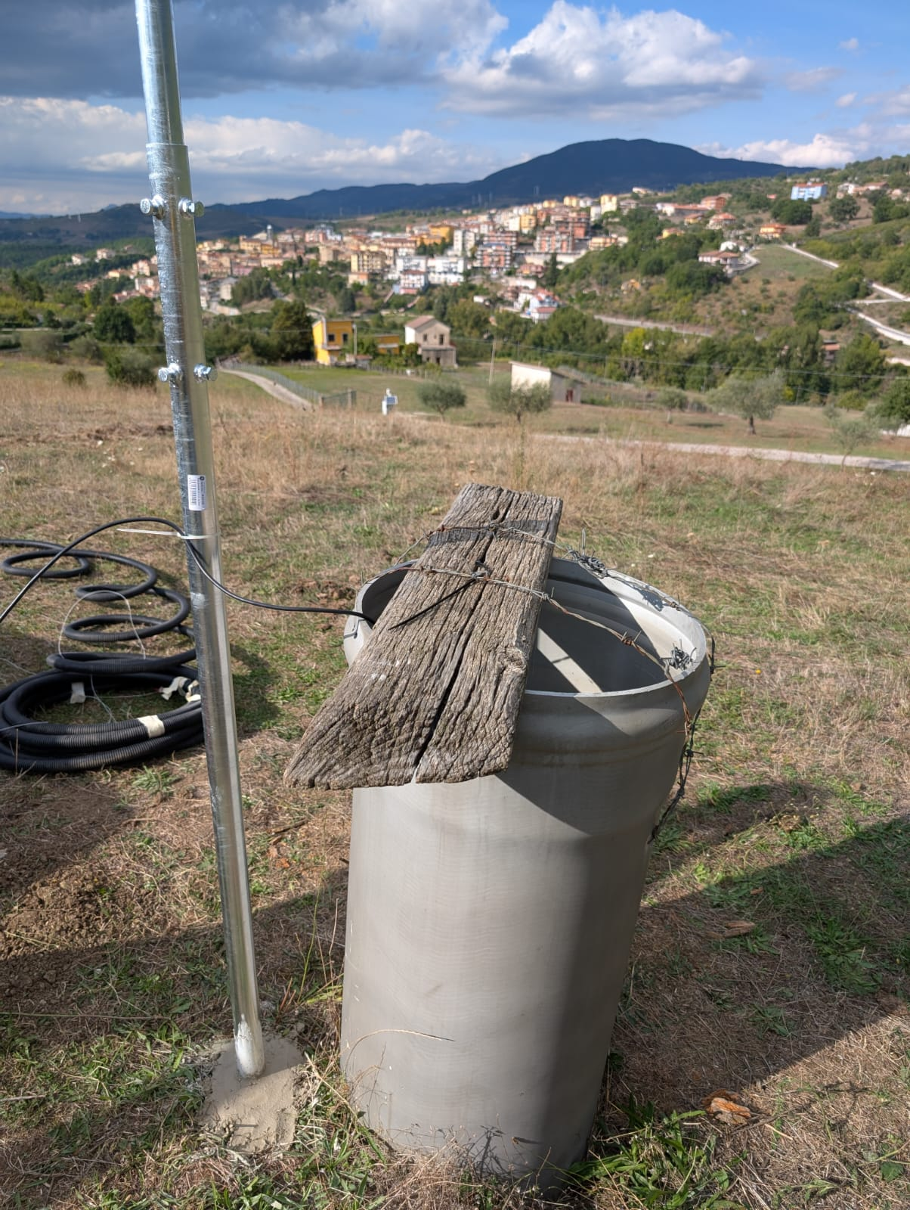
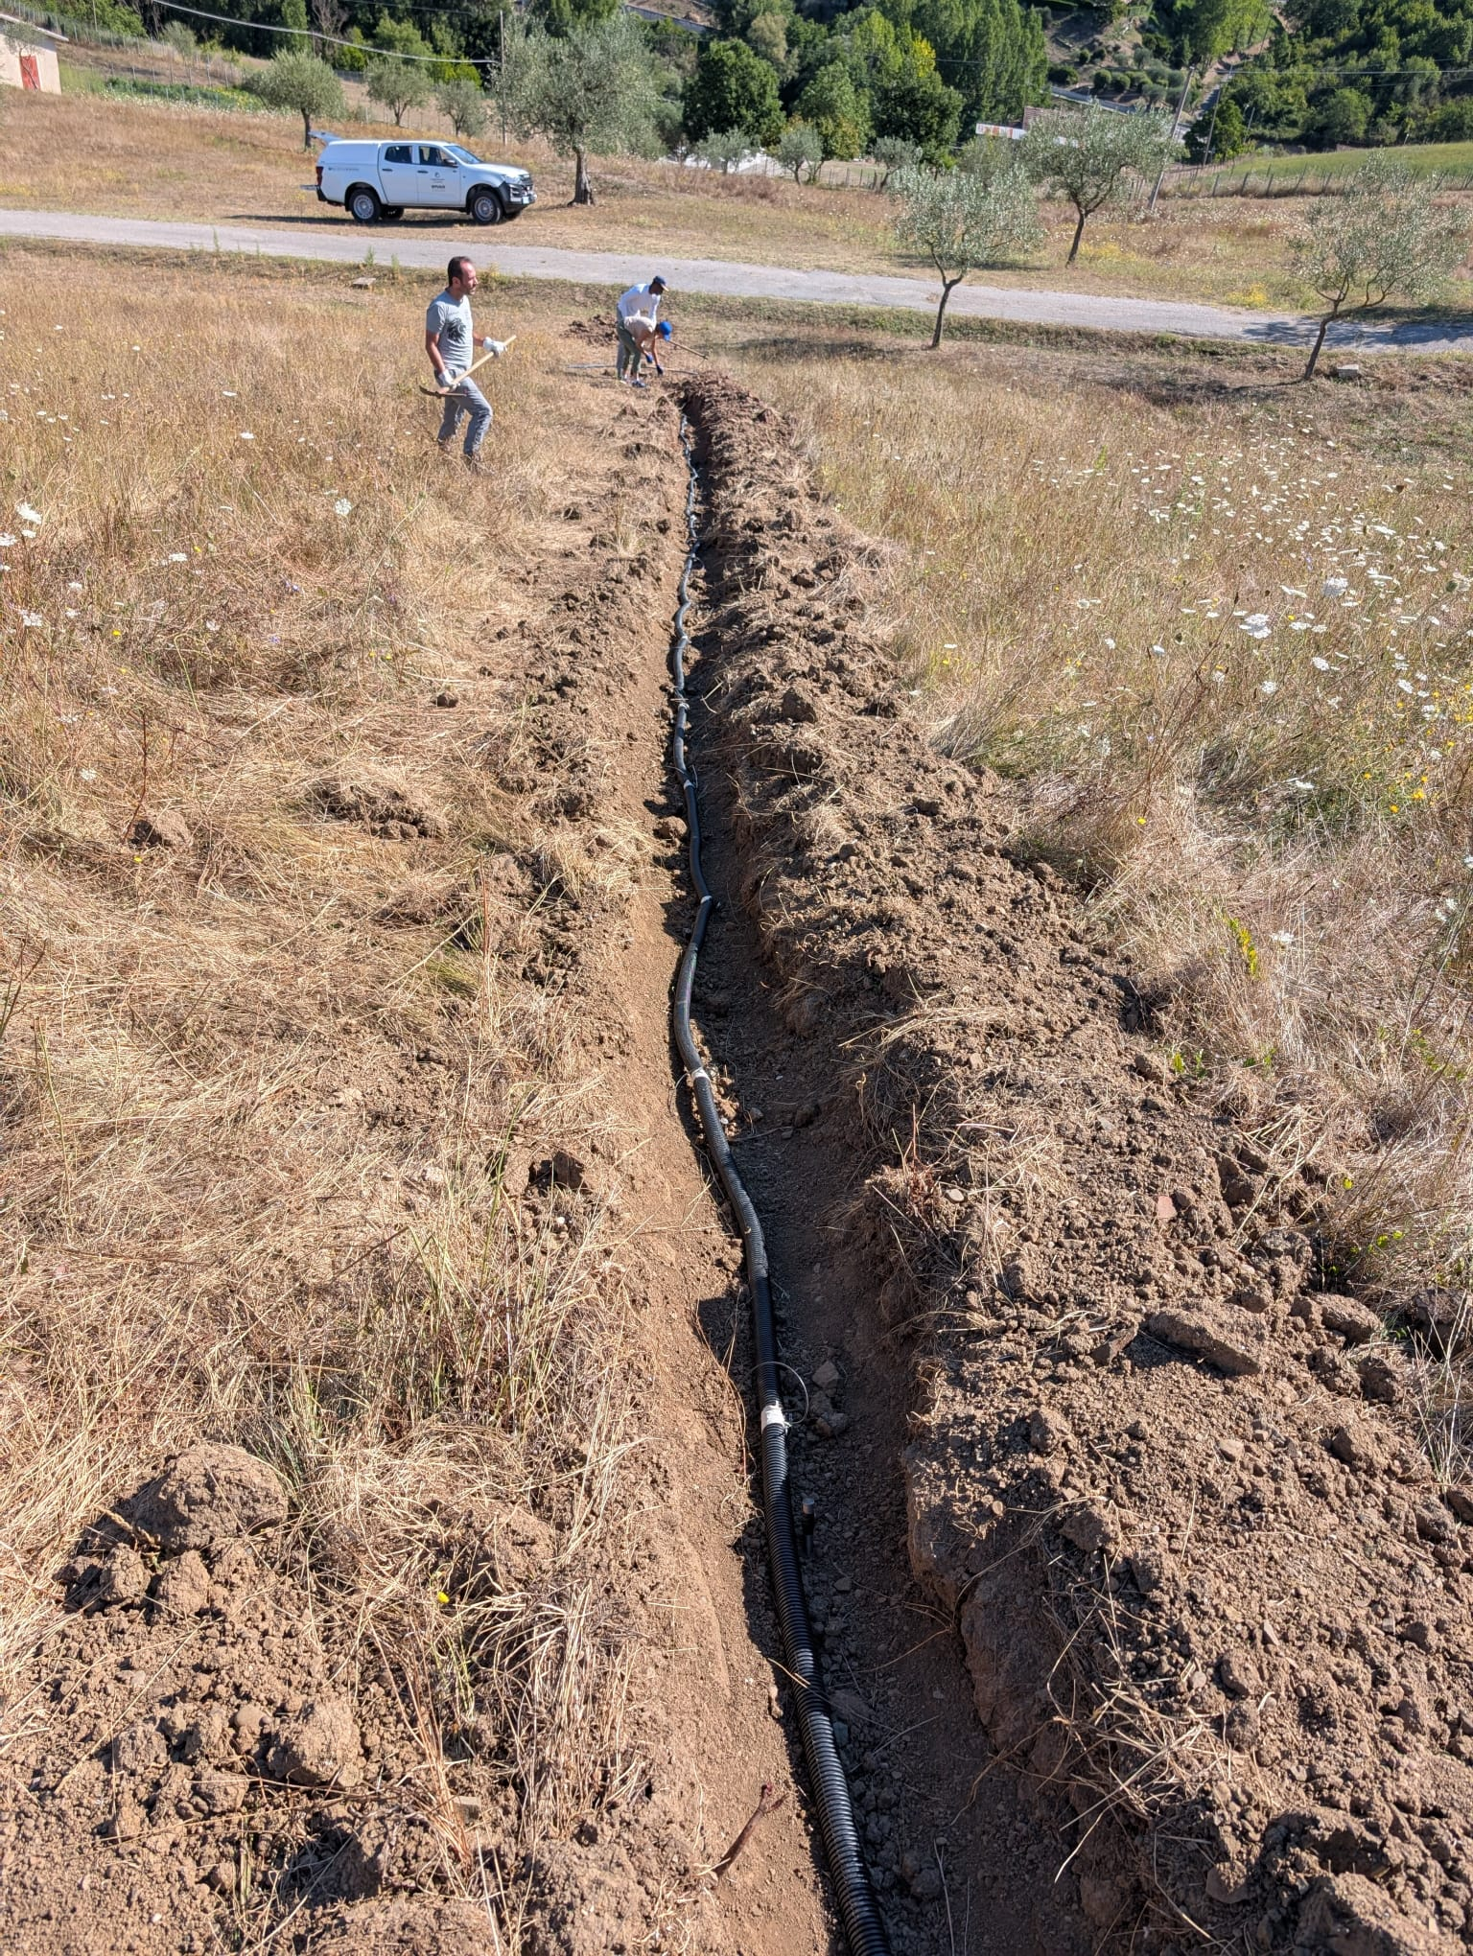
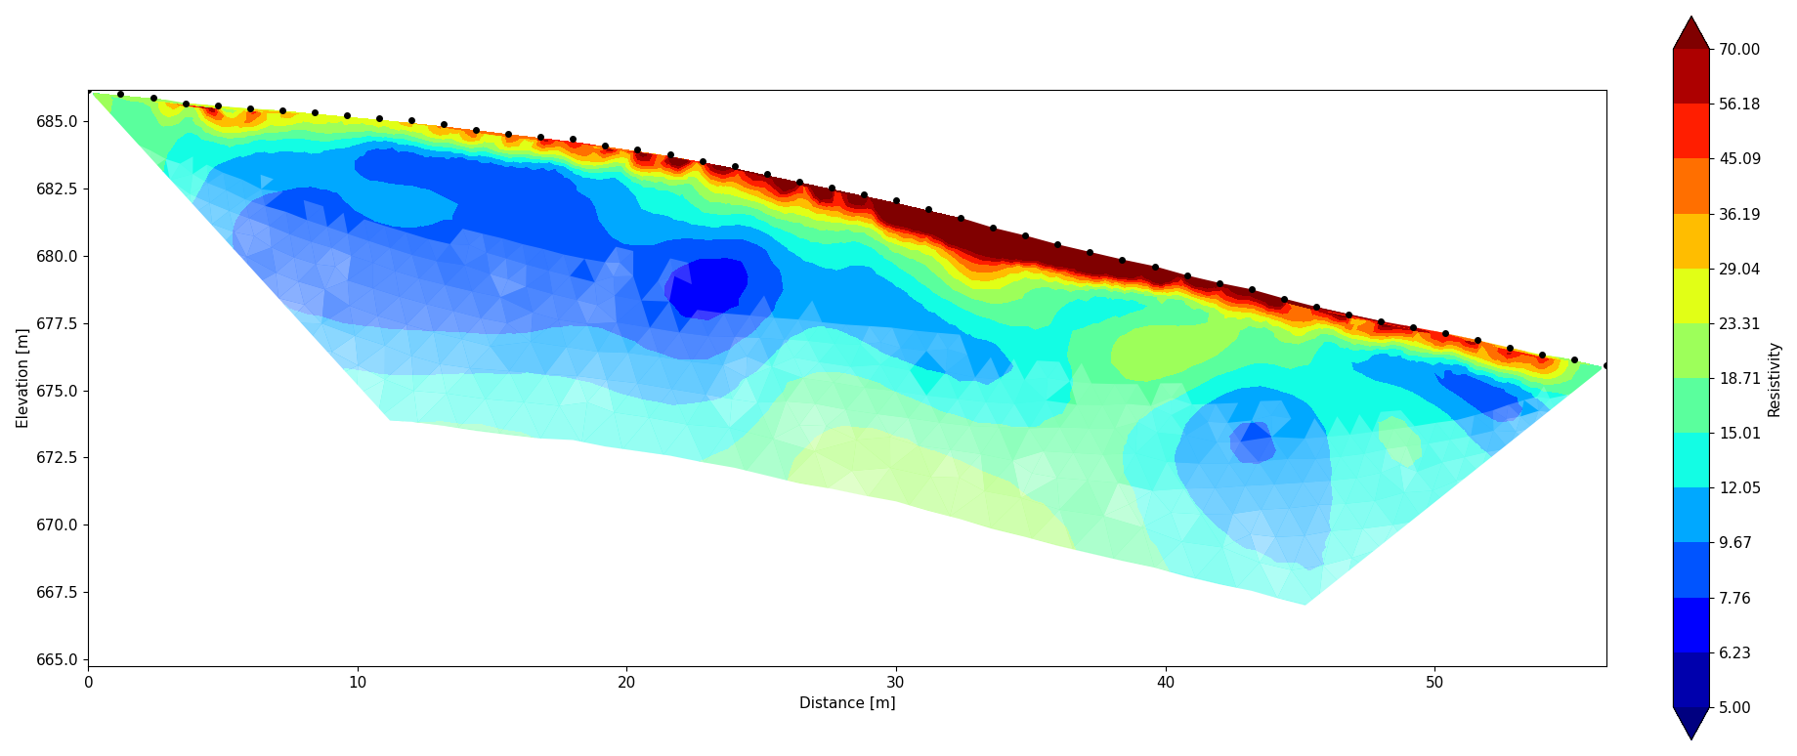
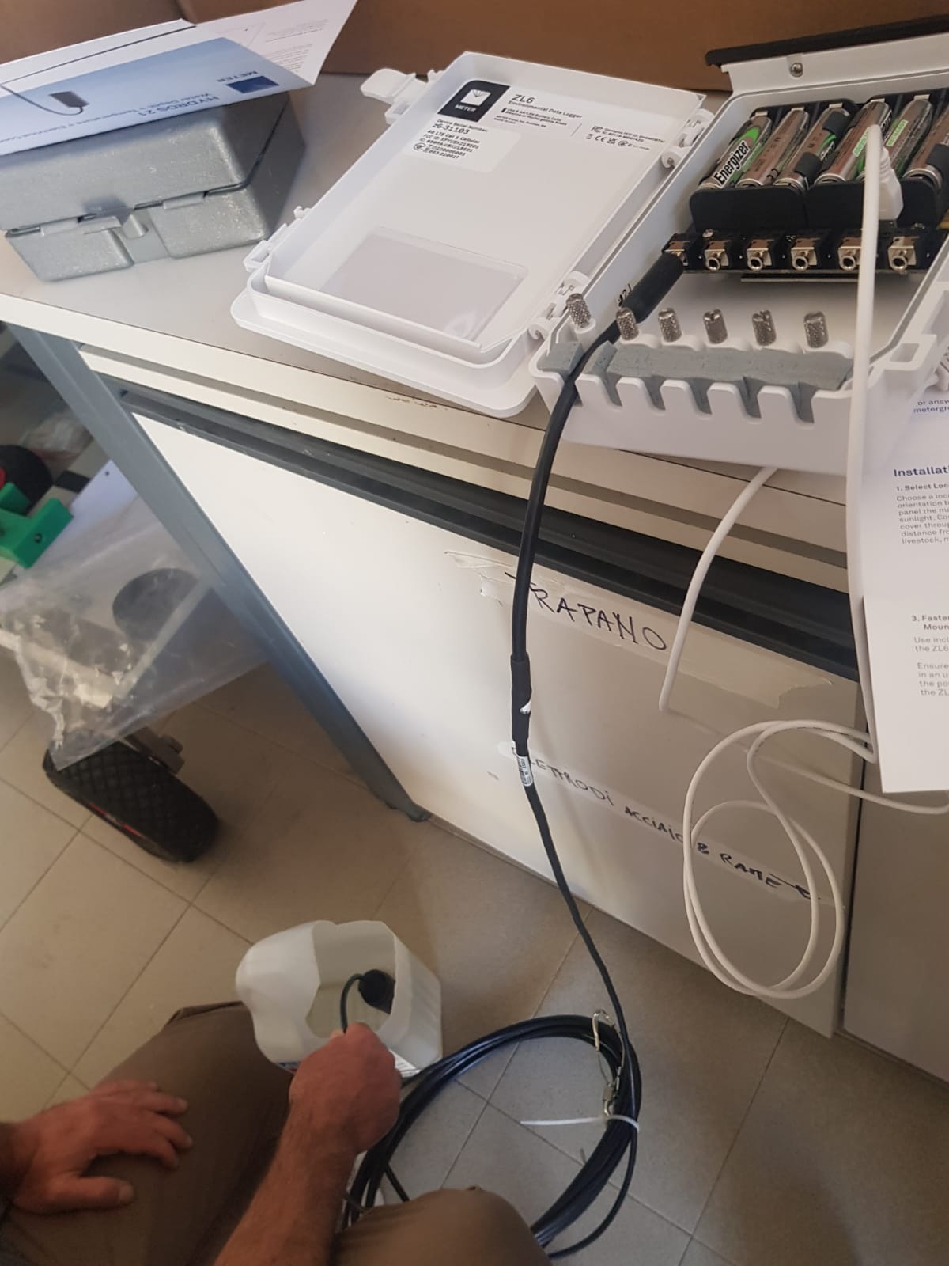
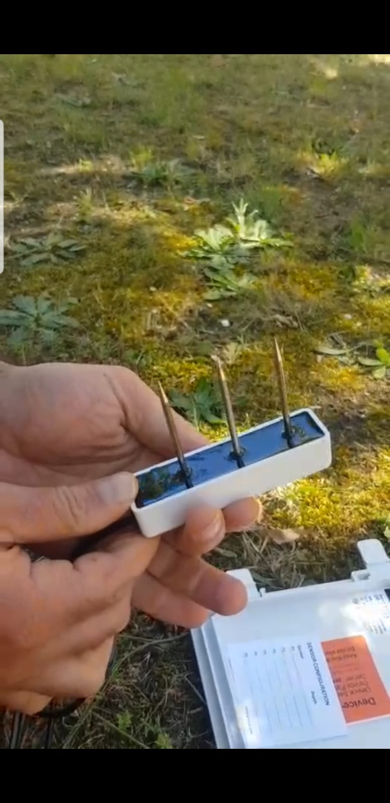
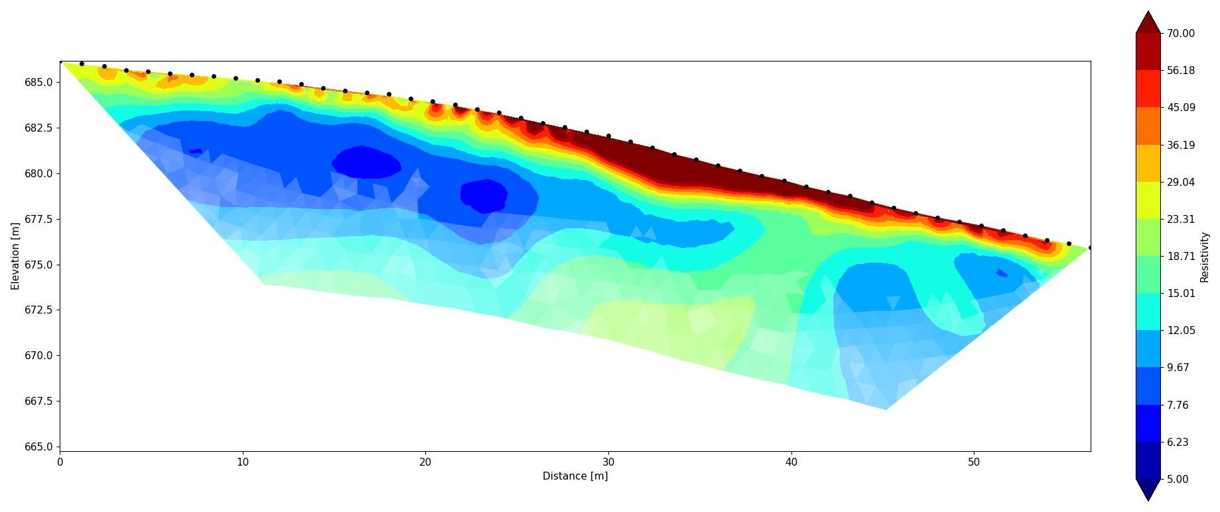
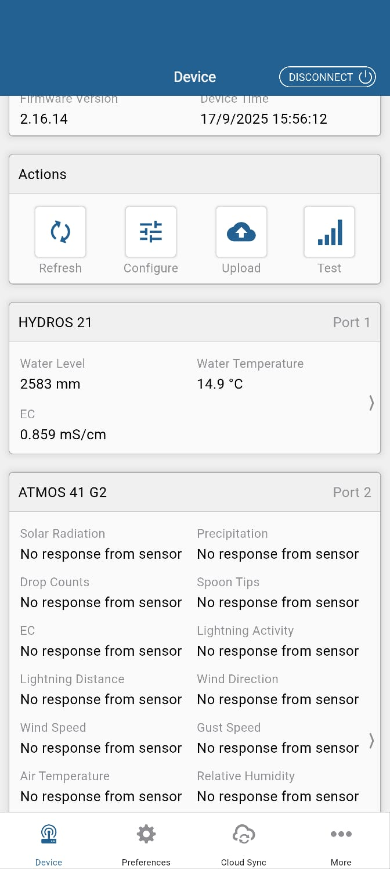
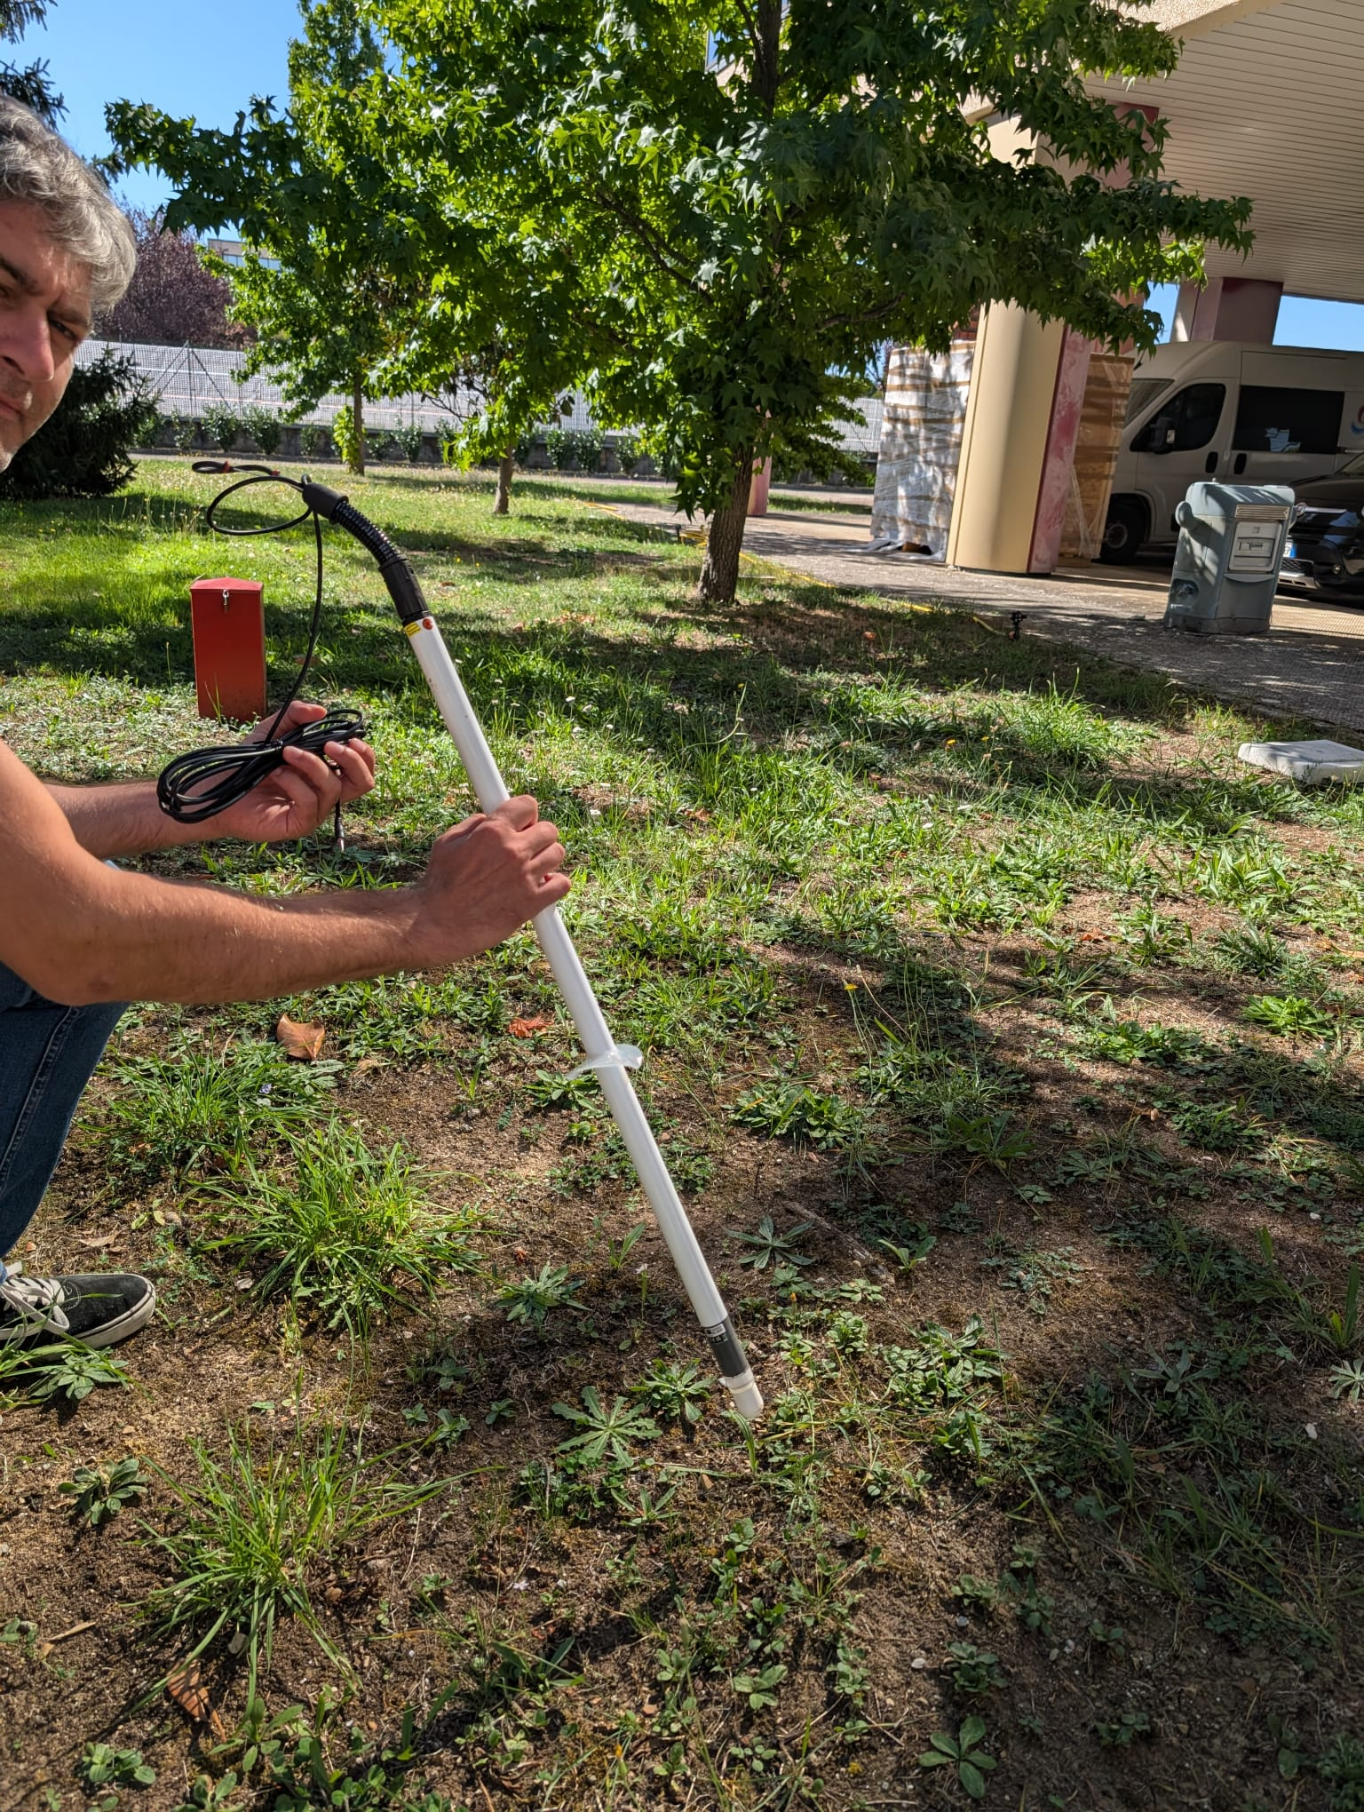
Ongoing Efforts bridging site and lab insights
3D TL ERT
TL data analysis
…In lab
Water
content
TL ERT system
Meteorological sensors
Tensiometr
TL Data gathering
Capturing drying process
Rain gauge station
08/25
Key messages
Field-to-Lab Replication
Imaging and TL Data analysis
Comparing Processes Across Scales
Assembling a Dataset
Datalogger
2D TL ERT
09/25
Pieazometer
…On site

Slide 5

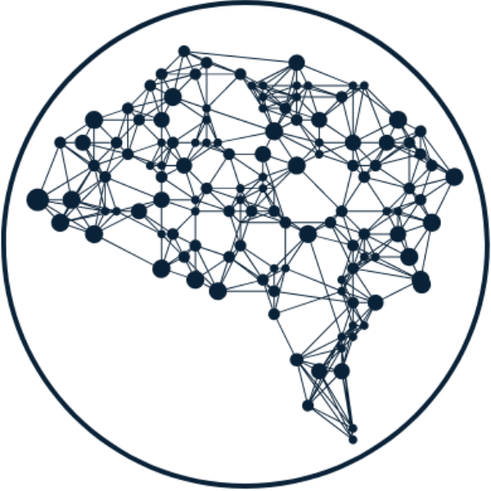
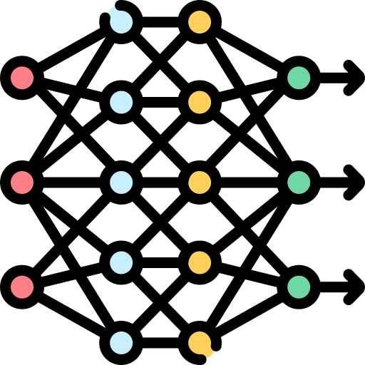


Next Steps
Data mining using Machine learning technique
Final Question
What is the real contribution that the ERT method can offer to advanced landslide monitoring, early warning systems, and to a broader range of applications, from agriculture to environmental remediation?
Measured and Derived property
Model Inference
Processing & Modelling
We aim to apply machine learning to quantify relationships between time-lapse resistivity variations, measured hydrological properties, and derived geotechnical parameters, in order to develop predictive models of landslide body behavior over time.

