Slide 1
Advancing User-Centered Strategies for Integrated Environmental Research Infrastructures: The ITINERIS Approach
Loperte S., Gagliardi S., Gargano G., Petracca Altieri R., Ricciardi F., Russo C., Saganeiti L., and Cornacchia C.

Slide 2

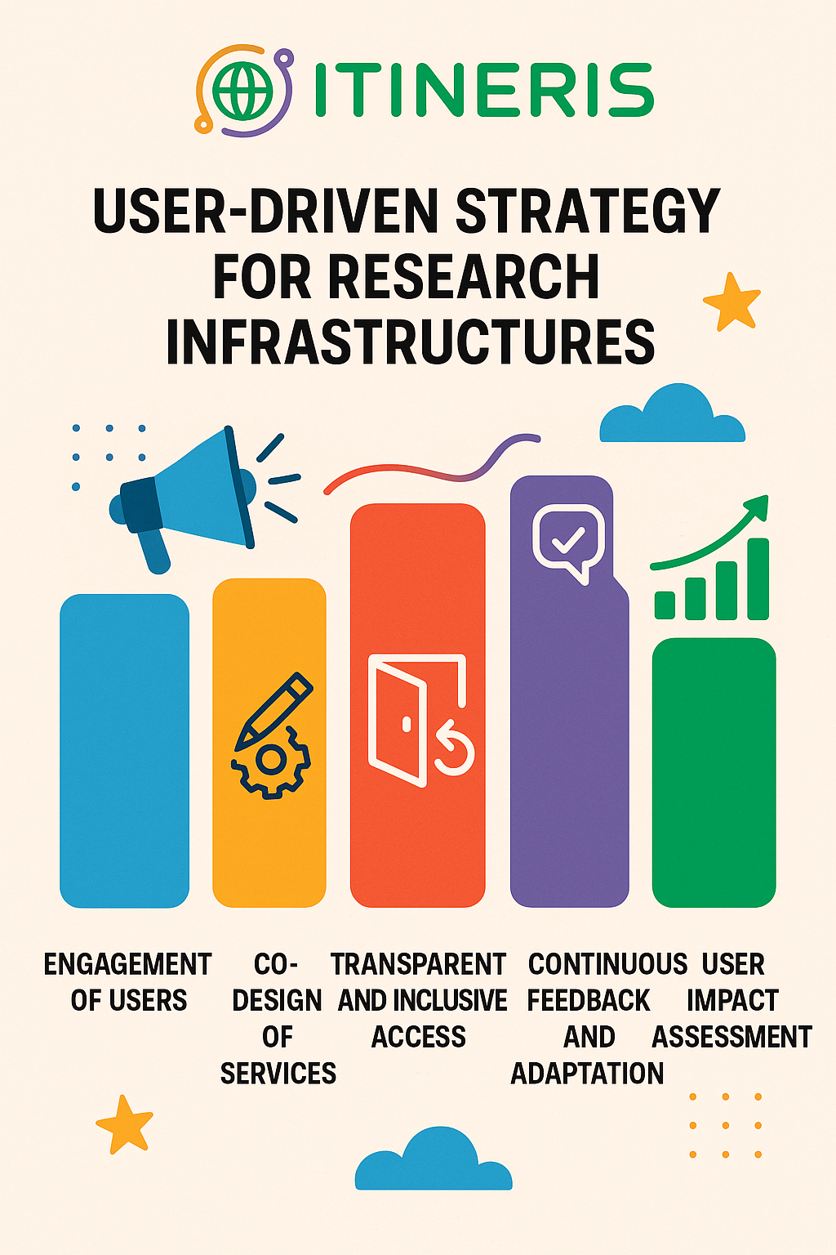
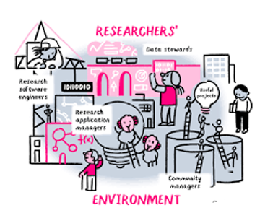
Agenda
What is ITINERIS US aimed at?
The methodological approach
First outcomes and future perspectives
ITINERIS 3° general meeting –Rome, 25-26/09/2025
Dr Simona LOPERTE

Slide 3

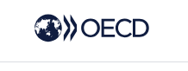
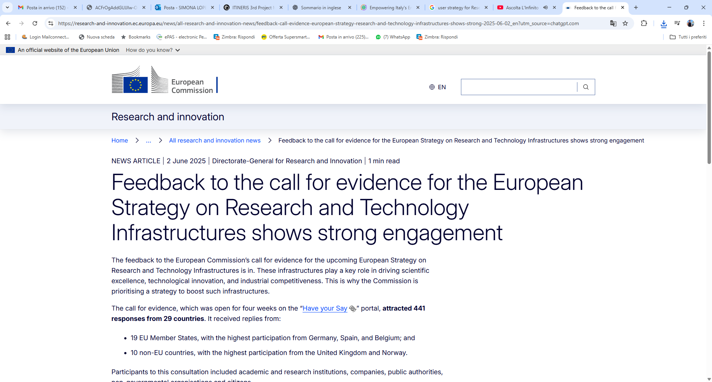
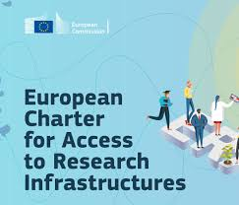

WHAT IS ITINERIS US AIMED AT?
Transparent and inclusive access
Continous Dialogue and feedback
Training and FAIR data practices
Growth and diversification of the user community
To address emerging environmental challenges
ITINERIS 3° general meeting –Rome, 25-26/09/2025
Dr Simona LOPERTE
Notes:
Questa proposta di user strategy per ITINERIS, basata sui contenuti del Deliverable 2.1 e integrata con le best practice e i modelli internazionali (come quelli evidenziati dal report OECD e le raccomandazioni ESFRI), mira a creare un sistema integrato e flessibile che: • Favorisca l’accesso e l’uso ottimale delle infrastrutture.
• Promuova una gestione trasparente e partecipativa.
• Risponda in modo dinamico alle esigenze di una base utenti diversificata.
• Contribuisca allo sviluppo di una cultura dell’innovazione e della sostenibilità nel campo ambientale a cui le IR di ITINERIS possono dare una risposta

Slide 4
THE METHODOLOGICAL APPROACH
Mapping & Strategic Classification of Potential Users
Good Practices & Process Harmonization
Enhance Access & Support
Attract New Users (Enlarged User Community)
Expand Competencies & Skills (Broaden knowledge)
Foster Innovation-oriented RI Ecosystem
Feedback Management
ITINERIS 3° general meeting –Rome, 25-26/09/2025
Dr Simona LOPERTE

Slide 5
The methodological strategies
USER COMMUNITY
Surveys
Desk research
PROCESS HARMONIZATION
Common standards for access & services
Addressing heterogeneous maturity levels
USER ACCESS
Simplified procedures
Unified service catalogue
Current & potential communities (academia, industry, public authorities, civil society)
Flexible modalities
User grants & financial support
The ITINERIS Catalogue: Unifying Environmental Resources Across RIs
ITINERIS 3° general meeting –Rome, 25-26/09/2025
Dr Simona LOPERTE

Slide 6
The methodological strategies
ENLARGED COMMUNITY
Targeted outreach (newsletters, events, campaigns)
CAPACITY BUILDING
Training activities
Knowledge & skills development
ORIENTED-RI ECOSYSTEM
Strategic alliances (ARPA, Civil Protection, Joint Calls -ACTRIS)
Knowledge exchange
Stakeholder Engagement (Industry-RI Integration)
ITINERIS 3° general meeting –Rome, 25-26/09/2025
Dr Simona LOPERTE

Slide 7
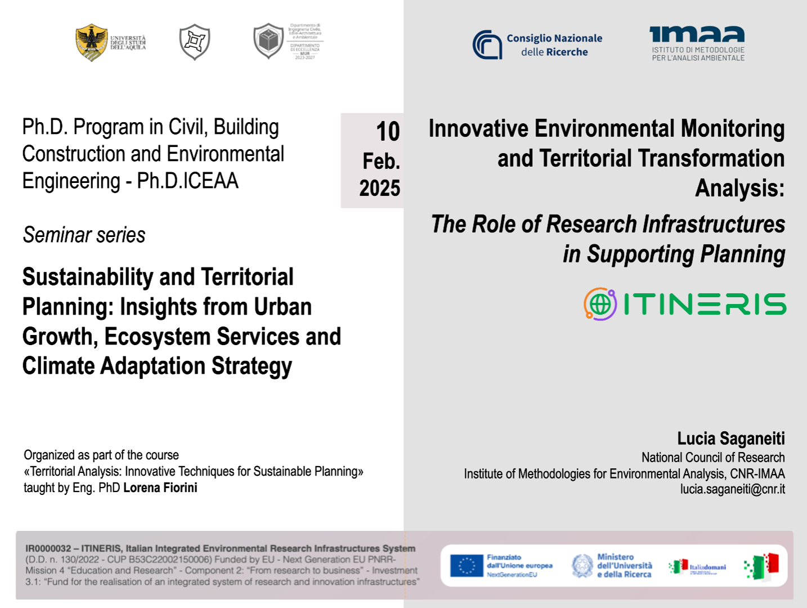

Some relevant experiences
 | TITLE | TARGET AUDIENCE | PURPOSE
 | Innovative Environmental Monitoring and Territorial Transformation Analysis | Researchers, planners, policymakers, professional bodies of Engineers and Architects, and stakeholders in territorial planning | To strengthen skills in using research infrastructures for sustainable urban regeneration, spatial monitoring, and the development of decision-making and planning tools.
 | Discovering the sky | Children aged 10–14 living in contexts of educational poverty | To foster scientific curiosity, inclusion, and empowerment through hands-on experiences in biodiversity exploration and sky observation, opening pathways to knowledge and hope.
CAPACITY BUILDING
RIs as knowledge-sparkling environment among the Ecosystems of Territorial Coehsion strategy: a study case about the social impact of the ITINERIS Project
ITINERIS 3° general meeting –Rome, 25-26/09/2025
Dr Simona LOPERTE

Slide 8

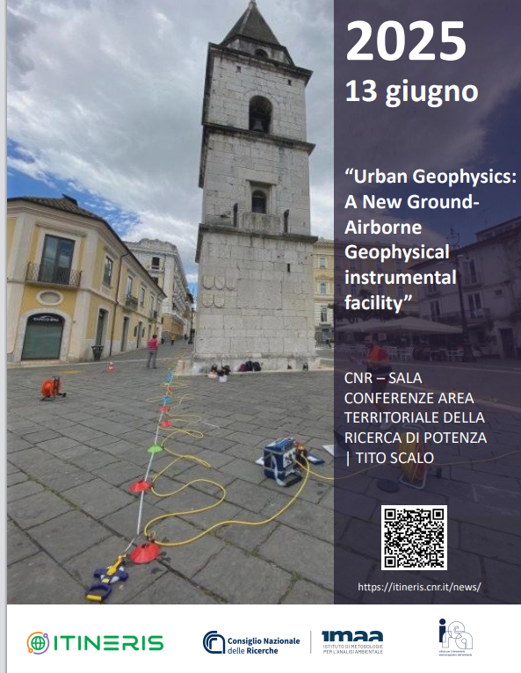
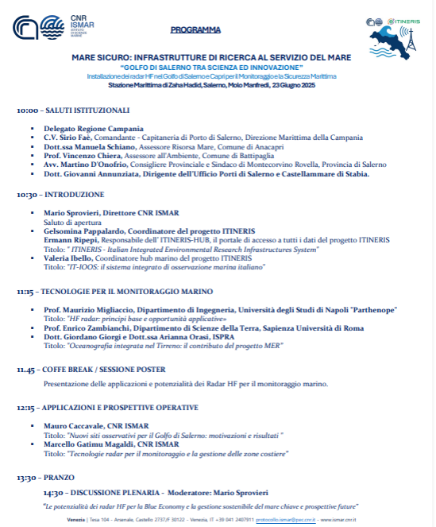
Some relevant experiences
 | TITLE | STAKEHOLDERS INVOLVED | SCIENTIFIC FIELD
 | Stakeholder Event on the New EU Air Quality Directive | National and regional environmental agencies, local authorities, businesses, research infrastructures (ACTRIS Italy, ITINERIS, RI-URBANS) | Air quality monitoring, science–policy interface, role of research infrastructures in supporting EU directives
 | Urban Geophysics: A New Ground–Airborne Geophysical Instrumental Facility | Institutional representatives (e.g. Civil Protection), professional body of Engineers, private sector stakeholders, research community | Geophysics, land use planning, risk mitigation (earthquakes, landslides), resilience and sustainability of urban areas, strategic role of RI
 | Coastal HF Radar Installation in the Gulf of Salerno and Capri | Local authorities (Region, Municipality), Coast Guard, Port Authorities, research institutions (CNR-ISMAR, ITINERIS), EuroGOOS network | Marine monitoring, maritime safety, environmental protection, role of research infrastructures in EU/global networks and data sharing
ORIENTED-RI ECOSYSTEM
ITINERIS 3° general meeting –Rome, 25-26/09/2025
Dr Simona LOPERTE
Notes:
Geophysics: demonstration to stakeholder

Slide 9


FIRST OUTCOMES & FUTURE PROSPECTIVES
Future Focus
Consolidating stakeholder alliances
Improving digital access tools
Monitoring long-term impacts
Positive Outcome
Greater visibility & attractiveness
More engagement from non-academic users
Progress on harmonized access policies & catalogues → interoperability
Stronger training & capacity building
Remaining Challenges
Securing stable funding
Balancing national vs. European priorities
Engaging underrepresented user groups
ITINERIS 3° general meeting –Rome, 25-26/09/2025
Dr Simona LOPERTE

Slide 10
For any further information, feel free to contact me at:
simona.loperte@cnr.it

