Slide 1
WP7 Geosphere and Landsurface
Giuliana Rossi & all the WP7 partners (CNR-ISMAR-BO; INGV; OGS_GEO +UniPV, UniMI, UniFI; CNR-IMAA; CNR-IREA; CpC-UniFI; OGS_CRS; OGS_GEO)

Slide 2
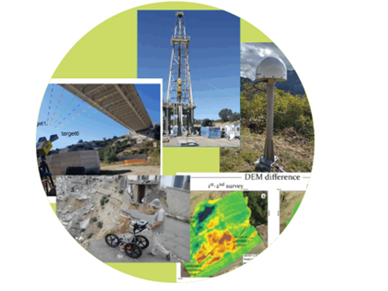
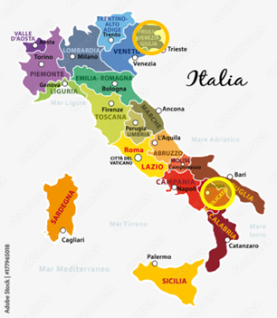
Environmental observations on Geosphere and Landsurface
Integrating key Research Infrastructure capabilities & related datasets including: SMINO, ATLaS, ECORD-ICDP, & EUFAR
Testing cutting-edge technologies in three pilot sites:
the Friuli Venezia Giulia region, Tito and Potenza in the Basilicata region
Interaction with other WPs [WP2, WP3, WP8 (VRE Downstream)]

Slide 3







WP7 Participants
OGS-CRS: Centro di Ricerche sismologiche OGS – Udine RI SMINO
OGS-GEO: Sezione di Geofisica OGS – Trieste RI ECORD
CNR-ISMARBO Istituto di Scienze Marine - Bologna RI ECORD
INGV-Roma RI ECORD
CNR-IMAA Istituto di Metodologie per l’Analisi Ambientale CNR
CNR-IREA Istituto per il Rilevamento Elettromagnetico dell’Ambiente CNR
UNIFI-CPC Centro per la Protezione Civile – RI ATLaS
OGS-CRS
OGS-GEO

Slide 4
Main results
Data: digitalization of geological data, online availability, FAIR: in all the activities
Instrumental and technological capacities: improved in all the activities
Progresses in harmonization and collaboration between various Activities/infrastructures/topics: 7.1-7.3; 7.4&7.5; 7.6&7.7; 7.7-7.9.
Progresses in harmonization and collaboration between various Activities/infrastructures/topics: 7.1-7.3; 7.4&7.5; 7.6&7.7; 7.7-7.9.
Interaction with the stakeholders: two meetings, one in Tito, the other in Udine
Further activities for the last months and what remains:
MEDA and seafloor seismometer and tests (SMINO) 7.7.;
Strapdown gravimeter and tests (EUFAR) 7.9;
Applications of the digital database (ECORD)7.1-7.3;
Tests and analysis of the data 7.4, 7.5; 7.6 ATLaS, 7.7 SMINO.

Slide 5
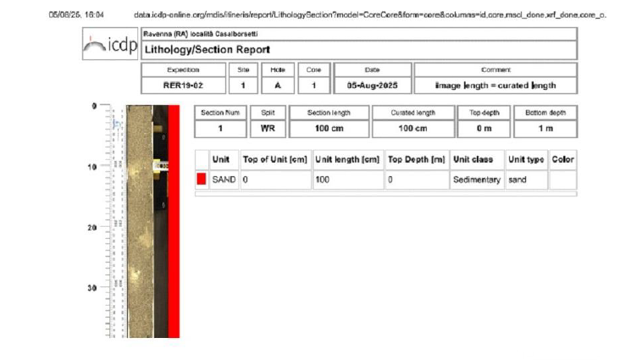
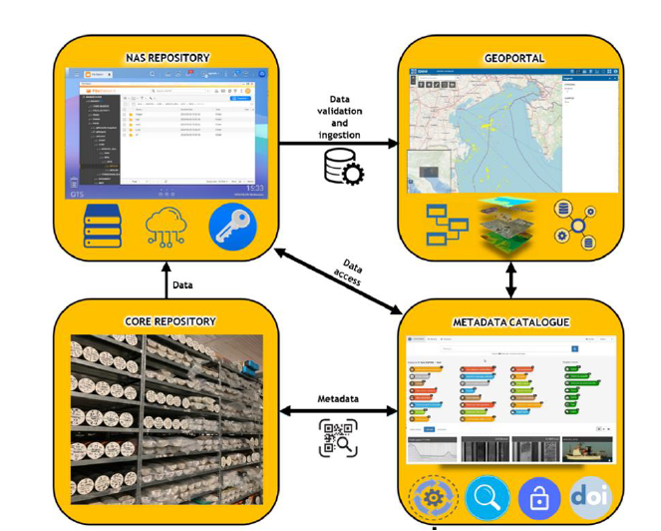
7.1 –Improving the access to the ECORD infrastructure and enabling scientific drilling micro-analysis, geochemical and site survey data sharing
core repository
a NAS repository
a geoportal
a metadata catalogue
Import in mDis
Data

Slide 6
7.3 – Data Improving the access to IODP scientific borehole geophysics, subsurface structural data, and stratigraphic/lithologic samples-data sharing
Data

Slide 7
7.3 – Data Improving the access to IODP scientific borehole geophysics, subsurface structural data, and stratigraphic/lithologic samples-data sharing
Data

Slide 8

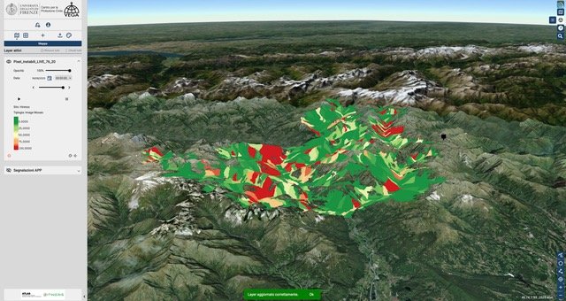

ATLaS Data Sharing and EW Platform
7.6 – Integrated platform for surface movements monitoring
Display and share planimetric and 3D data
Real-time monitoring data
Customised diagrams
Dashboard for emergency management
Tools for quickly defining risk scenarios
Real-time forecasting algorithms
Definition of alarm thresholds
Threshold exceeding notifications
Data

Slide 9
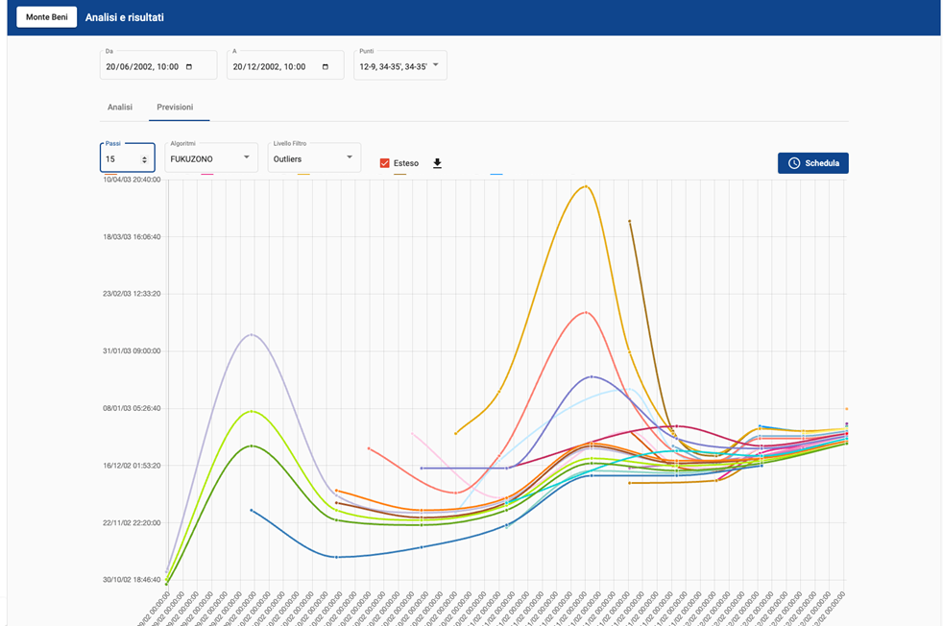
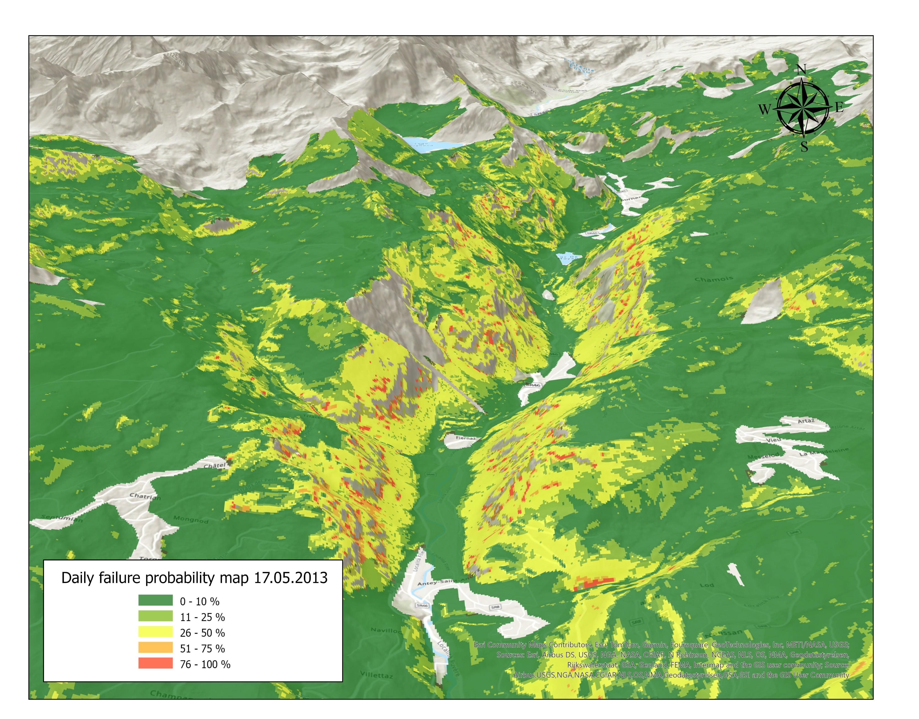

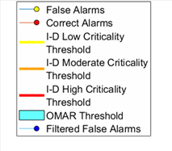
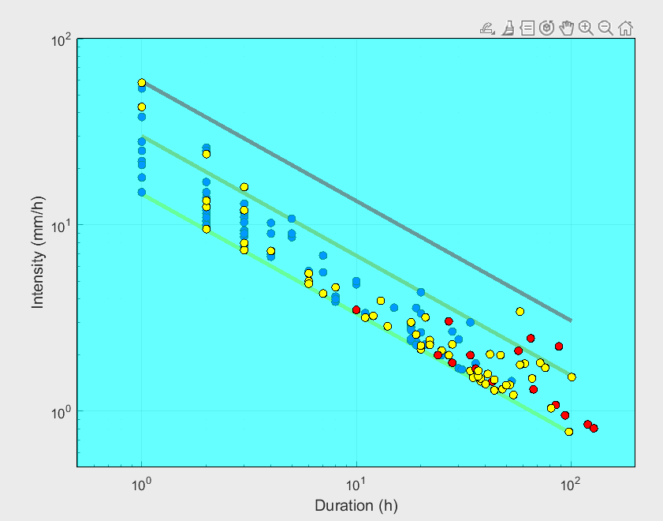
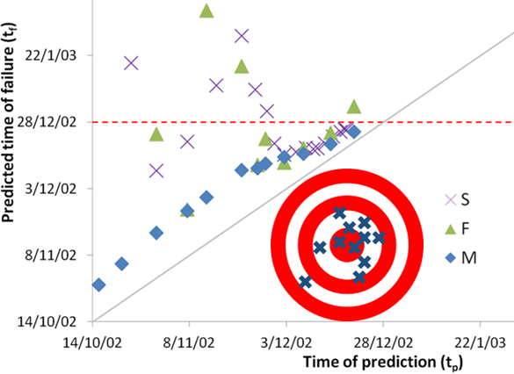
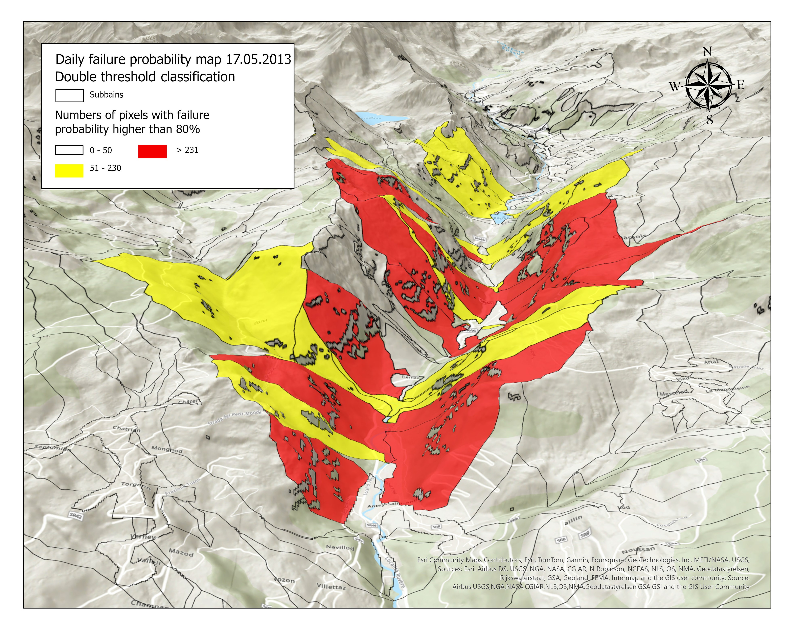
Forecasting Models integrated in the platform
7.6 – Integrated platform for surface movements monitoring
LAMPO
HIRESSS
Data

Slide 10
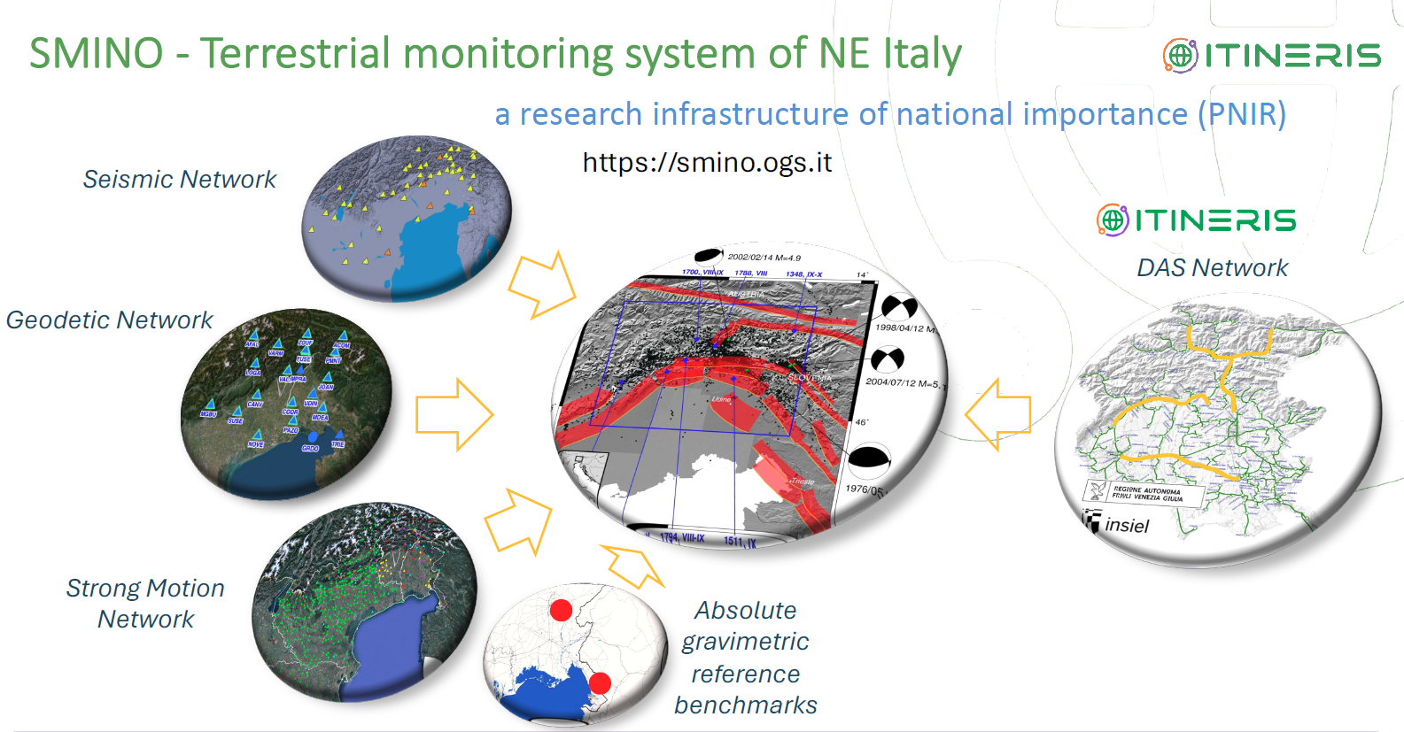
7.7 – Integrated facility for the access to SMINO observations
Data

Slide 11
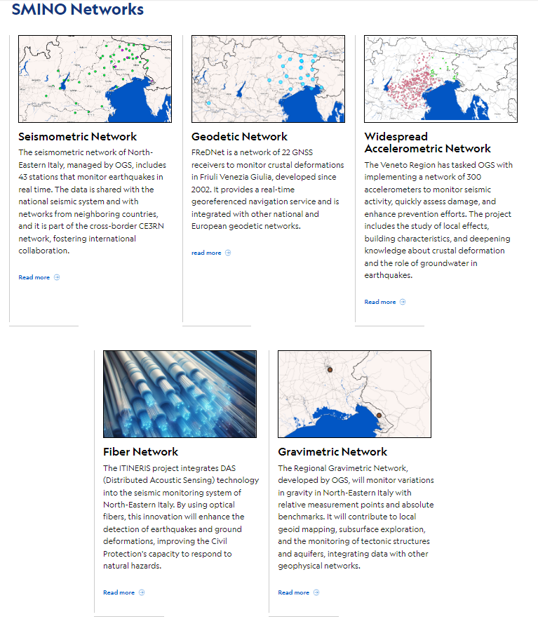
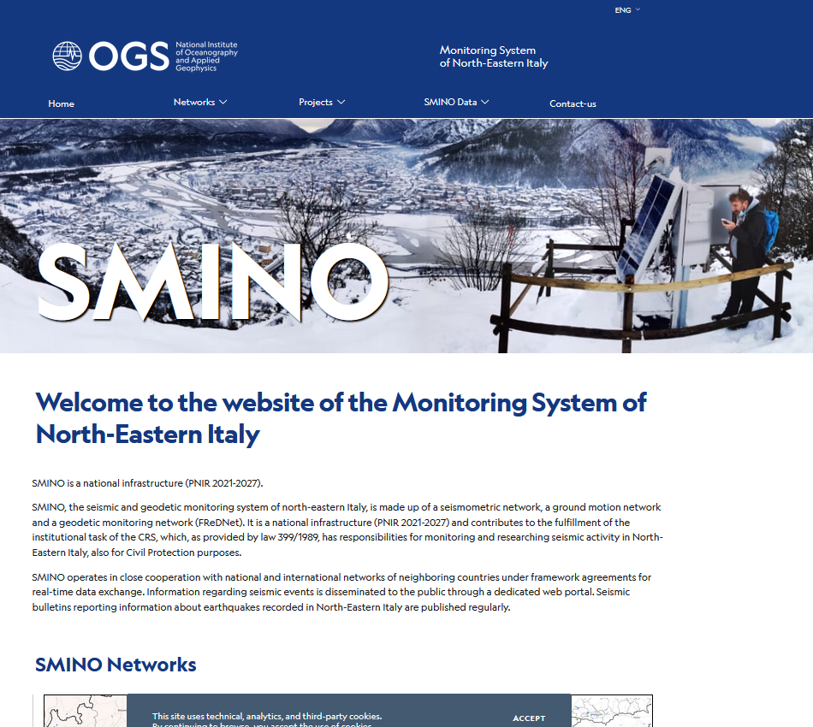
7.7 – Integrated facility for the access to SMINO observations
The new portal
Data

Slide 12
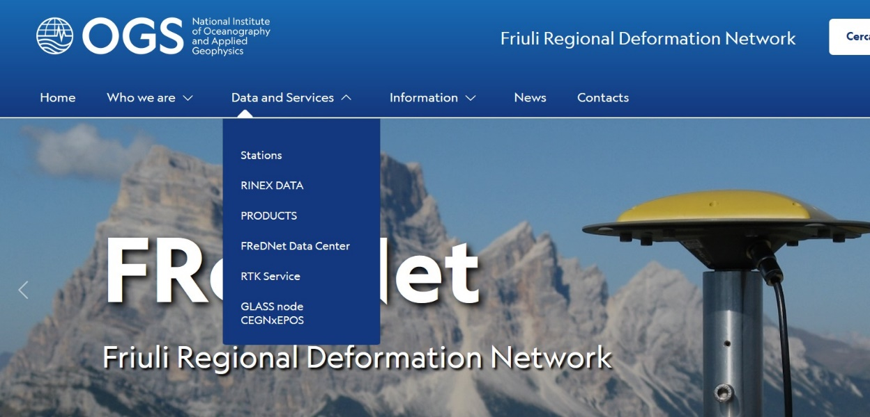
7.7 – Integrated facility for the access to SMINO observations
The new portal
Page of FReDNet portal with the menu for access to the data, raw and processed (https://frednet.crs.ogs.it/en/)
Data

Slide 13
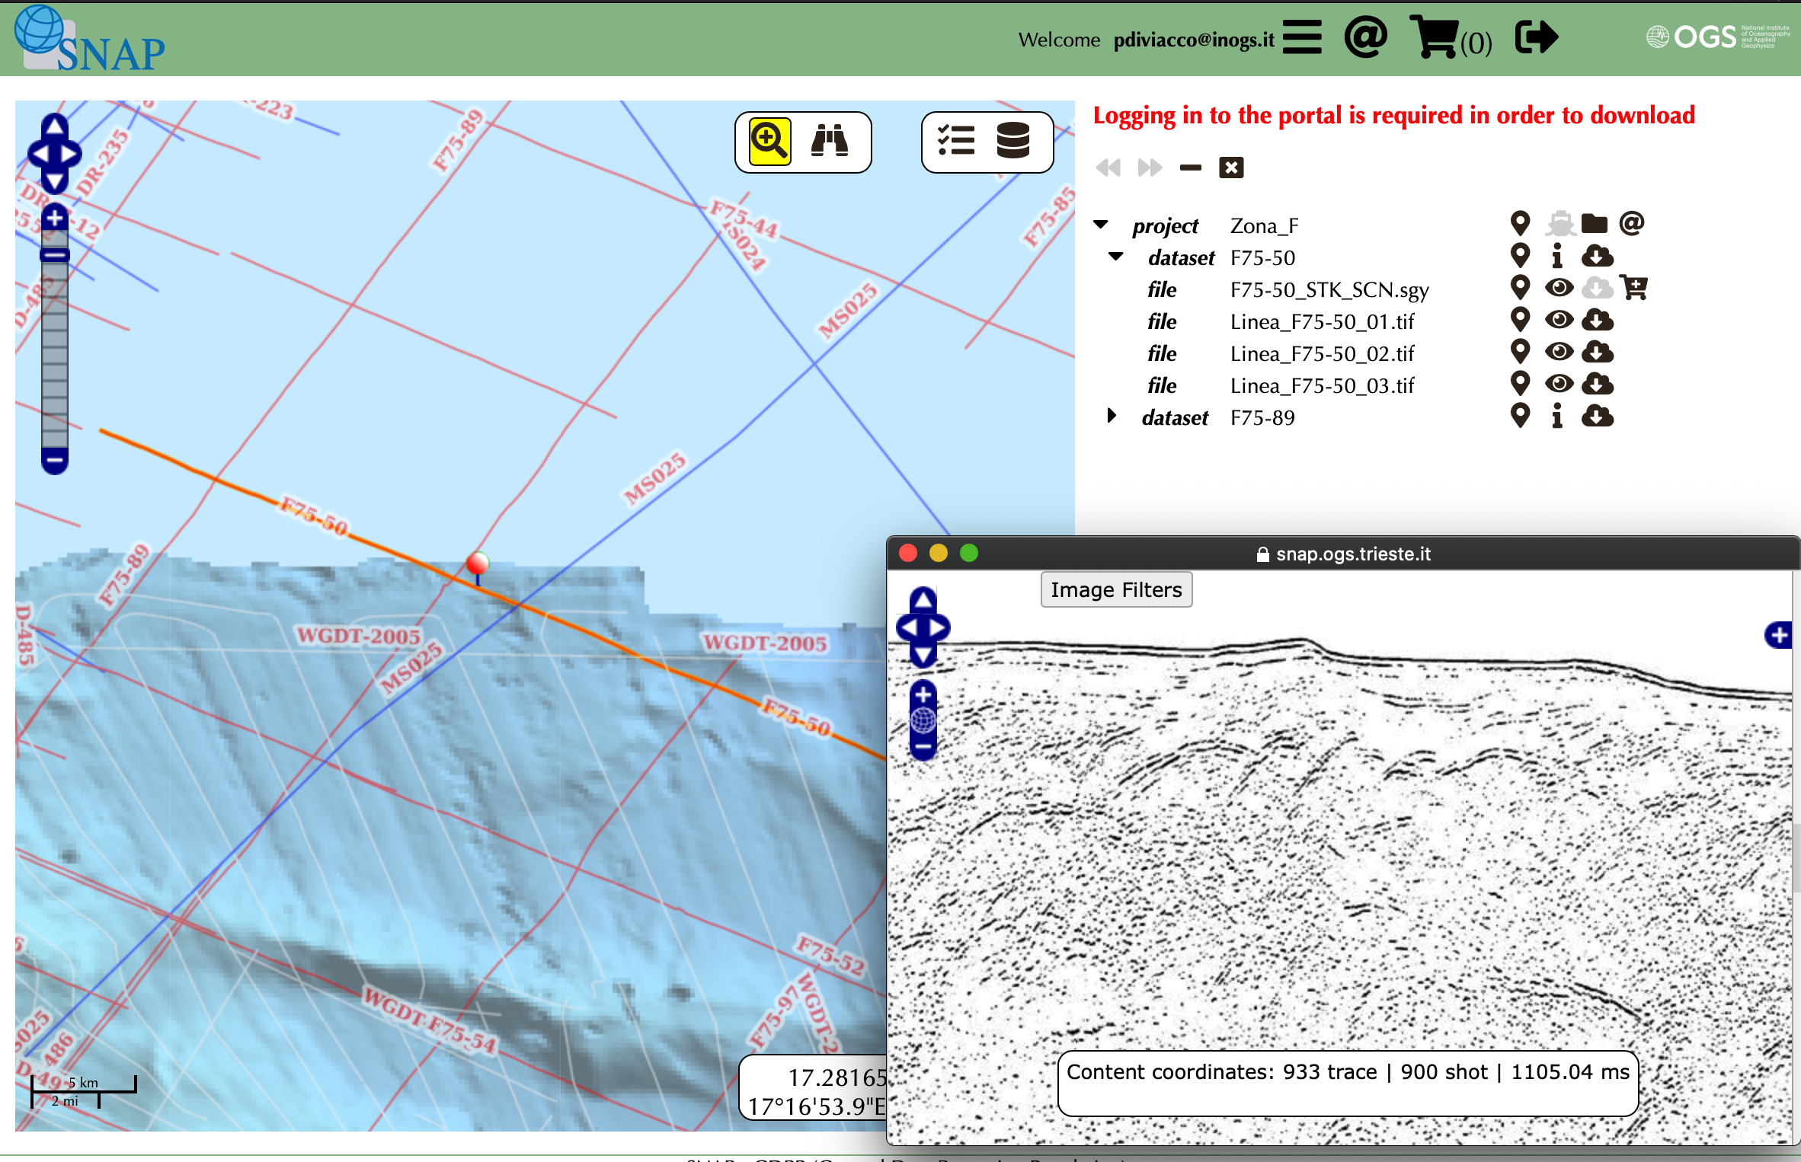
7.8 – Data integrated facility for the access to geophysical observations on the subsurface
Seismic data Network Access Point (SNAP)
FAIR compliant seismic data access system
100.000 Km of seismic lines
350.000 KM² Mbeam data
SEG-Y, UKOOA format files
Web services: OGC WMS WFS
Metadata: ISO19115, OGC O&M, SensorML, Inspire compliant
Geonetwork harvesting
Web-GIS and data preview
DOI
Data

Slide 14
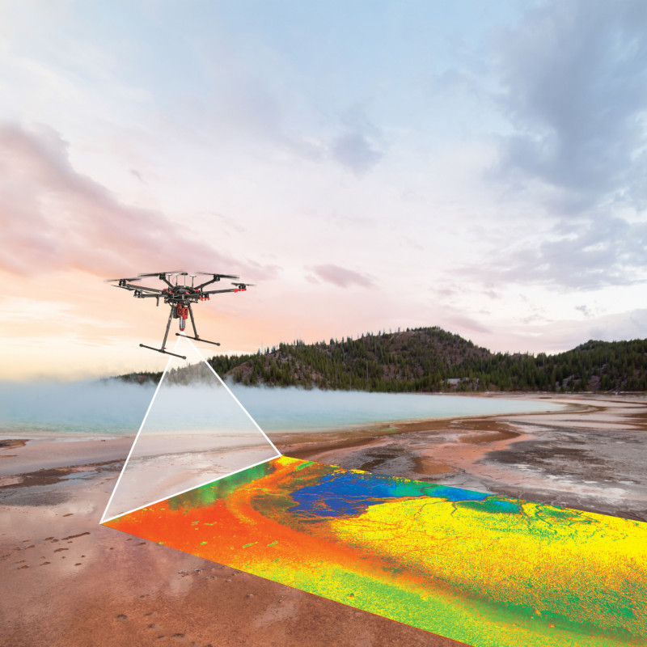
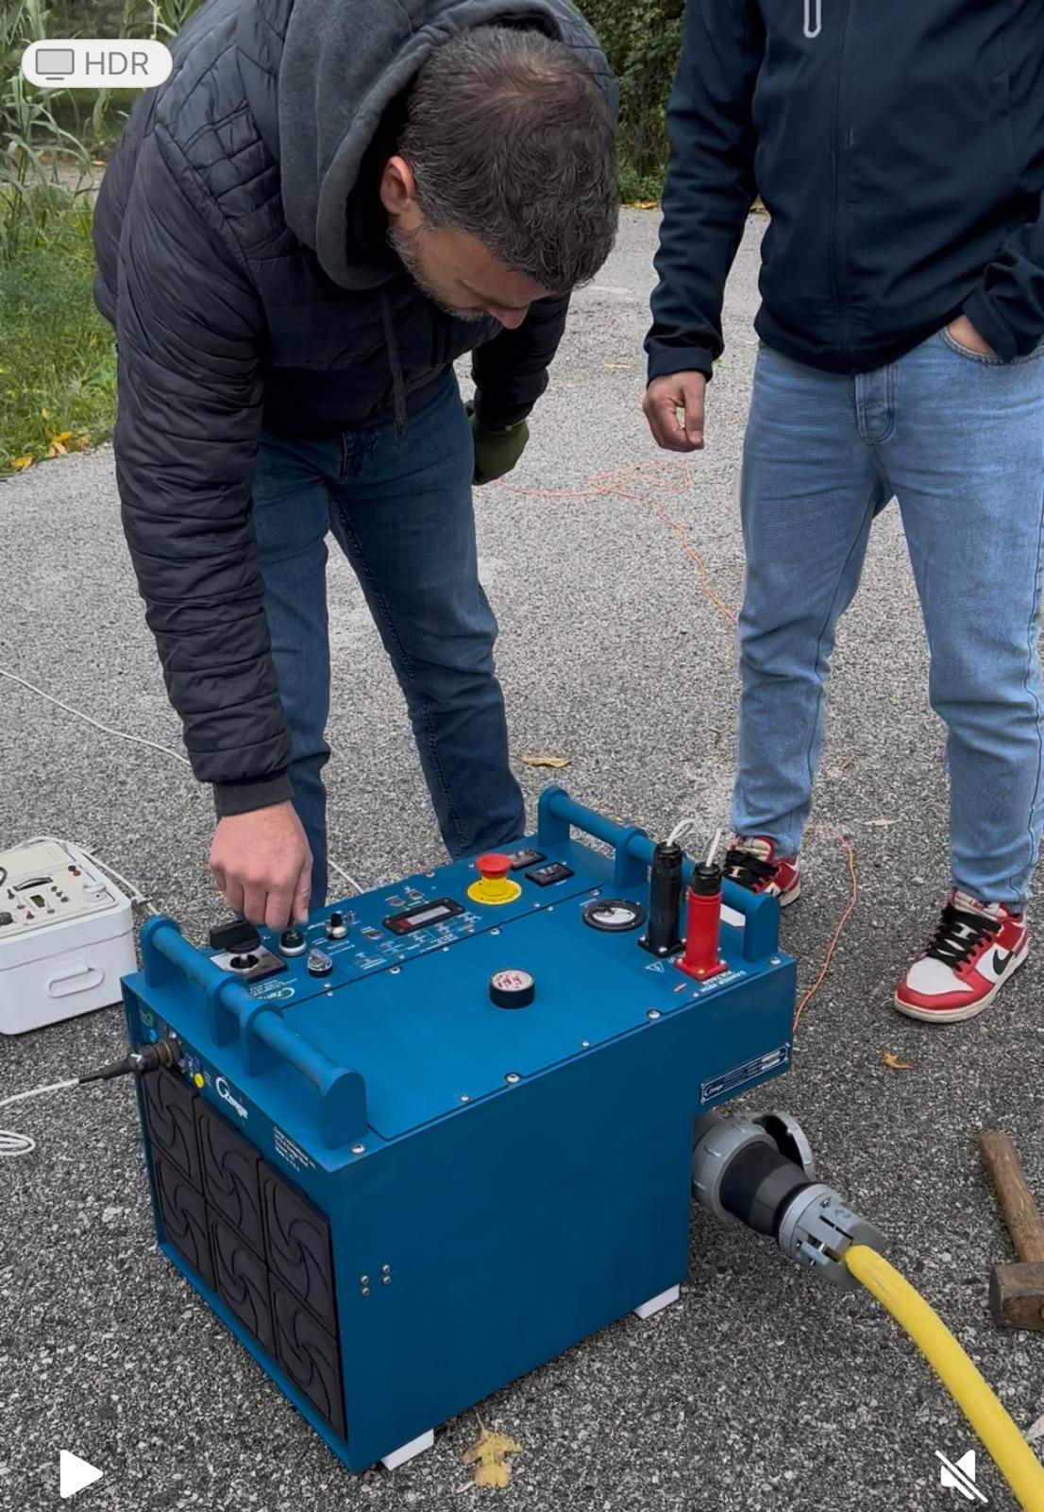
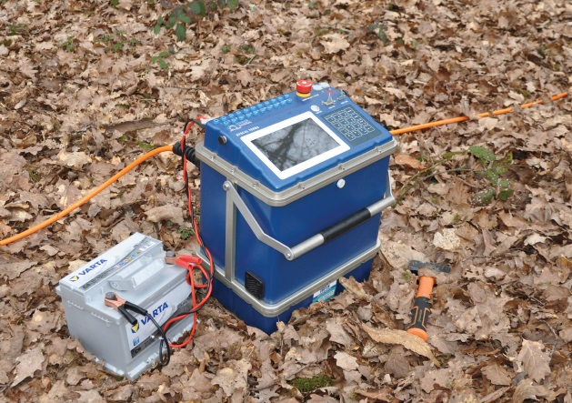
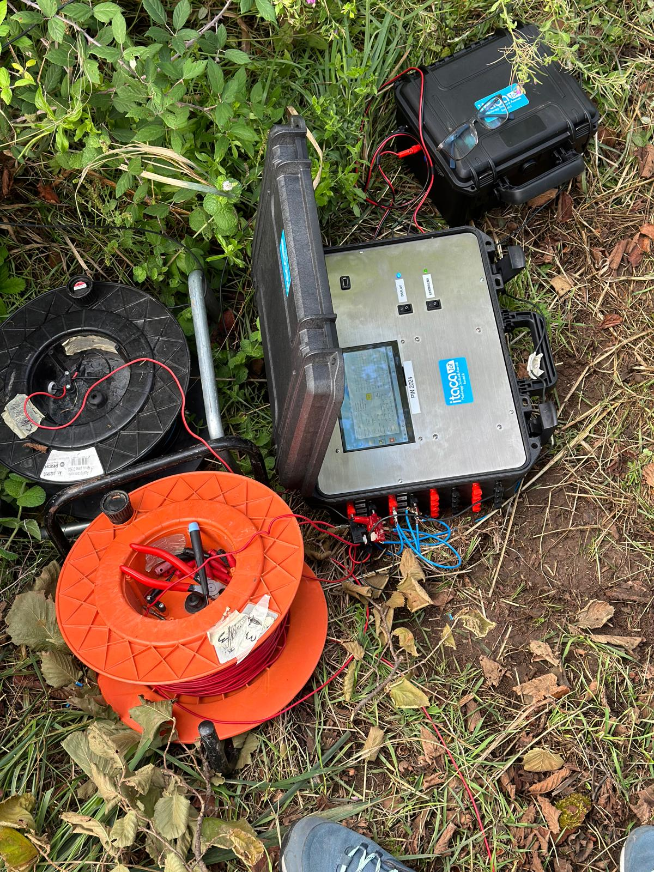
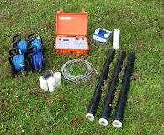
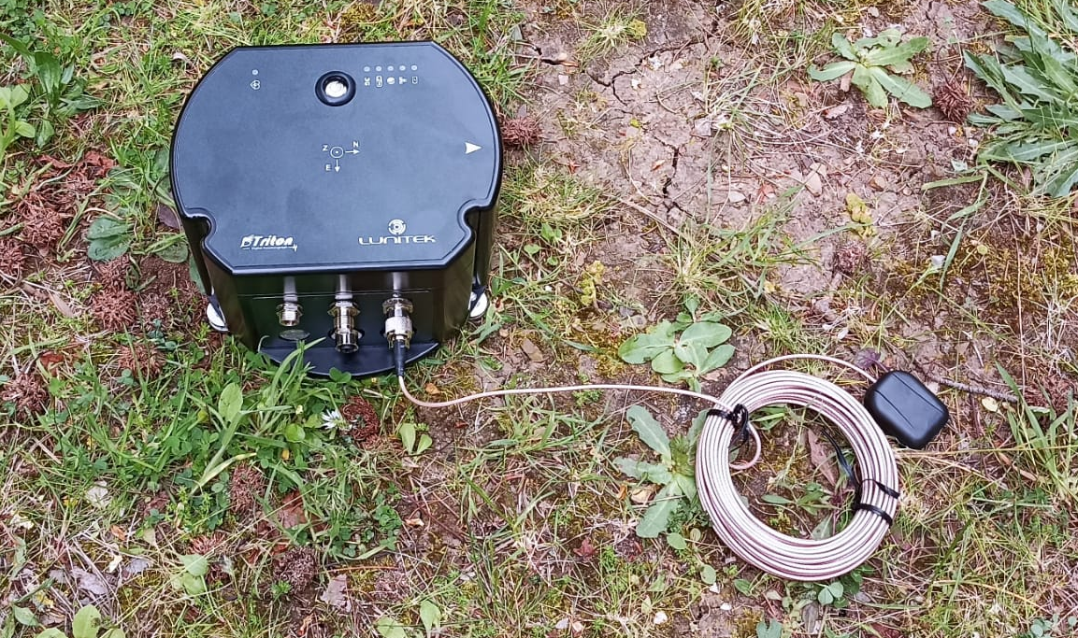
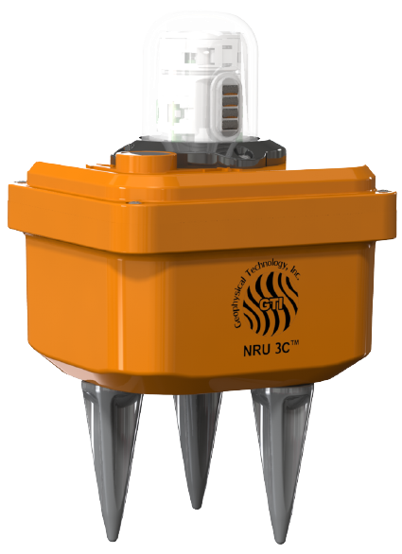
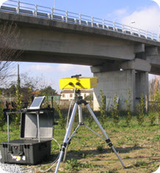
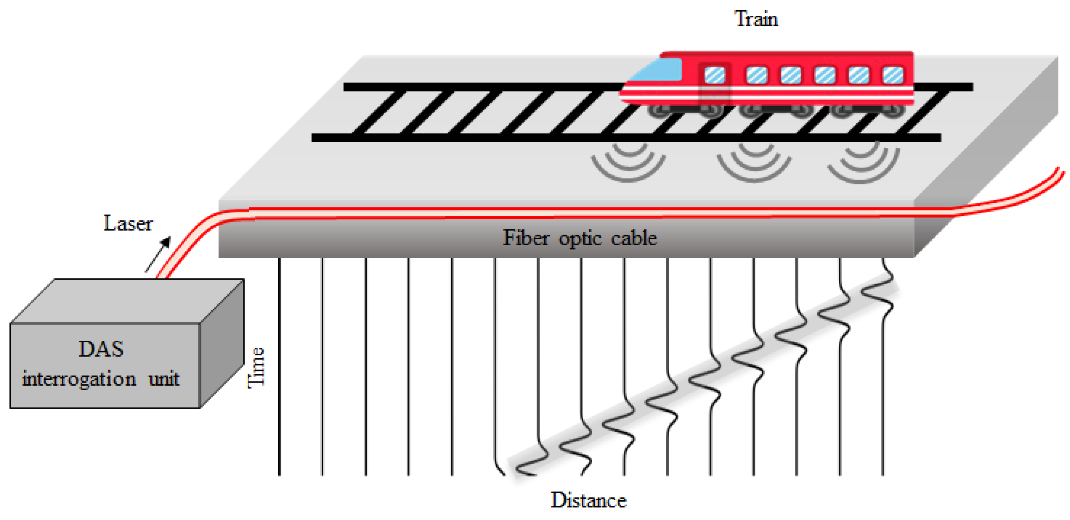
Activity 7.4 – Upgrade and networking of the ground-based and airborne facilities for geophysical exploration and land surface monitoring
New CNR IMAA geophysical instrumental facility
Airborne Hyperspectral Imaging Systems (VNIR-SWIR)
Continuous spectral coverage from 400nm to 2500nm
Spatial resolution of about 30/40 cm in the VNIR and about 1m in the SWIR
(IR EUFAR)
New electrical resistivity tomography system
- Different spatial e temporal resolution by using 2D and 3D tomographic methods,
investigation depth (from 0-1 m up to 1-10 km depth time-lapse acquisition,
ML data analysis techniques
Seismic data from new seismic sensors and fiber optic interrogator
- Nodal systems consisting into velocimeter and accelerometers,
iDAS interrogator for passive and active seismic surveys, and critical infrastructure monitoring
ML data analysis techniques
New GB-SAR and GB-RAR
monitoring surface deformation
studying the static and dynamic behavior of strategic infrastructure
Spatial resolution of at least 0.75 m
Instrumental capacities

Slide 15
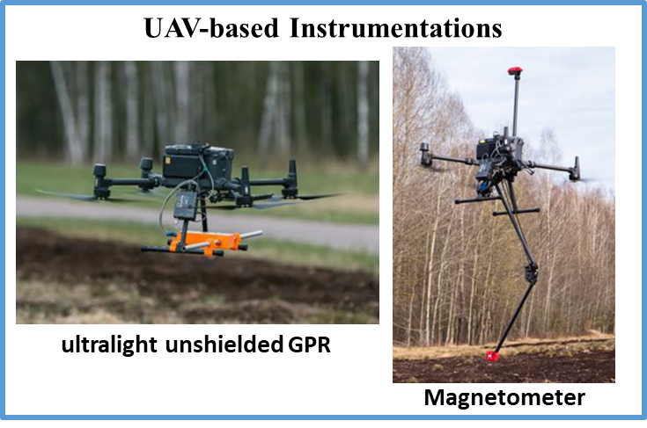
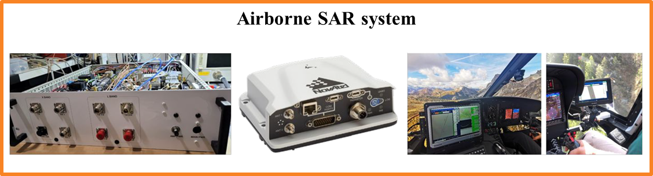

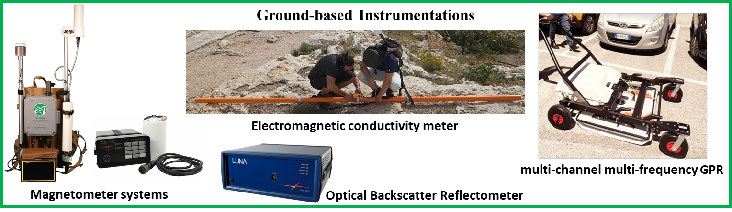
7.5 –Earth Observation infrastructure based on airborne X/L Band SAR and in-situ geophysical data
New CNR IREA geophysical instrumental facility
NOVEL INSTRUMENTS @ IREA
Computing resources
Instruments for proximal and on-site surveys in the fields of urban and structural geology, agronomy and shallow geothermal exploration, as well as terrain instability analysis.
Surveys are performed on demand, with the resulting data made available to the scientific community upon request.
Instrumental capacities

Slide 16
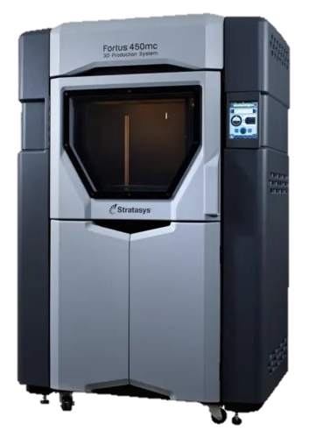
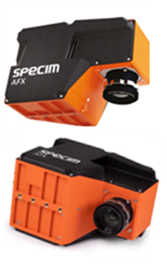
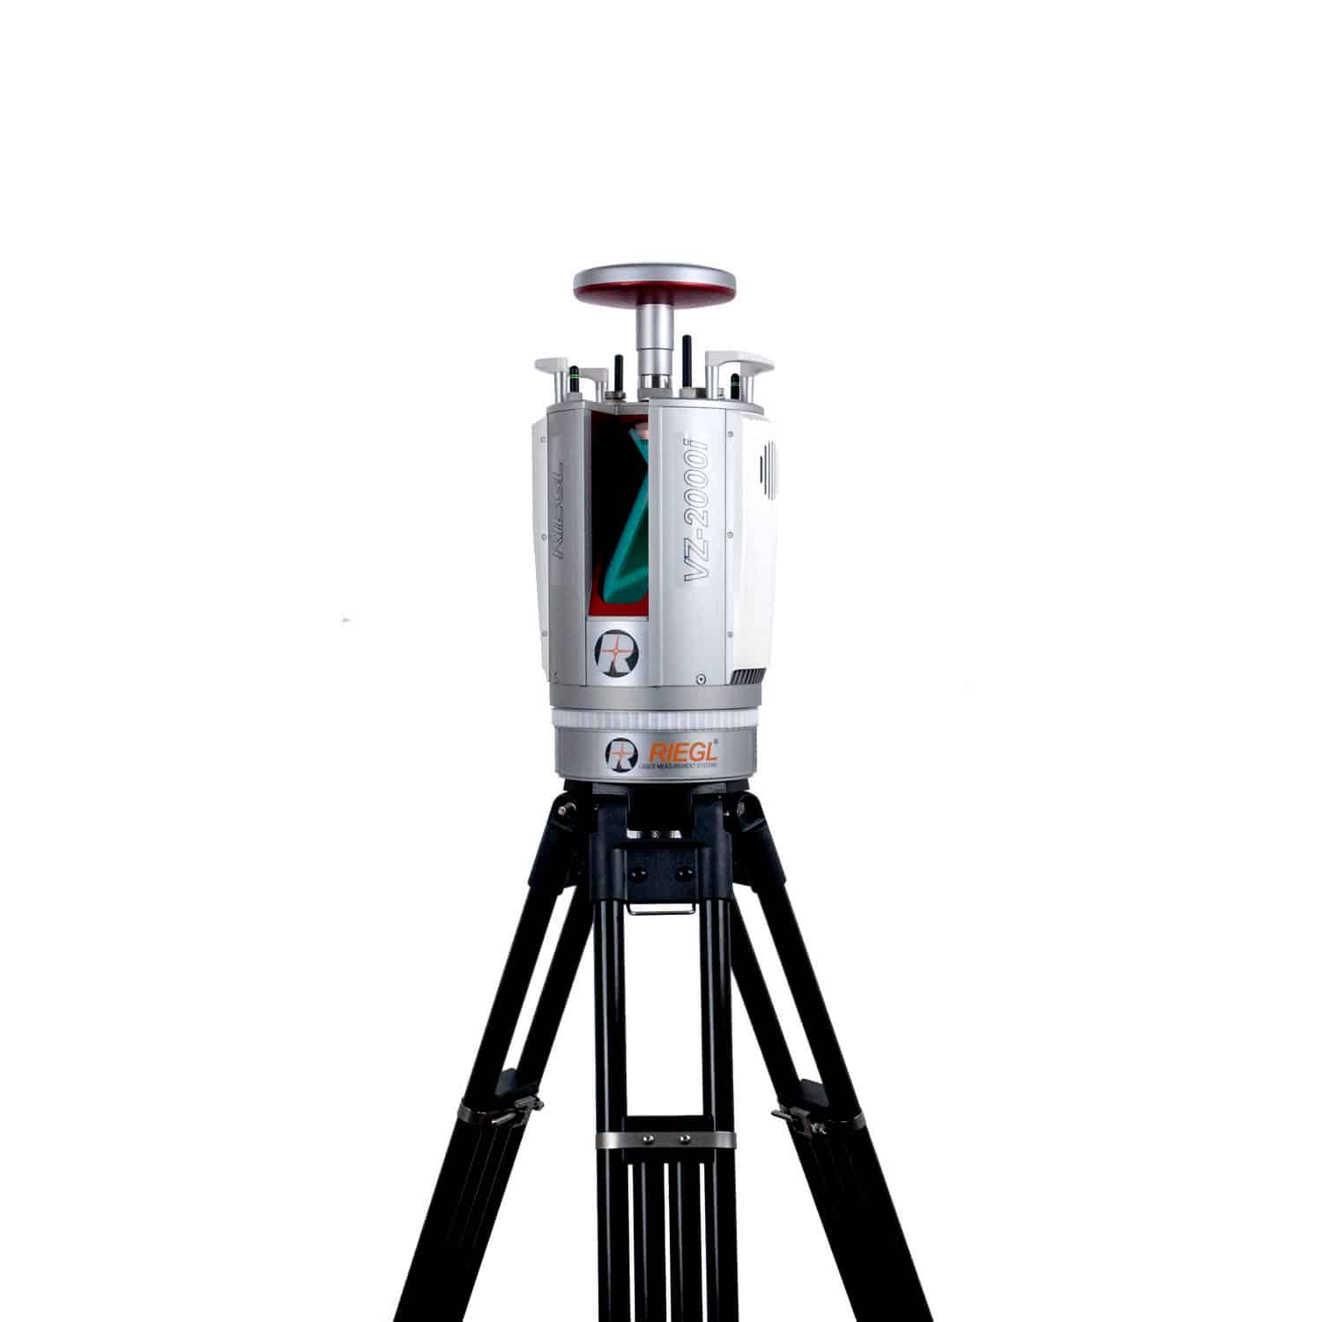
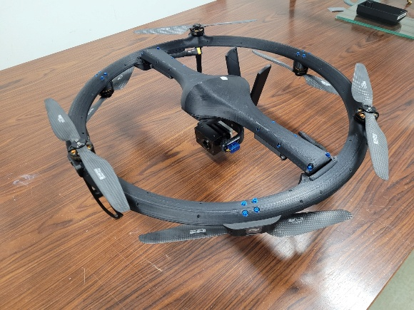
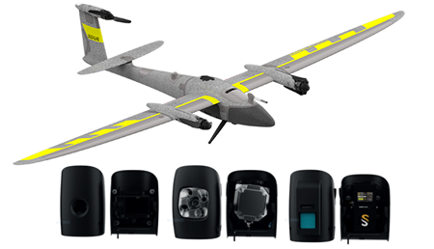
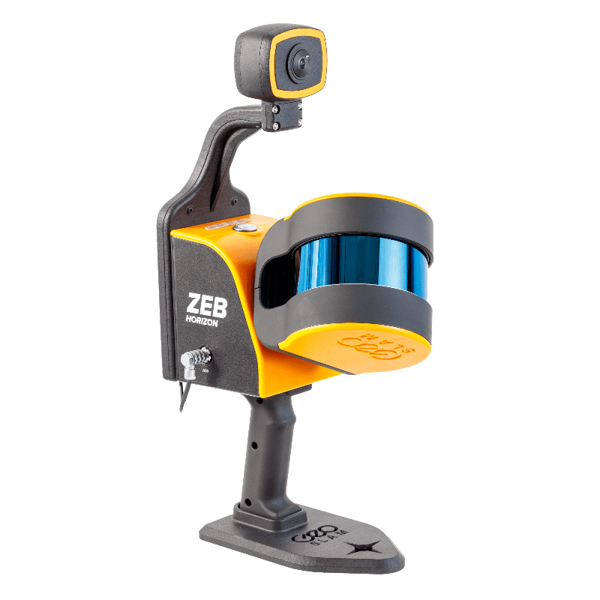
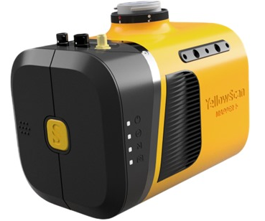
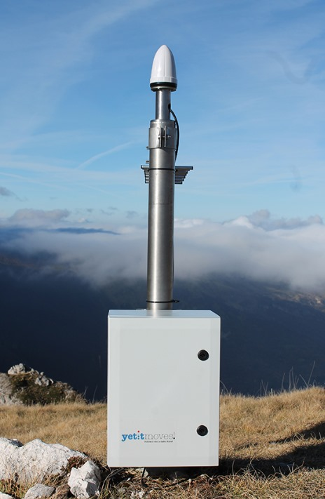
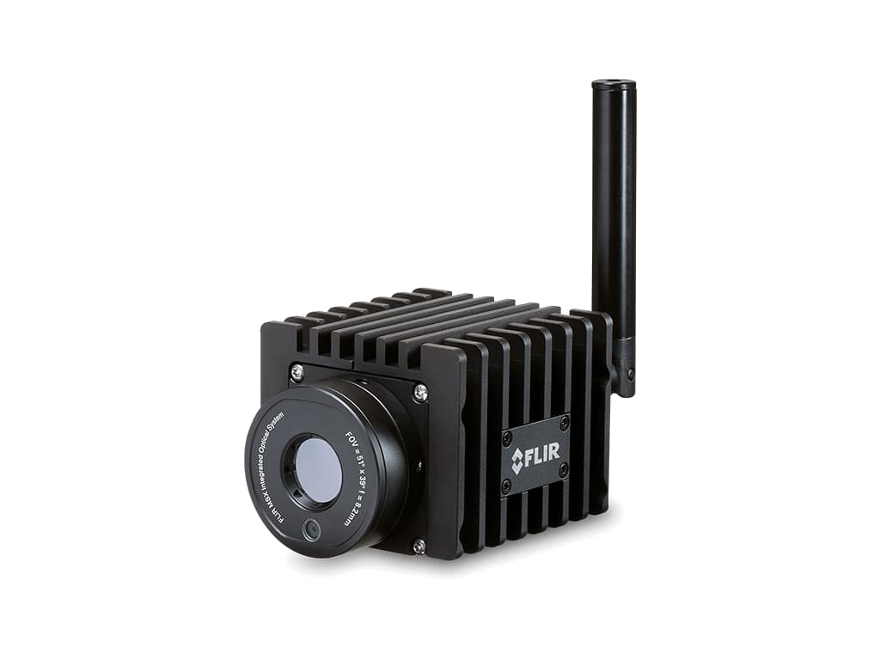
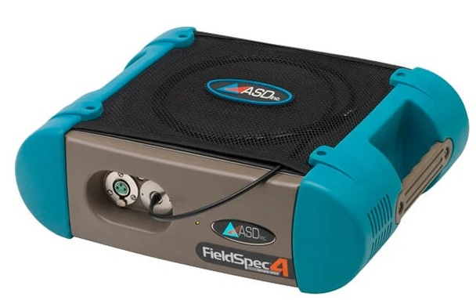
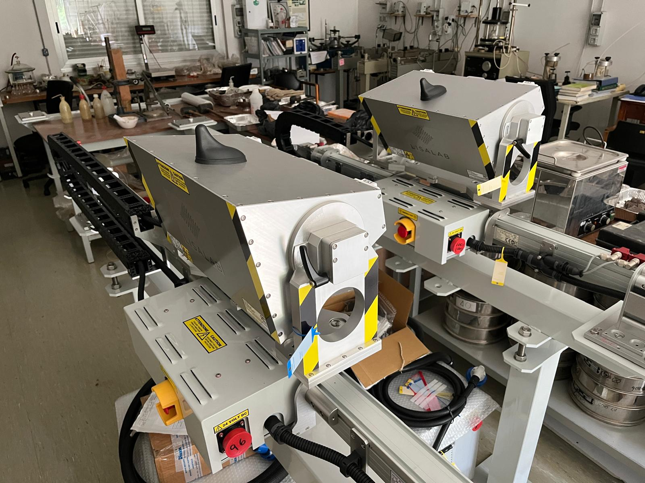
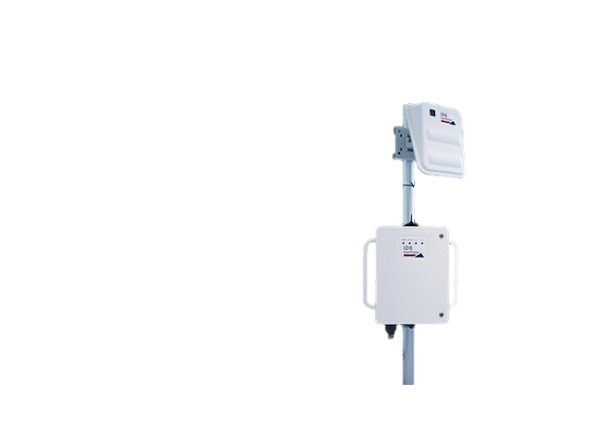
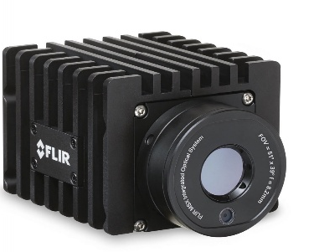
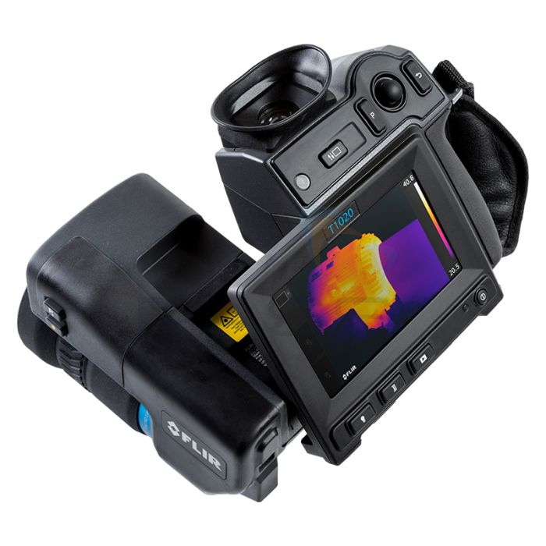

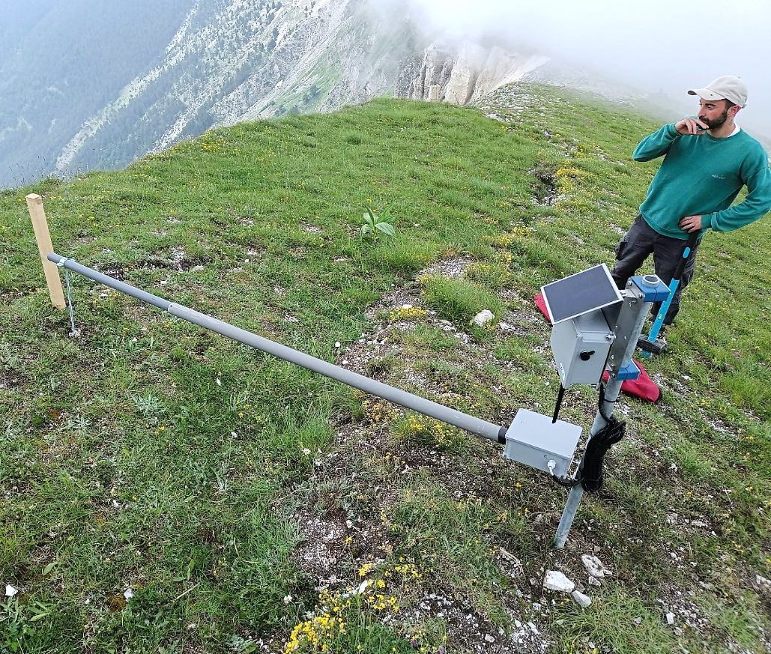
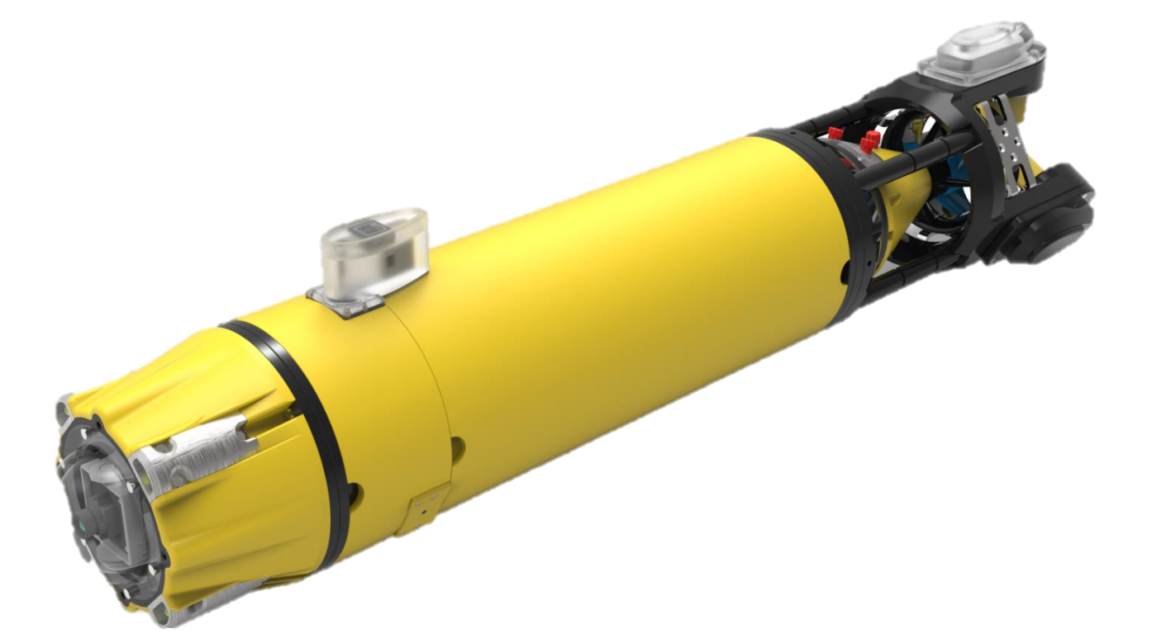
7.6 –Integrated platform for surface movements monitoring
3D printer
UAV LiDAR
Fixed-wing UAV
UAV Hyperspectral cameras
Mobile Slam Lidar
Long Range TLS
Wireless Sensor Network
Thermal camera
and sensors
Hi-Res spectroradiometer
GB InSAR
Underwater ROV
Doppler Radar
Mobile Unit
Instrumental capacities

Slide 17

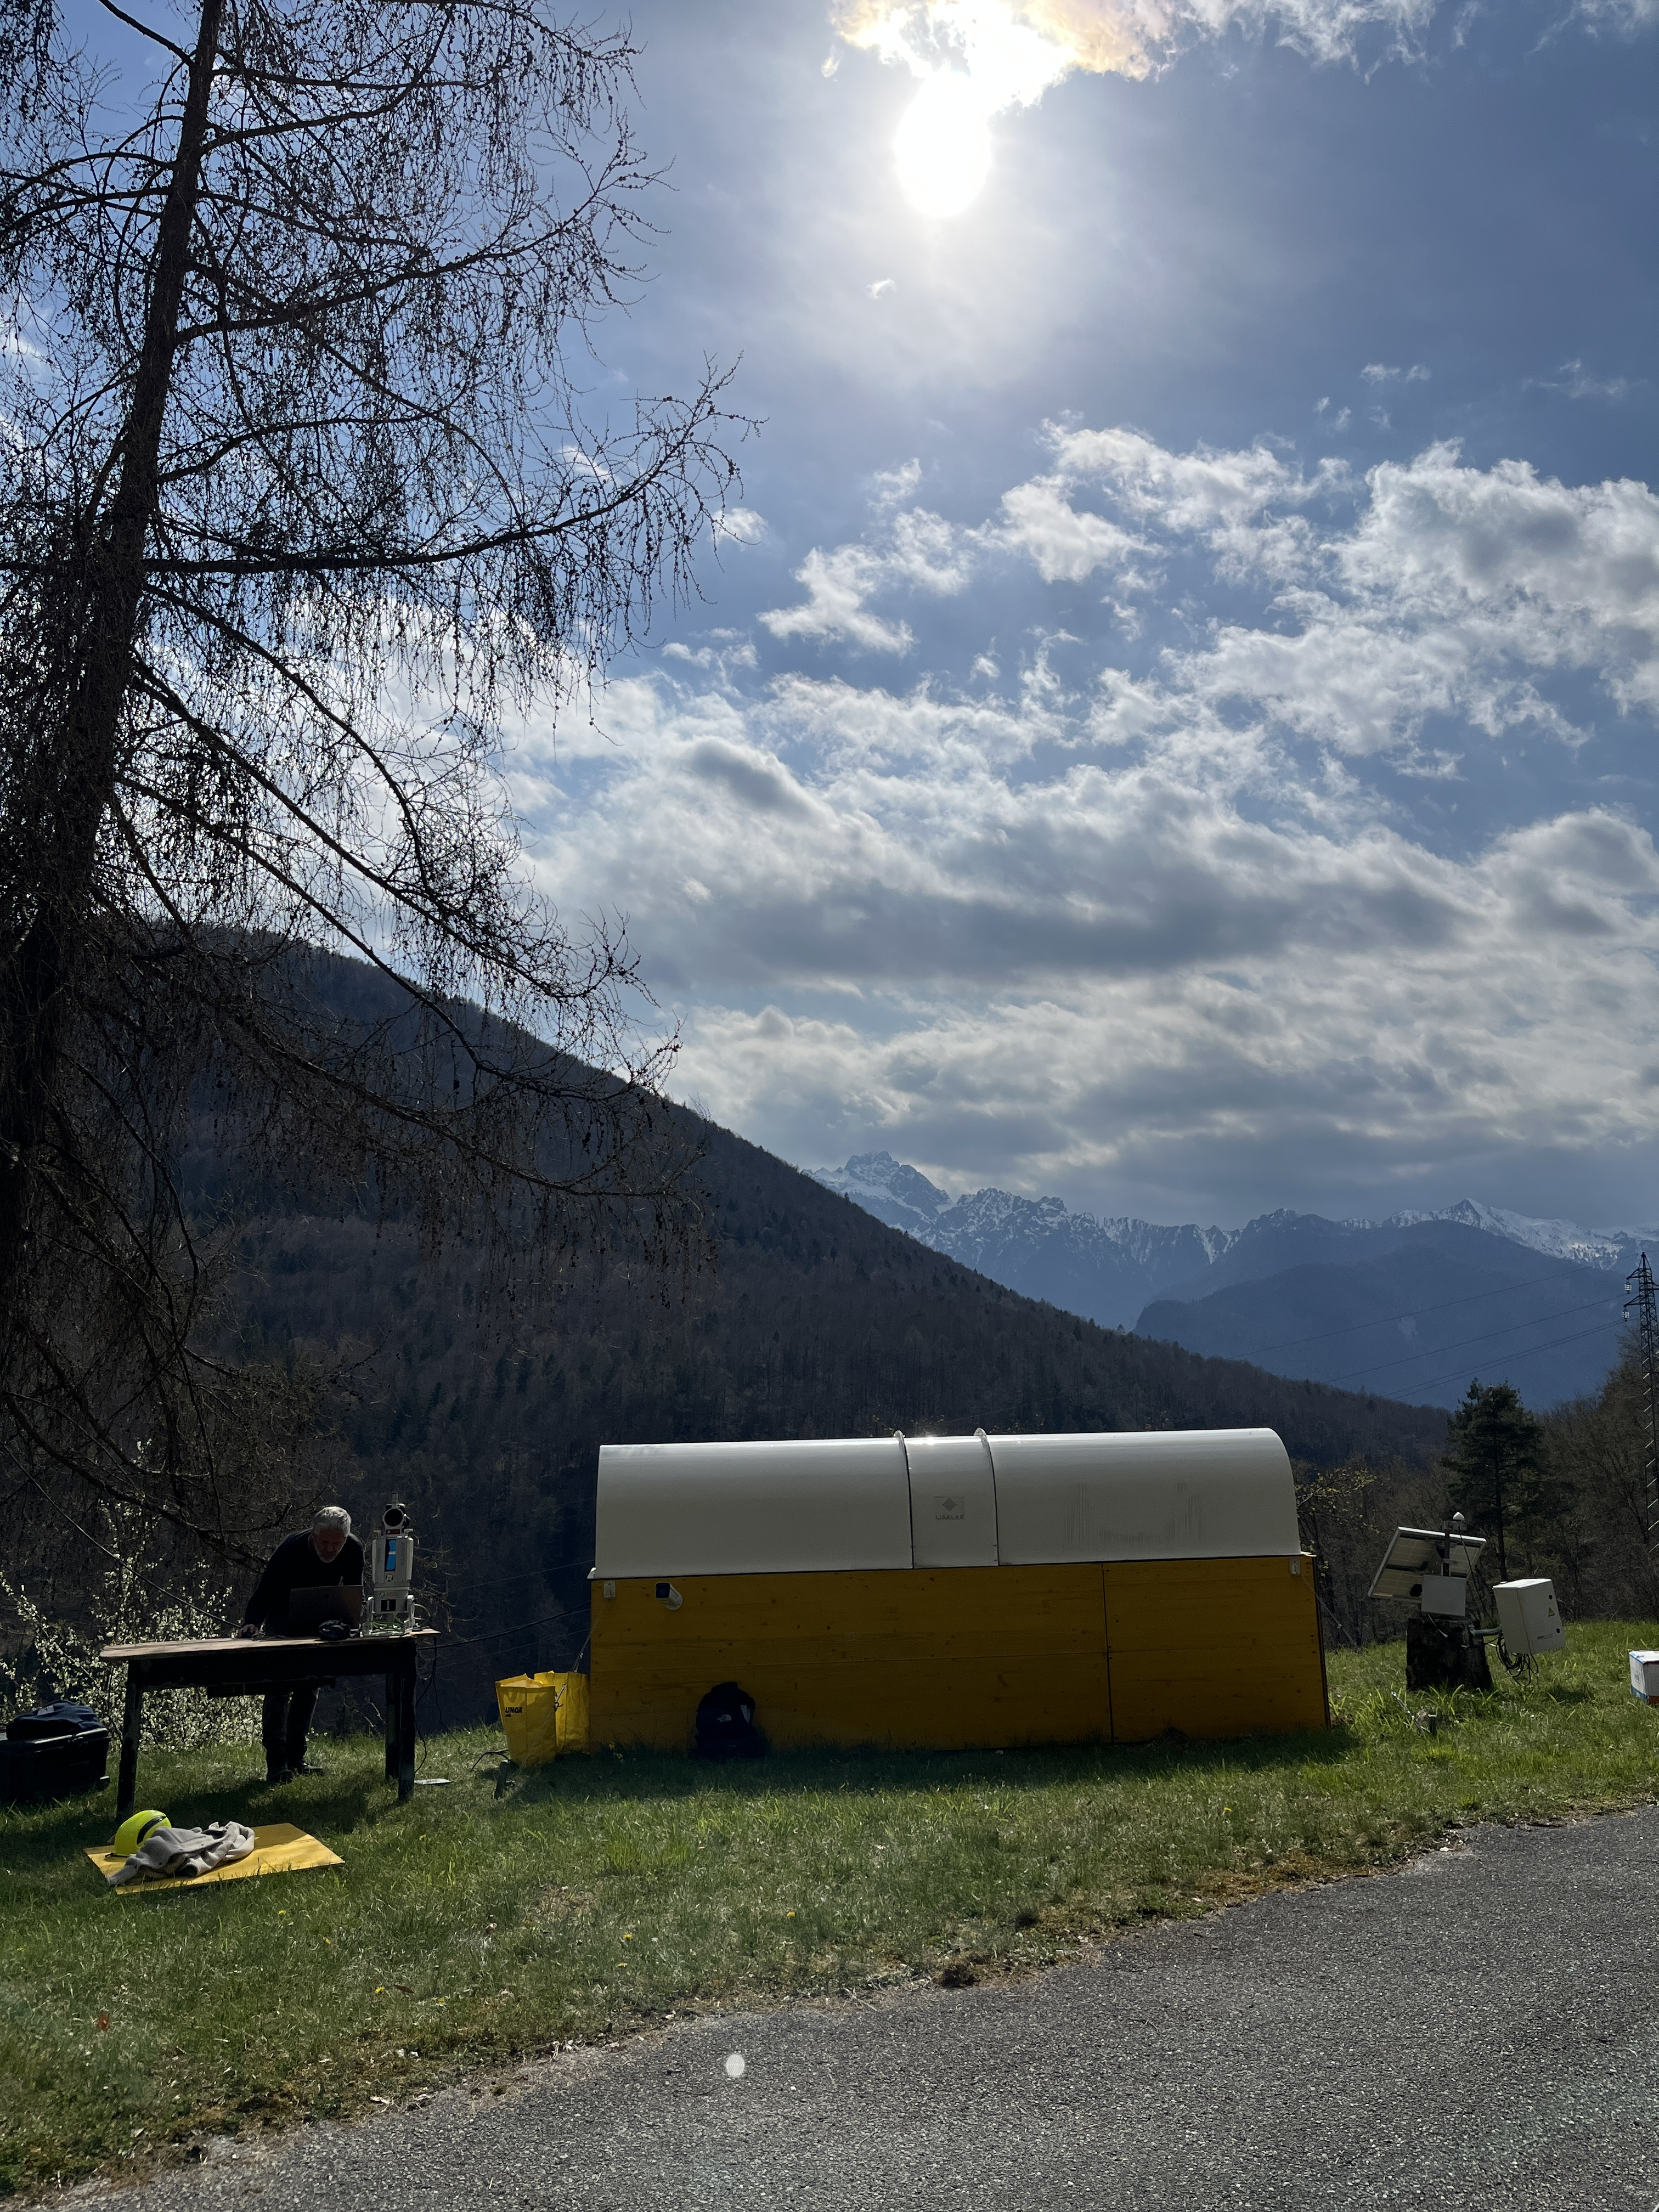
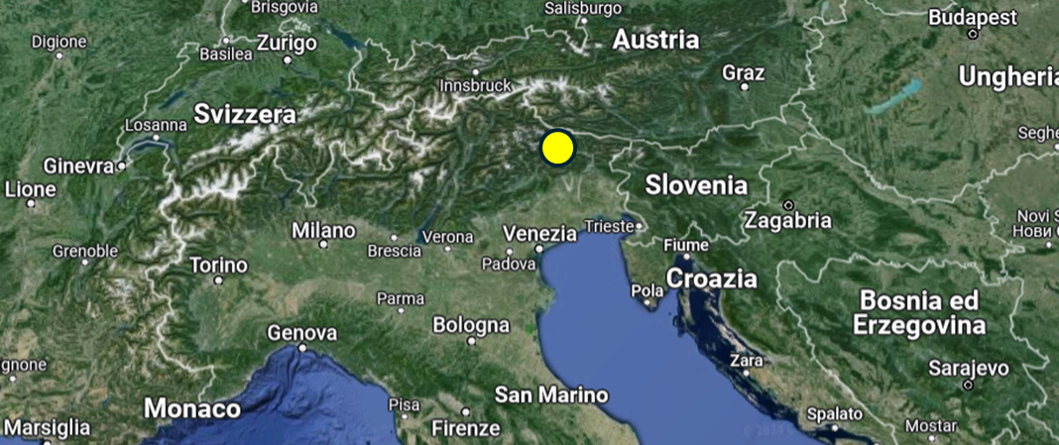
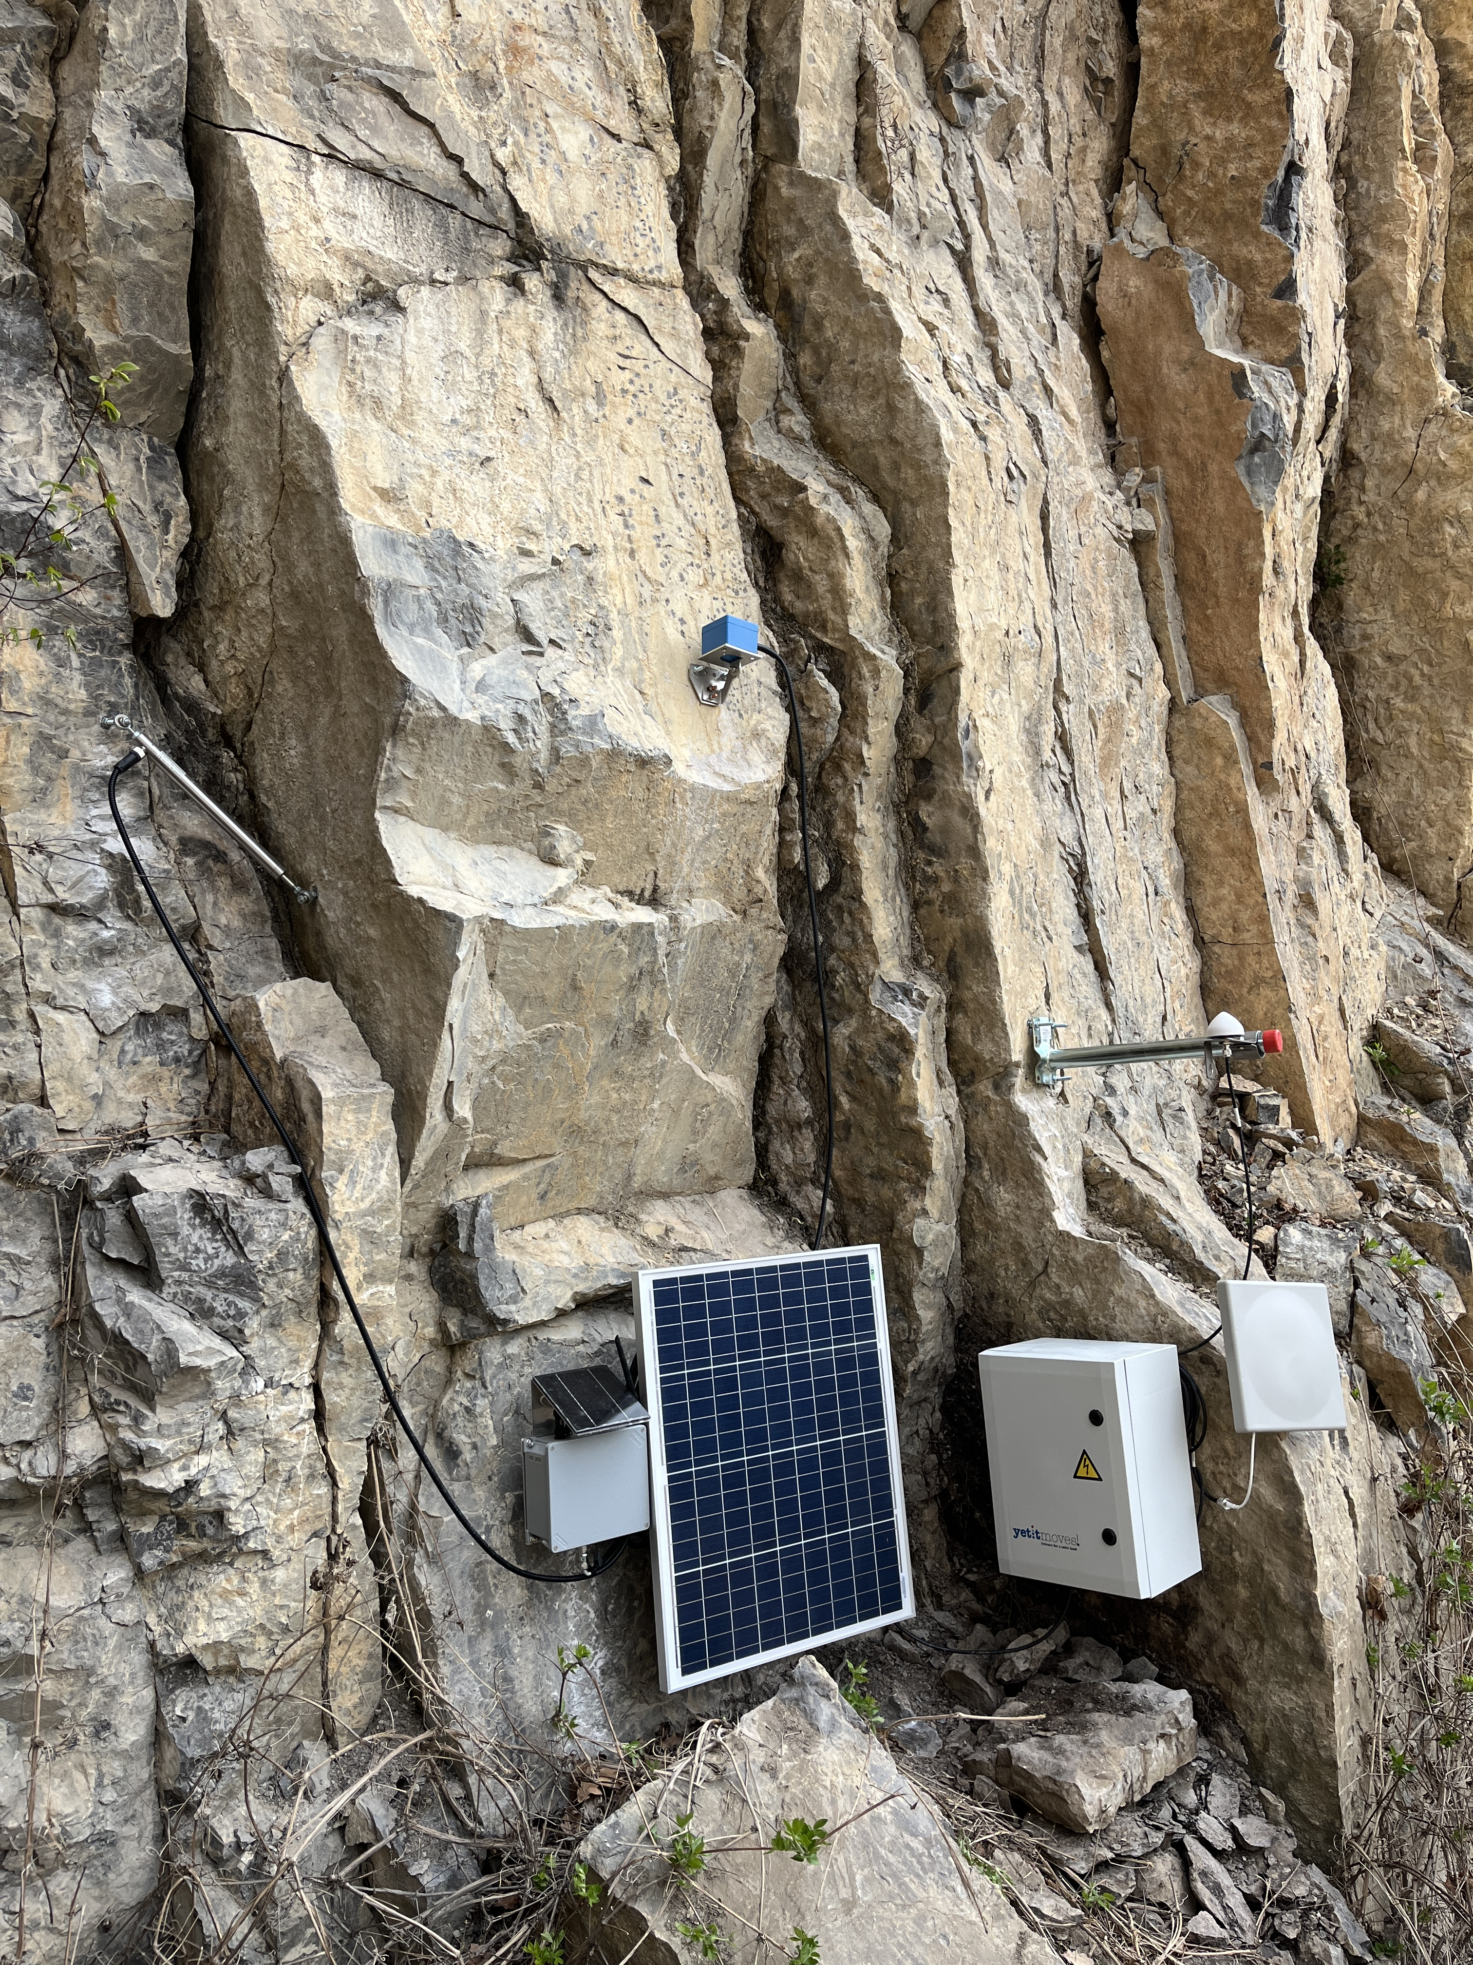
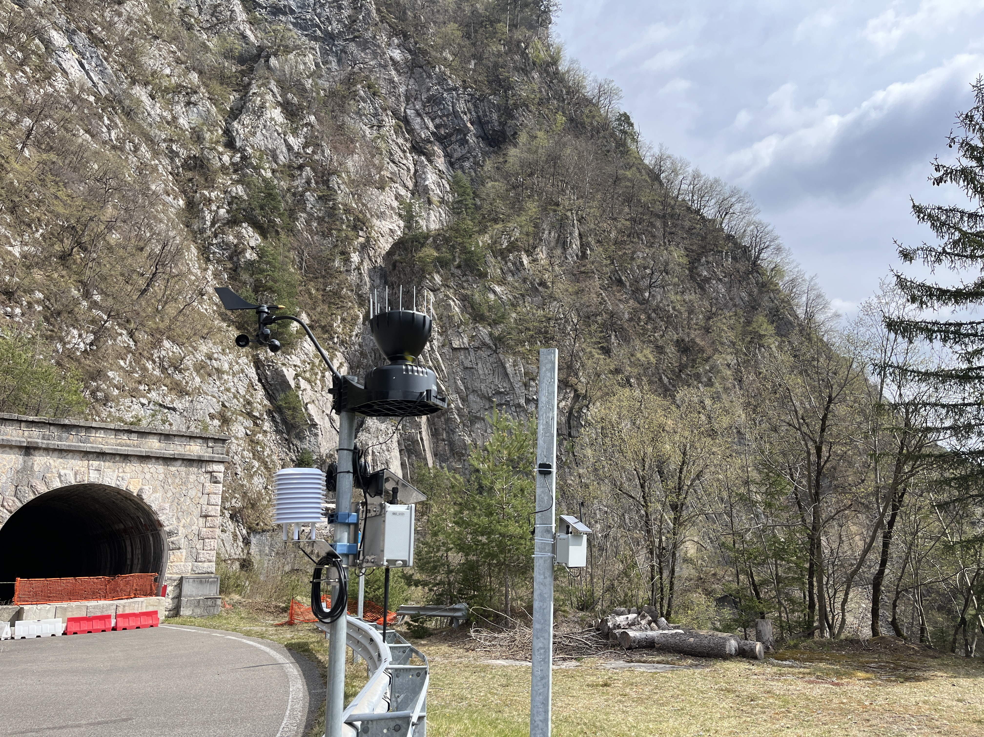
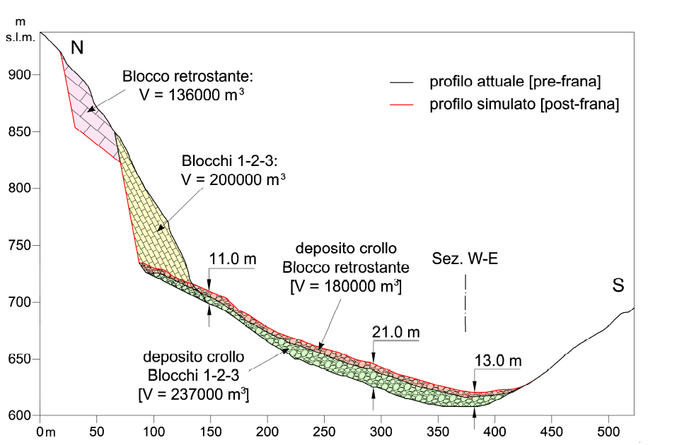
Test Site – Passo della Morte activities 7.6 & 7.7
Progresses in collaboration
Università degli studi di Udine
Dipartimento Politecnico
Ingegneria e Architettura, 2018

Slide 18

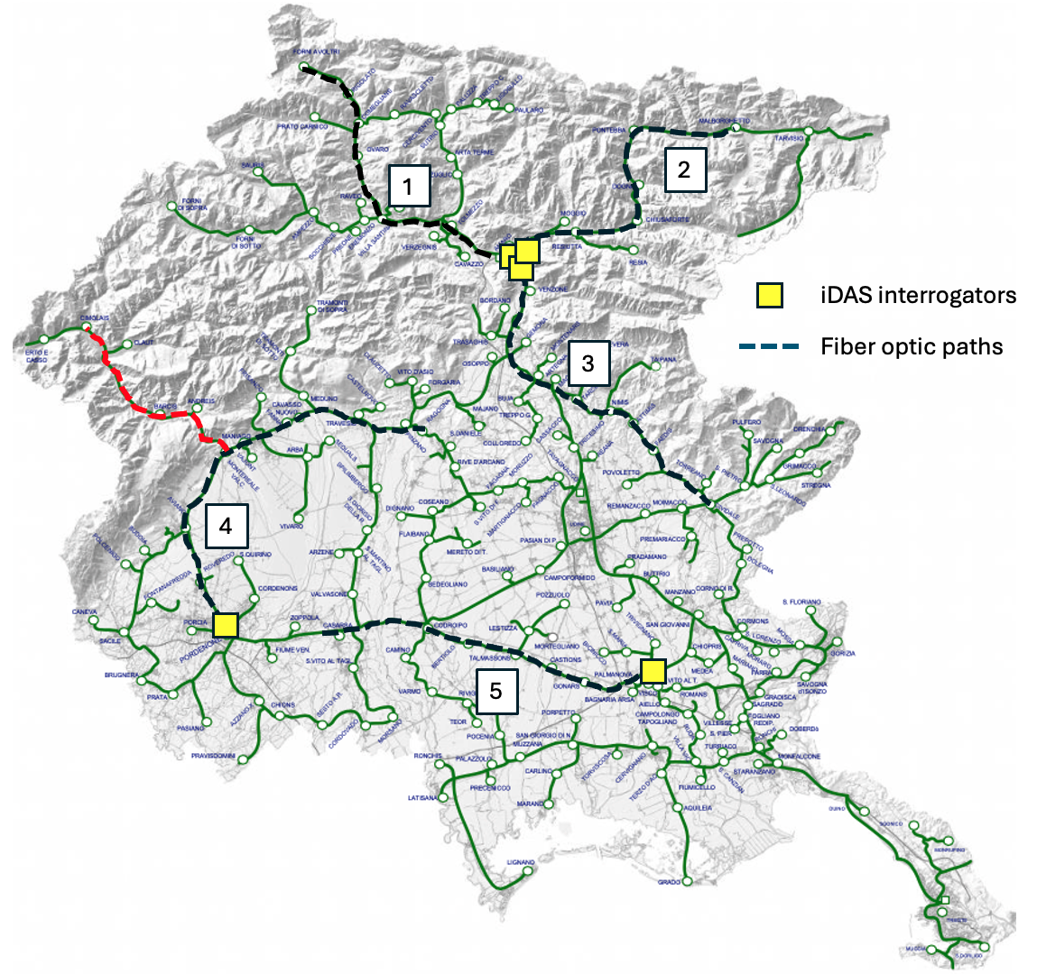


7.7 Integrated facility for the access to SMINO observations
New Regional Seismic Monitoring Using Optical Fibers
INSIEL is the regional ICT company managing telecommunication networks in Friuli Venezia Giulia.
An agreement was established between OGS, INSIEL, and the Regional FVG Government to use public fiber optic infrastructure for scientific monitoring.
This collaboration enables the installation of DAS systems on existing dark fibers to enhance seismic and geodetic monitoring.
It represents an innovative partnership for regional safety and research excellence.
Instrumental capacities

Slide 19



7.7 Integrated facility for the access to SMINO observations
New Regional Seismic Monitoring Using Optical Fibers
The node of Amaro (UD)
3 x NAS / Preprocessing units
(144Tb disk, 64 Gb RAM each)
iDAS line 1 – Amaro-Tarvisio
(50 km path, 16m spacing,
~3000 channels)
iDAS line 2 – Amaro-Udine/Cividale
(50 km path, 16m spacing,
~3000 channels)
iDAS line 3 – Amaro-Sappada
(50 km path, 16m spacing,
~3000 channels)
Instrumental capacities

Slide 20


7.7 Integrated facility for the access to SMINO observations
New Regional Seismic Monitoring Using Optical Fibers
The improved calibration centre
Instrumental capacities

Slide 21



7.8 Data integrated facility for the access to geophysical observations on the subsurface
PiTOP: geophysical test site in the ECCSEL – ERIC consortium
800 wireless nodes NuSeis (1600 channels), mono and 3C
Borehole receiver Avalon GSR-1
Borehole Distributed Acoustic Sensing (DAS) cable
Carina® (DAS) interrogator
Mobile laboratory/office
Carina® Sensing System (Silixa)
Instrumental capacities

Slide 22



7.9 Integrated facility for accessible airborne geophysical observations.
GPR drone
Electromagnetic drone
Instrumental capacities

Slide 23

7.9 Integrated facility for accessible airborne geophysical observations.
GPR drone
Electromagnetic drone
Instrumental capacities

Slide 24


7.9 Integrated facility for accessible airborne geophysical observations.
Strapdown gravimeter
Piper aircraft of OGS inserted in EUFAR
Instrumental capacities

Slide 25





Activity 7.4 - Networking the ground- airborne instrumental facilities for land surface monitoring
New datasets from «Carlone landslide» pilot site (Tito, PZ)
Multi-sensor “Carlone landslide” monitoring system (work in progress…)
(In collaboration with WP5 and WP6)
(In collaboration with CNR IREA)
Progresses in collaboration

Slide 26

7.7 Integrated facility for the access to SMINO observations
Ocean Bottom Seismograph- WP5 &WP7
Instrumental capacities & Progresses in collaboration

Slide 27


Interaction between WP5, WP7 (7.7) and WP8: Downstream VRE: Land and Marine domain toolboxes
The land domain aims to analysis areas exposed to hydrogeological hazards, in particular landslides. The focus is on the potential impact of climate change on pilot test sites. Data from the test site is collected using monitoring systems.
Progresses in collaboration

Slide 28







Activity 7.4 - Networking the ground- airborne instrumental facilities for land surface monitoring
Synergies with other projects
Deterioration assessment of reinforced concrete structures
(PRIN 2022 ICARUS)
Characterisation and management of historic centres and heritage buildings
(PRIN 2022 NEW AGE)
resilient and sustainable cities
Support to the Civil Protection Department for the Campi Flegrei THIRD LEVEL MICROZONATION
Sustainable geothermal
energy exploitation
(PRIN 2022 PNRR
TOGETHER)
Sustainable use of water resources in coastal areas (PRIN 2022 SUBGEO)
Progresses in collaboration

Slide 29






7.5 - Earth Observation infrastructure based on airborne X/L Band SAR and in-situ geophysical data (CNR-IREA)
ITINERIS support to other research activities
PRIN2022 – ARACNE (grant n. 202225CSP2)
A RAdar system for Contactless surveys of reinforced concrete
(PRIN-PNRR)—SEAWATCH (CUP B53D23023940001)
Short-rangE K-bAnd Wave rAdar sysTem Close to tHe coast
(PRIN-PNRR)—TR-HA-M
Relation between 3D Thermo-Rheological model and seismic HAzard for the risk Mitigation in the urban areas of Southern Italy
Progresses in collaboration

Slide 30


7.7 - Integrated facility for the access to SMINO observations
ITINERIS support to other research activities and synergy with other projects
EPOS
PiTOP is working to address the FAIR data principles, by starting to offer the download of its seismic data DOI: 10.13120/0DTM-JX93
To be part (in the future) of European distributed research infrastructures that facilitate the integrated use of data
Progresses in collaboration

Slide 31


WP7 – Demonstrations to stakeholders
13 June 2025, Tito 16 July, Udine
Demonstration to stakeholders

Slide 32



WP7 – Demonstrations to stakeholders
13 June 2025, Tito 16 July, Udine
Demonstration to stakeholders

Slide 34




Activity 7.4 - Networking the ground- airborne instrumental facilities for land surface monitoring
New dataset and products from Potenza pilot site
New dataset
New products
c) Map of Soil-Building Resonance
HVSR soil survey: 300 signals of the soils of the city of Potenza
HVSR buildings survey: 153 signals of buildings of the city of Potenza (their selection was performed by taking into account different characteristics i.e. height of the building, area in plan of the building, construction type, tipology of outcropping soils).
a) Iso-frequency map of the soil of the city of Potenza
b) Iso-frequency map of the buildings of Potenza

Slide 35
7.5 - Earth Observation infrastructure based on airborne X/L Band SAR and in-situ geophysical data (CNR-IREA)
Enhancement of instrumental and technological capabilities
IMPROVED DATA PROCESSING CAPABILITIES @ IREA
vs an optimized use of multi-channel Ground Penetrating Radar
design, implementation, validation of data processing approaches exploiting the increased amount of gathered data for improving the imaging performances
vs an optimized use of UAV based Ground Penetrating Radar and Magnetometer
design, implementation, validation of data processing approaches accounting for flight positioning information
vs an integrated use of electromagnetic methodologies for subsoils investigations
design and implementation of strategies to integrate results provided by different sensors
vs SAR focusing algorithms optimized for processing data collected by the new instrumentation
design, implementation, validation of data processing approaches accounting for the peculiarity of the novel available devices and exploiting GPU-based architectures for enabling faster generation of high-quality SAR imagery

Slide 36
Main results
Dati/servizi già disponibili, in particolare se si tratta di nuovi data product sviluppati grazie all’integrazione di risorse e competenze di più IR/domini
Capacità strumentali e tecnologiche realizzate o potenziate
Progressi nell’armonizzazione e collaborazione tra IR, sia all’interno dello stesso dominio che tra domini diversi
Altri risultati rilevanti
Ulteriori attività e sviluppi previsti nella fase conclusiva del progetto

