Slide 1

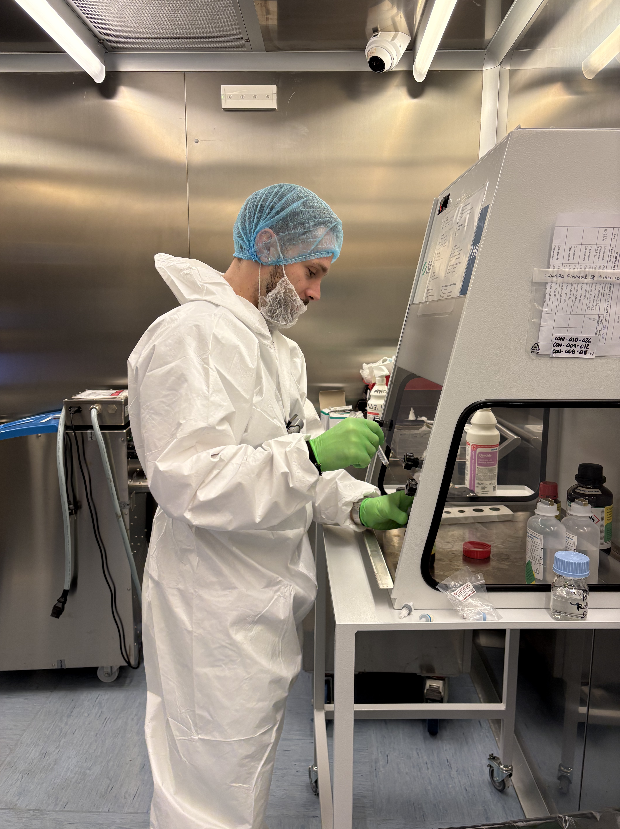
PROFETI: Trasferimento Tecnologico e Prima Rete per l’uso Oncologico della FET in Italia
A. Notaro, Curium Pharma

Slide 2
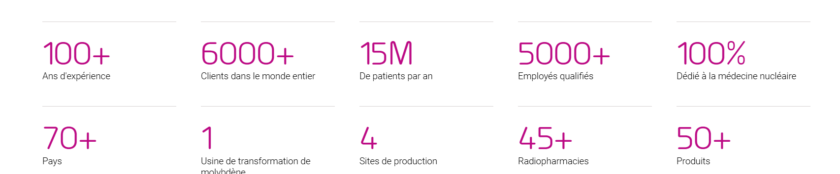


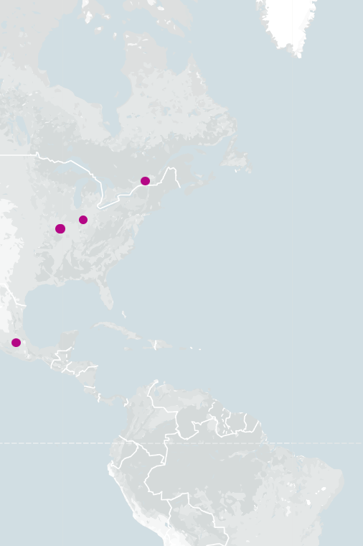
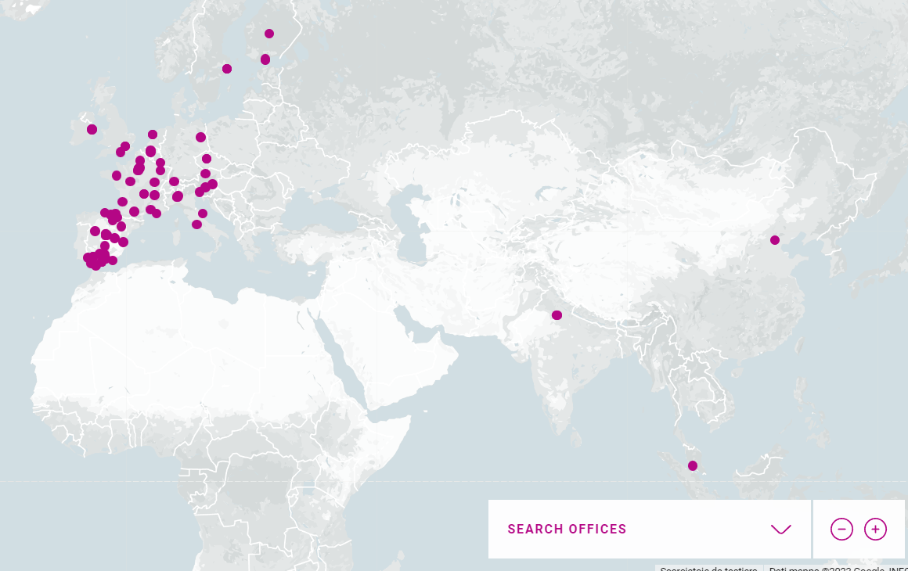
Network of 5 property PET Radiopharmacies in Italy:
Monza, Milano, Udine, Roma, Montecosaro (MC)
+ partnership with CNR in Pisa since 2021 (FDG and 18F-choline)
PET products portfolio:
FDG, 18F-choline, 18F-DOPA
Pylclari© (18F-PSMA)
Vizamyl© (property of GE)
Neuraceq© (property of LMI)
At CNR in Pisa the technology transfer of Pylclari©, 18F-DOPA, and IASOglio© hass been concluded in 2024!
Who are we?

Slide 3

Early stage R&D projects
Development of analytical methods
Development and/or optimization of manufacturing process
Technology Transfer
Technical support
Continuous improvement approach
CMC
(Chemical, Manufacturing, Control)

Slide 4
Promote and strengthen collaboration between research, industry, and local institutions
Create a network of expertise, for production of radiopharmaceuticals
Accelerate the technology transfer of O-(2-[¹⁸F]fluoroethyl)-L-tyrosine ([¹⁸F]FET), which began in Pisa, to the Italian production sites in Rome, Udine, and Milan
Making the drug available throughout the country

Slide 5
PROFETI
Goal 1: Definition of the functional and performance requirements.
Goal 2: Validation of analytical methods and personnel training.
Goal 3: Technology transfer and process validation.
Goal 4: Application to the Italian regulatory authority (AIFA) for the GMP-certification
Goal 5: Creation of a network of expertise, composed of Italian sites authorized for GMP-compliant production of [¹⁸F]FET, that can support the future production and marketing of the radiopharmaceutical by addressing issues related to quality and process efficiency in a shared manner.

Slide 6
Technology Transfer
Technology transfer represents the first step towards drug commercial production and refers to the transfer of documentation, manufacturing process, and analytical methods.
The successful completion of the technology transfer should provide the documentary evidence that the process delivers a final product complying to specifications in a reliable and reproducible manner, by adhering to the process and maintaining the process parameters within the examined range.

Slide 7





Clinical supply
Technology Transfer
Regulatory filing
Process validation
Methods validation
Gap analysis

Slide 8
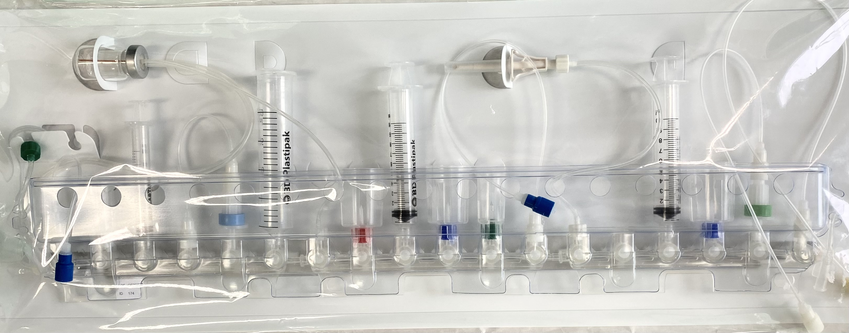
Identificaton of blocking points and corresponding corrective measures
Purchease of equipment, raw materials
Facilities: cyclotron, hotcells, dispensing capacity
Quality control: equipment, raw materials
Document implementation
Documentation: training material, protocols, SOPs
Production: Synthesis module, raw materials
Gap analysis

Slide 9
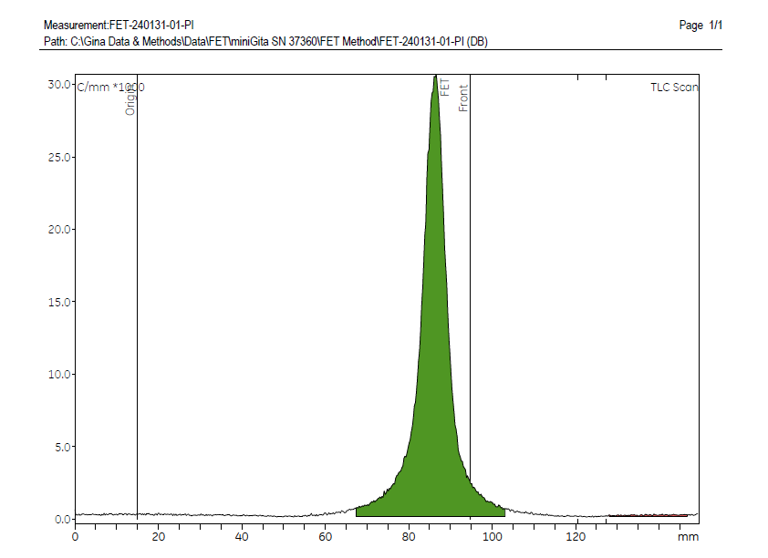
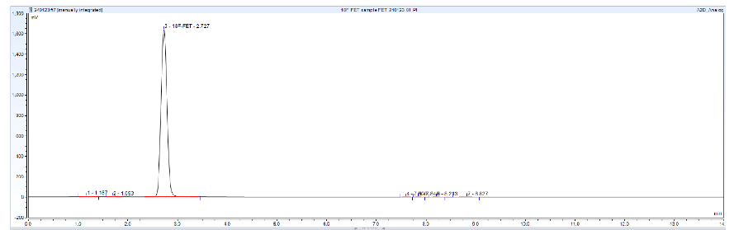
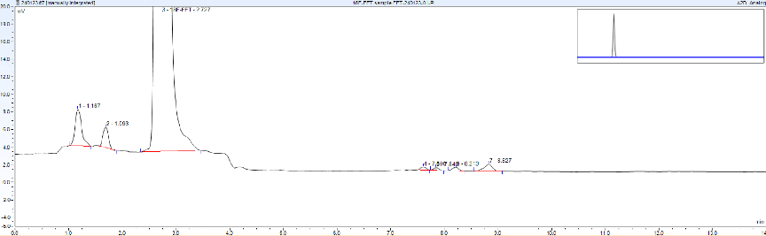
Analytical validation and personnel training
pH measurement
Chemical purity, Radiochemical Purity, Radiochemical identification by HPLC
Radiochemical Purity by TLC
Chemical purity by spot test
Residual solvents and Ethanol content by GC
Endotoxins

Slide 10
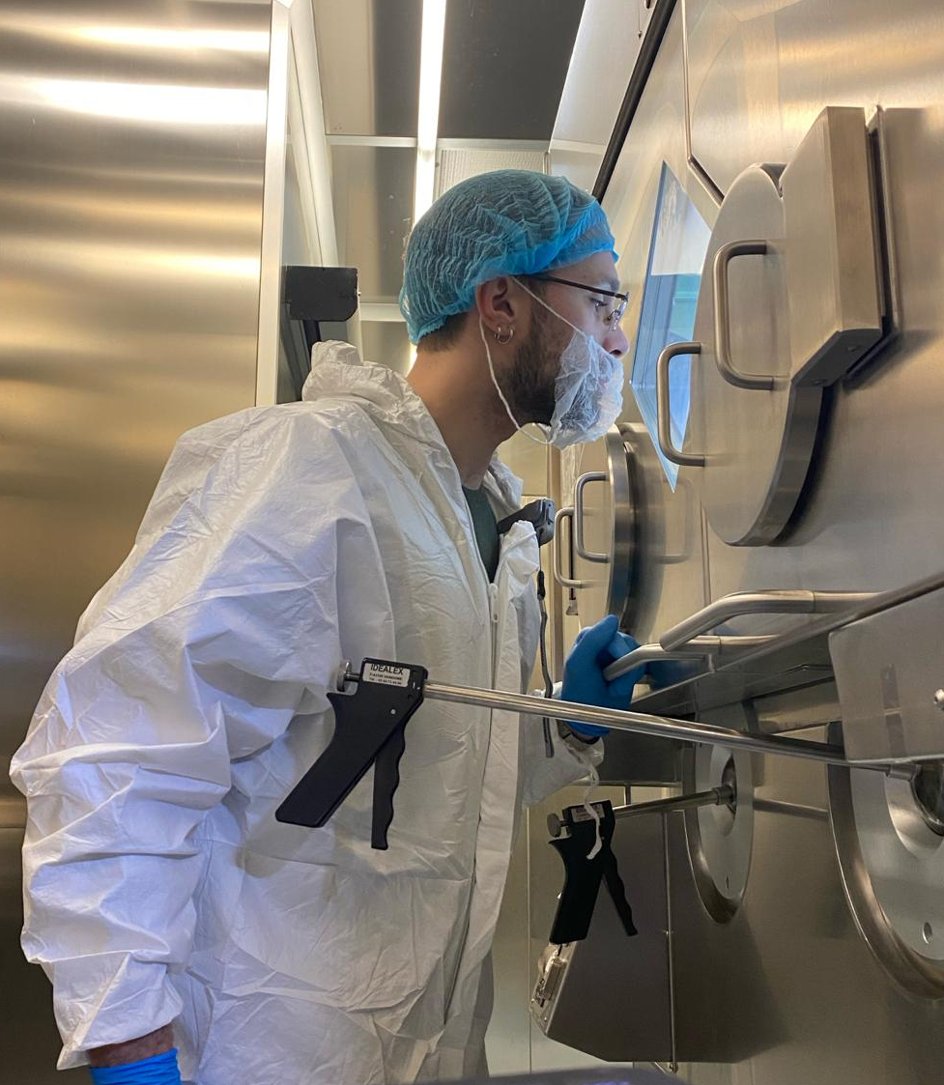
Process validation
3 consecutive process validation batches: quality control analysis at t0 and expiry
3 transfer batches
3 bioburden batches
Completion of the documentation after sterility results

Slide 11
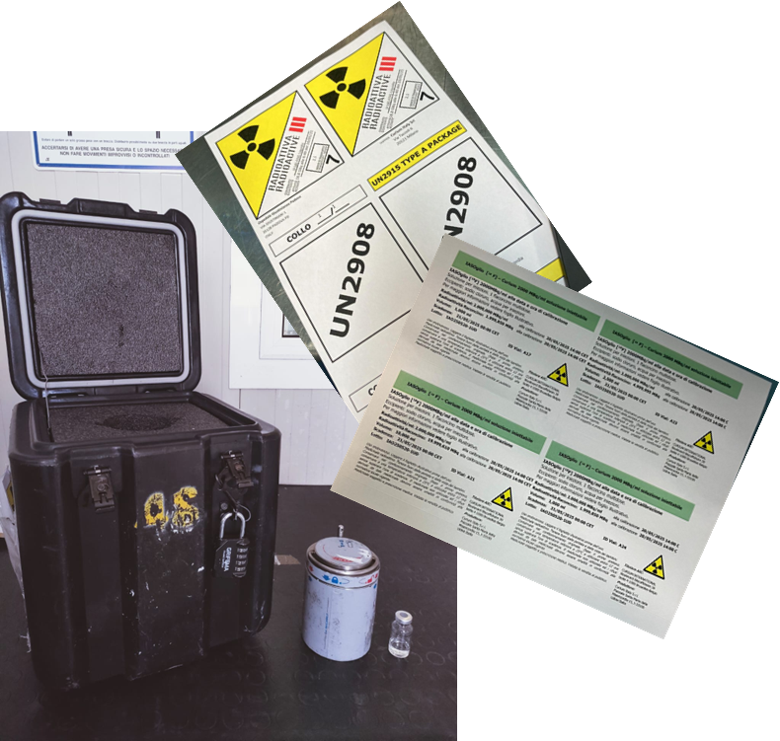


Regulatory filing
Preparation of regulatory package documentation
Submission to the designated authorities
Potential questions
Submission approval
Commercial production

Slide 12



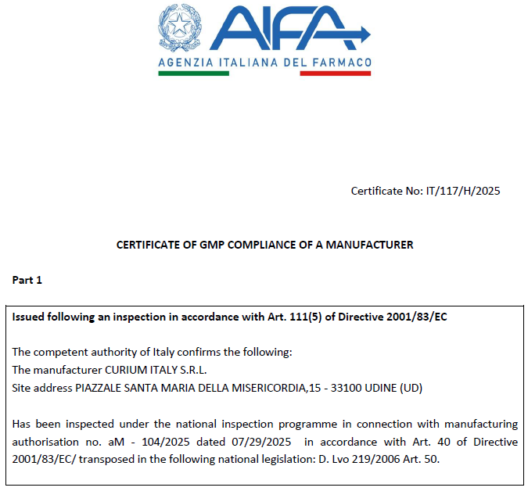
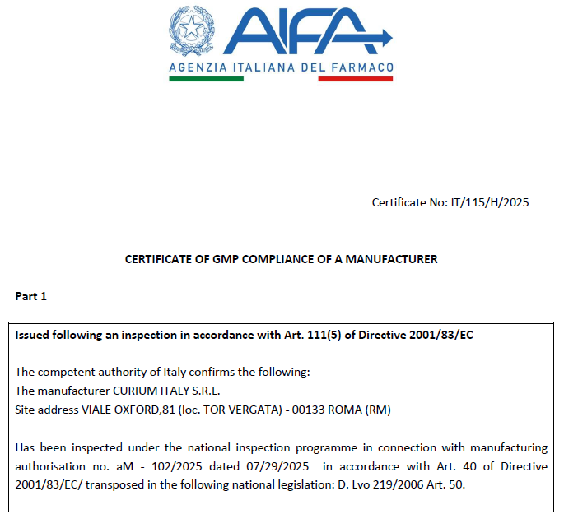
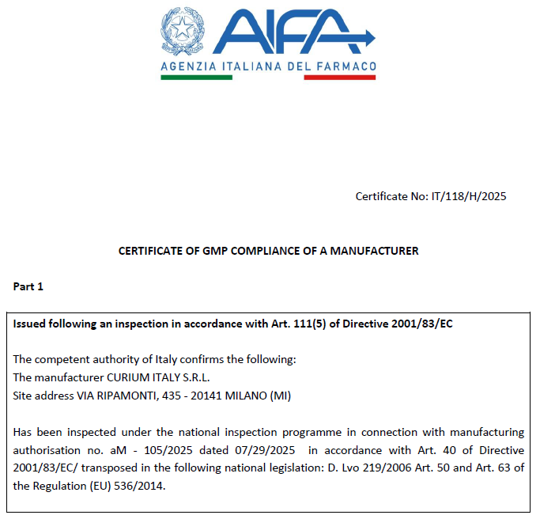
[¹⁸F]-FET technology transfer and AIFA authorization for the manufacturing sites
UDINE
ROME
MILAN

Slide 13
Clinical supply
First batch (October 2025)

Slide 14
Grazie per la gentile attenzione
Domande?
Relatrice:
Anna Notaro, PhD
R&D scientist presso Curium Pharma
anna.notaro@curiumpharma.com

