Slide 1

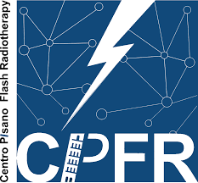
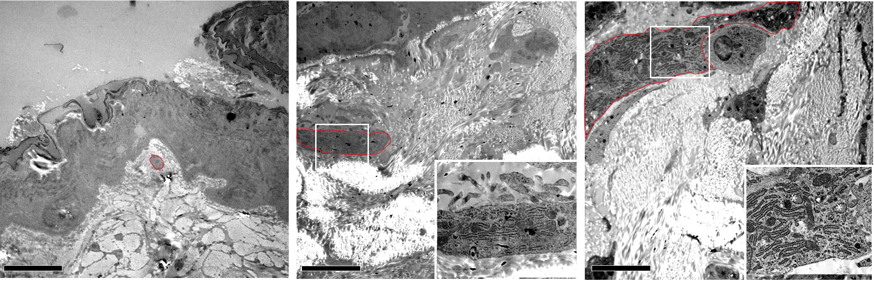
FLASH Radiotherapy Preserves Systemic and Tissue Homeostasis While Maintaining Antitumor Efficacy
Giulia Furini†, Eduarda Mota Da Silva†, Alice Usai, Gaia Scabia, Claudia Kusmic, Francesco Faita, Andrea Cavalieri, Mariagrazia Celentano, Mario Costa, Filippo Rossi, Giulia Asero, Roberta Di Pietro, Emanuela Guerra, Stefano Lattanzio, Tonia Luca, Sergio Castorina, Roberto Cusano, Riccardo Berutti, Jessica Milia, Simone Capaccioli, Alessandra Gonnelli, Noemi Giannini, Fabiola Paiar, Saverio Cinti, Fabio Di Martino & Margherita Maffei

Slide 2
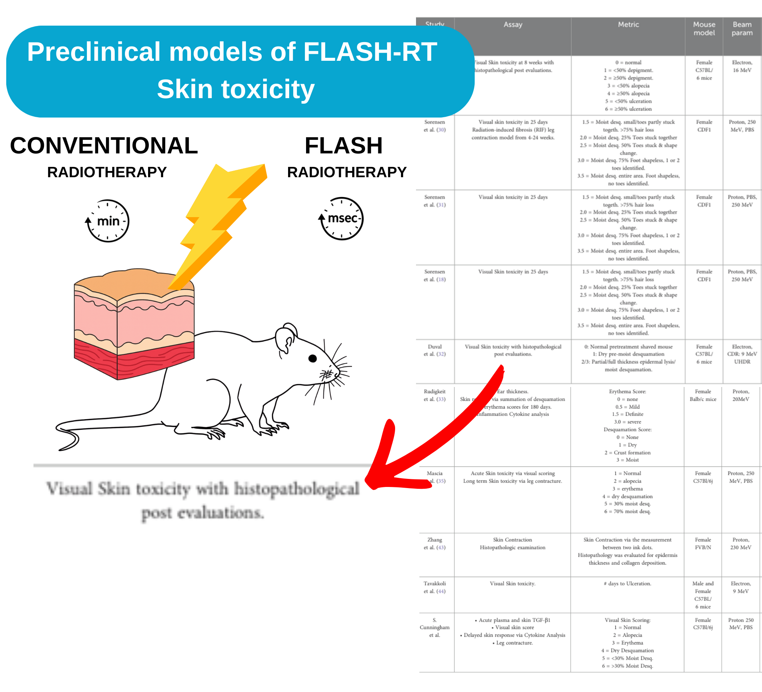

FLASH radiotherapy Preclinical Models
What did we already know?
Tumor iso-efficacy of FLASH-RT vs CONV-RT in multiple solid tumor models.
Reduced skin toxicity with FLASH-RT, mostly evaluated by qualitative damage scoring.
What was missing?
Is FLASH iso-effective on Melanoma?
What are the long-term effects of FLASH-RT on skin?
Does FLASH-RT affect underlying muscle tissue?
Does irradiation induce systemic alterations, and are they modulated by FLASH-RT?

Slide 3
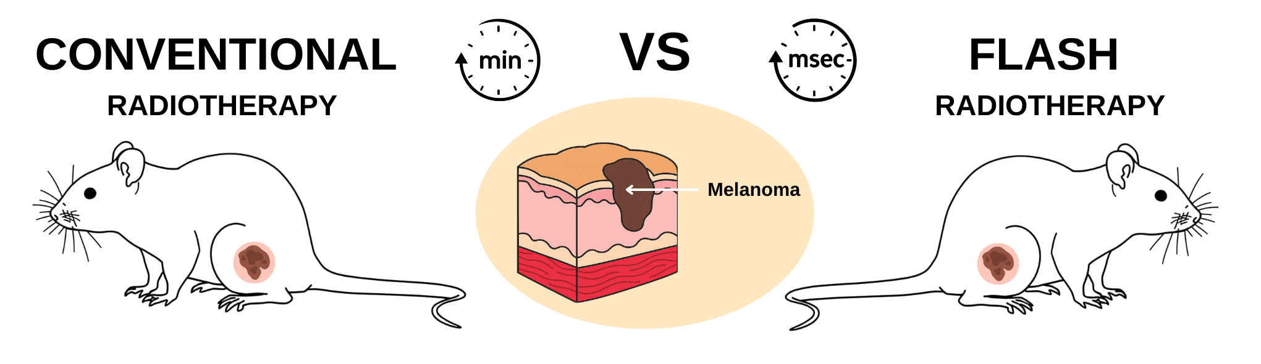
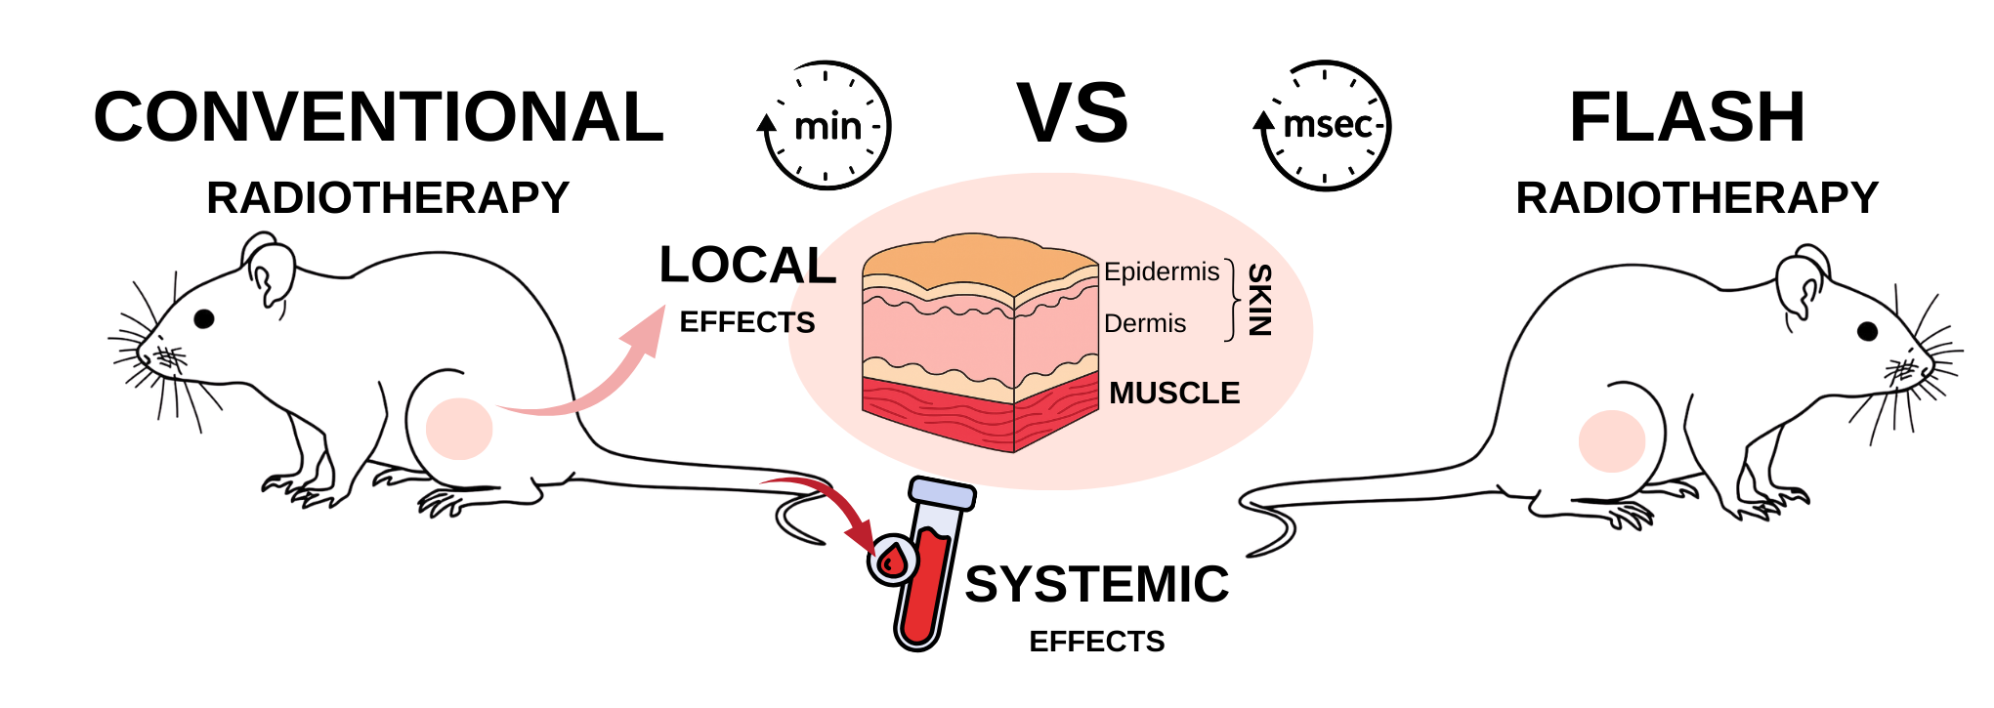
Aims
Melanoma Model
Tumor isoefficacy first: Comparing efficacy and toxicity of FLASH vs CONV-RT in a murine melanoma model as a benchmark for tumor response.
Tissue sparing — how deep does it go? Move beyond qualitative damage scoring, investigating the FLASH-RT sparing effect in skin and underlying muscle through integrated transcriptomics, histology, and ultrastructure, assessing long-term outcomes in a naïve murine model.
Beyond local effects: Investigate systemic effects of FLASH-RT in a naïve model by analyzing circulating metabolic and inflammatory markers.
Naïve Model

Slide 4
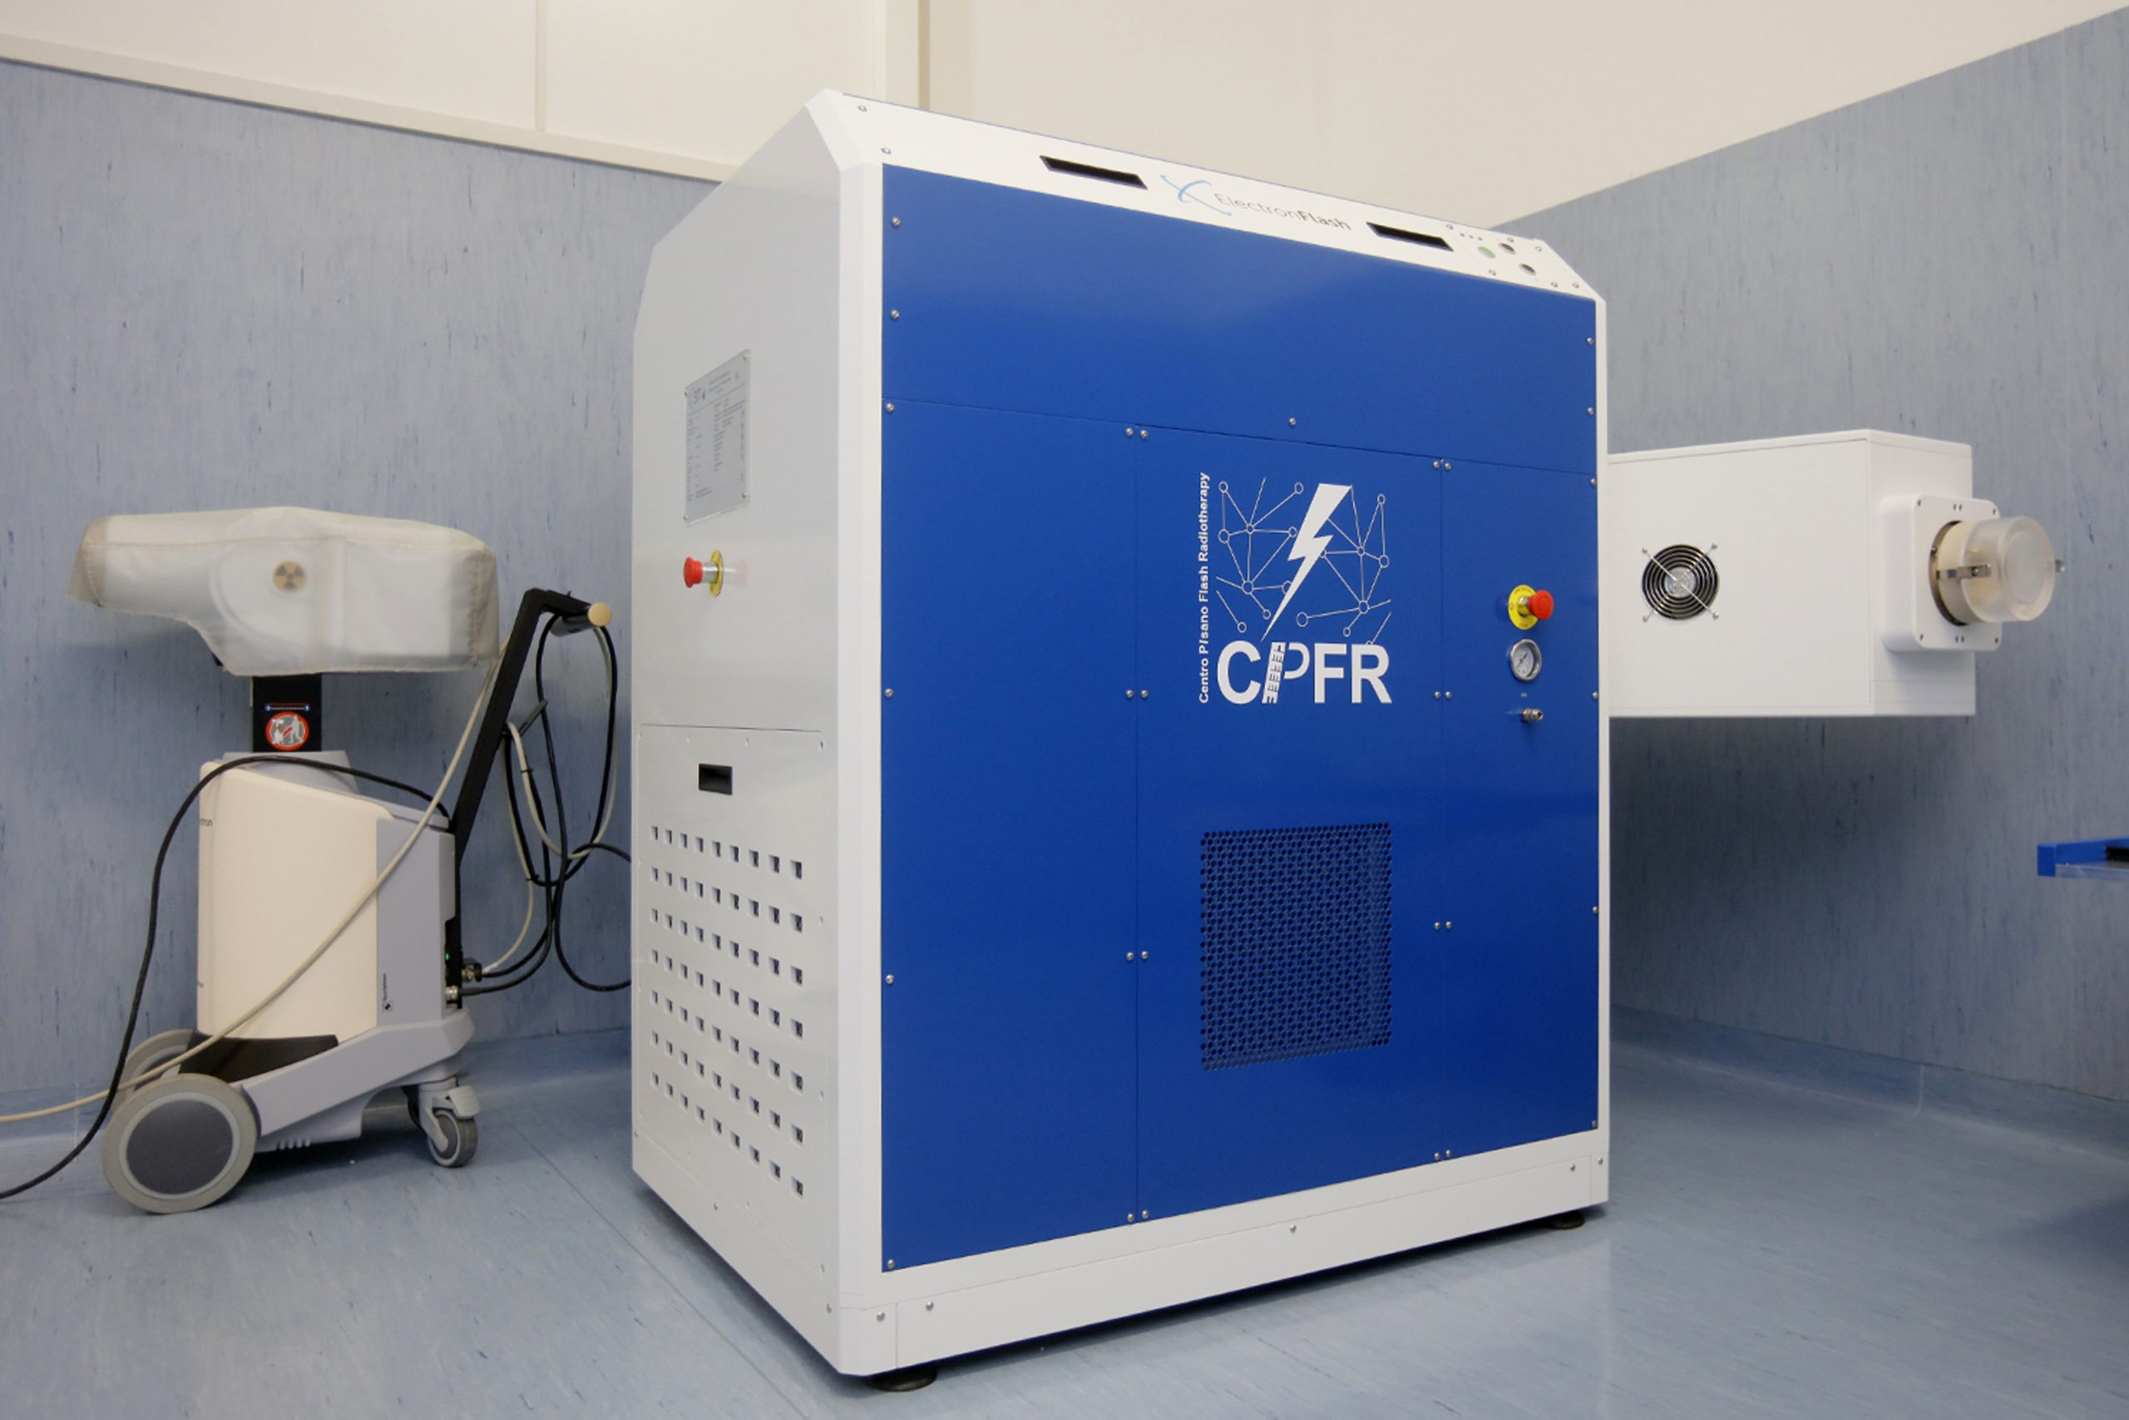
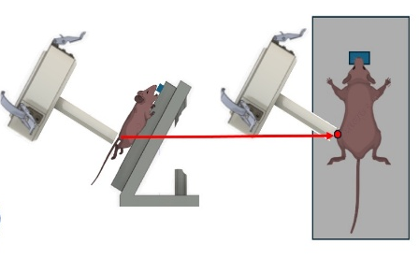
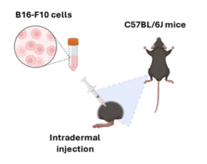
Table 1. Radiotherapy experimental parameters: relevant parameters used in each irradiation condition.
DPP, dose per pulse; PRF, pulse repetition frequency; ADR, average dose rate
The Melanoma Model:
Experimental Setup
Centro Pisano FLASH Radiotherapy
ElectronFlash linear accelerator
with triode gun ( 7 or 9 MeV)
B16-F10 cells
C57BL/6J mice
19 Gy and 33.3 Gy
FLASH RT
CONV-RT
Intradermal injection
Radiotherapy experimental parameters:
0
3
5
12
21
28
35
 | Total dose [Gy] | Number of pulses | DPP [Gy] | Pulse duration [µs] | PRF [Hz] | ADR [Gy/s]
FLASH-RT | 19.0 | 4 | 4.75 | 4 | 145 | 940
 | 33.3 | 7 | 4.75 | 4 | 170 | 940
CONV-RT | 19.0 | 103 | 0.19 | 4 | 1 | 0.18
 | 33.3 | 180 | 0.19 | 4 | 1 | 0.18
DAY
Baseline
Tumor volume - Systemic biomarkers
Vital parameters
Sacrifice
DPP, dose per pulse; PRF, pulse repetition frequency; ADR, average dose rate

Slide 5
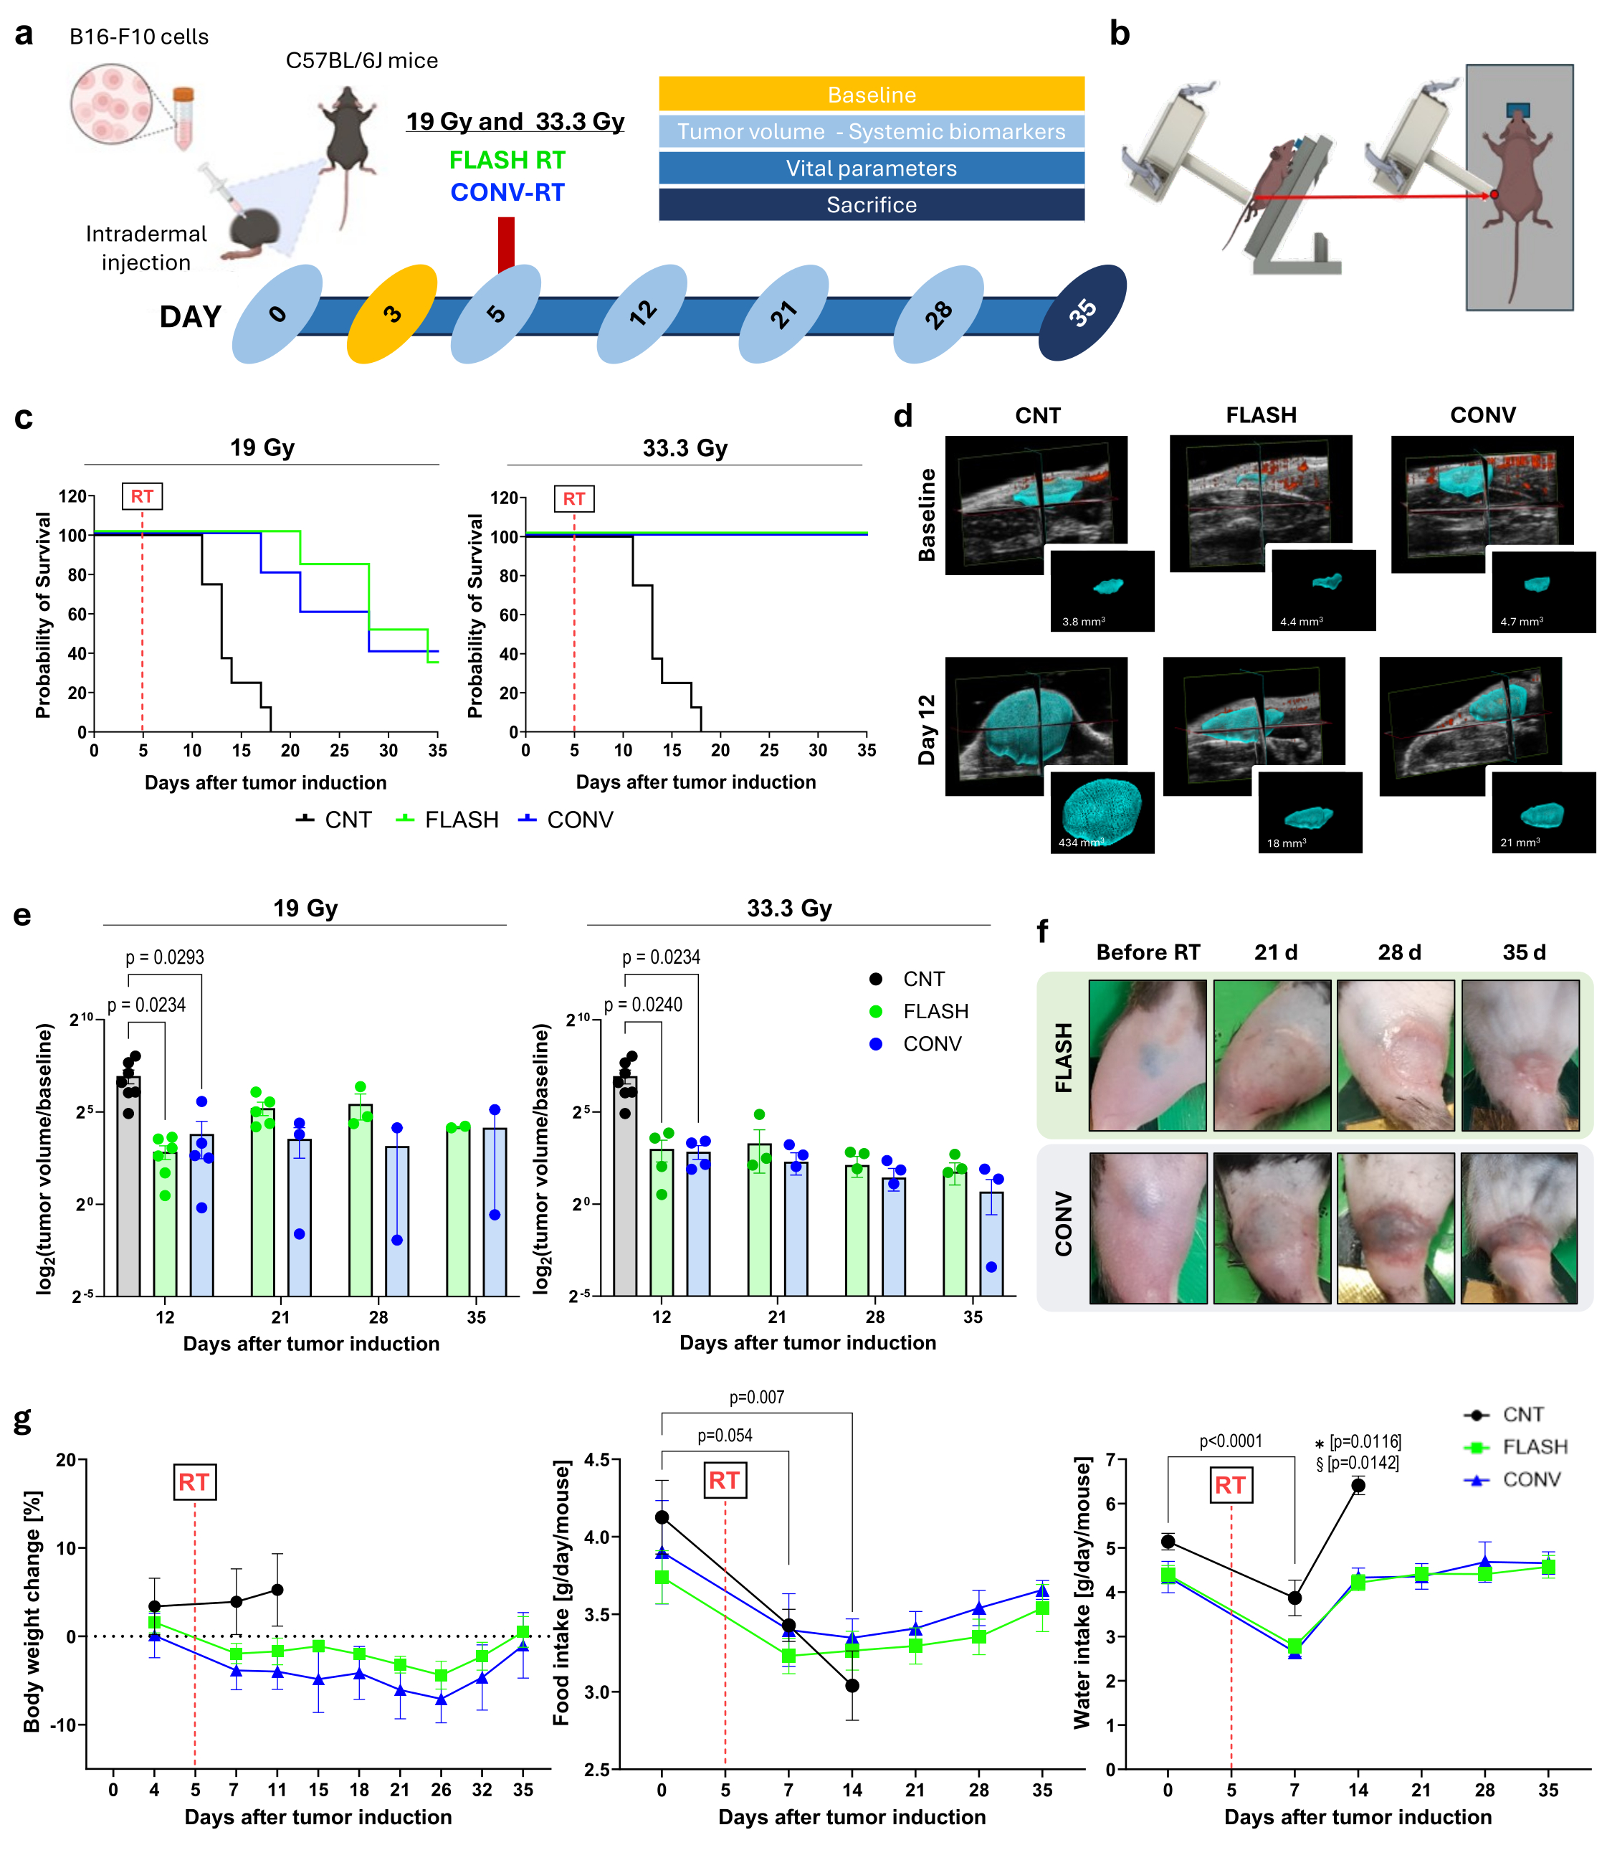
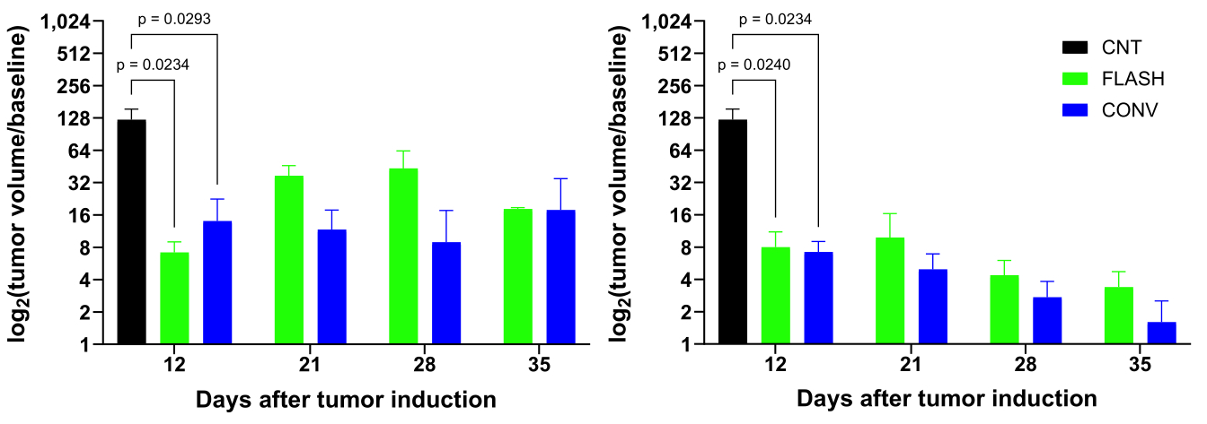
The Melanoma Model:
Survival and Tumor control
Comparable tumor control: FLASH-RT = CONV-RT
Comparable survival rate: FLASH-RT = CONV-RT
3D Volumetric measurement with Ultrasound
Furini et al., BMC Med 2026 Feb 26. doi: 10.1186/s12916-026-04724-z

Slide 6
The Melanoma Model:
Skin Toxicity
The healthy skin surrounding the tumor lesion appeared better preserved in FLASH-RT mice compared to those receiving CONV-RT
SKIN SPARING EFFECT of FLASH-RT
Naïve Model
Furini et al., BMC Med 2026 Feb 26. doi: 10.1186/s12916-026-04724-z

Slide 7
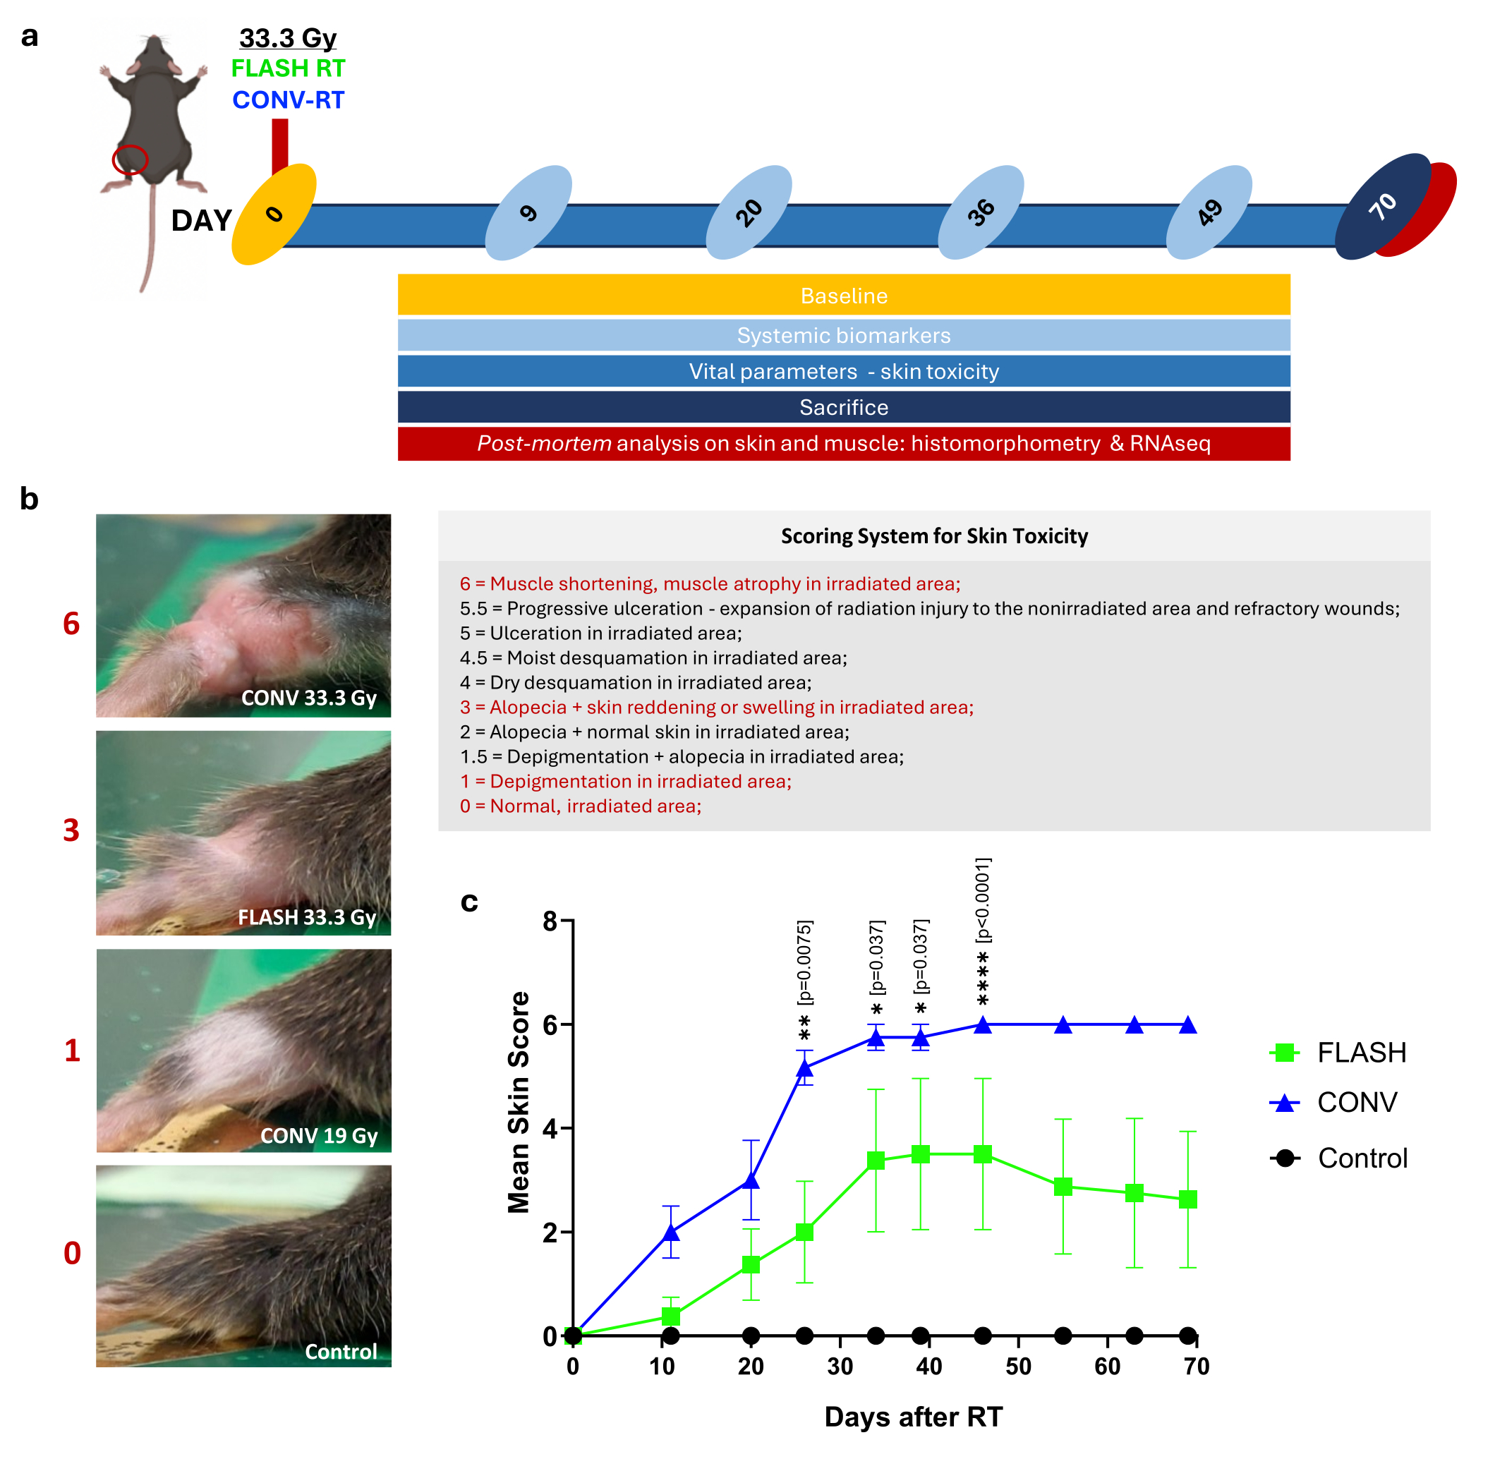
The Naïve Model:
Experimental Setup
Checkpoint 1: Local SKIN response
Checkpoint 2: SYSTEMIC response
Checkpoint 3: Local MUSCLE response
Blood
Blood
Skin biopsies
Muscle biopsies
Blood
Blood
Blood
Blood
up to 70 days post RT

Slide 8
SKIN Toxicity
Skin Damage
CONV-RT >> FLASH-RT
SKIN SPARING EFFECT of FLASH-RT
IS CONFIRMED
Furini et al., BMC Med 2026 Feb 26. doi: 10.1186/s12916-026-04724-z

Slide 9

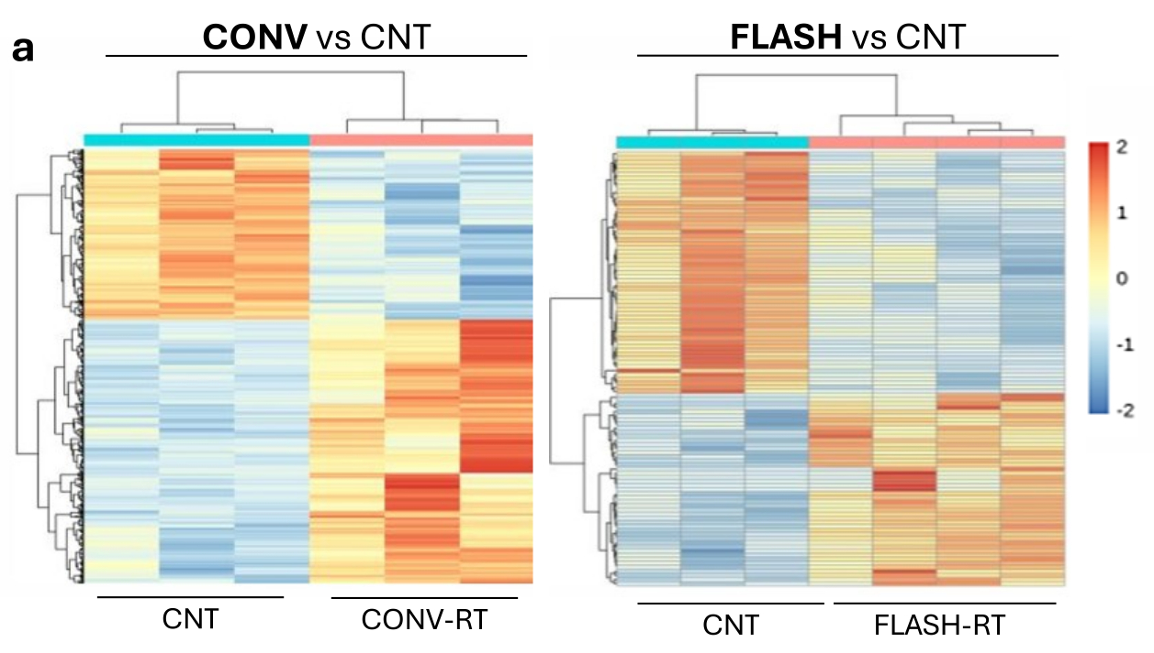
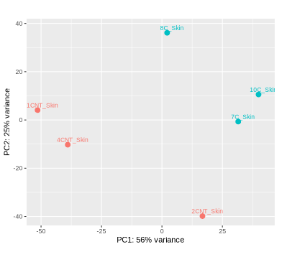
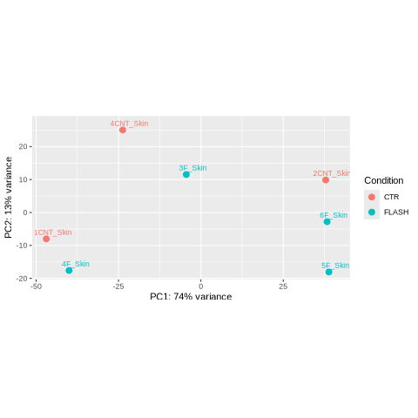
SKIN Transcriptiomic Profiling
1) Diferentially Expressed Genes (DEGs)
DEGs relative to CNT :
CONV-RT >>>> FLASH-RT
Both CONV-RT and FLASH-RT profiles clearly segregate from Controls (CNT)
CONV-RT: 2,461 DEGs (1,513 UP and 948 DOWN)
FLASH-RT: 93 DEGs (42 UP and 51 DOWN)
1486
27
15
911
37
14
CONV
FLASH
CONV
FLASH
Furini et al., BMC Med 2026 Feb 26. doi: 10.1186/s12916-026-04724-z

Slide 10

SKIN Transcriptiomic Profiling
2) Functional Enrichment
Main Functional Classes in CONV-RT
Keratinization
ECM deposition and fibrosis
Inflammation and Immunity
Cell-Matrix interactions
Cell death
Regulation of gene expression
Cell signaling
Enriched Biological Processes:
CONV-RT >>>> FLASH-RT
CONV-RT: 216 Enriched BPs (195 UP and 21 DOWN, p<0.001)
FLASH-RT: 6 Enriched BPs (3 UP and 3 DOWN, p<0.001)
Lipid turnover
Nervous system
Response to temperature
Regulation of gene expression
Cell signaling
192
3
0
21
0
3
CONV
FLASH
CONV
FLASH
Furini et al., BMC Med 2026 Feb 26. doi: 10.1186/s12916-026-04724-z

Slide 11
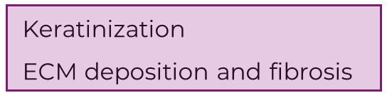
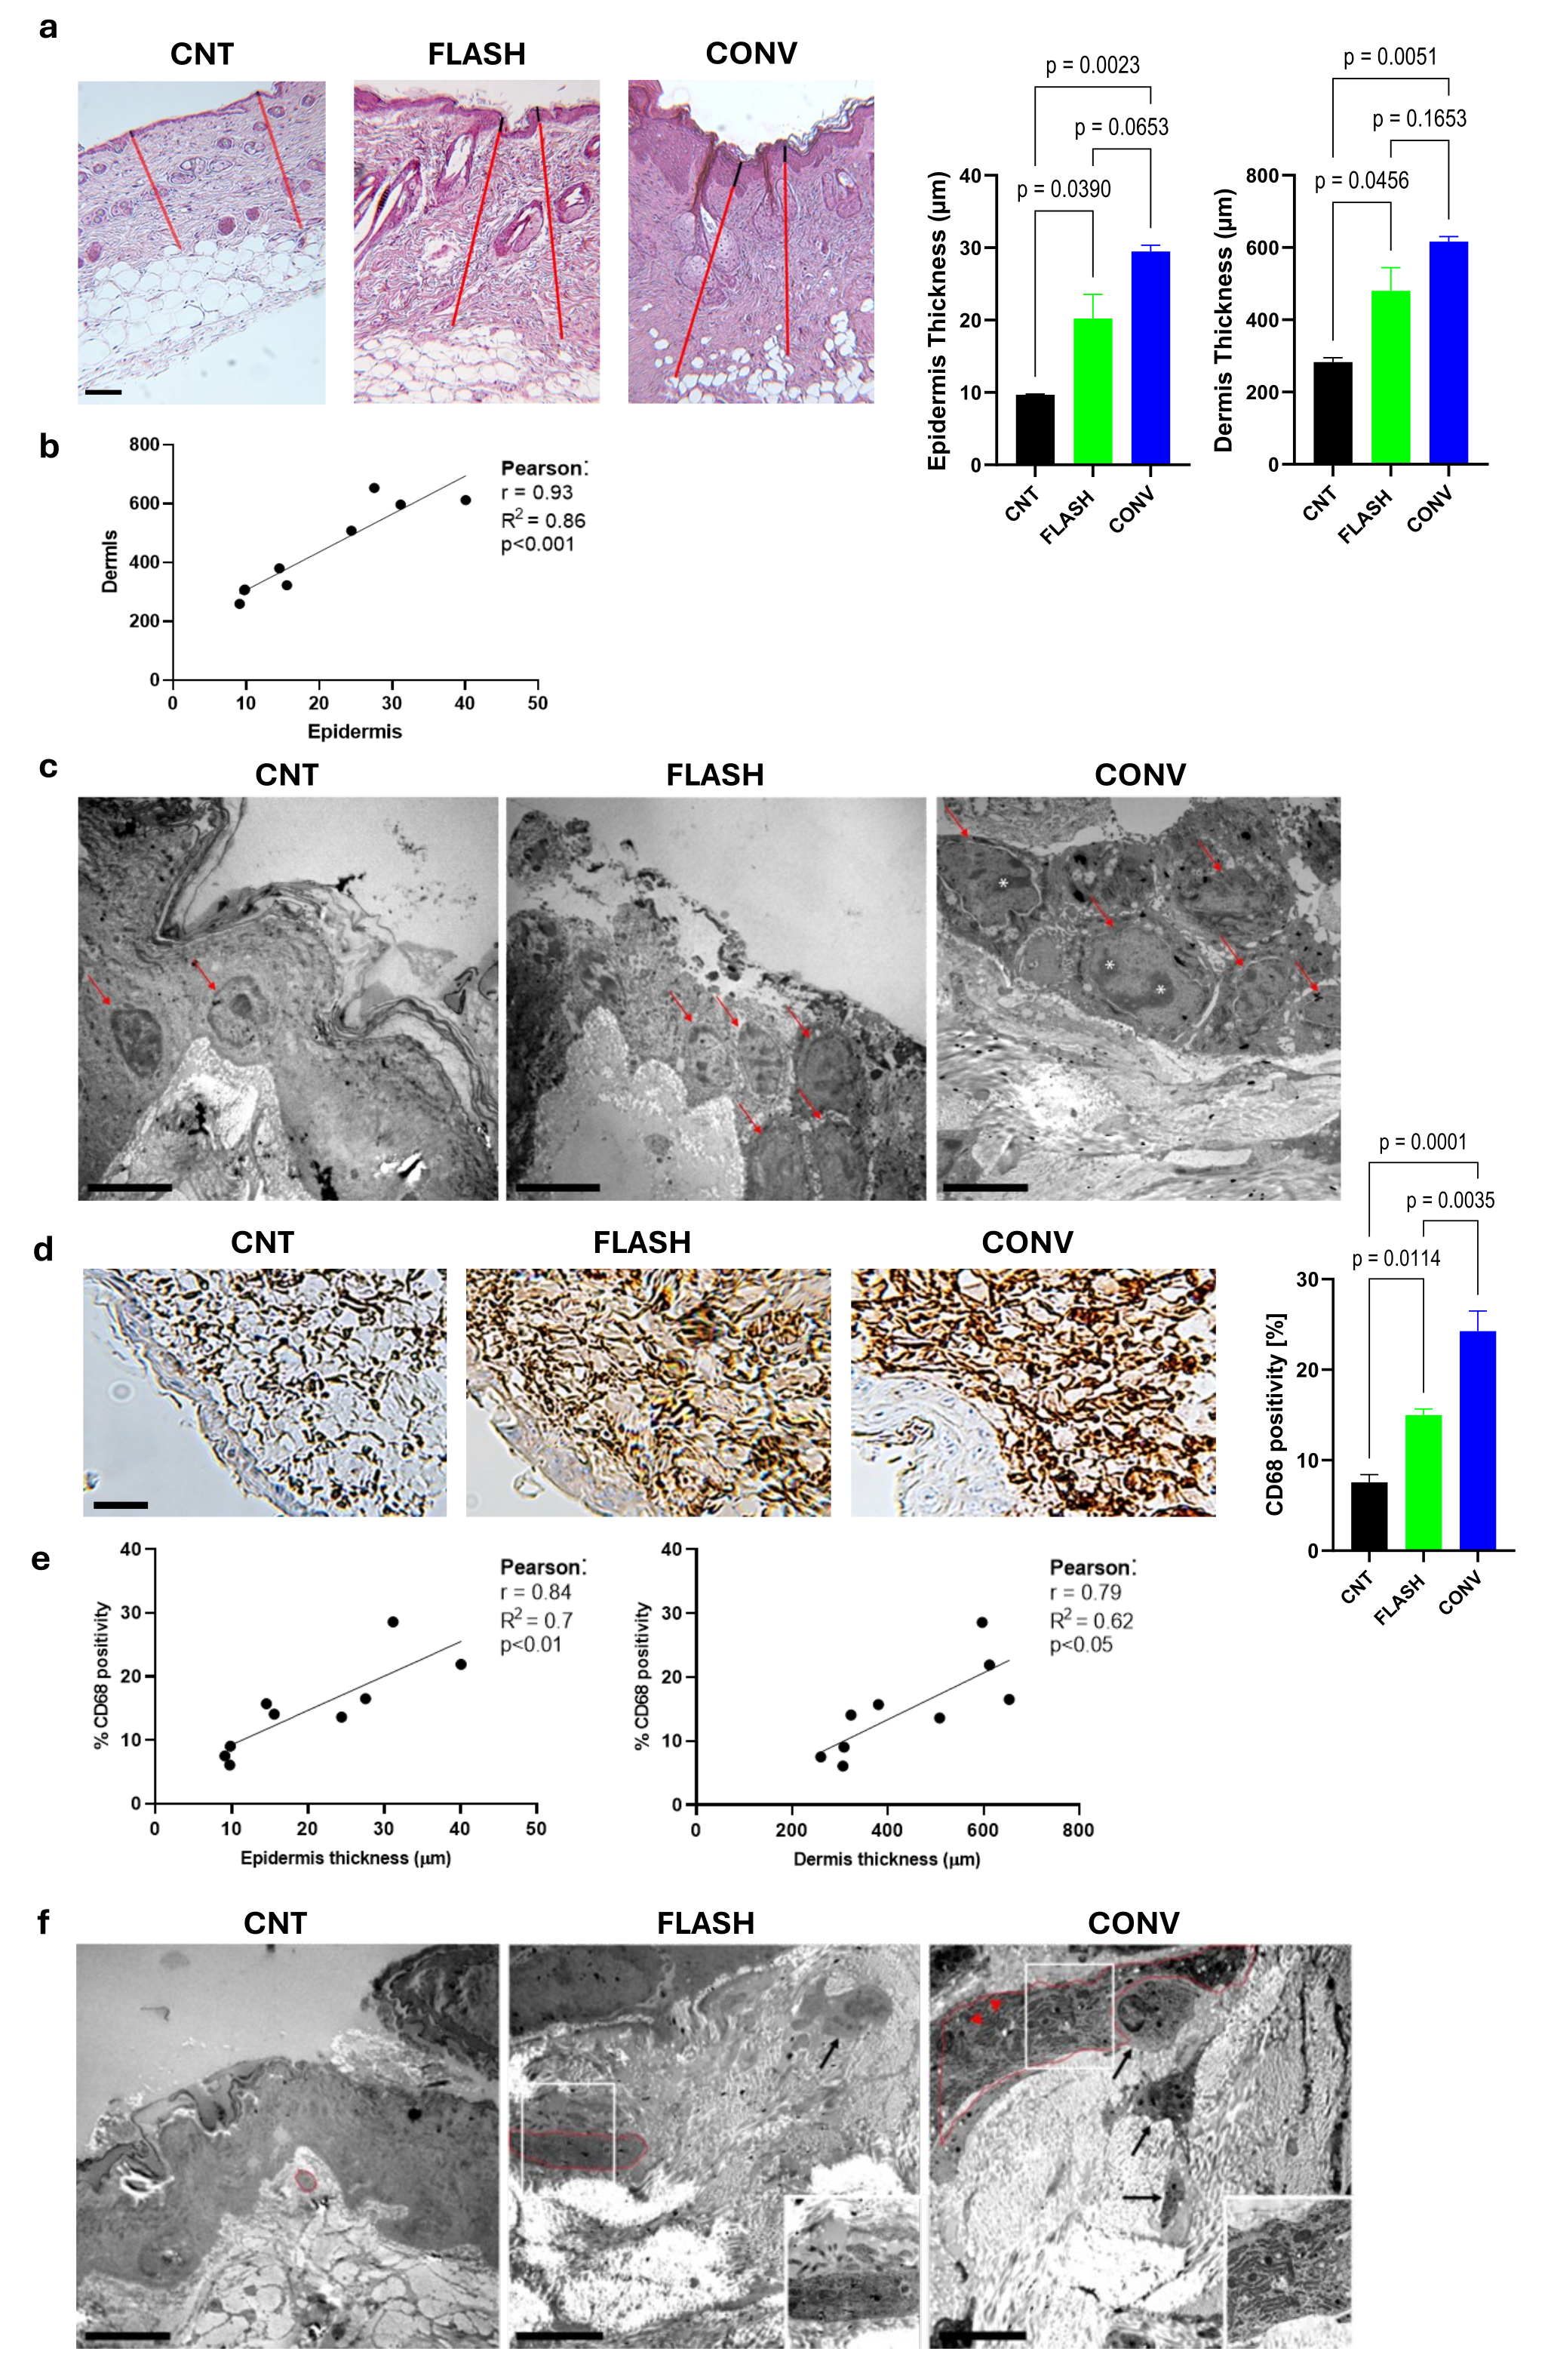
SKIN Architecture and Histomorphology
Skin Thickening
(Epidermis and Dermis)
CONV-RT >> FLASH-RT
Skin thickening in the CONV-RT group: Epidermal proliferation + Increased collagen deposition – fibrotic process
Furini et al., BMC Med 2026 Feb 26. doi: 10.1186/s12916-026-04724-z

Slide 12
Transmission electron microscopy (TEM) images of the epidermis. Red arrows: nuclei of epithelial cells, which are arranged in a single layer in CNT and in multiple layers following irradiation (FLASH and CONV); epithelial cells from irradiated skin display euchromatic nuclei. Asterisks: prominent nucleoli, observed exclusively in the CONV-RT group, suggesting higher transcriptional activity.
SKIN Architecture and Histomorphology
keratinocytes
EPIDERMIS
*
nucleoli
Ultrastructural
differences
CONV-RT >> FLASH-RT
Skin thickening in the CONV-RT group: Epidermal proliferation + Increased collagen deposition / fibrotic process
Fibroblasts
DERMIS
Inset, RER
*
Proteinaceous material in RER
Furini et al., BMC Med 2026 Feb 26. doi: 10.1186/s12916-026-04724-z

Slide 13
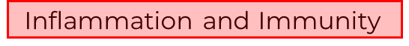
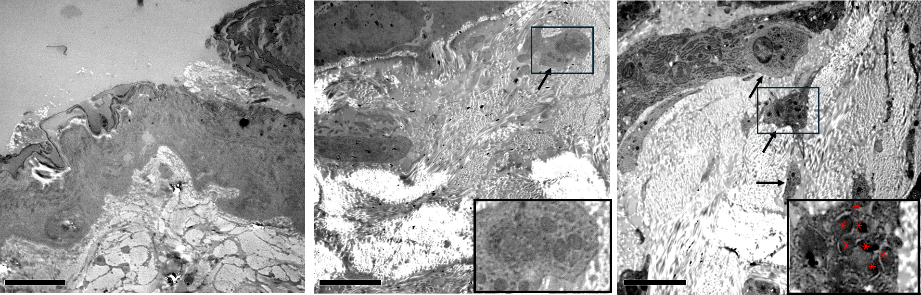
SKIN Architecture and Histomorphology
Inflammatory cells infiltration
CONV-RT >> FLASH-RT
Macrophage
Inset (macrophage)
*
Lysosomes
Furini et al., BMC Med 2026 Feb 26. doi: 10.1186/s12916-026-04724-z

Slide 14
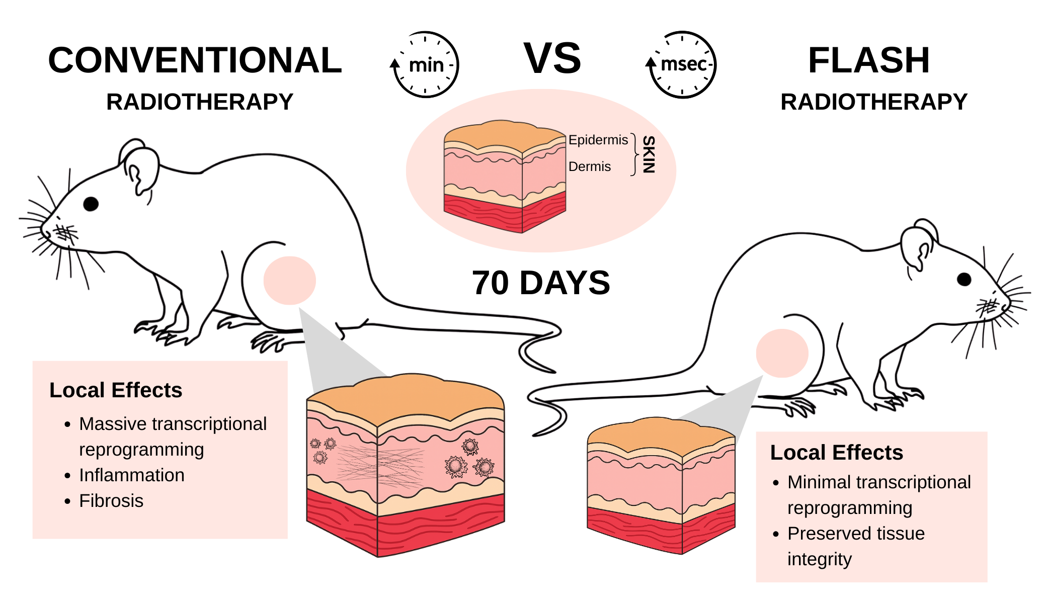
Checkpoint 1: SKIN LOCAL EFFECTS
In comparison with CONV-RT, FLASH-irradiated SKIN exhibits:
  Reduced Damage
  Null to moderate transcriptional changes
  Reduced Fibrosis
  Reduced Inflammation
Tissue sparing of FLASH-RT

Slide 15
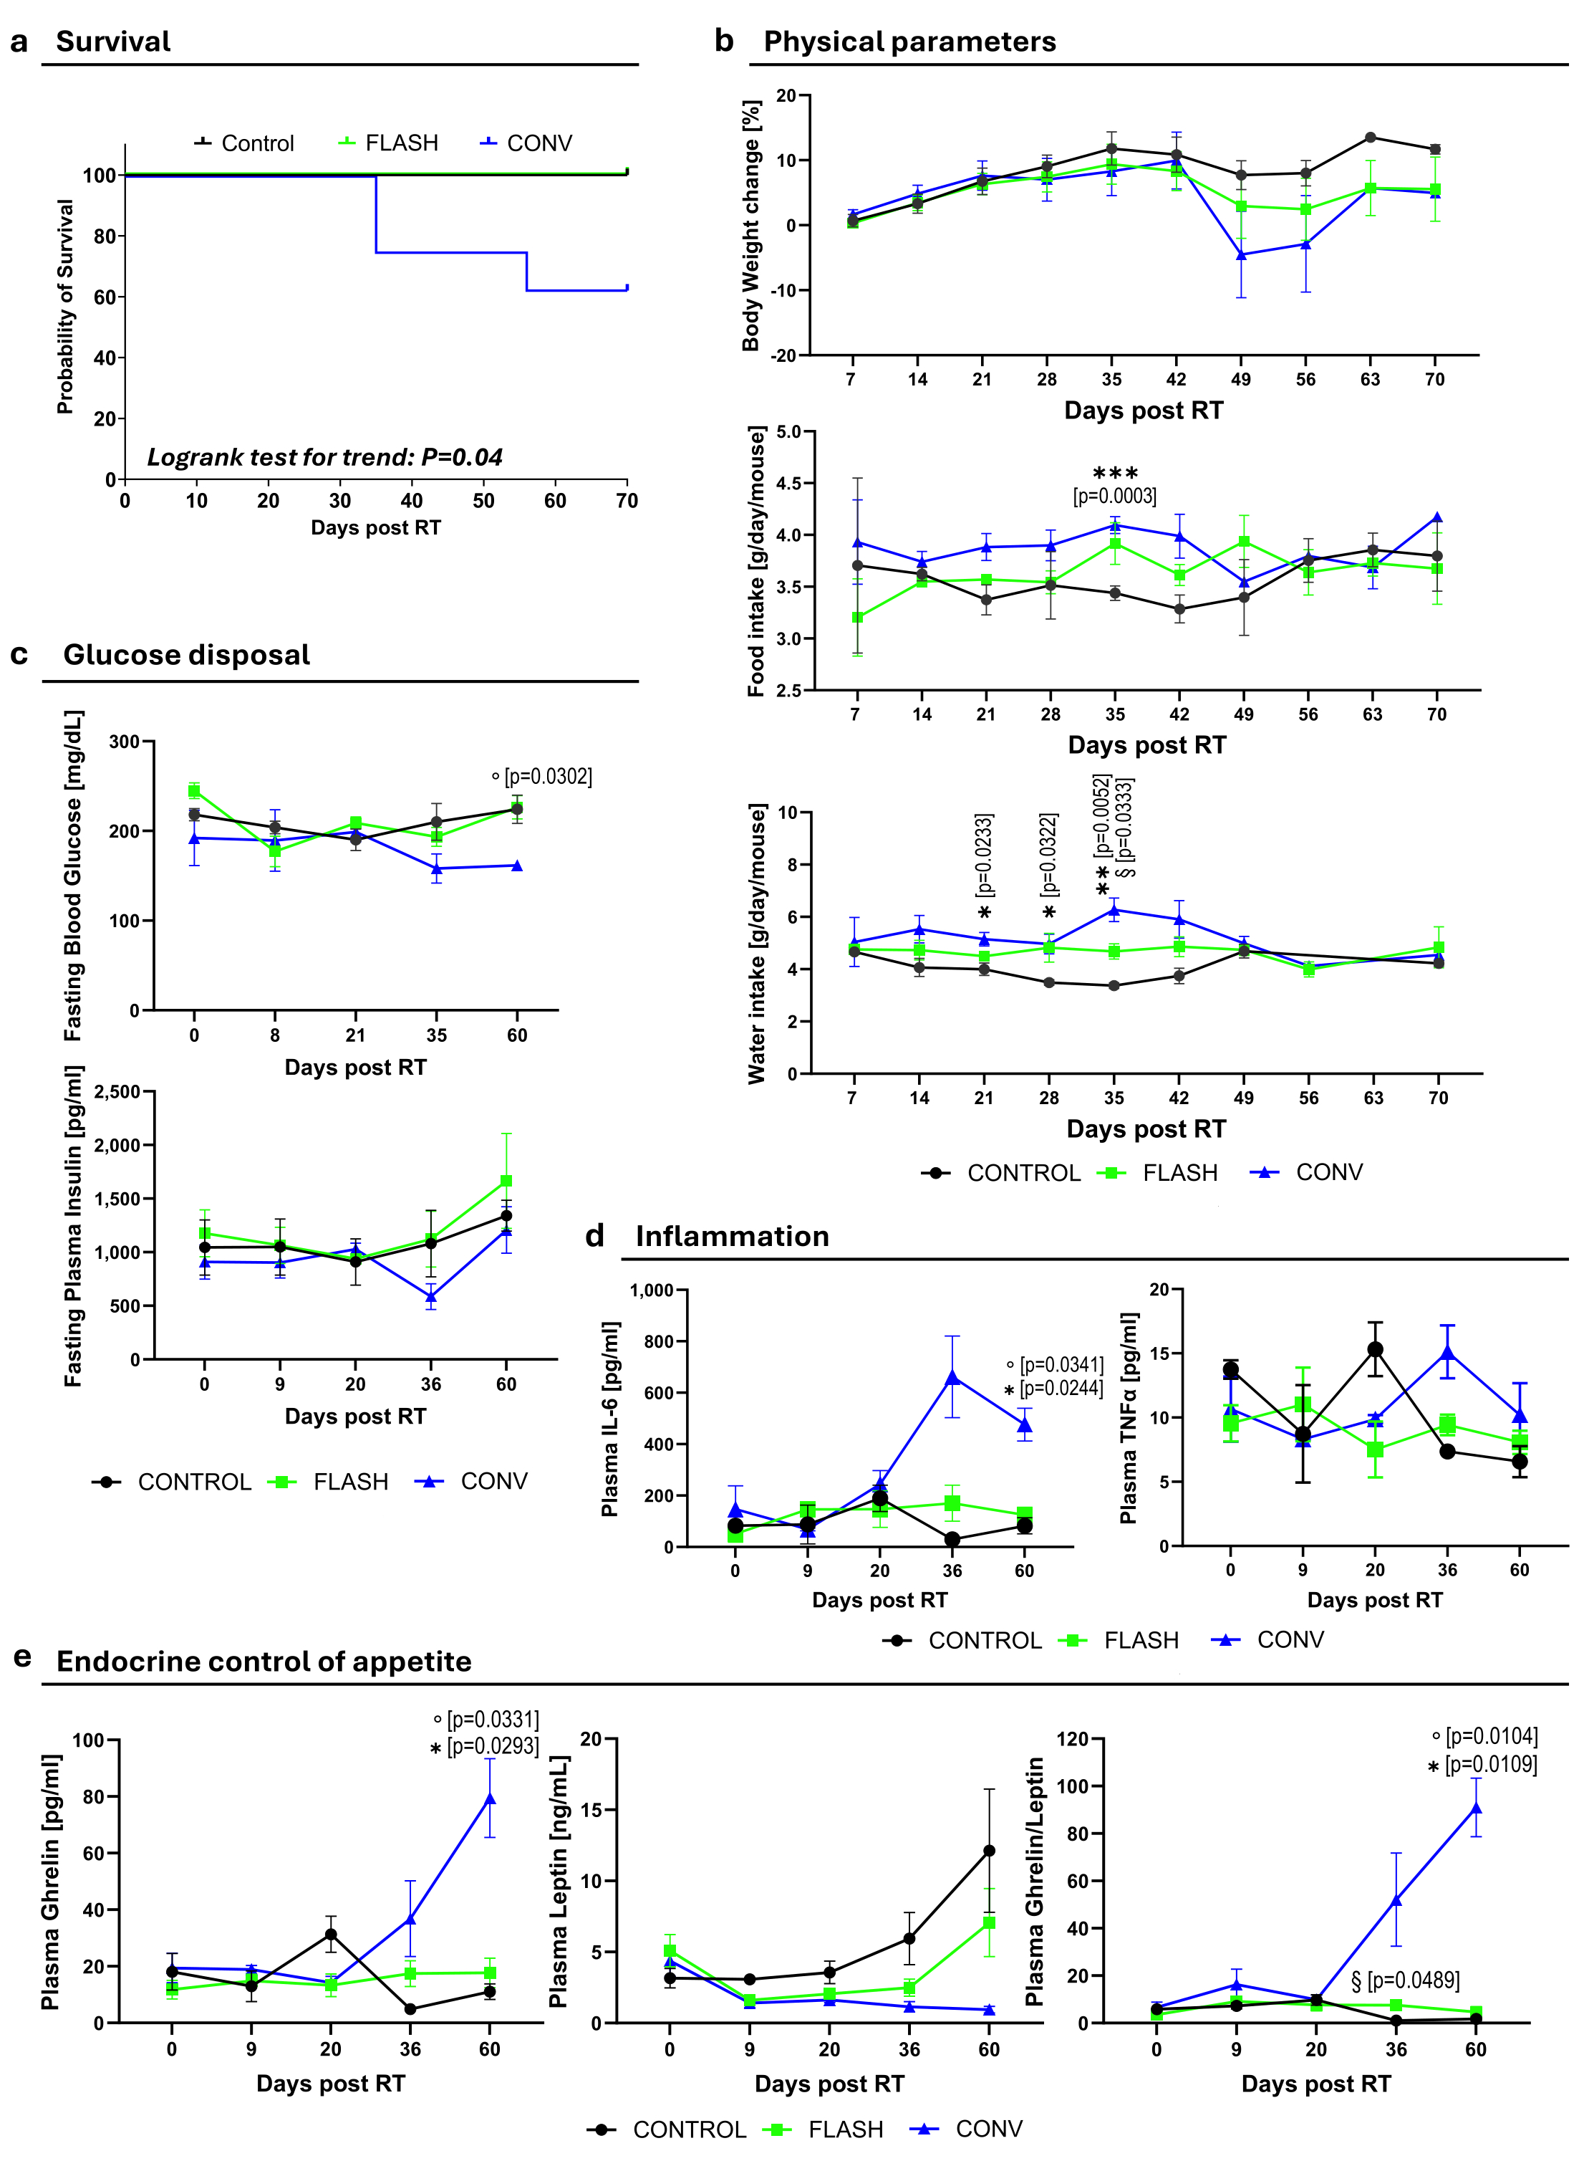
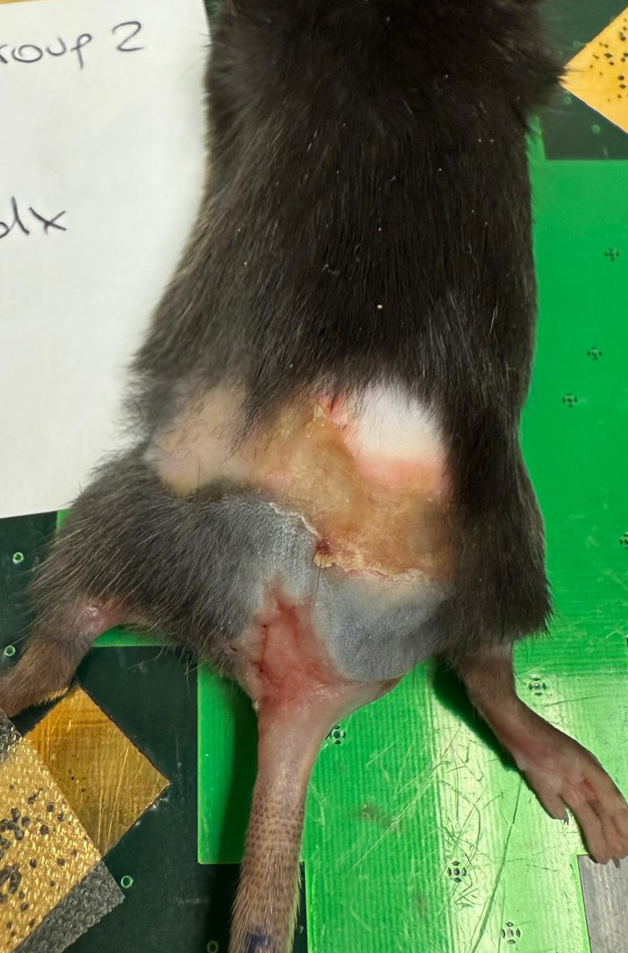
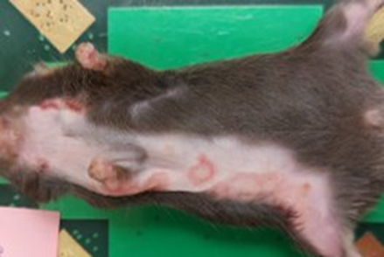
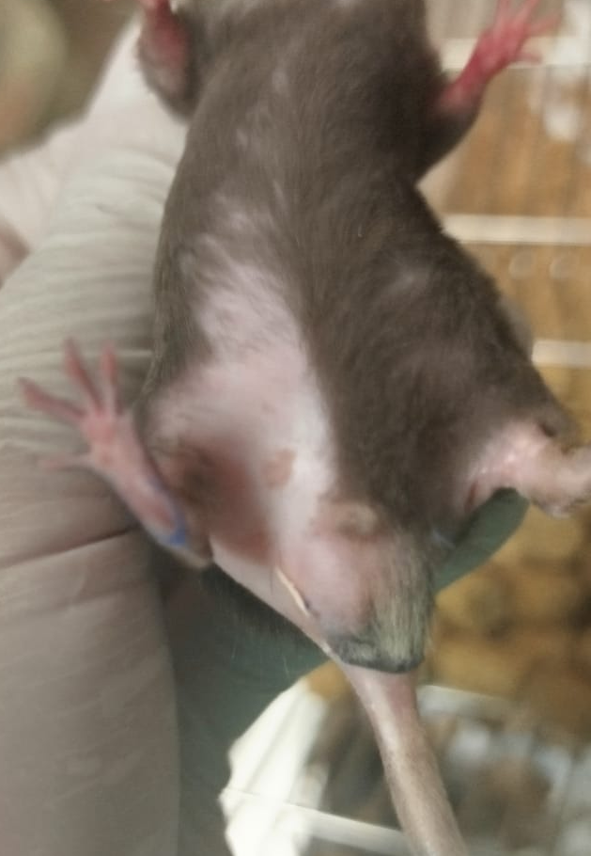
From LOCAL to SYSTEMIC effects
CONV-RT mice developed severe skin damage that sometimes extended beyond the irradiated field, leading to humane endpoints.
Furini et al., BMC Med 2026 Feb 26. doi: 10.1186/s12916-026-04724-z

Slide 16
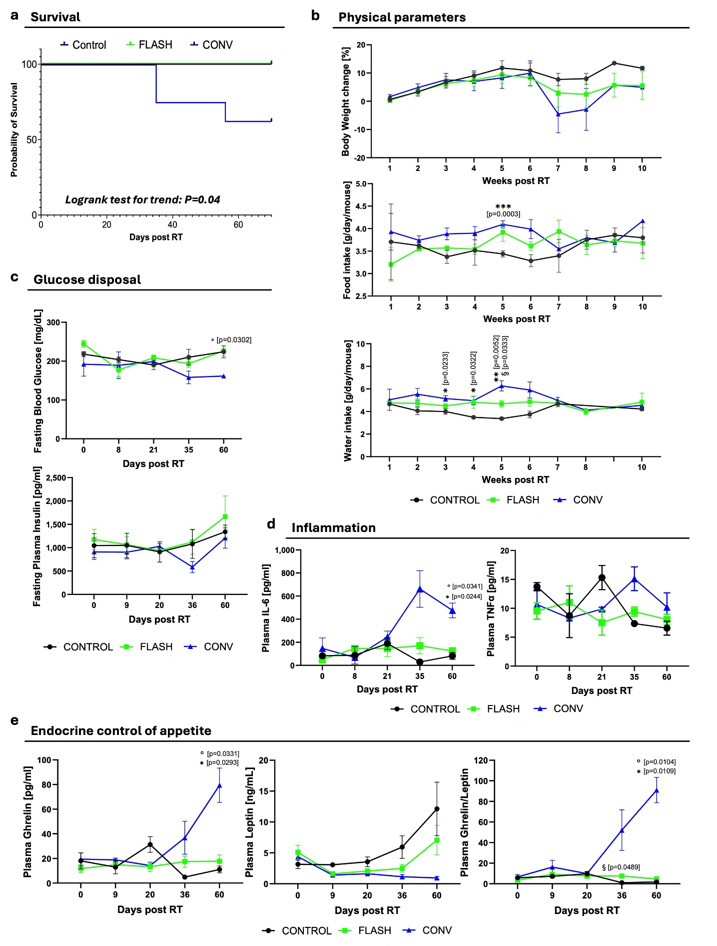
Vital Parameters, Energy Balance, Inflammation
PHYSICAL PARAMETERS
GLUCOSE HOMEOSTASIS
INFLAMMATORY MARKERS
Furini et al., BMC Med 2026 Feb 26. doi: 10.1186/s12916-026-04724-z

Slide 17
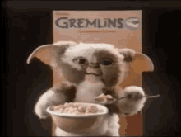

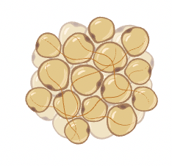
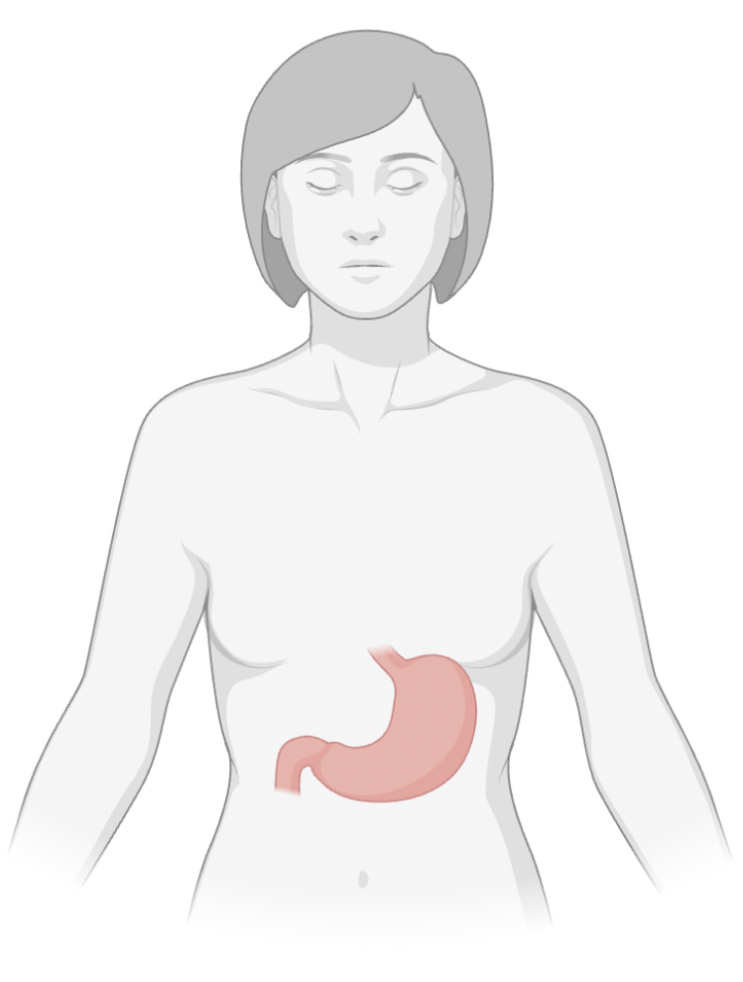
Endocrine control of appetite
Ghrelin
Leptin
Appetite index
“I am hungry!”
“I am full, stop eating!”
CONV-RT treated mice experience a long-term state of perceived starvation
“Eat more!!”
Furini et al., BMC Med 2026 Feb 26. doi: 10.1186/s12916-026-04724-z

Slide 18
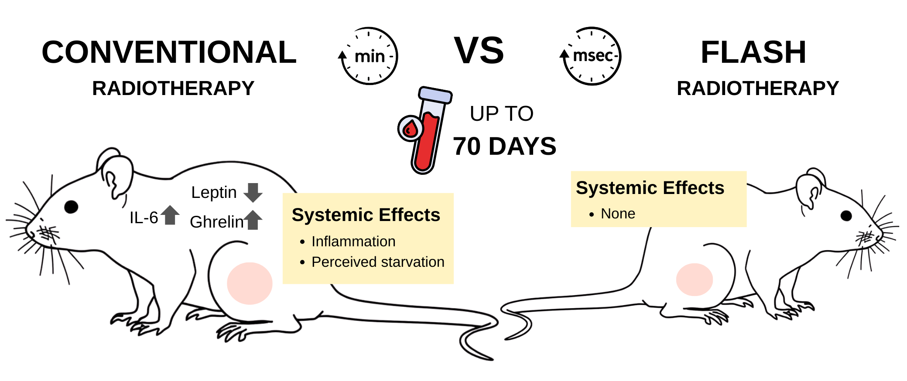
Checkpoint 2: SYSTEMIC EFFECTS
In comparison with FLASH-RT, CONV-RT mice exhibit:
Decreased survival
Increased systemic inflammation
Perceived starvation
FLASH-RT better preserves systemic homeostasis

Slide 19
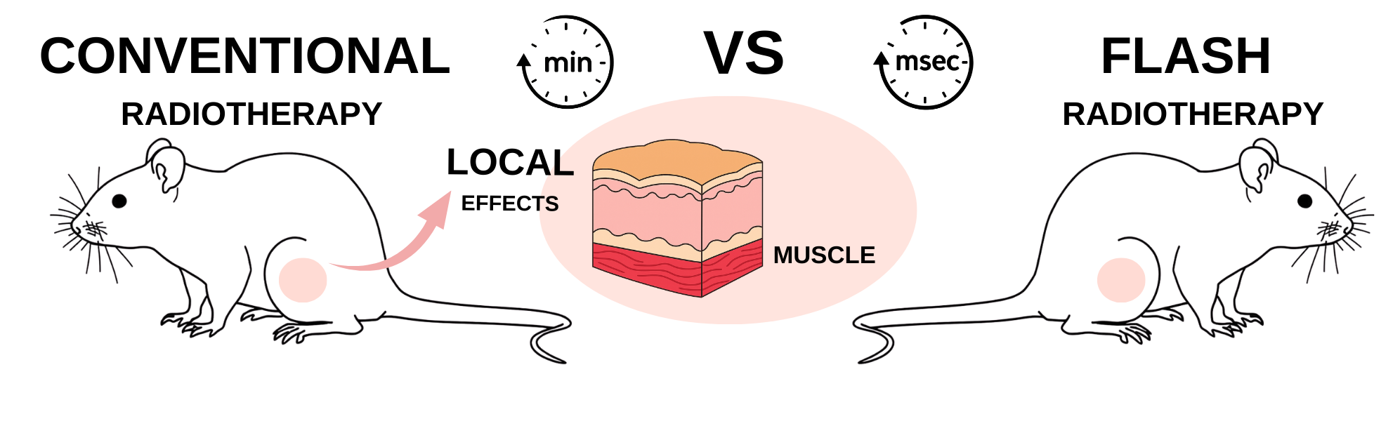
Perceived Starvation
Checkpoint 3: Local MUSCLE response
CATABOLISM
MUSCLE MASS LOSS?
Notes:
Now, when the organism is in a perceived starvation mode it starts multiple compensatory mechanisms to preserve the homeostasis of vital functions. And one one of the most prominent is skeletal muscle catabolism, and consequently muscle mass loss. So to test this hypothesis, we analysed the irradiated muscle – the quadriceps . In the presence of a starvation condition—whether actual or merely perceived—the organism responds by preserving energy and sparing functions or tissues not deemed essential for survival. Among the known responses to starvation, muscle alterations have been described (38,39).

Slide 20
MUSCLE Transcriptiomic Profiling
1) Diferentially Expressed Genes (DEGs)
DEGs relative to CNT :
CONV-RT >> FLASH-RT
Both CONV-RT and FLASH-RT profiles clearly segregate from Controls (CNT)
CONV-RT: 199 DEGs (129 UP and 70 DOWN)
FLASH-RT: 54 DEGs (41 UP and 13 DOWN)
105
24
17
64
6
7
CONV
FLASH
CONV
FLASH
Furini et al., BMC Med 2026 Feb 26. doi: 10.1186/s12916-026-04724-z

Slide 21
MUSCLE Transcriptiomic Profiling
2) Functional Enrichment
Main Functional Classes in CONV-RT
Enriched Biological Processes:
Lipid Turnover
Muscle remodelling
Unfolded protein response
Inflammation and Immunity
Cell death
Regulation of gene expression
Cell signaling
CONV-RT >> FLASH-RT
CONV-RT: 103 Enriched BPs (93 UP and 10 DOWN, p<0.05)
FLASH-RT: 25 Enriched BPs (25 UP and 0 DOWN, p<0.05)
Starvation
Signals!!
88
5
20
10
0
0
Muscle structural function
Proliferation
Nervous system
Regulation of gene expression
CONV
FLASH
CONV
FLASH
Furini et al., BMC Med 2026 Feb 26. doi: 10.1186/s12916-026-04724-z

Slide 22
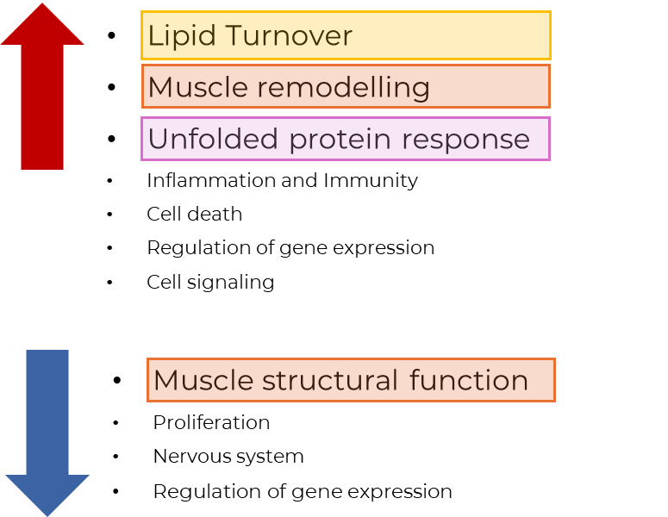
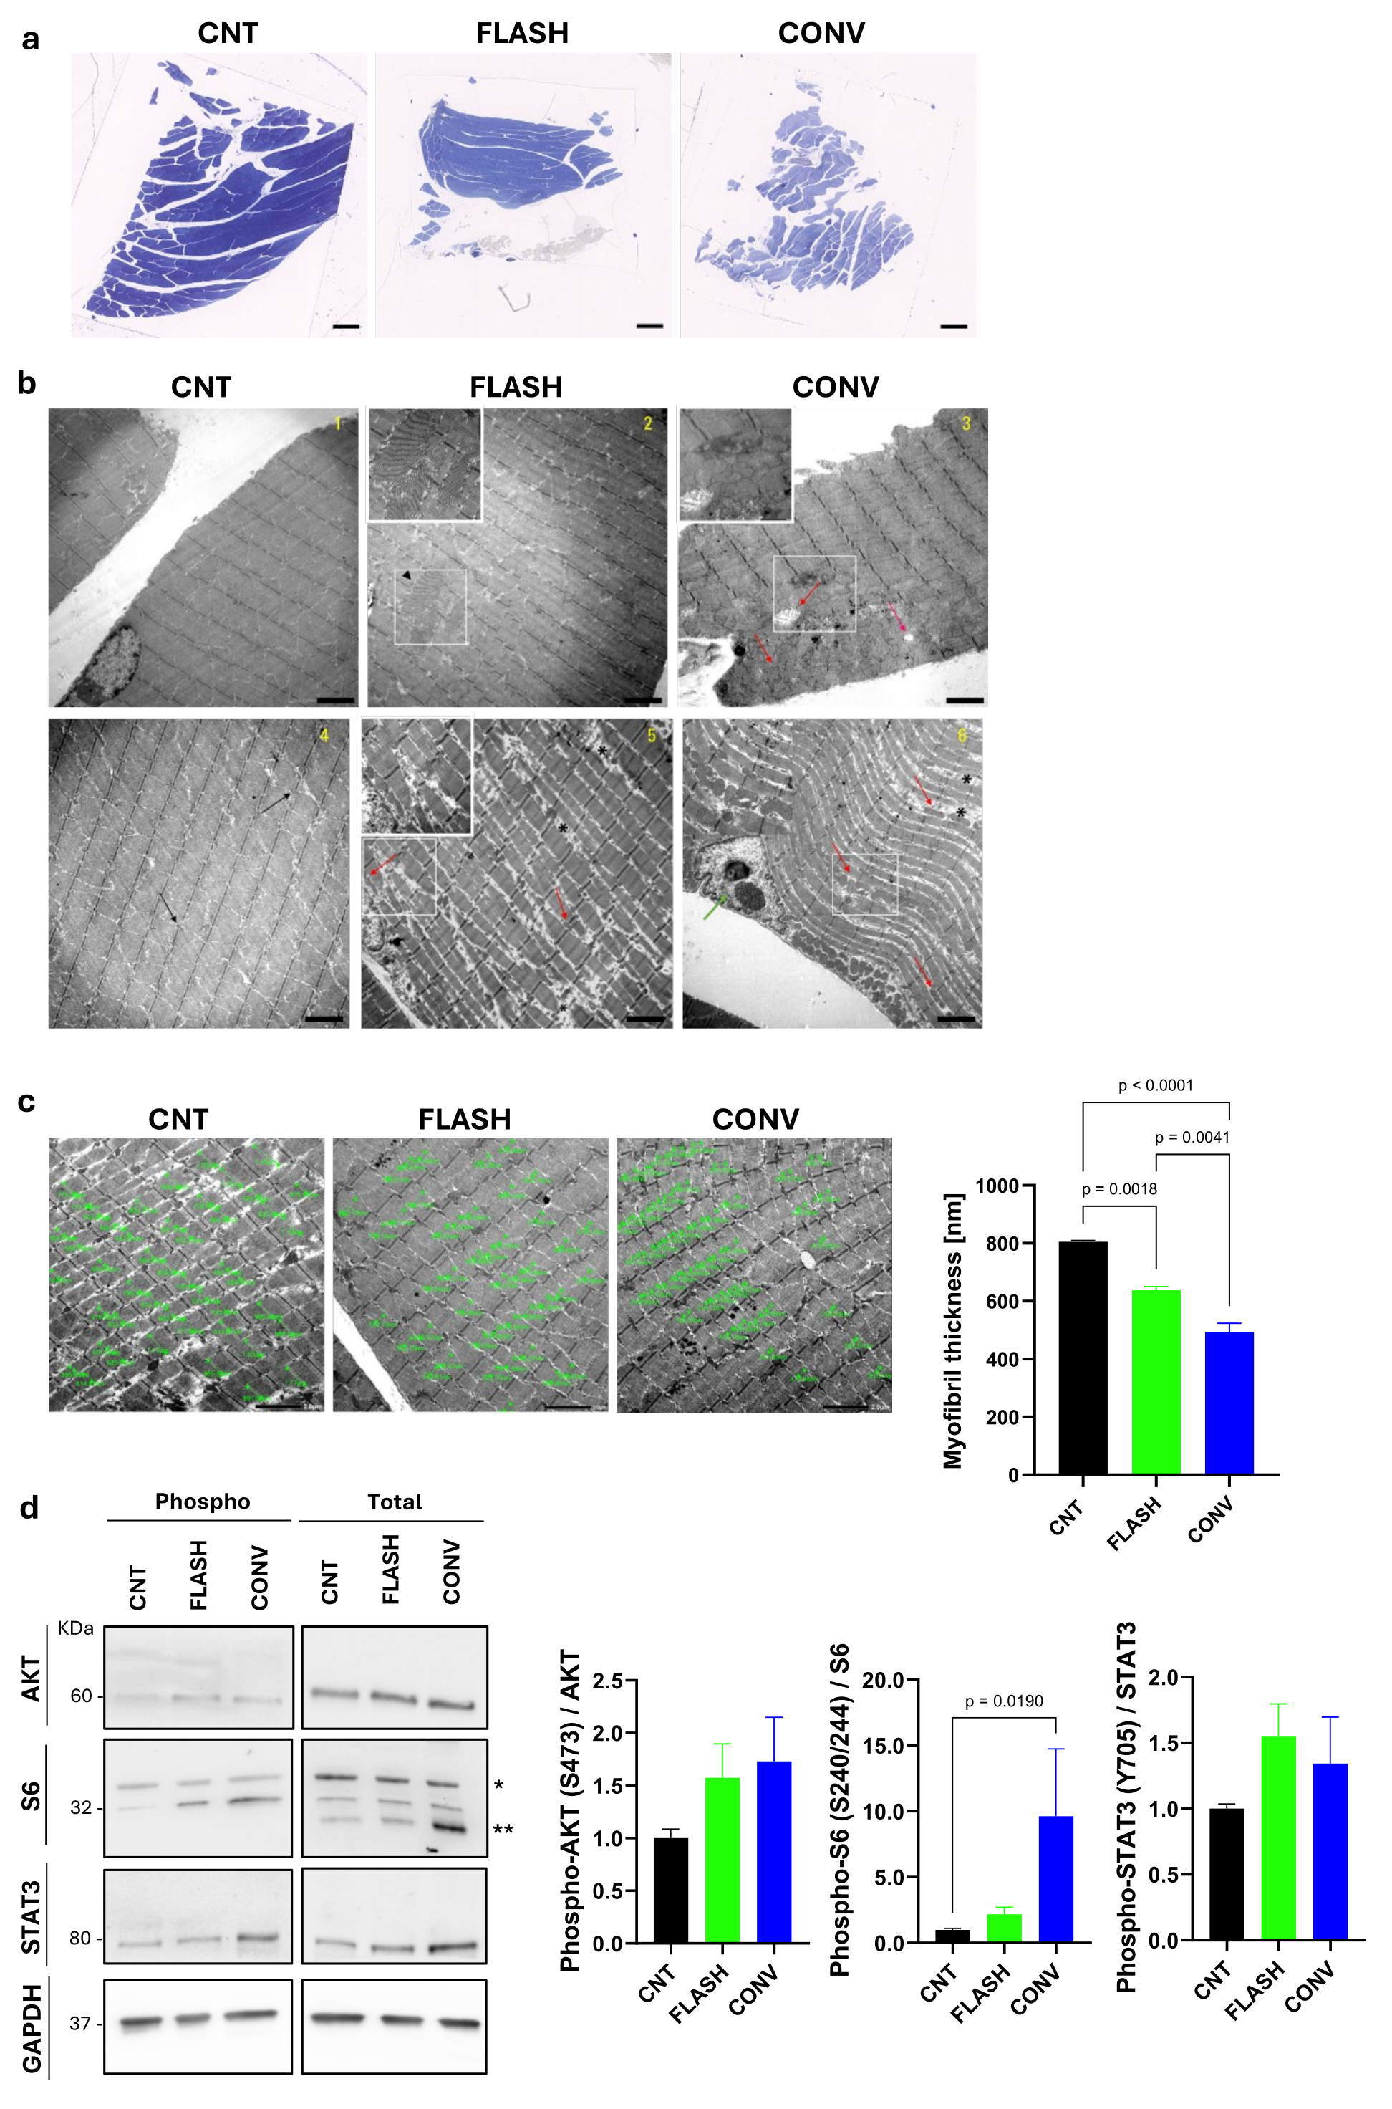
MUSCLE Architecture and Histomorphology
Compared to FLASH-RT, CONV-RT muscle shows
Enlarged intermyofibrillar sarcoplasmic spaces (*)
Pronounced mitochondrial hyperplasia and damage (→)
Reduced myofibrillar density and thickness (­---)
Muscle structural damage
CONV-RT >> FLASH-RT
Furini et al., BMC Med 2026 Feb 26. doi: 10.1186/s12916-026-04724-z

Slide 23
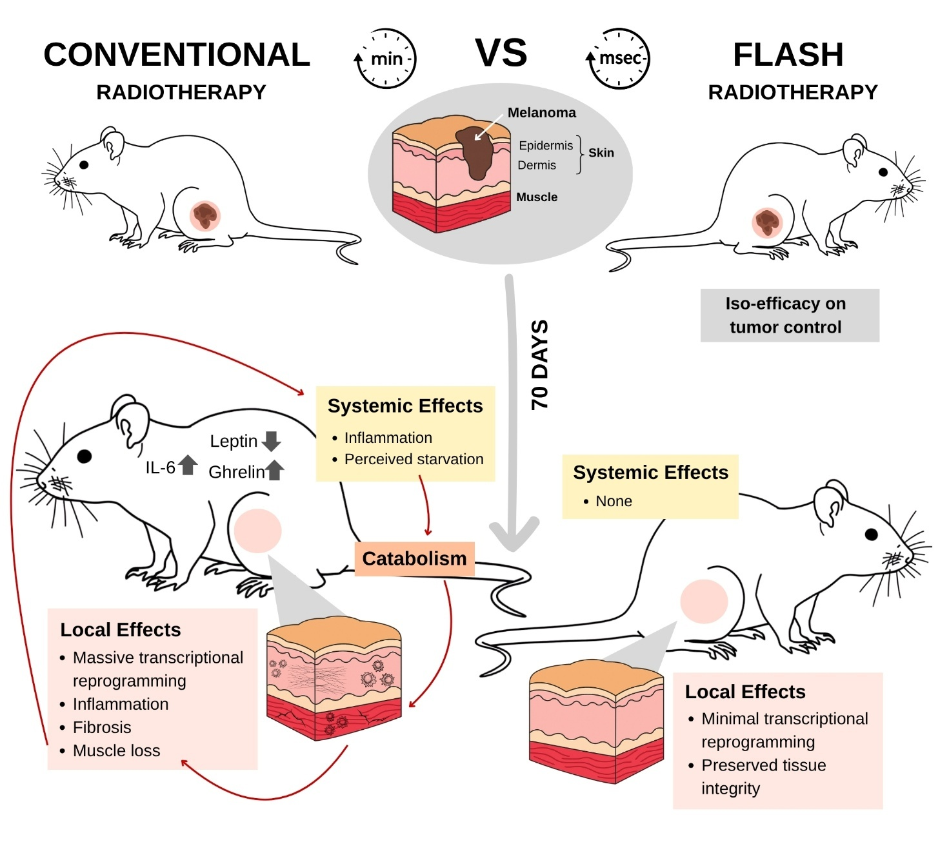
Conclusions
FLASH-RT: beyond local tissue sparing?
FLASH-RT maintains iso-efficacy on melanoma compared with CONV-RT while reducing long term local tissue damage.
CONV-RT induces long-term systemic alterations beyond the irradiated field.
FLASH-RT may mitigate these systemic effects of irradiation, potentially improving treatment tolerance with direct translational impact.
Furini et al., BMC Med 2026 Feb 26. doi: 10.1186/s12916-026-04724-z

Slide 24
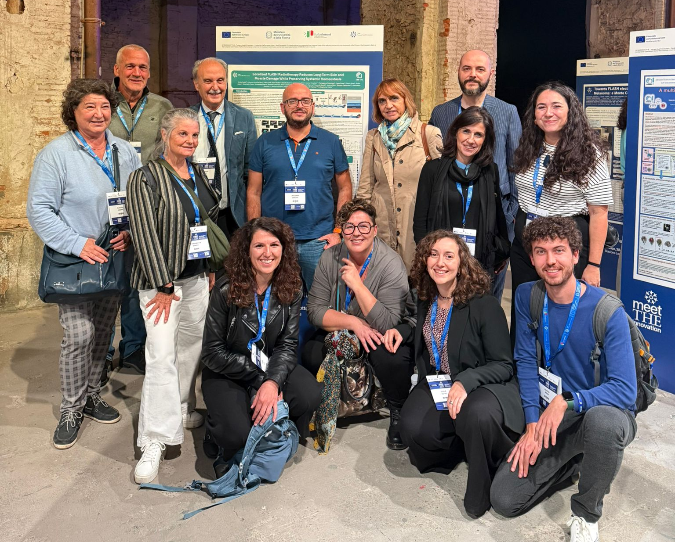
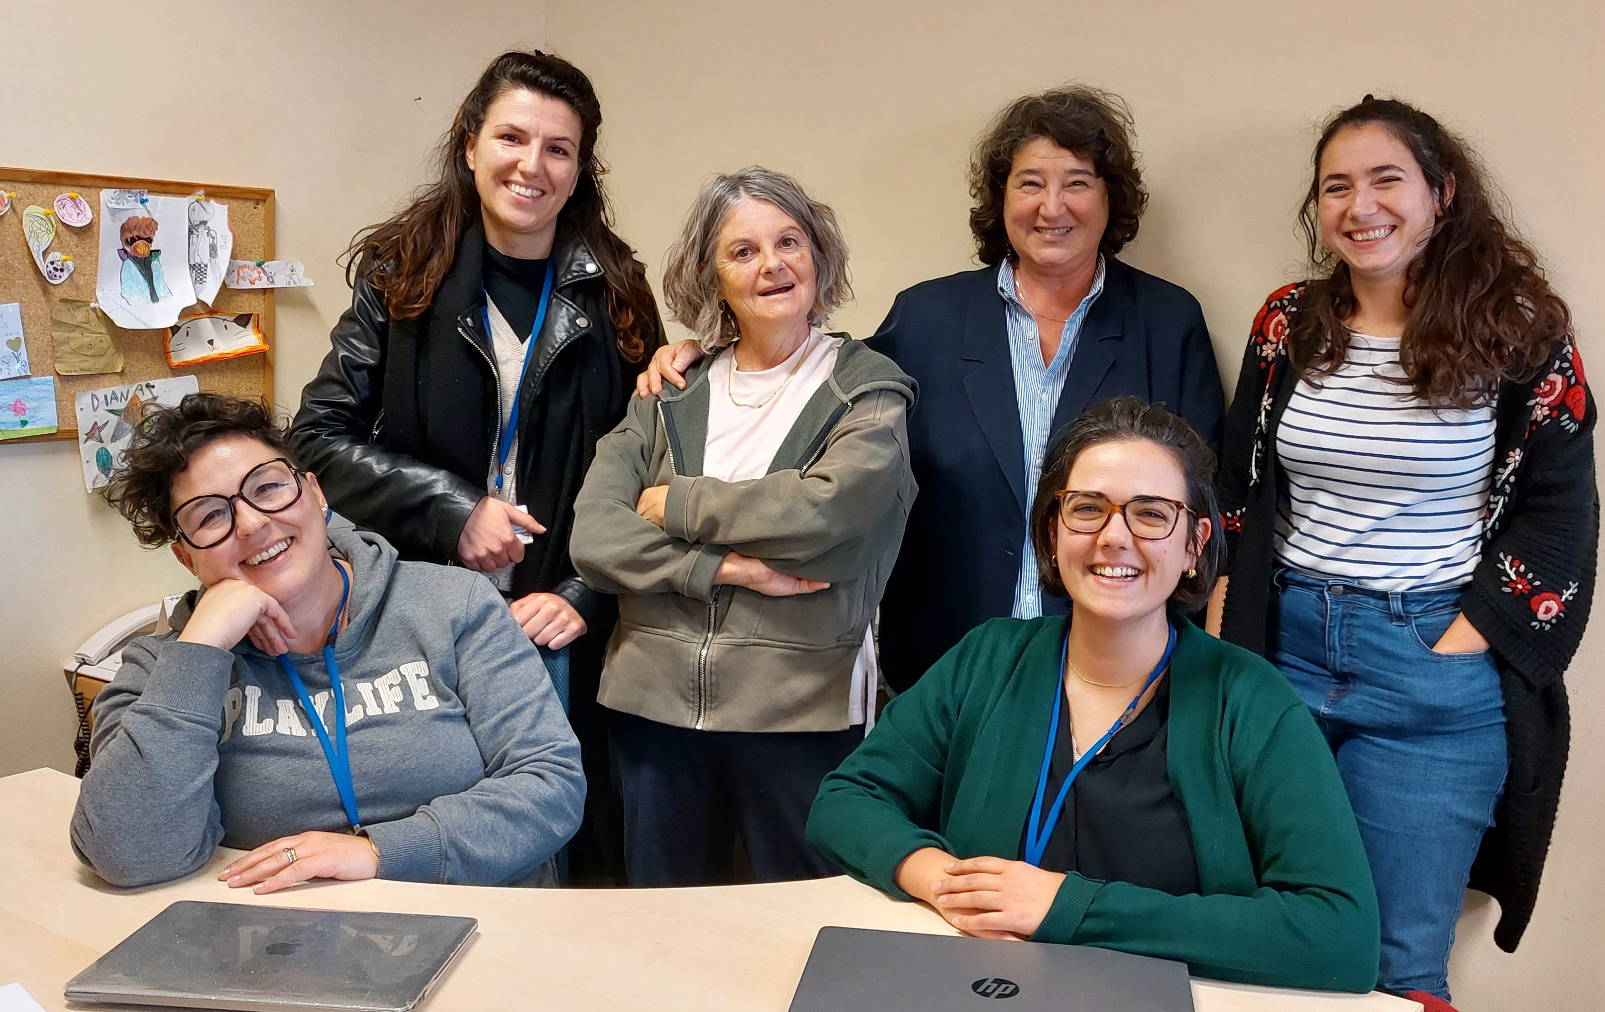







Thank You!

