Slide 1
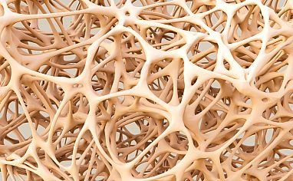
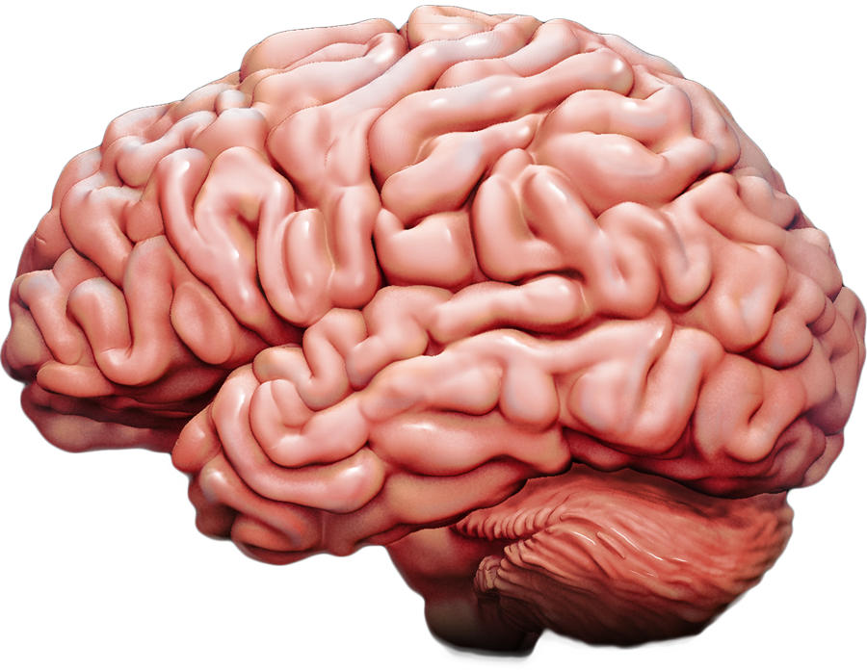
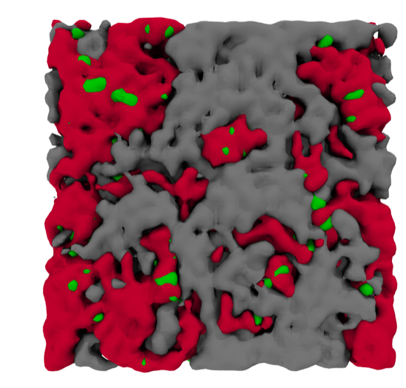
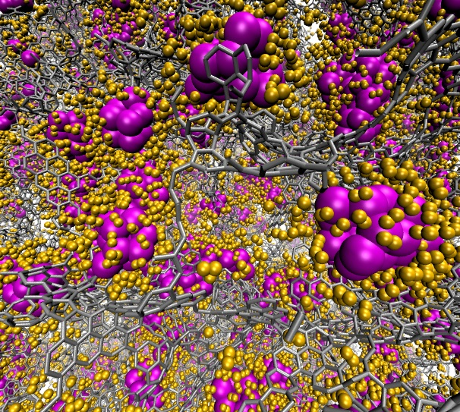
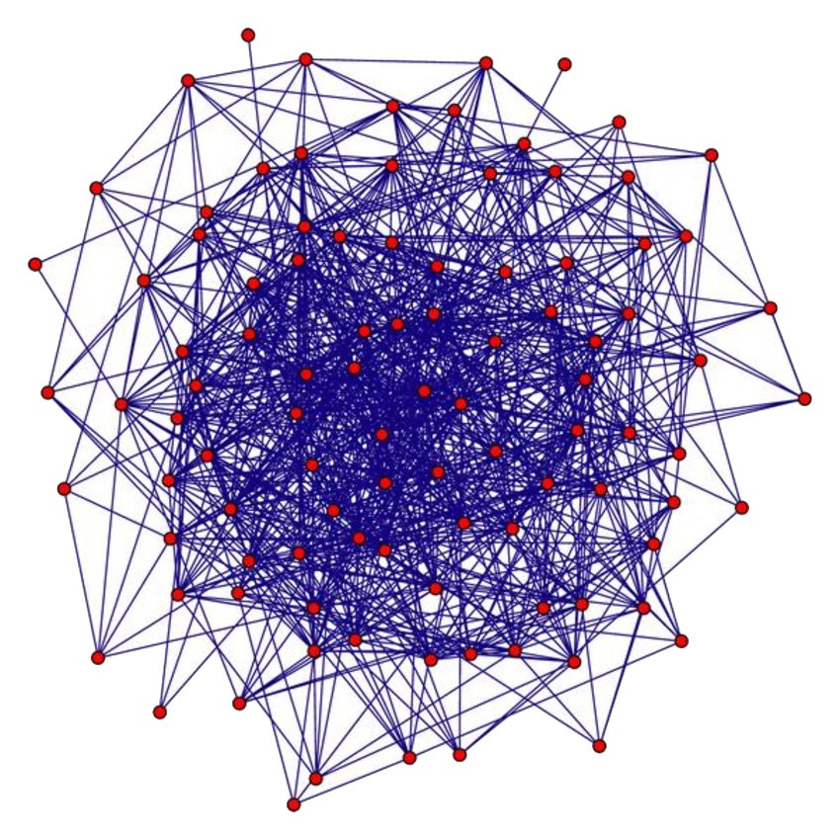
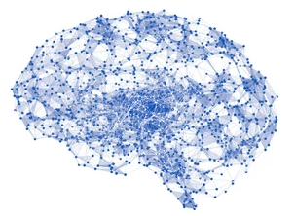
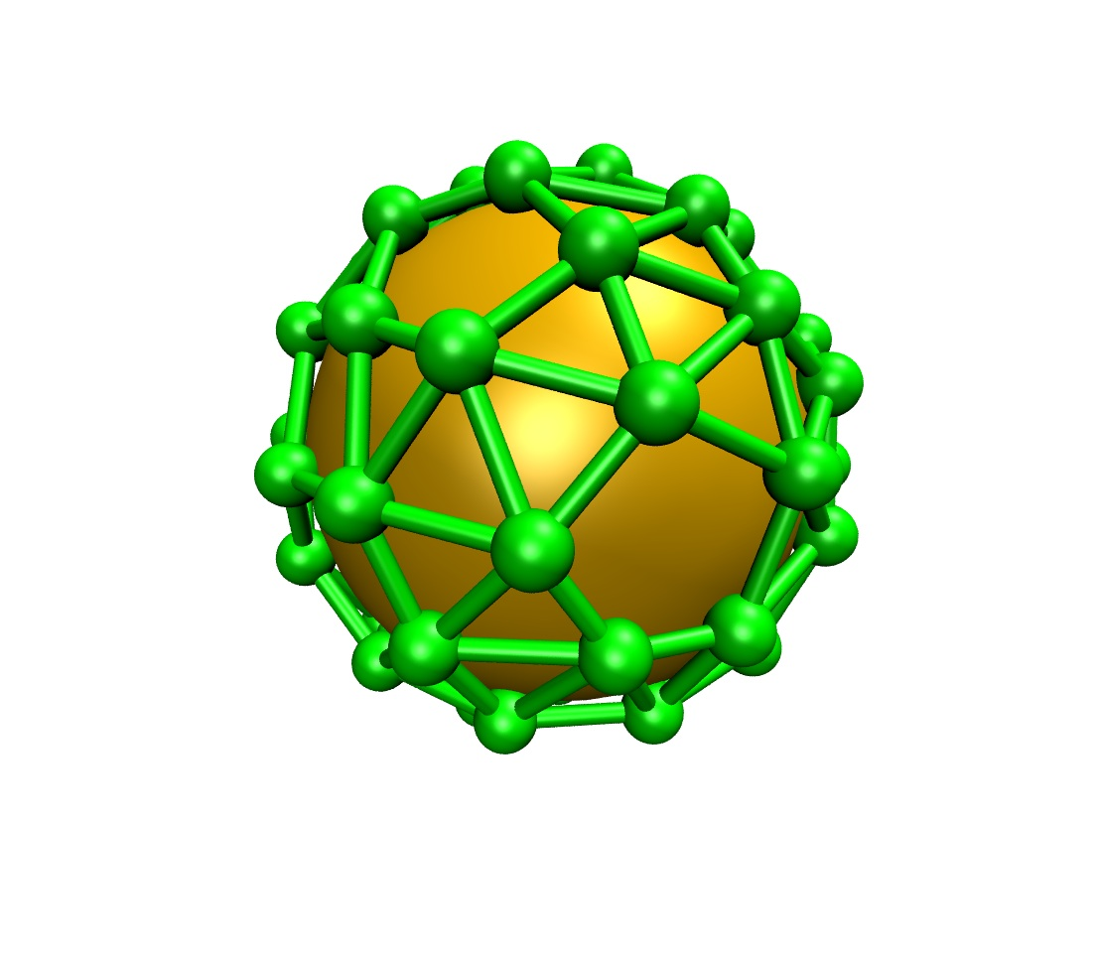
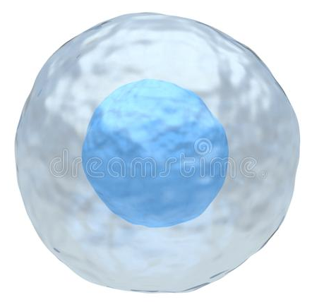
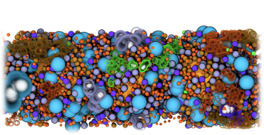

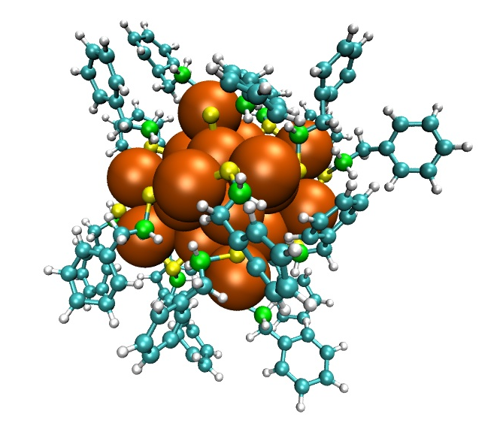
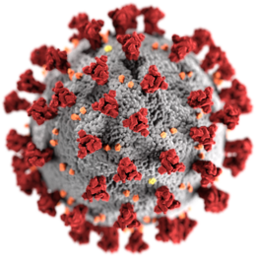

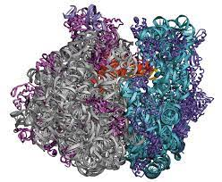


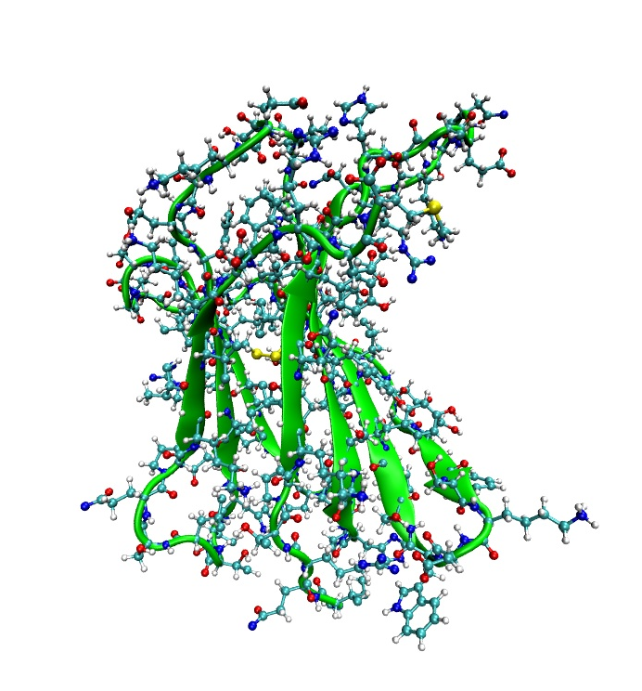
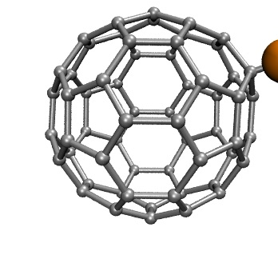
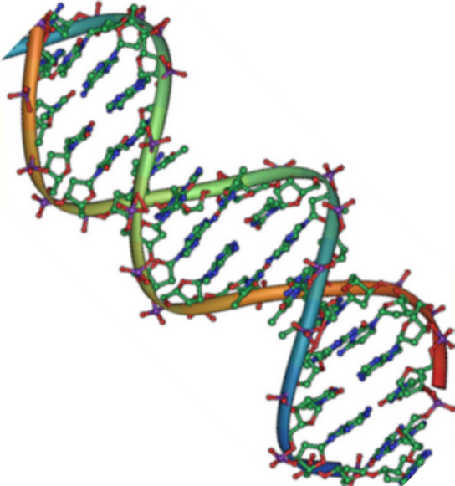




Integrating modelling and data analysis to understand and quantify the FLASH effect
Camilla Scapicchio, Igor Bodrenko, Lorenzo Castelli, Emanuele Scifoni, Alessandra Retico, Valentina Tozzini,
PI: Leonida Gizzi

Slide 2

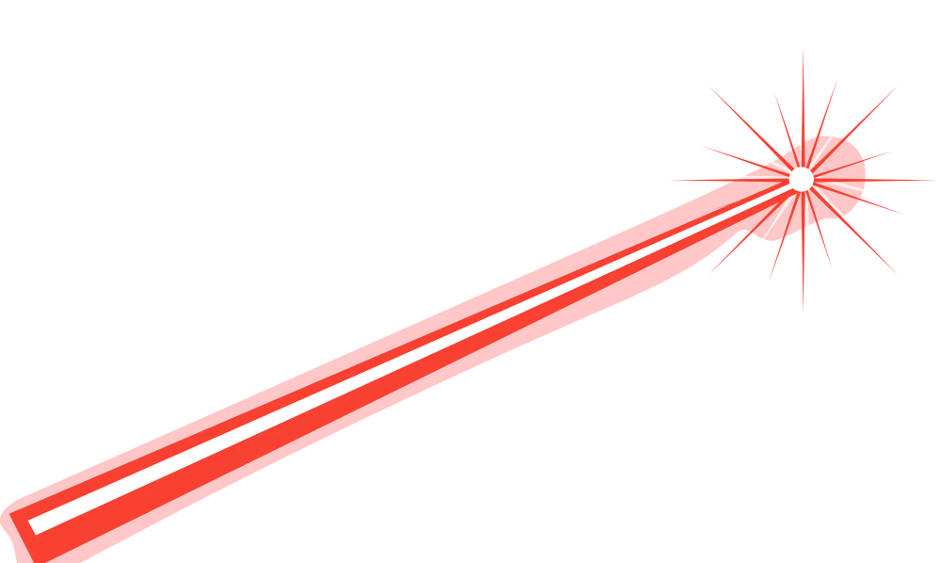

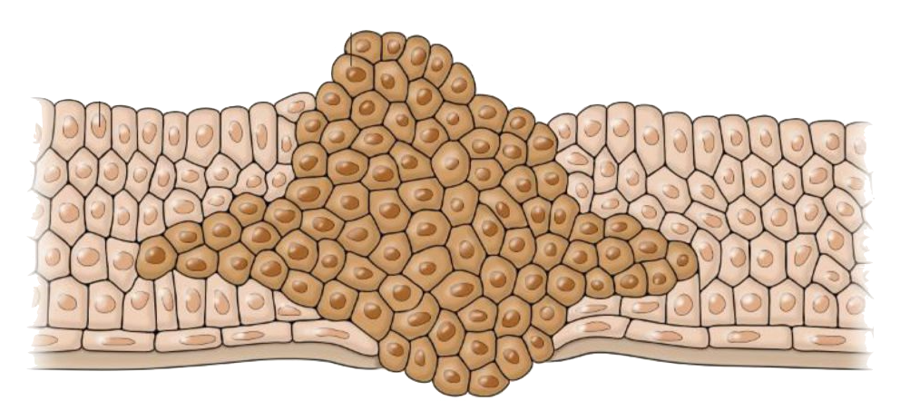
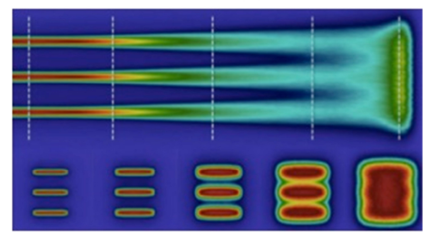
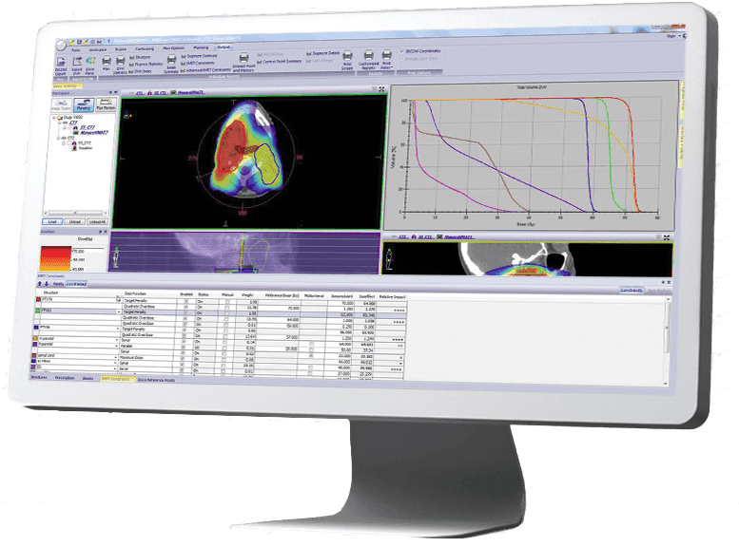
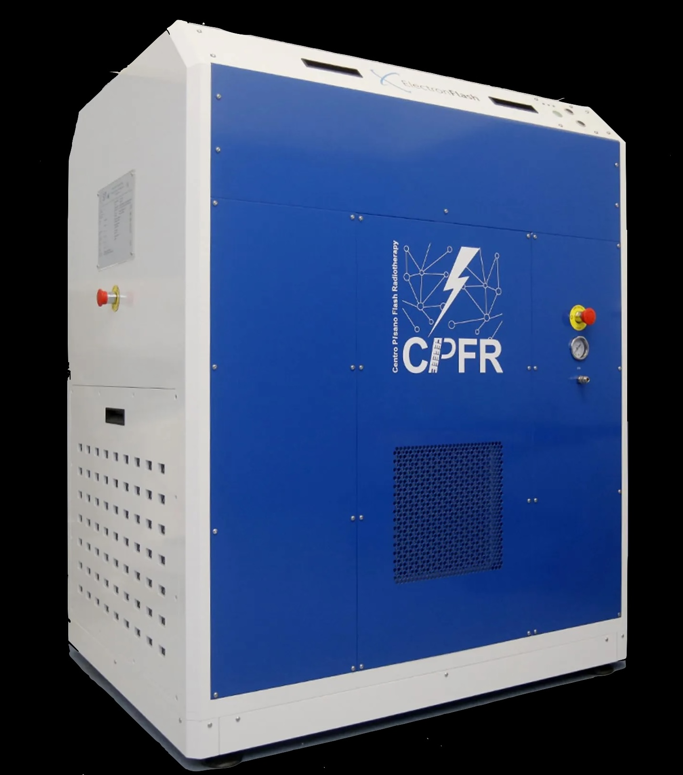

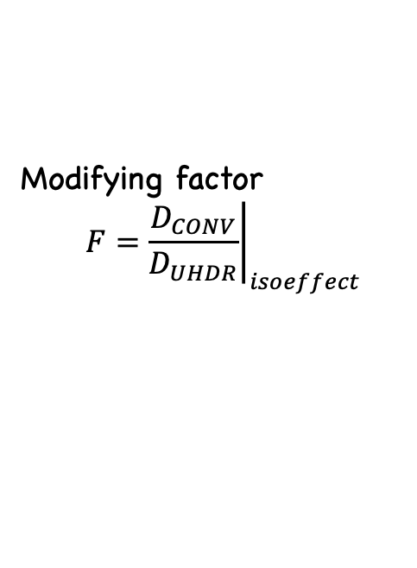

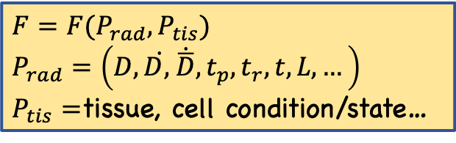
UHDR, FLASH and minibeams
Radiotherapy, kills tumor cells with ionizing radiation
Also damages normal tissues, and restricts radiotherapists actions to a narrow therapeutic window
Ultra-high dose rate pulsed irradiation and/or spatial comb shaping of the beam
produce a selective sparing of normal tissues! (“FLASH” and “minibeam” effect )
therapeutic window
normal tissue complication
tumor control
Expansion of the therapeutic window
Treatment planning
Delivered dose (D)
Dedicated linac
Modifying factor
  $$F={\left.\frac{D_{CONV}}{D_{UHDR}}\right|}_{isoeffect}$$
F_{cancer~}1, F_{healthy}<1
Cure & Spare
$$\left(P_{rad},P_{tis}\right)$$
~10-20 parameters
$$F=F(P_{rad},P_{tis})$$
$$P_{rad}=\left(D,\dot{D, }{\dot{\overline{D}},t}_{p},t_{r},t,L,…\right)$$
$P_{tis}=$tissue, cell condition/state…
An insight into hypothesized biological mechanisms contributing to the Flash effect F Del Debbio, et al FF (2023)

Slide 3

UHDR, FLASH and minibeams
Treatment planning
Expansion of the therapeutic window
Ultra High Dose Rate
+ time/space hyper fractioning
  ⇒ spare normal tissue
  ⇒ same or enhanced effect on tumor
  ⇒ Intrinsic selectivity at the cell level
But
D
$$F=F(P_{rad},P_{tis})$$
F as a function of the irradiation parameters and tissue/tumor type must be known in order to get to clinical translation
An insight into hypothesized biological mechanisms contributing to the Flash effect F Del Debbio, et al FF (2023)

Slide 4
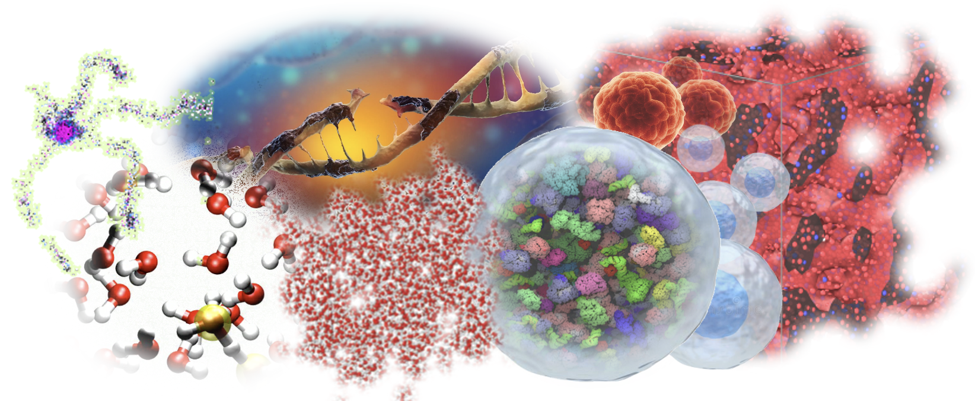
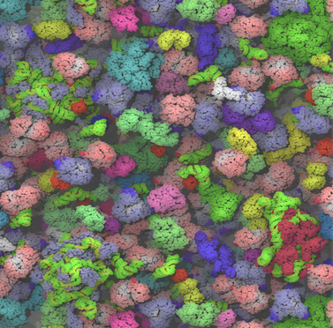

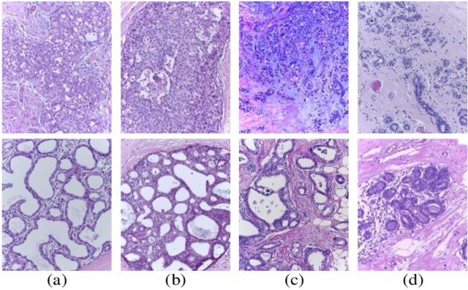


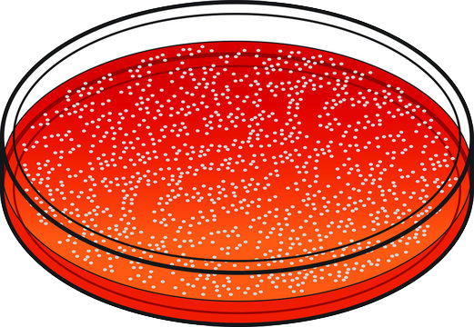
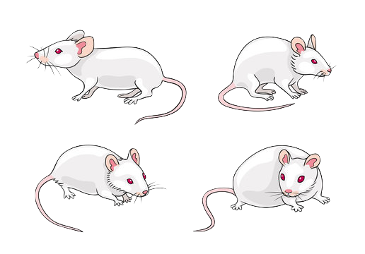
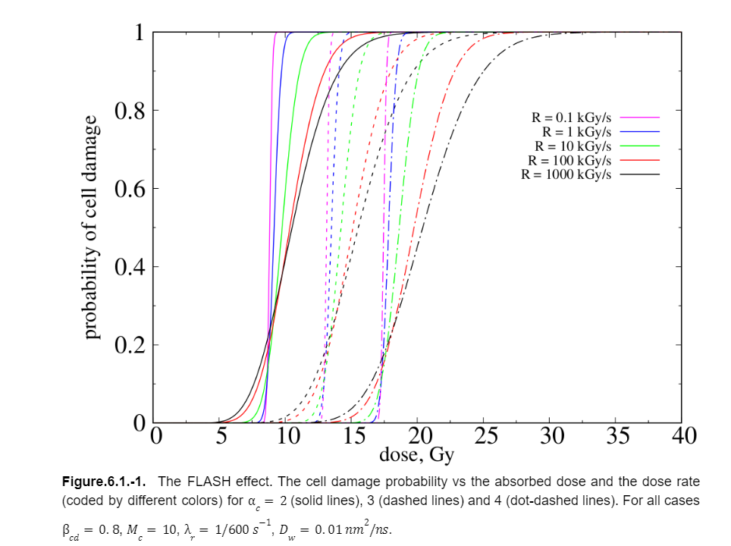
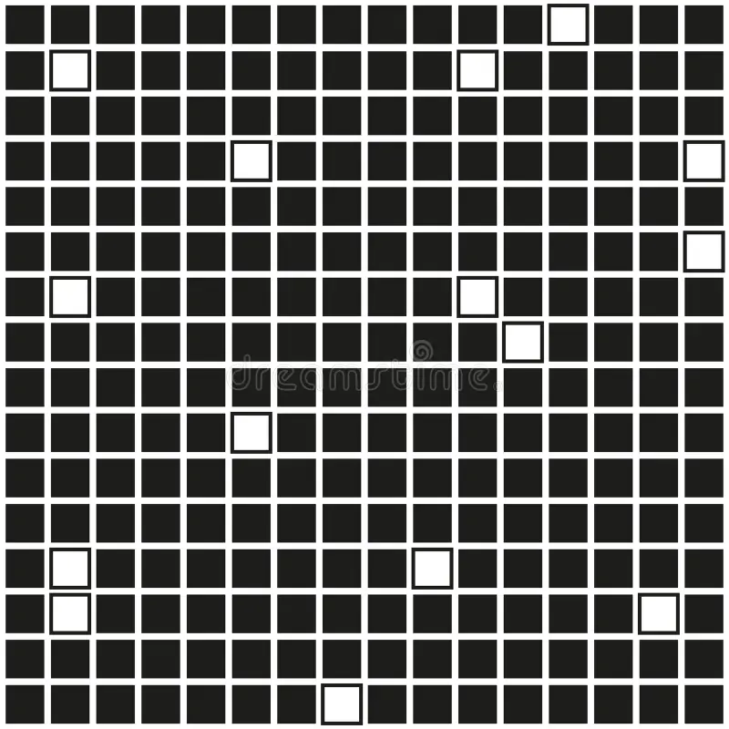

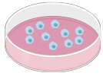





The grand scheme
radiobiological mechanism
multi-scale simulations
Irradiation pars
Machine learning
data
paras
$$P_{rad}$$
Data elaboration and
analysis
$$E→F$$
$$F(P_{rad},P_{tis})$$
data
params
minimalist empirical model
$$P_{tiss} ,E$$
tissue data/effect
Treatment planning

Slide 5


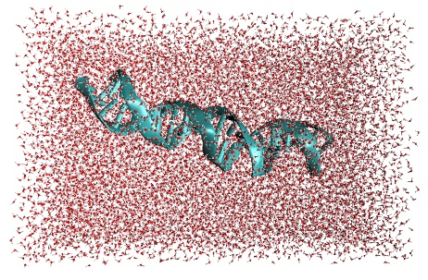





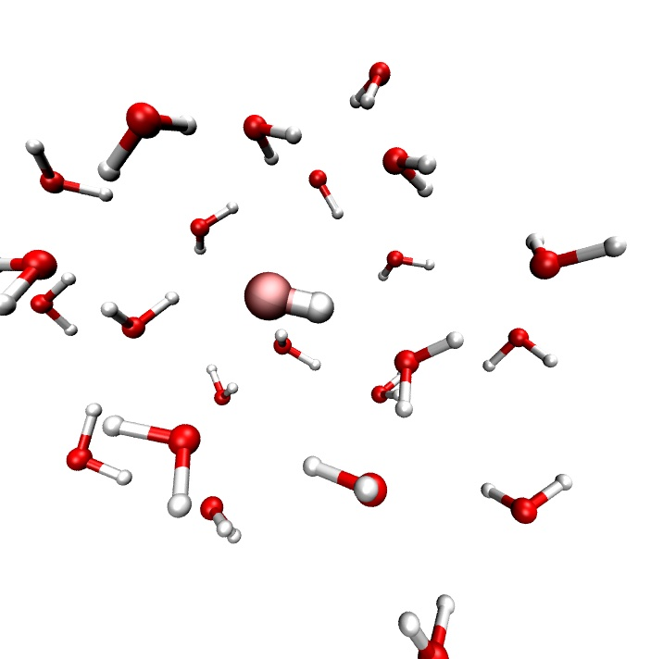
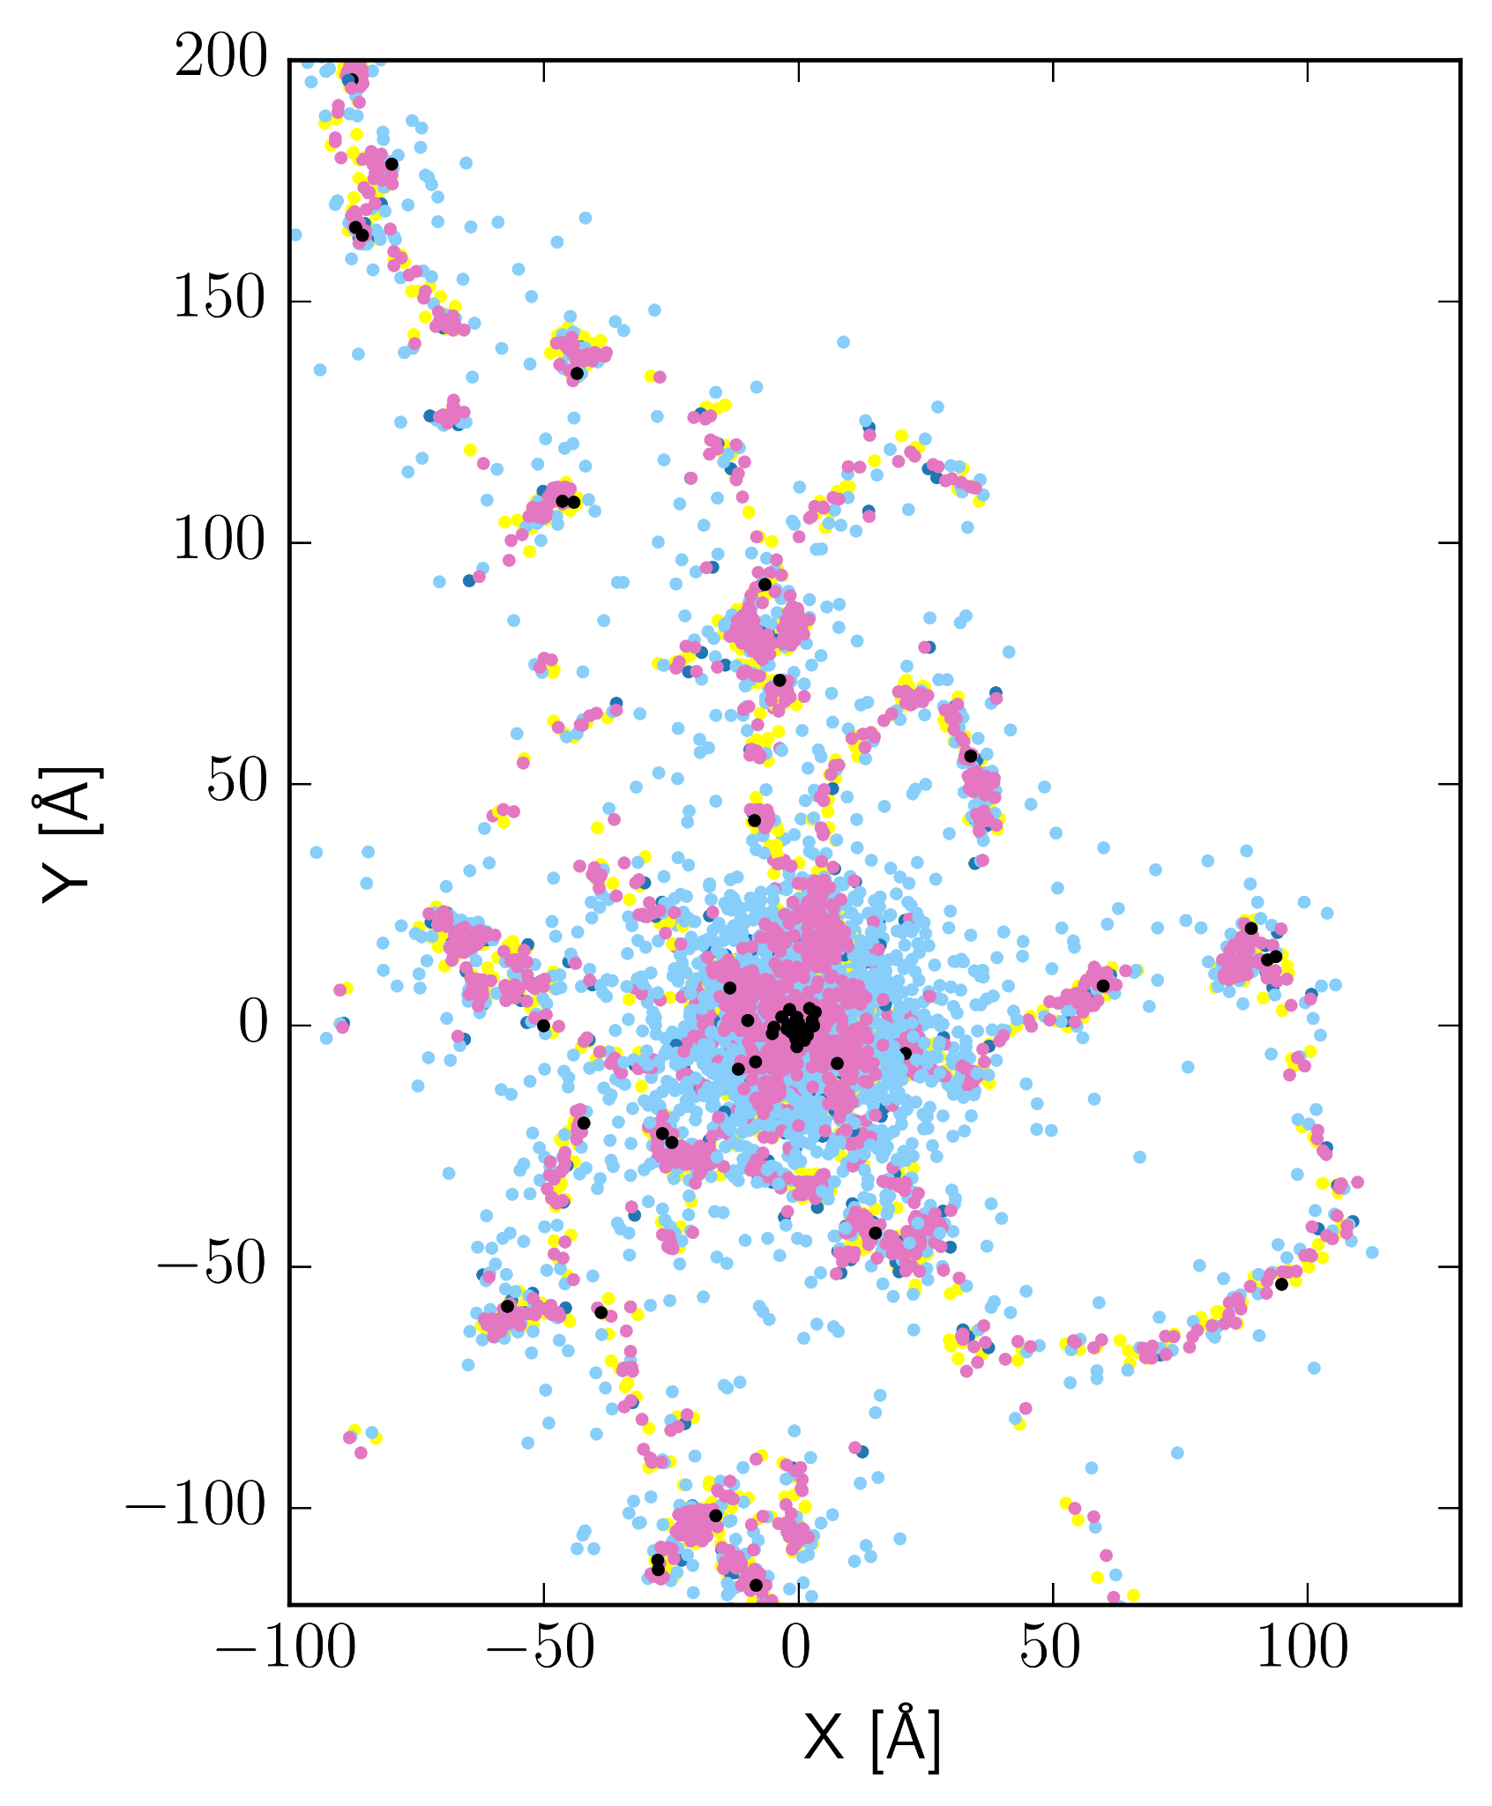


A computational task force
In silico Radiobiological Modeling @NANO
Valentina Tozzini
multi-scale biomodeling
Margherita Bini
coarse grained
models
Alessandra Retico
Camilla Scapicchio
Data organization
machine learning
Lorenzo Castelli
Emanuele Scifoni
Igor Bodrenko
empirical models
F Di Martino
F Cella Zanacchi
E Da Pozzo
M Maffei
E Ciarrocchi
M Costa…
Experiments
Susanna Monti
Reactive dynamics
Reaction-diffusion Monte Carlo

Slide 6
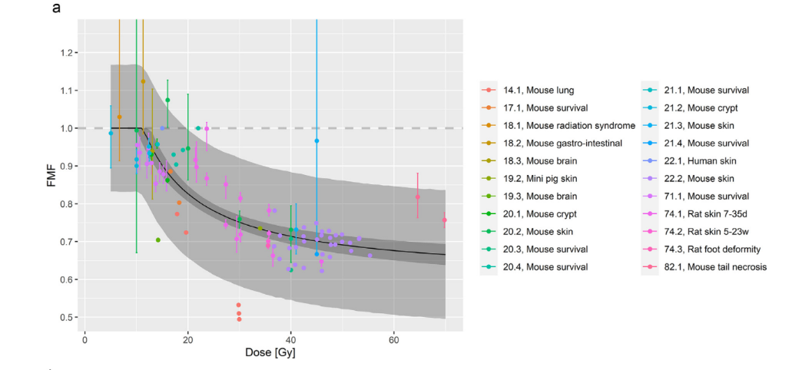

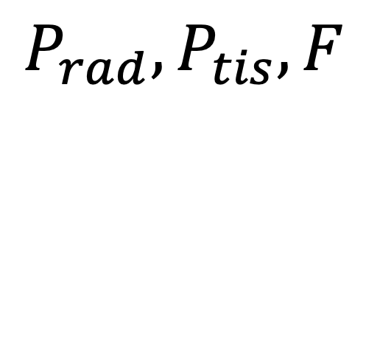
machine learning
“Brute force”
$$P_{rad}, P_{tis},F$$
Neural Network
$$F$$
Treatment planning
A platform for data collection/elaboration
Collect a complete set of data on the UHDR irradiation effects
Build a platform equipped with analysis and elaboration tools to train a neural network to evaluate F(P)
In progress
Issues
The training requires a large amounts of data, pre-elaborated for homogeneity
The NN gives answers with no explanation of the mechanism → unexplainability
            This might not be entirely satisfactory especially considered the medical application

Slide 7
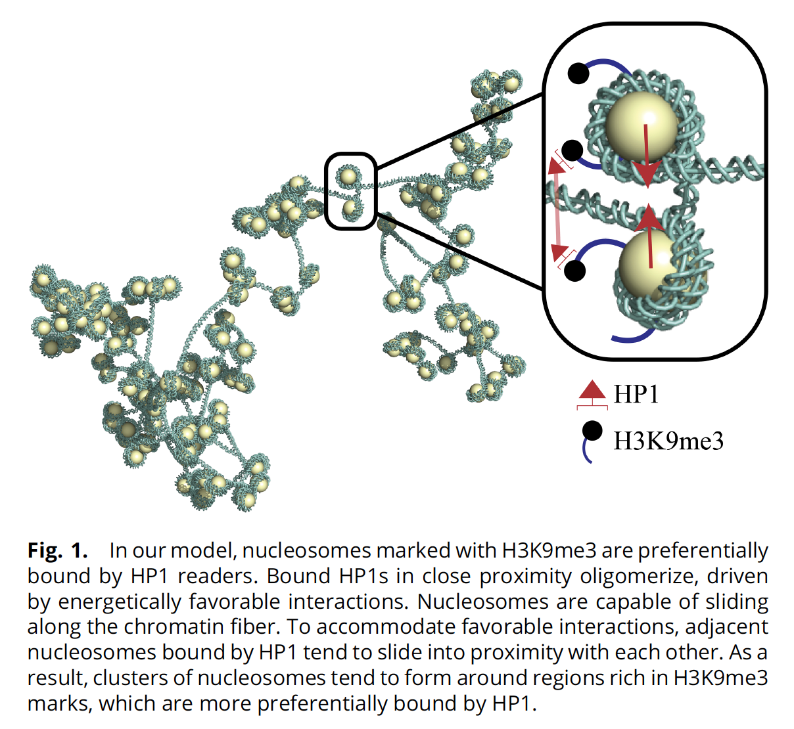
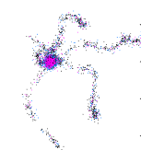
A completely opposite view: Direct simulation of the effect
Bio-chemical stage (intra-cell)
DNA breaks
Intra-cell signaling and diffusion
Repair/apoptosis
Tissue Level
Inter-cell signaling and
diffusion of repairing enzimes/radicals
Cell reorganization
mm
Chemical stage
Complex radicals
Formation and diffusion
Reactions with DNA
μm
Mini/microbeam irradiation
Physical stage
Irradiation
excitation
Heterogeneous chemistry
Water radiolysis
Radicals formation and diffusion
nm
Irradiation acts here
fs
ps
ns
μs
ms
sec
hours
The final effect occurs here
UHDR+pulsed irradiation
Differential cell survival/
tissue sparing

Slide 8
A completely opposite view: Direct simulation of the effect
The radiobological effects span 15-20 order of magnitude in time and space
Bio-chemical stage (intra-cell)
DNA breaks
Intra-cell signaling and diffusion
Repair/apoptosis
Tissue Level
Inter-cell signaling and
diffusion of repairing enzimes/radicals
Cell reorganization
mm
Chemical stage
Complex radicals
Formation and diffusion
Reactions with DNA
Possible determinants of differential effects
Oxygen concentration
⇒ Different production of ROO*
ROO* differential diffusivity
⇒ Reach different saturation level
μm
Physical stage
Irradiation
excitation
Heterogeneous chemistry
Water radiolysis
Radicals formation and diffusion
nm
Activation and diffusion of
reparatory enzymes/mols
⇒ Different efficiency of DNA damage reparation
fs
ps
ns
μs
ms
sec
hours
Oxygen concentration
Non-linear (e.g. inter-track) effects
⇒ differently activated/regulated by different architecture of cell/tissue
ROO* diffusion/saturation
reparation enzymes & related subst
Activation of inter-cell signaling
⇒ Different damg propagation/remediation
→ survival/death
Cell signaling/death/survival

Slide 9
Multi-Scale modeling in a nutshel: lower the cost, increase the empiricism
Coarse graining decrease the simulation cost
Continuum/
grid models
… but increase the empirical level of the model
Multi-scale modeling
= Use different resolution/models/ representations for modeling the different stages of a process
Particle models
Reduce resolution
m
mm
Time averaging
Spatial coarse graining
Reduce/hide degrees of freedom
Use collective variables
μm
Network, kinetic models
Coarse graining increase the number of parameters, and the empirical level of the model
Strategy for fitting parameters (regression/ML)
Target/input data (from
exp or higher level theory)
nm
Increase empiricism
fs
ps
ns
μs
ms
sec
hours
Months/years
Time coarse graining
Increase the time step of motion integration
cut off high frequencies
Use stochastic/enhanced sampling methods, statistical averages

Slide 10
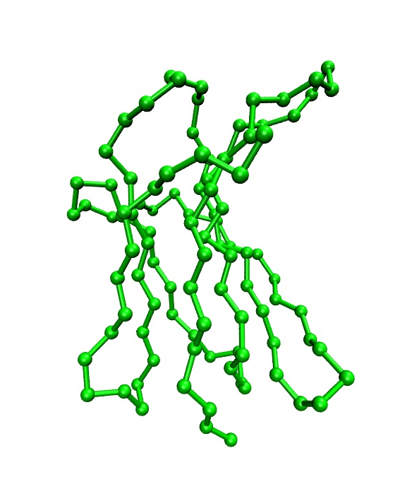
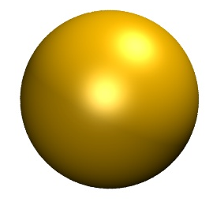
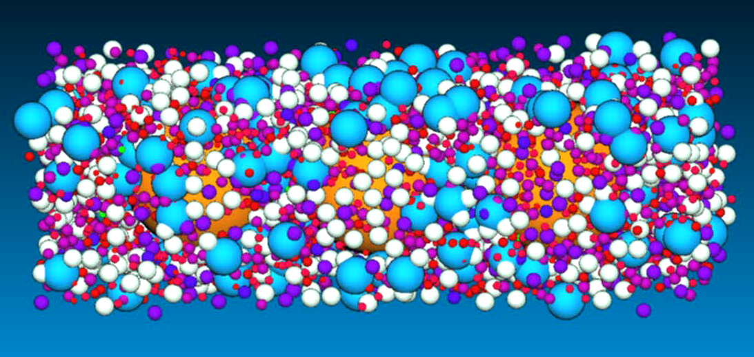
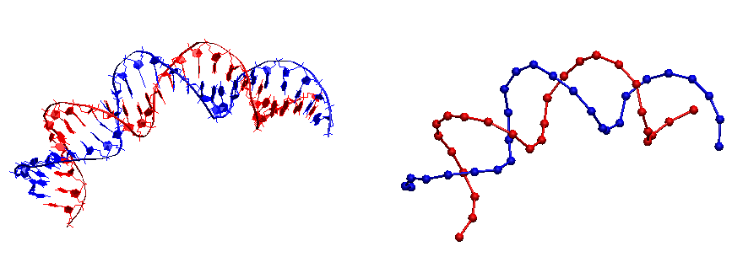
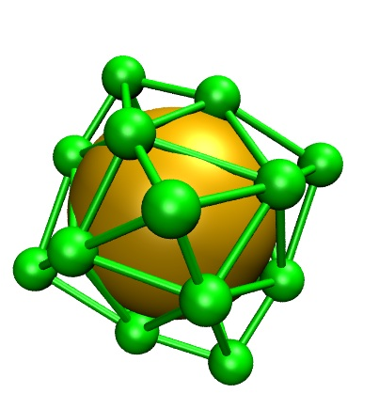
Multi-Scale modeling of bio-processes
Continuum/
grid models
Reduce resolution
Spatial coarse graining
Reduce/hide degrees of freedom
Use collective variables
Particle models
m
mm
Time coarse graining
Increase the time step of motion integration
cut off high frequencies
Use stochastic/enhanced sampling methods, statistical averages
μm
Time averaging
Network, kinetic models
nm
Increase empiricism
fs
ps
ns
μs
ms
sec
hours
Months/years
”Parameters” coarse graining
Interactions have increasing empiricism
Strategy for fitting parameters (regression/ML)
accuracy/trasferability
Target/input data

Slide 11
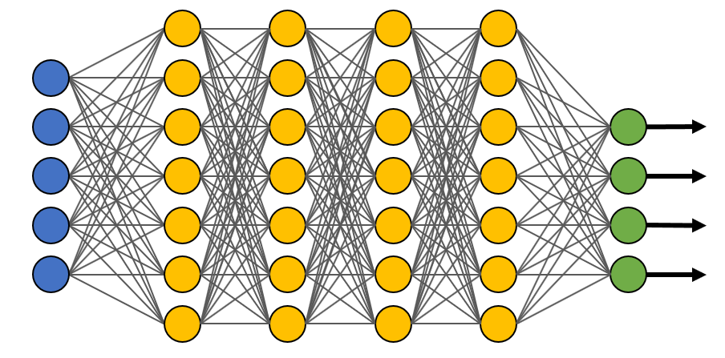
Typical workflow of multiscale bio-modeling
Continuum/
grid models
Predictions
Expt data
The multi-scale approach involves the feedback between different stages AND with experiment
Simulations and calculations return observables to compare with experiment
Experiment gives feedback to models and aid parameterization
Simulations give prediction for quantities unaccessible to experiment
Muli-metodological integration is necessary
params refinement
Particle models
Observable calculation
m
mm
μm
Network, kinetic models
nm
Dynamics
simulations
fs
ps
ns
μs
ms
sec
hours
Months/years
System and starting Parameterization
Models
(kinetic, DE, networks)
Adnvanced fit procedures, ML

Slide 12





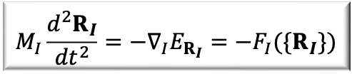

At any level there is a certain level of empirical content
$$M_{I}\frac{d^{2}R_{I}}{{dt}^{2}}=−∇_{I}E_{R_{I}}=−F_{I}({\{R}_{I}\})$$
$$E_{R_{I}}$$
The atomistic and CG empirical force fields (FFs) are many-parameters functions E[pi]
The empirical content increases as the resolution decreases
The parameterization strategy is crucial
GS
$$R_{I}$$
Parameters
Forces
energies
Fit methods:
PES matching
Force matching
Regression
IBI, Inverse MC
Entropy min…
training
Higher level atomistic theory
simulation
-> Use ML to parameterize the FF
$$F_{J}[p_{i}]$$
Force Field
Expt data set:
structures,
thermo-statistics
distributions
E$[p_{i}](R_{J})$
$${P (R}_{J})[p_{i}]$$
trajectories
$$R_{J}[p_{i}]$$

Slide 13








Computer modeling and Machine Learning
Machine Learning CG potentials
Parameters
Forces
energies
Fit methods:
PES matching
Force matching
Regression
IBI, Inverse MC
Entropy min…
training
Higher level atomistic theory
simulation
Force Field
training
$$F_{J}[p_{i}]$$
Higher level theory trajectories and Forces
E$[p_{i}](R_{J})$
Force Field
Expt data set:
structures,
thermo-statistics
distributions
E$[p_{i}](R_{J})$
$${P (R}_{J})[p_{i}]$$
-> Use ML to parameterize the FF
Forces
energies
$$F_{J}[p_{i}]$$
-> Use ML to calculate forces
simulation
trajectories
Empirical potential fit
$$R_{J}[p_{i}]$$
trajectories
distributions
training
-> Use ML to produce trajectories
$${P (R}_{J})[p_{i}]$$
Force Field
$$R_{J}[p_{i}]$$
Higher level theory
Trajectories
E$[p_{i}](R_{J})$
Faster simulation
Larger data amount needed for learning
Smaller explainability
trajectories
distributions
Graph Neural Networks
$$R_{J}[p_{i}]$$
$${P (R}_{J})[p_{i}]$$

Slide 14
Getting back to our problem, we are currently focusing on two scales
Bio-chemical stage (intra-cell)
DNA breaks
Intra-cell signaling and diffusion
Repair/apoptosis
Tissue Level
Inter-cell signaling and
diffusion of repairing enzimes/radicals
Cell reorganization
Possible determinants of differential effects
Oxygen concentration
⇒ Different production of ROO*
ROO* differential diffusivity
⇒ Reach different saturation level
mm
Chemical stage
Complex radicals
Formation and diffusion
Reactions with DNA
μm
Physical stage
Irradiation
excitation
Heterogeneous chemistry
Water radiolysis
Radicals formation and diffusion
nm
Activation and diffusion of
reparatory enzymes/mols
⇒ Different efficiency of DNA damage abnd reparation
fs
ps
ns
μs
ms
sec
hours
Oxygen concentration
Non-linear (e.g. inter-track) effects
⇒ differently activated/regulated by different architecture of cell/tissue
ROO* diffusion/saturation
reparation enzymes & related subst
Activation of inter-cell signaling
⇒ Different damg propagation/remediation
→ survival/death
Cell signaling/death/survival

Slide 15
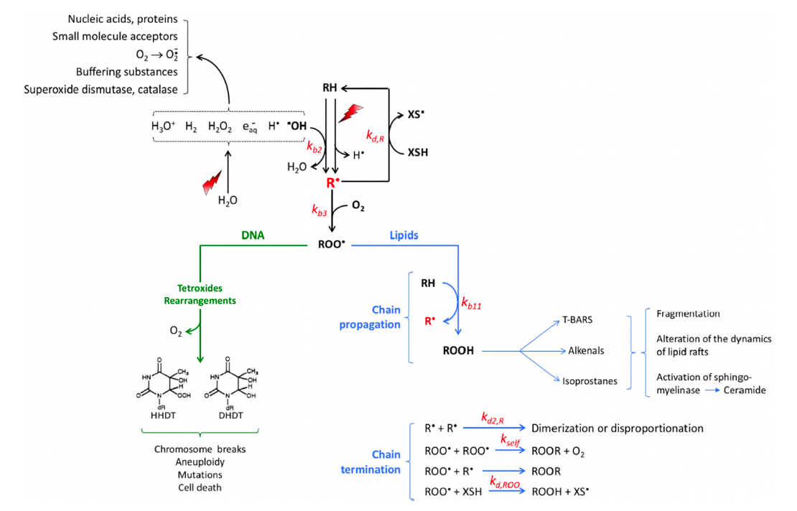
Radicals evolution scheme
mm
The mechanism is regulated by
Oxygen concentration
Several feedbacks on radicals and oxygen concentration
Highly non linear!
μm
nm
fs
ps
ns
μs
ms
sec
hours
The mechanism generates
DNA damage
Oxidative stress
Multiple damage pathways, different time scales

Slide 16
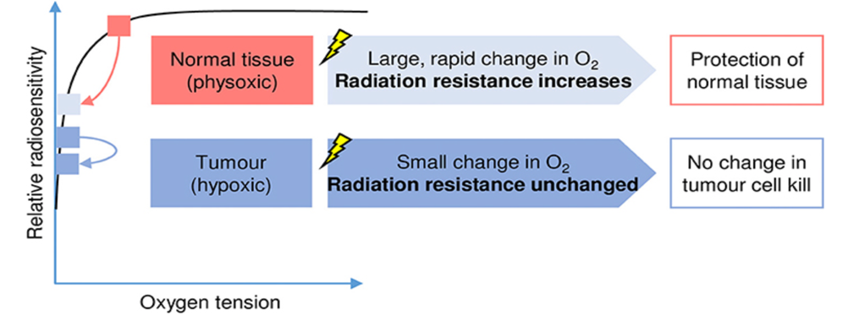
Radicals evolution scheme –the role of oxygen
mm
Oxygen depletion hopothesis:
a traditional explanation
μm
Oxygen is consumed to generate radicals, and this generate transient hypoxia, which induce radio-resistance
At High dose rate: Oxygen consuption is too quick to be within the pulse period which prolongs radio-resistance
Effect smalle in cancer cell because already hypoxic
(Already suggested in Hall&Brenner 1991)
Zhou Med Phys 2020
nm
fs
ps
ns
μs
ms
sec
hours
The effect would depend on a fine balance between the oxygen restoration time and the irradiation dynamics
The dependence of the oxygen dynamics on the cell type/environment/state is unclear
Current hypotheses
ODH is qualitatively correct but quantitatively insufficient
Oxygen has certainly a role however with feedbacks at several different levels: High non linearity
Other mechanisms at different time scales
Wilson J. Et al. (2020) Front. Oncol
redrawn from Pratx et al.2019

Slide 17
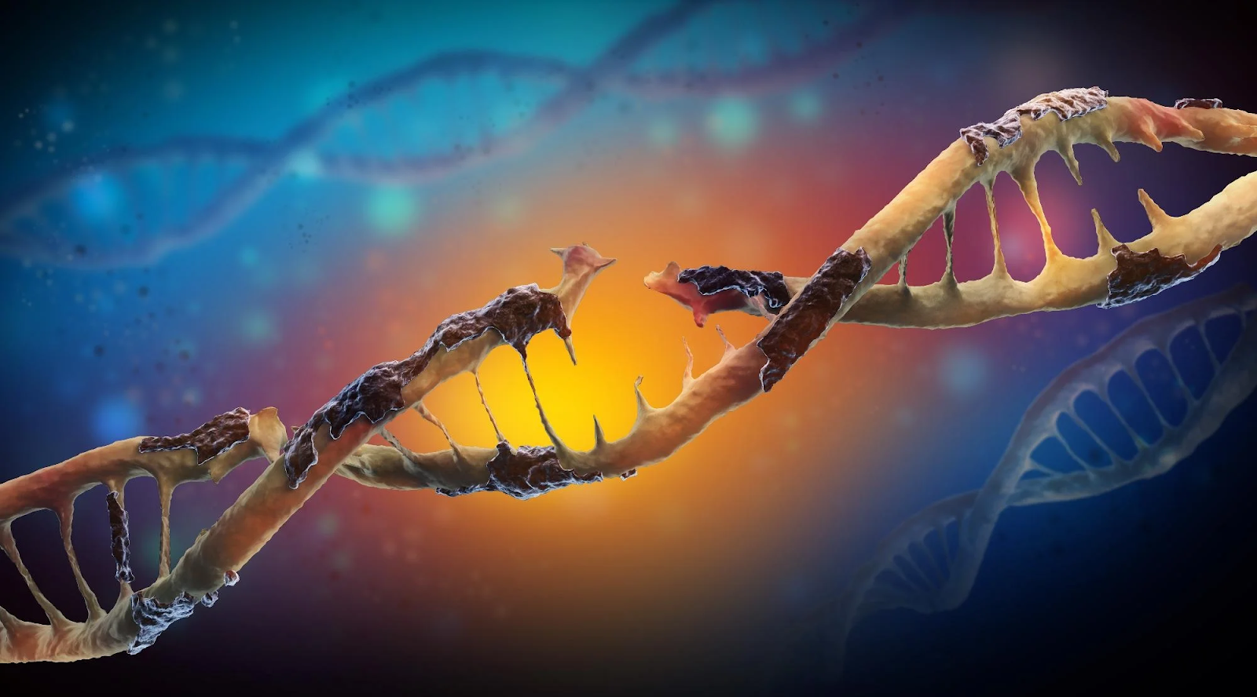
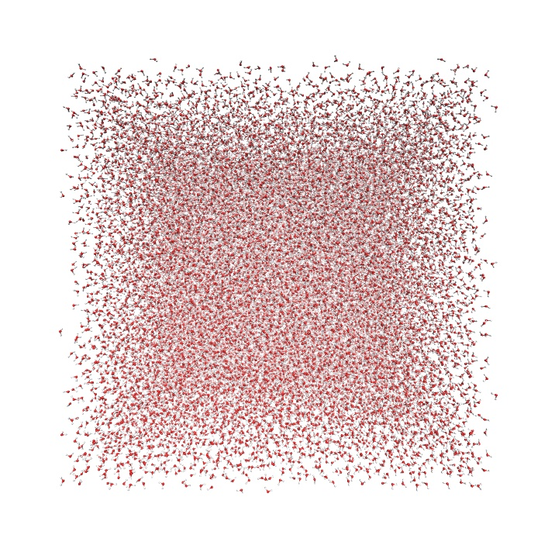
The atomistic scale:
Combining reaction-diffusion monte carlo with reactive MD
Simulate the water radiolysis, formation/diffusion of radicals and reaction with DNA
mm
μm
nm
fs
ps
ns
μs
ms
sec
hours
Probing Spatiotemporal Effects of Intertrack Recombination with a New Implementation of Simultaneous Multiple Tracks in TRAX-CHEML Castelli, G Camazzola, MC Fuss, D Boscolo, M Krämer, V Tozzini, E scifoni IJMS 26 (2), 571 (2025)
Indirect DNA damage by hydroxyl radicals: a molecular dynamics assessment L Castelli, E Scifoni, V Tozzini Phys Med (2026)

Slide 18
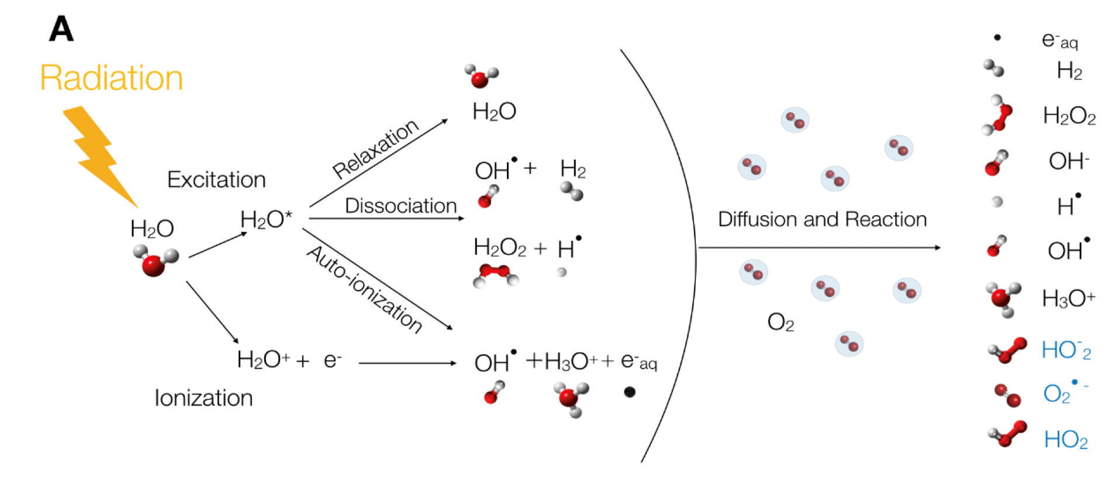
Starting from the beginning… First steps of ROS generation
mm
μm
Computer simulation of water radiolysis and formation early evolution/diffusion of ROS and interaction with biomolecules
Time-size scales: up to μsec and μm
Method: combine two “complementary” approaches
nm
Reaction-diffusion Monte Carlo
Reactive atomistic molecular dynamics
fs
ps
ns
μs
ms
sec
hours

Slide 19

mm
Combining Monte Carlo & Molecular dynamics
Reaction-diffusion Monte Carlo
(RDMC)
MC
Simulation procedure: Probability driven (Metropolis, MC) track based
Input: Cross sections, kinetic constants & diffusion coefficients; radiation type, energy and quality
Time/space scales: fs to μs, nm to μm
Output: tracks and spatial distribution in time of chemical species
μm
Reactive atomistic molecular dynamics
MD
nm
fs
ps
ns
μs
ms
sec
hours
Boscolo, Scifoni et al 2018-2024
Castelli, Petrolli, Micheloni 2020-2024

Slide 20


mm
Combining Monte Carlo & Molecular dynamics
Reactive atomistic molecular dynamics
(RAMD)
MC
Starting space distribution of species
Integration procedure: reactive MD FFs force driven $M_{i}{\ddot{R}}_{i}=−∇_{i}U\left(\left\{R_{i}\right\}\right)−{M_{i}γ}_{i}\dot{R_{i}}−F_{i}^{s}$ trajectory based
Input: Interactions $U\left(\left\{R_{i}\right\}\right),$box of water molecules,
+ other molecules of interest in starting state
Time/space scales: fs to μs, nm to μm
Output: Trajectories of each particle, reactions evolution and diffusion, kinetic constants for new species (e.g. DNA)
μm
MD
nm
Kinetic
constants
Diffusion coefficients
fs
ps
ns
μs
ms
sec
hours
MC and MD are complementary!

Slide 21
MC and MD are complementary!
PROS
CONS
Less computationally expensive
Same method can easily include different radiation type and quality
Can follow evolution of species on long time and large distance scales
Larger scales capability
Many parameters are needed: diffusion coefficients, cross sections … for all species and processes included in the calculations
Including different species and/or environmental conditions requires additional parameters
Larger empirical level
MC
Gives the evolution trajectories of all particles of the system in time
Diffusion coefficients, cross sections etc, reaction probabilities… are not needed, output of simulations
Different molecules of any type can be added with no additional effort
Larger predictive power
More computationally expensive
Need starting distribution of species and their energy
Needs a starting effort to parameterize interactions
Needs coarse graining to go on the long/large scales
Larger computational cost
MD

Slide 22
MC and MD are complementary!
MC
Tracks
DNA damage
+Cross sections
Diff coefficient etc of complex radicals and DNA
Radiation properties
Cross sections
Diffusion coefficients
(water and its ions/radicals)
MD
Trajectories
Water box + radicals/ions distributions
DNA, proteins,
other molecules
OH*

Slide 23





Interfacing MC with MD provides a complete view
Δx
Δt
Preliminary results on MC indicate strong non linear effects on [O] and [R*] due to space-time vicinity of radiation tracks
→ UHDR effects
Reactive MD simulation of radicals formation and diffusion and interaction with DNA are in the course, which will disclose the dependence of DNA damage on different radicals concentration and the damage mechanisms
Lorenzo Castelli PhD thesis

Slide 24






The coarse grained scale:
DNA damage evolution and beyond
The super-resolution data show DNA damaging in clusters and sub-clusters on the 100-300 nm scale, whose structure depends on the CONV/FLASH irradiation modality (data from F Cella group)
Coarse Grained model at the nucleosome level…
fs
ps
ns
μs
ms
sec
hours
Simulate:
Chromatin in different compaction states
Different level of damage
Dynamics of chromatin after damage
…
In progress
Editorial: Multidisciplinary approaches to the FLASH radiotherapyF Di Martino, E Scifoni, V Patera, P Montay-Gruel, F Romano, A Arafhshesh, V Tozzini Frontiers in Physics 12, 1439081 (2025)

Slide 25
Between direct modeling and AI brute force: empirical models
radiobiological mechanism
multi-scale simulations
Irradiation pars
Machine learning
data
paras
$$P_{rad}$$
Data elaboration and
analysis
$$E→F$$
$$F(P_{rad},P_{tis})$$
data
paras
minimalist empirical model
$$P_{tiss} ,E$$
tissue data/effect
Treatment planning

Slide 26


















A minimalistic stochastic model
Intrapulse Diffusion Recombination Interpulse Repair biological effects
fsec nsec μsec msec sec min
Ionization and production of radicals
$ID$ $=\frac{S}{ρ_{w}πR_{t}^{2}}$ dose released by a track
$R=D/T$
Cell deadly damage
$M_{p}=βM_{c}$ critical sites are damaged
$$F_{M_{c},β}≈\frac{1}{2}\left(1−erf⁡\left(\frac{β−f−1/2M_{c}}{\sqrt{2f_{ }(1−f)/M_{c}}}\right)\right)$$
Biological
damage
threshold for cell damage β
threshold for local damage $α$
α=4
α=2
α=3
β=0.8
Direct damage $f_{α}=\frac{γ\left(α,D/ID\right)}{Γ\left(α\right)}$
$$f_{α,t_{d},R}$$
beam fractioning
$$a_{m}$$
$$F_{α,{β,t}_{d},λ_{r}R,{t_{r},t}_{p}}$$
Indirect local damage
$η=\frac{D}{ID}\frac{\frac{D}{Rt_{d}}}{ln\left(1+\frac{D}{Rt_{d}}\right)}$
$m_{c}=α\frac{\frac{D}{Rt_{D}}}{ln\left(1+\frac{D}{Rt_{d}}\right)}$
$$f_{α,t_{D},R}=\frac{γ\left(m_{c},η\right)}{Γ\left(m_{c}\right)}$$
α=4
α=3
α=2
α=1
radicals diffusion ${t_{d}=R}_{t}^{2}/4D_{w}$
Micro/Minibeam
$a_{m}=\frac{A}{A_{m}}$
$$F→\frac{F(a_{m}D)}{a_{m}}$$
$$F(P_{rad},P_{tis})$$
$$f_{α,t_{d},λ_{r}R,t_{p}}$$
$$F_{α,{β,t}_{d},λ_{r}R,t_{r},t_{p, }a_{m}}$$
M_{c} sensitive loci
The model includes
Stochasticity
Multiple level thresholds
Diffusivity
Cell structural features
Recombination/repair
Minimal number of parameters
Pulsed irradiation $t_{p} {, t}_{r}$
Pulsed irradiation + recombination/repair
$η=\frac{D}{ID}\frac{\left(1−e^{−λ_{r}D/{R_{e}}}\right)}{{t_{d}λ}_{r}ln\left(1+\frac{D}{R_{e}t_{d}}\right)}$
$$f_{α,t_{D},λ_{r}R,t_{p},t_{r}}=\frac{γ\left(m_{c},η\right)}{Γ\left(m_{c}\right)}$$
2R_{t}
R
t_{p}
The model returns
FLASH effects due to diffusion
(No UHDR for direct damage)
Minibeam effect
Dose modifying factor
t_{r}
time

Slide 27

A minimalistic stochastic model
We built a model with the following Features: (I Bodrenko)
Minimal number of empirical parameters accounting for the behavior of F
Essential structural features (e.g. sensitive nucleous loci)
Essential non linear effects (threshoulds on damage, stochasticity)
Intra-cell diffusivity and non homogeneous ionization
Preliminary results
The combination of mesoscopic flucutations, stochastic damage and diffusivity imply the dependence of damage probability on dose rate, i.e. the UHDR effect
Adding a threshould on multiple sites damage, one also obtain a threshould on the dose triggering FLASH effect
The model is being extended to include pulsed radiation and space distribution (also from MC simulations)
The model has a limited number of parameters related to physical quantities and can easily include experimental or MC data
These can be either fixed, fitted or optimized with ML algorithms while preserving explainability
It can be readily adapted to the treatment planning system
I Bodrenko, V Tozzini, in preparation

Slide 28



Summary and conclusions
Milestone M 1.2 aggregated M 1.2.1-M 1.2.3
Design of the in silico multi-scale procedure and preliminary setup
Radiobiological effect simulations, and quantification of the radiation parameters-effect relationship
Database setup and implementation
multi-scale simulations
Specific Results
Database and platform currently up and in population phase
Monte Carlo+Reactive dynamics atomistic simulations performed
Coarse grained models built for chromatin simulation
Minimalistic Model for calculation of dose modifying factor built preliminary result returned
paras
Machine learning
$$P_{rad}$$
data
Data elaboration and
analysis
$$E→F$$
$$F(P_{rad},P_{tis})$$
data
paras
minimalist empirical model

Slide 29



Summary and conclusions
Perspectives: further steps to clinical translation
Continue database population and establish as general standard for data
Enrich the platform with analysis tools
Use data to learn predictive NN for the effects
Use coarse grained models to follow the evolution of intra-cell DNA damage
Integrate the coarse grained model with atomistic simulations to elucidate molecular mechanisms
Optimize the minimalist model for different tissue and cancer type to predict the dose modifying factor
multi-scale simulations
paras
Machine learning
$$P_{rad}$$
data
Data elaboration and
analysis
$$E→F$$
$$F(P_{rad},P_{tis})$$
data
paras
minimalist empirical model

Slide 30





Summary and conclusions
Acknowledgements
Giulia Asero, Maria Giuseppina Bisogni, Paolo Bosco, Simone Capaccioli, Satia Caroti, Andrea Cavalieri, Mariagrazia Celentano, Francesca Cella Zanacchi, Esther Ciarrocchi, Mirko Corosu, Mario Costa, Eleonora Da Pozzo, Francesca Del Debbio, Elisa De Santis, Beatrice Di Marco, Fabio Di Martino, Giulia Furini, Ruben Gianeri, Francesco Laruina, Simone Lossano, Margherita Maffei, Enrico Mazzoni, Eduarda Mota Da Silva, Piernicola Oliva, Vinoshene Pillai, Filippo Rossi, Gaia Scabia, Valeria Sipala, Enrica Strettoi

