Slide 1
THE - SPOKE 5
IMPLEMENTING INNOVATION FOR HEALTHCARE AND WELL-BEING
Partners: Spoke leader UNIFI, Toscana Life science (TLS), UNIPI, UNISI, UNISTRASI, CNR, Digital Innovation Hub (DIH).
CNR Institutes: IFAC, IFC, IIT, IN, INO, ISTI (Rossi Francesca, Cavigli Lucia, Farini Alessandro, Brandi Fernando, Di Renzo Renzo, Ghelardi Lucia, Palumbo Filippo, Selisca Daniela, Bianchini Elisabetta, Emma Buzzigoli, Jessica De Giovanni).
CNR’s activity UPDATE - focus on medical device regulation
Elisabetta Bianchini (IFC – CNR)
Spoke 1 project meeting, Pisa, Italy, December 12nd 2024

Slide 2
Spoke 5
Activities
Strategies for protecting know-how
Support for business startup
Dissemination of results
Networking for stakeholder engagement
Regulatory support
Training for cross-disciplinary skills
Hackathon focused on medical needs
Objective
Resources
VALORIZATION of research results with different TRLs:
Early stage
Proof of concept
Validation
Prototyping
Recruitment of technologists for scouting and valorizing projects
Diversified technical-scientific skills.
Notes:
Main aim: to support the other spokes as facilitators for the results’ transfer towards society, through interaction/integration with industry and with the regional healthcare system and monitoring of opportunities and barriers for the hub.
11 support figures recruited (Partners with budget: UniFI, UNIPI, UNISI, UNISTRASI).

Slide 3
Key Performance Indicators
Project Monitoring
200 projects monitored across 9 spokes
130+ meetings with research groups
Evaluation of connections
Valorization
Regulatory aspects
IP and Market analysis
Results Achieved (18 months)
12 Invention Disclosure Reports
12 Prior Art Analysis Reports
5 IPR Management Operations
13 Market Analyses
5 Business Idea Evaluation Reports
2 TT agreement reports
2 Business plan support
Startup creation
5 business idea proposals
2 business plan development support
8 business ideas applications
Regulation
Life science regulatory support service
The first 10 regulatory consultancy services entrusted.
Working group to orient the management of pre-market processes for medical device - (EU) 2017/745 MDR
Education
THRUSTER (Tuscany Health Ecosystem entRepreneUrial Skills Training)
THE TALK webinars

Slide 4
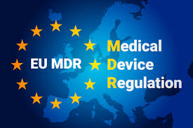
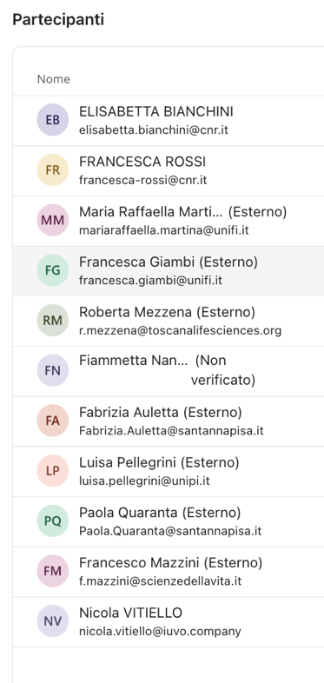
Pre-market processes for medical device in Public Institutions
Internal need emerged during spoke 5 meetings: sharing experiences about related to our Institutions in UE 2017/745 Medical Device Regulation (MDR).
Creation of a dedicated WG (July 2024) - UniFI, UNIPI, SNS, SS S.Anna, TLS, CNR volunteered.
Identification of two main tasks (1 operative/short term, 2 scientific/long term).
Missione 4 • Istruzione e Ricerca
Missione 4 • Istruzione e Ricerca
Notes:
UniFI’s input: need to better understand the role of our organizations within the pre-market processes for medical device - with specific focus on (EU) 2017/745 MDR.
Creation of a dedicated working group: UniFI, UNIPI, SNS, SS S.Anna, TLS, CNR volunteered.
To bring together people with interest/expertise in the sector.
To exchange past experiences and understand whether there are structured procedures within our organizations that could be shared.
To understand if there are actions that can arise from this brainstorming (e.g. scientific papers, questions to PQE, etc.).

Slide 5
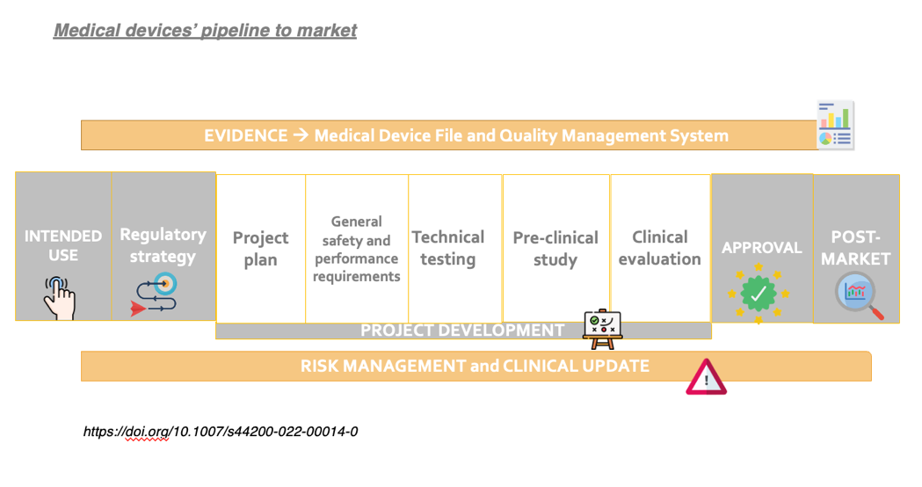
Task 1 – exchange of experiences and operative needs
Development of a survey based on detailed technical/operative questions related to MDR implementation.
23 members of THE directly involved in medical devices development were contacted.
16/23 answers.
Missione 4 • Istruzione e Ricerca
Missione 4 • Istruzione e Ricerca
Notes:
è stato concordato di identificare quesiti che da inoltrare alle Organizzazioni coinvolte in THE in modo da avere una overview dello stato attuale della gestione dei processi pre-market (vedi pagina successiva). Per facilitare questa fase si è utilizzato come riferimento lo schema riportato in figura 1. I destinatari potrebbero essere i membri dello spoke 5 con preghiera di diffusione anche ad Uffici dedicati interni ai loro Enti di cui siano a conoscenza. Sarà inoltre creata una lista di PI che potrebbero essere direttamente coinvolti in questi processi e quindi potrebbero essere ulteriori destinatari.
Risultati:
PI e team gestiscono la maggior parte di questi processi, spesso supportati da collaboratori esterni.
La mancanza di procedure per la gestione dei processi pre-market nello sviluppo di Medical Devices.
La necessità di unità dedicate per la preparazione della documentazione e l'interazione con i CE e gli enti di notifica, riducendo il ricorso ad enti esterni.
Necessità di formazione sul tema Medical

Slide 6
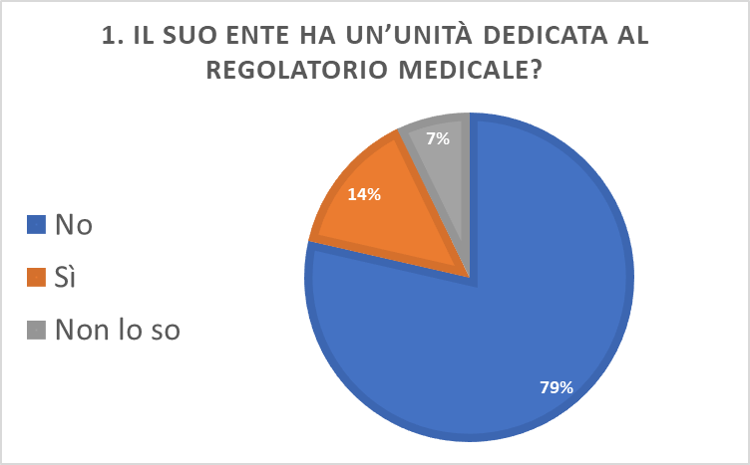
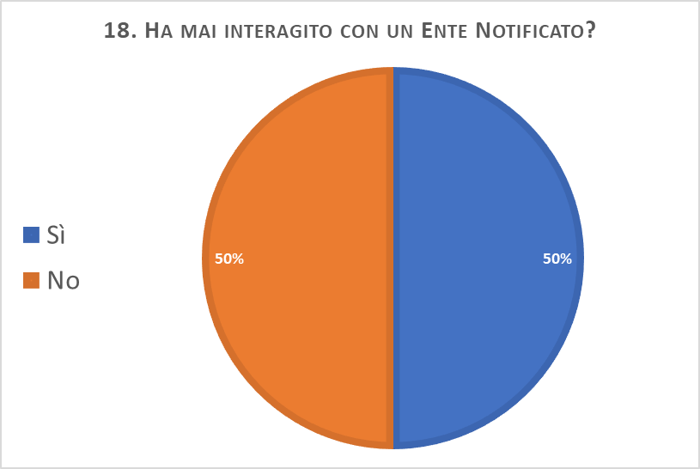
Task 1 - emerged key points
The PIs and teams manage most of these processes (intended use, qualification, classification, risk assessment etc), often supported by external collaborators.
The lack of info/procedures for managing pre-market processes in the development of Medical Devices.
The need for dedicated units for the preparation of documentation and to improve interaction with Ethical Committes and Notification Bodies.
The need for training/education in the field.
OUTPUT: 1) dedicated service by the supplier (PQE solution) for i) training; ii) inputs about the backbone of internal operative procedure. 2) first contacts with other local stakeholders.
Missione 4 • Istruzione e Ricerca
Missione 4 • Istruzione e Ricerca

Slide 7
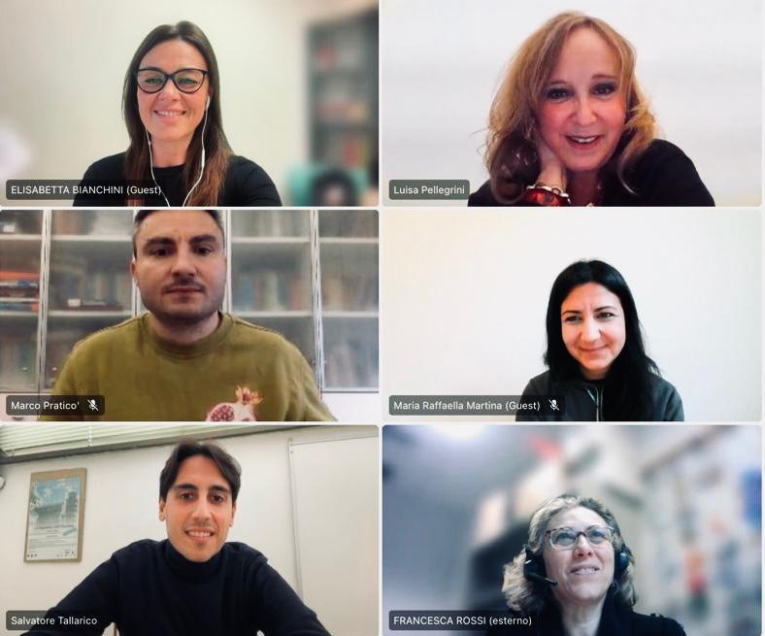
Task 2 – how can we facilitate the process?
Research Goal
(RG)
Develop comprehensive recommendations (tool) for regulatory affairs related to medical devices, specifically tailored for public research entities
Research Question
(RQ)
What challenges and emerging needs do public research entities face regarding medical device regulatory processes during the pre-market phase?
CNR (Francesca Rossi and Elisabetta Bianchini) in collaboration with UniPI (Salvatore Tallarico, Marco Praticò e Luisa Pellegrini) and UniFI (Maria Raffaella Martina, Francesca Giambi).
Missione 4 • Istruzione e Ricerca
Missione 4 • Istruzione e Ricerca

Slide 8
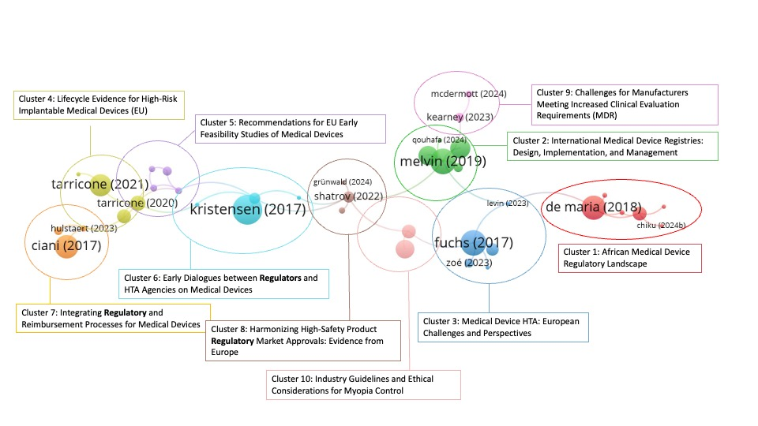
Task 2 – how can we facilitate the process?
Theoretical Background
Case studies
Expert group and Delphi method
Theoretical Background
Keywords | Medical device |  | Regulatory affairs |  | Context
 | Medical device* OR MD | AND | "MDR 2017/745" OR "MDR 2017-745" OR mdr OR "medical device* regulation" | AND | "public" OR "hospital*" OR "universit*" OR academ*
Missione 4 • Istruzione e Ricerca
Missione 4 • Istruzione e Ricerca
Notes:
Method: Bibliometric analysis using VOSViewer/Pajek software.
Process: Keyword search in Scopus database (using Boolean operators), citation analysis (or bibliographic coupling, or keyword co-occurrence analysis)
Outcome: Identification of key research streams, construction of a primary network of articles, and development of a solid theoretical foundation for the study.

Slide 9
Task 2 – how can we facilitate the process?
Theoretical Background
Case studies
Expert group and Delphi method
Case studies
Based on multiple case studies
Identification and analysis of relevant case studies within public research entities. Semi-structured interviews.
Description of experiences, critical issues, and adopted solutions. This phase will use qualitative research methods.
Missione 4 • Istruzione e Ricerca
Missione 4 • Istruzione e Ricerca
Notes:
Method: Bibliometric analysis using VOSViewer/Pajek software.
Process: Keyword search in Scopus database (using Boolean operators), citation analysis (or bibliographic coupling, or keyword co-occurrence analysis)
Outcome: Identification of key research streams, construction of a primary network of articles, and development of a solid theoretical foundation for the study.

Slide 10
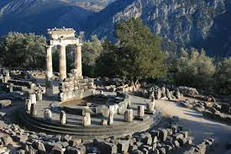
Task 2 – how can we facilitate the process?
Theoretical Background
Case studies
Expert group and Delphi method
Expert group and Delphi method
Delphi method is a structured communication process used to reach consensus (for e.g. forecasting or guidelines) based on the results of multiple rounds of questionnaires sent to a panel of experts.
Formulation of the Delphi theses based on findings from background/case studies.
Facilitators and definition/selection of the panel of experts.
Missione 4 • Istruzione e Ricerca
Missione 4 • Istruzione e Ricerca
Notes:
Method: Bibliometric analysis using VOSViewer/Pajek software.
Process: Keyword search in Scopus database (using Boolean operators), citation analysis (or bibliographic coupling, or keyword co-occurrence analysis)
Outcome: Identification of key research streams, construction of a primary network of articles, and development of a solid theoretical foundation for the study.

Slide 11
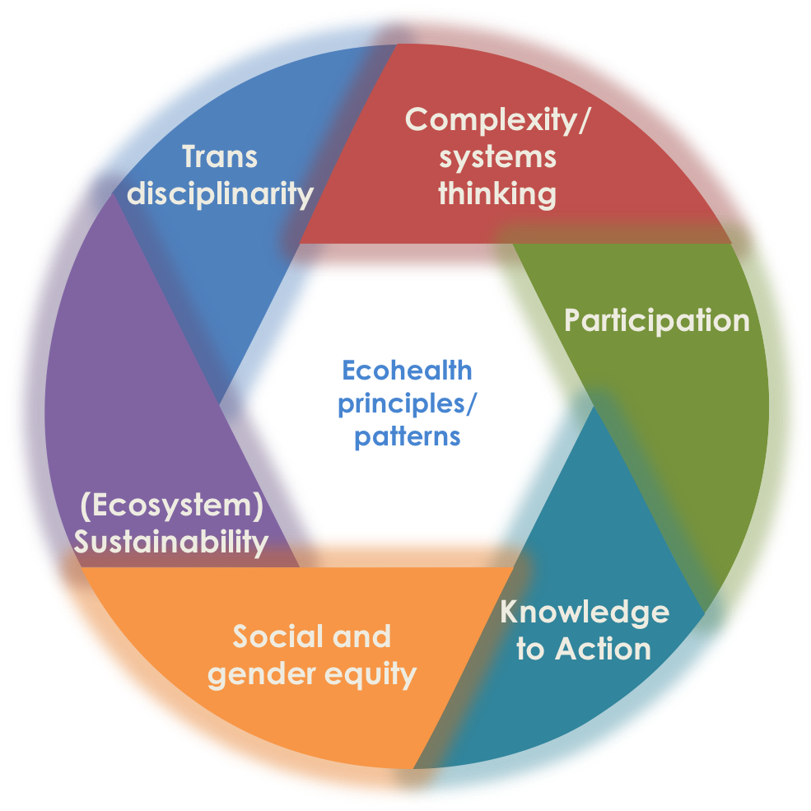
Final Remarks
Is the Ecosystem starting to become real?
Morrison K, Feagan M, and Brisbois B, (2012) Ecosystem approaches to health principles and histories. In: McCullagh S ed. (2012). Ecosystem Approaches to Health Teaching Manual. Canadian Community of Practice in Ecosystem Approaches to Health. Available: www.copeh-canada.org
Notes:
Process of creating value for the Society from knowledge by linking different areas and sectors.
What we were asked to provide: support in some activities.
What we added: interaction with other partners; active and constructive contribution in our field of interest/expertise.
Knowledge into Action is an iterative sequence of activities and support which together bridge the gap between knowledge and practice, by converting knowledge into decisions and actions to deliver safer, more effective care.

Slide 12
Contacts
Italian National Research Council
Institute of Clinical Physiology
elisabetta.bianchini (skype)
elisabetta.bianchini@ifc.cnr.it

Slide 13
Task 2 –Delphi method
Expert group and Delphi method
Method: Delphi method to gather and analyze expert insights
Process: Engagement of experts to refine and integrate findings from background/case studies.
Outcome: Development of a tool serving as comprehensive recommendations for regulatory affairs related to medical devices in public research entities
Missione 4 • Istruzione e Ricerca
Notes:
Method: Delphi method to gather and analyze expert insights
Process: Engagement of experts to refine the guideline based on the findings from Phases 1 and 2
Outcome: Development of a tool serving as a comprehensive guideline for regulatory affairs related to medical devices in public research entities
In questo caso si potrebbe pensare ad un’implementazione che possa in qualche modo fornire delle linee di orientamento sul processo pre-market ad inventori/ricercatori che si trovino ad operare in organizzazioni simili ai nostri Enti. Questo costituirebbe uno strumento di supporto che non andrebbe ovviamente a sostituirsi ai requisiti normativi che sono ben chiari, ma a volte poco conosciuti o compresi nel nostro ambito a causa di un gap culturale. L’applicazione del metodo necessita di un gruppo di facilitatori (noi) ed un panel di esperti. Si concorda sul fatto che per produrre un risultato solido, senza bias e ben rappresentativo dei vari stakeholder di settore, il panel di esperti debba essere esteso almeno a livello nazionale a figure esterne a THE.
Durante il prossimo incontro ci confronteremo sulla volontà/possibilità di proseguire o meno con questo (ambizioso) obiettivo, e nel caso inizieremo a pensare ai punti specifici.

Slide 14
Task 2 – Delphi method
Delphi method is a structured communication process used to reach consensus (for e.g. forecasting or guidelines) based on the results of multiple rounds of questionnaires sent to a panel of experts.
Formulation of the Delphi theses.
Facilitators.
Definition and selection of the panel of experts.
Missione 4 • Istruzione e Ricerca
Missione 4 • Istruzione e Ricerca
Notes:
The Delphi method or Delphi technique (/ˈdɛlfaɪ/ DEL-fy; also known as Estimate-Talk-Estimate or ETE) is a structured communication technique or method, originally developed as a systematic, interactive forecasting method that relies on a panel of experts.^{[1][2][3][4][5]} Delphi has been widely used for business forecasting and has certain advantages over another structured forecasting approach, prediction markets.^{[6]}
Delphi can also be used to help reach expert consensus and develop professional guidelines.^{[7]} It is used for such purposes in many health-related fields, including clinical medicine, public health, and research.^{[7][8]}
Delphi is based on the principle that forecasts (or decisions) from a structured group of individuals are more accurate than those from unstructured groups.^{[9]} The experts answer questionnaires in two or more rounds. After each round, a facilitator or change agent^{[10]} provides an anonymised summary of the experts' forecasts from the previous round as well as the reasons they provided for their judgments. Thus, experts are encouraged to revise their earlier answers in light of the replies of other members of their panel. It is believed that during this process the range of the answers will decrease and the group will converge towards the "correct" answer. Finally, the process is stopped after a predefined stopping criterion (e.g., number of rounds, achievement of consensus, stability of results), and the mean or median scores of the final rounds determine the results.^{[11]}
Experts’ group providing recommendations by Delphi method on the pre-market process to inventors/researchers who find themselves working in organizations similar to ours.
This would constitute a support tool that obviously would not replace the regulatory requirements that are very clear, but sometimes difficult to be applied in our field due to a cultural gap.
The application of the method requires a group of facilitators (us) and a panel of experts.
We agree that in order to produce a solid result, without bias and well representative of the various stakeholders in the sector, the panel of experts should be extended at least at a national level to figures external to THE.

Slide 15
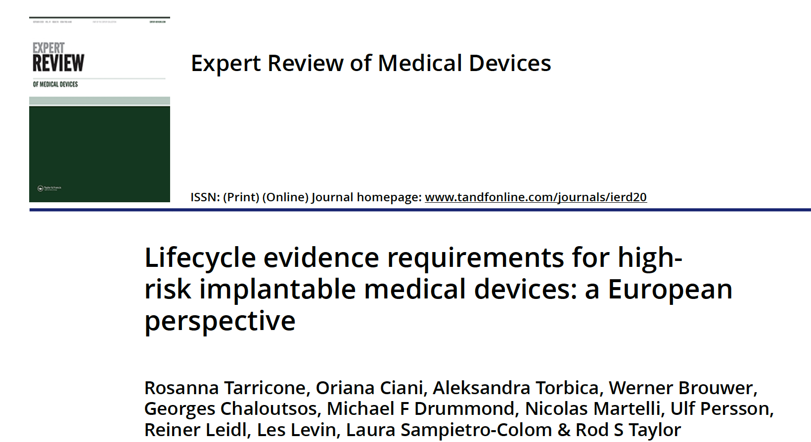
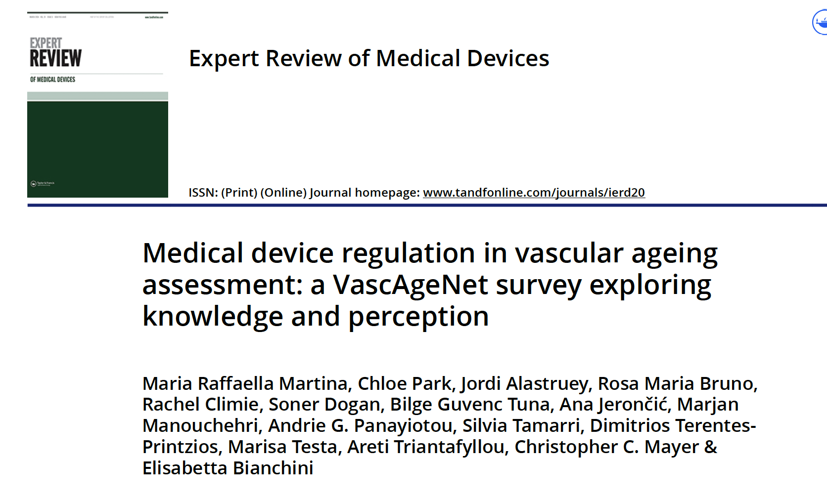
Obj 3 – scientific aims
Alignment with obj 2
Survey experience (Francesco)
Inputs by Luisa: experts’ group addressing specific points by Delphi method → Which specific points could we cover? Can we implement a (modified) delphi method?
Missione 4 • Istruzione e Ricerca
Missione 4 • Istruzione e Ricerca
Notes:
Da tutto questopotrebbe pure scaturire un paper "scientifico" che descrive uno spaccato della pipeline dalla ricerca al mercato, ma davvero dipende dal reale interesse degli altri membri.

Slide 16
M 5.3 – regulation and preclinical/clinical trials
A survey on regulatory framework and life science products development was designed, implemented and sent to THE research groups (June ‘23) in order to understand the needed services.
A total of 220 contributions was collected.
The majority of respondents hold positions as researchers/professors, mainly with engineering, medicine, biology/biotechnology, and chemistry/pharmacy education, half claiming more than a decade experience in the life science domain.
Participants self-assessed knowledge about certifications, quality protocols, and costs was scarce.
A strong interest in regulatory support emerged (confirmed in the meetings with PIs).
Missione 4 • Istruzione e Ricerca
Missione 4 • Istruzione e Ricerca

Slide 17
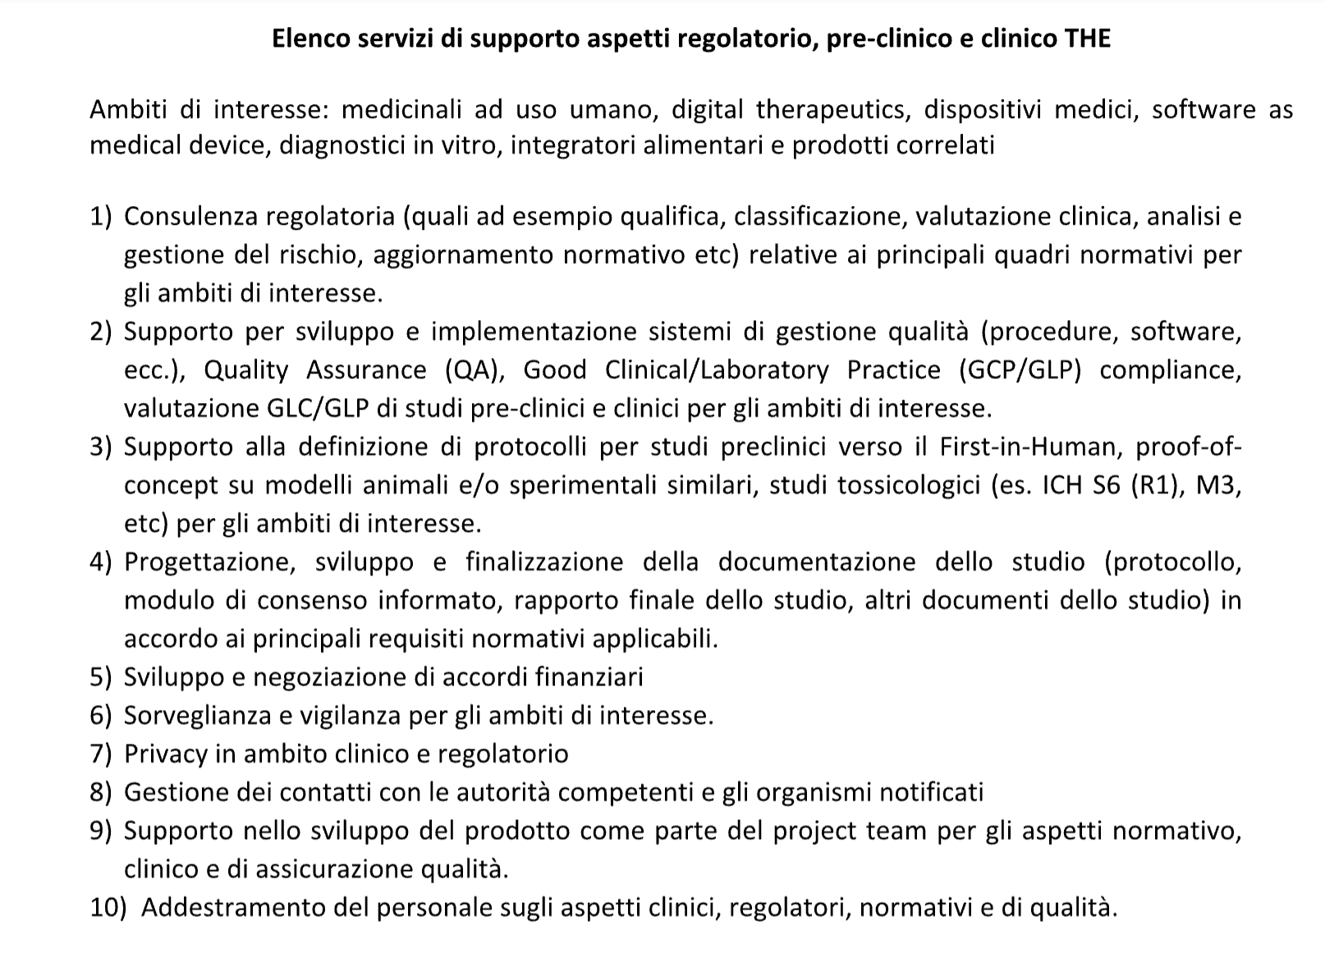
M 5.3 – regulation and preclinical/clinical trials
A provider was selected (PQE solution)
An call for interests was open and inputs have been collected through a form in October/November 23.
If interested you can still fill the form and send it to f.mazzini@scienzedellavita.it and elena.catani@unifi.it
Missione 4 • Istruzione e Ricerca
Missione 4 • Istruzione e Ricerca

Slide 18
PLANNED activities
Activity | Milestone | Period (M) | Partners
5.0 – Open calls for recruitment and spoke management setup | M 5.0.x | 1-3 | All
5.1 - Technology transfer activities, IPR strategy for research results valorization, support in drafting licensing agreements, market analysis | M 5.1.x | 1-36 | UNIFI, TLS, UNIPI, UNISI, CNR
5.2 - Startup creation and development (including entrepreneurship courses & hackathon) | M 5.2.1-3 M 5.2.4-6 | 1-36 5-29 | UNIFI, TLS, UNIPI, UNISI, CNR
5.3 - Clinical and regulatory plans support and assessment | M 5.3.1-3 M 5.3.4-6 | 1-36 1-36 | UNIFI, TLS, UNIPI
5.4 - Development of new innovation tools framework | M 5.4.x | 8-28 | UNIFI, TLS
5.5 - Training and reskilling/upskilling activities | M 5.5.x | 1-36 | UNIFI, TLS, DIH, UNISTRASI, UNISI
5.6 - Networking, technological dissemination and hub promotion activities 5.7 - Institutional advocacy and engagement | M 5.6.x | 1-36 | UNIFI, UNISI, CNR, DIH, TLS
5.8 - R&I projects open calls management and spoke committee support | M 5.8.x | 1-36 | UNIFI
5.9 – Final report on spoke 5 activities | M5.9.1 | 34-36 | UNIFI, UNIPI, UNISI, CNR, TLS
CNR
CNR
Notes:
5.5 Activity: monitoring of training needs of local industry and healthcare system; development of initiatives to address the needs.
Specific research projects: i) study and development of management and marketing approaches for healthcare services and for patinets involvement based on emerging technologies; ii) study of skills’ needs related to the market evolution in Life Science; iii) cultural intermediation in the healthcare sector.
In these times of fast changes pushed by the emerging technologies and complex evolution of social
scenarios, new professional profiles are requested by the economic and social system, life science
sector included, to maximize innovation adoption and make the changes smoother. Thus, analysis of
possible gaps in academic education programmes and professional training courses is recommended.
In that regard, milestone 5.5.1 activity aims to establish a dialogue with relevant stakeholders
(companies, institutions, ITS Vita, regional health system etc) to collect their training needs and
identify possible actions through meetings and surveys. As reported by survey carried out in this
milestone and in M5.3.1, quality and regulatory topics resulted skills to be improved together with
the expected digitalization and soft skills. Human resources management is also going through a
human-centric paradigm shift, both looking for candidates and in the employees management.
THE partners network (universities, industrial associations, institutions) will be leveraged to
modulate and implement the actions identified to be taken based on the surveys data and input from
THE network.
In the reporting period, in order to design possible training activities, a second more comprehensive
survey was envisaged, following the first one launched at the beginning of the project. Since the main
objective of THE project is to stimulate and support the growth and consolidation of the ecosystem
of life sciences and related technologies, the survey target was expanded to all companies considered
to be medium to high technology intensive, not only strictly life science, because of the strong
connection between those sectors. A selection of ATECO codes (economic activities codes, Italian
translation of NACE codes) of enterprises to be involved in the survey was carried out, together with
the setting of the questionnaire for the survey.

