Slide 1
VHEE beam at sample and dosimetry: experimental approach
(Milestone 1.1 and 1.6)
Simona Piccinini, F. Avella, F.Baffigi, G. Bandini, G. Benincasa, F. Brandi, M. Ezzat, A. Fregosi, L. Fulgentini, D. Gregocki, P. Koester, L. Labate, D. Palla,
M. C. V. Panaino, M. Salvadori, S. G. Vlachos & L. A. Gizzi.
Notes:
I will present the dosimetric characterization of a laser-plasma accelerated Very High Enenergy Electron beam at the sample, along with the development of an experimental setup for radiobiological measurements (at the Intense Laser Irradiation Laboratory).

Slide 2
Toward FLASH-RT with laser - driven VHEE beams?
Böhlen Ttet al. Characteristics of very high-energy electron beams for the irradiation of deep-seated targets. Med Phys. 2021 Jul;48(7):3958-3967. doi: 10.1002/mp.14891
Ronga MG et al. Back to the Future: Very High-Energy Electrons (VHEEs) and Their Potential Application in Radiation Therapy. Cancers (Basel). 2021 Sep 30;13(19):4942. doi: 10.3390/cancers13194942.
Böhlen TT et al. Very high-energy electron therapy as light-particle alternative to transmission proton FLASH therapy - An evaluation of dosimetric performances. Radiother Oncol. 2024 May;194:110177. doi: 10.1016/j.
…
Panaino, Piccinini et al. Very High-Energy Electron Therapy. Toward Clinical Implementation: A Review Study - Doi: 10.20944/preprints202411.0913.v1
Notes:
Our work is part of this challenge
The dosimetric characteristics of VHEEs … make them very interesting for use as radiation in innovative radiotherapies for deep tumors (as an alternative to photons and protons.)
The interest in VHEE for the treatment of deep tumors has grown further with the rediscovery of the FLASH effect. The use of charged particles is often considered the most suitable approach to achieve the ultra-high dose rates required for FLASH applications.
In particular, (while proton therapy offers precise tumor targeting (with minimal damage to surrounding tissues)) VHEE by LPA represent a potentially compact, less expensive and highly promising alternative for the treatment of deep seated tumors, especially in the context of FLASH radiotherapy.
Below I have reported some articles on the subject. You can find the full list in our review cited by Costanza
Laser Wakefield Acceleration (LWFA) enables accelerating gradients orders of magnitude higher than conventional RF-based accelerators
(GeV/m instead of 10 MeV/m)
The possibility of deliver them in short-temporal bunches (tens of fs) characterized by an ultra-high-dose rate pave the way to a VHEE FLASH-RT combining the benefits of both.

Slide 3
Radiobiology measurements: introduction
UHDR LPA VHEE → DNA damage
Few experiments using
LPA VHEE irradiation
(UHDR per pulse 10¹² Gy/s)
C.A. McAnespie et al.
arXiv:2409.01717v2 [physics.med-ph] (2024)
S. Orobeti et al.
Sci Rep 14,14866 (2024)
Notes:
Let's focus on the radiobiological aspects of this challenge, which I have mainly dealt with
Only an introduction to contextualize the issues associated with conducting these experimental studies.
As highlighted during the recent FRPT2024 conference in Rome, the radiation pulses time regime appears to be a fundamental parameter in the FLASH mechanism.
Understanding the interaction of Laser-Driven VHEE beams, characterized by ultra-short pulses lasting tens of femtoseconds and delivering extremely high dose rates per pulse, is crucial.
DNA is the primary target of radiation-induced damage, investigating these aspects is of paramount importance. Currently, there are very few experimental studies analyzing DNA damage caused by VHEE produced through Laser-Plasma Acceleration. And we have decided to focus on this aspect

Slide 4
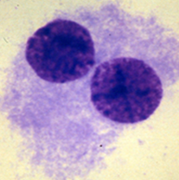
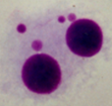
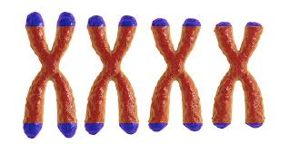
Radiobiology measurements:
introduction
Evaluation of the dose-response curve of Peripheral Blood Lymphocytes DNA damage due to laser-guided ultra-high dose rate VHEE pulses irradiation
Radiobiological endpoints
Micronucleus Test
Telomere Shortening
UHDR LPA VHEE → DNA damage
Few experiments using
LPA VHEE irradiation
(UHDR per pulse 10¹² Gy/s)
C.A. McAnespie et al.
arXiv:2409.01717v2 [physics.med-ph] (2024)
S. Orobeti et al.
Sci Rep 14,14866 (2024)
Follow A. Borghini Talk !
Notes:
My colleague, Andrea Borghini, will delve into the biological aspects in greater detail during his upcoming talk.

Slide 5
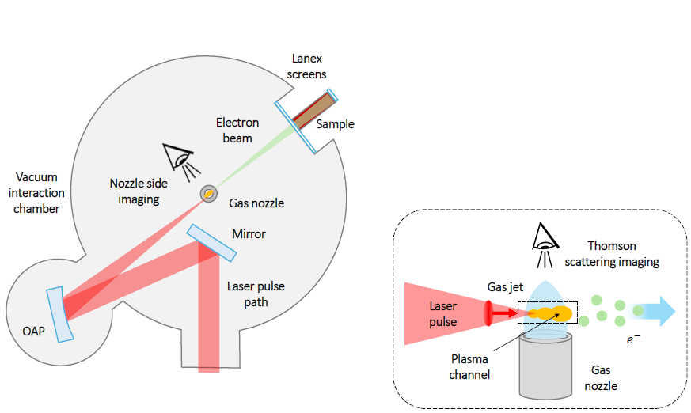
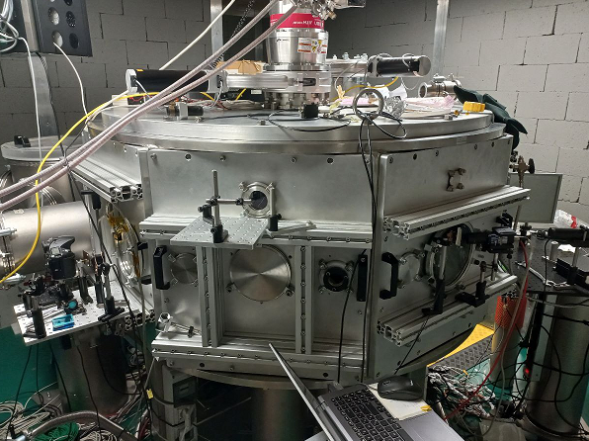
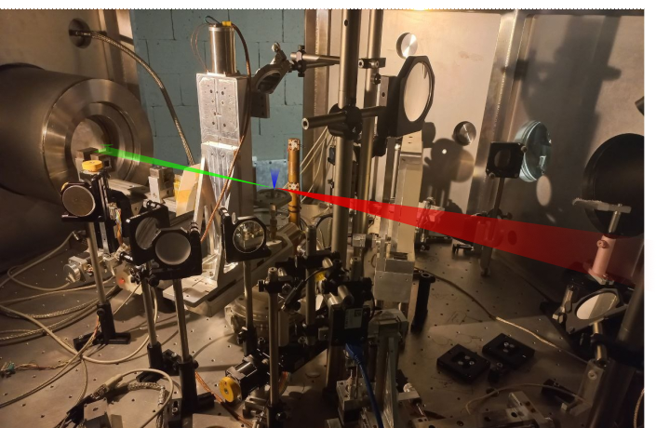
Radiobiology measurements VHEE set up at ILIL, CNR-INO Pisa
LWFA experiment set-up
Notes:
(The LWFA acceleration mechanism was discussed in previous talks.)
Some images of the experimental setup to highlight the challenges associated with irradiating biological samples.
In the top left the exterior of the interaction chamber.
Below that, an image of the chamber’s interior shows the laser beam (in red) focused on the nozzle, and the electron beam (in green) generated through the laser wakefield process.
On the right, diagrams of the chamber illustrate the diagnostic setup and, most importantly, the positioning of the biological sample in air, located just in front of the vacuum chamber’s exit window (Mylar, thickness …). I hope these visuals will help to guide your understanding of the subsequent images that will be presented.

Slide 6
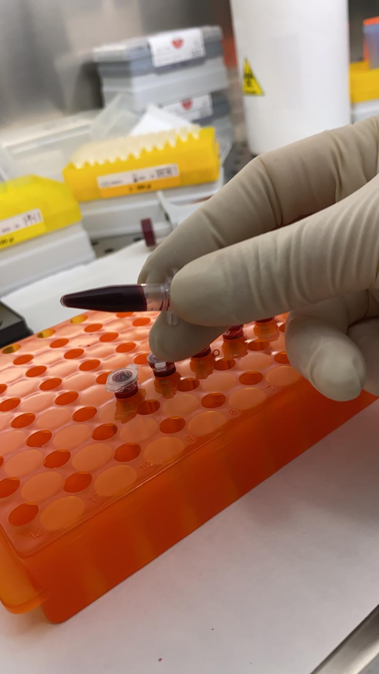
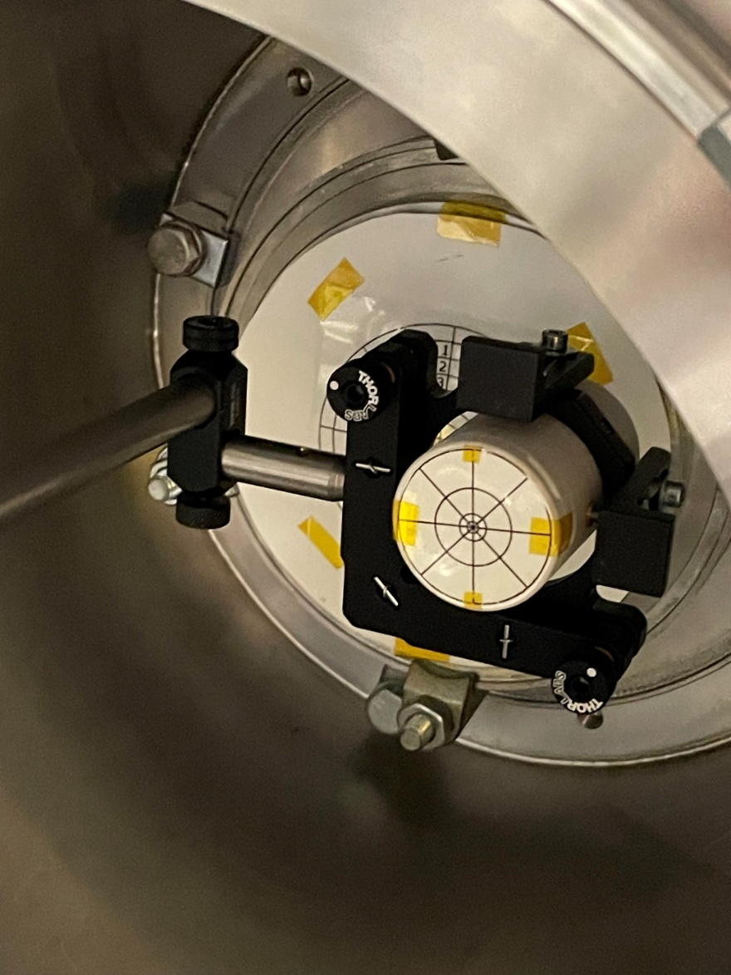
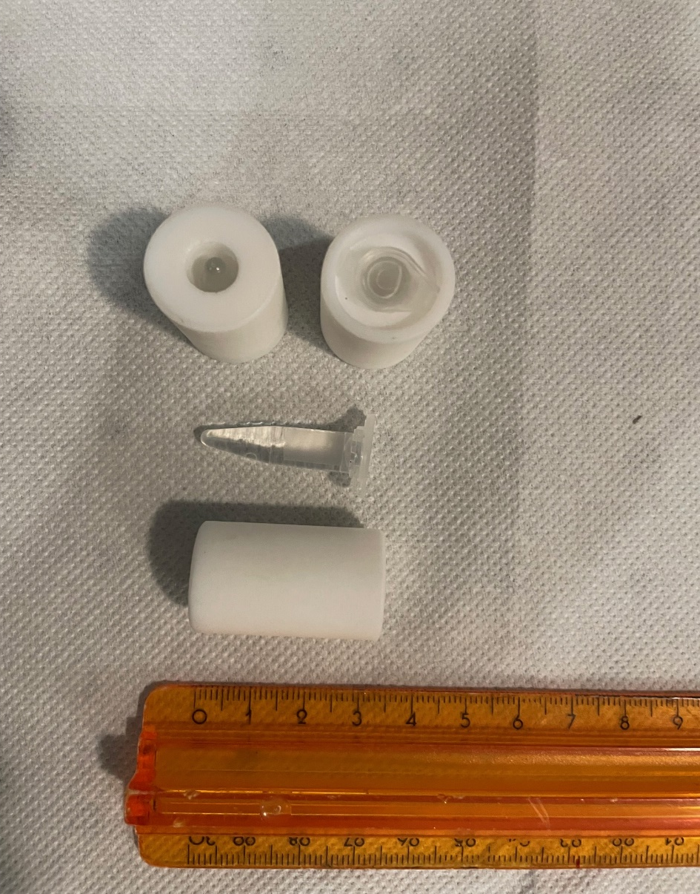
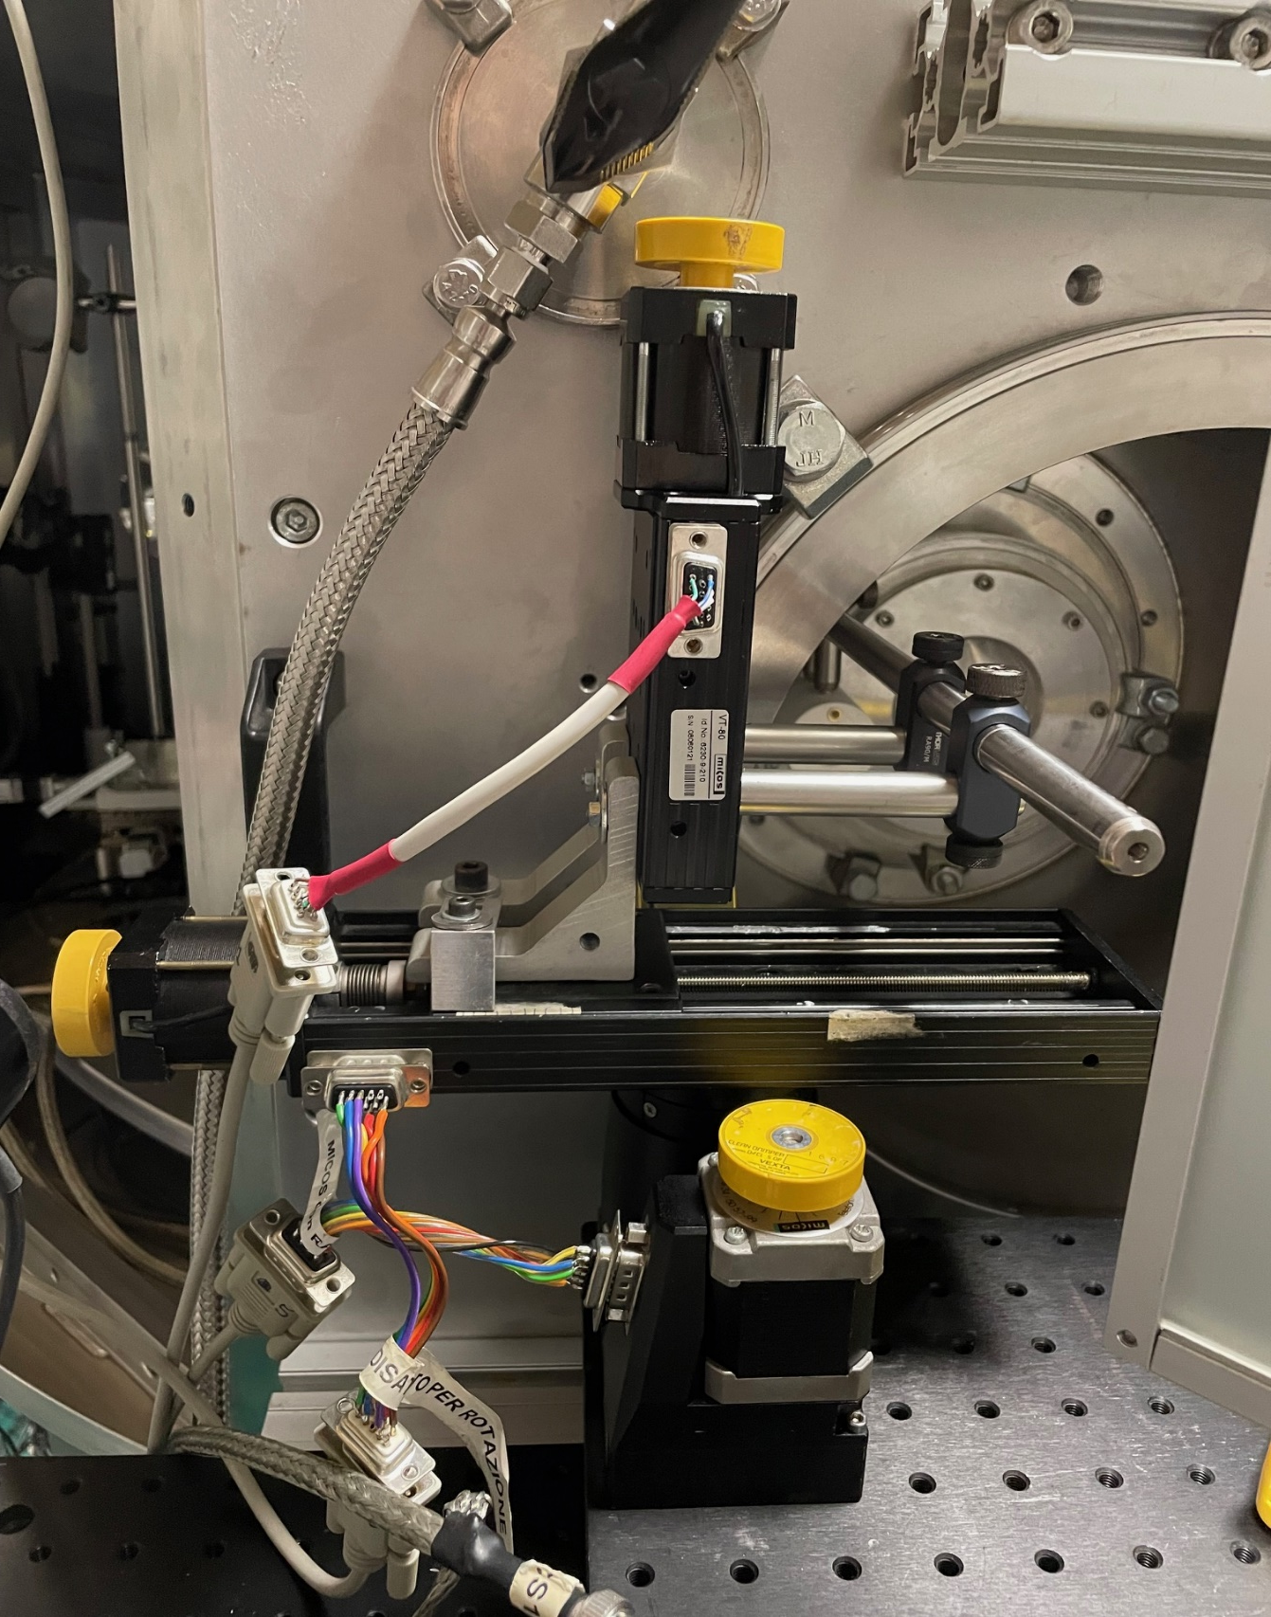
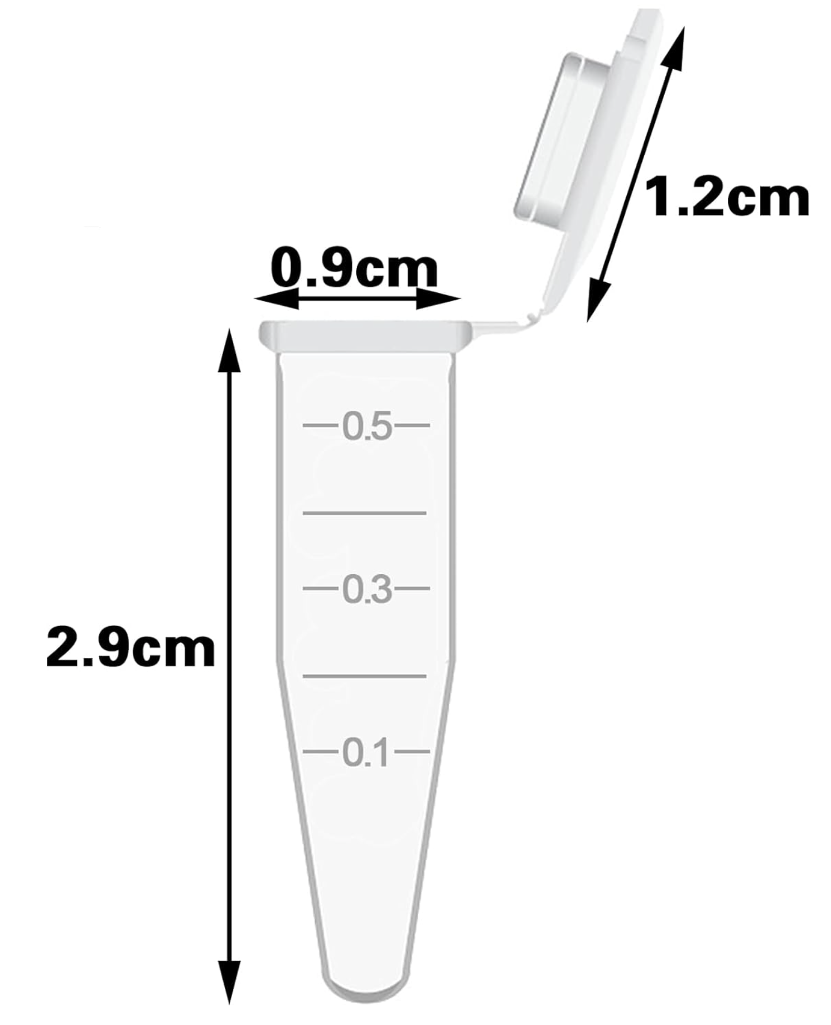
Radiobiology measurements VHEE set up at ILIL, CNR-INO Pisa
0,5 ml Eppendorf tube
Eppendorf tube adapter
Exit window
Vacuum interaction chamber
Sample holder
3 cm
e⁻ beam
stainless-steel
collimator
sample
Notes:
In detail, the experimental set-up for radiobiological measurements. From left: the blood sample contained in a 0.5 ml Eppendorf tube, the adapters for this type of standard biological container, the sample holder in front of the VHEE exit window from the vacuum interaction chamber. Below : a detail of the cross-section of the sample behind the steel collimator.

Slide 7
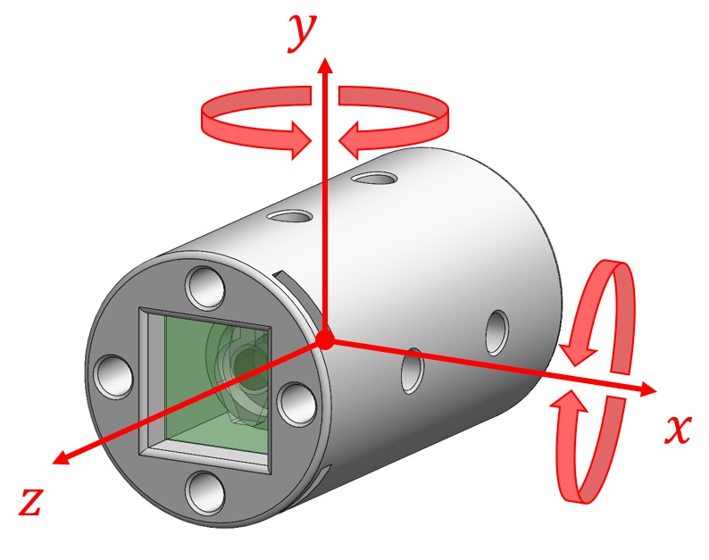
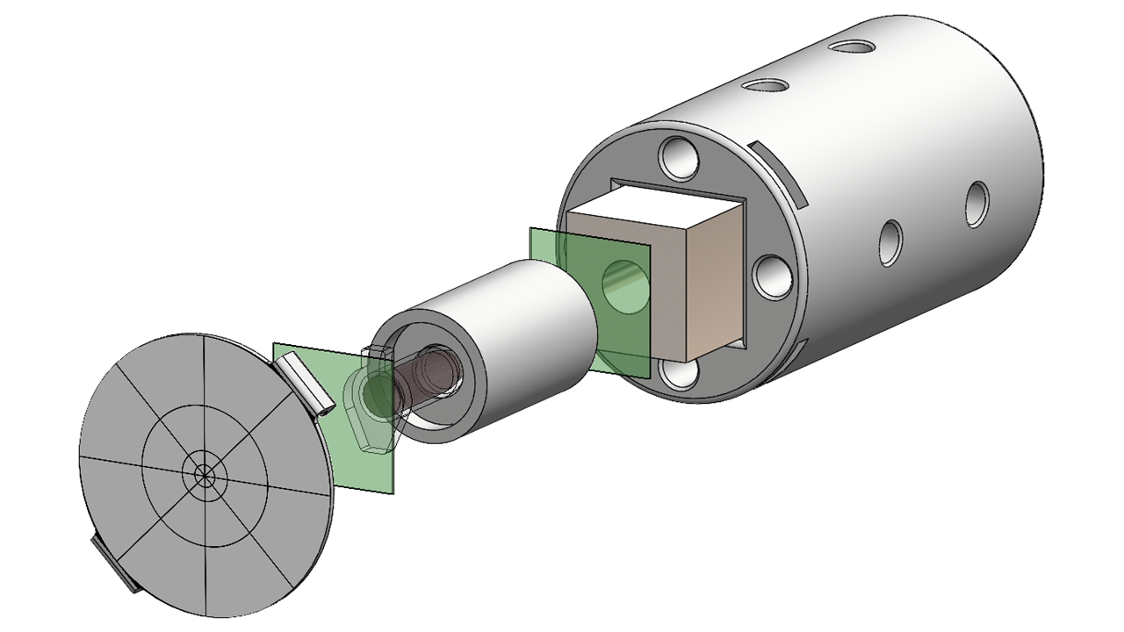
3D printed motorized sample holder
3D printed sample holder with 0.5 ml Eppendorf tube adapter.
roll
collimator
e⁻ Beam
Eppendorf tube
adapter
Lanex for sample irradiation control
3 motorized ortogonal translational movements
Side view
pitch
EBT3 Gafchromic® film
Nozzle tip
He-N₂ mixture
G. Bandini
S. Piccinini
A Subiel et al. Dosimetry of very high energy electrons (VHEE) for radiotherapy applications: using radiochromic film measurements and Monte Carlo simulations 2014 Phys. Med. Biol. 59 5811.
2 angular movements
Notes:
Here, we present an exploded view of the sample holder, highlighting its components: the collimator, the adapter containing the Eppendorf tube positioned between two radiochromic films for measuring the dose at the front and back (relative to the VHEE beam direction), and finally, a lanex screen for verifying sample irradiation.
The system includes three motorized translational movements and two angular movements, which enable optimal alignment between the sample and the beam. These degrees of freedom are currently critical for ensuring precision in radiobiological measurements, as you will soon understand.
Gafchromic film is a common dosimetry tool for external beam radiotherapy and brachytherapy (Devic 2011). It has a high spatial resolution, tissue equivalence and has been successfully applied for a wide range of radiotherapy modalities.

Slide 8
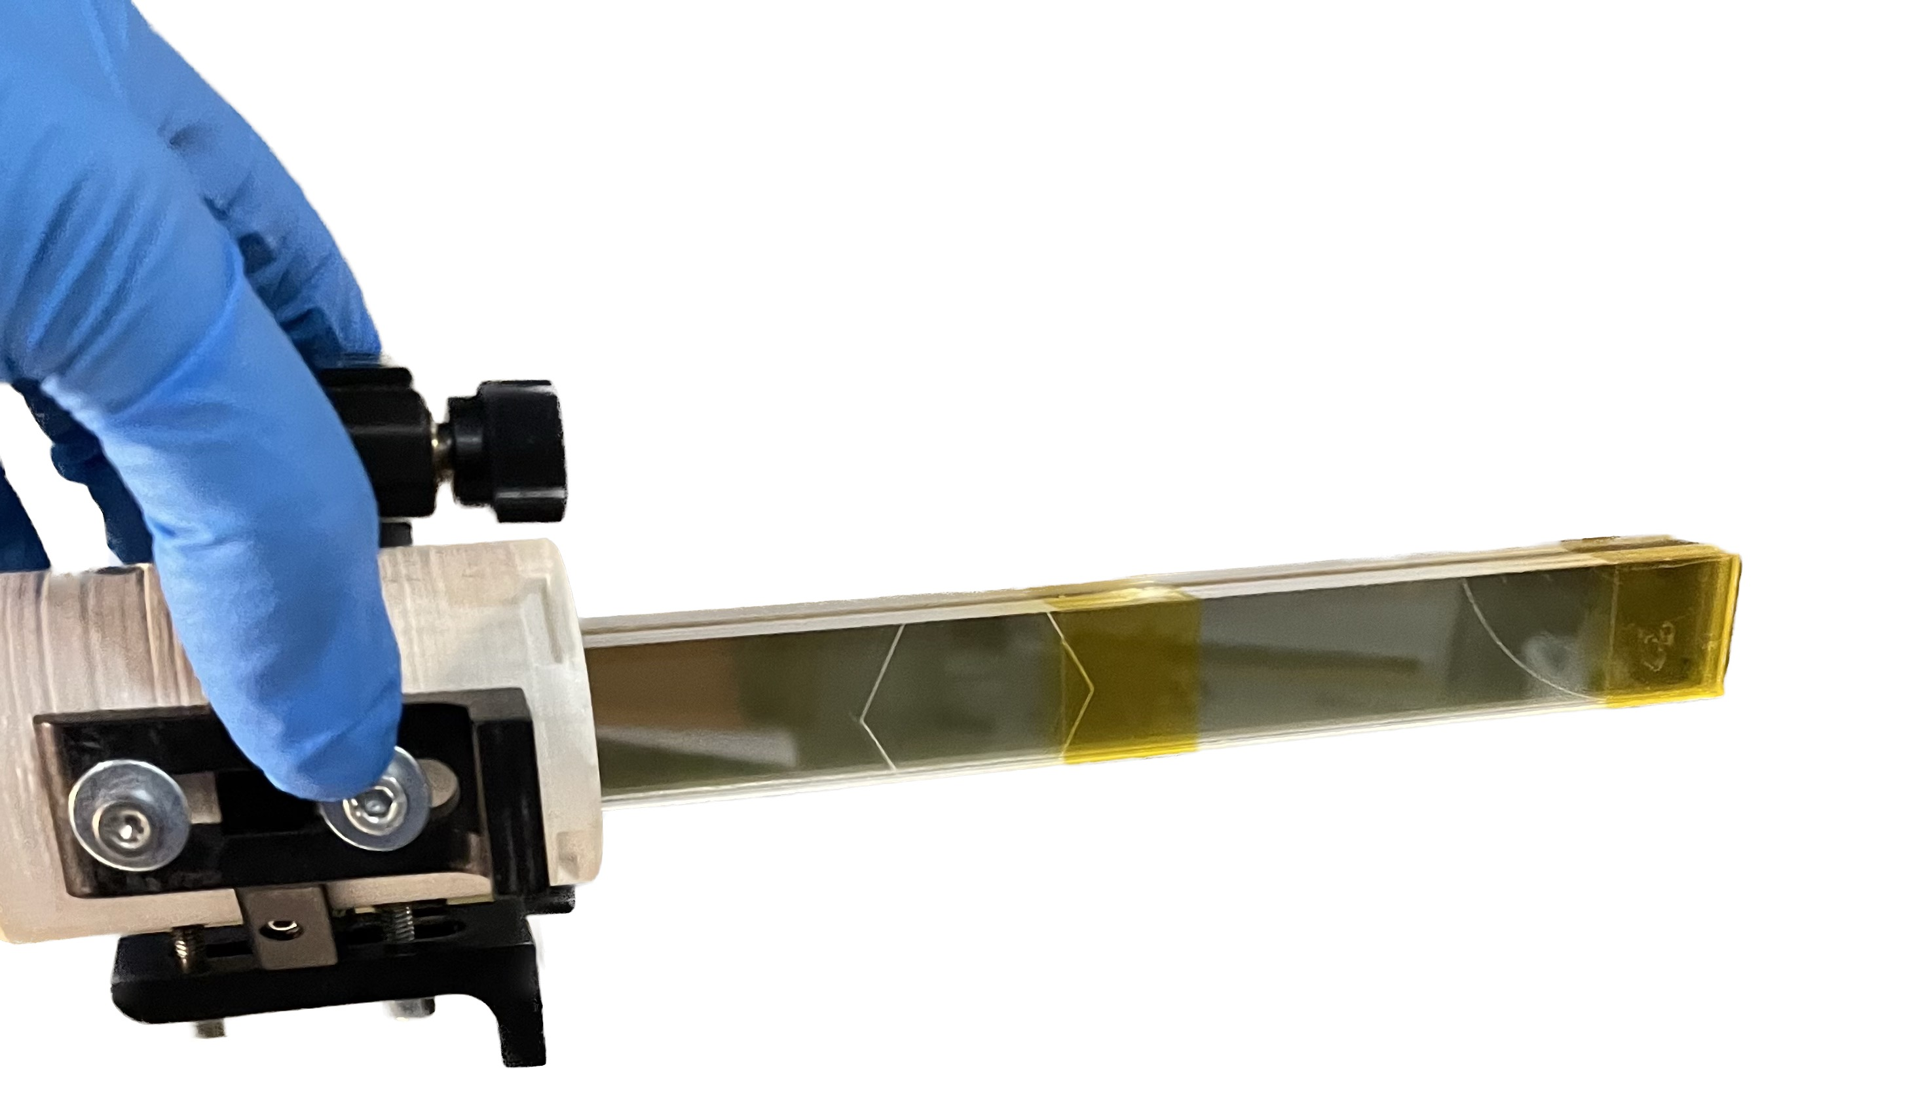
Dosimetric characterization of a 7 mm diameter collimated VHEE beam
2 cm x 20 cm 10 EBT3 stack
Energy spectrum
Notes:
A preliminary dosimetric analysis of the VHEE beam was performed by a radiochromic films stack placed in the housing of the biological sample.

Slide 9
Dosimetric characterization of a 7 mm diameter collimated VHEE beam
2 cm x 20 cm EBT3: longitudinal irradiation
Depth dose in RCF- EBT3 stack
(Cumulative dose of 120 shots)
Energy spectrum
dose per bunch ≈ 8 cGy, charge per bunch of ≈ 150 pC
Notes:
Top – Left: An image of the 7 mm collimated VHEE beam on the central GAF in the stack. Bottom: The central linear dose deposition measured."

Slide 10
Dosimetric characterization of a 7 mm diameter collimated VHEE beam
2 cm x 20 cm EBT3: longitudinal irradiation
Transverse
dose profile
Depth dose in RCF- EBT3 stack
(Cumulative dose of 120 shots)
Energy spectrum
dose per bunch ≈ 8 cGy, charge per bunch of ≈ 150 pC
Notes:
Up right: the transversal deposition at different depth showed with corrispondent colors at left

Slide 11
Dosimetric characterization of a 7 mm diameter collimated VHEE beam
2 cm x 20 cm EBT3: longitudinal irradiation
Depth dose in RCF- EBT3 stack
(Cumulative dose of 120 shots)
Energy spectrum
dose per bunch ≈ 8 cGy, charge per bunch of ≈ 150 pC
Notes:
All this is done not only to characterize the VHEE beam but also to understand the irradiation conditions of our biological sample, which is represented in red and shown to scale.

Slide 12
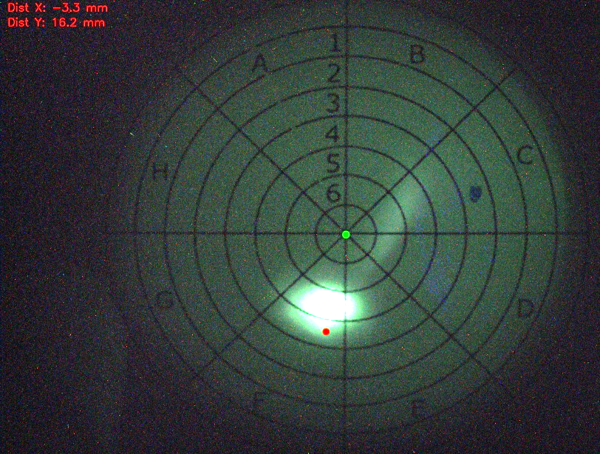
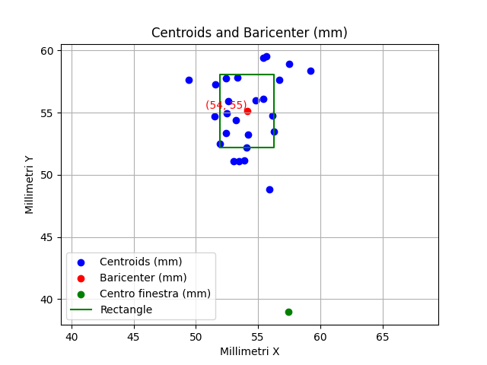
VHEE beam pointing control
Online control of blood samples irradiation
Collimated beams reproducibility 90%
Average pointing stability:
σ_{x}= 2,0 mm σ_{y}= 2,8 mm
at 57 cm from the nozzle
Bright dots mean beam
perfectly aligned with the sample
Notes:
The importance of the movements ...
Left: The position of the beam prior to the irradiation of the biological samples is represented by the blue dots. During the run, these positions are recorded, the barycenter of the distribution is calculated (red dot), and the center of the sample holder is moved to that point. Subsequently, the sample axis is aligned with the prevailing beam direction (from the nozzle to the barycenter on the window).
Right: Control of blood sample irradiation is performed using the lanex screen, as shown earlier.

Slide 13
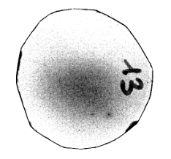
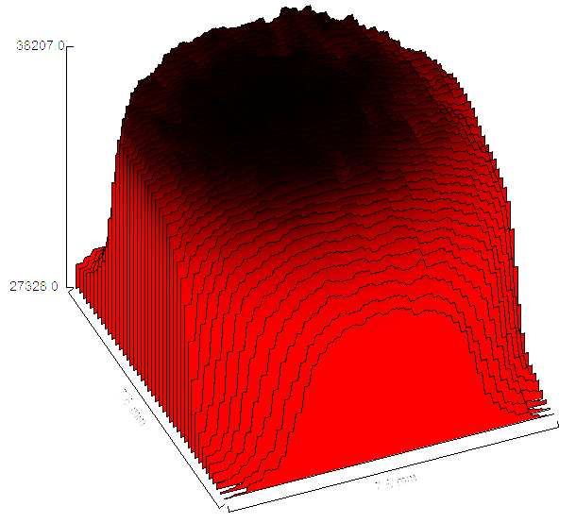
Radiobiology measurements: VHEE irradiation homogeneity
No collimator
With collimator
Improvement in dose deposition
(20 shots –Front RCF)
No tilt
Manual tilt
Fine laser alignement
B
Side view
Nozzle tip
Front RCF surface plot (grey value)
homogeneus dose deposition (>80%)
Front RCF plot profile (grey value)
Notes:
Thanks to the translational and angular movements of the sample holder, we were able to achieve a significantly homogeneous irradiation of the sample.

Slide 14
1 Shot: irradiation homogeneity
S2:
RCF13 Front: 0,04-0,05 Gy
S3:
RCF15 Front: 0,03 Gy
S8:
RCF29 Front: 0,06-0,07 Gy

Slide 15
Dose distribution (F)
20 S
10 S
5 S
1 S

Slide 16
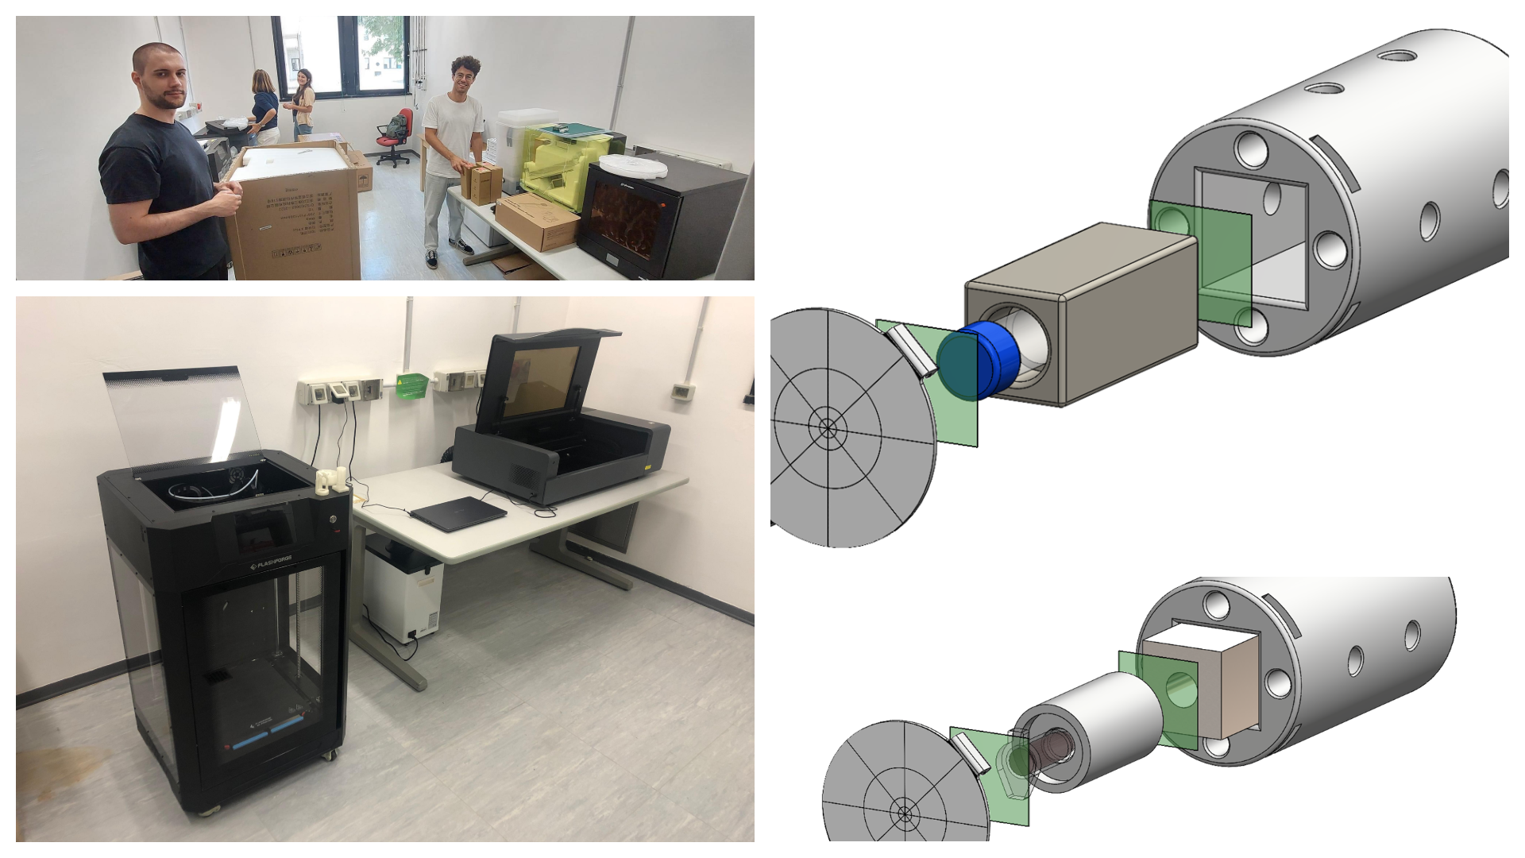
Conclusions and Perspectives for Radiobiological Mesurements
Enhancements in Source Stabilization
Beam reproducibility: improved from 90% → 95%
Beam pointing:
initial: σ_{x}= 2,0, mm σ_{y}= 2,8 mm
current: σ_{x}= 1,2 mm, σ_{y}= 2,1 mm
In progress with Magnetic Beam Line: σ_{x}= 0,55 mm, σ_{y}= 0,45 mm
New Prototiping Lab - July 2024
Two new 3D printers and a laser cutter have been installed in our laboratories. These tools allow for flexible setups tailored to specific experimental needs
These advancements will enable greater precision
and reliability in radiobiological measurements
Nozzle tip
He-N₂ mixture
Notes:
In the last year we have set up a new prototyping laboratory
Different adapters for different standard biological containers to make the work of our biologist colleagues easier, more reproducible and faste
The number of collimated beams on the total has risen from... The oscillation of the beam in position is decreased by ... And it is still improving thanks to the use of a magnetic line in progress

Slide 17
Leonida A. GIZZI* (Head)
Fernando BRANDI
Petra KOESTER
Luca LABATE *
Federica BAFFIGI
Lorenzo FULGENTINI
Gabriele BANDINI
Alessandro FREGOSI
Daniele PALLA
Costanza PANAINO
Martina SALVADORI
David GREGOCKI
Simon VLACHOS
Federico AVELLA*
*associato INFN
Maria Grazia ANDREASSI (Head)
Andrea BORGHINI
Rudina NDREU
Antonella MERCURI
Paola CANALE
Stefano TURCHI
Thank you for your kind attention!
simona.piccinini@ino.cnr.it
Acknowledgments:
Funded by the European Union - Next Generation EU. Views and opinions expressed are however those of the author(s) only and do not necessarily reflect those of the European Union or the European Commission. Neither the European Union nor the European Commission can be held responsible for them.
PNRR MUR M4 C2 Inv. 1.5 CUP I53C22000780001
Notes:
Finally, I would like to thank my entire group and my colleagues at the Institute of Clinical Physiology.
As ambassador of the Spoke I renew my invitation to connect with the THE communication channels.
Thank you all for your kind attention!

