Slide 1
VHEE generation and transport: Experimental Work
M. Salvadori, F. Avella, F.Baffigi, G. Bandini, G. Benincasa, F. Brandi, M. Ezzat, A. Fregosi, L. Fulgentini, D. Gregocki, P. Koester, L. Labate, D. Palla, M. C. V. Panaino, S. Piccinini, S. G. Vlachos & L. A. Gizzi.
Milestone 1.1 and 1.6

Slide 2

Radiation therapy is used to treat around 60% of all cancer cases worldwide
Deliver lethal dose of radiation to tumor cells
Sparing healthy tissues

Slide 3


Radiation therapy is used to treat around 60% of all cancer cases worldwide
Deliver lethal dose of radiation to tumor cells
Sparing healthy tissues
Dose deposition profiles in tissue equivalent media
Photons
Protons
ease of production, routinely applied
Dose deposition Bragg Peak,
Ok for deep-seated tumors
Not suitable for deep seated tumors
High entrance dose
Cost and facility availability,
highly affected by inhomogeneities
Electron 5 MeV $≤$ E $≤$ 20 MeV
VHEE 50 MeV $≤$ E $≤$ 350 MeV
Sharp fall off after 5cm (IORT, TSEBT)
Ok for deep-seated tumors
Sharp beam penumbra
Low sensitivity to inhomogeneities
Not suitable for deep seated tumors
High entrance dose
High lateral spread
High entrance and exit dose
Carbon ions
Even sharper Bragg peak
high relative biological effectiveness
L. Whitmore et al., Scientific Reports 11,14013 (2021)
Cost and facility availability, affected by inhom.

Slide 4


Radiation therapy is used to treat around 60% of all cancer cases worldwide
Deliver lethal dose of radiation to tumor cells
Sparing healthy tissues
Dose deposition profiles in tissue equivalent media
Photons
Protons
ease of production, routinely applied
Dose deposition Bragg Peak,
Ok for deep-seated tumors
Not suitable for deep seated tumors
High entrance dose
Cost and facility availability,
highly affected by inhomogeneities
Electron 5 MeV $≤$ E $≤$ 20 MeV
VHEE 50 MeV $≤$ E $≤$ 350 MeV
Sharp fall off after 5cm (IORT, TSEBT)
Ok for deep-seated tumors
Sharp beam penumbra
Low sensitivity to inhomogeneities
Not suitable for deep seated tumors
High entrance dose
High lateral spread
High entrance and exit dose
Carbon ions
Even sharper Bragg peak
high relative biological effectiveness
L. Whitmore et al., Scientific Reports 11,14013 (2021)
Cost and facility availability, affected by inhom.

Slide 5
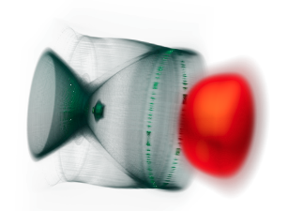
Delivering high doses in an extremely short irradiation time (Dose rate >40 Gy/s, $∼$ 1 Gy per pulse…)
FLASH - RT
Damages to cancer cells equivalent to conventional RT but reduced toxicity for healthy tissues!
VHEE
VHEE
FLASH
FLASH
VHEE FLASH-RT
dosimetric characteristics of VHEE
+
Sparing capability of FLASH

Slide 6
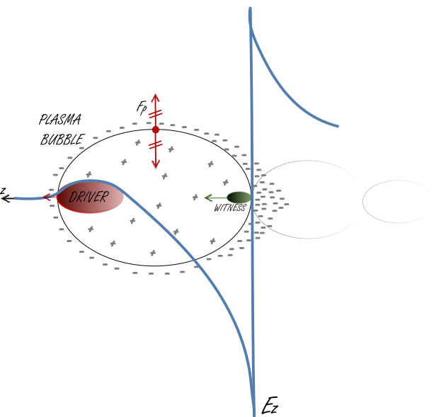
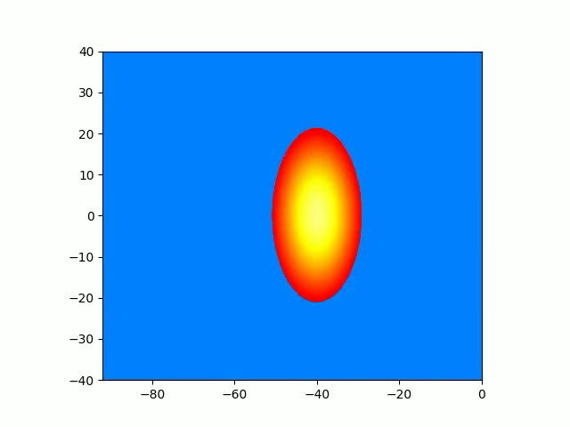
High intensity laser,
Gaseous target
Plasma Generation
High intensity laser pulse exerts a ponderomotive force on plasma charges.
Electrons, being lighter than ions, experience a larger displacement from their rest position.
An emptying zone is created:
The plasma bubble.
The displaced electrons oscillate around their rest position at the plasma frequency.
As the driver pulse travels in the plasma the negative charges accumulate at the back of the bubble.
F. Avella
The electric field generated by the charge separation exhibits a longitudinal component
Charged particles moving in the same direction as the laser pulse are accelerated!
T. Tajima and J. M. Dawson Physical Reviev Letters 43, 267 (1979)

Slide 7
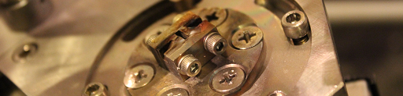
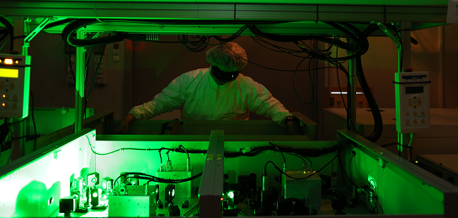
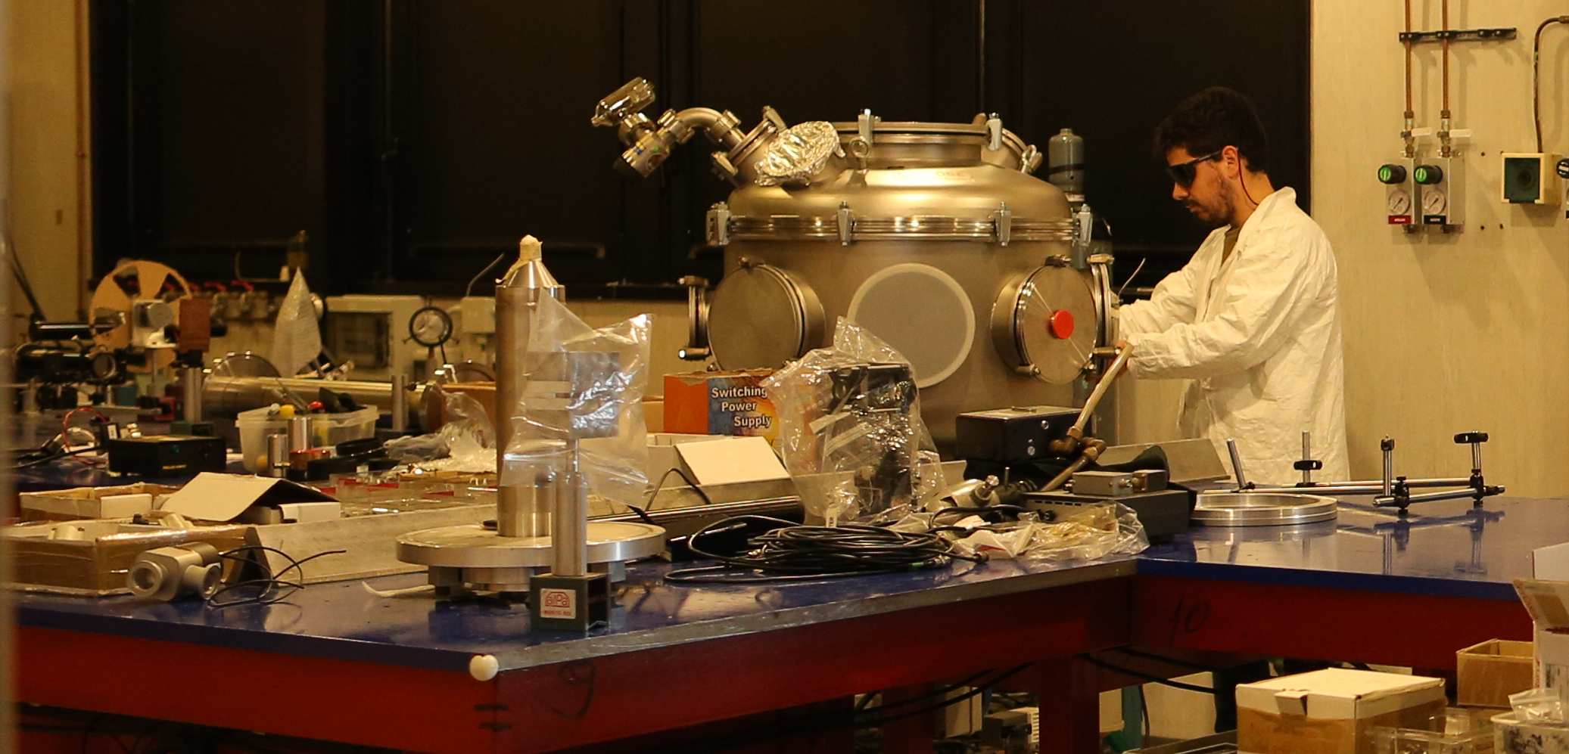


LASER DEV. LAB
Relatore:
Nome relatore
USER CONTROL
ROOM
TESTING AND PROTOTYPING
LASER FRONT END
10 TW, 10Hz
NEW HIGH DOSE UNDERGROUND BUNKER
POWER AMPLIFIER Up to 240 TW
LASER CAPABILITIES:
• 240 TW, Ti:Sa, up to 5 Hz, 27 fs;
• 1kHz, >20 mJ, Ti:Sa + OPA (commissioning in progress)
• 100 Hz, >1J, TiSA (procurement in progress)
SHIELDED TARGET AREA FOR PARTICLE ACCELERATION
Evento:
NEW BEAMLINE FOR PRE-CLINICAL STUDIES
Nome evento

Slide 8
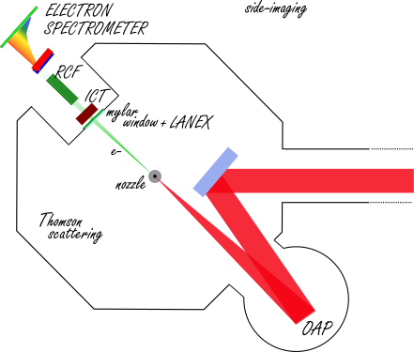
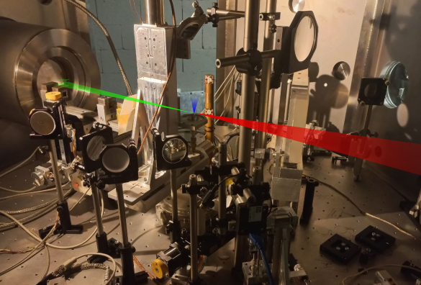
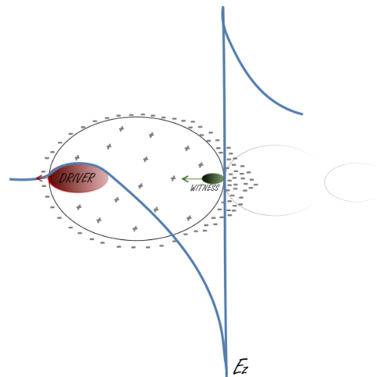
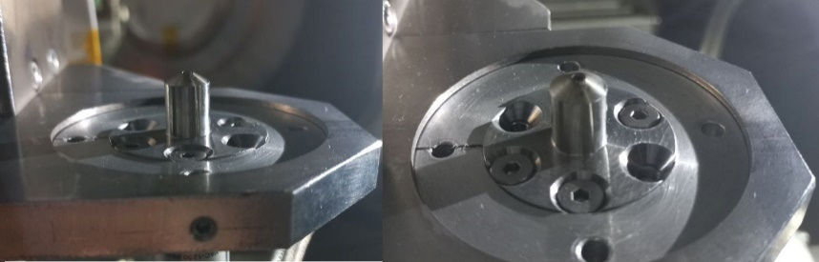
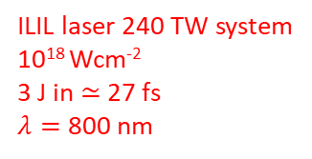

Interaction Chamber
Output window
e⁻
ILIL laser 240 TW system
10¹⁸ Wcm⁻²
3 J in $≃$27 fs
$λ=$ 800 nm
Circular aperture 2 mm
Supersonic flow of Helium Gas with 1% Nitrogen
Operative electron density $≃{10}^{18} cm^{−3}$
LWFA Ionization Injection
Beam Charge
Beam Size and Pointing
M. Chen et al., Physics of Plasmas 19, 033101 (2012)
Beam Spectra
Dose and DPP

Slide 9
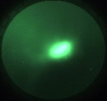
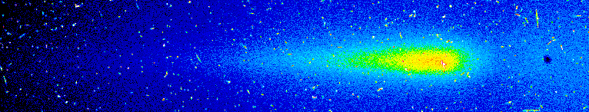
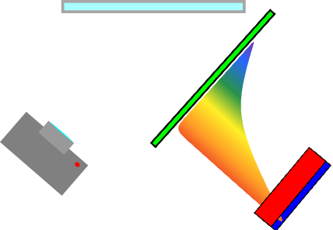
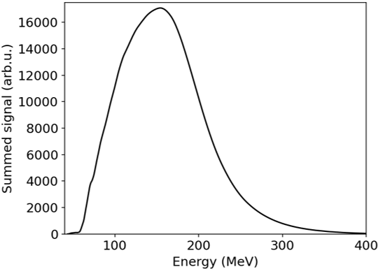
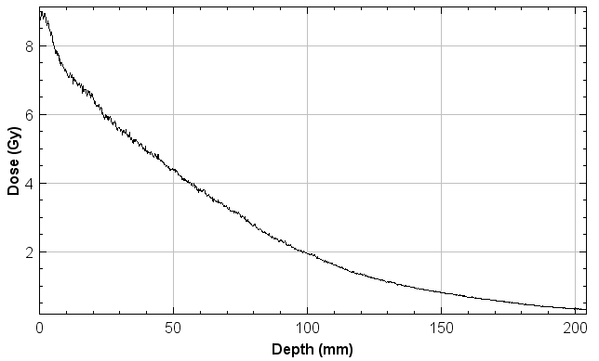
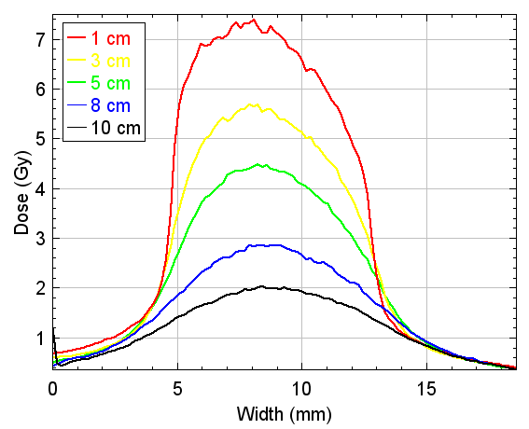
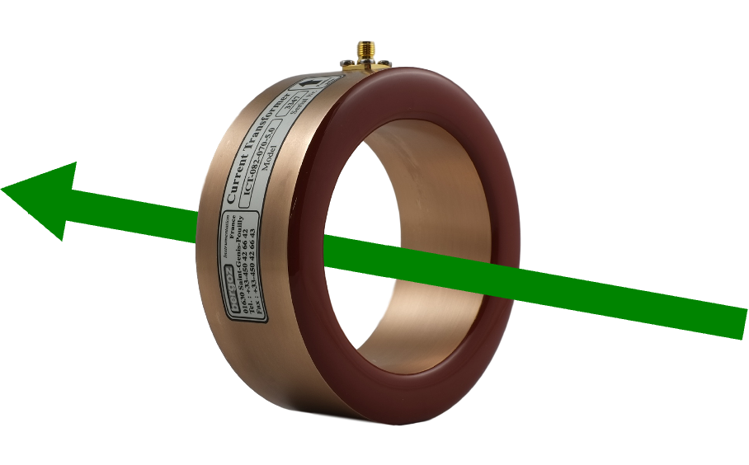


Beam Spectra
Dose and DPP
recorded spectrum image
RCF stack
Mirror
Lanex
Cumulating 120 consecutive shots
Magnetic
dipole
Camera
e-
collimator
e-
Typical peak energies: $≃ 150−200$MeV
Longitudianl profile
Transverse profile
S. Vlachos paper in preparation
Beam Charge
Integrating Current Transformer (ICT)
Non destructive
On line charge
estimate
ICT controller
Scope
e-
Typical beam charges: $≃ 150 pC$
D. Gregocki paper in preparation
S. Piccinini

Slide 10
Beam Spectra
Dose and DPP
recorded spectrum image
RCF stack
Mirror
Lanex
Cumulating 120 consecutive shots
Magnetic
dipole
Follow S. Vlachos Talk !
e-
Camera
collimator
e-
Typical peak energies: $≃ 150−200$MeV
Follow S. Piccinini Talk !
Longitudianl profile
Transverse profile
S. Vlachos paper in preparation
Beam Charge
Integrating Current Transformer (ICT)
Non destructive
On line charge
estimate
Follow D. Gregocki Talk !
ICT controller
Scope
e-
Typical beam charges: $≃ 150 pC$
D. Gregocki paper in preparation
S. Piccinini

Slide 11
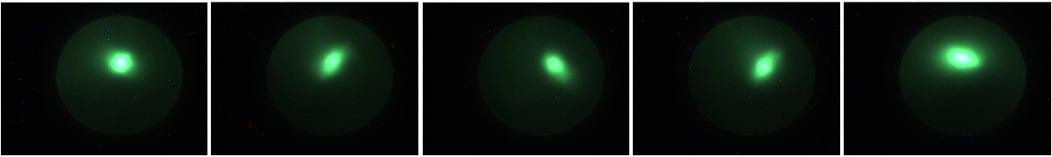
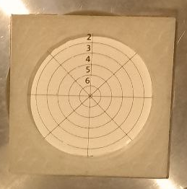
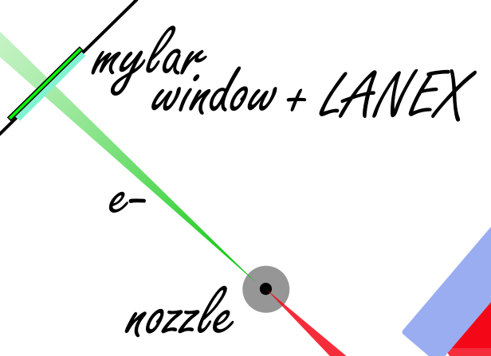
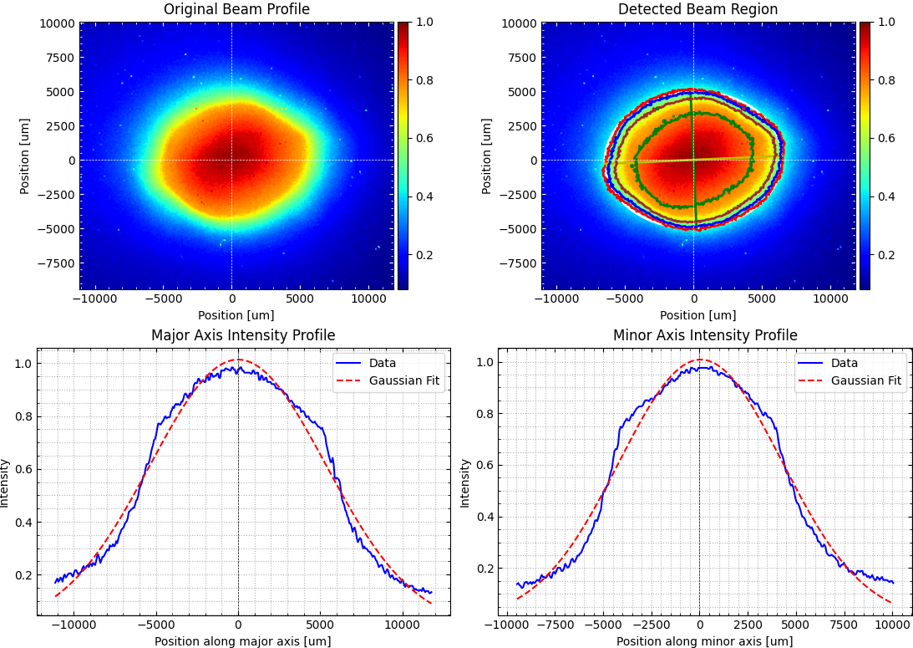


Beam Size and Pointing
Typical signal acquired during experiments
Distance Lanex screen to source: 57 cm.
Typical measured beam size: 1.15 $×$ 0.90 cm
Typical fluctuation around centroid: $σ_{x}=1.99 mm$
$$σ_{y}=2.81 mm$$
D. Gregocki

Slide 12
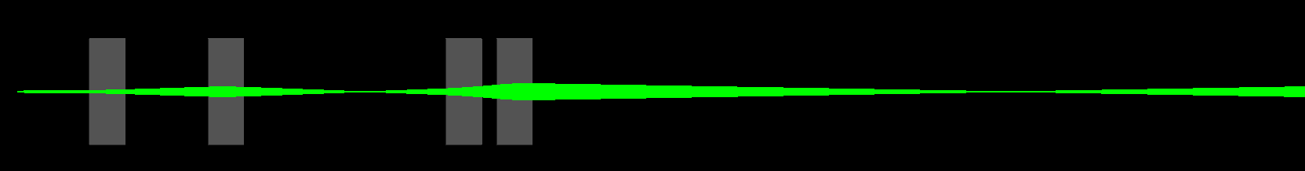
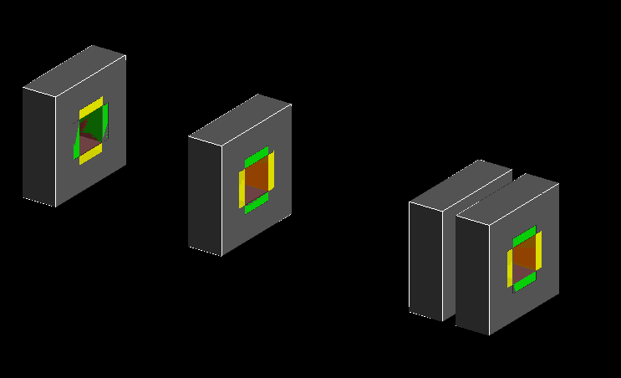
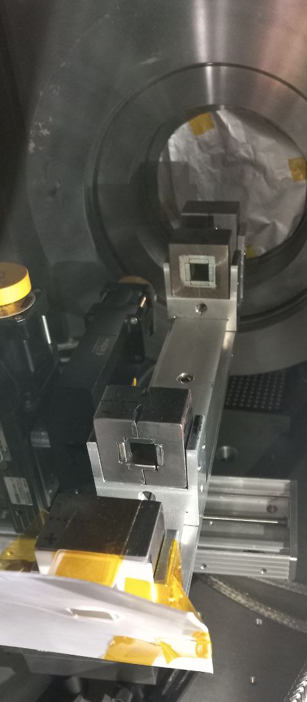
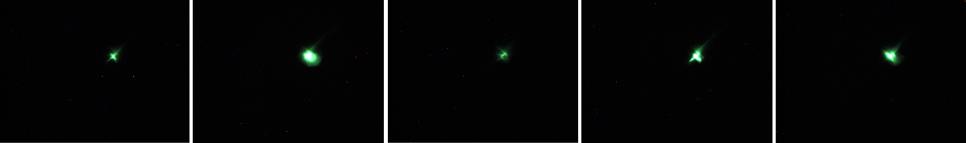
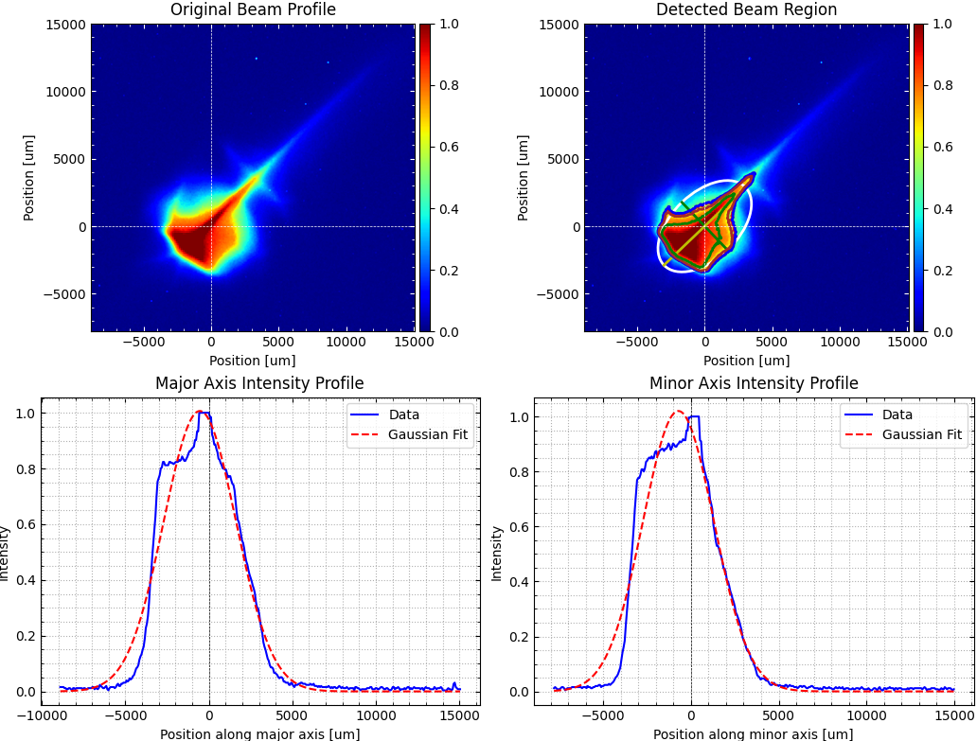
Geant4
Geant4
Beam Size and Pointing with MBL during experiments
e-
Magnetic Beamline main effects:
Enhance pointing stability
Energy selector
Reducing beam size
C. M. V. Panaino
L. Labate
Typical beam size at 57 cm from source: 0.60 $×$ 0.44 cm
Fluctuations around centroid $σ_{x}=0.55 mm ,$ $σ_{y}=$ 0.46 mm

Slide 13
Geant4
Geant4
Beam Size and Pointing with MBL during experiments
e-
Magnetic Beamline main effects:
Enhance pointing stability
Energy selector
Reducing beam size
C. M. V. Panaino
L. Labate
Typical beam size at 57 cm from source: 0.60 $×$ 0.44 cm
Further investigated in LPA-STAR cascading calls
Fluctuations around centroid $σ_{x}=0.55 mm ,$ $σ_{y}=$ 0.46 mm

Slide 14
Very High Energy Electron have an extraordinary potential for the application in radiation therapy. The possibility of deliver them in short-temporal bunches characterized by an ultra-high dose rate pave the way to a VHEE FLASH-RT combining the benefits of both.
Laser-driven electron acceleration can be used to drive such electron bunches.
A brief overview of the laser-driven electron beamline at ILIL has been given providing its main features. Electron spectra peaked beyond 150 MeV, charge per bunch of ≈ 150 pC delivered in tens of fs are routinely obtained.
Relatore:
Nome relatore
A modular and cost-effective magnetic beamline has been designed. Its capability of reducing beam size and enhancing pointing stability has been experimentally demonstrated.
A new gas system is currently being tested as a preparatory phase for enabling high-repetition rate workflow.
The VHEE beamline has already been used to irradiate peripherical human blood samples. The radiation damage has been evaluated through the micronuclei and telomere shortening biological endpoints. A new set of measurements on cancer cell is scheduled with an improved irradiation system which is currently being developed.
Follow A. Borghini Talk !
Thank you for your atttention!

Slide 15
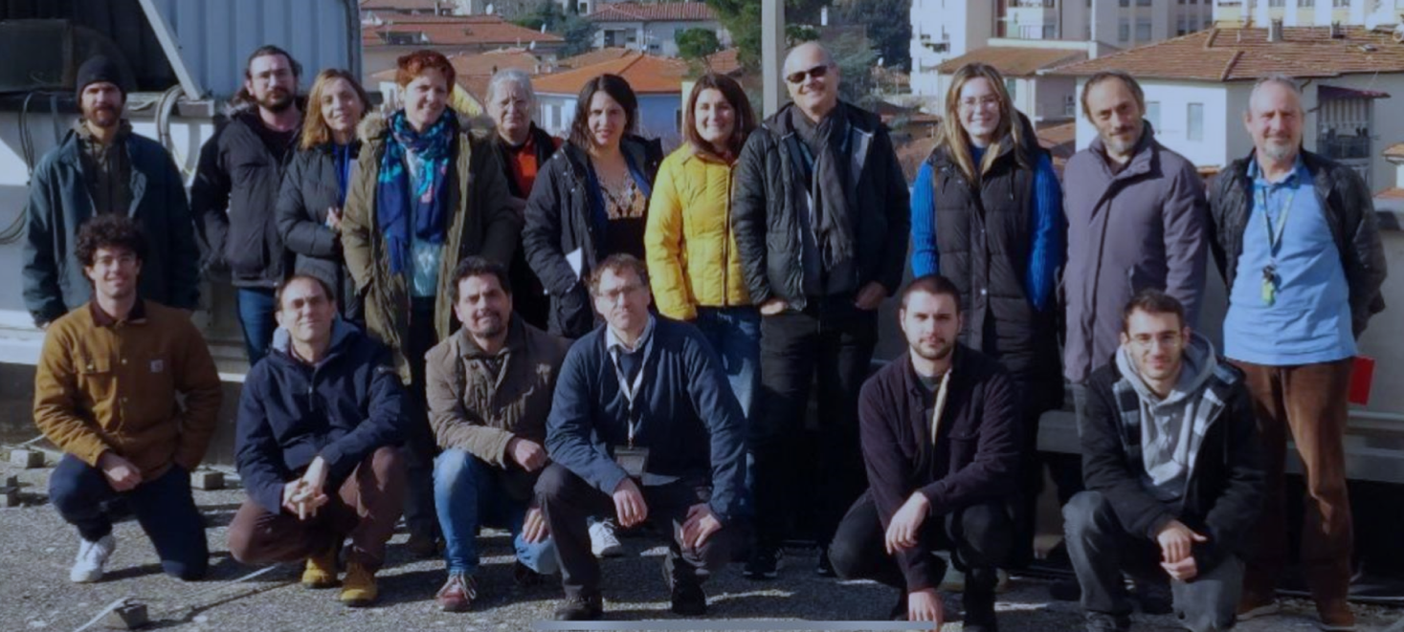




This work was supported by the PNRR MUR project ECS00000017-THE “Tuscany Health Ecosystem”, funded by the European Union –Next Generation EU.
Relatore:
Nome relatore
Advanced Photon Sources
PNRR MUR project IR0000016-I-PHOQS, funded by the European Union –Next Generation EU
EuPRAXIA Advanced Photon Sources - EuAps (IR0000030, CUP I93C21000160006).
EU Horizon IFAST, under Grant Agreement No.101004730
Evento:
Nome evento

