Slide 1
Correlation Study of Integrating Current Transformer Charge and Lanex Screen Emission Signal in High-Energy Beam Measurements
Milestones 1.1 and 1.6
Cascade grant LPA-STAR
D. Gregocki, F. Avella, F.Baffigi, G. Bandini, G. Benincasa, F. Brandi, M. Ezzat, A. Fregosi, L. Fulgentini, P. Koester, L. Labate, D. Palla, M. C. V. Panaino, S. Piccinini, M. Salvadori, S. G. Vlachos & L. A. Gizzi.

Slide 2
Table of contents:
01 - Motivation
Why integrating current transformers are usefull
02 - General description
Operating principle and signal processing
03 – Experimental setup
Measuremetns performed at ILIL, CNR-INO
04 - Results

Slide 3
01 -Motivation
Integrating current transformers (ICT) have been used as reliable charge diagnostics in the radio-frequency acceleration’s community
Quickly gained popularity also in laser-plasma acceleration (LPA) field thanks to nondestructive, energy independent (and compact) charge measurement
However, in some cases
ICT measurements overestimated charge by more than an order of magnitude¹.
ICT measurements overestimated charge by 3-4 times².
Charge measurement consistent with calibration – Measurement at large distance (4m) from interaction region³.
Main unwanted contributor to charge overestimation was electro-magnetic pulse (EMP) signal
Can we correlate ICT charge and Lanex screen emission signal?
Is EMP influence observed also in our case?
¹Glinec et al., Rev. Sci. Instrum. 77, 103301 (2006)
²B. Hidding et al., Rev. Sci. Instrum. 78, 083301 (2007)
³K. Nakamura et al., PRST-AB 14, 062801 (2011)

Slide 4
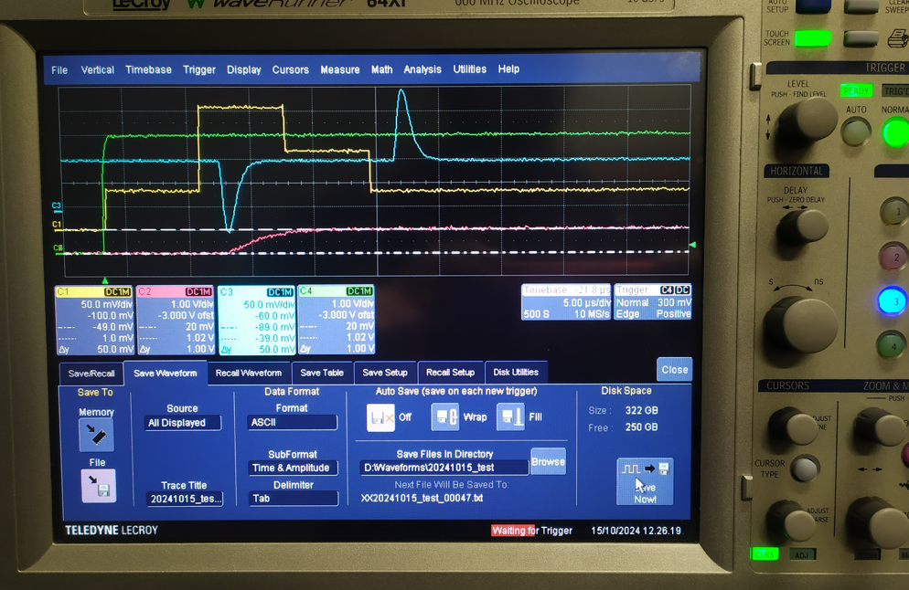
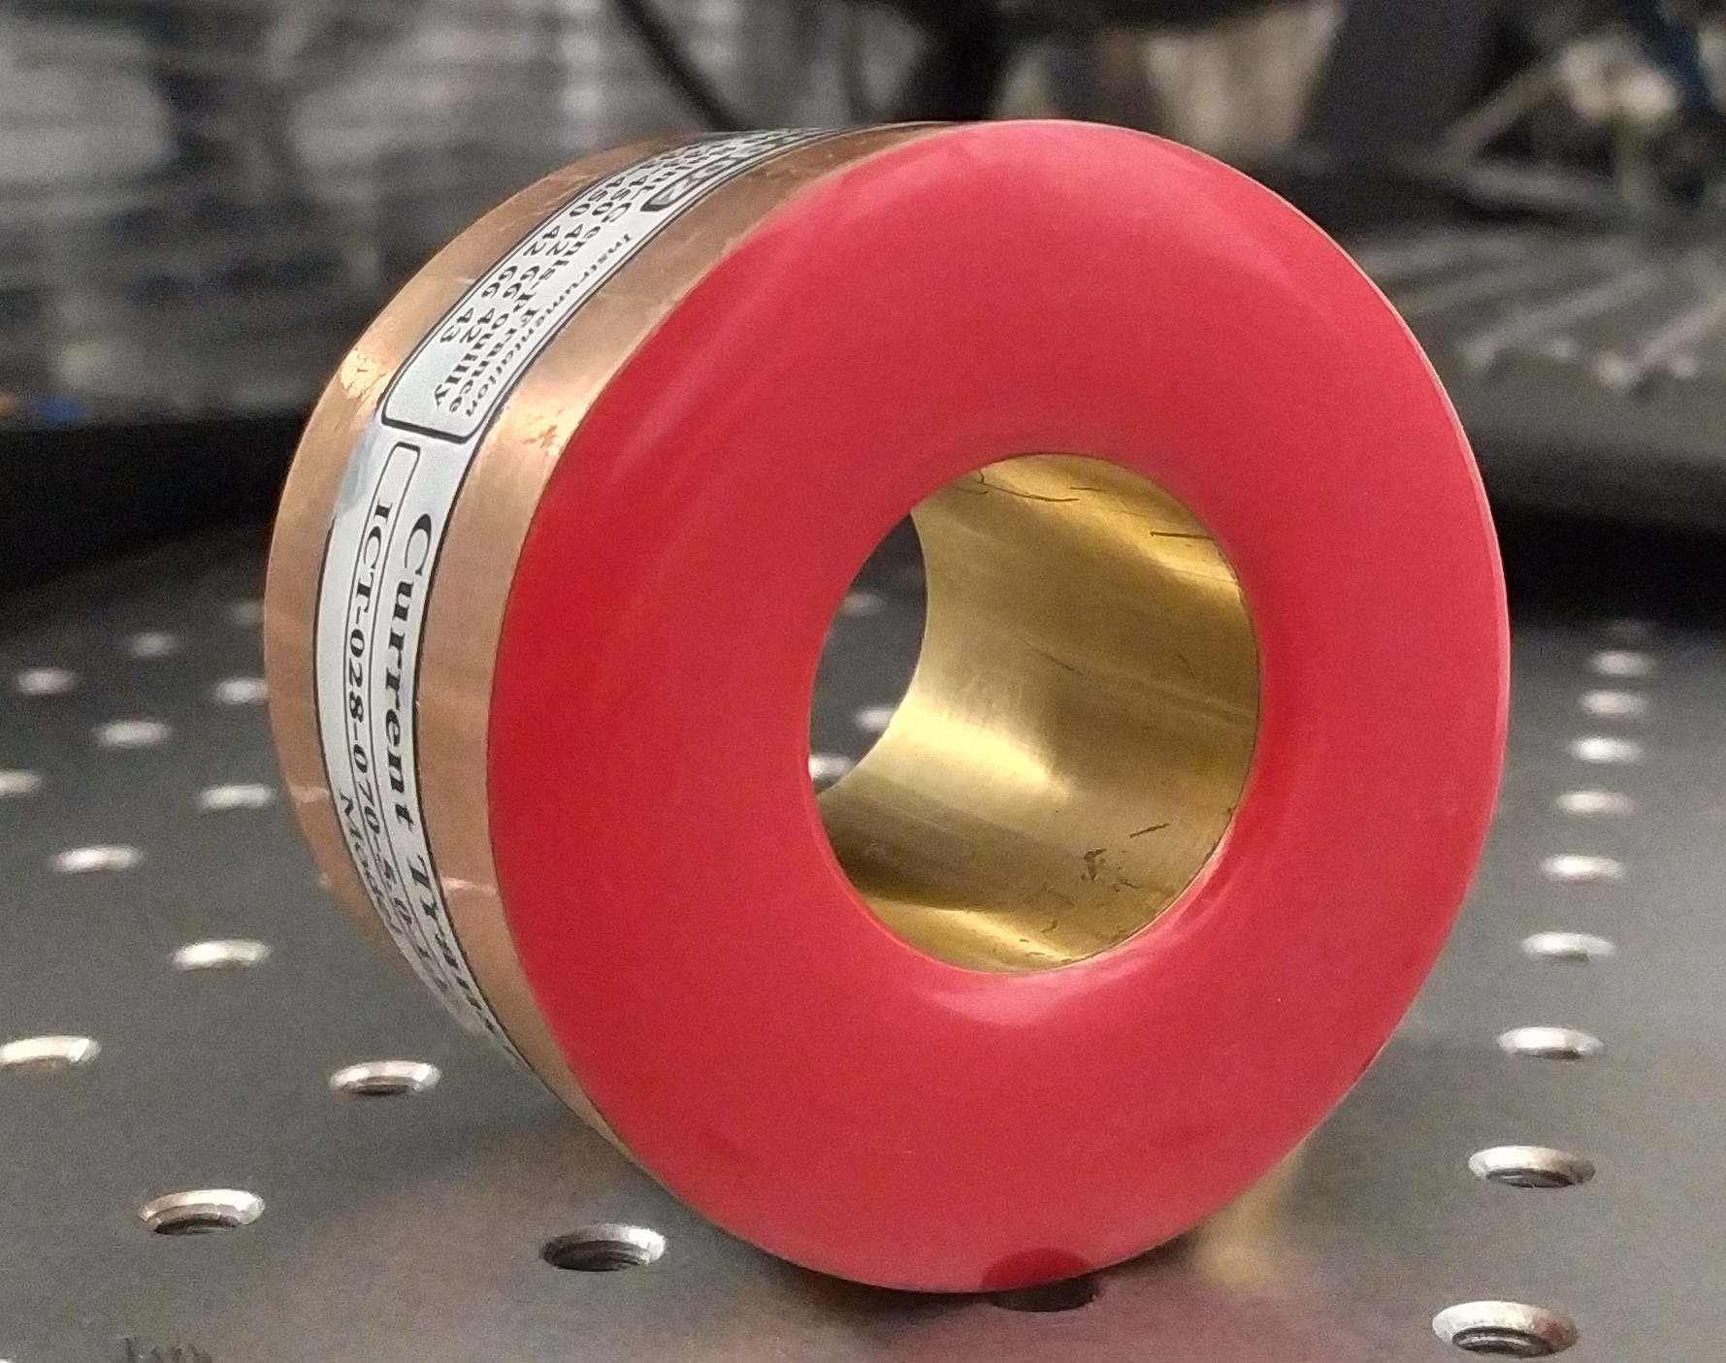
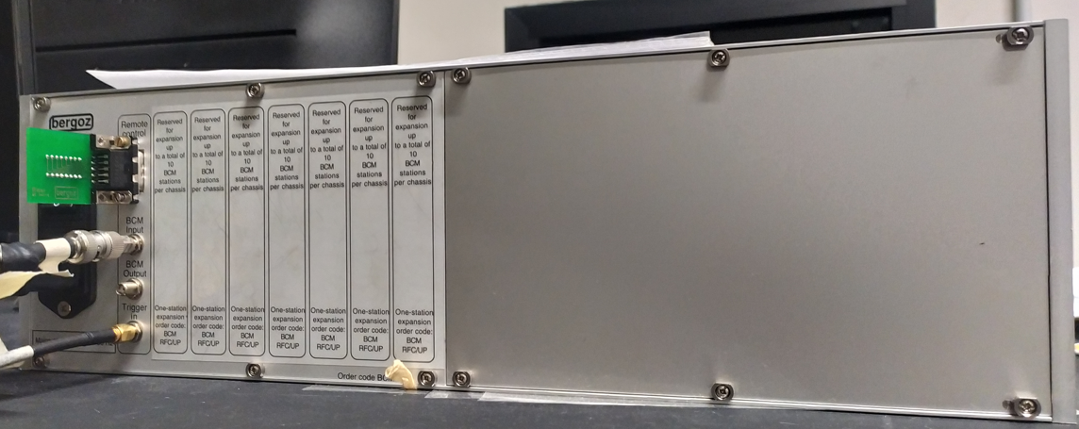
02 – General description
ICT consists of a coil with magnetic core shaped into a loop through which electron bunches can pass
Electron charge induces a voltage in the coil
Integrating over this voltage produces an output voltage proportional to the electron beam charge
Integrator (part of the ICT controller) consists of op-amp, filter …
3
1
2

Slide 5
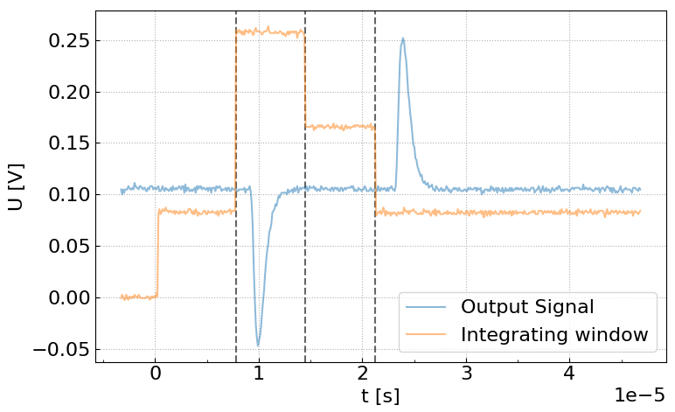
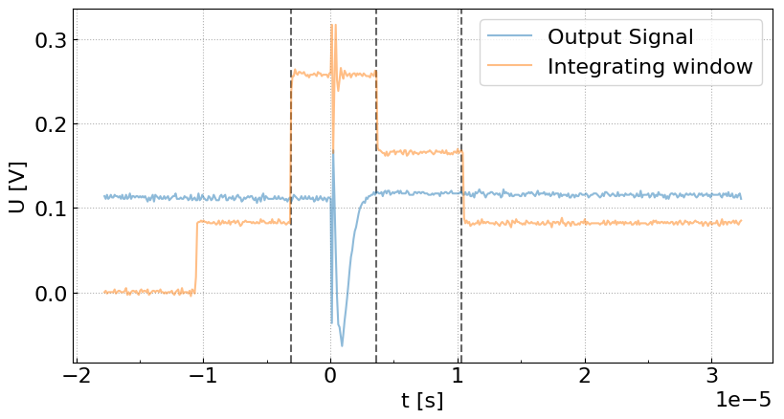
02 – General description
One window integrates the signal, and the second one integrates the background for noise reduction
Ideal signal for integration
Signal from LPA generated electrons

Slide 6
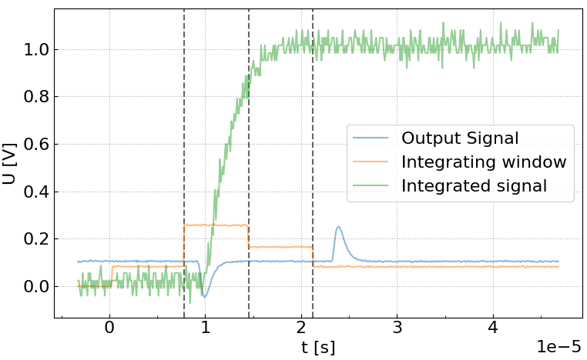
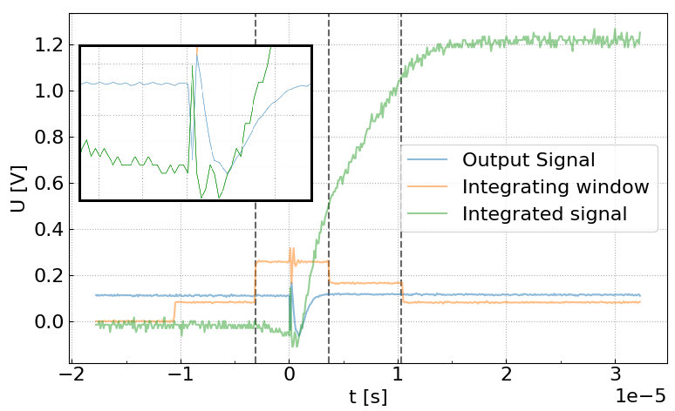
02 – General description
One window integrates the signal, and the second one integrates the background for noise reduction
Ideal signal for integration (Example)
Signal from LPA generated electrons

Slide 7
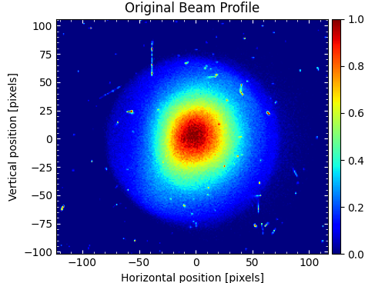
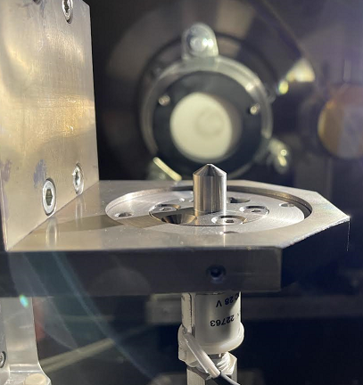
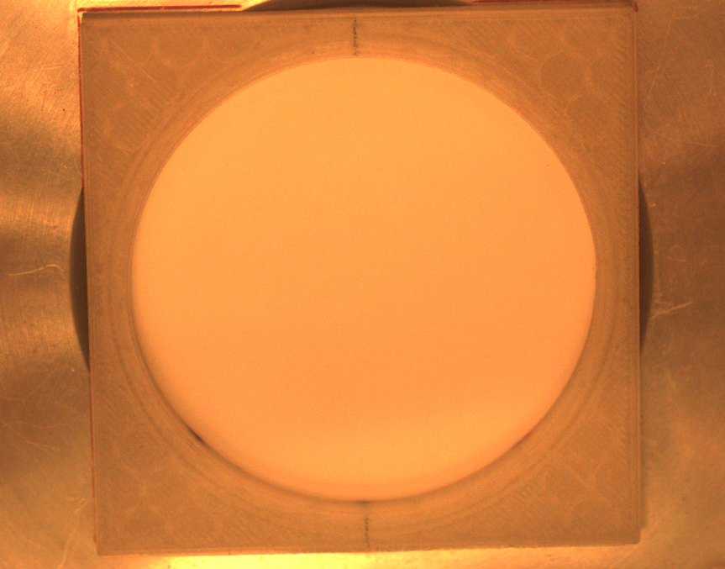
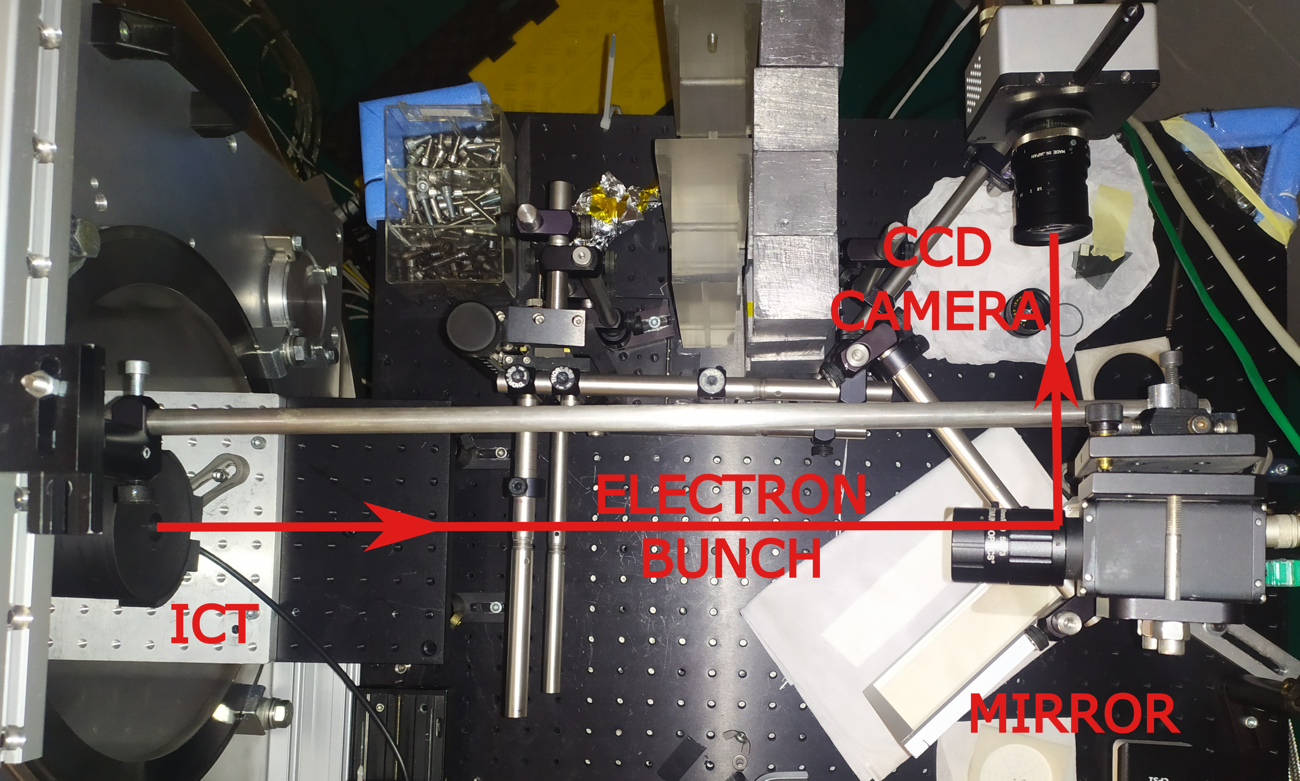
03 – Experimental setup
4
1
2
Lanex
3
LPA generated electrons passed through the Lanex screen after the vacuum-air transition
Afterwards they passed through ICT
Lanex emission signal was captured by CCD

Slide 8
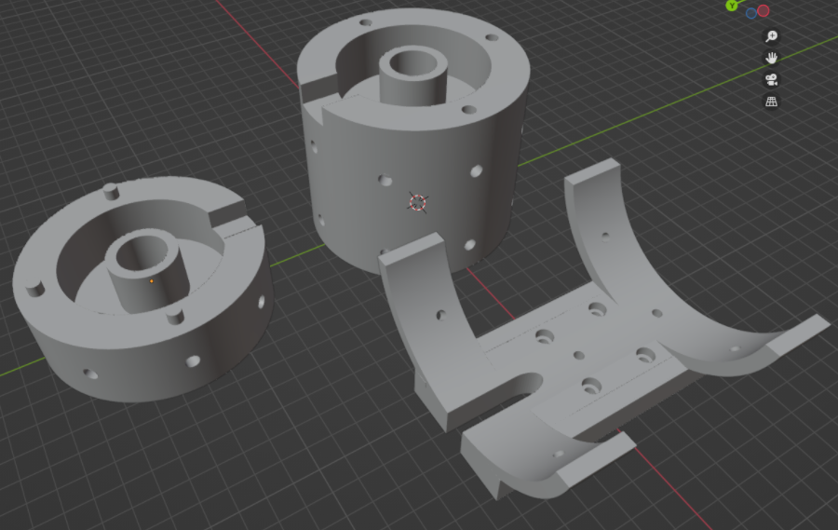
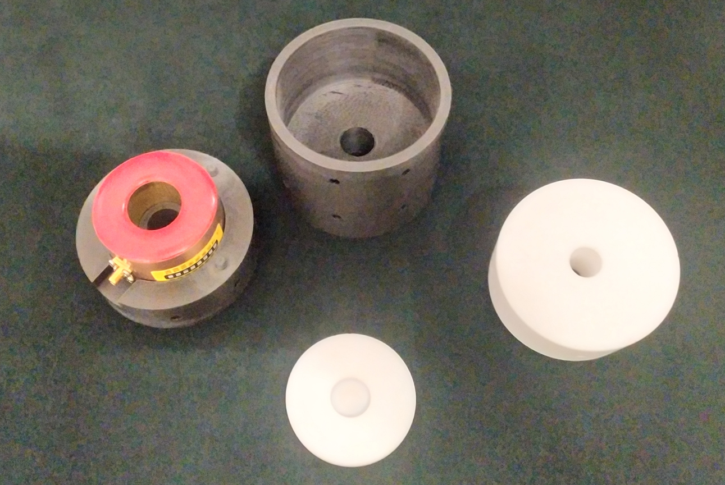
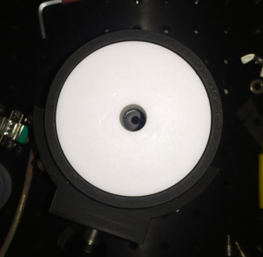
03 – Experimental setup
Front
ICT mount/shielding was designed in Blender
3D printed with PLA filament
The front part allows the main shielding to be replaced

Slide 9
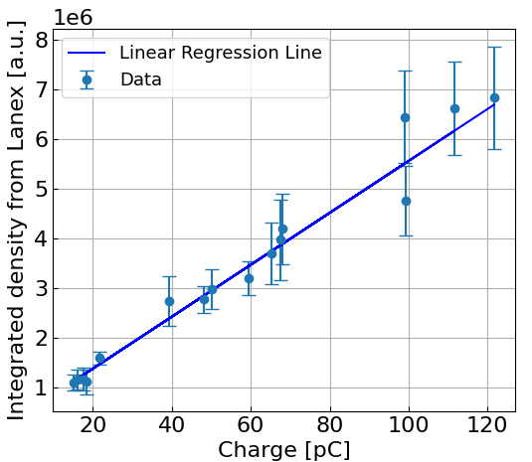
04 – Results
From the linear regression:
R² = 0.97
𝜒² = 3.06
Pearson coefficient = 0.98
$y=54602∙x+260277$
Correlation between the electron charge and Lanex emission signal is present

Slide 10
Summary
ICTs provide noninvasive, energy-independent charge measurements
In laser-plasma acceleration, EMP signals can influence ICT results
During the experiment, EMP signal spikes were observed
However, correlation between the ICT charge and Lanex emission signal was still preserved
At the moment, an experiment aimed at retrieving the charge from the radiochromic films is being conducted
To assess whether the ICT is overestimating the measured charge

Slide 11
Acknowledgement
Advanced Photon Sources
Experimental investigation on biomedicine
This work was supported by the PNRR MUR project ECS00000017-"Tuscany Health Ecosystem & the LPA – STAR project, funded by the European Union – Next Generation EU
Laser Development
This work was supported by the EU Horizon IFAST, under Grant Agreement No.101004730
Infrastructure Development
This work was supported by the PNRR MUR project IR0000016-I-PHOQS, funded by the European Union – Next Generation EU and EuPRAXIA Advanced Photon Sources – EuAps (IR0000030, CUP I93C21000160006).

Slide 12
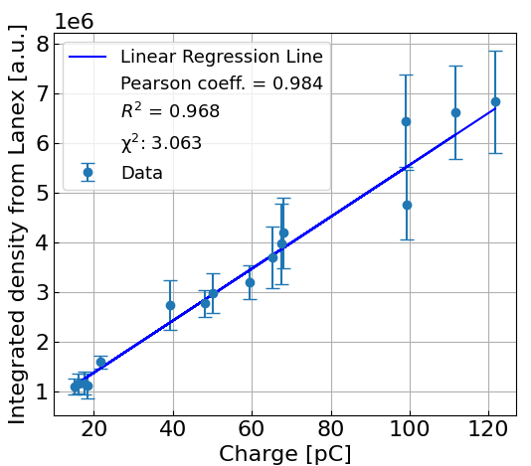
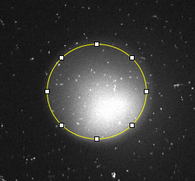
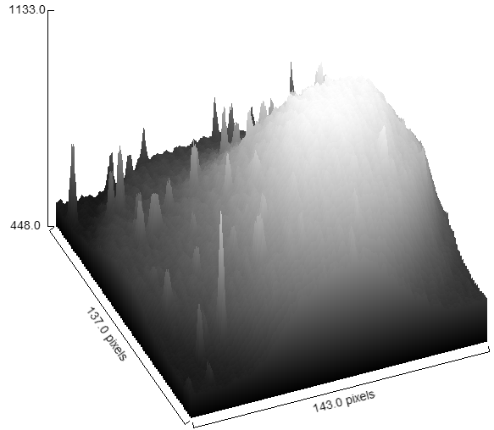
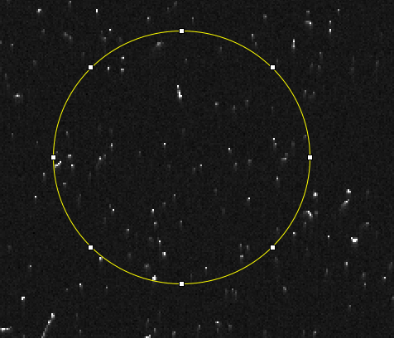
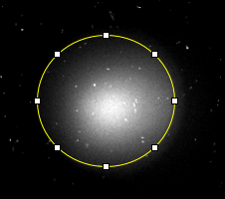
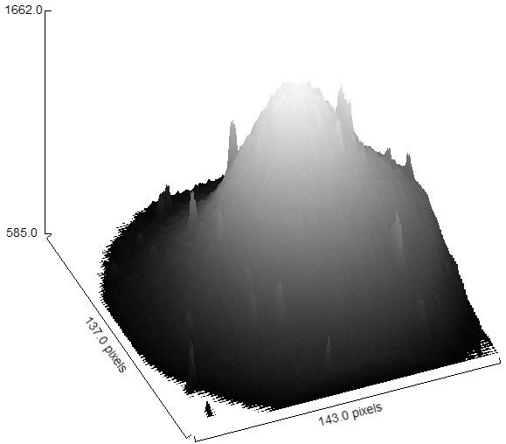
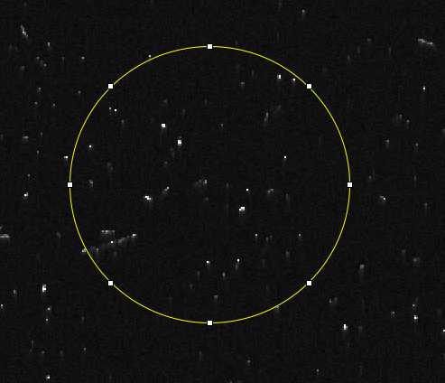
Backups
Background

Slide 13
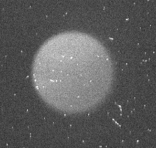
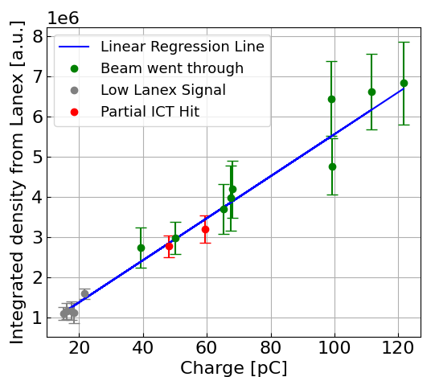
Backups
Beam went through
Low Lanex Signal
Partial ICT hit

