Slide 1
Spectral features of very high-energy electron beams
Milestones 1.1 & 1.6
S. G. Vlachos
The ILIL team: F. Avella, F. Baffigi, G. Bandini, G. Benincasa, F. Brandi, G. Cristoforetti, M. Ezzat, A. Fregosi, L. Fulgentini, D. Gregocki, E. Hume, P. Koester, L. Labate, D. Palla, M. C. V. Panaino, S. Piccinini, M. Salvadori & L. A. Gizzi.

Slide 2
Progress & challenges
Multi-GeV peak energy - record at $7.8 GeV$.¹
Divergence $≤1 mrad$ and energy spread $≤1\%$.²
Charge above $1 nC$ reached in a single shot.³
Shot-to-shot stability $→$ Electron beam pointing $→$ Energy miscalculations.
Horizintal mean deviation: $1.7 mrad$, Vertical mean deviation: $6.8 mrad$.
Pixel value
A. J. Gonsalves et al., Phys. Rev. Lett. 122, 084801 (2019).
W. T. Wang et al., Phys. Rev. Lett. 117, 124801 (2016).
J. Götzfried et al., Phys. Rev. X. 10, 041015 (2020).

Slide 3
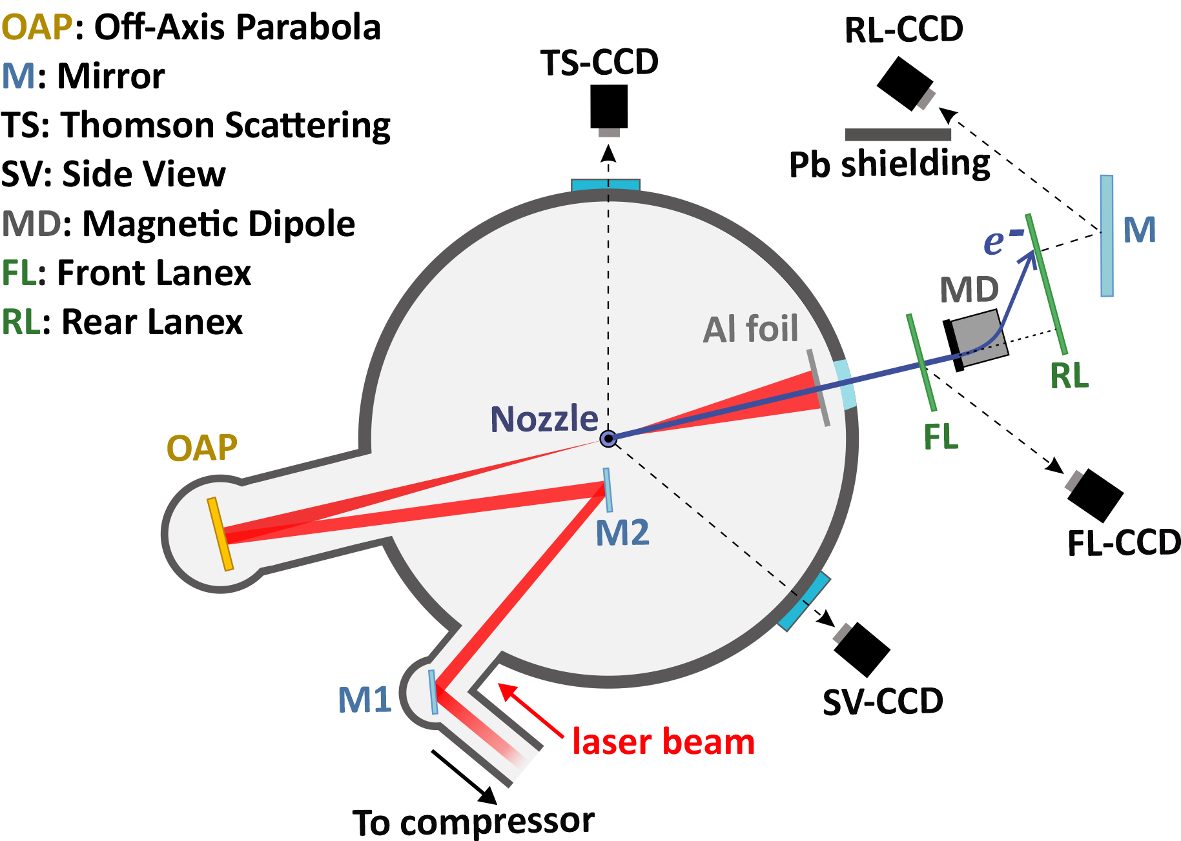
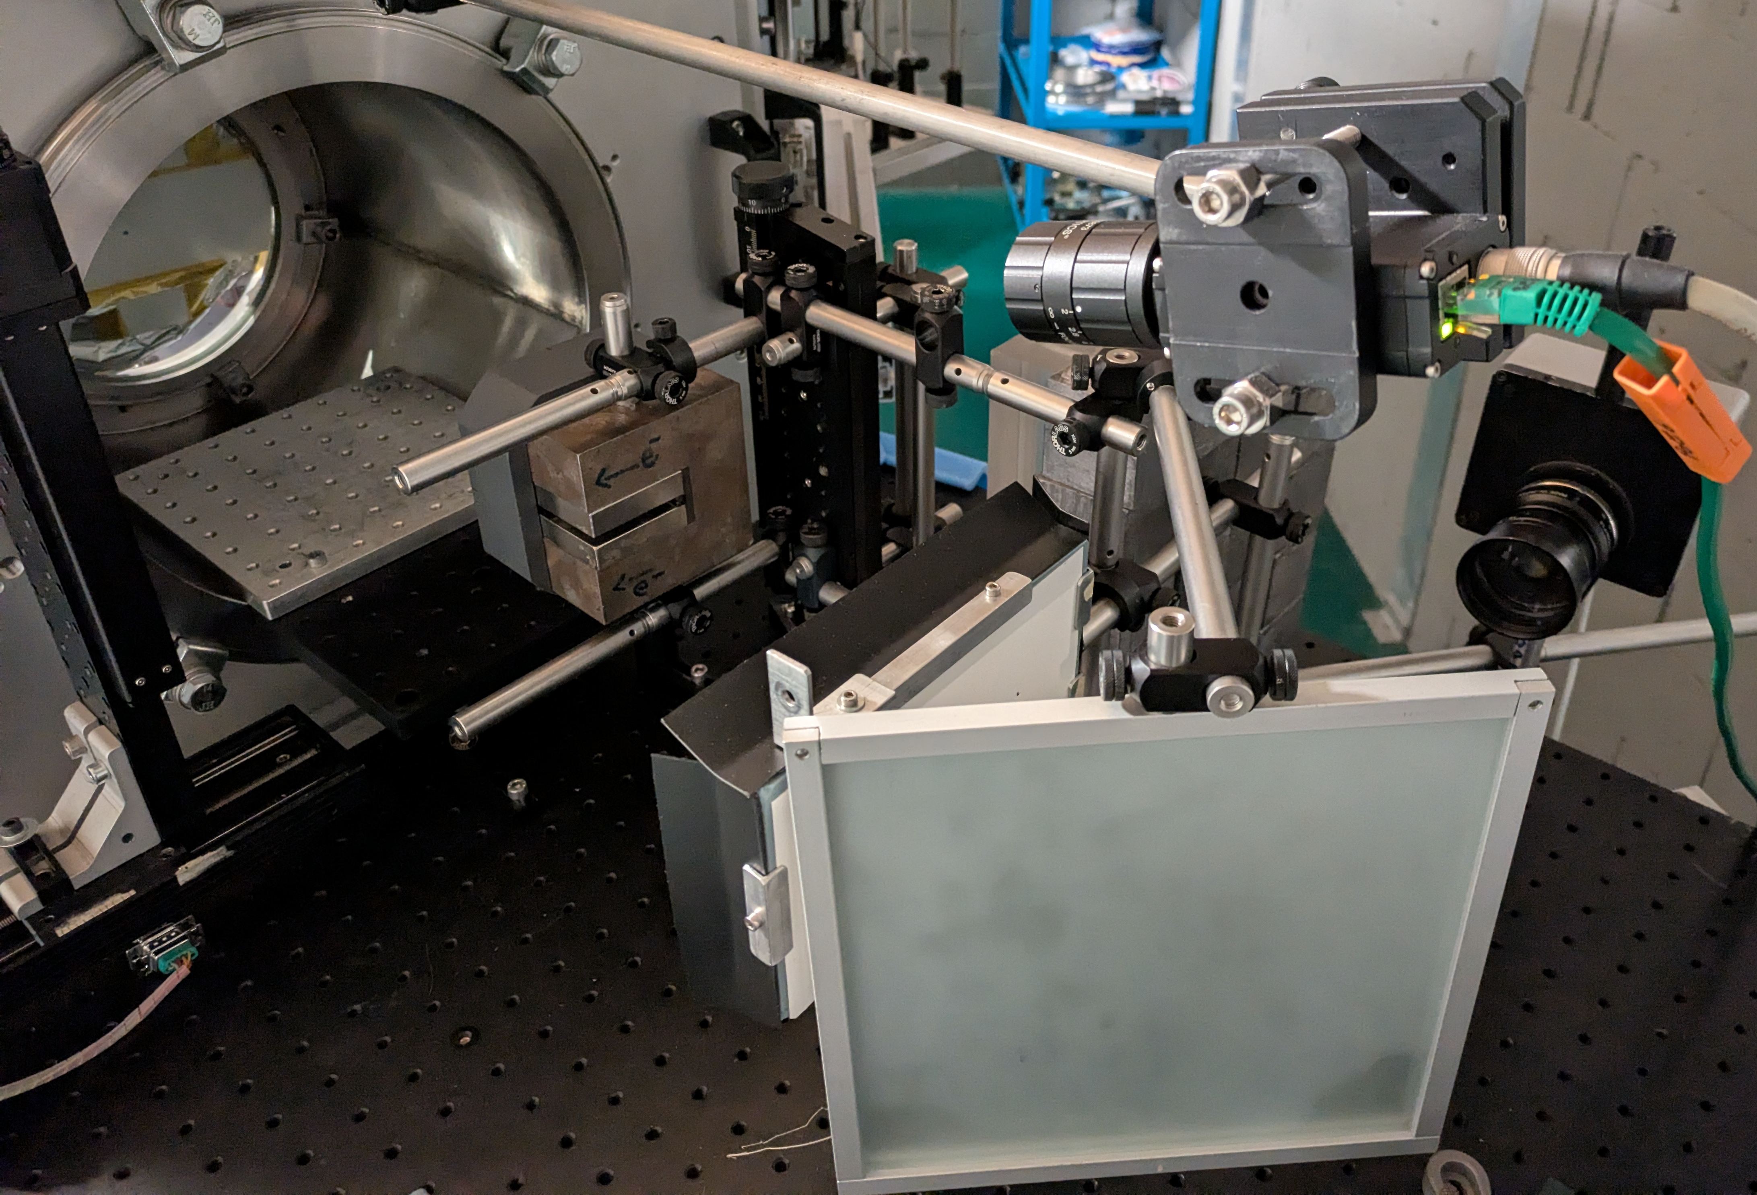
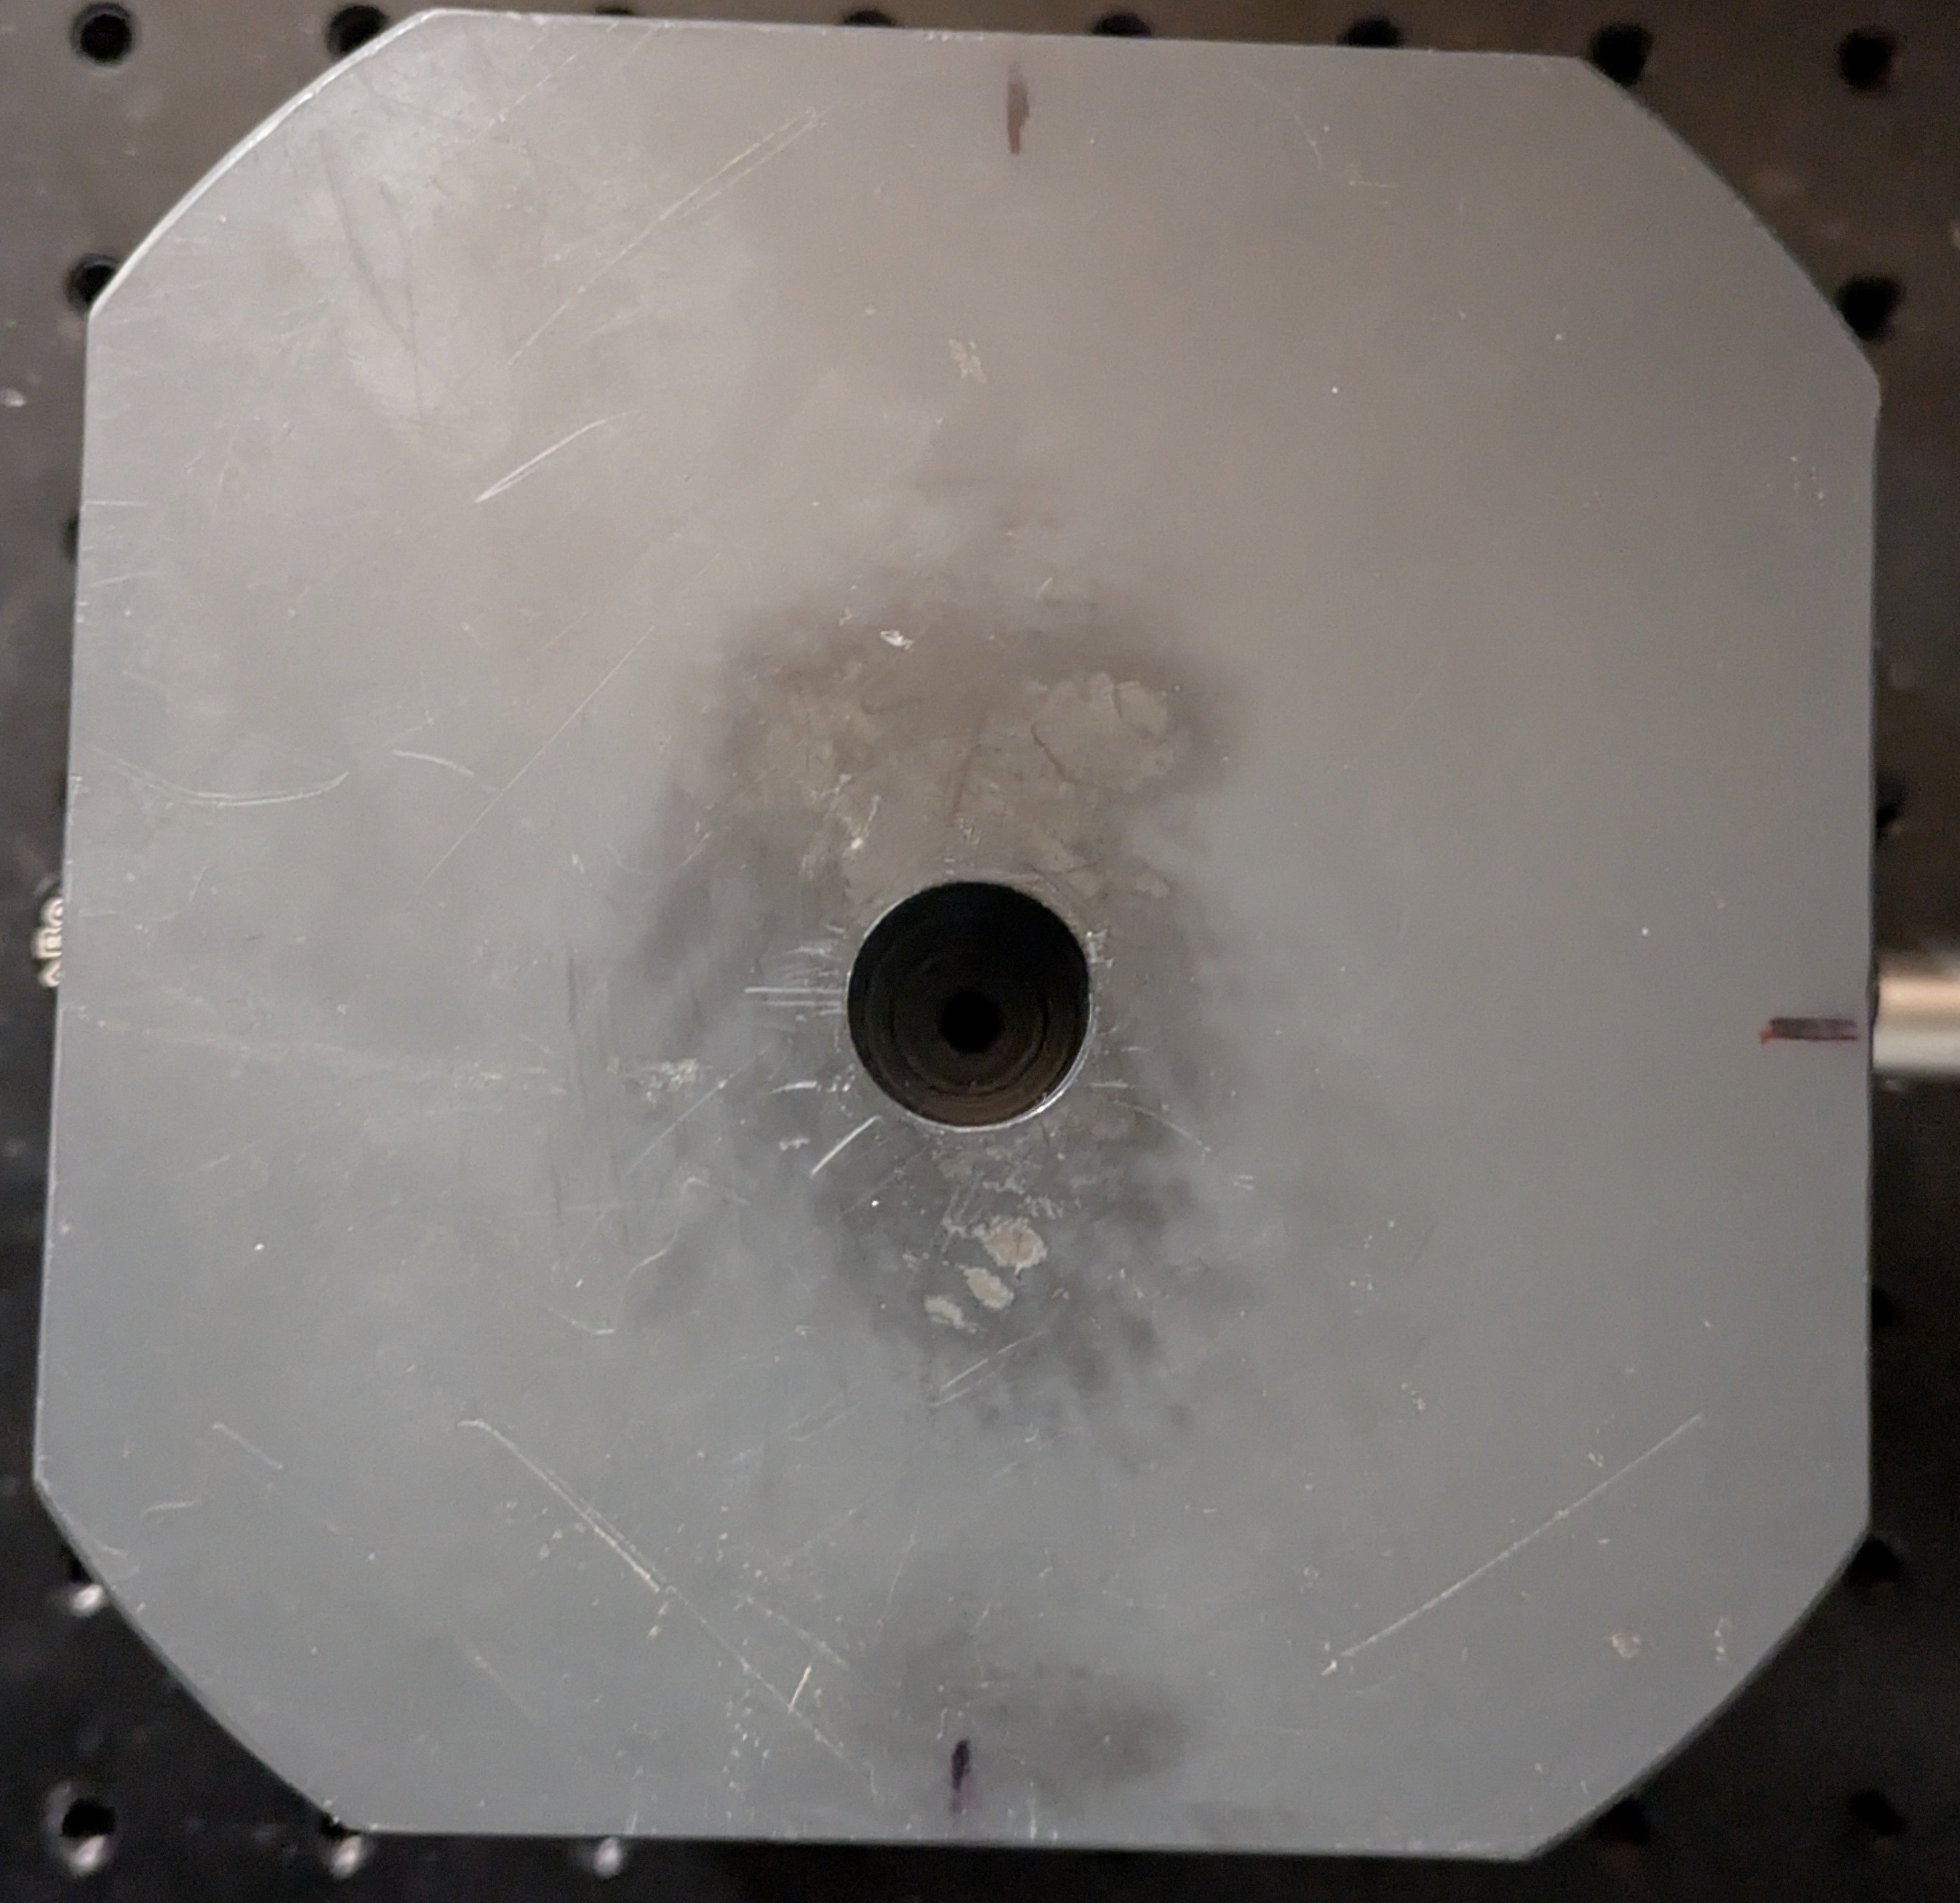
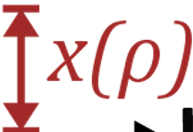
Spectrometer setup
$$θ$$
$$ρ=\frac{\sqrt{E^{2}−{\left(mc^{2}\right)}^{2}}}{eBc}$$
$$x\left(θ,ρ\right)=\left(\frac{a}{2}+b\right)\left(\frac{a}{ρ}\right)+\left[\left(a+b+c\right)+\left(\frac{a}{2}+\frac{3b}{2}\right){\left(\frac{a}{ρ}\right)}^{2}\right]θ+\frac{1}{2}\left[\left(\frac{3a}{2}+3b\right)\left(\frac{a}{ρ}\right)\right]θ^{2}$$
$x\left(ρ\right)=\left(\frac{a}{2}+b\right)\left(\frac{a}{ρ}\right)$ ,
$B$: magnetic field strength, $e,m$: electron charge & mass, $c$: speed of light,
$E$: electron energy
H. J. Cha et al., Rev. Sci. Instrum. 83, 063301 (2012).

Slide 4
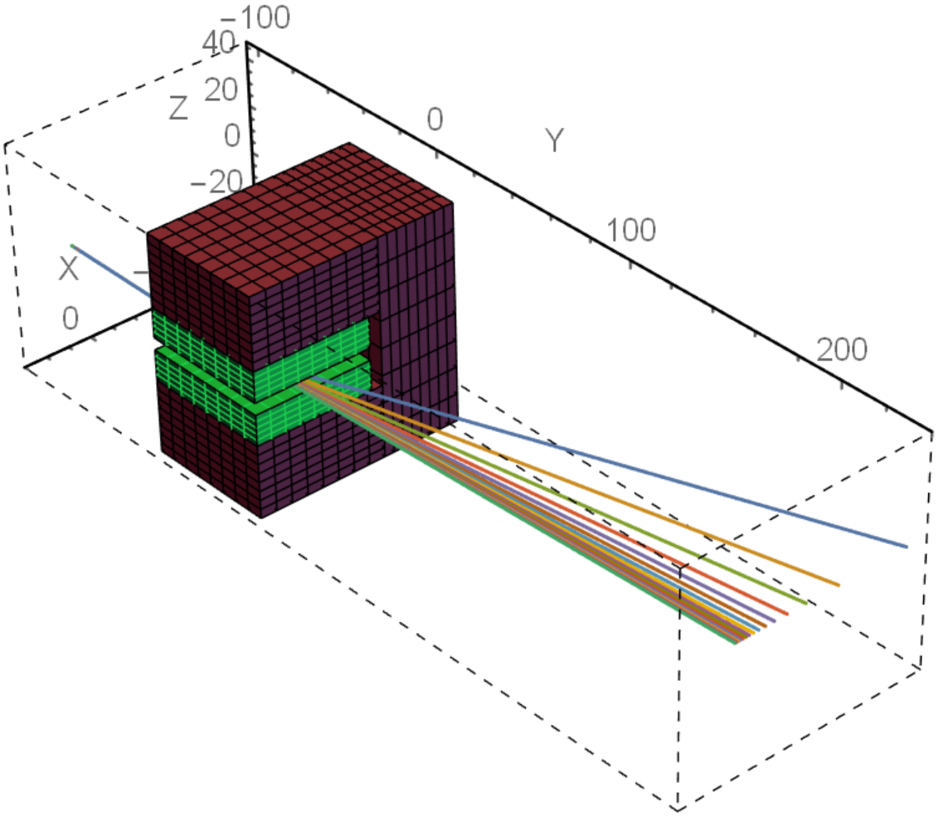
Rear Lanex analysis
$$f\left(x\right)$$
(mm)
(mm)
(mm)
$$S\left(E\right)=\frac{dx}{dE}f\left(x\right)$$
$$S\left(E\right)$$
$$E=\frac{C_{1}}{x}+C_{2}$$
$$x→$$
$C_{1},C_{2}:$ constants
O. Chubar, P. Elleaume, J. Chavanne, J. Synchrotron Radiat. 5, 481–484 (1998)

Slide 5
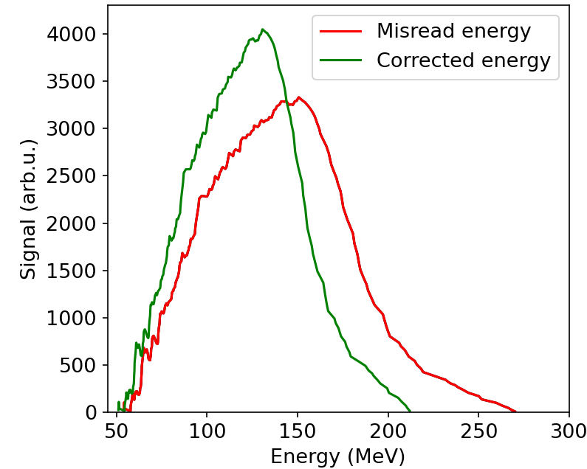
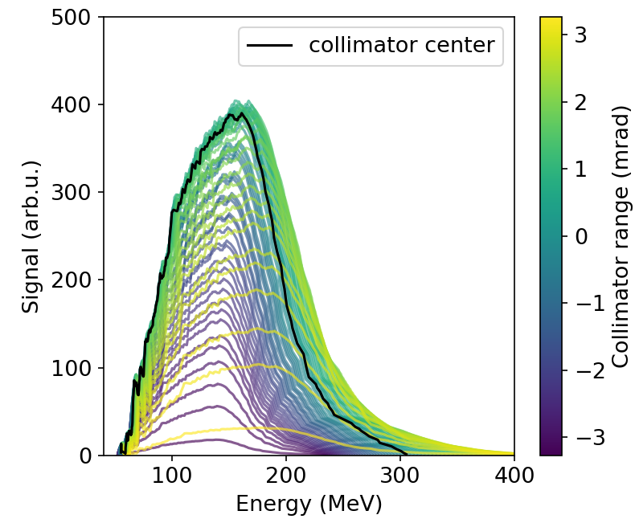
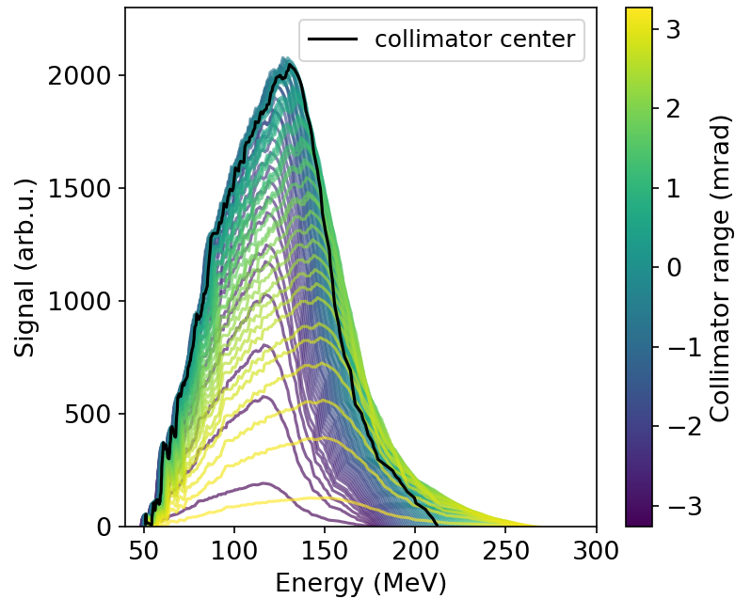
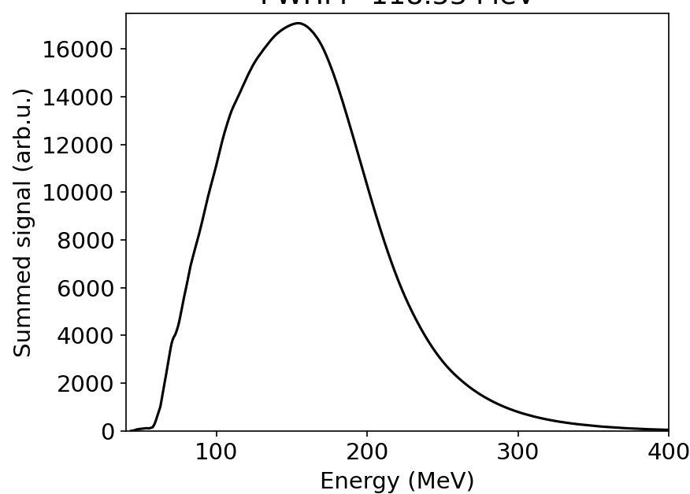
Front Lanex analysis
$$130 MeV$$
$$151 MeV$$
$$θ=0$$
$θ=−2 mrad$
$θ=1.4 mrad$
$$154 MeV$$
$$θ=0$$

Slide 6
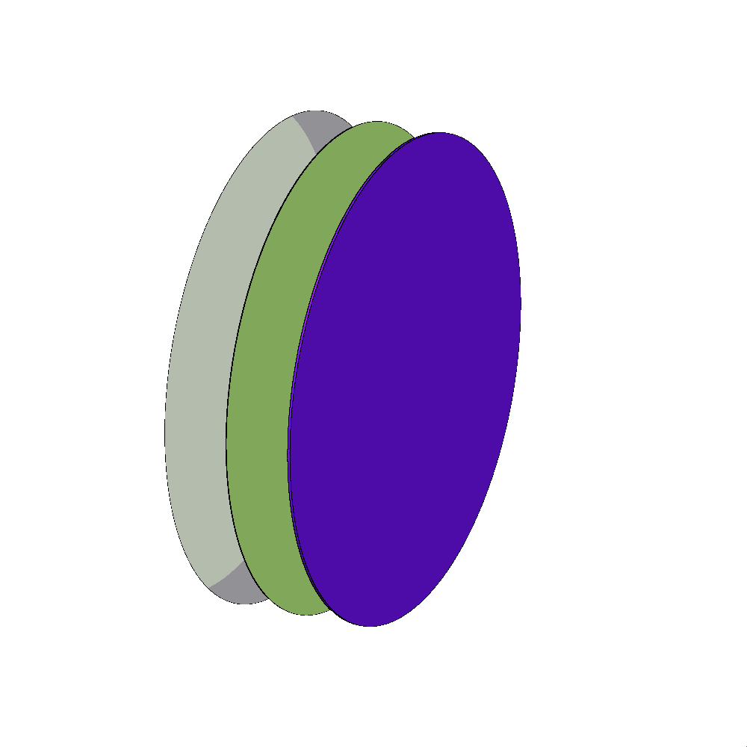
Lanex scattering – Fluka
Fluence measured at the exit of the Lanex and at the entrance of the collimator.
Monoenergetic pencil-like electron beams from $5 MeV−400 MeV$.
Statistical errors $<2\%$ except in the case of $5 MeV$ at $8\%$.
$$1 cm$$
$$1 cm$$
$$42 cm$$
Material characteristics
Name | Material | Density ($g/cm^{3}$) | Thickness ($μm$)
Lanex Regular (93% Phosphor) | $${Gd}_{2}O_{2}S:\left(1\%\right)Tb$$ | 7.35 | 380
Lanex Regular (7% Binder) | $${La}_{2}O_{2}S:\left(1\%\right)Tb$$ | 5.75
Mylar window | $${\left(C_{10}H_{8}O_{4}\right)}_{n}$$ | 1.40 | 75
Aluminum foil | Al | 2.69 | 13
Al
Mylar
Lanex
$$e^{−}$$
Fluence
detector

Slide 7
2D electron fluence
Lanex exit
Collimator entrance

Slide 8
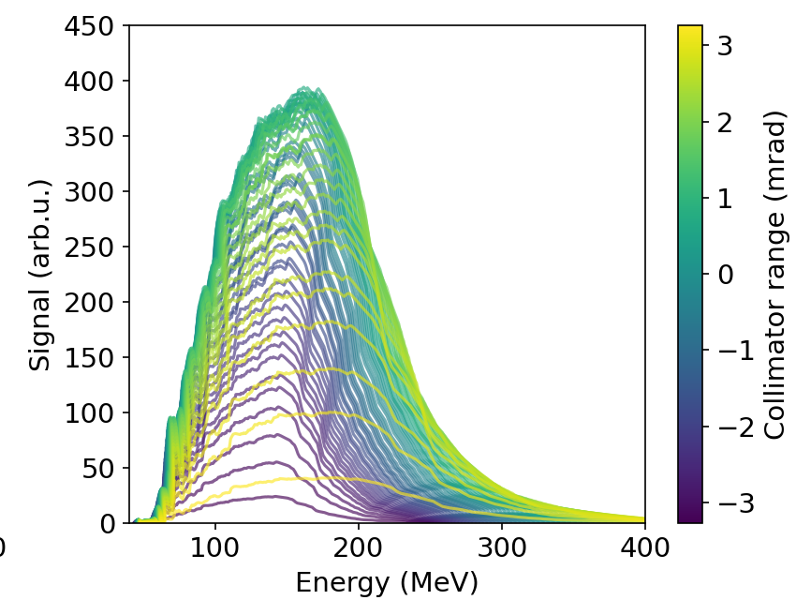
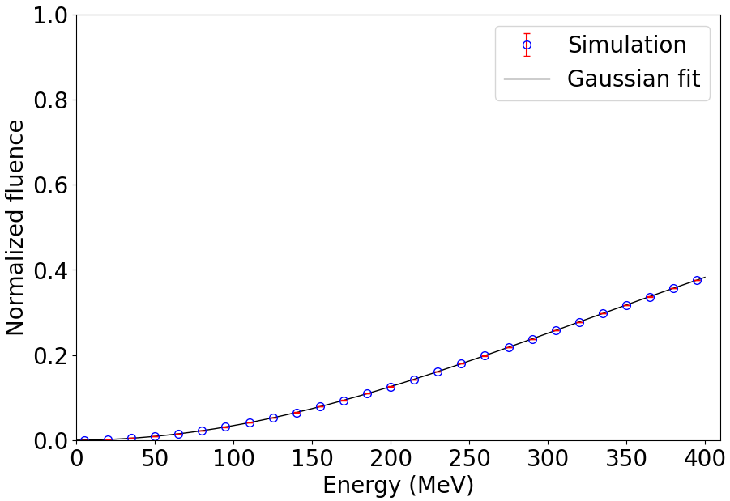
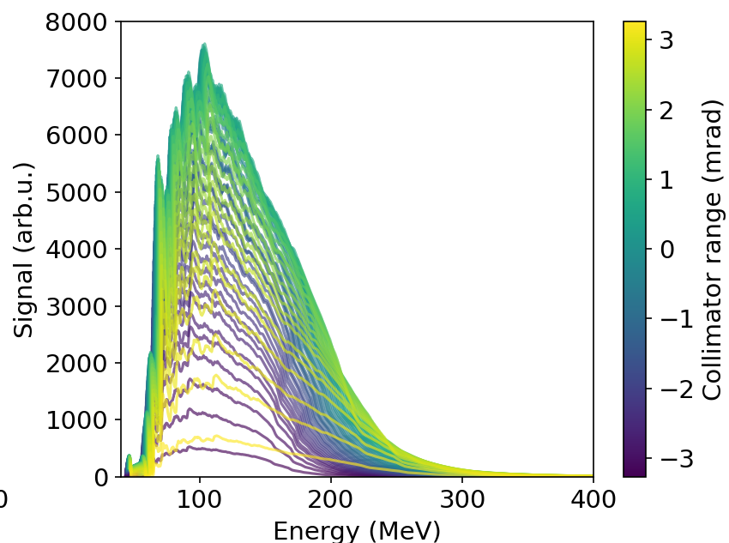
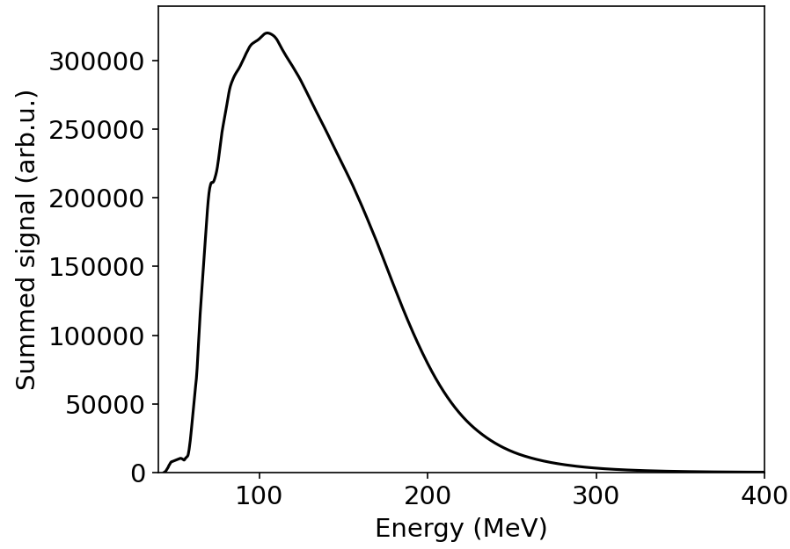
Scattering correction
Before
$$154 MeV$$
After
$$104 MeV$$

Slide 9
Conclusions
Pointing instability needs to be considered when measuring energy.
Scattering caused by the Lanex and the mylar window significantly changes the arriving charge.
Other spectrometers may remove front Lanex but are either slow, large or require $\sim GeV$ energies.
Our method:
- Compact, non-invasive, on-shot measurements of energy.
- Assumes electron trajectories are parallel.
Calibrating the rear Lanex for charge measurements becomes challenging. An Integrating Current Transformer (ICT) is recommended.

Slide 10
Acknowledgements
Experimental investigation on biomedicine
This work was supported by the PNRR MUR project ECS00000017-"Tuscany Health Ecosystem & the LPA – STAR project, funded by the European Union – Next Generation EU
Infrastructure Development
Laser Development
This work was supported by the PNRR MUR project IR0000016-I-PHOQS, funded by the European Union – Next Generation EU.
EuPRAXIA Advanced Photon Sources – EuAps (IR0000030, CUP I93C21000160006).
This work was supported by the EU Horizon IFAST, under Grant Agreement No.101004730
&
Advanced Photon Sources

