Slide 1
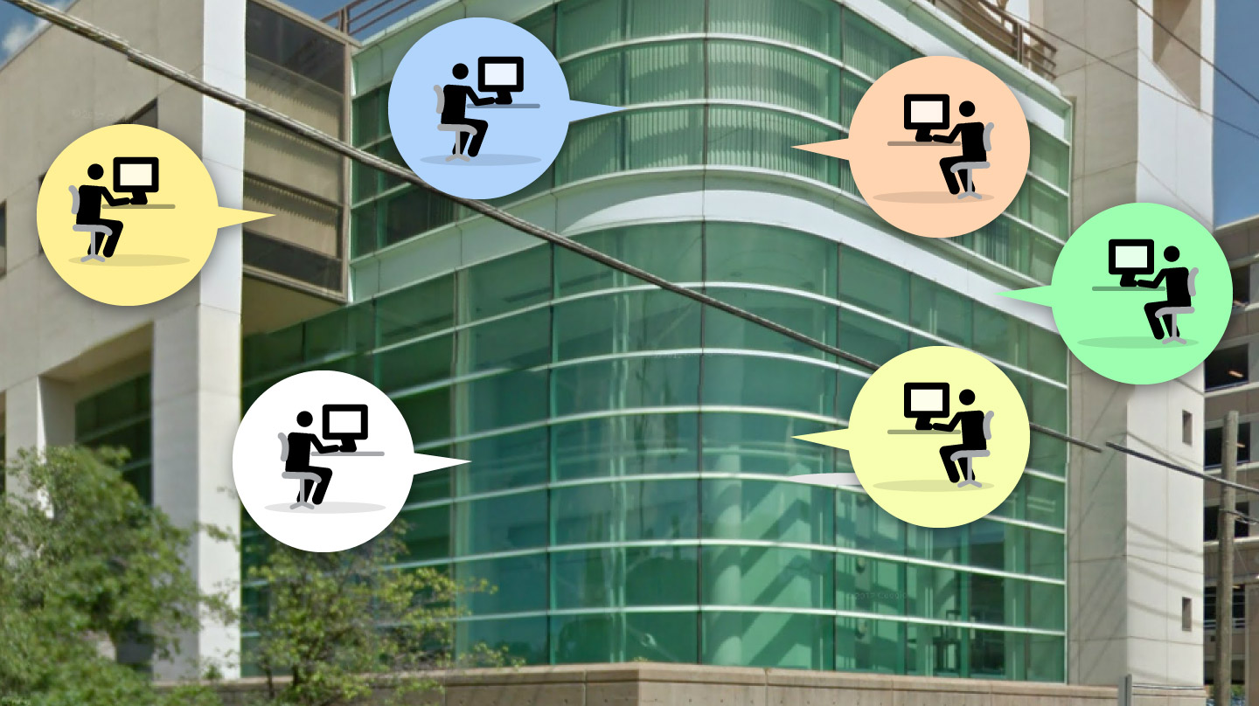
UPDATE ON REQUIREMENTS COLLECTION AND FIRST PROTOTYPES OF THE DATA PLATFORM
Camilla Scapicchio, PhD
INFN, Sezione di Pisa
INFN Team:
S. Arezzini, T. Boccali, M. Celentano, A. Formuso, A. Kraan, S. Lossano, E. Mazzoni, A. Moggi, A. Retico

Slide 2
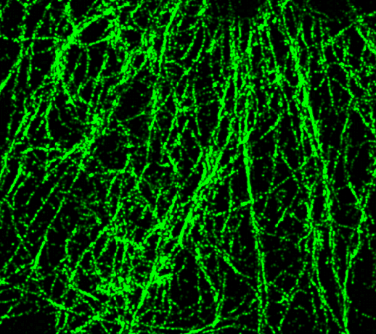
OVERVIEW
Why a
Data Platform in
THE-Spoke 1
Demo of first prototype
Translation of the collected requirements into an XNAT organizational scheme
Overview of possible AI-assisted analysis

Slide 3
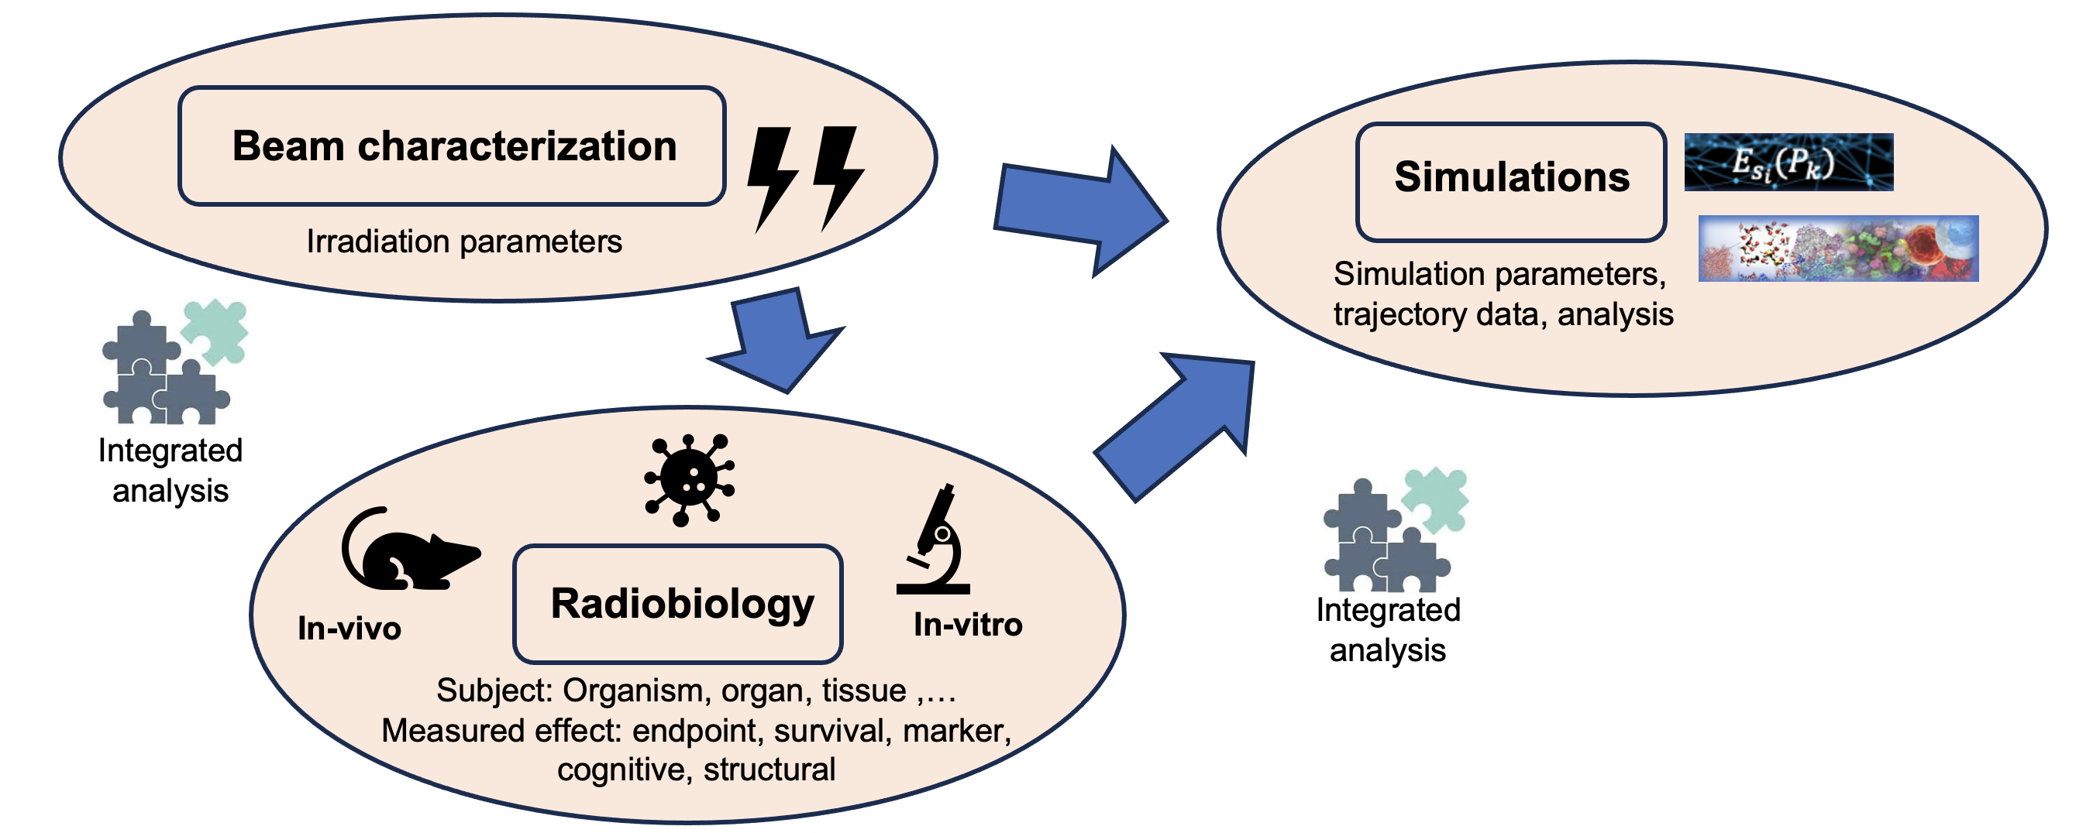
WHY A DATA PLATFORM IN THE-SPOKE 1
A common database to store and compare heterogeneous data coming from different experiments within the THE-Spoke 1 project.
Useful across different WPs to avoid an inhomogeneous, patchy, and sporadic organization of the data.

Slide 4
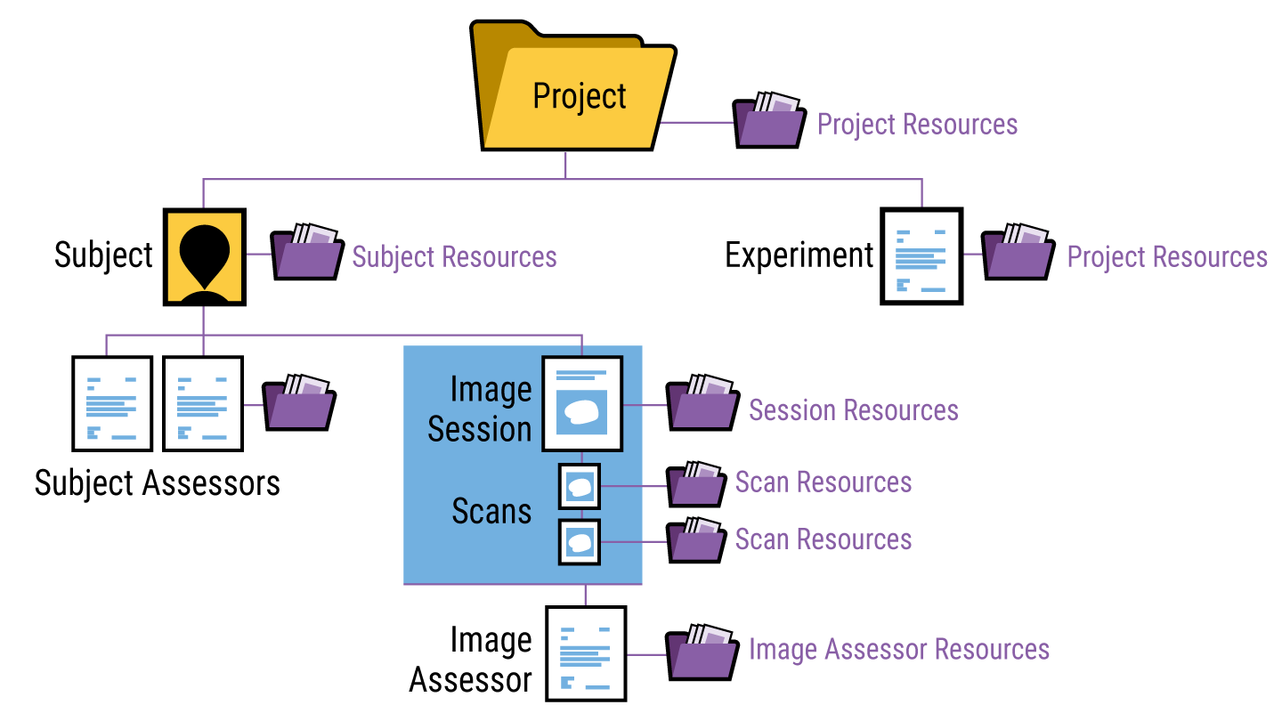
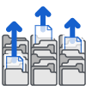
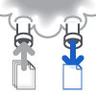
PLANNED APPROACH
https://www.xnat.org/
An open source imaging informatics platform developed by neuroimaging data (Washington University).
Thanks to its extensibility, XNAT can be used to support a wide range of projects.
Upload Data
View and Download Data
Search and Explore Large Data Sets
Organize and Share Data
Securing and Managing Access
Run Complex Processing (HPC)

Slide 5
PLANNED APPROACH
Study XNAT documentation
Install and configure XNAT on the computing center of INFN Pisa
Requirements collection
Translation of the requirements in an XNAT organizational scheme
Integrate data analysis pipelines
Testing and validation
Maintenance and continuous integration
Cascade Call Project «FLASH_IT»

Slide 6
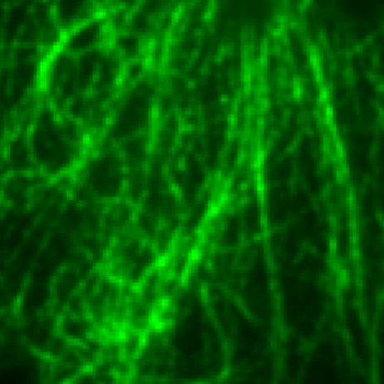
Super Resolution Microscopy (Collaboration with Spoke 4)
DEMO OF FIRST PROTOTYPE
A generative deep learning approach for super-resolution microscopy.
Lossano S., Scapicchio C., Retico A., et al, FRPT2024
Lossano S, Scapicchio C, et al, A generative deep learning approach for super-resolution microscopy, WS INFN CCR, 2024
Super Resolution GAN
Subject_ID | Protein | Quality score | Widefield image | SR image
sample_1 | Alpha-tub | Good
sample_2 | Beta-tub | Fair
sample_3 | Alpha-tub | Fair

Slide 7
DEMO

Slide 8
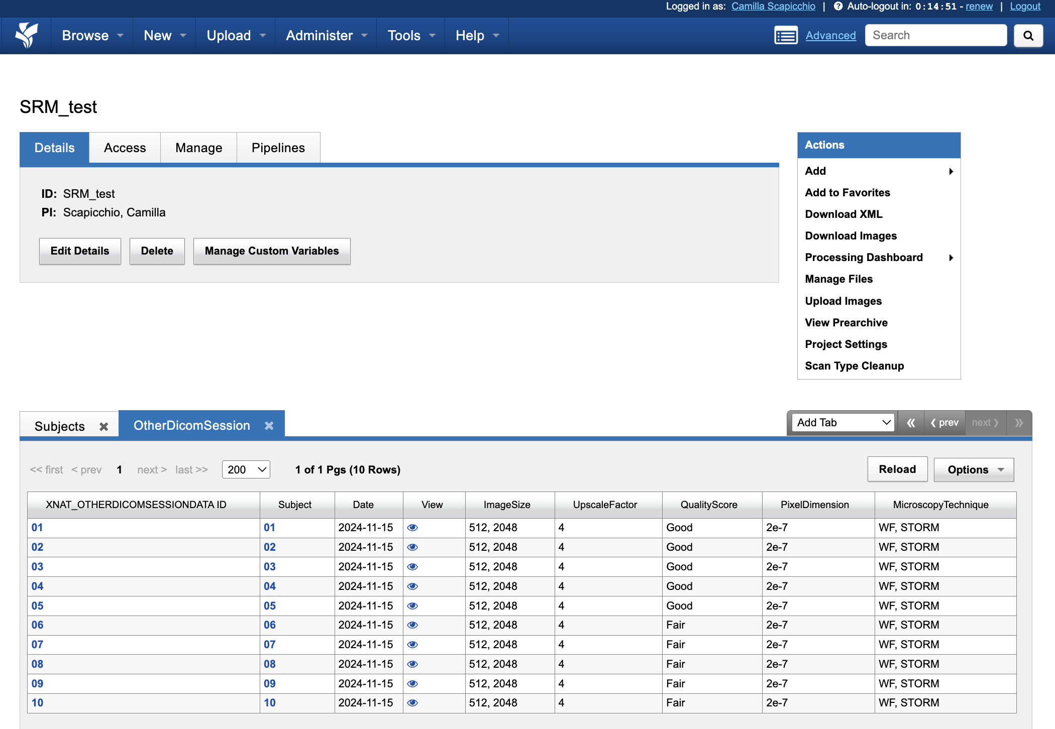
DEMO

Slide 9
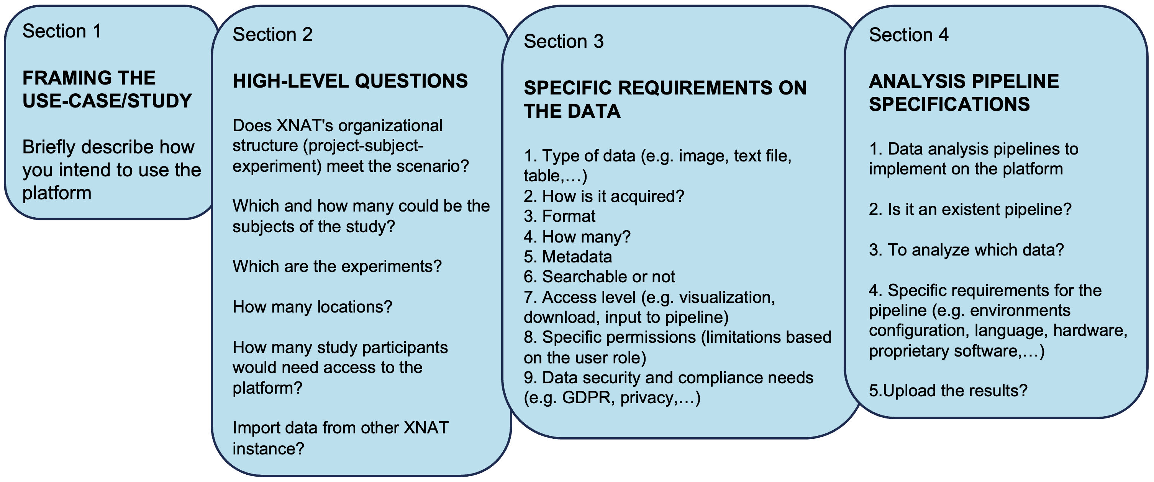
UNDERSTAND REQUIREMENTS AND TRANSLATION INTO XNAT MODEL
GOOGLE FORM
https://forms.gle/vUbWzewvD6BrRaoZA

Slide 10
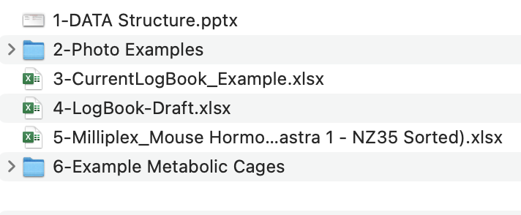
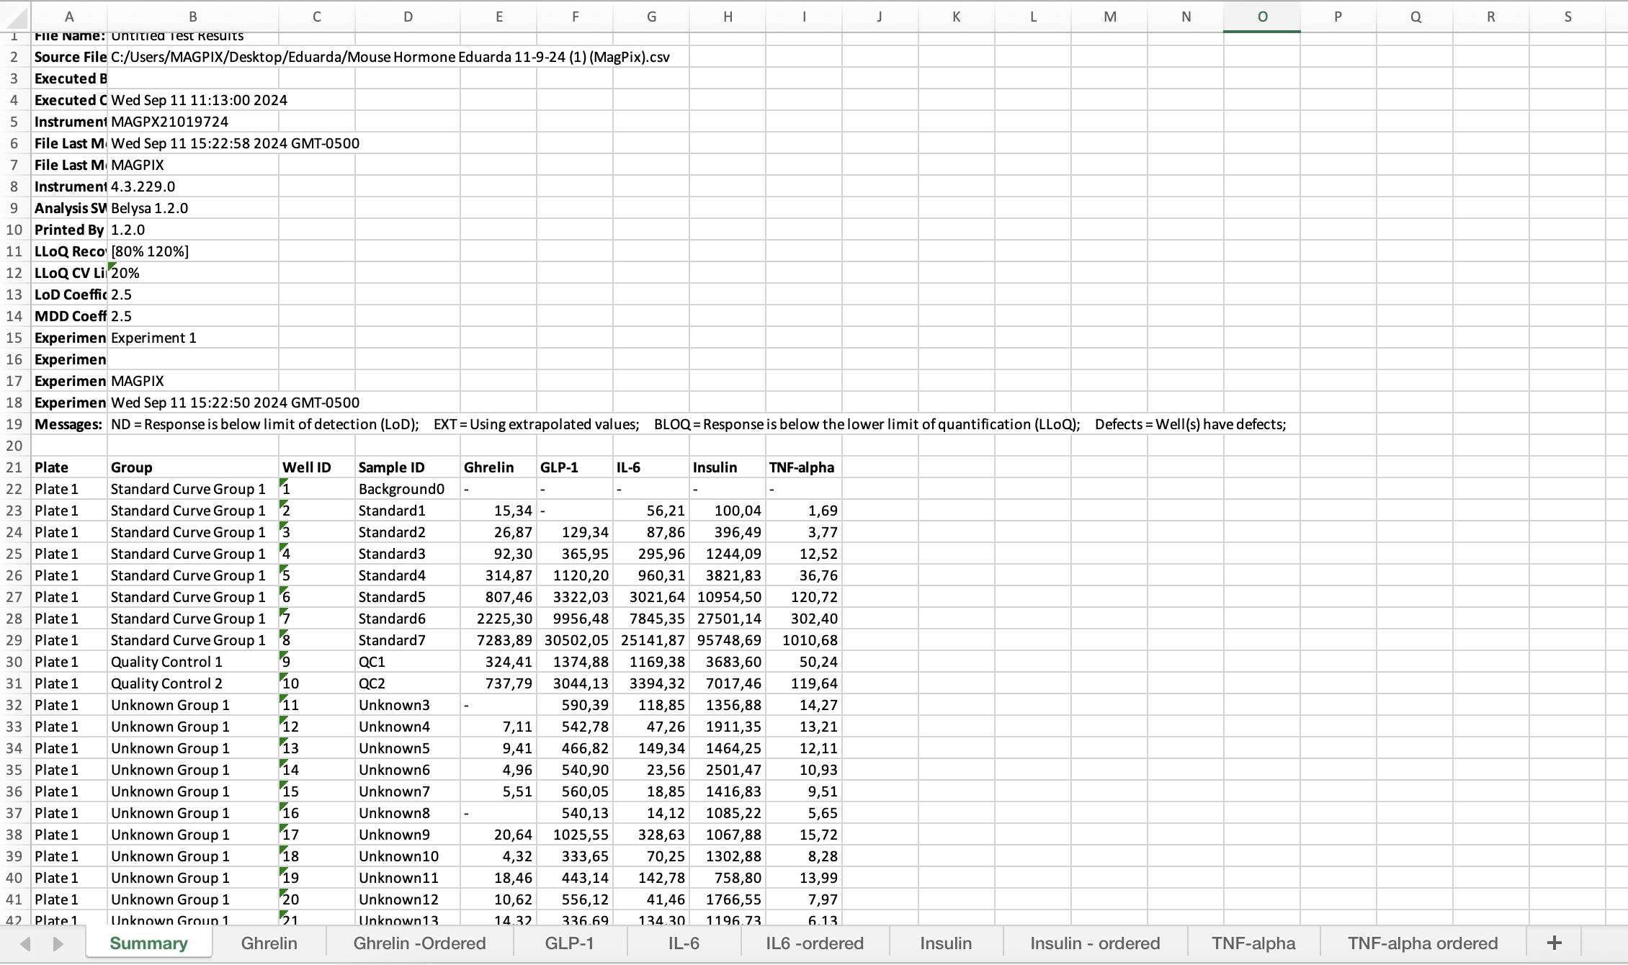
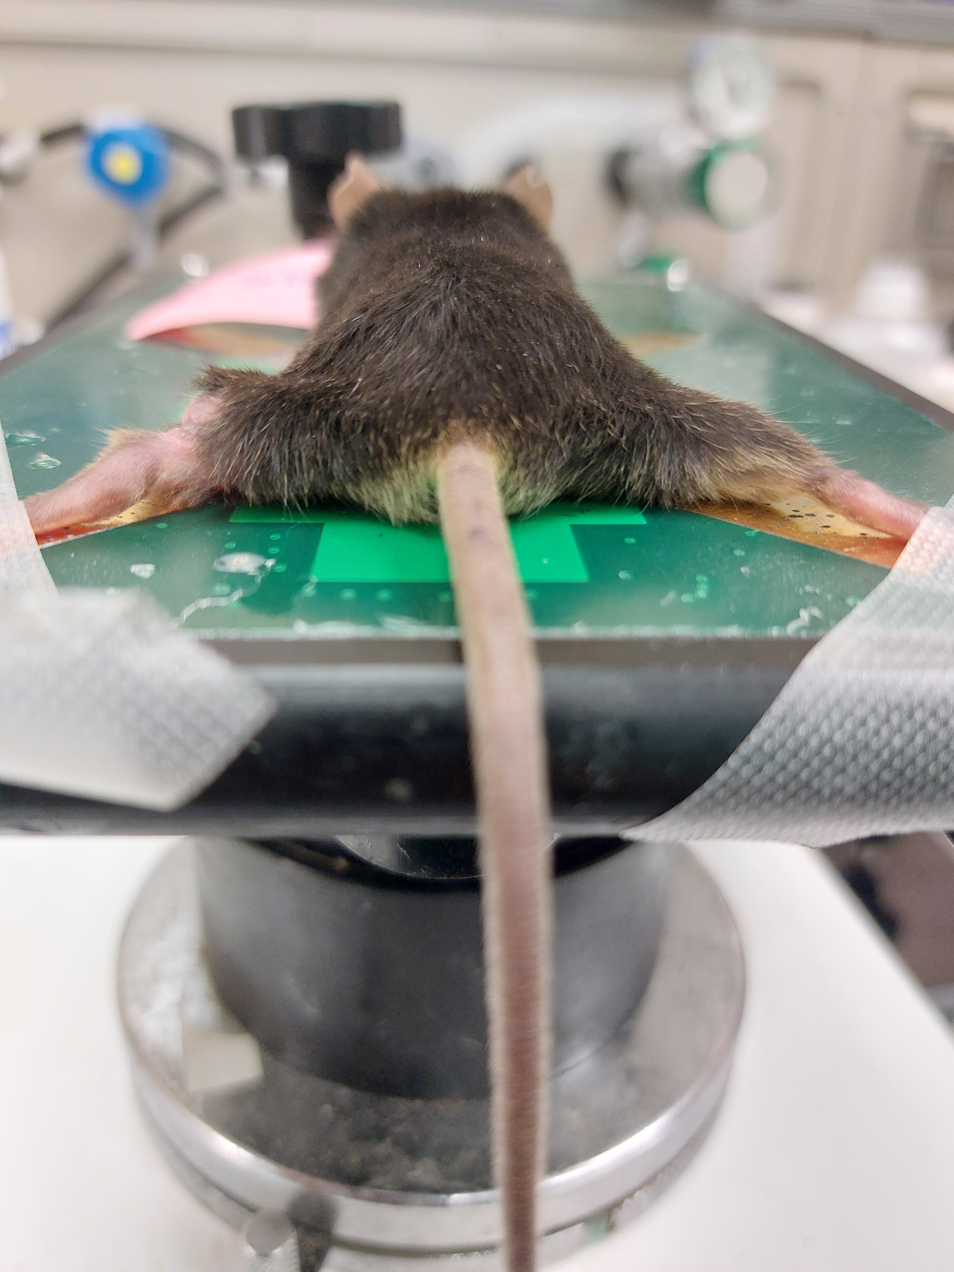
UNDERSTAND REQUIREMENTS AND TRANSLATION INTO XNAT MODEL
https://drive.google.com/drive/folders/1ezm03A8leOfFoR04tp81xYYb0XXVh4Wv?usp=drive_link
+ Example DATA or logbook

Slide 11
First use-case
Project
Naive Group
FLASH
Conv
Identified by a set of parameters
Control
Subject ID
Experiment «Periodical Assessment»
Experiment «Circulating Biomarkers»
Tumor Group
Experiment «Metabolic cages»
FLASH
Experiment «Sacrifice-Collected samples»
Conv
Control
Identified by a set of parameters
Subject ID
Experiment «Periodical Assessment»
E. Mota Da Silva experiments
Experiment «Circulating Biomarkers»
Experiment «Ultrasound Evaluation»
Experiment «Sacrifice-Collected samples»

Slide 12
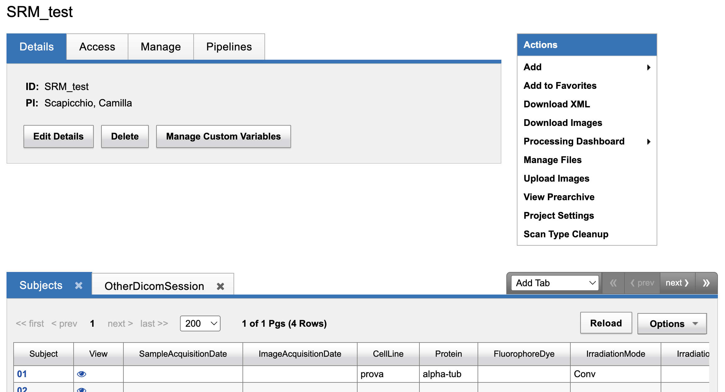
PROJECT NAME
MouseID + EarCode + Group +Treatment + Dose + ProtocolStartingDate
Subject ID | Mouse ID | Ear Code | Group | Treatment | RT Dose | Protocol Starting Date | Cage | Irradiated Area | RT Date | Date | Day after RT | CODE | Initial Body Weight | Experiment ID
ID | #1 | 2sx | Tumor | Flash | 35 | 12/01/24 |  | Leg | 13/01/24 | 16/01/24 | 3 | #1TF 3D | 28
 | #4 | sxdx | Naive | Conv | 25 | 02/01/24 | 1 | Torax | 04/01/24 | 05/01/24 |  | TX25#4 1D

Slide 13
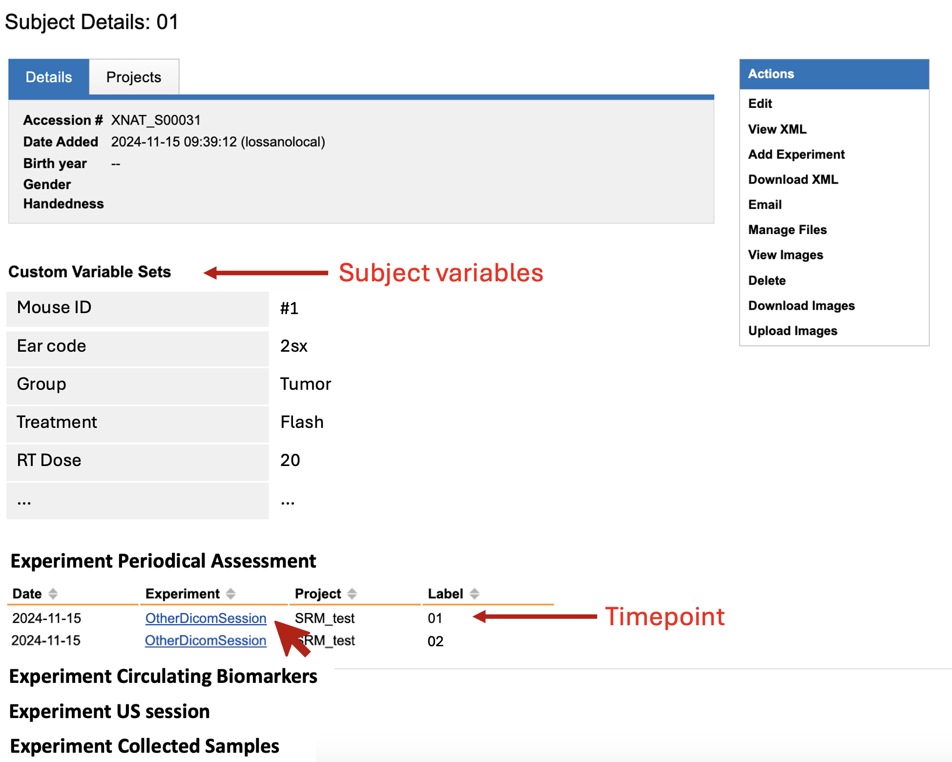
Photo ID
Photo ID
Project ID
Project ID

Slide 14
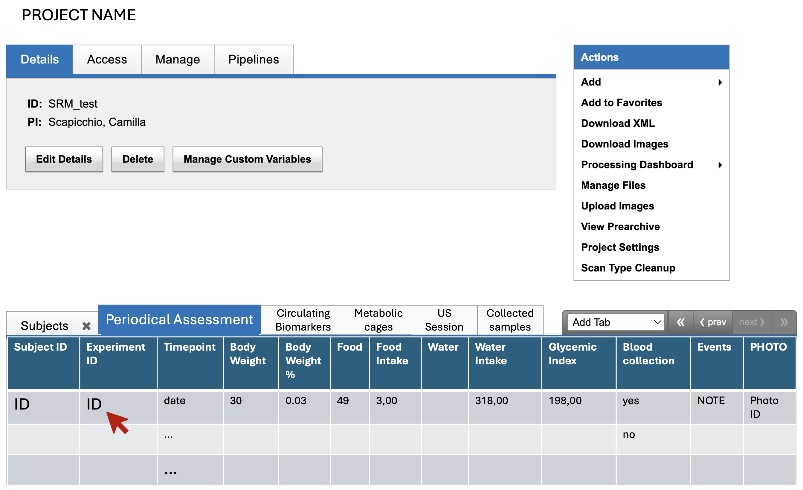
Periodical Assessment

Slide 15
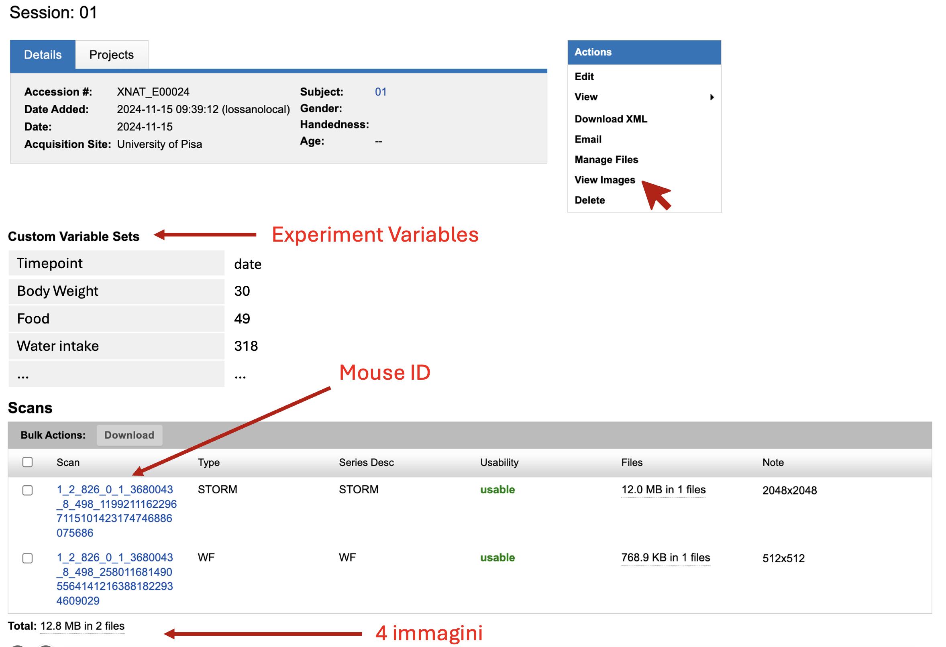
#10TF 20D + Tissue
NZ35#3F 20D + Tissue
4 images

Slide 16
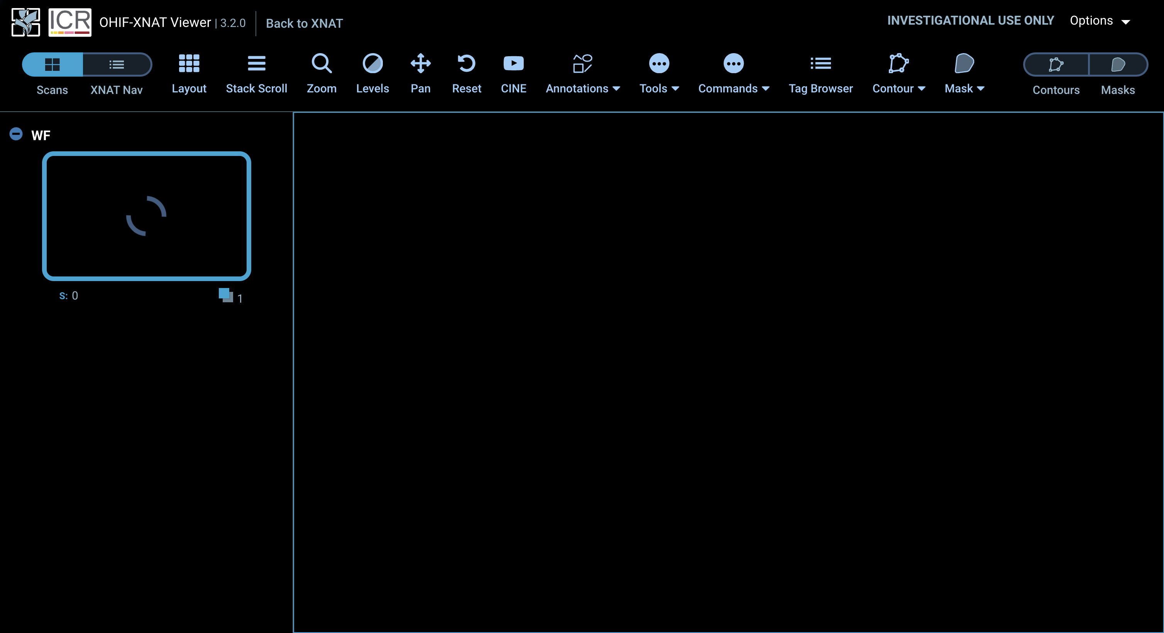
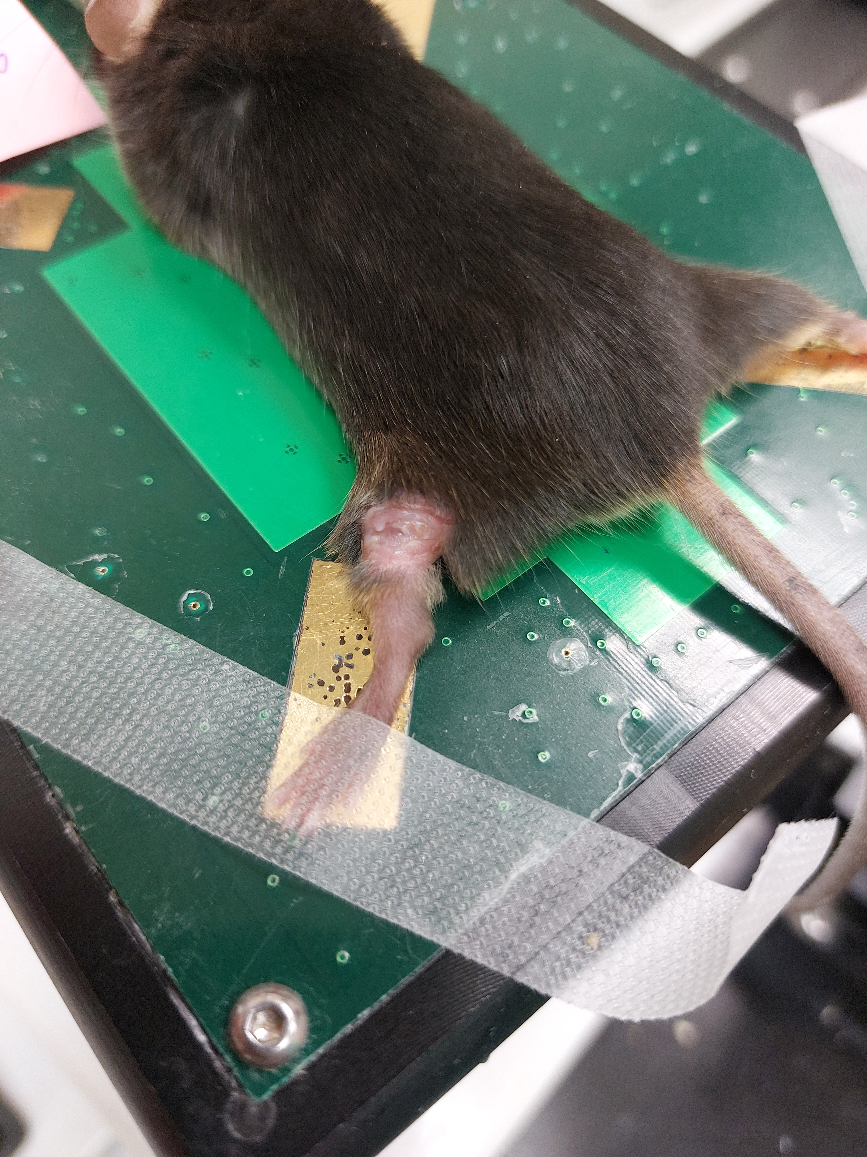
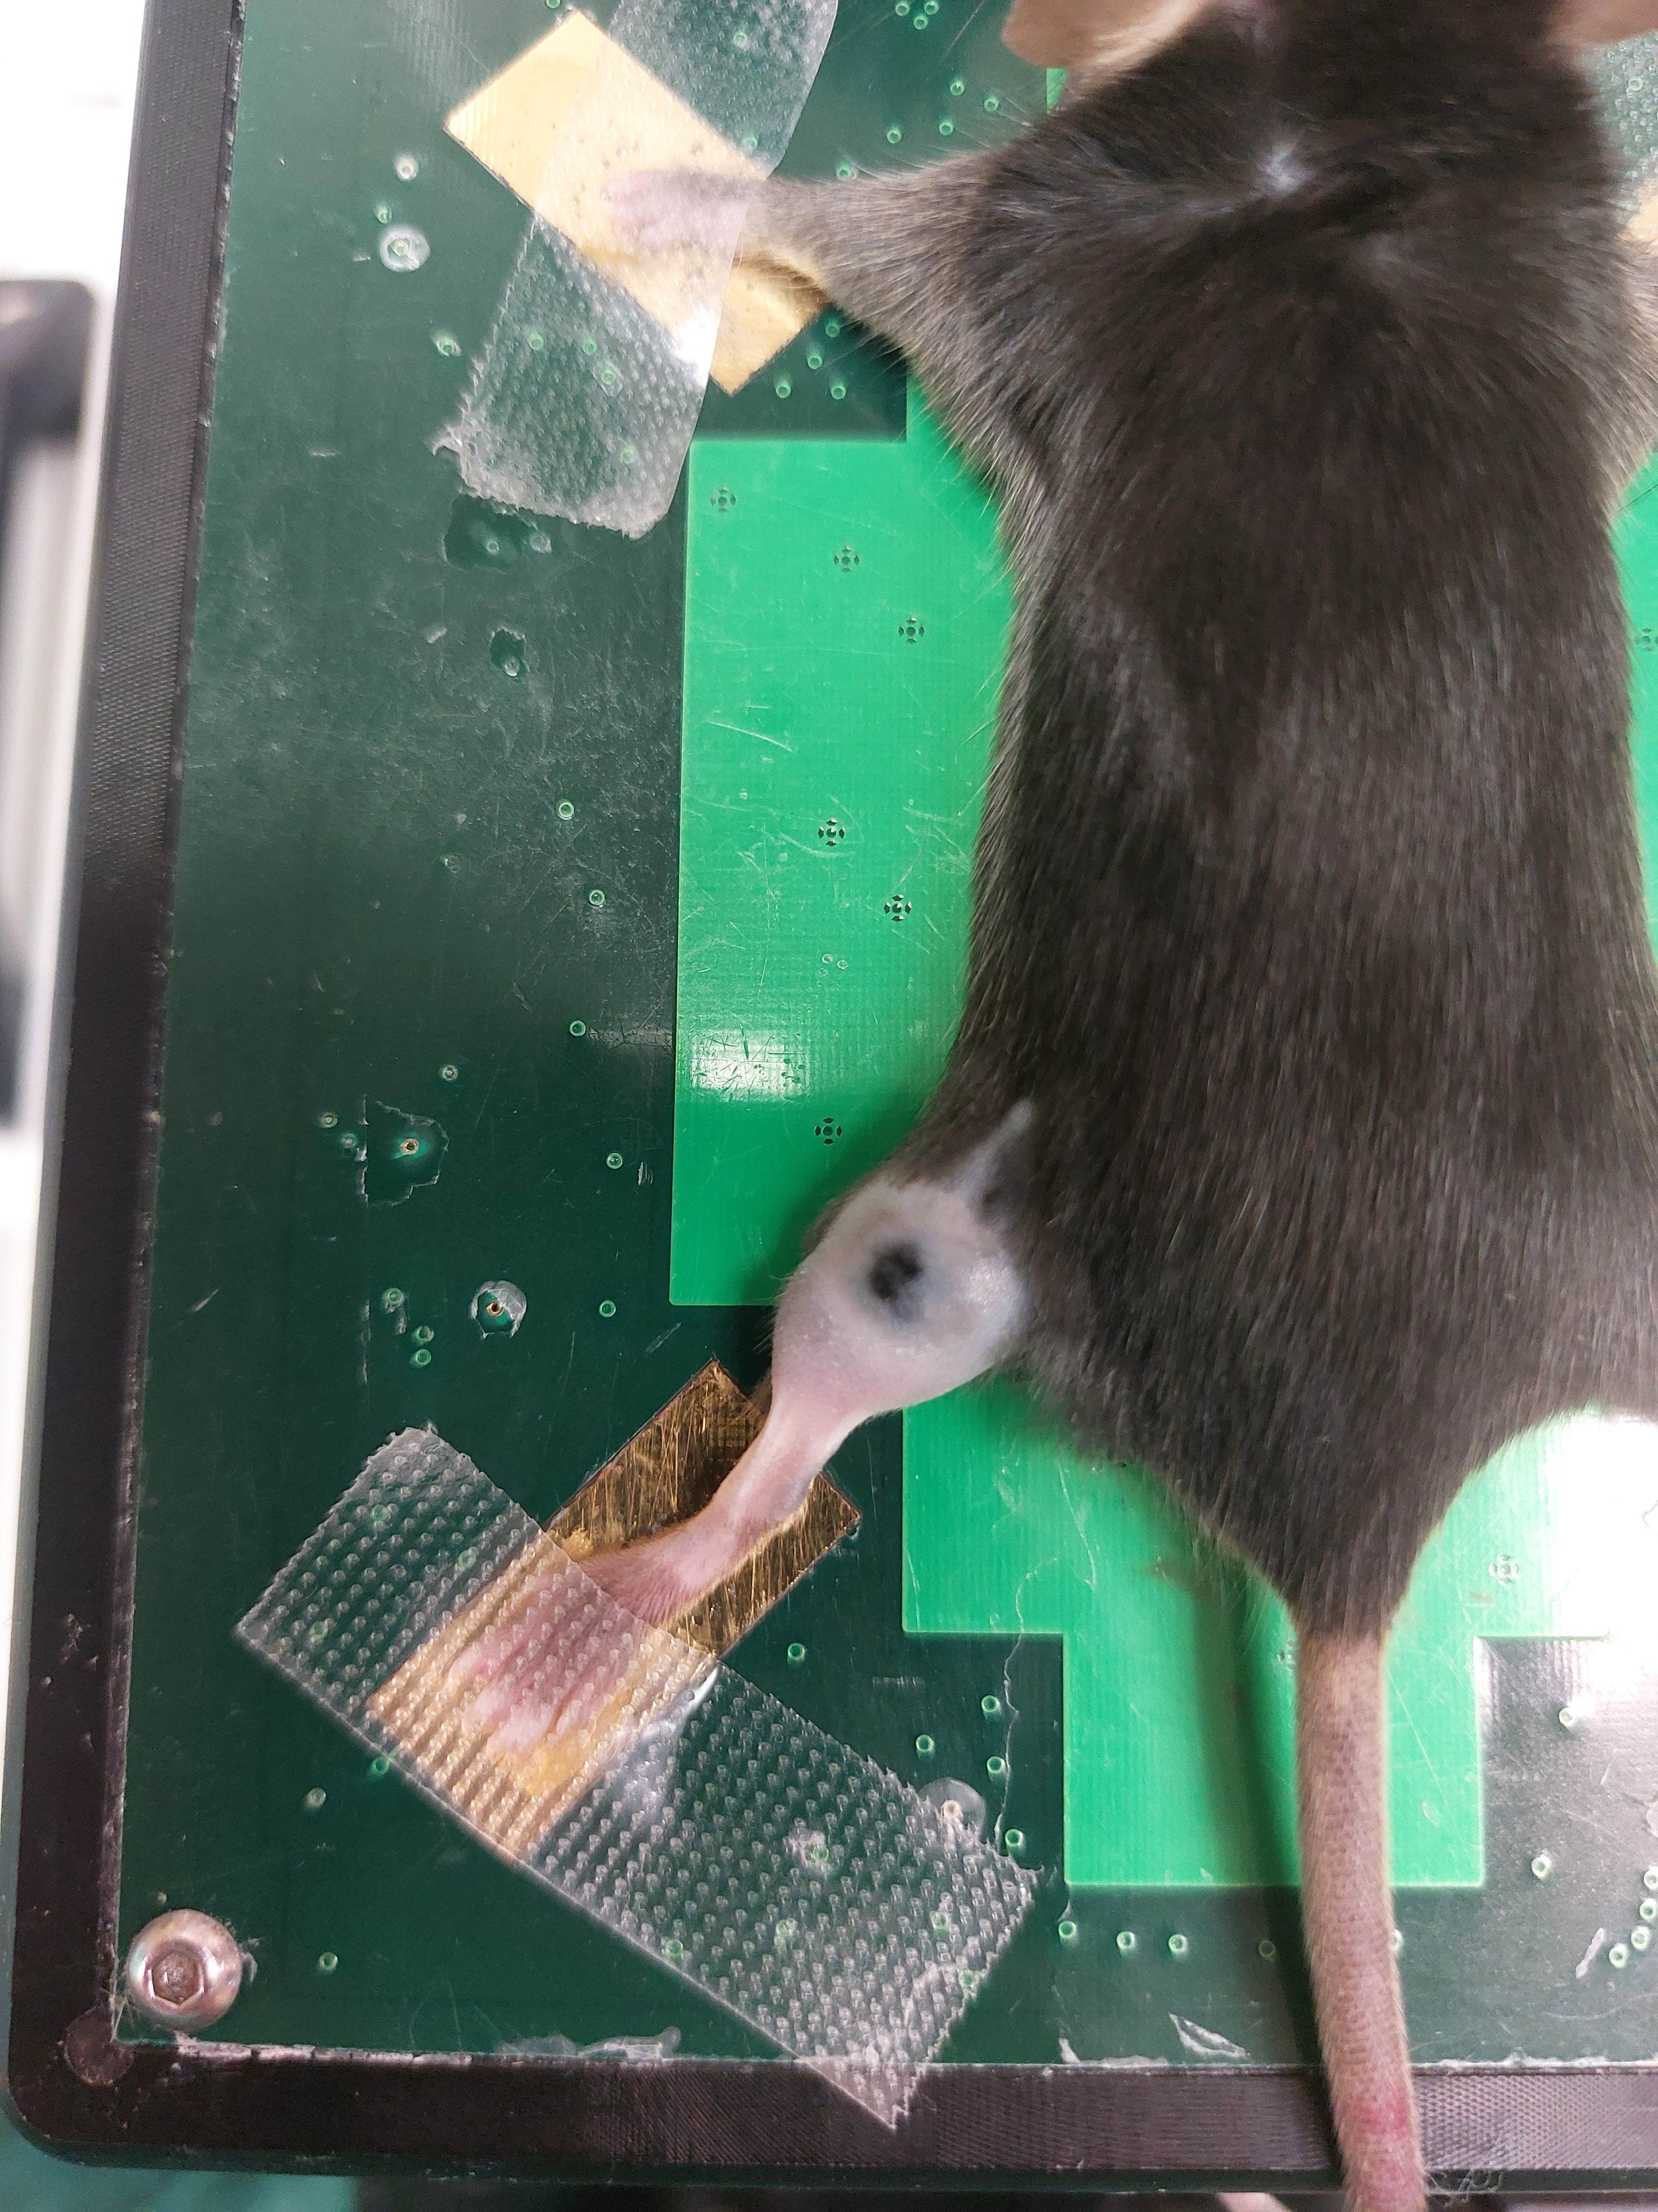
Previously converted into DICOM file

Slide 17
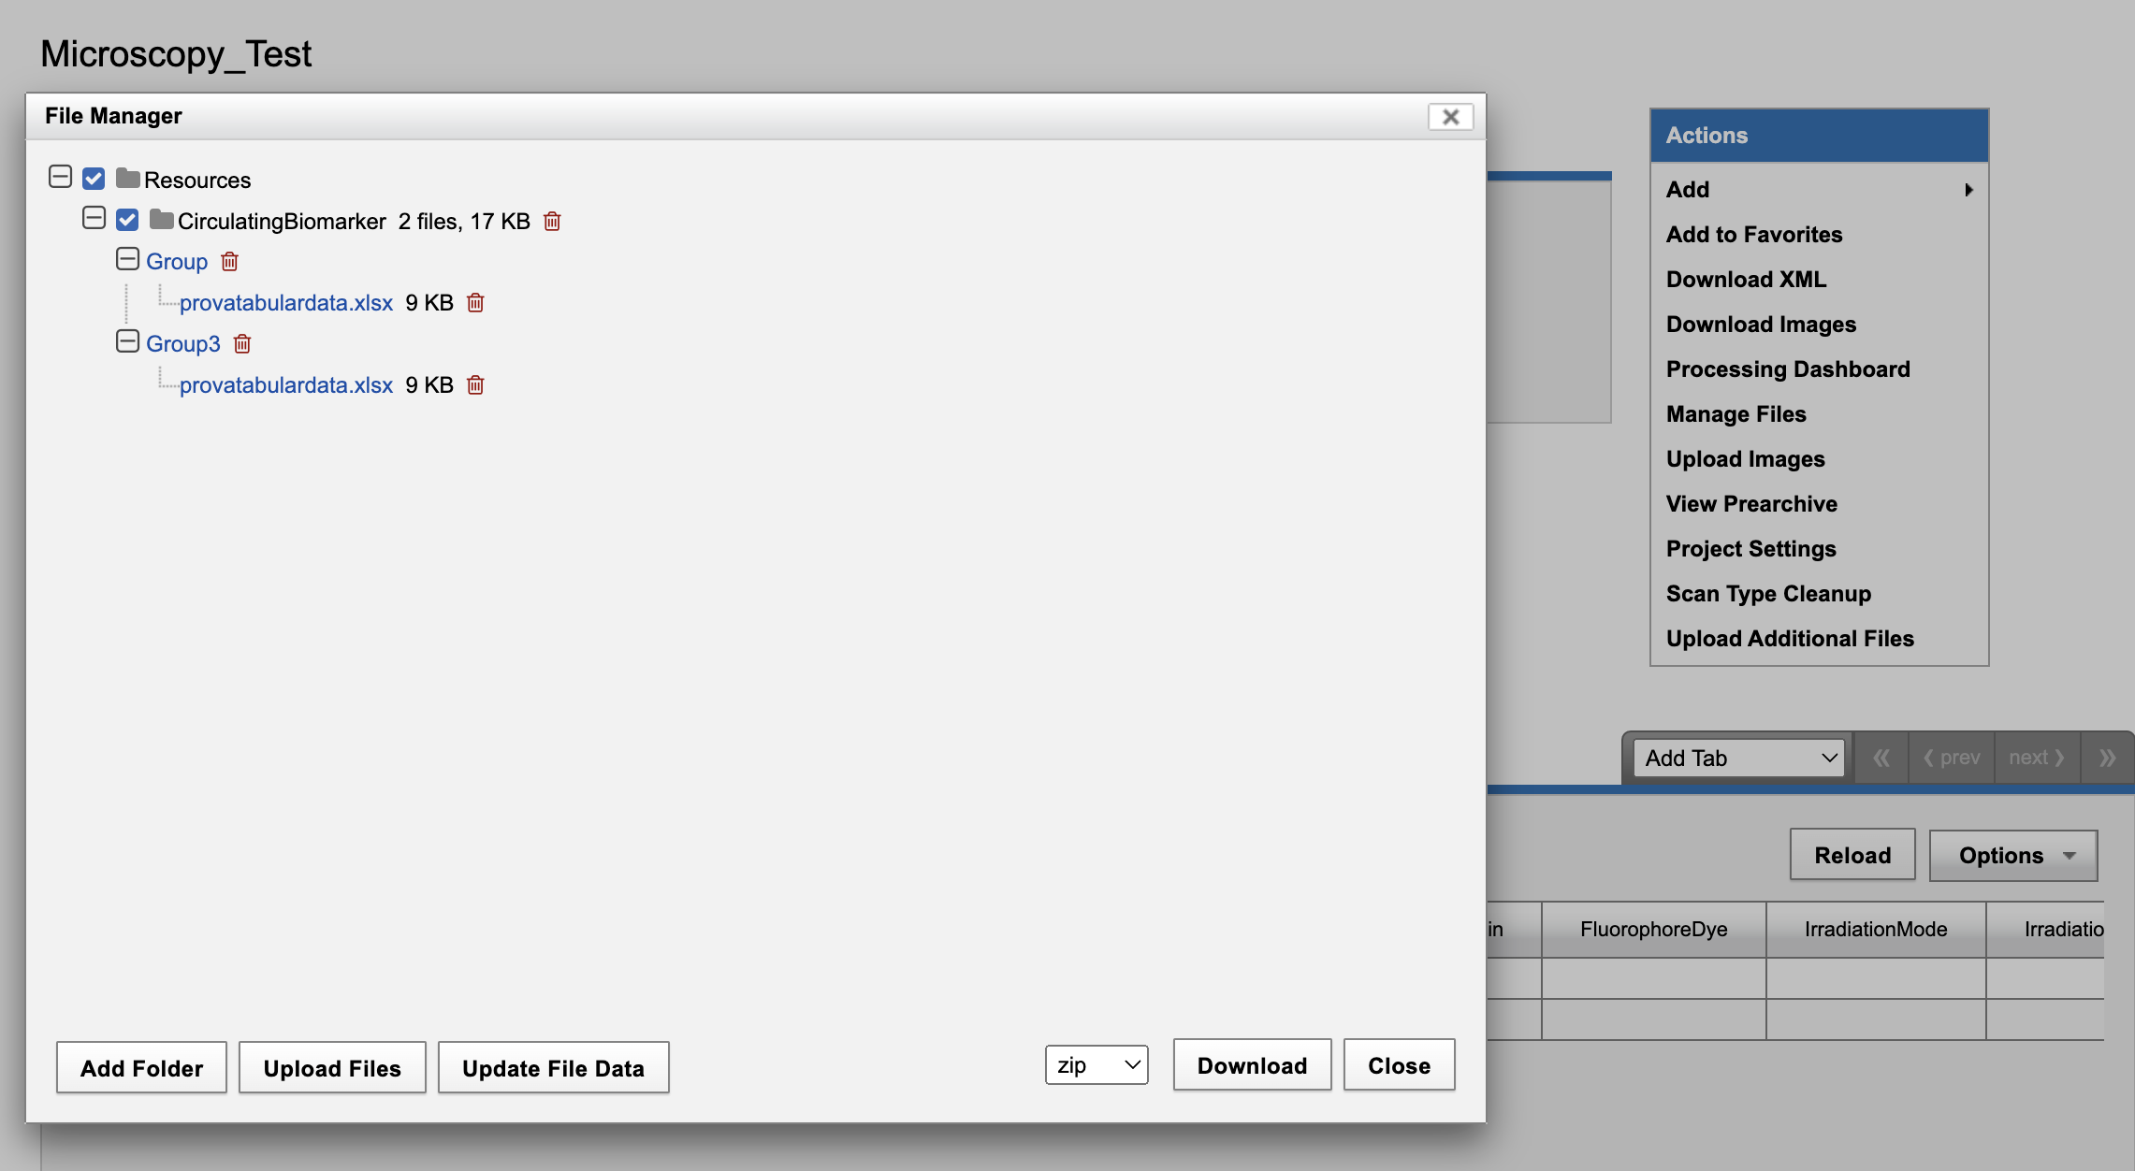
Circulating Biomarkers Experiment
CONV/FLASH-date
biomarker names
(GLP-1, Ghrelin, IL-6, TNFa, Leptin)

Slide 18
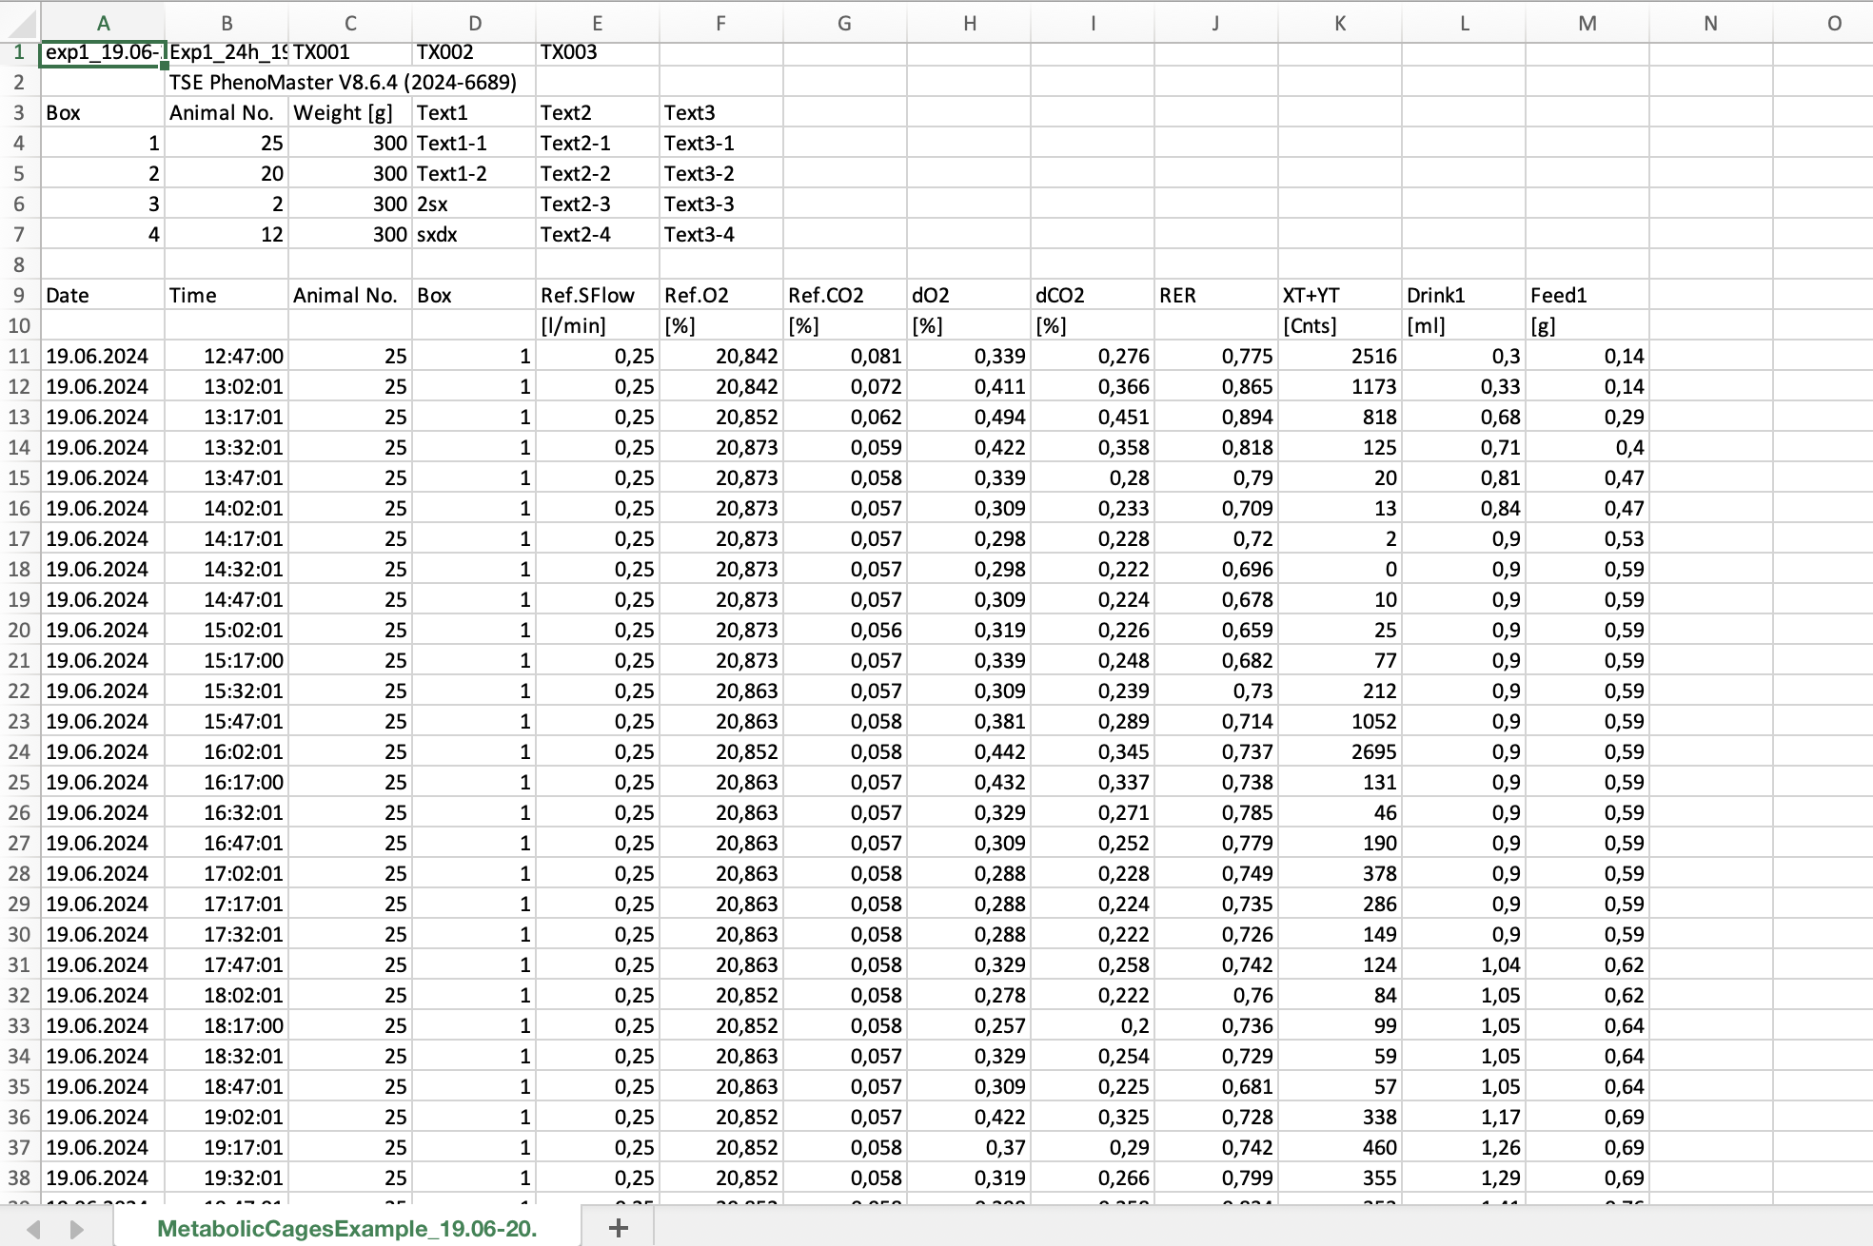
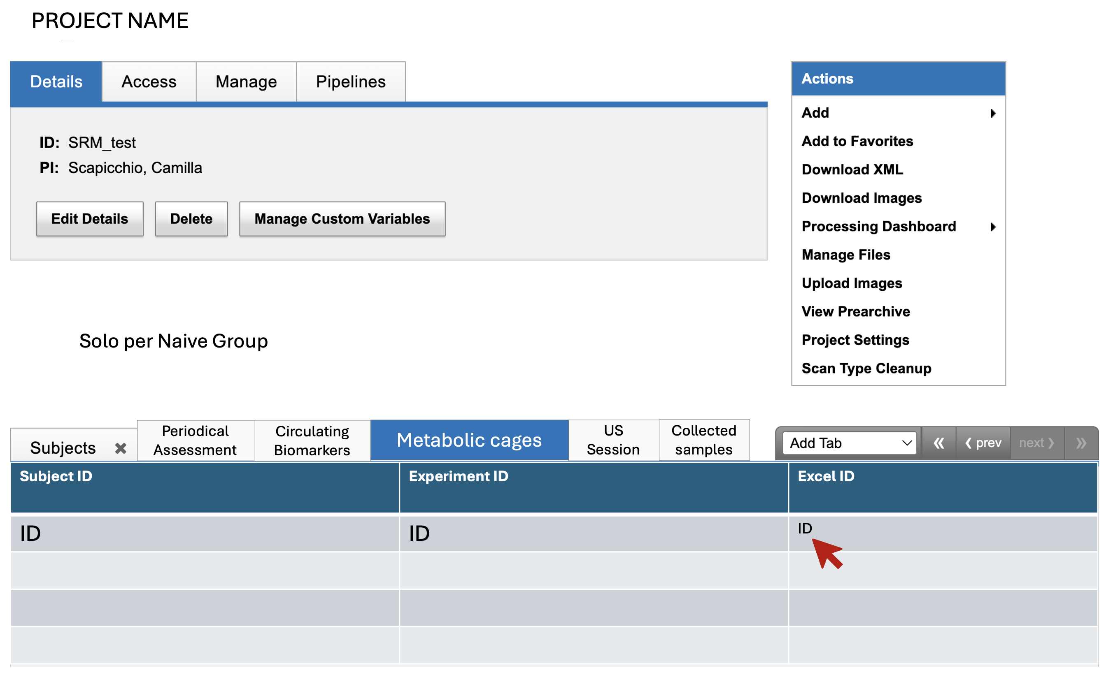

Slide 19
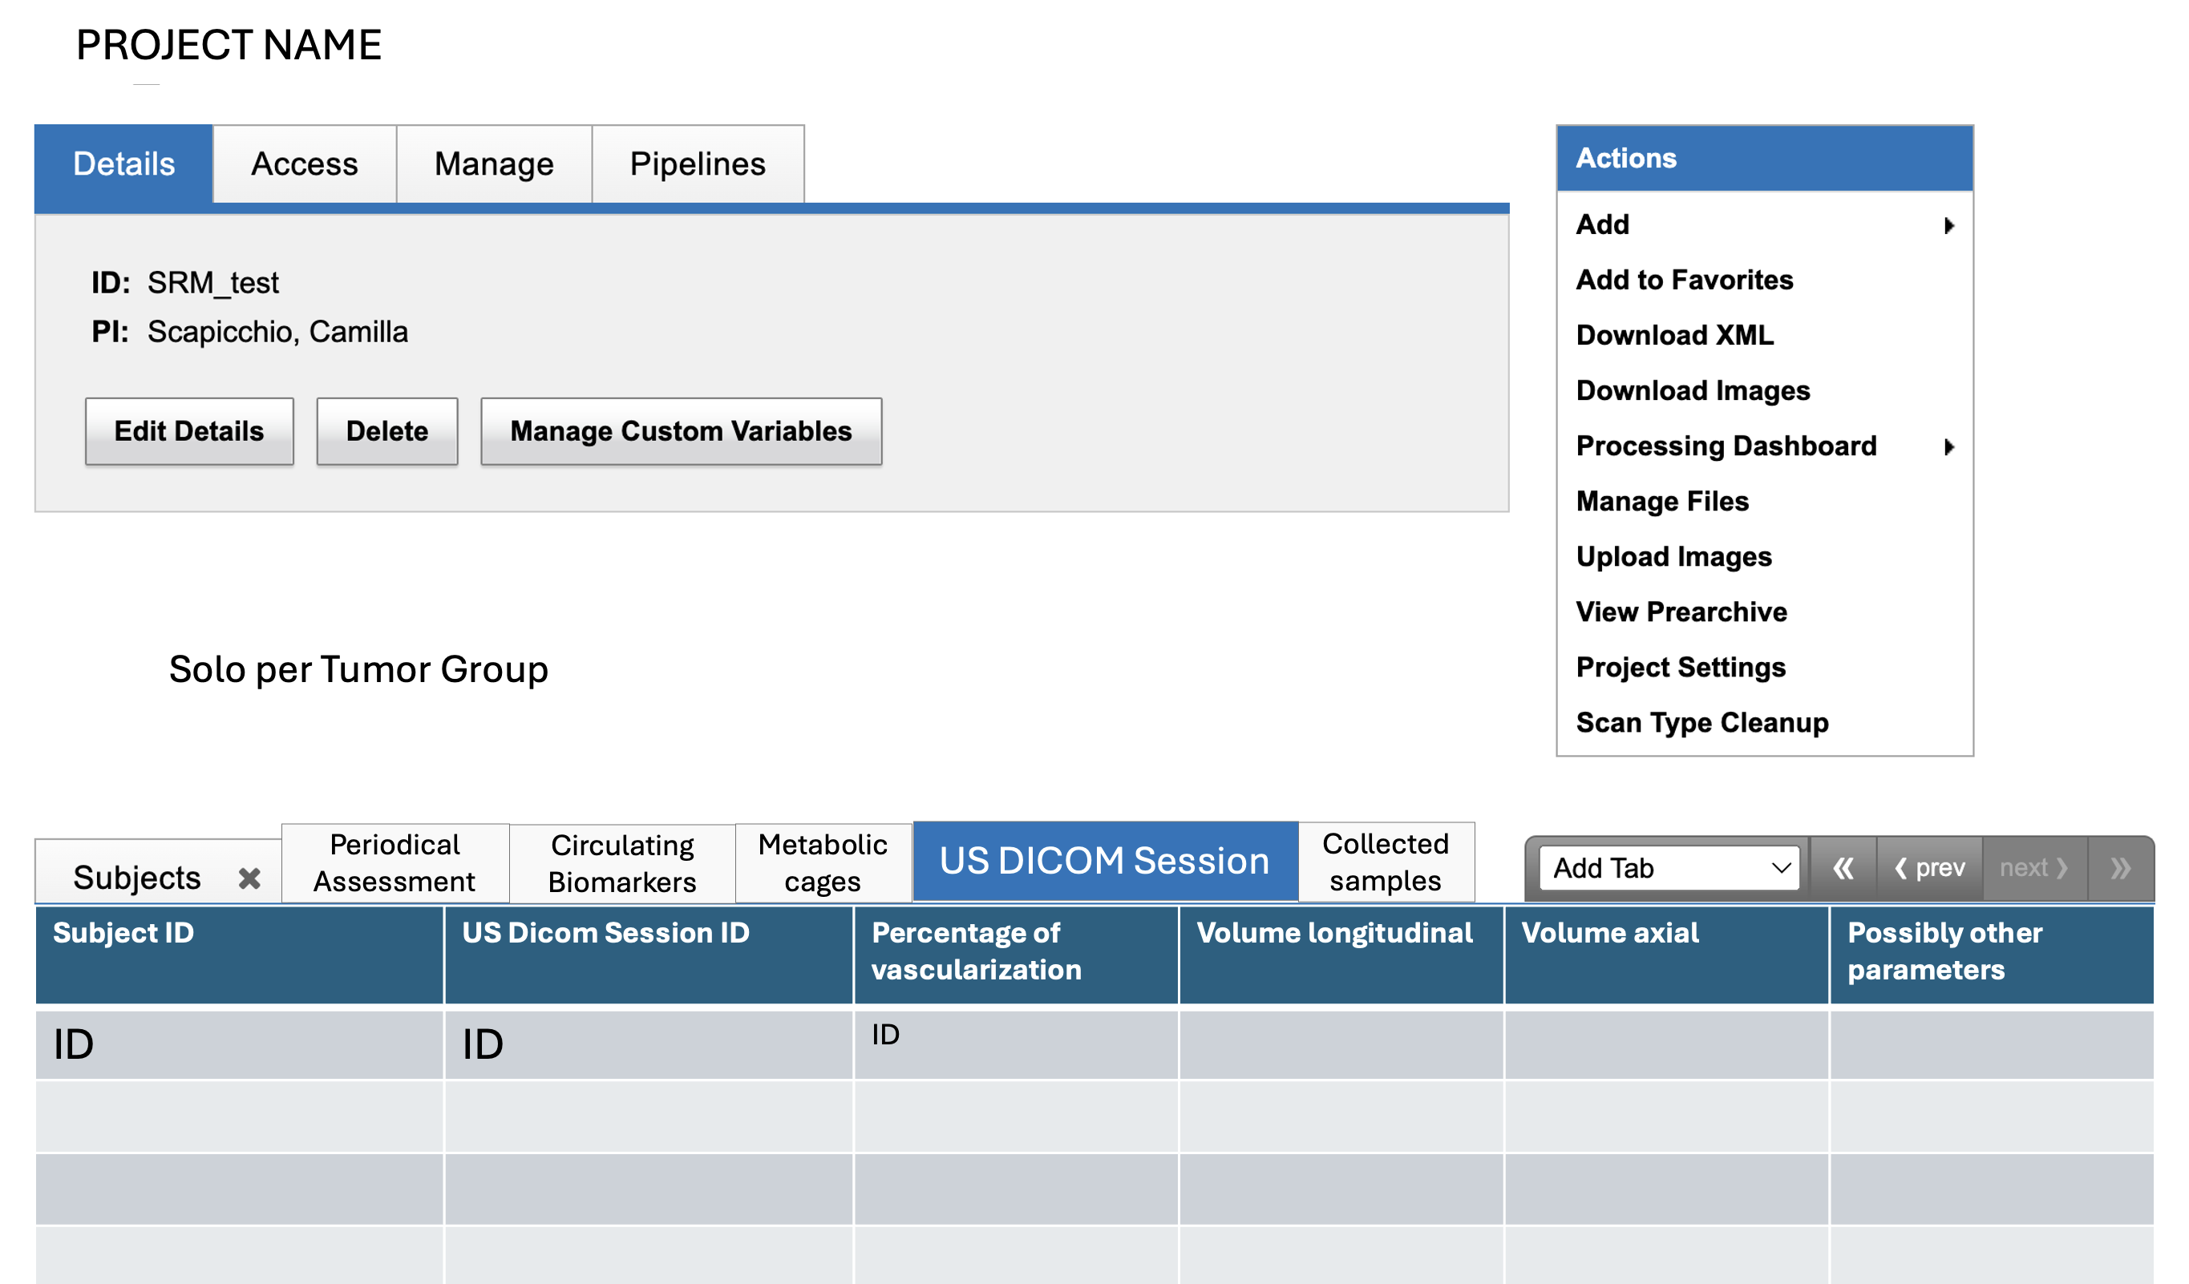
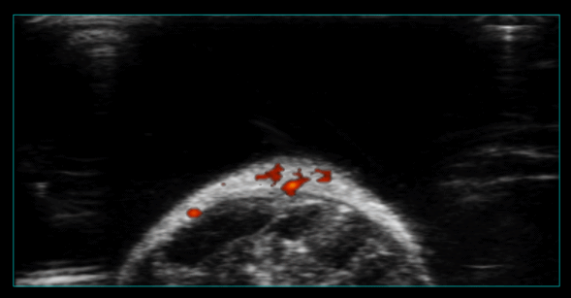
Tumor group only

Slide 20
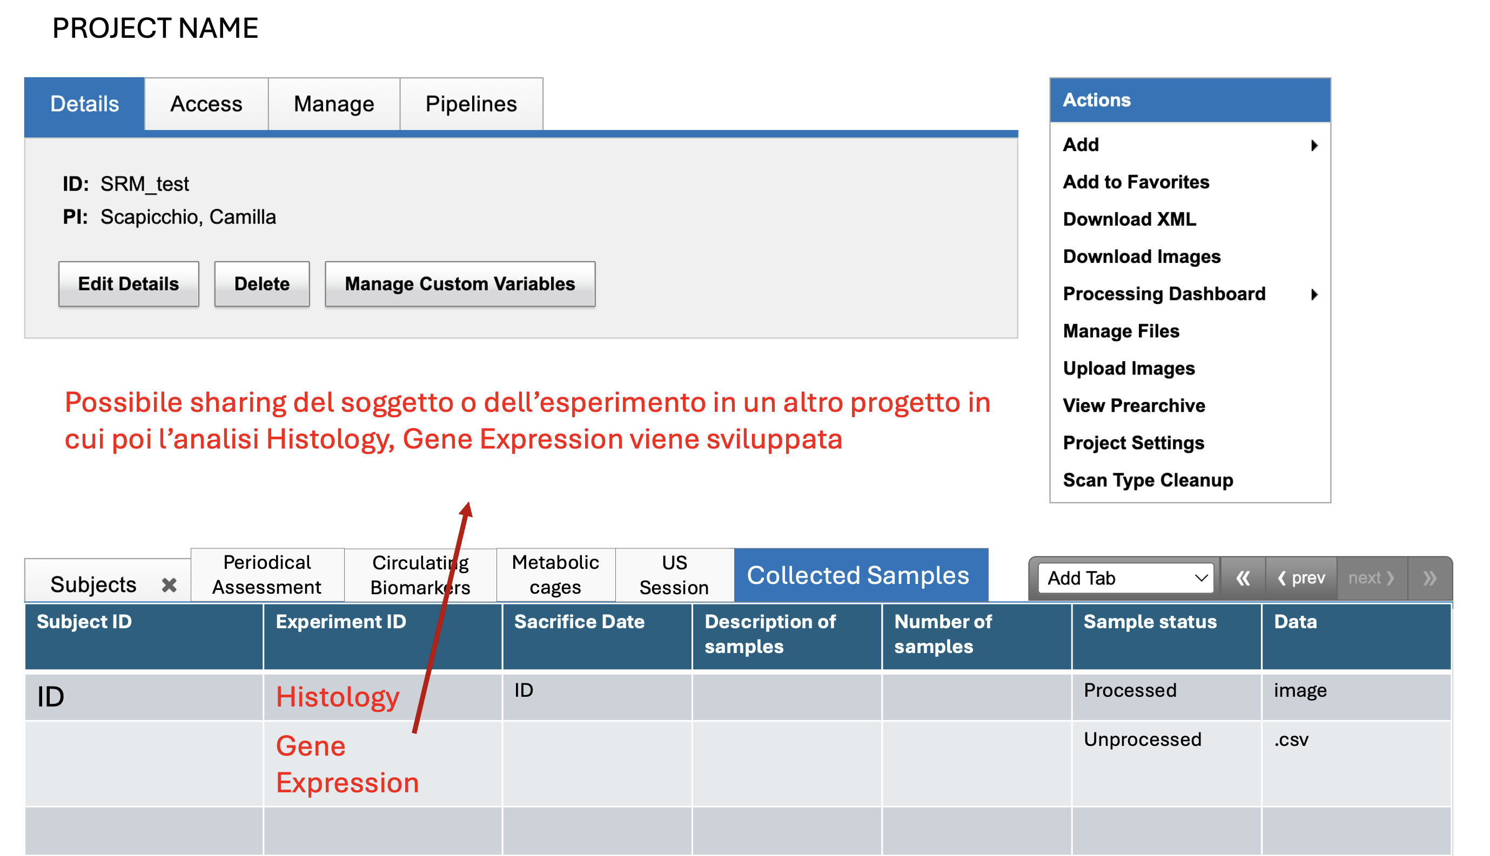
Possible sharing of subjects/experiments into another project in which the analysis is developed

Slide 21
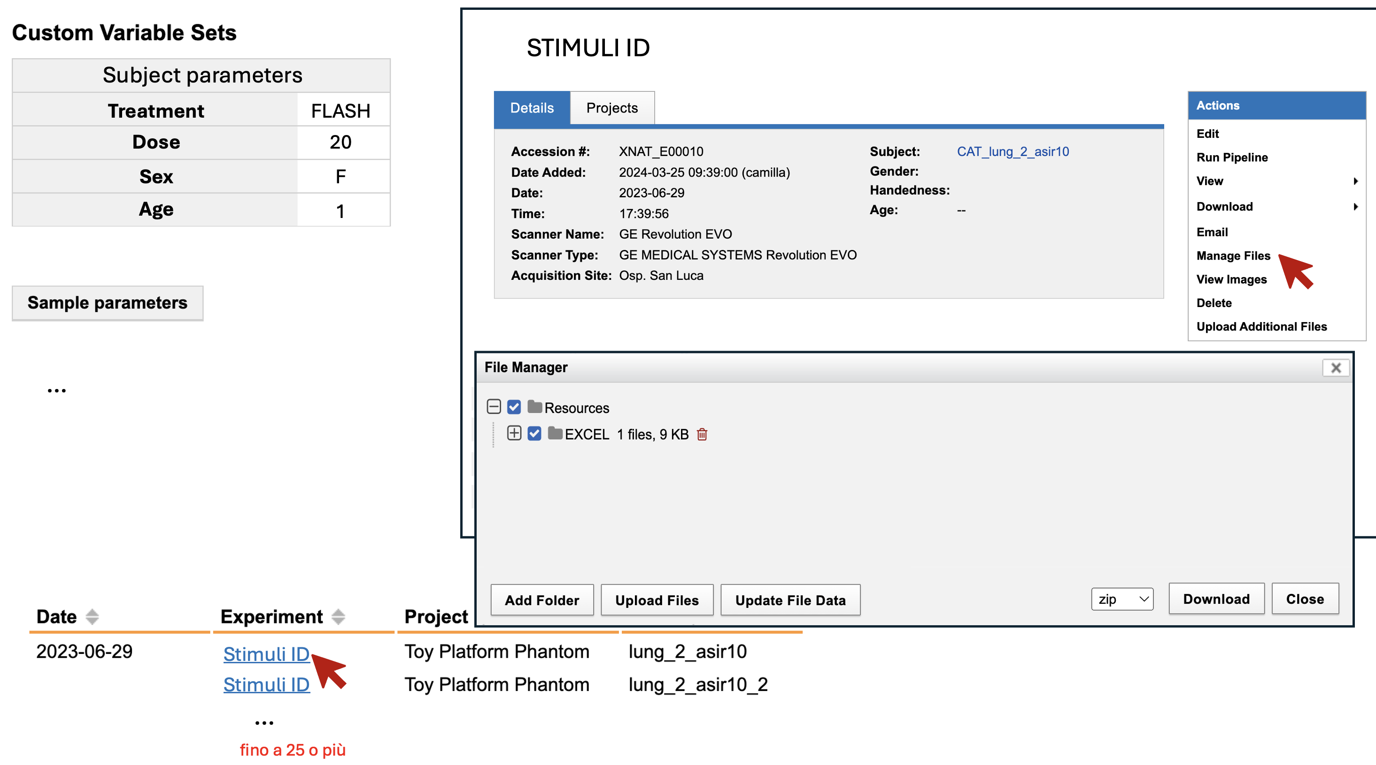
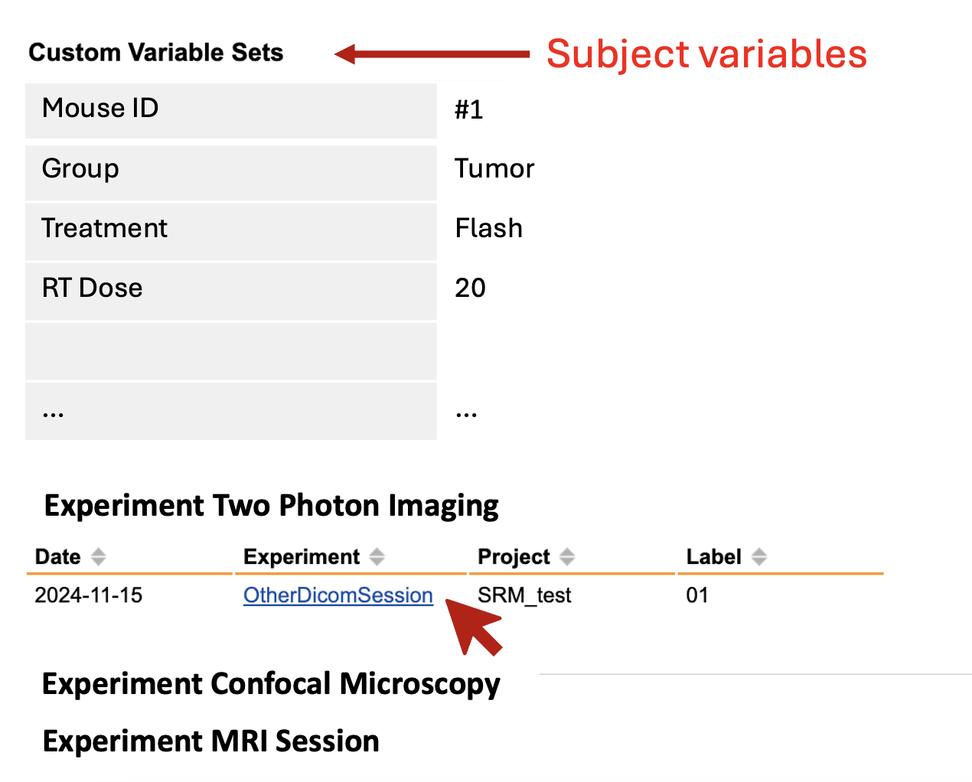
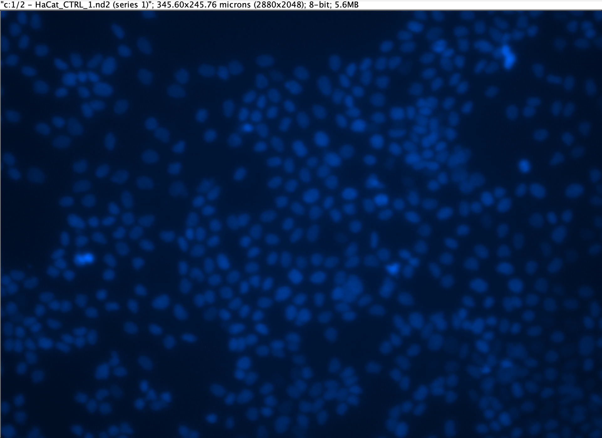
UNDERSTAND REQUIREMENTS AND TRANSLATION INTO XNAT MODEL
This is just a single use-case…it seems easy, but it requires not trivial technical configuration steps!
(The involvement of collaborators from the cascade call «FLASH_IT» project is fundamental)
Other use-cases have been translated (G. Sansevero, V. Pillai, M. Costa, G. Scabia, A. Usai, M. Maffei, …)
(1-1 meeting for feedback…)

Slide 22
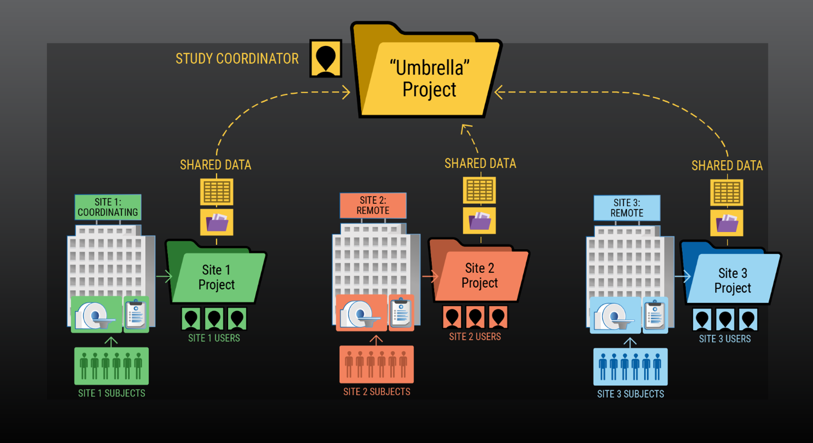
UNDERSTAND REQUIREMENTS AND TRANSLATION INTO XNAT MODEL
Starting from individual use-cases and prototypes for the different experimental groups, BUT…
Leveraging the Umbrella Project type available in XNAT as a project-subproject structure in the end.

Slide 23
UNDERSTAND REQUIREMENTS AND TRANSLATION INTO XNAT MODEL
Physics and biology variables
Dose
Dose Rate
…
Cell line
Cell group
…
DNA Content
Quantitative output (average voltage)
Predictive Model
Artificial Intelligence (ML) – Simulation Modelling
Output
Radiobiological Endpoint (Survival Fraction, ROS,…)
Notes:
.

Slide 24
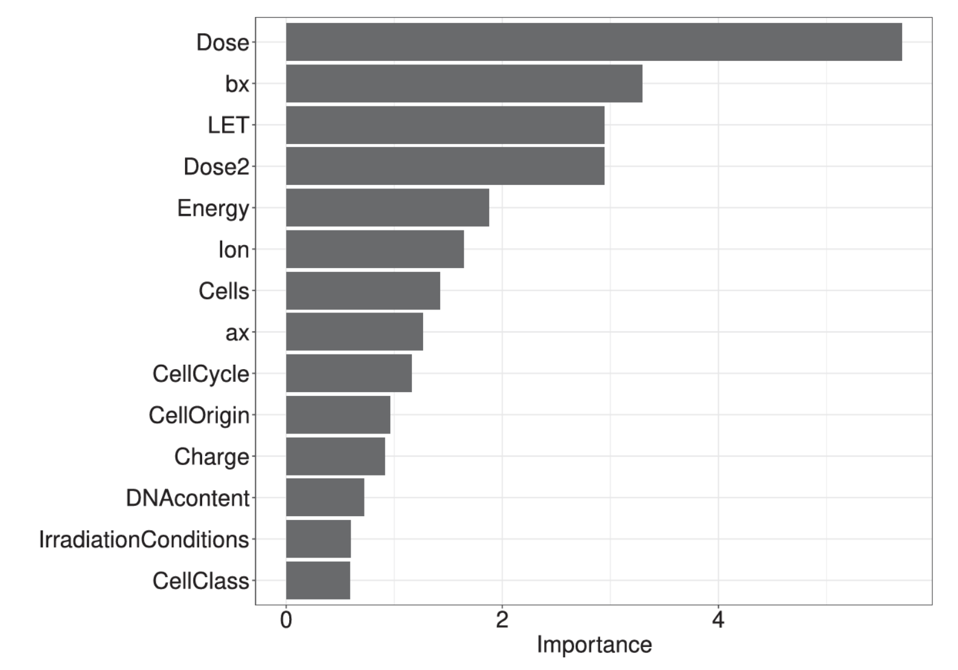
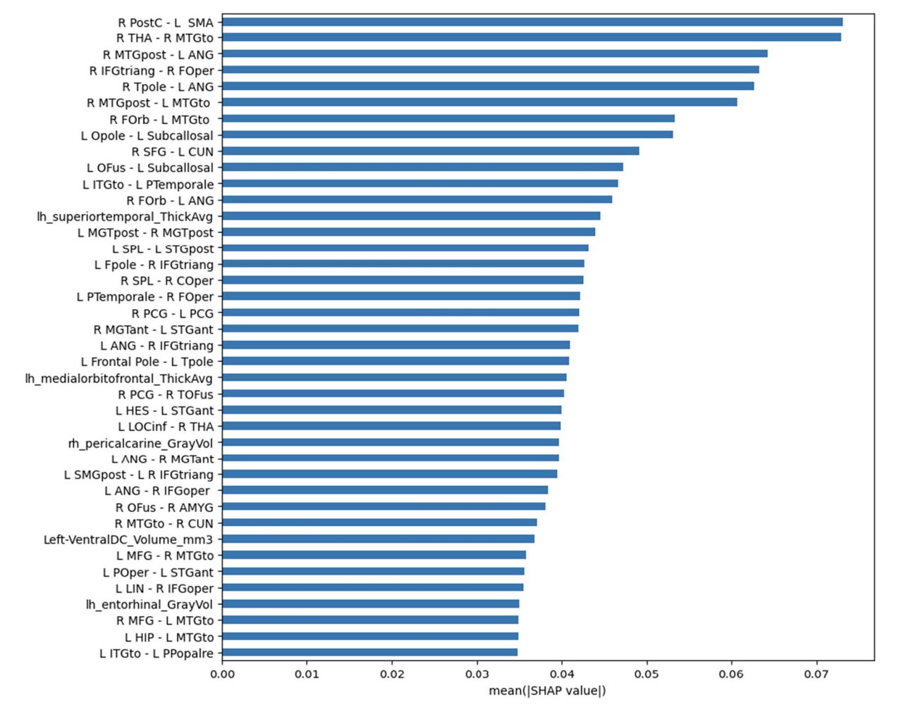
UNDERSTAND REQUIREMENTS AND TRANSLATION INTO XNAT MODEL
EXPLAINABLE AI
Feature Importance
Shap method
Predictive Model
Artificial Intelligence
(Machine Learning)
Understand which parameters characterize the effect and study the impact of each separately
Output

Slide 25
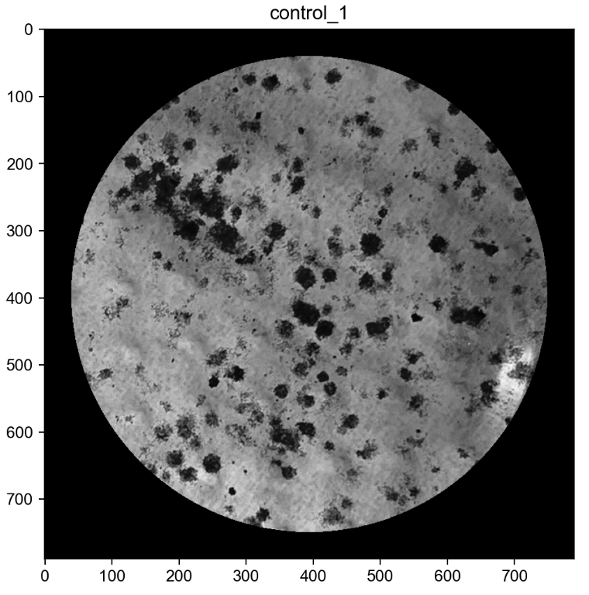
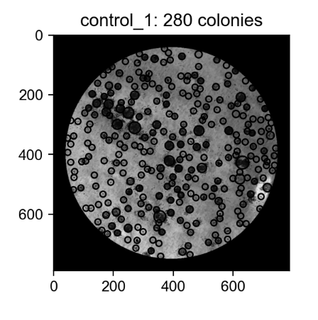
OVERVIEW OF POSSIBLE AUTOMATED/AI-ASSISTED ANALYSIS TOOLS
IT Data Platform ≠ Artificial Intelligence
Automated quantification of cell colonies concentration in clonogenic assay
280
Automated tumor segmentation in US images of mice
…Explainable Machine Learning

Slide 26
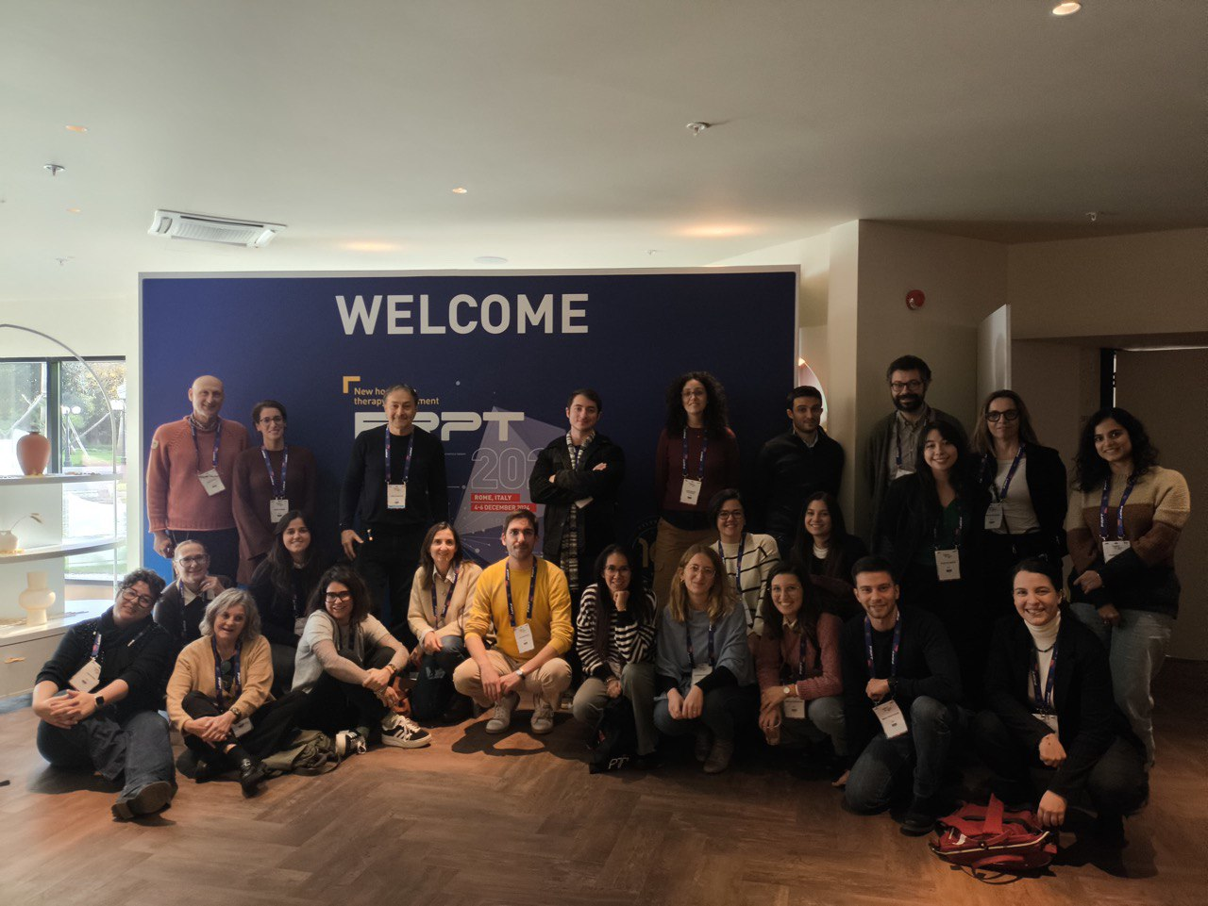
THANK YOU FOR YOUR ATTENTION!
camilla.scapicchio@pi.infn.it
Acknowledgement
INFN Team:
S. Arezzini, T. Boccali, M. Celentano,
A. Formuso, A. Kraan, S. Lossano,
E. Mazzoni, A. Moggi, A. Retico
FRPT 2024
Funded by the European Union - Next Generation EU. Views and opinions expressed are however those of the author(s) only and do not necessarily reflect those of the European Union or the European Commission. Neither the European Union nor the European Commission can be held responsible for them. PNRR MUR M4 C2 Inv. 1.5 CUP I53C21000350006

Slide 27
BACK-UP SLIDES

Slide 28
CONCLUSIONS
Work in progress...but we are well on our way (Your cooperation is crucial!)
Essential from the scientific point of view: only through an organized and properly indexed database, it is possible to perform an advanced statistical analysis that can reveal nontrivial emergent properties, associations and relationships (FLASH effect).
A comprehensive object that could remain at the end of the project, around which a possible continuation can be built. The possibility to open the data platform to other research groups and experiments to force the standardization of data, formats, parameters and definitions.

Slide 29
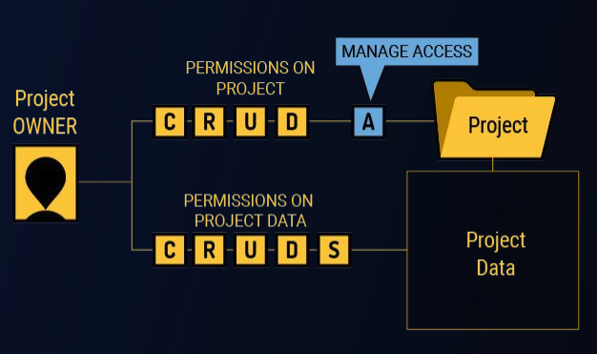
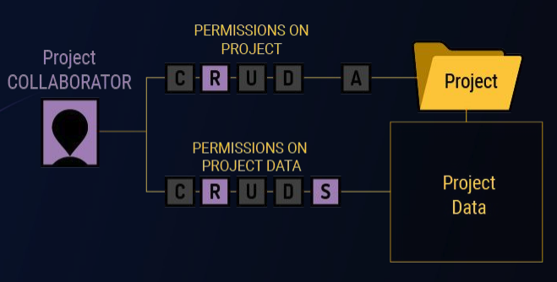
USER PERMISSIONS
● 5 activities: Create, Reade, Update, Delete, Share
● 3 default permissions group: Owner, Member, Collaborator
● It is possible to create custom groups with different permissions depending on the type of data

