Slide 1
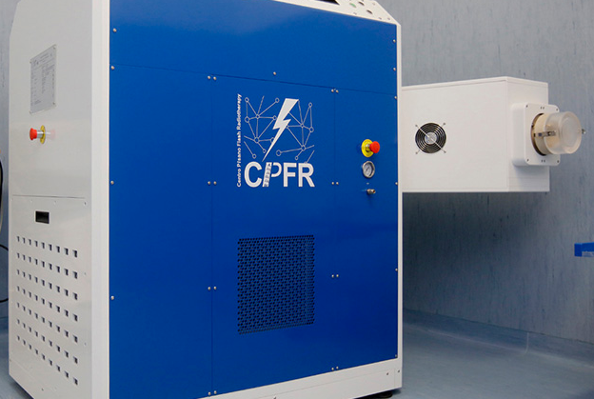
Saving neurons: THE sparing effects of Flash radiotherapy
Gabriele Sansevero
Elisa De Santis

Slide 2
20 GY
FLASH: 257 ± 2 Gy/s
CONV: 4 ± 0,02 Gy/s

Slide 3







K90
K50
K30
Stimulus onset
Amplitude (µV)
Time (ms)

Slide 4
15 GY
FLASH: 257 ± 2 Gy/s
CONV: 4 ± 0,02 Gy/s

Slide 5
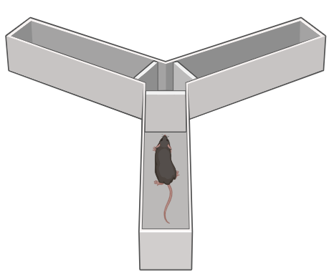
Y maze
Number of Entrances

Slide 6
Y maze
Percentage of Alternance
Control
FLASH
CONV

Slide 7
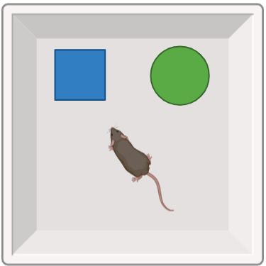
ORT

Slide 8
ORT

Slide 9
ORT

Slide 10
Conclusions
15 Gy appears to be a dose safer than 20 gy for adult mice
Treatment with FLASH 15 Gy does not hamper the capability to form stable memory with respect of CONV-treated animals
Future Perspectives
Spines dynamics with 2P microscopy (with Vinoshene Pillai)
Molecular underpinning of the differences between CONV and FLASH-treated mice

Slide 11
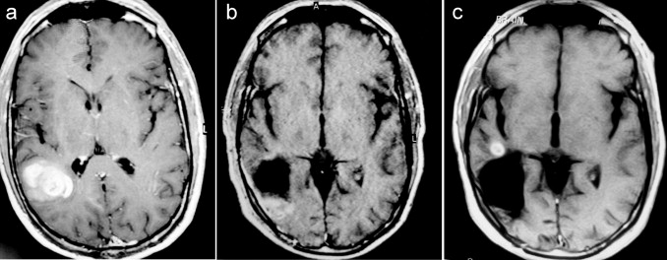



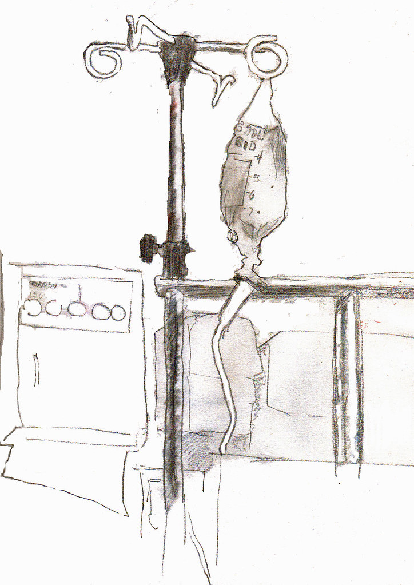
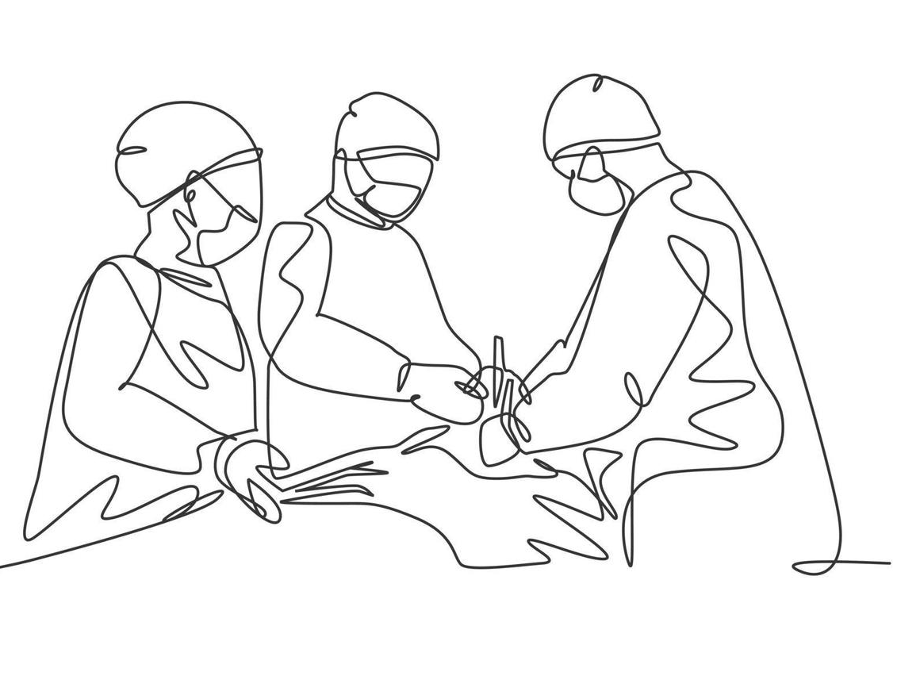
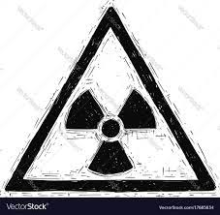
Can we use FLASH RT to treat one of the most aggressive form of brain cancer?
Glioblastoma Multiforme (GBM)
Glioblastoma Multiforme (GBM) is the most aggressive and malignant form
None of the current treatments is effective
Surgical resection
Chemotherapy
Radiotherapy
Median GBM survival is of 12-14 months after diagnosis, <10% survival until 2 years and 5.6% survival of 5 years

Slide 12
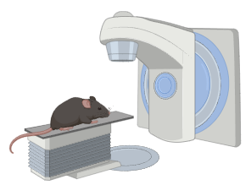
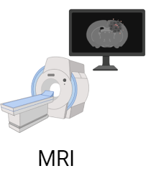
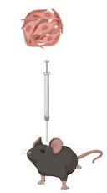
Experimental protocol
Dose: 15Gy
Motor tests (Grip strength and Gridwalk)
FLASH-RT (940Gy/s)
CONV-RT (0,1 Gy/s)
Non-irradiated
Open Field test
Gl261 injection in the motor cortex
IR
MRI
MRI
MRI
MRI
12
14
19
26
33
0

Slide 13
Survival
Control n=6
FLASH n=6
CONV n=7

Slide 14
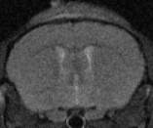
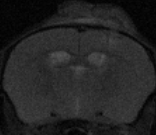
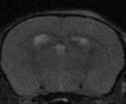
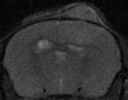
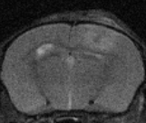
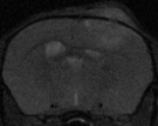
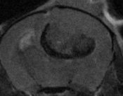
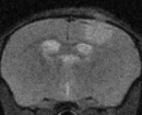
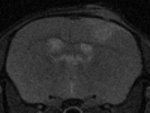
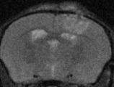
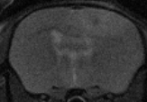
Tumor growth: MRI
Control
FLASH
CONV
12 days post inj
19 days post inj
26 days post inj
Control
FLASH
CONV
33 days post inj
Control n=4
FLASH n=7
CONV n=7

Slide 15
Motor performances:
motor tests
Iso-efficacy against tumor
Grip strenght
Gridwalk
Control n=4
FLASH n=7
CONV n=7

Slide 16
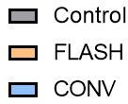
Motor performances:
Open Field
Iso-efficacy against tumor
n=4
n=7
n=7
Notes:
Immagine

Slide 17
Anxious state:
Open Field
Iso-efficacy against tumor
n=4
n=7
n=7
Notes:
Immagine

Slide 18


Conclusions
Both CONV and FLASH RT increase survival in GBM murine model
Both Conventional and FLASH radiotherapy is effective in slowing down and in some case in reducing the tumoral mass
Iso-efficacy against tumor
No significant differences in motor performances in the 2 irradiated groups
Sparing effect

Slide 19

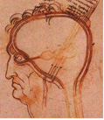


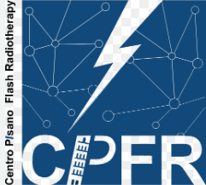

Acknowledgments
CNR Neuroscience Institute:
Dr Mario Costa
Dr Eleonora Vannini
Dr Enrica Strettoi
Dr Beatrice D’Orsi
Lab members:
Marta Scalera
Elisabetta Mori
Beatrice Di Marco
CPFR:
Fabio Di Martino
Andrea Cavalieri
Luigi Masturzo
Mariagrazia Celentano
Prof. Fabiola Pajar
Noemi Giannini
IN-CNR
PISA
Scuola Normale Superiore:
Prof. Tommaso Pizzorusso

